Slide 1

2014/15 Annual Report
PORTFOLIO COMMITTEE ON COMMUNICATIONS
13 October 2015
Donald Liphoko
Acting DG: GCIS

Slide 2
Presentation Outline
Topic/Task | Speaker
1. The Mandate | Acting DG
1.2 Vision, Mission, Values | Acting DG
1.3 Strategic Objectives 2014/15 | Acting DG
3. 2014/15 Performance per Programme | Deputy DGs
4. Financial Performance per Programme | CFO
5. Auditor-General’s Report | Acting DG

Slide 3
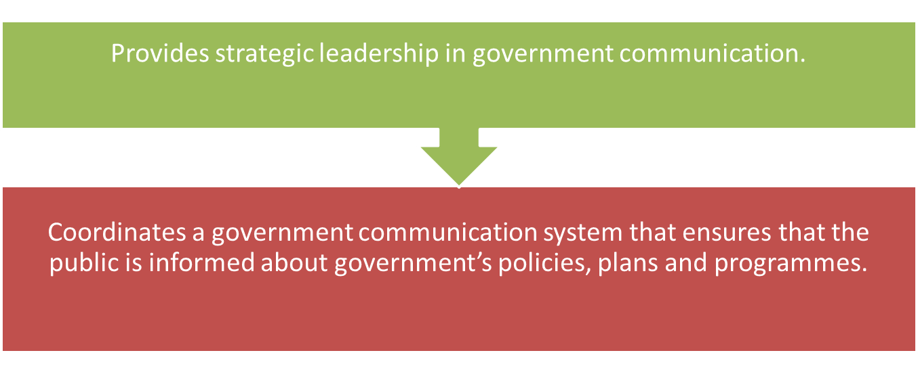
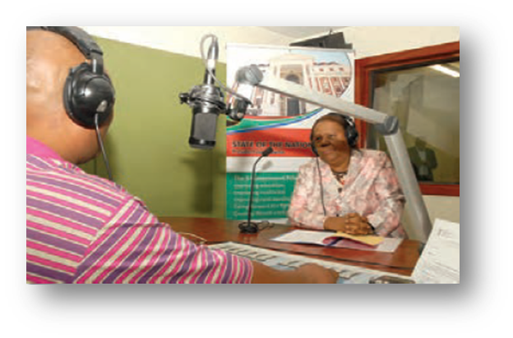
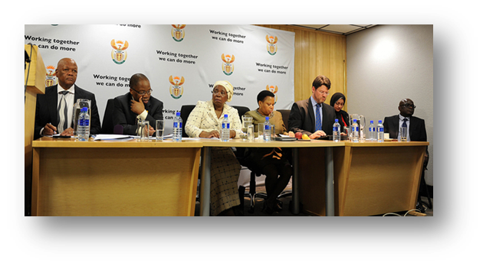
The Mandate
3

Slide 4




Vision, Mission, Values
Mission
To provide professional services, to set and influence adherence to standards for an effective government communication system, to drive coherent government messaging and to proactively communicate with the public about government policies, plans, programmes and achievements.

Slide 5
Strategic Objectives
Strategic outcome-oriented goal:
Coherent, responsive and cost effective communication services for all government programmes
3. Maintain and strengthen a well-functioning communication system that proactively informs and engages the public
5. Enhance the image of government and that of the State
4. Provide efficient and effective communication services
1.Provide a responsive, cost effective, compliant and business-focused organisation
2. Professionalise the communication system, build a reliable knowledge base and enhance communication products.

Slide 6
2014/15 KEY ACHIEVEMENTS
Providing communication support to government’s cross-cutting communication campaigns including national days
  Ensuring a comprehensive, coordinated approach to the 2015 SoNA,
  Implemented a communications strategy for the country’s 20 Years of Freedom Tell Your Story initiative.
  Presidential Local Government Summit, which adopted the Back-to-Basics strategy
  Operation Phakisa and launch of the African Charter,
  The repatriation of the mortal remains of South Africans who died in building collapse tragedy in Nigeria,
Notes:
MAKING HEADLINES
GCIS continues to interact with the media and monitors the environment to enable accurate responses to topical issues. The GCIS provides media monitoring services to all government departments both electronic and print on a daily basis.
GCIS invests significant resources in tracking media coverage daily and continuously to assess the impact of government’s own messaging and the tone and content of journalistic reporting, editorial comment, analysis by commentators and others. GCIS issues short message service (SMS) alerts to communicators, DGs and political principals at 06:00 am. Messages are also sent out in the event of breaking news. This is preceded by a media monitoring service that starts at 03:00. GCIS also produces media clippings of the print coverage to all government communicators at 07:00, followed by electronic media coverage in the morning and in the afternoon.
Among GCIS’ proactive and reactive interventions in the media environment were the following:
The Acting CEO has weekly columns in the Pretoria News and the The New Age newspapers to communicate government messages on a variety of topical issues linked to the five priorities. In 2013, more than 74 opinion pieces have appeared in the Pretoria News, The New Age, the government blog on www.gov.za and the Acting CEO’s Home Brewed feature on SANews.gov.za, government’s official news agency. Opinion pieces also featured on SABC Online.
The GCIS Radio Unit has started broadcasting two news bulletins on weekdays to community radio stations on topical issues. The news is part of the Rapid Response Strategy and is broadcast live to 35 radio stations at 12:00 and at 16:00. So far, 190 news bulletins have been produced and also posted on the government and GCIS websites, www.gcis.gov.za and www.gov.za
The GCIS through its Radio Unit has also produced a total of 88 radio spots with eight adverts in 11 languages each, apart from live reads. This work was produced on behalf of The Presidency, the Department of Agriculture, Forestry and Fisheries, the Department of Health and the South African National Roads Agency Limited.
Furthermore, the GCIS Radio Unit has produced at least 32 one-hour long phone-in programmes for community radio stations. These shows were in English, as well as in the Nguni and Sotho languages. However, callers are allowed to speak the languages of their choice. These programmes were produced on behalf of various government departments and Parliament.
GCIS coordinates government’s cluster media briefings against Cabinet’s quarterly reporting cycles. These cluster briefings are aimed at updating the country on the implementation of government’s five priorities.
Following every Cabinet meeting, the Acting CEO briefs the media on Cabinet’s decisions. Some departments elaborate on certain key issues from the Cabinet statement in separate media briefings. This needs to be enhanced.
GCIS also in this year issued 199 statements and hosted 62 media briefings on behalf of departments. These statements did attract coverage in a broad range of print and broadcast media.
The media monitoring products produced are as follows:
364 media coverage reports covering broadcast and online media between 1 January and 31 May
143 sets of print headline news, and 7 799 sets of general press clippings.

Slide 7
2014/15 KEY ACHIEVEMENTS
Some of the communication products produced to grow the voice of government were as follows:
  45000 Copies of the 2013/14 SA Year Book
  11 editions (18.7 million copies ) of the government newspaper, Vuk’uzenzele, were produced in all official languages and 4 950 Braille copies were distributed.
  11 editions (151 991 copies) of Public Sector Manager magazine were produced.
  48 copies of the weekly electronic newsletter My District Today, which provides updates on government's delivery on its Programme of Action (PoA) were published.
  2014 Media Landscape which monitors media transformation was launched
Notes:
MAKING HEADLINES
GCIS continues to interact with the media and monitors the environment to enable accurate responses to topical issues. The GCIS provides media monitoring services to all government departments both electronic and print on a daily basis.
GCIS invests significant resources in tracking media coverage daily and continuously to assess the impact of government’s own messaging and the tone and content of journalistic reporting, editorial comment, analysis by commentators and others. GCIS issues short message service (SMS) alerts to communicators, DGs and political principals at 06:00 am. Messages are also sent out in the event of breaking news. This is preceded by a media monitoring service that starts at 03:00. GCIS also produces media clippings of the print coverage to all government communicators at 07:00, followed by electronic media coverage in the morning and in the afternoon.
Among GCIS’ proactive and reactive interventions in the media environment were the following:
The Acting CEO has weekly columns in the Pretoria News and the The New Age newspapers to communicate government messages on a variety of topical issues linked to the five priorities. In 2013, more than 74 opinion pieces have appeared in the Pretoria News, The New Age, the government blog on www.gov.za and the Acting CEO’s Home Brewed feature on SANews.gov.za, government’s official news agency. Opinion pieces also featured on SABC Online.
The GCIS Radio Unit has started broadcasting two news bulletins on weekdays to community radio stations on topical issues. The news is part of the Rapid Response Strategy and is broadcast live to 35 radio stations at 12:00 and at 16:00. So far, 190 news bulletins have been produced and also posted on the government and GCIS websites, www.gcis.gov.za and www.gov.za
The GCIS through its Radio Unit has also produced a total of 88 radio spots with eight adverts in 11 languages each, apart from live reads. This work was produced on behalf of The Presidency, the Department of Agriculture, Forestry and Fisheries, the Department of Health and the South African National Roads Agency Limited.
Furthermore, the GCIS Radio Unit has produced at least 32 one-hour long phone-in programmes for community radio stations. These shows were in English, as well as in the Nguni and Sotho languages. However, callers are allowed to speak the languages of their choice. These programmes were produced on behalf of various government departments and Parliament.
GCIS coordinates government’s cluster media briefings against Cabinet’s quarterly reporting cycles. These cluster briefings are aimed at updating the country on the implementation of government’s five priorities.
Following every Cabinet meeting, the Acting CEO briefs the media on Cabinet’s decisions. Some departments elaborate on certain key issues from the Cabinet statement in separate media briefings. This needs to be enhanced.
GCIS also in this year issued 199 statements and hosted 62 media briefings on behalf of departments. These statements did attract coverage in a broad range of print and broadcast media.
The media monitoring products produced are as follows:
364 media coverage reports covering broadcast and online media between 1 January and 31 May
143 sets of print headline news, and 7 799 sets of general press clippings.

Slide 8
2014/15 KEY ACHIEVEMENTS
Outreach campaigns included:
2238 development communication project reaching more than 53 million people.
2506 community and stakeholder liaison visits conducted
326 public participation events where political principals interacted with the community
746 marketing events to increase the visibility of the Thusong Service Centres
Cost effective media bulk-buying for government:
272 media bulk-buying campaigns with a total committed amount of R273 253 041.98, saving the departments a total of R24 636 398.98
Notes:
MAKING HEADLINES
GCIS continues to interact with the media and monitors the environment to enable accurate responses to topical issues. The GCIS provides media monitoring services to all government departments both electronic and print on a daily basis.
GCIS invests significant resources in tracking media coverage daily and continuously to assess the impact of government’s own messaging and the tone and content of journalistic reporting, editorial comment, analysis by commentators and others. GCIS issues short message service (SMS) alerts to communicators, DGs and political principals at 06:00 am. Messages are also sent out in the event of breaking news. This is preceded by a media monitoring service that starts at 03:00. GCIS also produces media clippings of the print coverage to all government communicators at 07:00, followed by electronic media coverage in the morning and in the afternoon.
Among GCIS’ proactive and reactive interventions in the media environment were the following:
The Acting CEO has weekly columns in the Pretoria News and the The New Age newspapers to communicate government messages on a variety of topical issues linked to the five priorities. In 2013, more than 74 opinion pieces have appeared in the Pretoria News, The New Age, the government blog on www.gov.za and the Acting CEO’s Home Brewed feature on SANews.gov.za, government’s official news agency. Opinion pieces also featured on SABC Online.
The GCIS Radio Unit has started broadcasting two news bulletins on weekdays to community radio stations on topical issues. The news is part of the Rapid Response Strategy and is broadcast live to 35 radio stations at 12:00 and at 16:00. So far, 190 news bulletins have been produced and also posted on the government and GCIS websites, www.gcis.gov.za and www.gov.za
The GCIS through its Radio Unit has also produced a total of 88 radio spots with eight adverts in 11 languages each, apart from live reads. This work was produced on behalf of The Presidency, the Department of Agriculture, Forestry and Fisheries, the Department of Health and the South African National Roads Agency Limited.
Furthermore, the GCIS Radio Unit has produced at least 32 one-hour long phone-in programmes for community radio stations. These shows were in English, as well as in the Nguni and Sotho languages. However, callers are allowed to speak the languages of their choice. These programmes were produced on behalf of various government departments and Parliament.
GCIS coordinates government’s cluster media briefings against Cabinet’s quarterly reporting cycles. These cluster briefings are aimed at updating the country on the implementation of government’s five priorities.
Following every Cabinet meeting, the Acting CEO briefs the media on Cabinet’s decisions. Some departments elaborate on certain key issues from the Cabinet statement in separate media briefings. This needs to be enhanced.
GCIS also in this year issued 199 statements and hosted 62 media briefings on behalf of departments. These statements did attract coverage in a broad range of print and broadcast media.
The media monitoring products produced are as follows:
364 media coverage reports covering broadcast and online media between 1 January and 31 May
143 sets of print headline news, and 7 799 sets of general press clippings.

Slide 9
UNQUALIFIED AUDIT WITHOUT MATTERS: 2014/15 OUTCOMES
Lines of Defence
Audit Committee
Internal Audit
Management & Staff

Slide 10
Auditor-General Reports – Trend Analysis
Audit Findings

Slide 11
Programme 2: Content Processing and Dissemination
Communication & Content Management
Purpose: Provide strategic leadership in government communication to ensure the coherence, coordination, consistency, quality, impact and responsiveness of government communication
Overview of Achievements
Produced research cluster reports to guide planning and inform communication strategies of government communication clusters.
Produced 93 Research Advisory reports for various national departments and Premiers’ Offices. Content convergence delivered government information to more people on more platforms
The South African Government News Agency (SAnews) Twitter following grew tremendously the followers was at 19 000 in April 2014 and grew to more than 45 000 by March 2015.
SAnews wrote at least 20 opinion pieces, which were published in the mainstream media.
A new-look South Africa Government website (www.gov.za) was launched, combining the previous SA Government Online and Government Services websites.
Two Apps were launched for Vuk’uzenzele and the SA Government website respectively, allowing quick access to selected information from the websites
GCIS Golf Day raised R210 000 in support of the 16 Days of Activism for No Violence Against Women and Children

Slide 12


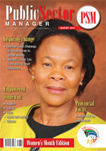

Programme 2: Content Processing and Dissemination
KEY ACHIEVEMENTS
Communication & Content Management
Implemented 100% of ( 1705) language services requests
Produced one edition South Africa Yearbook , ( 45 000 copies) & produced 4 000 DVDs of and 20 000 copies of Pocket Guide to South Africa.
Published 11 editions (18.7 million copies) of Vuk’uzenzele, 5 400 braille copies.
Published 11 editions (175 000 copies) of Public Sector Manager magazine.
Published 4 editions (56 000) GovComms copies.
Held workshops on government web managers on website best practices.

Slide 13


Programme 2:Content Processing and Dissemination
Communication & Content Management
KEY ACHIEVEMENTS
Developed 100% (154) key messages for government spokespersons and departments to inform government communications.
Produced two Pulse of the Nation reports
Produced two reports per cluster biannually and two integrated overview cluster reports biannually.
Eight Insight newsletters published.
Conducted 12 corporate identity workshops.

Slide 14
Programme 2: Content Processing and Dissemination
Non-achievements
Sub-programme : Policy and Research
Objective statement: Provide strategic leadership and support in government communication through media monitoring, research, surveys and analysis to understand the communication environment.
INDICATOR | TARGET | ACTUAL PERFORMANCE | REASON FOR VARIANCE
An annual publication of an assessment of the media landscape published. | An annual publication of an assessment of the Media Landscape published. | Production of the Media Landscape book has been finalised and printers proof has been signed off for printing. | Annual Report not printed within the 2014/15 financial year
Number of reports on government communication monitoring and evaluation produced. | Produced four reports on communication monitoring and evaluation. | Produced three reports on communication monitoring and evaluation. | The one outstanding report has been finalised and will be shared with Manco for approval.

Slide 15
Programme 2: Content Processing and Dissemination
Non-achievements
Sub-programme : Marketing and Distribution
Objective statement: Provide efficient and effective marketing and distribution services for government.
INDICATOR | TARGET | ACTUAL PERFORMANCE | REASON FOR VARIANCE
Number of Public Sector Magazine (PSM ) forums held | Nine forums per annum held. | Held five PSM forums. | The PSM forums are sponsorship driven as GCIS does not have a budget to pay for them. The sponsorship for four forums could not be secured.

Slide 16
Programme 3:Intergovernmental Coordination and Stakeholder Management (ICSM)
Communication & Content Management
Purpose : Implement development communication through mediated and unmediated communication and sound stakeholder relations and partnerships.
Overview of Achievements
A total of 235 content toolkits (key messages, communication strategies; fact sheets, summaries or media statements) in relation to government’s implementation of its mandate and the PoA, were disseminated to key stakeholders.
GCIS hosted 435 local community radio activations reaching over 47 million listeners.
The district and provincial offices distributed a total of 869 861 government information products through 1 019 distribution networks.
Around 87 communication coordination forums are in place countrywide and met monthly or quarterly.
Annual communication programmes for clusters were developed and implemented in collaboration with the departments.
The GCIS coordinated weekly media briefings for the Inter-Ministerial Committee to influence and set the media agenda.
Developed 54 communication strategies aligned to the National Communication Strategy (NCS) and the GCP;

Slide 17


Programme 3:Intergovernmental Coordination and Stakeholder Management (ICSM)
Communication & Content Management
Purpose: Implementation of development communication, through mediated and unmediated communication and sound stakeholder relations and partnerships
Key Achievements
Implemented 2238 development communication projects.
Compiled 746 reports of marketing events for Thusong Service Centres.
Produced 48 electronic My District Today newsletters.
Conducted 2506 community and stakeholder liaison events.
Consolidated report on 326 public participation events by political principals

Slide 18
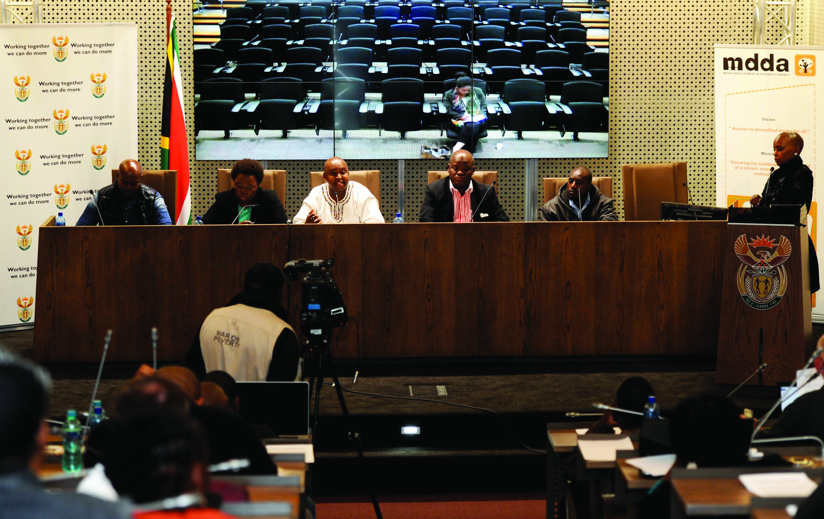
Programme 3: Intergovernmental Coordination and Stakeholder Management ( ICSM)
Key Achievements Cont…
The Clusters coordinated six cluster media briefings to inform the media, public and stakeholders of progress made in implementing government’s Programme of Action.
Coordinated the Presidential State Visit to China, African Union Summit in Ethiopia and the World Economic Forum in Davos
Produced biweekly Rapid Response Reports for the Minister
Provided communication support in the parliamentary precinct by distributing parliamentary questions and programmes,
Issued post-Cabinet media briefings and/or statements after ordinary Cabinet meetings.

Slide 19
Programme 3: Intergovernmental Coordination and Stakeholder Management ( ICSM)
Non-achievements
Sub-programme : Media Engagement
Objective statement: Implement a proactive media engagement system by building, maintaining and improving relations with the media and driving the communication agenda.
INDICATOR | TARGET | ACTUAL PERFORMANCE | REASON FOR VARIANCE
Number of Government Communications Forum (GCFs) held. | Two GCFs held per annum. | Held one Government Communicators’ Forum | The GCF was postponed to 2015/16 financial year due to increased demand for communication services in support of government’s response to the spate of attacks on foreign nationals.

Slide 20



Programme 4: Communication Service Agency ( CSA )
Purpose: Provide media bulk-buying services and media production for the entire national government
Communication & Content Management
Key Achievements
Implemented 272 media-buying campaigns.
2 189 requests for photographic products and services were received and responded to (100%)
1 080 requests for video products and services were received and responded to (100%).
652 requests for radio products and services were received and responded to (100%).
584 requests for graphic design were received and responded to (100%).

Slide 21
Programme 1: Administration
Communication & Content Management
Purpose: Provides overall management and support for the organisation
Overview of Achievements
Practised sound financial management processes and procedures leading to an unqualified audit without matters
Maintained vacancy rate at 8.5%
Compliance with relevant legislations - human resource, strategic management, finance and supply chain management
Developed staff through extensive training and coaching programmes to retain skilled human capital
Human resources and financial constraints put staff under pressure but the organisation still achieved its goals
Information systems and hardware was available more than 95% of the year, enabling the department of function efficiently.

Slide 22
Programme 1: Administration
Purpose: Provides overall management and support for the department.
KEY ACHIEVEMENTS
Submitted four interim financial statements to National Treasury within the legislated timeframes.
Interim and audited annual financial statements submitted to Treasury and AG on legislated deadlines
Produced four progress reports on assurance audits.
Compiled four reports on the implementation of the EE Plan
Approved and implemented Work Skills Plan and Gender Mainstreaming plan

Slide 23
KEY ACHIEVEMENTS CONT…
Programme 1: Administration
Four progress reports on the implementation of the risk mitigation plans were produced and approved by the management committee.
Four quarterly progress reports on the implementation of the GCIS portfolio of projects were produced and approved by Manco.
The 2015/20 SP and 2015/18 APP were tabled in Parliament on 11 March 2015
The 2013/14 AR was tabled on 30 September 2014.
Submitted four approved quarterly performance reports to relevant authorities according to prescribed legislation.

Slide 24
Programme 1: Administration
Non-achievements
Subprogramme : Human Resource Management
Objective Statement: Competent personnel attracted and retained to ensure the GCIS delivers on its mandate.
INDICATOR | TARGET | ACTUAL PERFORMANCE | REASON FOR VARIANCE
Identified strategic elements of the 2013/17 HR strategy implemented. | Strategic elements of the 2013/17 HR strategy implemented. | Implementation reports on the strategic elements of the 2013/17 HR strategy were not submitted to the DPSA | The DPSA amended the HR Planning Directive which affected the submission dates
Percentage of GCIS staff performance agreements signed within legislated timeframe. | 100% of GCIS staff’s performance agreements signed | 94% of GCIS staff performance agreements for new employees were signed within three months | The under achievement is due to non-compliance by employees despite several reminders and follow-ups by HRM staff.

Slide 25
FINANCIAL PERFORMANCE PER PROGRAMME –
2014/15 Annual Report
PROGRAMME | BUDGET (R’000) | EXP (R’000) | % | VARIANCE (R’000)
1 ADMINISTRATION Operational Personnel | 93 986 72 241 | 94 734 72 203 | 100.8% 99.9% | (748) 38
2 CONTENT PROCESSING AND DISSEMINATION Operational Personnel | 42 298 44 915 | 41 657 44 414 | 98.5% 98.9% | 641 501

Slide 26
FINANCIAL PERFORMANCE PER PROGRAMME –
2014/15 Annual report
PROGRAMME | BUDGET (R’000) | EXP (R’000) | % | VARIANCE (R’000)
3 INTERGOVERNMENTAL COORDINATION AND STAKEHOLDER MANAGEMENT Operational Transfer to MDDA Personnel | 25 633 21 815 68 636 | 25 633 21 815 68 630 | 100% 100% 100% | - - 6
4 COMMUNICATION SERVICE AGENCY Operational Personnel | 33 280 22 265 | 33 280 22 265 | 100% 100% | - -

Slide 27
FINANCIAL PERFORMANCE PER PROGRAMME –
2014/15 Annual report
PROGRAMME | BUDGET (R’000) | EXP (R’000) | % | VARIANCE (R’000)
GRAND TOTAL OPERATIONAL TRANSFERS TO MDDA PERSONNEL | 425 069 195 197 21 815 208 057 | 424 631 195 298 21 815 207 518 | 99.9% 100% 100% 99.7% | 438 (101) - 539

Slide 28


