Slide 1



www.agrement.co.za
Agrément South Africa
Slide 1
PRESENTATION OF 2014/15 ANNUAL REPORT TO THE PARLIAMENTARY PORTFOLIO COMMITTEE ON PUBLIC WORKS
Date: Tuesday, 20 October 2015
Old Assembly Chamber, Parliament, Cape Town
Mr Pepi Silinga: Chairman: Agrément South Africa Mr. Joe Odhiambo: CEO, Agrément South Africa
Mr Thabelo Tshikomba: Rep CFO, Agrément South Africa
Tel: 012 841 4075 / 0828928089
jodhiambo@csir.co.za

Slide 2


Slide 3
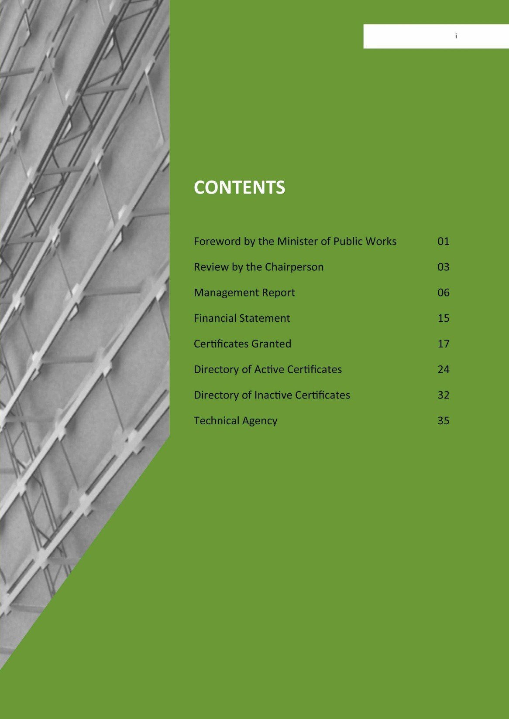

Slide 4

Slide 4
Key points of 2015 Annual Report
Importance and use of Agrément certificates.
Progress on legislative process.
Board oversight role.
Mandate of Agrément South Africa & its promotion of innovation.
Main stages covered in granting certificates.
Quality inspections and validity reviews.
Annual and quarterly targets.
Achievements in reporting year measured against Agrément's mandate.
Technical outputs
Financial performance

Slide 5
Slide 5
Background
Agrément South Africa was established by the then Minister of Public works in 1969
For the last 46 years the entity has been undertaking technical assessments of non-standard or alternative building technologies (ABTs) in South Africa.
Agrément South Africa evaluates the fitness for purpose of innovative non-standard construction related systems or products for use in the construction industry for which no national standard or code of practice exists.

Slide 6
Wednesday, 07 October
2015
www.agrement.co.za
Slide 6
The Legislative process to establish Agrément
The Bill was submitted to Parliament and subsequently referred by the Speaker of the National Assembly to the Portfolio Committee for consideration
ASA observed the process of the Portfolio Committee on Public Works to consider the Bill until its approval with amendments.
ASA observed the consideration of the Bill by the National Council of Provinces until it was passed.
Parliament has submitted the Bill the President for assent.
The enactment of the Bill will pave way for ASA to be established as juristic person and this will eliminate the challenge of irregular transfers to the entity by the Department of Public Works

Slide 7
Wednesday, 07 October
2015
www.agrement.co.za
Slide 7
ASA’s Board oversight role
The Department of Public Works and the Board of Agrément South Africa continued to play an oversight role over the entity.
This is to ensure that the entity’s mandate is fulfilled whilst also providing guidance under applicable circumstances.
In this regard regular meetings, feedback sessions were held with the Department of Public works. Regular Board meetings were also held.
This enabled the Agency to deliver on its mandate and fulfill its regulatory reporting requirements.

Slide 8
Slide 8
Chairman’s review: Origin of Agrément.
The Board exercised its oversight role on the Agency as well as interacted with the National Department of Public Works to ensure Agrément South Africa was adequately managed.
The Agrément system is a procedure which facilitates and encourages the use of the innovations in the building and construction industry.
The system entails the issuing of certificates which indicate to clients and building control authorities that the building system, product or technique is, in the opinion of the Agrément South Africa, technically sound and capable of giving satisfactory performance.
Certificates are granted after a technical investigation has been carried out by the Agrément South Africa’s Evaluation Team.
The agency makes use of knowledgeable expert opinions and laboratory tests at the Council for Scientific Research (CSIR), local universities, accredited laboratories and the South African Bureau of Standards (SABS).

Slide 9
Slide 9
Chairman’s review: Promotion of innovation.
Although the standard building regulations & national codes of practice have been in existence for many years in many parts of the world, the Agrément system was nevertheless introduced to accommodate systems and products falling outside the scope of these standards and codes of practice.
Agrément certificates or their equivalents are now being issued on a regular basis.
The Agrément system, in fact, supports these codes and regulation and does not supplant them.
Today’s innovations may be tomorrow’s familiar practices and it does occur that many innovations which may be currently certificated, become considered as conventional and accepted without a certificate in perhaps something like six or ten years after introduction into the market.

Slide 10
Slide 10
Board Governance
8 Board members.
Current Chairperson is Mr. Pepi Silinga.
Strategic planning session held annually.
Board focussed on consolidating its previous strategic plans and moving the Agency forward.
The Board's Technical sub-committee focused on key objectives & approved Agrément certificates of fitness for purpose.
The Board ensured Agrément South Africa was well governed.
Financial statements are audited and received a clean audit report.

Slide 11

Slide 12
Benefits of Agrément certification¹
Technical conduit to new and improved standardized building materials.
Improved performance of infrastructure development due to advancements in products & building systems.
Can lead towards improvement of existing products.
Helps delivery of infrastructure at a faster & cheaper rate.
Wednesday, 07
October 2015

Slide 12
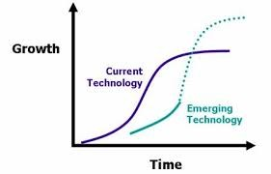
Slide 13
Benefits of Agrément certification²
contribute to accelerated infrastructure development.
Reassurance of fitness of purpose.
Authoritative assessment of system performance.
Contributes towards addressing infrastructure backlogs.

Slide 13
Slide 15
“Modus Operandi”: The Performance Concept
Agrement South Africa receives from members of the public, innovative construction systems & products, for which there are no national standards or codes of practice.
Agrement carries out holistic & comprehensive technical assessments to evaluate the suitability of the product or systems as being “fit for purpose” or not.
Independent & authoritative based on actual tests carried out.
Define performance in use without specifying how the performance will be attained.

Slide 14
Slide 16
“Modus Operandi”: The Performance Concept
Develop performance criteria (Criteria for local conditions developed by a team of experts).
Develop suitable test methods.
Measure actual performance.
Judgement of acceptability in light of actual performance.

Slide 15
Slide 17
Typical Scope of Evaluation
structural strength & stability
water penetration and rising dampness
thermal & energy performance
performance in fire
quality management system
Conformity to National Building Regulations
condensation
acoustic performance
accuracy in building
durability

Slide 16
Operating Procedures
Slide 18
www.agrement.co.za
1: Applications for certification.
2: Preparation of evaluation programme and contract offer. 3: Certification.
4: Recourse procedure where Board has refused certification.
5: Preparation and development of technical guidelines and indicators.

Slide 17

Certificates
Slide 19
Certificate Number.
Check Validity with office.
Uses applicable.
Limitations if any.
Applicable conditions.
Registered owner or licensee.
Competent builder and complies with the cidb register of contractors.
Compliance with NHBRC.

Slide 18
Slide 20
Achievements measured against mandate
Agrément South Africa serves the consumer interest by providing assurance of fitness-for-purpose of innovative, non-standard construction products as well as on-going quality assurance.
Agrément South Africa works with the construction industry in the development of cost-effective, innovative and non-standardised construction technology.
Agrément South Africa disseminates correct, objective and relevant information to all concerned in respect of the technical, socio-economic and regulatory aspects of innovative and non-standard construction technologies.

Slide 19
Slide 21
Achievements measured against mandate
Agrément South Africa continues to support policy makers at all levels to minimise the risks associated with the use of innovative technologies. The agency’s staff members are actively involved in the SABS’s standards generation committee and various other technical committees.
Agrément
South Africa supports the application of the National
Building Regulations.
Agrément South Africa actively maintains international links with peer organisations and continues to support the South African construction industry in its export activities by facilitating the approval of South African innovative construction products to countries abroad.
Agrément
South Africa continues to facilitate the acceptance of
innovative products within the context of the government’s new priorities and policies.

Slide 20
Performance Outputs
Slide 22
List of certificates granted
List of Active and inactive certificates.

Slide 21
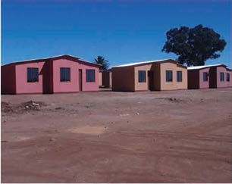
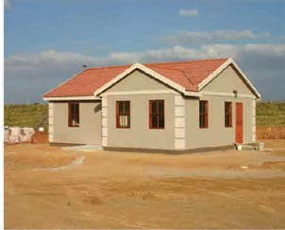
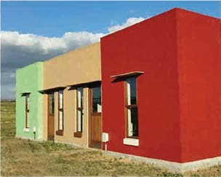
Slide 23
Certificates approved
Africote One Coat PVA Coating System
Alternative Steel Frame Building System
The Alternative Steel Frame Building System consists of galvanised light gauge steel structural components to both wall panels and roof trusses.
The design concept is based on steel frame technology conforming to SANS517.
Benex Masonry Building System
Benex Masonry Building System is for single storey buildings. It comprises Benex Masonry Hollow Blocks used for external walls and timber stud frame clad with Benex wall panels used for internal walls. Foundations and roof are conventional with insulated ceilings.
Africote One Coat PVA Wall Coating is a ready-to-use, styrene acrylic copolymer for interior and exterior wall coating. It is available in a variety of colours and packed in 5 litre and 20 litre plastic buckets. It is thoroughly stirred on site before application and applied using a paint brush or a good quality roller.

Slide 22
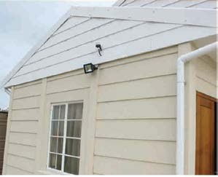

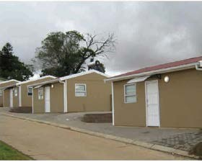
Slide 24
Certificates approved
Cavcon Modular Building System
DesignBuilder Energy Analysis Software
DesignBuilder Energy Analysis Software is a user-friendly interface for the US Department of Energy software, EnergyPlus.
EnergyPlus has been developed from both of the BLAST (Building Loads Analysis and System Thermodynamics) and the DOE-2 programmes of the 1970’s and 1980’s.
Everite ABT House Building System
Everite ABT Building System comprises both conventional and innovative aspects of construction. The foundations are conventional and always the responsibility of a registered professional competent engineer.
The Cavcon Modular Building System is for the erection of single- storey buildings. Walls are cavity construction, formed by factory produced pre- stressed concrete posts and pre-cast, reinforced concrete wall panels. The external walls are 103 mm thick and internal walls are 86 mm thick.

Slide 23
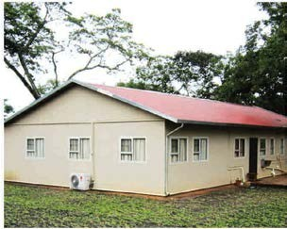
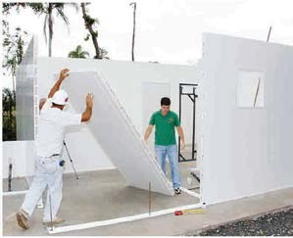
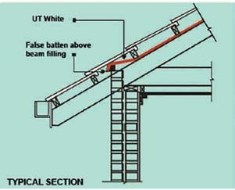
Slide 25
Certificates approved
FSM FR Polycore Building System
GHS Wall Technology Building System
The GHS Wall Technology Building System utilizes conventional concrete foundations and surface bed, 100 mm thick that are always the responsibility of the professional engineer.
Gundle UT Woven Roof Tile Underlay
The Gundle UT Woven 118 Roof Tile Underlay is manufactured from a laminate of spunbonded material and virgin polyethylene. The spunbond layers are UV- stabilised. The membrane has a weight of 118 g/m2 and the thickness varies between 0.40 mm to 0.50 mm. It is supplied in rolls of 30 m, 40 m long and
1.25 m wide.
FSM FR Polycore Building System is used for single storey buildings. The system comprises prefabricated components that are assembled on site, conventional strip or raft foundations and roofs with insulated ceilings.

Slide 24

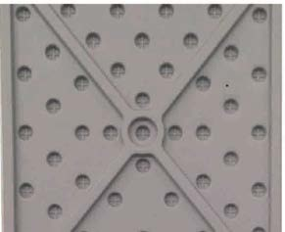
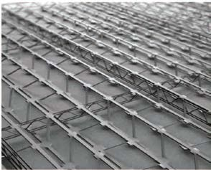
Slide 26
Certificates approved
Gundle Anti-Termite Damp proof Membrane
The Gundle Anti -Termite Damp-Proof Course and Membrane is manufactured from three layers of co- extruded, low density polyethylene (LDPE). The membrane has a thickness of 250 µm and it is supplied in rolls of 30 m long x 1 m and 6 m wide.
High Density Polymer Envirodoor
High Density Polymer Envirodoor is a pivot hinge plastic door designed for sanitation top structures installed on site to provide privacy, protection from the elements and security for users. The door fits into lugs that can be attached to the floor and roof or cast into the floor and roof for improved resilience.
JK Structures Building System
JK Structure Building System is a cast in-situ reinforced light- weight concrete system for use in the erection of single-storey buildings. The system makes use of permanent formwork/shuttering made up of a three-dimensional metal lath or cage to which the chicken mesh is tied.

Slide 25
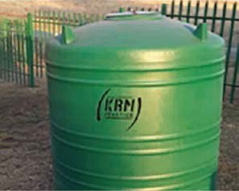
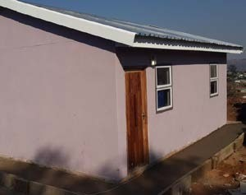
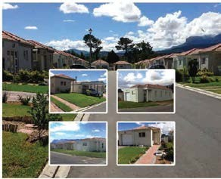
Slide 27
Certificates approved
KRM Water and Liquid Storage Tanks
KRM Water and Liquid Storage Tanks are prefabricated and rotary moulded tanks. The tanks’ wall thicknesses vary from
2.5 mm to 6 mm, depending on the volume and intended use of the tank.
Legna Solidwall Building System
Legna Solidwall Building System comprises both conventional and innovative aspects of construction. The foundations are conventional and always the responsibility of a registered professional competent engineer.
Nu Cover Wall Coating System
Nucover Wall Coating is a two coat ready-to-use, water-based flexible acrylic emulsion wall coating. It is available in a range of colours and packaged in 5 litre and 20 litre containers. It is to be thoroughly stirred on site before application. It is applied by using a block brush, a heavy duty roller, a stipple roller or spray gun.

Slide 26
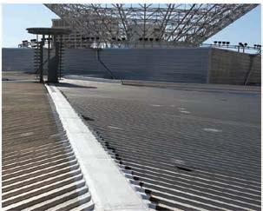
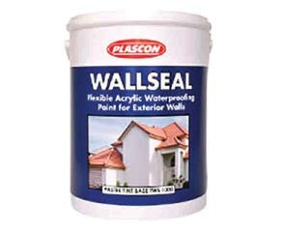
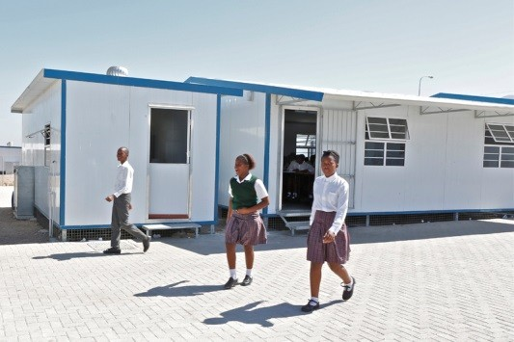
Slide 28
Certificates approved
Optiflash Waterproofing System
Optiflash Waterproofing System as a sealing component for parapet walls, timber decks and concrete roof slabs. It is also used in conjunction with galvanised iron flashings as a sealing agent between walls and light- or heavy-weight roof cladding.
Plascon Wallseal Coating System
The Plascon Wallseal Coating System is a two coat ready-to- use, water-based flexible acrylic emulsion wall coating. It is available in a standard white colour and a range of colours can be achieved with an addition of pastel tint bases and colourants. It is applied using a block brush, roller or airless spray.
RIC Prefabricated Building System
RIC Prefabricated Building System is constructed with prefabricated components that are assembled on site.

Slide 27
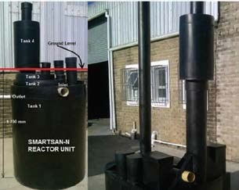
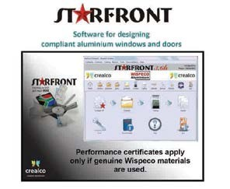
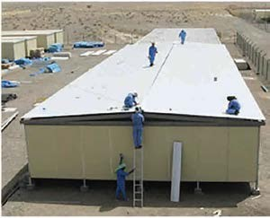
Slide 29
Certificates approved
Smartsan Sanitation System
SMARTSAN Recycle Digester Sanitation System consists of the N-series and SMARTSAN Bulk units manufactured by Nano Water Technologies (Pty) Ltd, based in unit 57A, Ivory Street Thamsui Industries, George.
Starfront Designer Computer Software
Starfront Designer cost and cutting computer software is the software package intended to assist the manufacturers of aluminium window, door and shop-fronts to design, cost and manufacture products based on Wispeco (Pty) Ltd.’s aluminium extrusion systems.
Sterling Building System
The Sterling Building System is for single-storey structures.
Foundations are the conventional cast in-situ concrete surface beds with thickened edge beams. They are always the responsibility of a professional registered competent engineer.

Slide 28
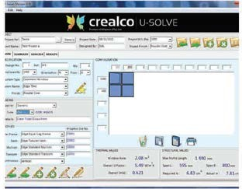
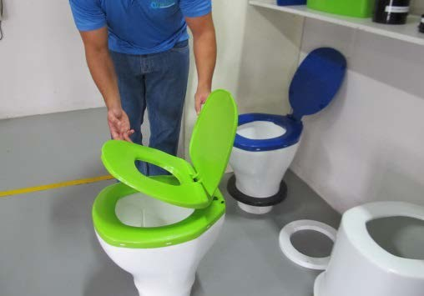
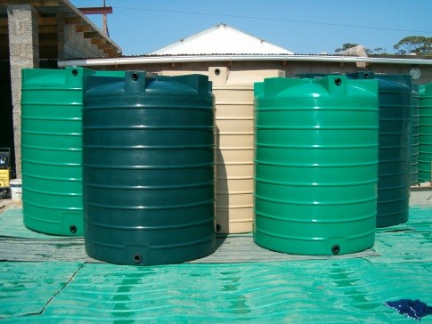
Slide 30
Certificates approved
U-Solve Whole Window U-value Calculator
Crealco U-Solve Whole Window U-Value & SHGC Calculator Software (U-Solve) is MS-Windows based software for the calculation of whole- window thermal transmittance (U-Values) and solar heat gain coefficients (SHGC) for Wispeco’s Aluminium window and door systems.
VIP & Urine Diversion Toilet
VIP and Urine Diversion Toilet System consists of sanitation components for installation on site for the typical superstructure constructed over a vented pit.
Yebo Water and Liquid Storage Tanks
Yebo Water and Liquid Storage Tanks are prefabricated and rotary moulded polyethylene tanks. The material thickness varies between 3 mm and 6 mm, depending on the volume and intended use of the tank.

Slide 29
Technical Outputs (Certificates Approved) Slide 32
2015
www.agrement.co.za
 | Actual 2014/15 | 2008/09 | 2009/10 | 2010/11 | 2011/12 | 2012/13 | 2013/14
Applications received: | 33 | 17 | 17 | 29 | 36 | 33 | 33
Evaluation offers made: | 33 | 16 | 15 | 24 | 33 | 30 | 30
Evaluation offers accepted: | 25 | 12 | 7 | 19 | 16 | 24 | 24
Certificates issued: | 23 | 9 | 12 | 15 | 20 | 31 | 31
Building products: | 107 | 65 | 71 | 84 | 94 | 95 | 95
Building systems: | 127 | 70 | 80 | 98 | 102 | 116 | 116
Roads products: | 17 | 10 | 11 | 15 | 16 | 17 | 17
No. of Board meetings | 4 | 3 | 4 | 3 | 4 | 4 | 4

Slide 30
www.agrement.co.za
Slide 31
Financial performance

Slide 31
Comparison of Actual Audited Annual Financial Performance With Previous Years
 | 2011/12 | 2012/13 | 2013/14 | 2014/15
Total Income | 9 778 965 | 9 947 491 | 11 056 266 | 11 660 485
Grant Received | 8 272 807 | 8 692 992 | 9 121 053 | 9 667 544
Contract Income | 1 505 983 | 1 240 339 | 1 930 963 | 1 983 429
Local private sector | 1 293 939 | 1 138 529 | 1 688 133 | 1 823 233
Local Public Sector | 99 165 | 31 400 | 5 000 | 0
International Sector | 112 879 | 70 400 | 237 830 | 160 196
Total Expenses | 9 876 645 | 10 298 870 | 10 911 181 | 11 475 091
Employee remunerations | 5 082 398 | 5 411 237 | 5 624 813 | 5 927 633
Depreciation | 369 948 | 439 947 | 278 171 | 516 002
Operating Expenses(admin) | 4 424 299 | 4 447 686 | 5 008 197 | 5 031 456
Margin before Interest | -97 680 | -351 379 | 145 085 | 185 394
Interest | 182 508 | 185 755 | 162 442 | 181 848
Nett Margin/Surplus | 84 828 | -165 624 | 307 527 | 367 242

Slide 32
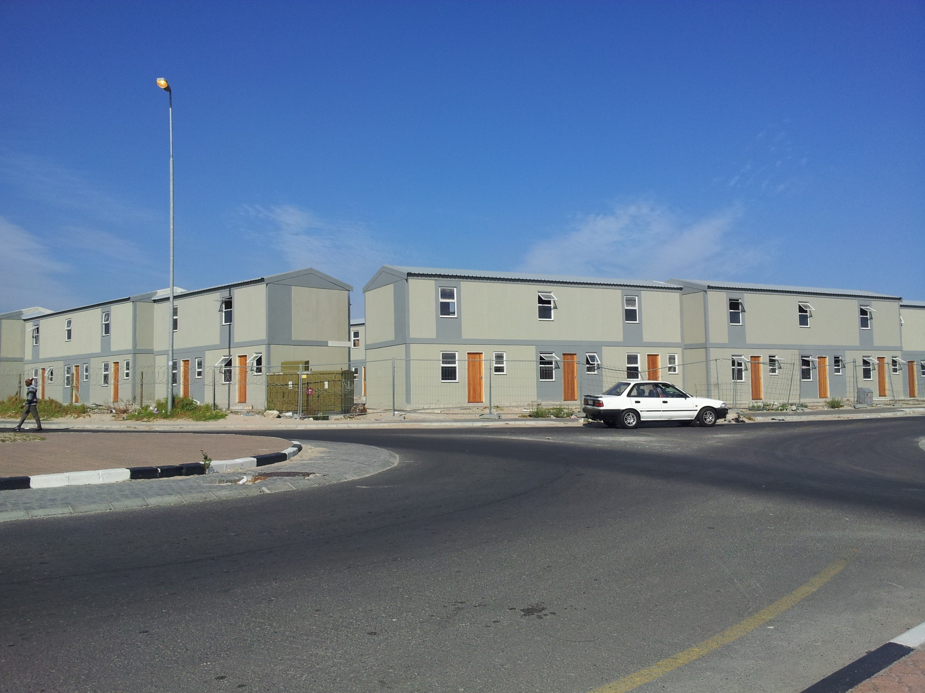
Wednesday, 07 October 2015 Slide 37 of 54
www.agrement.co.za

Slide 33
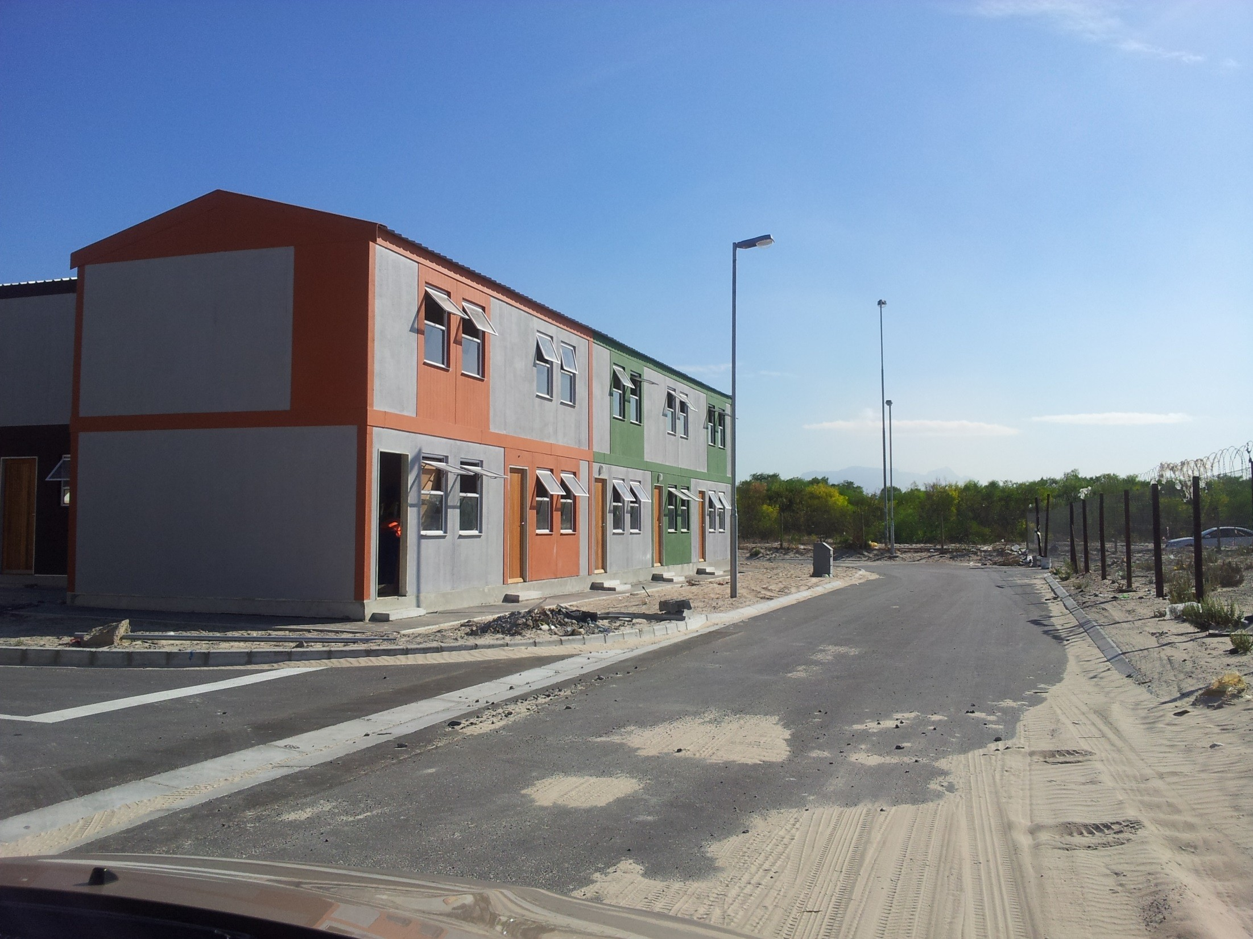
Wednesday, 07 October 2015 Slide 38 of 54
www.agrement.co.za

Slide 34
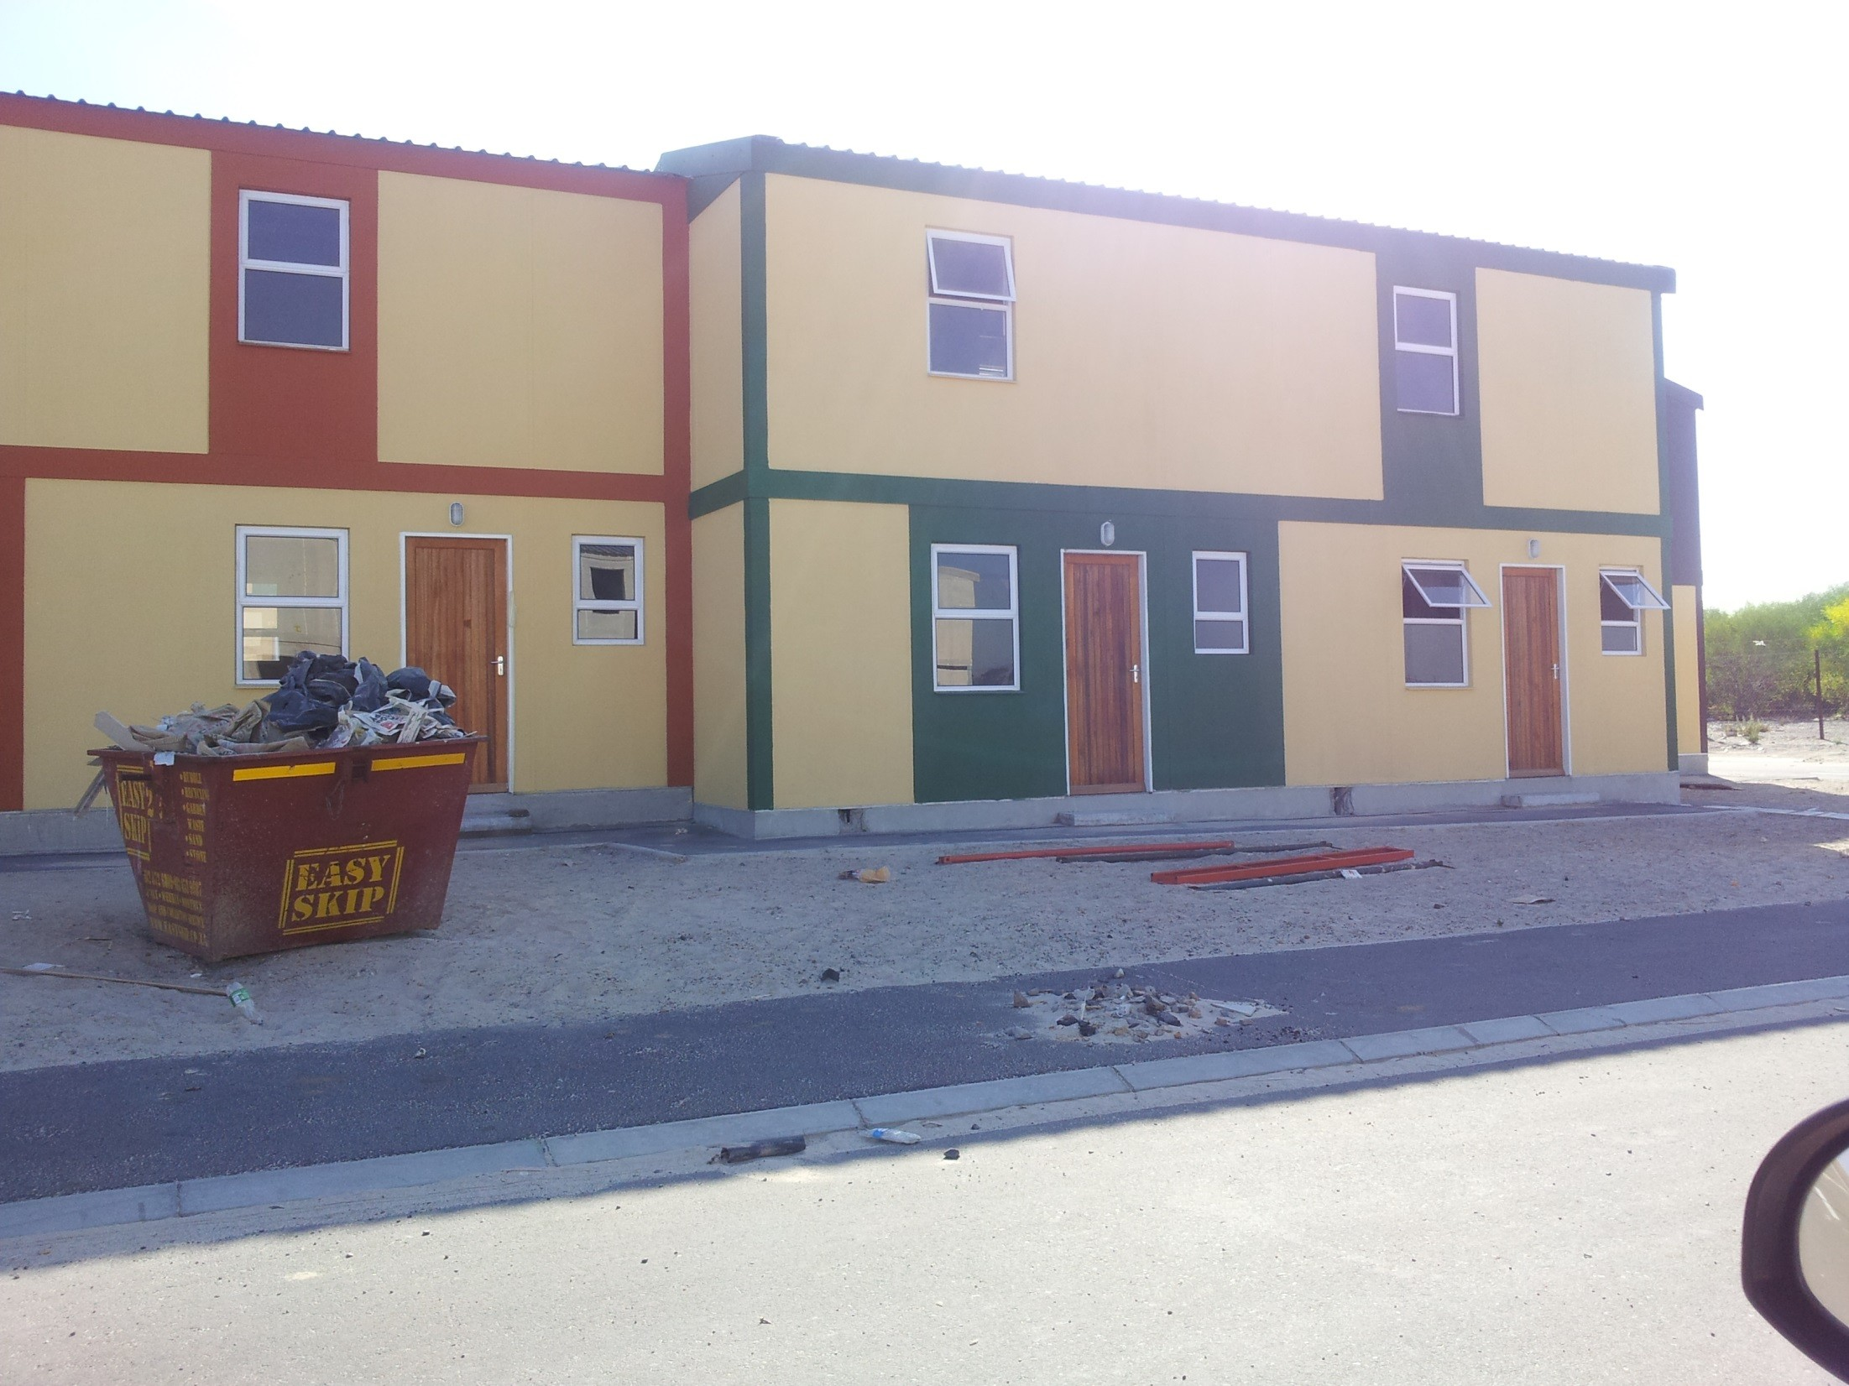
Wednesday, 07 October 2015 Slide 39 of 54
www.agrement.co.za

Slide 35
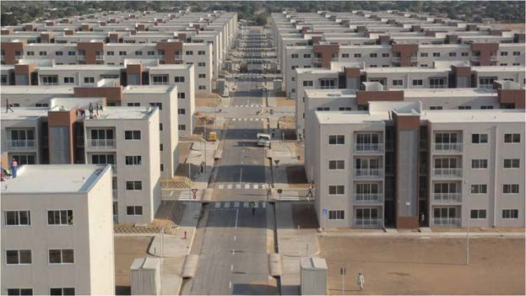
Slide 38

Slide 36
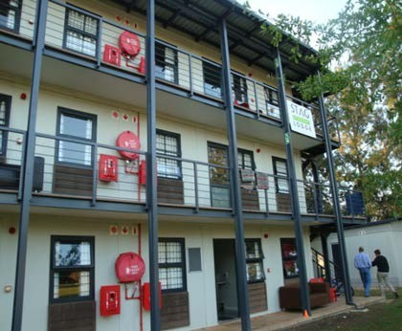
Slide 39
ment.co.za

Slide 37
Slide 40
Thank you…
for Achieving excellent results TEAM: Together Everyone Achieves More

