Slide 1
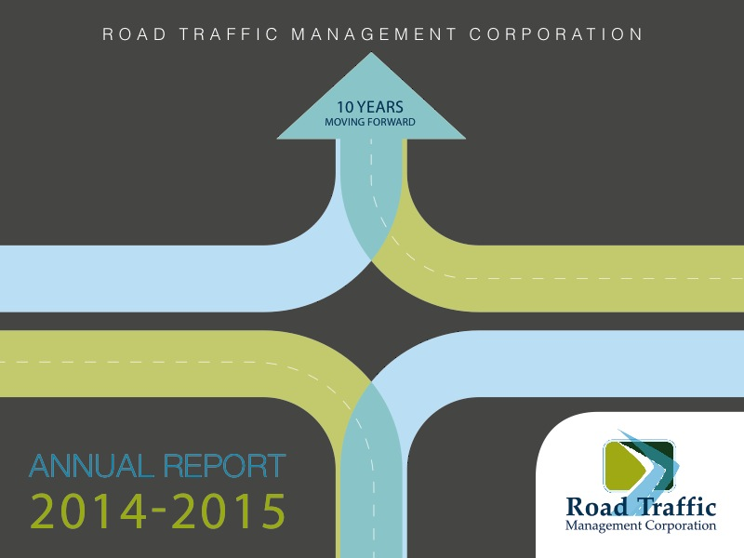

Slide 2
Contents
Introduction
Governance
Performance Information
Human Resources
Financial Information
Audit Committee Report
Audit-General’s Report

Slide 3
Introduction
To provide a report on the Annual Performance of the RTMC for the period 2014/15 in line with Section 22 of the RTMCA, Section 55 of the PFMA and National Treasury Regulation 55.2
To take stock of the road travelled since the previous appearance and share some lessons and milestones achieved
Give a brief account of our past history and narrate our desired destiny
Scope of the report:
  Governance
  Performance Information
  Human Resources
  Financial Performance
  Audit Report
  Auditor-General Report

Slide 4
Contents
Introduction
Governance
Performance Information
Human Resources
Financial Information
Audit Committee Report
Audit-General’s Report

Slide 5
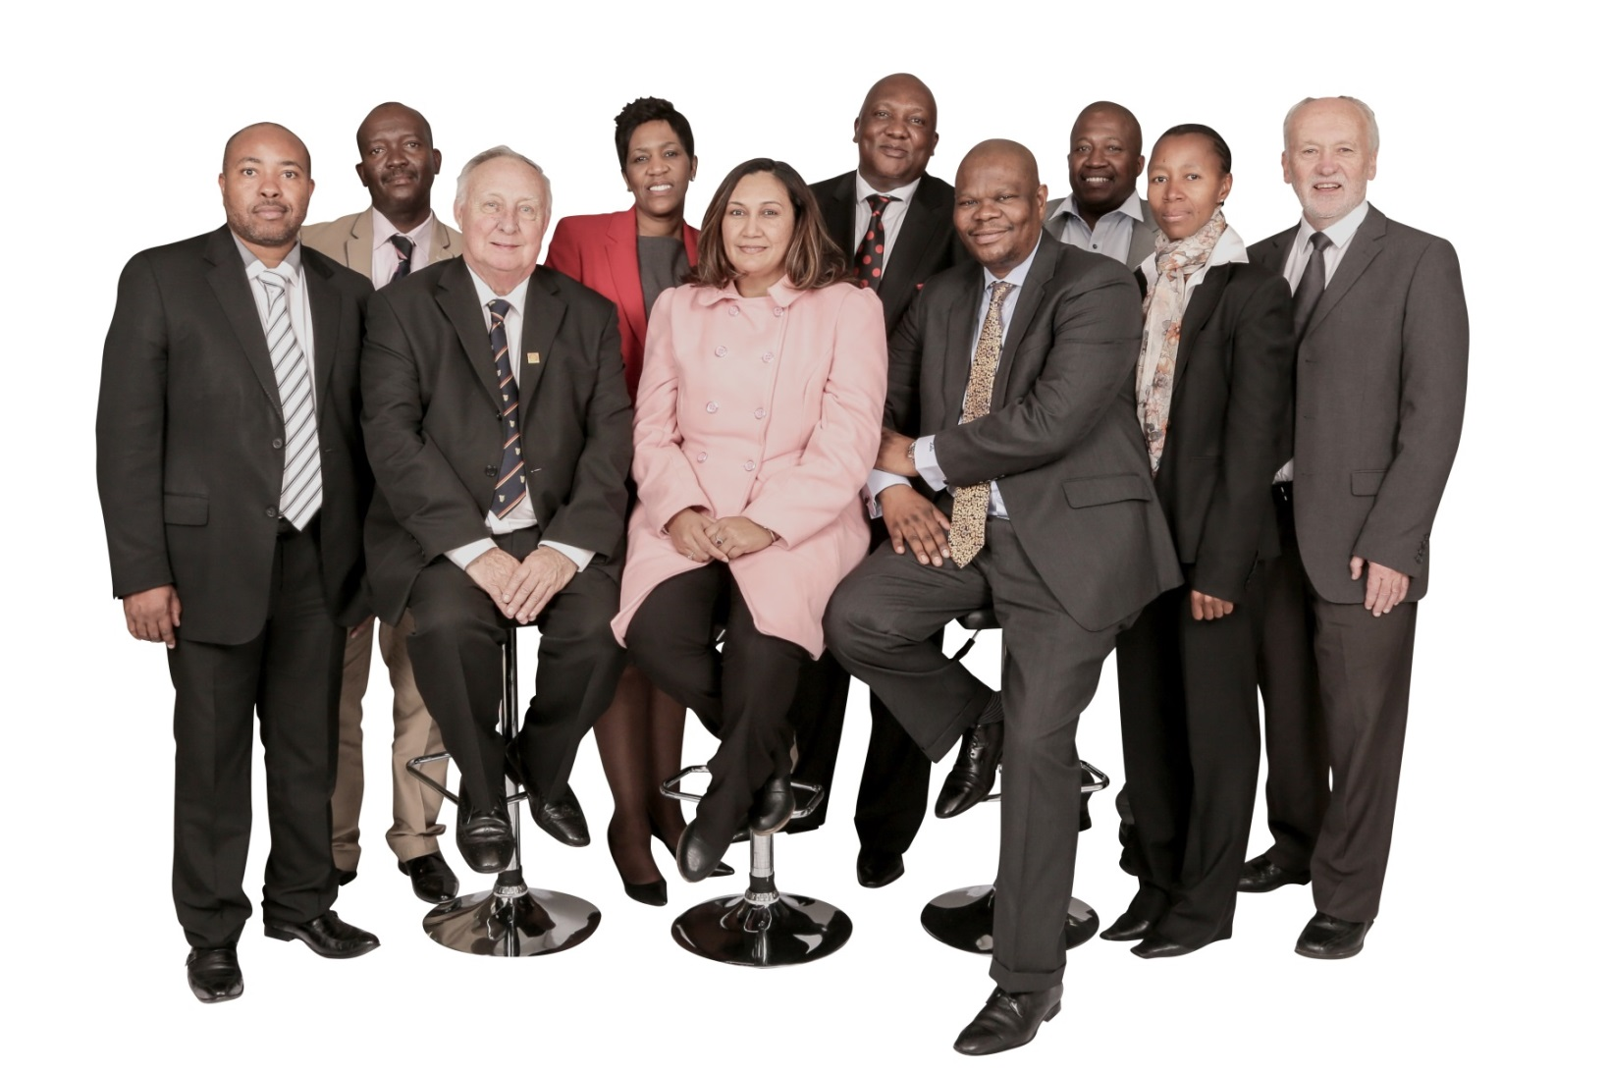
RTMC Board
Confronted by unprecedented challenges for the year under review sixteen (16) Board Meetings were held including two (2) strategy sessions.

Slide 6
Board Committees
The Board is supported by the following committees
Board
Company Secretariat
Audit and Risk Committee
Strategy and Monitoring Committee
Remuneration Committee
Social and Ethics Committee

Slide 7
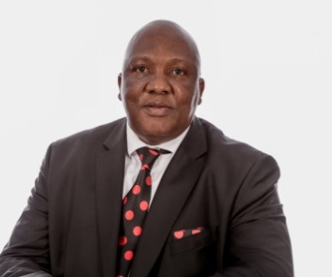
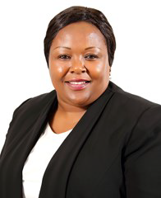
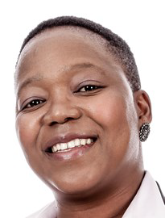
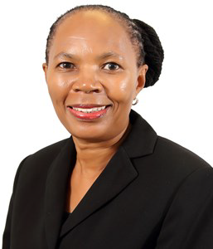


RTMC Executive
Chief Executive Officer
Chief Law Enforcement
Chief Human Capital
Chief Strategy Officer
Chief Financial Officer
Chief Operations Officer
67% women representation at Executive Level

Slide 8
Contents
Introduction
Governance
Performance Information
Human Resources
Financial Information
Audit Committee Report
Audit-General’s Report

Slide 9
Strategic Goals and Objectives
Improve and institutionalise stakeholder relations
Enable legislation to promote Road Safety
Improve financial sustainability
Create a dynamic and transformed organisation
Foster Good Governance
Promote and support road safety
Regulate the road traffic environment
Improve revenue generation
Develop a 21st century curriculum and cadre
Following the rule of law
Develop and implement interventions for targeted road users
Effective management of operational costs
Establish a centre of excellence
Implement Equity
Imperatives
Mobilise and Sustain Relations with other Spheres of Government
Develop and implement a funding model
Create a learning organisation
Collaborate with Other
State Agencies and
Government
Promote Private Sector Participation
Enhance public confidence and trust in road traffic information
Implement Corporate
Social Investment
Programmes
Combat Fraud and Corruption
Implement innovative technologies
Create a Conducive
Environment Geared
Towards Service Delivery
Collaborate with DoT on road safety
Develop Norms and
Standards
The 2014/15 Annual Report is based on the 2014-2019 approved Strategy and 2014/15 approved Annual Performance Plan

Slide 10
Summary of performance
Item | KPI
Not Achieved | The National Road Traffic Law Enforcement Code Funding model Revenue increase Regional Offices Vacancy rate State of road safety reports
Partially Achieved | Road safety supporting systems

Slide 11
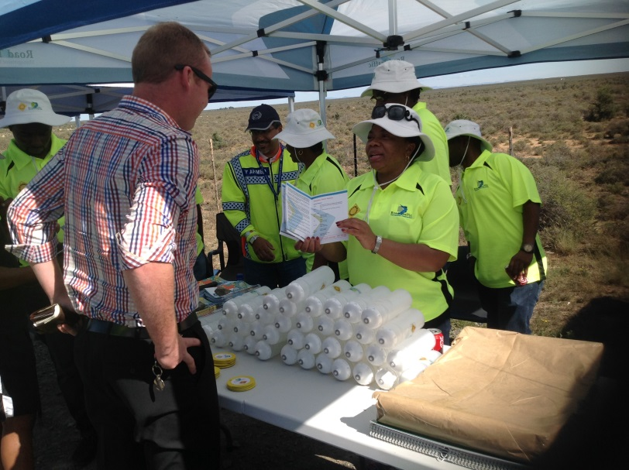
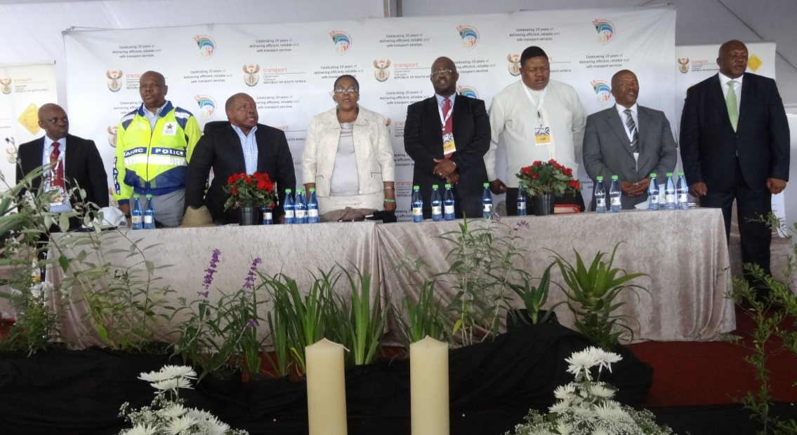
Highlights of Achievements
Performance Environment ROAD SAFETY
Road Safety Programmes in collaboration with provinces
Supported by a road safety marketing strategy

Slide 12


Highlights of Achievements
Performance Environment ROAD SAFETY
Road Safety Programmes in collaboration with provinces
Supported by a road safety marketing strategy

Slide 13
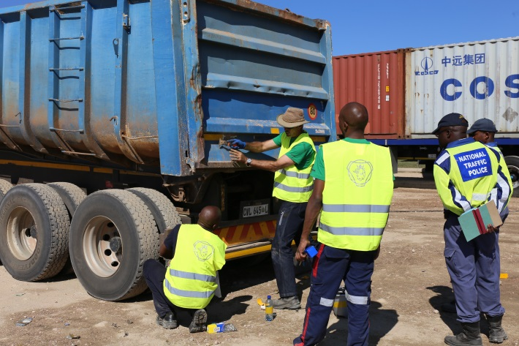
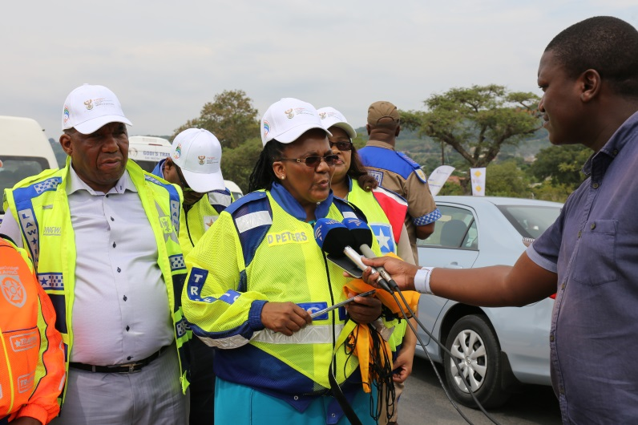
Highlights of Achievements
Performance Environment LAW ENFORCEMENT
Law Enforcement Programmes in collaboration with provinces

Slide 14
Highlights of Achievements
Other Areas
Stakeholder Management
Training of Traffic Personnel
The Corporation concluded 12 MOUs with various stakeholders within the following sectors:
  Government
  State Agencies
  Private
Developed strategy on the establishment of a center of excellence for road traffic management practitioners
A strategy on the rationalisation of traffic training colleges was approved by the Corporation as well as the development of norms and standards for road safety practitioners
A revised basic traffic officer qualification to produce competent and ethical traffic officers was submitted to Quality Council for Trades and Occupation (QCTO) and is awaiting registration
An Authorised Officer Deployment Model was developed by the Corporation
Anti-Fraud and Corruption
The Corporation investigated all (100%) reported cases on fraud and corruption and as a proactive measure – 69 cases, 49 arrests
48 awareness campaigns on fraud and corruption were conducted

Slide 15
Highlights of Achievements
Other Areas
Traffic, Engineering, Information, Research
Support Services
The Corporation developed and implemented the Road traffic information standards
An independent road traffic information committee was established through STATS SA existing structure
Two (2) research and development products (studies) were developed
Human Resources
The Corporation implemented 100% of its performance management systems and implemented 100% of its workplace skill plan targets
Finance
A reduction of 51% on the non-core costs was achieved by the Corporation against the planned target of 10%

Slide 16
Underachieved Targets
Performance Environment
Targets not Achieved | Mitigating Action
The National Road Traffic Law Enforcement Code | Currently in progress – tender has been advertised
Developed funding model
Revenue increase | Revenue streams are monitored (will also be informed by the implementation of a funding model) and controls are implemented in the NTP for the management of infringements
Regional Offices | The process is under review to changes in organisational service environment
Vacancy rate | Personnel appointed post the financial year end
State of road safety reports | Reports have since been completed, pending publication

Slide 17
Contents
Introduction
Governance
Performance Information
Human Resources
Financial Information
Audit Committee Report
Audit-General’s Report

Slide 18
Organisational Environment
Staff Complement
National Traffic Police make up 78% of the RTMC resources
In the year under review the vacancy rate dropped from 31% in the previous year to 26%, however, more effort needs to be placed in recruiting in specialised fields

Slide 19
Contents
Introduction
Governance
Performance Information
Human Resources
Financial Information
Audit Committee Report
Audit-General’s Report

Slide 20
Budget Spend per Programme
Performance Environment
The Corporation was able to decrease none core costs by 51% against a planned target of 10%
The Corporation underspent by 38% during the year under review

Slide 21
Budget Spend..Cont
Financial Environment

Slide 22
Highlights of Expenditure
Financial Environment
High expenditure items were:

Slide 23
Statement of Financial Position
Financial Environment

Slide 24
Financial
Statement of Performance

Slide 25
Declaration of Surplus
Financial Environment
  The audited Annual Financial Statements of the Road Traffic Management Corporation (RTMC), for the year ended 31 March 2015 reflects a Surplus of R 313 241 162 (2013/14: a revised surplus of R 377 002 863)
  Accumulated surpluses amounting to R545 900 000 from previous financial years were distributed to the shareholders during 2014/15 financial year in line with the RTMC Act
  The RTMC requested the Shareholders Committee to retain the surplus of 2014/15 to focus on the following strategic programmes amongst other things:
      The upgrading of the e-NaTIS system
      Intensifying Road Safety Mobilisation and Education
      Extensive marketing of Road Safety programmes
      Nationalisation of Road Traffic and Law enforcement
      Training of Road Safety and Traffic personnel
      Development of Road Safety Education & Traffic Curriculum
      The acquiring of office space by considering different means including procuring a building

Slide 26
Contents
Introduction
Governance
Performance Information
Human Resources
Financial Information
Audit Committee Report
Audit-General’s Report

Slide 27
Audit Committee Report
  In the year under review the Audit Committee:
  Assisted and guided management to improve internal controls and compliance with the PFMA, IFRS and adopted appropriate Terms of Reference and Charter;
  Assessed the performance and effectiveness of the Internal Audit and Risk functions;
  Assisted with the development and review of all organizational policies;
  Played an important role on the stabilization of the organization and development of the risk framework; and
  Assessed the effectiveness of the Auditor-General South Africa.
  Recommendation:
  That the audited financial statements be accepted and read together with the report of the Auditor General

Slide 28
Contents
Introduction
Governance
Performance Information
Human Resources
Financial Information
Audit Committee Report
Audit-General’s Report

Slide 29
Auditor-General Report
  Unqualified audit report for 2014/15 - Improvement from 2013/14 qualified audit opinion
  Events after reporting date:
  Transfer of e-NATIS
  Emphasis of Matter:
  The Corporation suffered a material loss of R4.4million due to Fraud that took place amounting to R8.5million, R4.2 million has since been recovered
  Performance Information
  No material findings on the usefulness and reliability of the reported performance information for the selected objectives

Slide 30
Auditor-General Report ..Cont
  Other matters:
  The financial statements submitted for auditing were not prepared in accordance with the prescribed financial reporting framework and/or supported by full and proper records as required by section 55(1)(a) and (b) of the Public Finance Management Act.
  Non-compliance with SCM guidelines
  Lack of Internal control systems

Slide 31
Questions and Discussions

