Slide 1

Water Research Commission
Annual Report 2014/15
October 2015

Slide 2
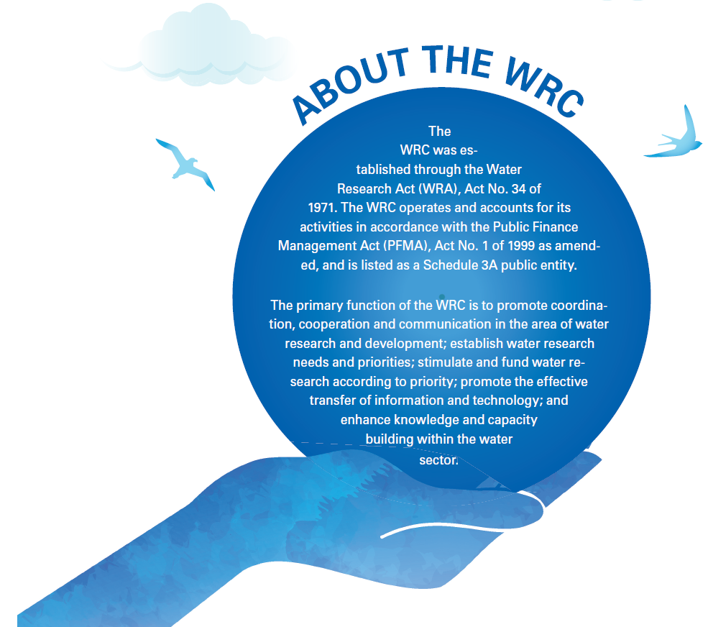

Slide 3
WRC Strategic Intent
The WRC’s strategy for knowledge creation and impact in its research, development and innovation portfolio covers the following:
Water resource management
Water linked ecosystems
Water use and waste management
Water utilisation in agriculture
Water knowledge management, dissemination & impact

Slide 4
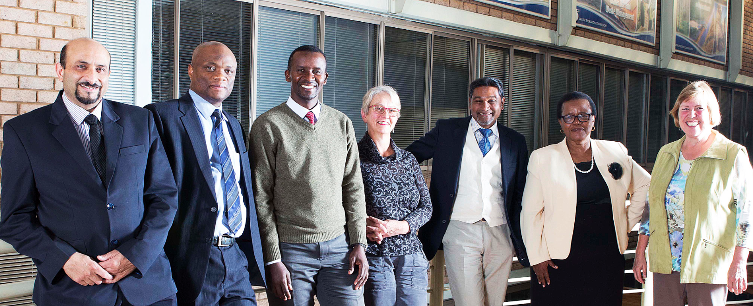
WRC Board
Mrs Barbara Schreiner (Chairperson); Mr Nala Mhlongo; Mr Godfrey Mwiinga; Ms Dora Ndaba (Vice-chairperson); Mr Imraan Patel, Prof Eugene Cloete, Dr Barbara van Koppen; Mr Dhesigen Naidoo (WRC CEO and Ex-officio member); Ms Margaret-Ann Diedricks (DWS DG and Ex-officio member)

Slide 5
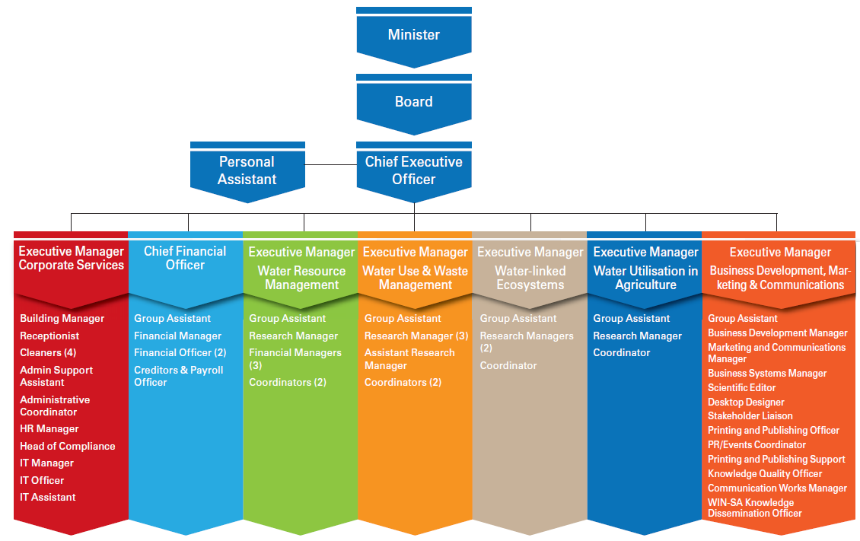
Organisational Structure

Slide 6

WRC Performance
• Research, Development and Innovation
• Human resources
• Financial performance

Slide 7
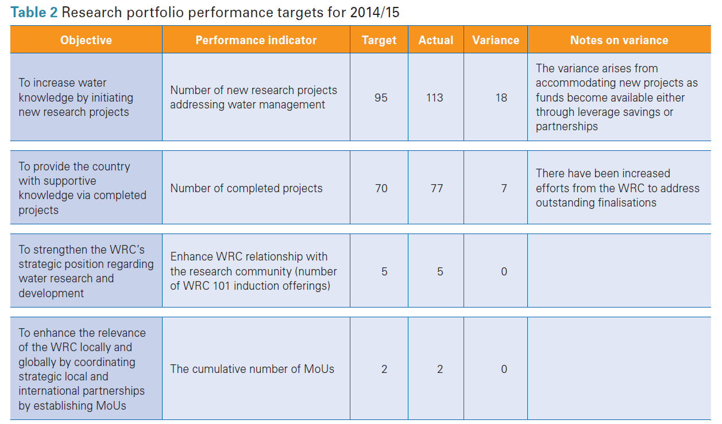
Research portfolio targets for 2014/15

Slide 8
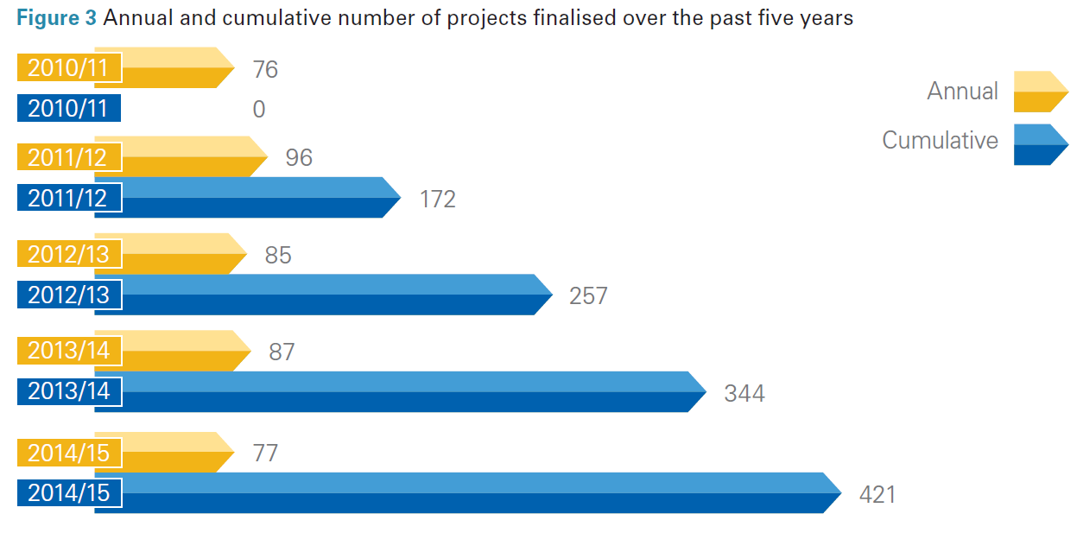
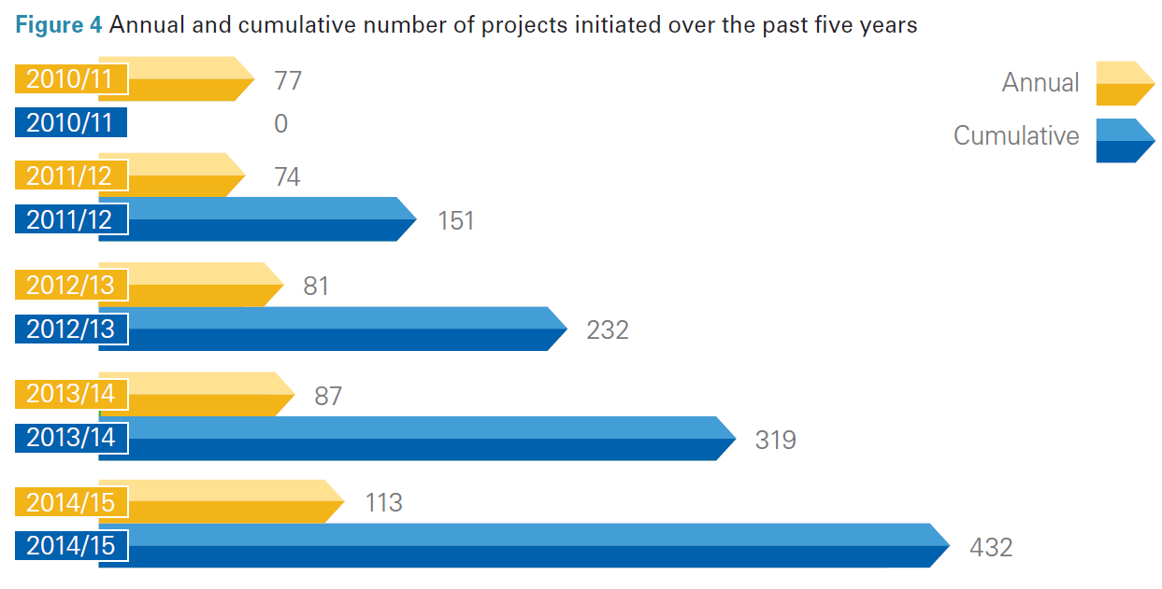
Research portfolio targets for 2014/15
Annual and cumulative number of projects finalised over the past five years
Annual and cumulative number of projects initiated over the past five years

Slide 9
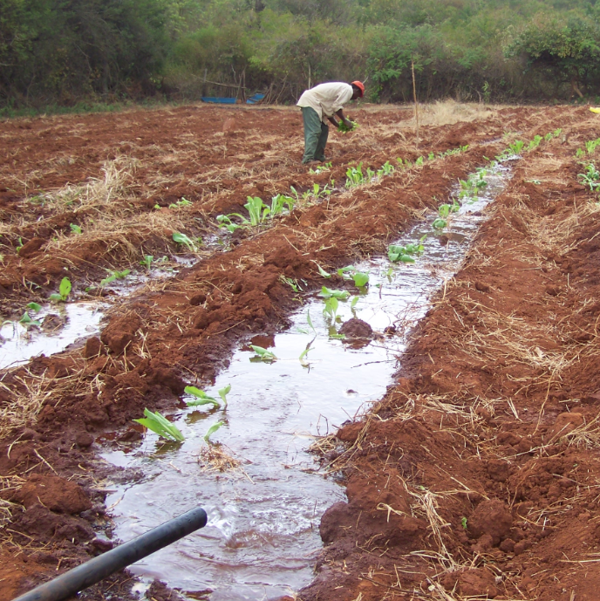
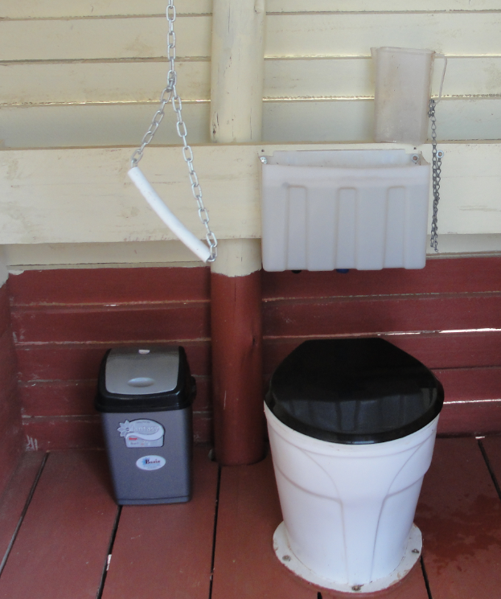
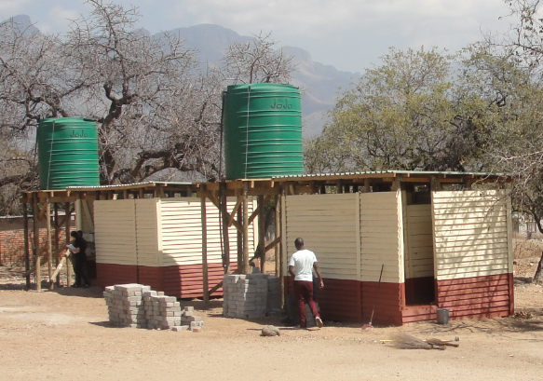
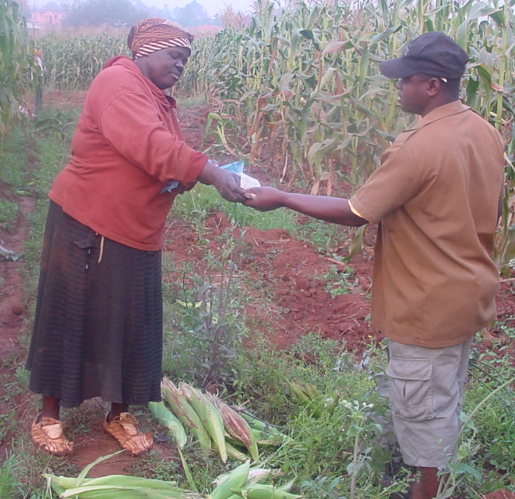
Transforming SA society
Testing pour flush sanitation
Improving food production, nutrition and health in South Africa

Slide 10
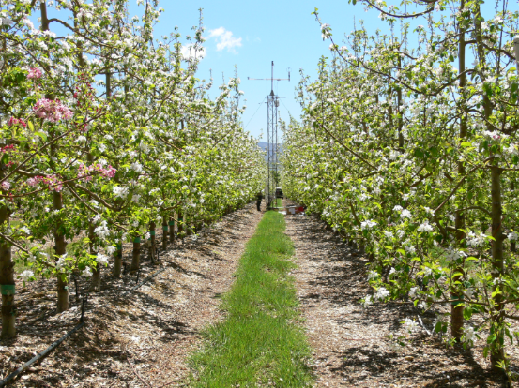
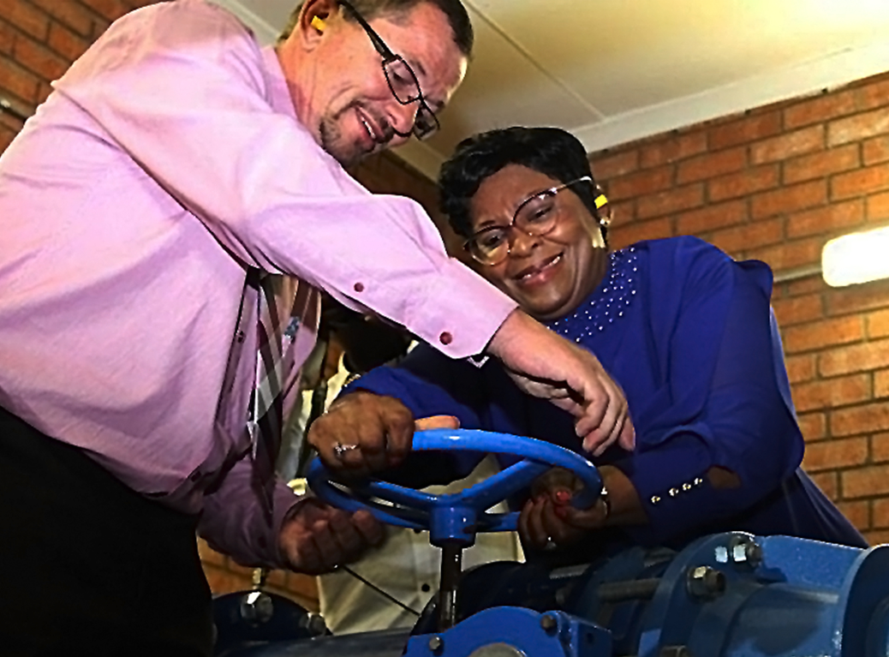
Sustainable development solutions
Determining the water use of selected fruit-tree orchards
Conduit hydropower

Slide 11
Research portfolio targets for 2014/15

Slide 12
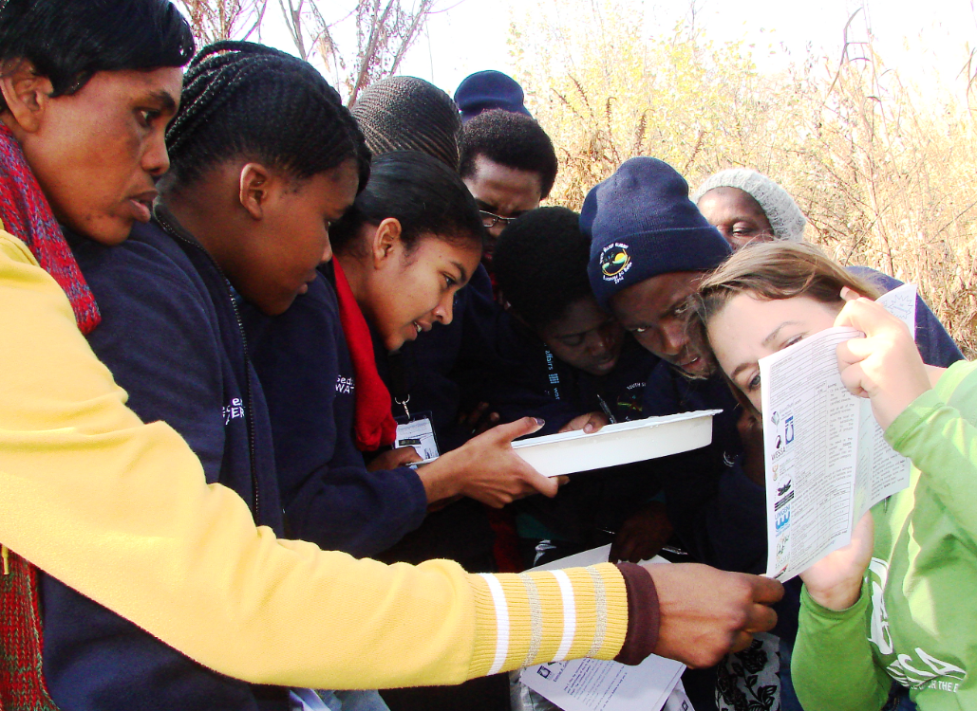

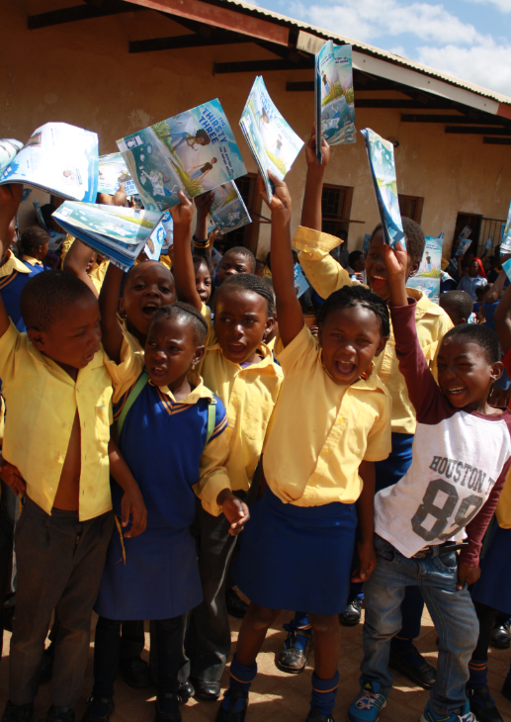
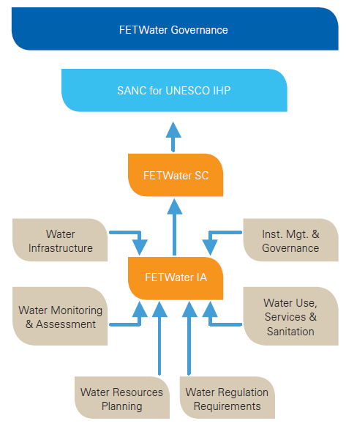
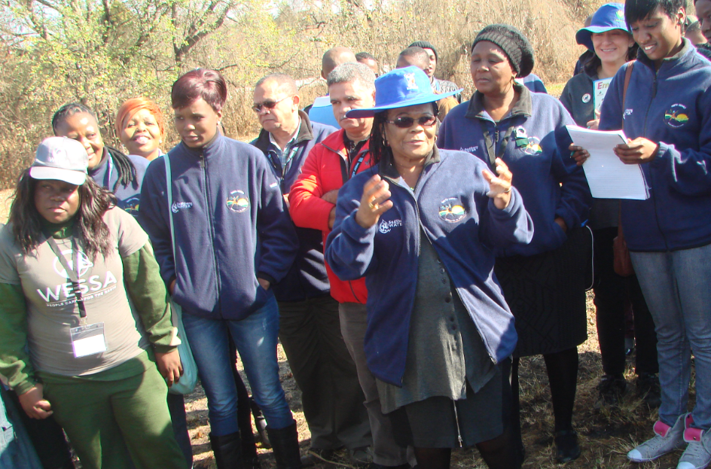

Human capital development
‘Thirsty three graphic novel’
Mini-SASS
FETWater – Building capacity through partnerships

Slide 13
Students in WRC projects (by race)

Slide 14
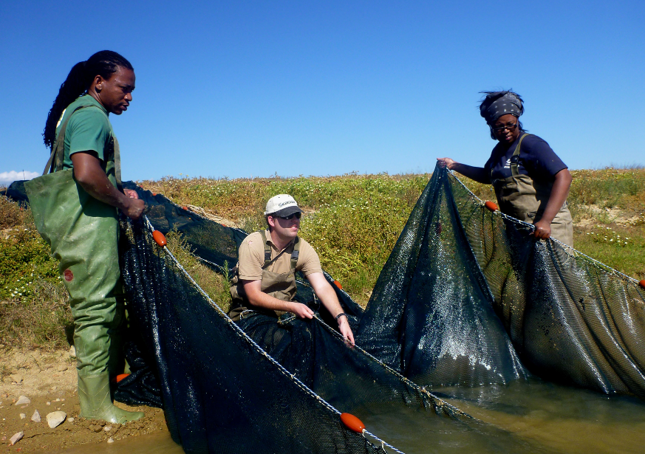
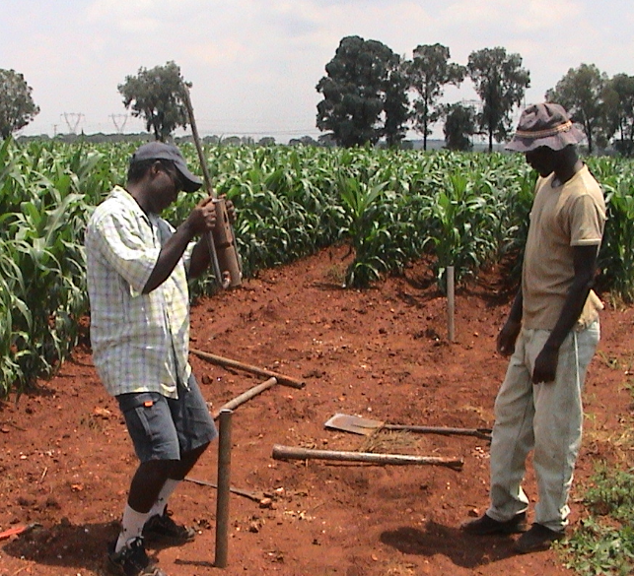
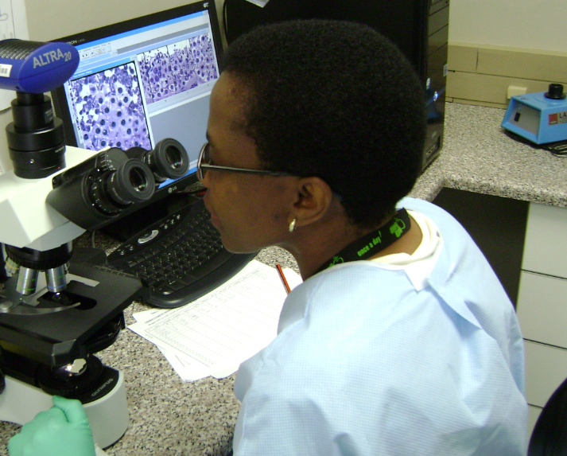
Human capital development
Building a new generation of water scientists
Number of students supported
60+% project leaders from designated groups
32 WRC projects led by SMMEs
83% of students are PDIs

Slide 15
Research portfolio targets for 2014/15
Number of community-based projects

Slide 16
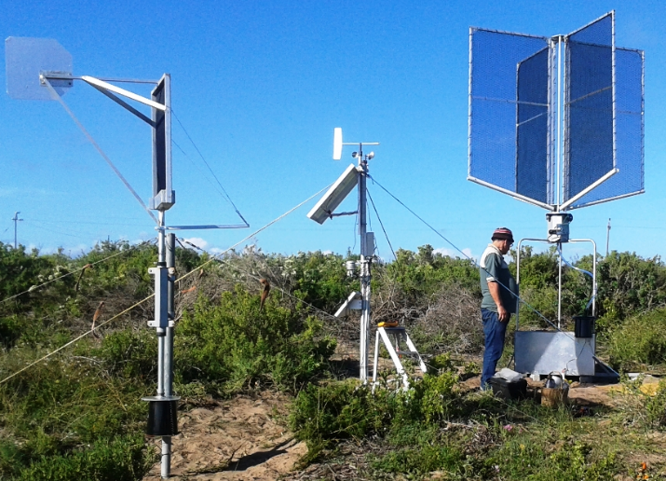
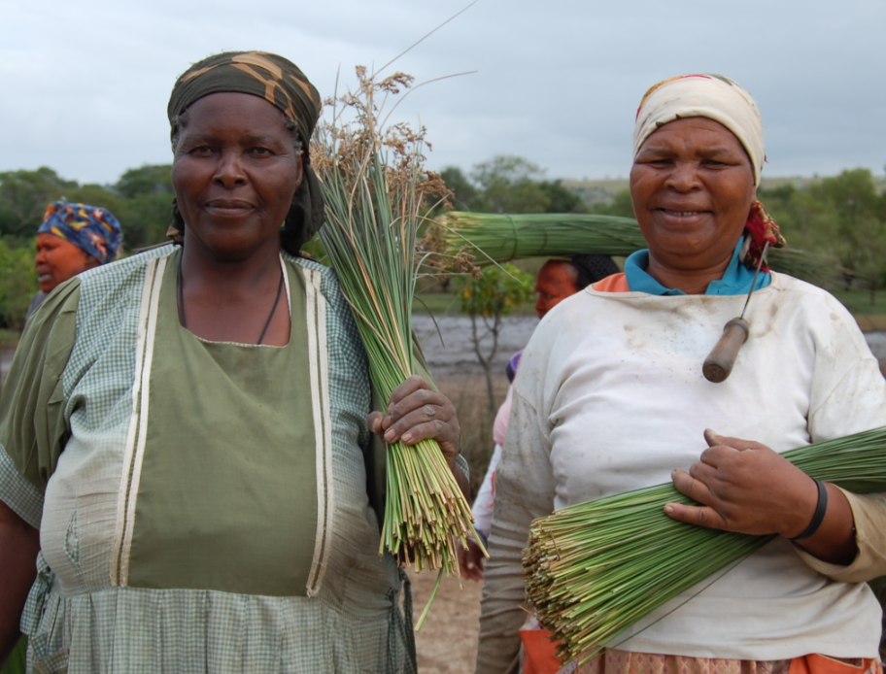
Empowering communities
Sustaining linkages between wetlands and people
Optimising fog water harvesting

Slide 17
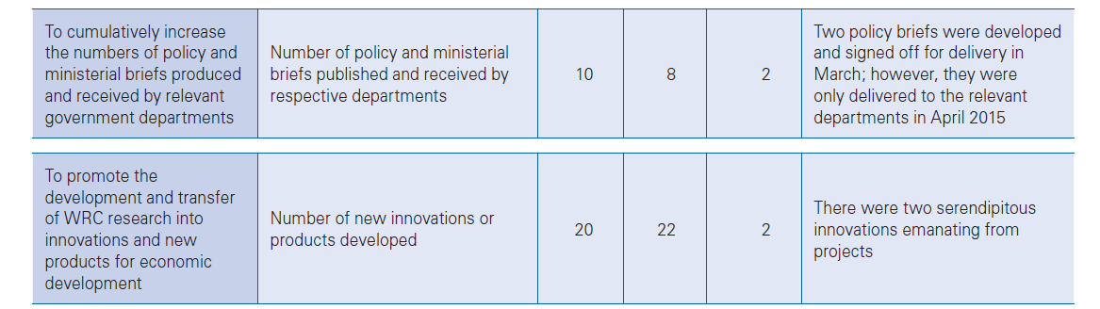
Research portfolio targets for 2014/15
( )

Slide 18

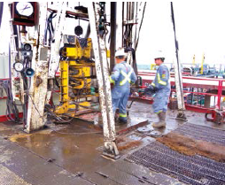
Informing policy and decision making
Ensuring water safety during emergency response situations
Growing SA’s knowledge on unconventional gas mining

Slide 19
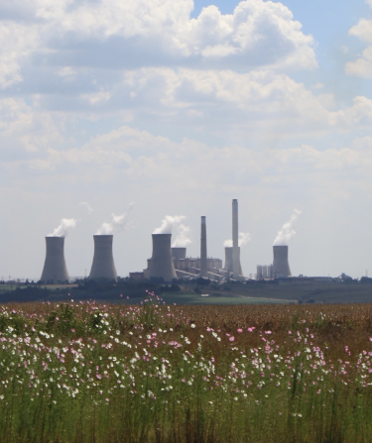
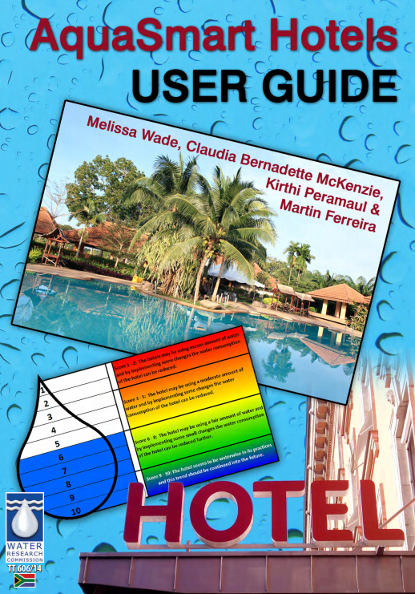
New products and services for economic development
Optimising water use at a major power station
Making hotels water smart

Slide 20
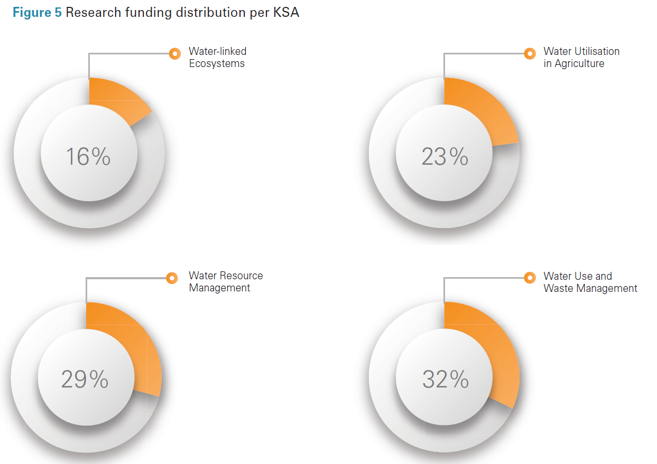
Research portfolio targets for 2014/15
Research funding per KSA

Slide 21
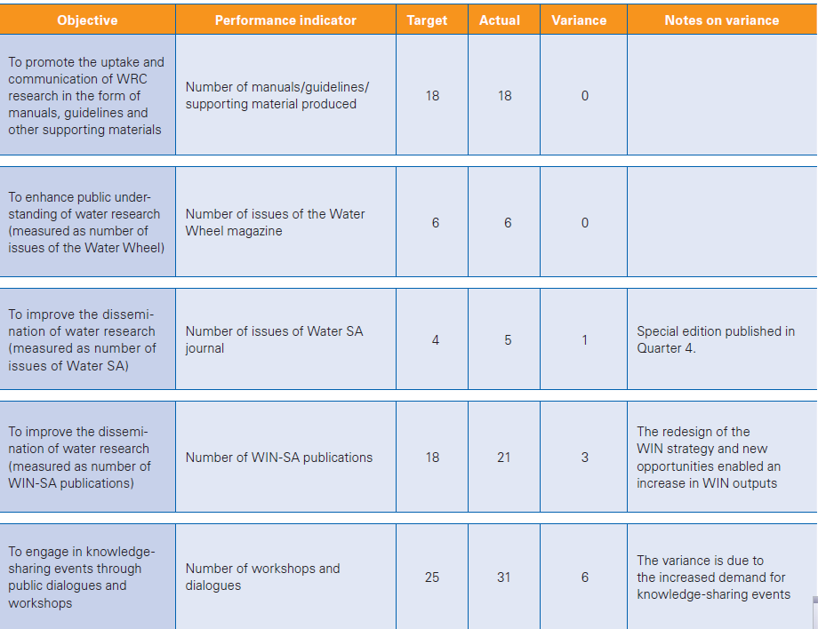
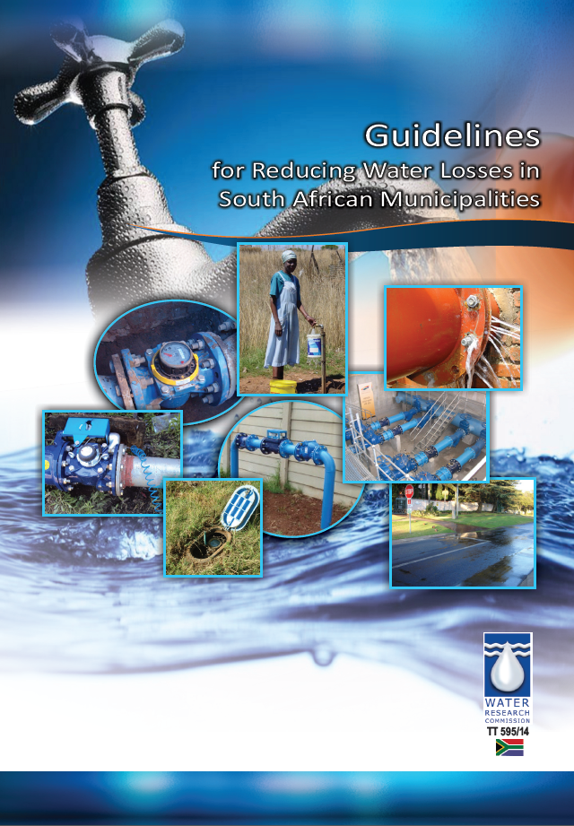
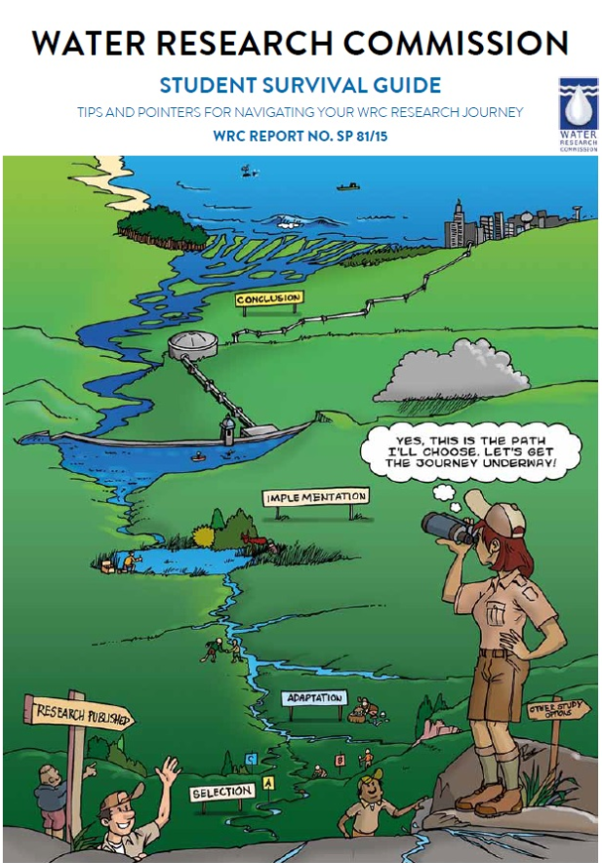

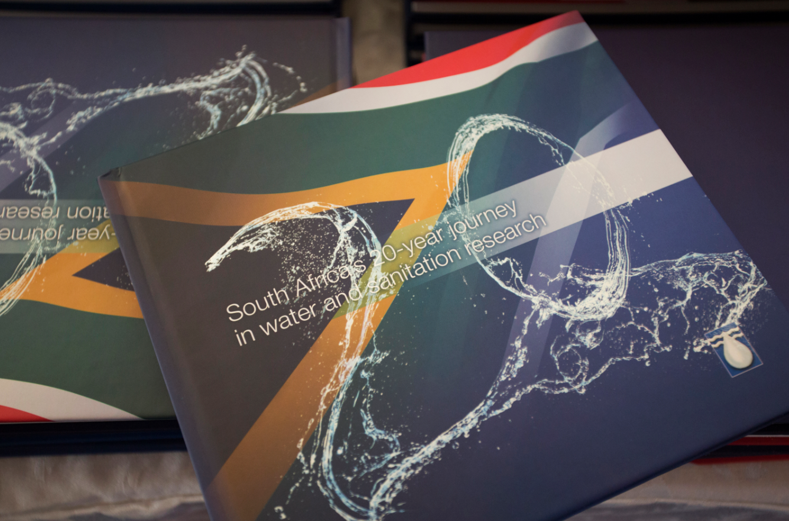

Research portfolio targets for 2014/15

Slide 22
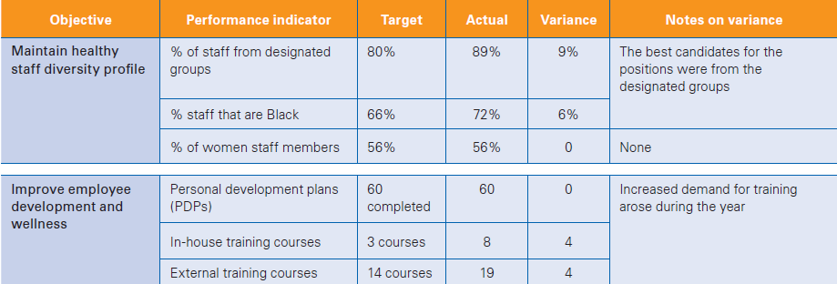
Human resources performance targets 2014/15

Slide 23
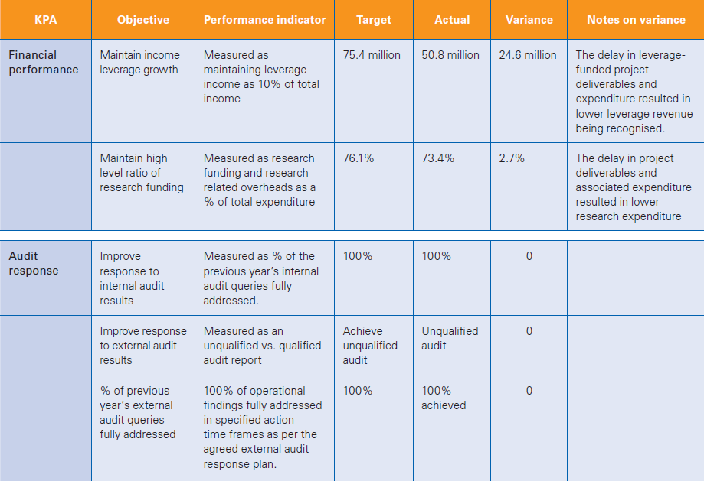
Financial performance targets 2014/15

Slide 24
Response Plan to the Audit
Consequence
Management
Restatement of
AFS
Expenditure –
Irregular and fruitless and wasteful

Slide 25
Response Plan to the Audit
Non-research procurement and financial representation

Slide 26
Response Plan to the Audit
Personnel
Changes – developing a new FIN team
Non-research procurement and financial representation
Institutional and governance changes
Capacity Building and Training

Slide 27
Audit response
In FY 2013/14 the WRC received a qualification of audit opinion, in respect of its accounts receivable balance reflected at R45.6 million in the AFS. The AGSA found uncorrected errors in the AFS amounting to R 8 390 741. In order to address this matter the following process was embarked upon:
A full reconciliation going back in some instances to 2001 was conducted of the accrual debtors, revenue and other related accounts in the general ledger
This process also included the sourcing of relevant supporting documentation.
Ensuring proper compliance with GRAP
In addition to dealing with the 2013/14 audit qualification we agreed that it would be advisable to perform a detailed reconciliation of current and historical transactions of all other key general ledger accounts such as leverage income, accruals, property plant and equipment. This resulted in many prior year adjustments to ensure fair presentation.
  The above intervention required that the human capacity in the Finance department be increased and strengthened by appointing: a technically astute CA(SA) as Finance Manager Reporting; a Supply Chain
  Manager and two SCM practitioners; a Team of three people to perform a physical asset
  verification, bar-coding, completeness check.
  In addition to addressing the finance staff and skill shortcoming in 2015/16 we are also in the process of implementing internal controls, business processes and assessing the functional adequacy of our IT systems

Slide 28
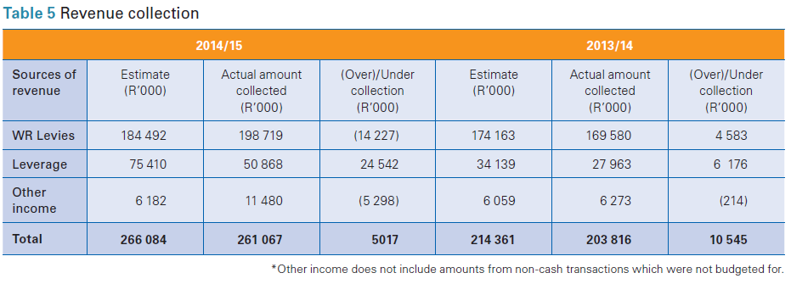
Summary of financial information
Revenue Collection

Slide 29
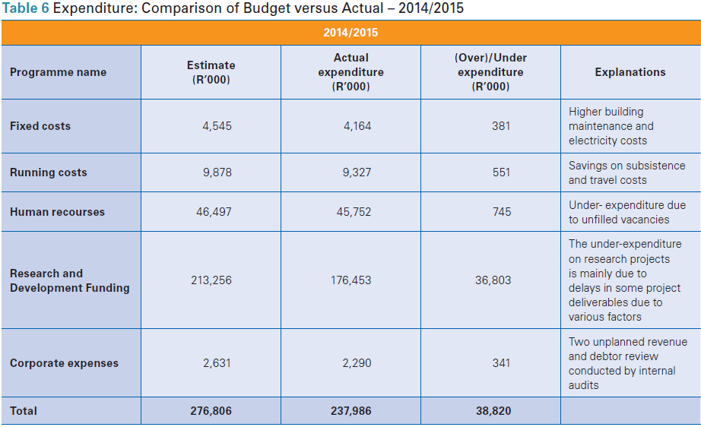
Summary of financial information
Expenditure: Comparison of Budget versus Actual – 2014/15

Slide 30
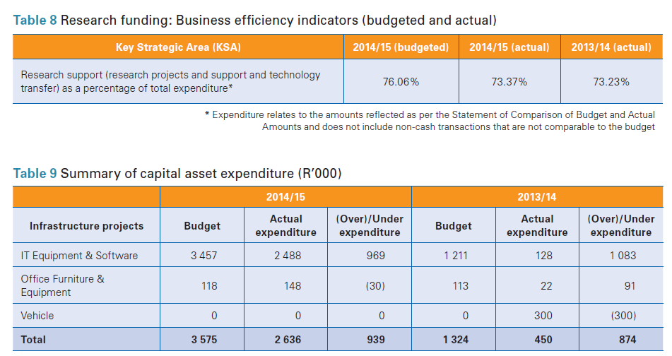
Summary of financial information
Research funding: Business efficiency indicators (budgeted and actual)
Summary of capital asset expenditure (R’000)

Slide 31
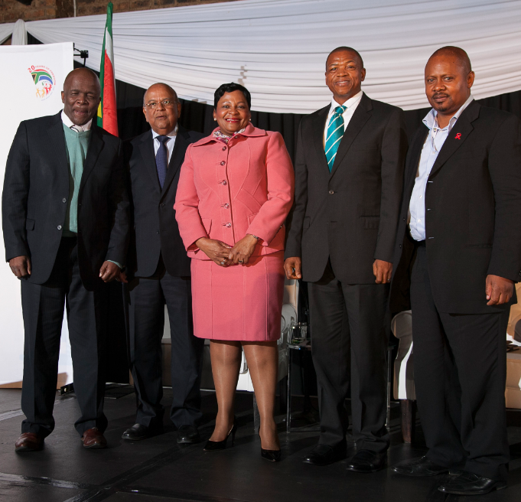
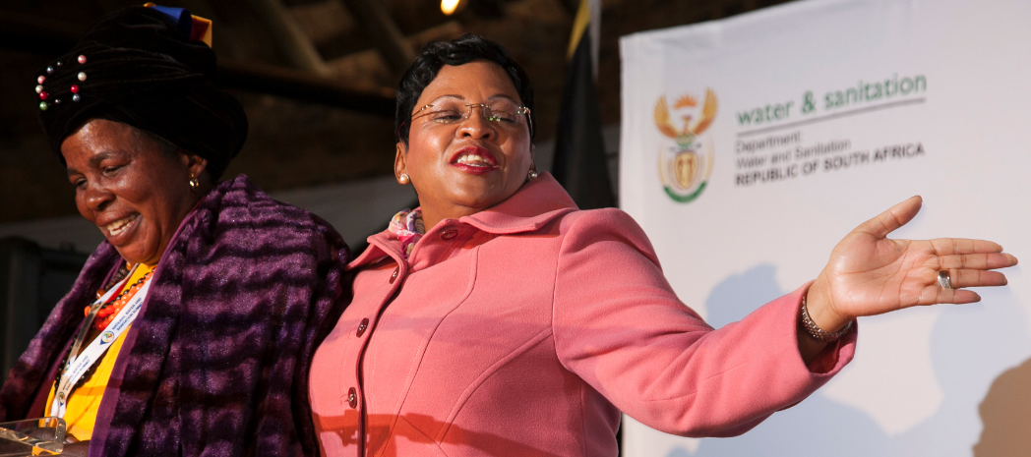
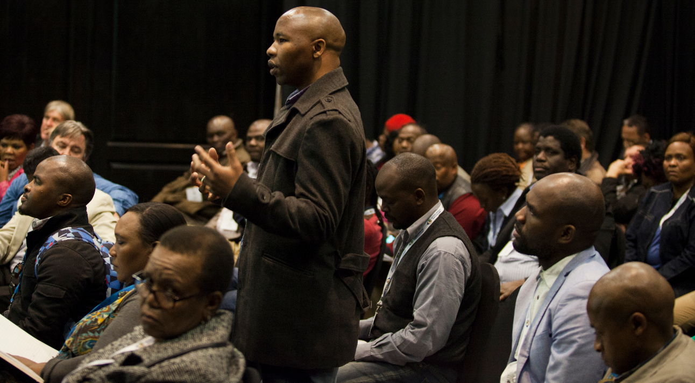
Strategic initiatives
National Water and Sanitation Summit

Slide 32

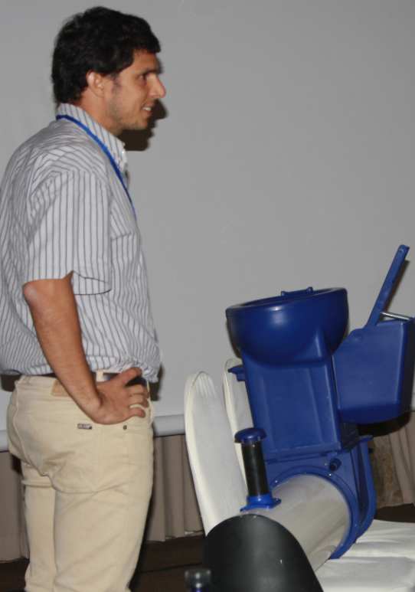
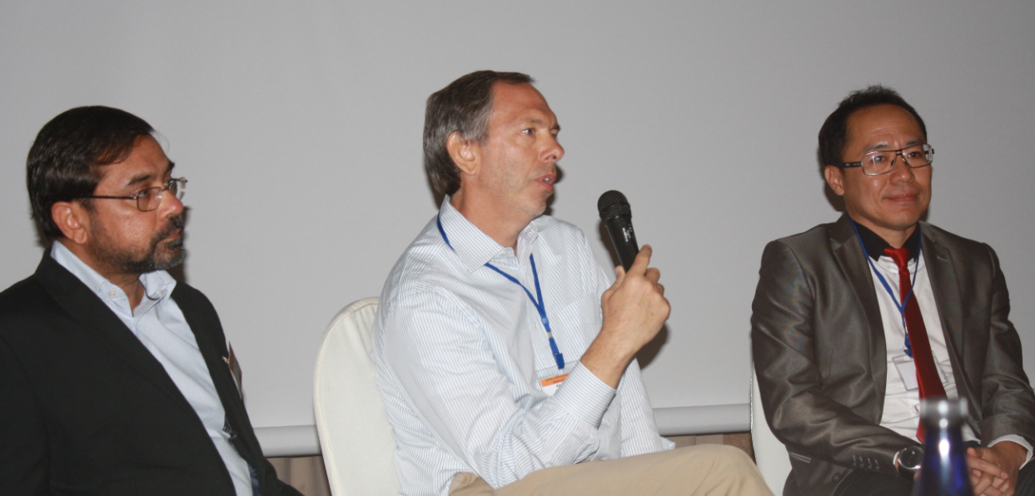
Strategic initiatives
Partnering for innovation (WADER)
SASTEP (Sanitation Technology Demonstration Programme)

Slide 33

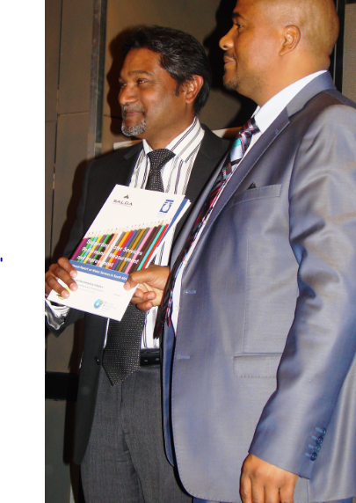
Strategic initiatives
Gender Water and Development Conference
Providing support to improving municipal operational performance

Slide 34
Statutory Compliance
The WRC complied with all statutory reporting requirements for the reporting period including:
strategic plans
business plans
budget
quarterly reports
other relevant statutory submissions

Slide 35
Summary and conclusion
The WRC is the Strategic Knowledge Partner to the Water and Sanitation Sector and operates by establishing needs and priorities, stimulating and funding research, promoting the transfer of information and technology and enhancing knowledge and capacity building in the water sector.

Slide 36
Thank You

