Slide 1
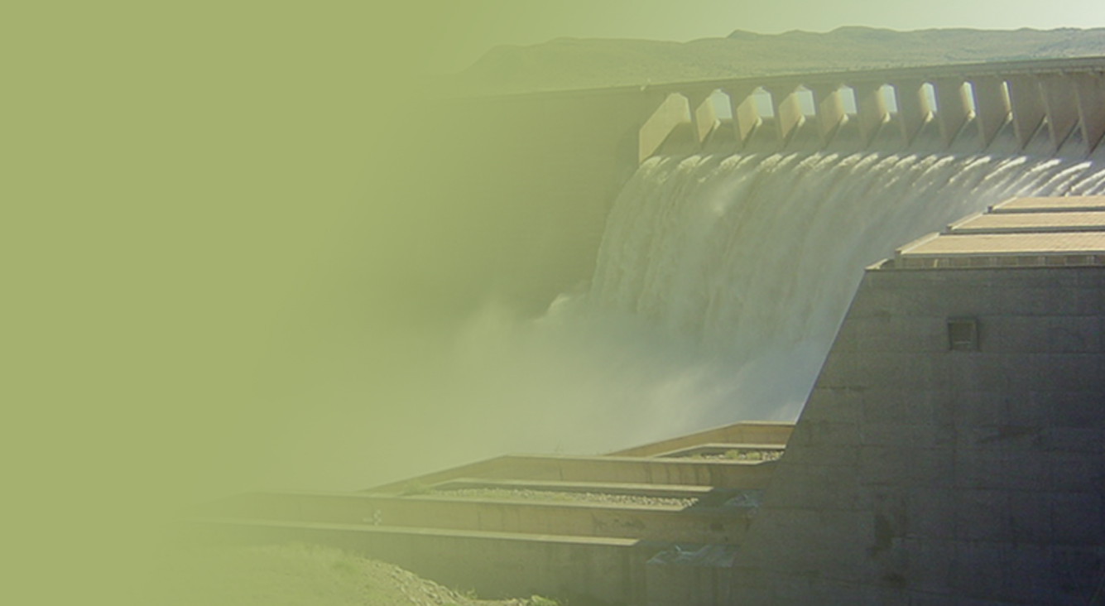
BRIEFING OF THE SELECTION PANEL FOR WATER SECTOR ENTITIES
Name Surname: MR ANIL SINGH
Designation: DEPUTY DIRECTOR-GENERAL WATER SECTOR REGULATION
Date: 30 JUNE 2015
PRESENTATION TITLE
Presented by:
Name Surname
Directorate
Date

Slide 2
Contents
Part 1:Trans Caledon Tunnel Authority (TCTA)
Part 2: Water Research Commission (WRC)

Slide 3
Trans-Caledon Tunnel Authority (TCTA)
Part 2

Slide 4
Overview of TCTA
Establishment and regulation:
Established in 1986 through the Notice of Establishment in terms of the National Water Act to fulfil South Africa’s obligations in terms of the Treaty on the Lesotho Highlands Water Project
Mandate subsequently expanded to Non-Treaty functions and the funding and implementation of bulk raw water infrastructure and other functions under Directives by the Minister
Regulated under the PFMA as a Schedule 2 entity
Funding and implementation of bulk raw water resource infrastructure:
Arranges commercial funding for off-budget schemes
Lesotho Highlands Water Project funded with a government guarantee
Other off-budget schemes do not carry a government guarantee – revenue stream is secured through off-take agreements with water users to service debt
Off-budget projects rated by Fitch Ratings – all currently rated AA+

Slide 5
Relationship with the Minister and Department
Threefold relationship
With the Minister as the Executive Authority to ensure TCTA is delivering as required by the client in terms of the policies and strategies of Government
With the Department as the client to manage the implementation of infrastructure to ensure that the service delivery objectives of the client are met in the most cost effective and socio/environmental sustainable manner

Slide 6
Relationship with the Minister and Department (Cont.)
With the Department as the sector leader to help build an understanding with users of the liabilities incurred when borrowing money to fund

Slide 7
Delivery on predetermined objectives

Slide 8
How TCTA contributes to Government Outcomes
Outcomes | Government Outcomes | Department Priorities | TCTA Contribution
4 | Decent employment through inclusive economic growth | (1) Contribute to Economic Growth, Rural Dev, Food Security and Land Reform (outcomes 6, 7 and 9) | Providing cost-effective water infrastructure as an enabler of economic growth
5 | A Skilled and capable workforce | - | Through the projects and internal training develop entrepreneurship in small business and up-skill the workforce to enable South Africa to compete in the world markets
6 | Efficient, competitive and responsive economic infrastructure network | (1) Contribute to Economic Growth, Rural Dev, Food Security and Land Reform (outcomes 6 and 7) (3) Strengthening the regulation of the water sector - (outcome 6 and 10) | Providing a comprehensive financial and implementation package to ensure the most cost effective solution
7 | Vibrant, equitable and sustainable rural communities with food security for all |  | Support to other water sector institutions to enable them to deliver on their mandate
8 | Sustainable human settlements and improved quality of household life | Contribute to Economic Growth, Rural Dev, Food Security and Land Reform (outcomes 6, 7 and 9) | Provision of affordable infrastructure
9 | A responsive, accountable, effective and efficient local government system | (4) Support local government to deliver water services (outcome 9) | Support to other water sector institutions to enable them to deliver on their mandate
10 | Environmental assets and natural resources that are well protected and continually enhanced | (2) To promote Sustainable and Equitable Water Resources Management (outcome 10) | Contribute to the development of knowledge in the sector (desalination, water reuse)
 |  | (3) Strengthening the regulation of the water sector (outcome 6 and 10) | Participation in the Institutional Reform and Realignment process
12 | An efficient, effective and development oriented public | (6) Build capacity to deliver Quality Services | Comprehensive internal training programme to enable TCTA to deliver quality products in the most efficient manner.
8

Slide 9
Predetermined Objectives
Manage the funding and debt on the infrastructure projects in a manner that achieves cost-effective funding, taking into account current and projected market conditions as well as managing risks objective
Construct infrastructure on time, within budget, to the appropriate standard and in a sustainable socio/environmental manner
Acid mine drainage is treated to the correct standard before discharging to the environment
Raise finance for the construction of infrastructure in the most effective manner

Slide 10
Status and Future Progress
Project | Date Directive Received | Progress as of 31 March 2015 | Medium Term Targets
 |  |  | 31 March 2016 | 31 March 2017
Lesotho Highlands Water Project: To fulfil all the Republic’s financial obligations in terms of or resulting from the Treaty | 3 August 1994 (and incorporated into amended Notice of Establishment 24 March 2000) | Outstanding debt R 19 247 mil | Funding model was restructured during the year to accommodate LHWPII and AMD debt repayment by 2036.
Berg Water Project | 6 May 2002 | Outstanding debt R 1 040 mil | Projected outstanding debt R 795 mil | Projected outstanding debt R 693 mil Debt repayment 31 March 2029
Vaal River Eastern Subsystem Project | 6 October 2004 | Outstanding debt R3 807 mil | Projected outstanding debt R 3 753 mil | Projected outstanding debt R 3 726 mil Debt repayment 31 March 2028
Notes:
On this slide it needs to be emphasised that the debt for LHWP I is held by South Africa and is repaid through inclusion of a capital unit charge on the Vaal River System. This Capital Unit Charge will also pay for LHWP II, where South Africa will raise the funds and give it to the Lesotho Highlands Development Authority to build the infrastructure on our behalf, and Acid Mine Drainage in the Witwatersrand gold basins

Slide 11
Status and Future Progress
Project | Date Directive Received | Progress as of 31 March 2015 | Medium Term Targets
 |  |  | 31 March 2016 | 31 March 2017
Olifants River Water Resources Development Project (Phase 2C) | 17 June 2008 (directive revised 12 March 2012) | 39 km out of 40 km pipeline laid Water Delivery to De Hoop Water Treatment works to be achieved in Jan 2014 | In commissioning | Water delivery Jul 2016
Komati Water Scheme Augmentation Project | 29 September 2008 | Outstanding debt R 1 229 mil | Projected outstanding debt R 1 152 mil | Projected outstanding debt R 1 089 mil Debt repayment 2033
Mokolo and Crocodile River (West) Water Augmentation Project | 19 May 2010 | Outstanding debt R 711 mil In commissioning | Projected outstanding debt R 1 703 mil Ready for operation 12 June 2015 | Projected outstanding debt R 1 686 mil Debt repayment 2033

Slide 12
Status and Future Progress
Project | Date Directive Received | Progress as of 31 March 2015 | Medium Term Targets (planned milestones
 |  |  | 2015/16 | 2016/17 and Beyond
Mooi Mgeni Transfer Scheme – Phase 2 | 29 November 2007 | Outstanding debt R 1 401 mil 13.3 km of 14.5 km of the transfer pipeline laid | Projected outstanding debt R 1 455 mil Water delivery 31 October 2015 | Projected outstanding debt R 1 461 mil Debt repayment 2034 Project closeout Dec 2016
AMD: Western and Central Basin | 6 April 2011 | Completed | Central basin completion of defects liability period May 2015
AMD: Eastern Basin | 6 April 2011 | Tender awarded April 2014 36% Completed | Takeover in Jan 2016 | Completion of defects liability period Jan 2017.
MMTS Phase 1 | 29 November 2011 | Practical completion completed by November 2014
Notes:
On Mooi-Mgeni Phase 2 emphasis should be place on the construction of houses for the 37 farmworker families who were displaced by the flooding of the dam basin. A new village was built near Mooi River for 33 of the families, the remaining 4 families choosing to relocate to other locations.
The houses are designed for low maintenance, energy efficient and are exempt from rates so as not to burden the families with additional costs associated with home ownership.

Slide 13
Financial summary

Slide 14
Overview
Raising finance for projects, on behalf of DWS, that will be recovered through user tariffs (either partially or fully);
If implementing the projects on behalf of DWS, ensuring that sufficient funds are available at all times to meet the requirements during construction. Where long-term funds are utilised TCTA enters into short-term investments to offset costs of these long-term funding;
Working with DWS to ensure that the tariff, set in terms of the Pricing Strategy, is sufficient to cover their obligations and the obligations that TCTA has incurred on their behalf. These obligations comprise of interest payable on funding obligations and capital repayments on all projects funded outside the fiscus, operation and maintenance costs on certain projects, and other obligations of the South African Government in respect of the Lesotho Highlands Water Project.

Slide 15
Cash Inflows

Slide 16
Utilisation of Cash Received

Slide 17
TOTAL DEBT BY PROJECT

Slide 18
Audit Opinion
In our opinion, the financial statements present fairly, in all material respects, the financial position of Trans-Caledon Tunnel Authority as at 31 March 2015, and its financial performance and cash flows for the year then ended in accordance with International Financial Reporting Standards and the requirements of the Public Finance Management Act of South Africa.
18

Slide 19
Water Research Commission (WRC)
Part 3

Slide 20
We thank members of the Selection Panel for agreeing to be of service to the country.
CONCLUSION

Slide 21
The End

