Slide 1
SANBI ANNUAL PERFORMANCE REPORT DASHBOARD 2014/15
Dr Tanya Abrahamse, CEO

Slide 2
SANBI DELEGATION
Ms Carmel Mbizvo, Head of Branch: Biodiversity Science & Policy Advice
Mr Christopher Willis, Chief Director: Conservation Gardens & Tourism Division
Mr Alan Smith, Director: Finance

Slide 3
PRESENTATION OUTLINE
SANBI background and key information
Legislative, policy, mandate and reporting
SANBI’s role in brief
SANBI’s Programmes (CSP 2014 -2019 and APP 2014/15)
Strategic Objectives, Performance Indicators and Targets
Dashboard 2014/15 targets achieved per quarter

Slide 4
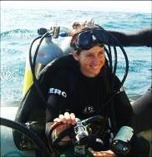
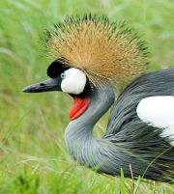
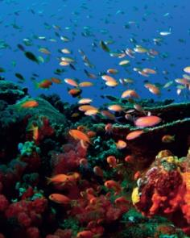
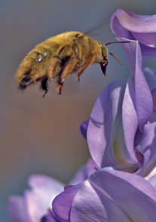
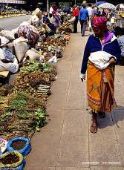
SANBI Vision Biodiversity richness for all South Africans

Slide 5
KEY INFORMATION
Schedule 3A Public entity (for public good) reporting to DEA
Responsibility of the Minister of Environment
Minister & Cabinet appointed Board – Accounting Authority
Subject to PFMA & other Treasury regulations including AG
Not subject to Public Service regulations but use most of the prescripts (main differentiator – SANBI Pension Fund)
Number staff about 700, most Gardens staff (also 946 Groen Sebenza Pioneers)
Geographic locations – at 10 NBGs, Kwelera NBG launched in 2014 (11 NBG by end of year)
Head Office in Pretoria

Slide 6
POLICY and LEGAL FRAMEWORK (source of mandate)
National Environmental Management: Biodiversity Act NEMBA (Act No 10 of 2004) | Gazetted
SANBI role in NEMBA Regulations: Threatened or Protected Species; CITES including the National Scientific Authority; Alien and Invasive Species | Gazetted
Obligations in the National Biodiversity Framework (NBF) -the five year plan from Cabinet approved 20 year vision the National Biodiversity Strategic Action Plan (NBSAP) | Gazetted
Obligations in Minister’s Delivery Agreement – in Outcome 10 / in the MTSF targets | Published / Parliamentary approved
The Climate Change Response White Paper – SANBI role in delivering Long Term Adaptation Scenarios for the bio-natural resources / designated National Implementing Entity (NIE) for the Global Adaptation Fund | Published/ Ministerial approved

Slide 7
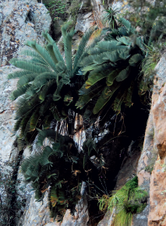
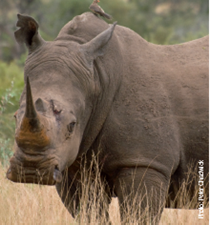
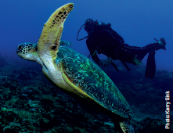
REPORTING ON DELIVERY OF MANDATE
Key mandate deliverables are reflected in 5 years Corporate Strategic Plan (CSP) & Annual Performance Plan (APP) and achievements are documented in Annual Report.
Governance Protocol agreement with DEA.
Progress report on APP is done quarterly and analysed and approved by DEA.

Slide 8
human wellbeing
improved service delivery
job creation
harnessing biodiversity value
investment in ecological infrastructure
ecosystem-based adaptation to climate change
streamlined environmental decision-making
WHAT WE INFLUENCE
SCIENCE INTO POLICY / ACTION:
information | planning | policy advice | models | tools
BUILDING BIODIVERSITY KNOWLEDGE:
assessments | status | trends | monitoring | modelling
GARDENS
windows on biodiversity
HUMAN CAPITAL DEVELOPMENT
WHAT WE DO
FOUNDATIONS OF BIODIVERSITY:
collections| taxonomy | inventory | maps | classification of ecosystems and species

Slide 9
SANBI’s contribution to DEA’s Outcomes
National Development Plan (NDP) desired 2030 outcome
Transition to a society & economy which is internationally competitive, equitable, job creating & sustainable
Medium Term Strategic Framework (MTSF) Sub-outcomes
ENVIRONMENTAL ECONOMIC CONTRIBUTION OPTIMISED Facilitate sustainable Socio- economic Growth & Development by catalysing, optimising & scaling up the contribution of the environmental sector to economic prosperity
ECOLOGICAL INTEGRITY
SAFEGUARDED & ENHANCED
Provide leadership in promoting & ensuring environmental sustainability through the management, utilisation, conservation, protection & valuing of our natural resources
SOCIALLY TRANSFORMED & TRANSITIONED COMMUNITIES
Drive socio-economic transformation & transition by optimising the fair & equitable sharing of benefits & enabling Social Development
GLOBAL AGENDA INFLUENCED & GLOBAL/LOCAL OBLIGATIONS MET
Enhanced international cooperation supportive of SA environmental /Social Development priorities
DEA Outcomes
GARDENS AS WINDOWS ON BIODIVERSITY
FOUNDATIONS OF BIODIVERSITY SCIENCE
BUILDING BIODIVERSITY KNOWLEDGE
SCIENCE INTO POLICY/ ACTION
HUMAN CAPITAL DEVELOPMENT
SANBI’s Contribution

Slide 10
SANBI’s Programmes
1: Render effective and efficient corporate services
2: Manage and unlock benefits of the network of National Botanical
Gardens as windows into South Africa’s biodiversity
3: Provide science-based evidence to support policy and decision making relating biodiversity, including the impacts of climate change.
4: Co-ordinate and provide access to biodiversity information and scientific knowledge
5: Provide biodiversity and climate change adaptation policy tools and advice in support of South Africa’s development
6: Drive human capital development, education and awareness in response to SANBI’s mandate

Slide 11
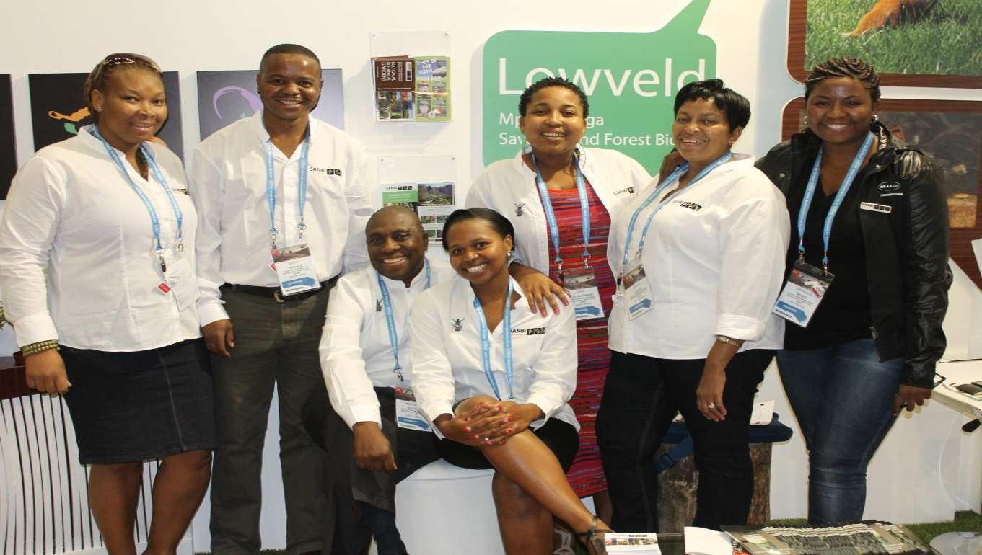
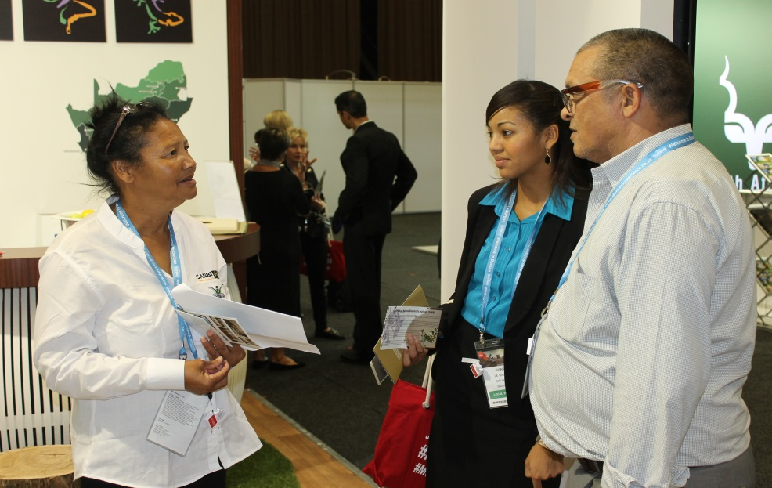
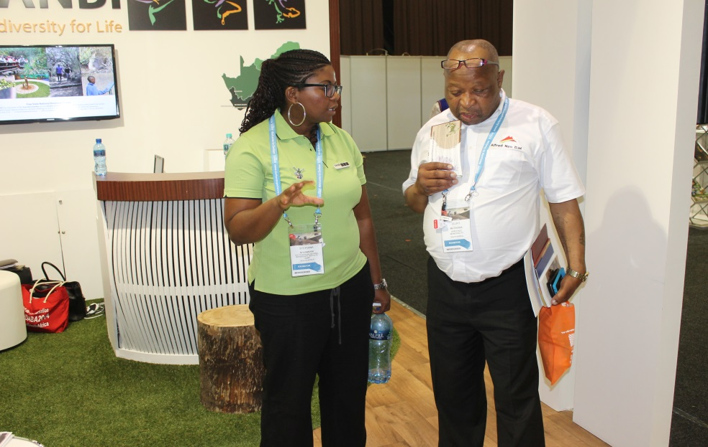
PROGRAMME 1 : Render effective & efficient Corporate Services

Slide 12
PROGRAMME 1 : Render effective & efficient Corporate Services
1.1: SANBI is positioned as an employer of choice in the biodiversity sector
Performance indicator | Baseline | Annual target 2014/15 | Achievements/Challenges/Corrective measures
Percentage of qualifying staff on the scientist and horticulturalist career path. | Approved Human Resources and Transformation Strategy. Career ladder for scientists. | 70% of qualifying staff placed on scientist career path | Progress: Achieved. 70% of qualifying staff were placed on scientist career path.
 |  | 60% of qualifying staff placed on horticulturist career path | Progress: Partially achieved. 29 Horticulturists identified and placed on career ladder. Career ladder for Horticulturists was developed and approved by SANBI Board. A work study approved by EXCO was conducted aimed at assessing the work load amongst Horticulturists in order to create an enabling environment for the implementation of the horticulturists career ladder. A total of 29 Horticulturists have been identified and will be placed on the career ladder accordingly.
Percentage of payroll allocated and spent on staff development | 1% of payroll spent on staff development | 1% of payroll allocated and spent on staff development | Progress: Achieved. The 1% of payroll allocated was spent on staff development.
Percentage of Employment Equity targets achieved | Employment Equity Plan is approved | 60% of EE targets achieved | Progress: Partially achieved. Out of 60% EE targets (numerical), only 45% was achieved. The variation was caused by the fact that EXCO approved specific posts to be filled. Not all vacant posts were filled. EE targets will be applied as and when EXCO approves the vacant posts to be filled.

Slide 13
Employment Equity Profile
Top & Senior Management levels
Occupational Level | Male |  |  |  | Female |  |  |  | Total
 | A | C | I | W | A | C | I | W
Top and Senior Management (13, 14,15 & 16) | 5 | 3 | 1 | 7 | 3 | 3 | 0 | 7 | 29
Target % | 40.30% | 5.90% | 1.80% | 6.60% | 33.80% | 5.20% | 1.10% | 5.30% | 100%
SANBI % | 18% | 10% | 4% | 24% | 10% | 10% | 0% | 24% | 100%
Occupational Level | Male |  |  |  | Female |  |  |  | Total
 | A | C | I | W | A | C | I | W
Top and Senior Management (13, 14,15 & 16) | 7 | 3 | 1 | 5 | 4 | 2 | 2 | 7 | 31
Target % | 40.30% | 5.90% | 1.80% | 6.60% | 33.80% | 5.20% | 1.10% | 5.30% | 100%
SANBI % | 23% | 10% | 3% | 16% | 13% | 6% | 6% | 23% | 100%

Slide 14
Gender Profiles Top & Senior Management levels
Gender | Number | Percentages
Male | 16 | 55%
Female | 13 | 45%
Total | 29 | 100%
Gender | Number | Percentages
Male | 16 | 52%
Female | 15 | 48%
Total | 31 | 100%

Slide 15
PROGRAMME 1 : Render effective & efficient Corporate Services (continue...)
1.2: Compliant financial management systems and policies are provided
Performance indicator | Baseline | Annual target 2014/15 | Achievements/Challenges/Corrective measures
Annual financial statements produced to comply with PFMA and GRAP requirements. | AFS produced and submitted to Parliament | Unqualified AFS produced to comply with PFMA and GRAP requirements. | Progress: Achieved. Unqualified, PFMA and GRAP compliant AFS produced.
1.3 : Effective corporate services rendered to achieve the mandate of SANBI
All identified risks managed through an annual risk assessment and implementation of the risk management plan. | Annual risk assessment completed | Annual risk assessment completed | Progress: Achieved. Annual Risk Assessment has been completed.
SANBI complies with all relevant Acts and SANBI/DEA protocol through implementation of the Compliance Framework. | SANBI is compliant with all relevant Acts including SANBI/DEA Protocol and regulations. | Reporting monitored according to specified time frames. | Progress: Achieved. The reporting was monitored according to specified time-frames, on a quarterly basis.
1.4 : Effective communication and technology support services through enhanced communication and technology infrastructure
Percentage availability of SANBI network and business applications | 90% Network availability 90% Business Application Services Availability | 95% of ICT Services are available | Progress: Achieved. 95% of ICT Services were made available.

Slide 16
PROGRAMME 1 : Render effective & efficient Corporate Services (continue)
1.5: Effective marketing and communication services delivered to internal and external stakeholders.
Performance indicator | Baseline | Annual target 2014/15 | Achievements/Challenges/Corrective measures
Number of communication platforms and methods utilised to keep internal and external stakeholders informed of SANBI activities and its NBGs | New corporate identity applied to approximately 70% material. | Quarterly newsflash, information brochures, intranet, website and CEOs letter. Pull up banners, outdoor branding material including signage. | Progress: Achieved. The quarterly newsflash, information brouchers, intranet, website and CEO's letters were published.
Number of marketing initiatives and platforms identified and effectively utilised for brand SANBI and NBGs profiling | At least 1 media release per quarter. | Produced newspaper articles, adverts and recorded interviews | Progress: Achieved. The newspaper articles, adverts and recorded interviews were produced.
 |  | Increased media coverage received. | Progress: Achieved. Received increased media coverage.
Number of media platforms utilised to educate and inform the public about SANBI, its products and services | SANBI’s gardens and tourism assets are being promoted and marketed to target audiences through at least 1 advert per quarter, 2 concerts series, 2 major events and other activities. | Attended exhibitions, activations, shows and campaigns Gardens implemented initiatives and activities to attract increased number of visitors. | Progress: Achieved. Exhibitions, activations, shows and campaigns were attended and Gardens implemented initiatives and activities to attract increased number of visitors.

Slide 17
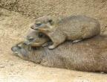
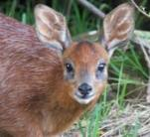
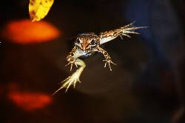
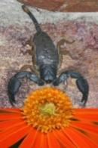
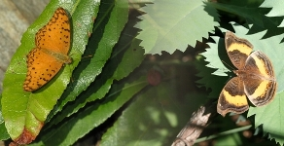
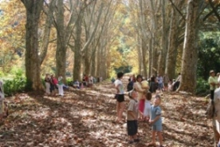
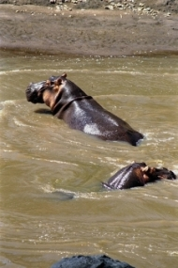
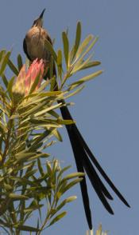
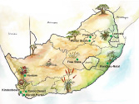
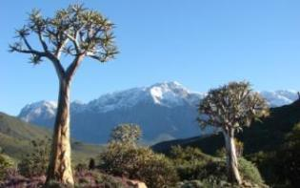
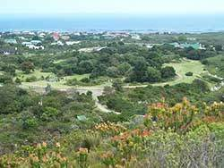
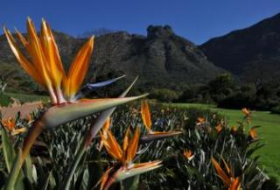
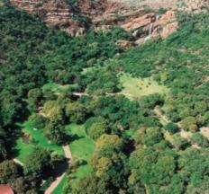
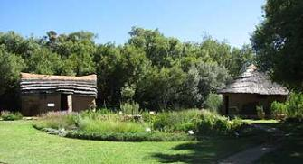
Windows to biodiversity

Slide 18
PROGRAMME 2: MANAGE AND UNLOCK BENEFITS OF THE NETWORK OF NATIONAL BOTANICAL GARDENS
2.1: A world-class network of National Botanical Gardens are managed
Performance indicator | Baseline | Annual target 2014/15 | Achievements/Challenges/Corrective measures
Number of best-practice maintenance or development projects completed across SANBI’s National Botanical Gardens | Nine National Botanical Gardens with associated SANBI estates, infrastructure and living collections (biological assets), located in six provinces. | Five (5) Maintenance/ development projects per Garden and two (2) corporate SANBI capital infrastructure projects completed. | Progress: Achieved. Five (5) maintenance/development projects per Garden and two (2) corporate SANBI capital infrastructure projects have been completed.

Slide 19
PROGRAMME 2: MANAGE AND UNLOCK BENEFITS OF THE NETWORK OF NATIONAL BOTANICAL GARDENS (continue…)
2.1: A world-class network of National Botanical Gardens are managed (continue…)
Performance indicator | Baseline | Annual target 2014/15 | Achievements/Challenges/Corrective measures
Number of new National Botanical Gardens established and operational | EPWP allocations made by DEA for new gardens planned for the Eastern Cape (R30 million) and Limpopo (R20 million) Provinces. MoA signed between SANBI, ECPTA and DEDEAT for the co-management of the Kwelera Nature Reserve as the natural portion of the proposed Kwelera National Botanical Garden. | Management responsibility for new Limpopo Garden transferred from LEDET to SANBI | Progress: Not Achieved. LEDET has supported the transfer of the management of the Thohoyandou Botanical Garden to SANBI, and LEDET has agreed to retain and remunerate their employees currently working in the Garden. Awaiting formal approval from the Limpopo Executive Council.
 |  | Professional team appointed for the establishment and development of the new Eastern Cape Garden | Progress: Achieved. Professional team has been appointed for the establishment and development of the new Eastern Cape Garden.
 |  | Acquisition of land by SANBI for the establishment of the new Eastern Cape Garden | Progress: Not achieved. Option Agreement signed. Application for subdivision, consolidation and special consent use submitted to the Buffalo City Metropolitan Municipality. Awaiting formal approval by BCMM.
 |  | New national botanical garden in the Eastern Cape proclaimed and gazetted by the DEA Minister | Progress: Achieved. New national botanical garden in the Eastern Cape proclaimed and gazetted by the DEA Minister

Slide 20
PROGRAMME 2: MANAGE AND UNLOCK BENEFITS OF THE NETWORK OF NATIONAL BOTANICAL GARDENS (continue…)
2.1: A world-class network of National Botanical Gardens are managed
Performance indicator | Baseline | Annual target 2014/15 | Achievements/Challenges/Corrective measures
Increased representation of indigenous plants in the living collections of SANBI’s National Botanical Gardens or the Millennium Seed Bank, Kew, UK | Through involvement in implementation of the Convention on Biological Diversity (CBD), SANBI is contributing towards two international plant conservation initiatives (International Agenda for Botanic Gardens in Conservation (through Botanic Gardens Conservation International or BGCI) and the Global Strategy for Plant Conservation (GSPC), 2010 to 2020) | 20 new indigenous plant species added to the living collections of the combined network of National Botanical Gardens or MSB, UK | Progress: Achieved. 22 new indigenous plant species were added to the living collections of the combined network of National Botanical Gardens or MSB, UK
 | Signed MoA with the Royal Botanic Gardens, Kew’s (UK) international Millennium Seed Bank Partnership (2011 to 2015) which contributes towards the implementation of specific targets (particularly Target 8) of the GSPC . | Increased incentive income generated by NBGs from acquisition of collections for MSB programme. Negotiations with the Millennium Seed Bank Partnership, Kew, about the extension of the 5-year MoA. | Progress: Achieved. Incentive income generated by NBGs from acquisition of collections for MSB programme. Negotiations with the Millennium Seed Bank Partnership, Kew, about the extension of the 5-year MoA was increased.

Slide 21
PROGRAMME 2: MANAGE AND UNLOCK BENEFITS OF THE NETWORK OF NATIONAL BOTANICAL GARDENS (continue…)
2.2: Revenue generating activities are strengthened in all National Botanical Gardens
Performance indicator | Baseline | Annual target 2014/15 | Achievements/Challenges/Corrective measures
Percentage own income and visitor numbers increased through expanded and more effective revenue generating activities in National Botanical Gardens | Income Generation Plan for SANBI’s gardens included as part of SANBI’s Financing Strategy External review conducted of commercial operations across SANBI’s national botanical gardens Business skills training given to Curators of SANBI’s National Botanical Gardens | 1.5 per cent (1.5%) annual increase in visitor numbers | Progress: Exceeded Target by 25,2%. Various SANBI marketing interventions, additional garden-based events and the unprecedented success and popularity of the new Tree Canopy Walkway (commonly referred to as the ‘Boomslang’) in Kirstenbosch, opened to the public in May 2014, have resulted in better than expected visitor numbers. The gardens have also benefited from the increased number of tourists visiting South Africa in general and Cape Town in particular.
 |  | Four per cent (4%) annual increase in own income. | Progress: Exceeded Target by 30%. Various SANBI marketing interventions, additional garden-based events and the unprecedented success and popularity of the new Tree Canopy Walkway (commonly referred to as the ‘Boomslang’) in Kirstenbosch, opened to the public in May 2014, have resulted in better than expected own income. The gardens have also benefited from the increased number of tourists visiting South Africa in general and Cape Town in particular.

Slide 22
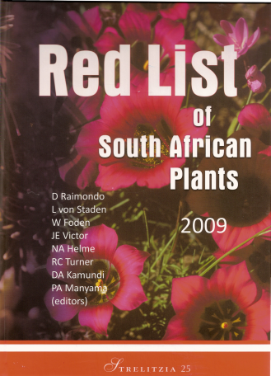
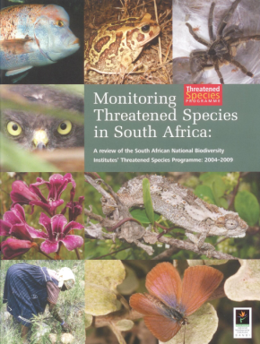
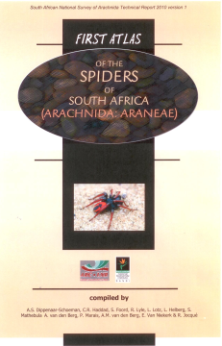
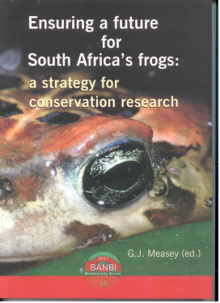
Science-based evidence

Slide 23
PROGRAMME 3: PROVIDE SCIENTIFIC EVIDENCE TO SUPPORT POLICY AND DECISION MAKING RELATING TO BIODIVERSITY, INCLUDING THE IMPACTS OF CLIMATE CHANGE
3.1: Foundational information on species and ecosystems is generated and collated.
Performance indicator | Baseline | Annual target 2014/15 | Achievements/Challenges/Corrective measures
Number of data sets compiled or updated providing national inventories for plant and animal taxa, spatial datasets for conservation planning, monitoring data, and national classification Systems | An inventory of all South African plants is in place but needs to be regularly updated. | Two inventories, comprising (i) an inventory of animal species with 33 000 species and (ii) an inventory of all South African plants updated four times per annum | Progress: Achieved. The two inventories, comprising (i) an inventory of animal species with 33 000 species and (ii) an inventory of all South African plants were updated four times per annum
 | There is no comprehensive inventory for animals, although data on some animal groups (e.g. butterflies) has been assembled | One inventory of SANBI Gardens Biodiversity updated with new records and information. | Progress: Achieved. One inventory of SANBI Gardens Biodiversity was updated with new records and information
 | A foundational biodiversity information programme has been implemented together with DST/NRF to generate information | Two complete and updated classification systems | Progress: Achieved. The two classification systems were completed and updated.
 | A classification system for terrestrial ecosystems is in place based on the vegetation map and a classification for wetlands has been published | Two spatial datasets compiled to provide information for conservation planning | Progress: Achieved. The two spatial datasets to provide information for conservation planning were compiled.
 | Initial spatial information is available for plants, butterflies, and reptiles | One monitoring database being updated (SABAP2) with at least 65% coverage of South African surface area, monitoring underway for one further taxon | Progress: Achieved. One monitoring database was updated (SABAP2) with at least 65% coverage of South African surface area, monitoring underway for one further taxon.

Slide 24
PROGRAMME 3: PROVIDE SCIENTIFIC EVIDENCE TO SUPPORT POLICY AND DECISION MAKING RELATING TO BIODIVERSITY, INCLUDING THE IMPACTS OF CLIMATE CHANGE (continue…)
3.2: Scientific evidence on the status of biodiversity, risks and benefits is produced in order to inform policy and decision making
Performance indicator | Baseline | Annual target 2014/15 | Achievements/Challenges/Corrective measures
Number of research papers published in scientific literature | 497 papers in scientific journals over the past 5 years | 90 publications | Progress: Achieved. 90 publications were produced.
Number of synthesis reports produced that deal with national assessments of biodiversity, impacts of genetically modified organisms, sustainable trade and support for the wildlife economy. | The National Biodiversity Assessment was published in 2011 | Two preliminary reports on assessment of biodiversity based ecosystem services; coral bleaching as an indicator of climate change. Timetable for delivery of NBA (2018) | Progress: Achieved. The two preliminary reports on assessment of biodiversity based ecosystem services; coral bleaching as an indicator of climate change were done.
Percentage of assessments completed dealing with priority species for the Scientific Authority and invasive species | 12 NDF assessments were completed for the Scientific Authority, representing ca. 60% of prioritised taxa. | 60% of priority species identified by the Scientific authority assessed | Progress: Achieved. The 60% of priority species identified by the Scientific authority were assessed.
 | A list of potentially invasive species (suspect list) was published in 2012/13 | 50% of species assessed for AIS regulations | Progress: Achieved. The 50% of species were assessed for AIS regulations.

Slide 25
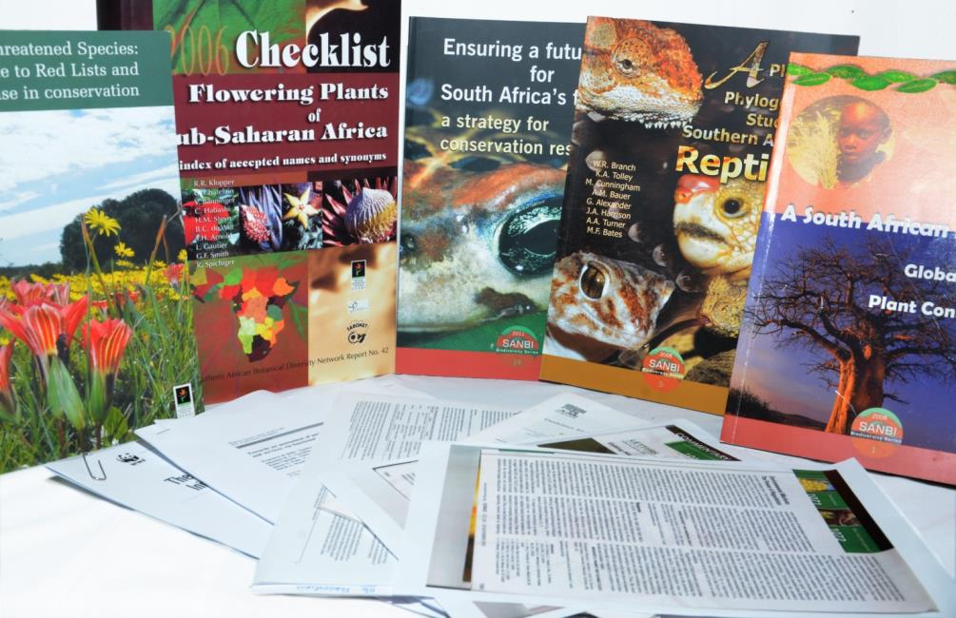
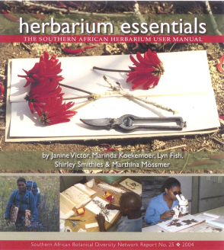
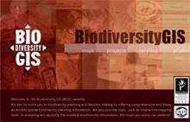
Access to biodiversity information
Since 2004, SANBI has produced 2700 articles, including 1115 peer reviewed papers, 81 books, and >1000 popular articles

Slide 26
PROGRAMME 4: CO-ORDINATE AND PROVIDE ACCESS TO BIODIVERSITY INFORMATION AND KNOWLEDGE
4.1: Access is provided to biodiversity data, information and knowledge.
Performance indicator | Baseline | Annual target 2014/15 | Achievements/Challenges/Corrective measures
Percentage of records accessed from the Biodiversity Advisor website. | 150,000 records accessed from the Biodiversity Advisor website | 5% cumulative increase in records accessed. | Progress: Achieved. The 5% cumulative increase in records was accessed.
Percentage of registered users on the Biodiversity Advisor website. | 1300 registered users | 5% cumulative increase in registered users. | Progress: Achieved. The 5% cumulative increase in registered users.

Slide 27
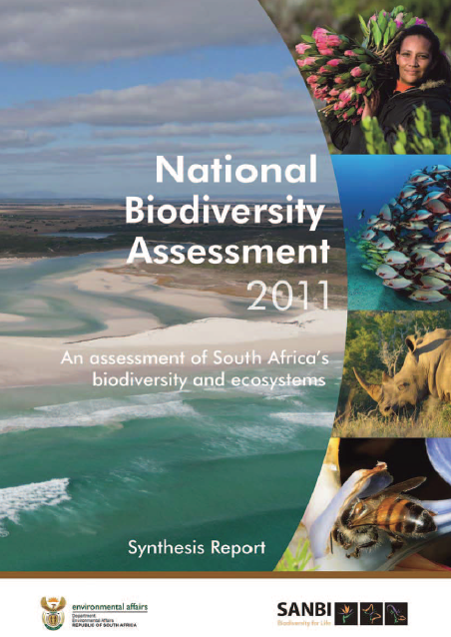
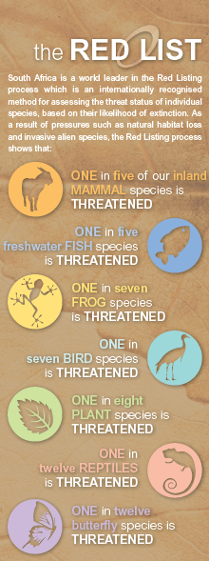
Provide policy tools & advice

Slide 28
PROGRAMME 5: PROVIDE BIODIVERSITY AND CLIMATE CHANGE ADAPTATION POLICY TOOLS AND ADVICE IN SUPPORT OF SOUTH AFRICA’S DEVELOPMENT
5.1: Ecosystem management tools developed and applied
Performance indicator | Baseline | Annual target 2014/15 | Achievements/Challenges/Corrective measures
Number of tools developed to support mainstreaming of biodiversity and ecological infrastructure in production sectors and resource Management | Tools developed include, e.g: Framework for Investments in Ecosystem Services; guidelines for Grasslands Biodiversity; Toolkit; Mining and Biodiversity Guidelines, etc. | Two tools produced. | Progress: Achieved. The two tools produced. Biodiversity and climate change adaptation implementation plan scoping workshop session was held.
 | Branding biodiversity toolkit developed | Six knowledge resources demonstrating the value of biodiversity developed and disseminated. | Progress: Achieved. The six knowledge resources demonstrating the value of biodiversity were developed and disseminated.
Number of coordination or learning mechanisms convened to share lessons and build capacity | National events have been convened, e.g Offshore Environmental Forum; National Biodiversity Planning Forum, etc. An average of four training sessions held annually for provincial, municipal or other relevant decision-makers for uptake of tools. | Four learning or coordination events convened. | Progress: Achieved. The four learning or coordination events were convened.
 |  | Three training sessions held for provincial, municipal or other relevant decision makers for uptake of tools. | Progress: Achieved. The three training sessions were held for provincial, municipal or other relevant decision makers for uptake of tools.

Slide 29
PROGRAMME 5: PROVIDE BIODIVERSITY AND CLIMATE CHANGE ADAPTATION POLICY TOOLS AND ADVICE IN SUPPORT OF SOUTH AFRICA’S DEVELOPMENT (continue..)
5.2: Projects for ecosystem restoration developed and implemented
Performance indicator | Baseline | Annual target 2014/15 | Achievements/Challenges/Corrective measures
Number of wetlands under rehabilitation to restore high value ecosystems | Working for Wetlands Programme established; implementation of programme on-going; 308 wetlands under rehabilitation over 3 years (2011 – 2014). | 110 wetlands under rehabilitation. | Progress: Exceeded Target. A total of 115 wetlands were under rehabilitation. Unforeseen maintenance was done on five wetlands (three in Mpumalanga and two in Eastern Cape) during the course of the year. This maintenance was not planned for, and hence not included in the targets, but needed to be done promptly once the need for it was detected, in order to avoid further degradation of the structures that required maintenance.

Slide 30
PROGRAMME 5: PROVIDE BIODIVERSITY AND CLIMATE CHANGE ADAPTATION POLICY TOOLS AND ADVICE IN SUPPORT OF SOUTH AFRICA’S DEVELOPMENT (continue...)
5.3: Scientific advice to support national and international policy processes provided
Performance indicator | Baseline | Annual target 2014/15 | Achievements/Challenges/Corrective measures
Number of national policy requests responded to within timeframe stipulated in the request | Business Case for Biodiversity Stewardship finalised; Draft national strategy for plant conservation; List of threatened terrestrial ecosystems gazetted; Draft list of threatened river ecosystems developed as part of the NBA 2011; etc. | Two written requests for support from DEA responded to within timeframe stipulated. | Progress: Achieved. The two written requests for support from DEA were responded to within timeframe stipulated.
 | Participation in Water Sector Leadership Group and Water Pricing Strategy Review; contributed to the National Water Resource Strategy II, agricultural mainstreaming strategy; input provided into agriculture sector policy. | One report on the Scientific Authority submitted to the Minister | Progress: Achieved. One report on the Scientific Authority was submitted to the Minister.
 | Support provided to DEA on the 5th Country Report, 2nd and 3rd National Communication to the UNFCCC. SANBI staff sits on international science/policy committees. | Two biodiversity planning processes supported | Progress: Achieved. The two biodiversity planning processes were supported

Slide 31
PROGRAMME 5: PROVIDE BIODIVERSITY AND CLIMATE CHANGE ADAPTATION POLICY TOOLS AND ADVICE IN SUPPORT OF SOUTH AFRICA’S DEVELOPMENT (continue..)
5.3: Scientific advice to support national and international policy processes provided
Performance indicator | Baseline | Annual target 2014/15 | Achievements/Challenges/Corrective measures
Number of national policy processes for which support is provided to other relevant organs of state | Two project concepts approved by the Adaptation Fund for further development | Submissions provided into two national policy process | Progress: Achieved. Submissions were provided into two national policy process. (Participation in relevant meetings; comments and input provided by SANBI where applicable)
Number of international policy support requests responded to within timeframe stipulated |  | Four written requests relating to core multi-lateral environmental agreements responded to within timeframe stipulated. | Progress: Achieved. Four written requests relating to core multi -lateral environmental agreements were responded to within timeframe stipulated.

Slide 32
PROGRAMME 5: PROVIDE BIODIVERSITY AND CLIMATE CHANGE ADAPTATION POLICY TOOLS AND ADVICE IN SUPPORT OF SOUTH AFRICA’S DEVELOPMENT (continue..)
5.4: The direct access climate finance modality is proved to be effective in building resilience in communities vulnerable to adverse climate impacts
Performance indicator | Baseline | Annual target 2014/15 | Achievements/Challenges/Corrective measures
Number of climate change adaptation pilot projects developed and implemented via the direct access modality | NIE lessons and experiences shared at three international and three national meetings | Detailed project concepts approved for two climate change adaptation fund direct access modalities | Progress: Achieved. The detailed project concepts were approved for two climate change adaptation fund direct access modalities
Number of cases where South Africa’s experience with direct access is documented and Shared |  | NIE lessons and experiences shared at least four international, regional and national meetings per annum | Progress: Achieved. NIE lessons and experiences were shared at least four international, regional and national meetings per annum.

Slide 33
‘Bridging into work’ project developed toolkit for mentors
Fellowship: supported over
60 Masters, PhD, Professional
Development and Senior
Fellowships
Fundisa for Change: trained 206 teachers, 41 subject advisors and 160 partners and facilitated 17 workshops to 359 beneficiaries
NSTF GreenMatter award established
Advocacy and communication campaigns undertaken
PengWin Trax run with 25 high schools and universities
946 pioneers skilled
44 host partner institutions
shared training & in-house mentoring (life & work skills, environment & technical)
185 permanent jobs created
101 mentors trained
Groen Sebenza
GreenMatter Biodiversity HCD
SANBI Staff Development
Education and Outreach
47 staff bursaries awarded:
25 undergraduate
22 postgraduate
25 work-integrated learning students
40 interns
postgraduate studentships:
7 Honours
30 Masters
8 PhD
13 Post Docs
Garden learning & awareness:
52 486 beneficiaries
(with 11 538 from ‘new’ schools – first
attendance)
Environmental days awareness:
6 930 beneficiaries
Garden Holiday programmes: 659 beneficiaries
Primary and high school career programmes: 3 337 beneficiaries

Slide 34
PROGRAMME 6: HUMAN CAPITAL DEVELOPMENT (HCD): DRIVE HUMAN CAPITAL DEVELOPMENT, EDUCATION AND AWARENESS IN RESPONSE TO SANBI’S MANDATE
6.1: A socially equitable and suitably skilled workforce is developed
Performance indicator | Baseline | Annual target 2014/15 | Achievements/Challenges/Corrective measures
Number of individuals participating in Groen Sebenza, GreenMatter beneficiaries, internship and studentship capacity development and job creation initiatives with a percentage coming from designated groups. | 4 GreenMatter initiatives started. | 1000 unemployed youth skilled and hosted in the biodiversity sector. | Progress: Exceeded Target 195 and the total achieved is 1197. The Groen Sebenza Project Steering Committee took a resolution to replace transitioned pioneers (pioneers who left due to attrition, job placements and further study) . This created opportunities to host more unemployed youth thereby increasing the numbers
 | Individuals participating in Groen Sebenza and GreenMatter capacity development and job creation initiatives | 75% representation of designated groups in HCD Programmes | Progress: Exceeded Target. The 84.38% representation of designated groups in HCD programmes was exceeded by 9.38%. The Groen Sebenza Project Steering Committee took a resolution to replace transitioned pioneers (pioneers who left due to attrition, job placements and further study) . This created opportunities to host more unemployed youth thereby increasing the numbers.

Slide 35
PROGRAMME 6: HUMAN CAPITAL DEVELOPMENT (HCD): DRIVE HUMAN CAPITAL DEVELOPMENT, EDUCATION AND AWARENESS IN RESPONSE TO SANBI’S MANDATE (continue..)
6.2: All national botanical gardens are promoted and used as platforms for biodiversity awareness, education and recreation.
Performance indicator | Baseline | Annual target 2014/15 | Achievements/Challenges/Corrective measures
Number of users and beneficiaries of botanical gardens and school-based programmes for education, awareness, training and recreation have been increased. | 44 000 beneficiaries reached through school group activities predominantly garden based. | 46 000 | Progress: Exceeded Target. The target was exceeded by reaching 52897 as opposed to 46 000 planned beneficiaries. Due to the increased capacity from the Groen Sebenza Programme SANBI was able to host more school based programmes and thereby increase the number of users and beneficiaries.
6.3: Civil society is engaged to contribute to science and monitoring
Number of platforms facilitated for civil society engagement that contribute to biodiversity monitoring | New | One platform facilitated. | Progress: Achieved. One platform facilitated.

Slide 36
DASHBOARD - 2014/15
TARGETS ACHIEVED PER QUARTER
 | QUARTER 1 | QUARTER 2 | QUARTER 3 | QUARTER 4
TOTAL NUMBER OF TARGETS PLANNED | 48 | 48 | 48 | 48
TARGETS ACHIEVED | 42 | 42 | 40 | 38
EXCEEDED TARGETS | 4 | 4 | 5 | 6
TOTAL NUMBER OF TARGETS ACHIEVED (INCLUDING EXCEEDED) |  |  |  | 44
TARGETS PARTIALLY ACHIEVED | 2 | 2 | 3 | 2
TARGETS NOT ACHIEVED | - | - | - | 2
MODIFICATION/ DEVIATION OF TARGETS | - | - | - | -

Slide 37
SANBI Achievements 2014/15
At least 5 years of unqualified annual audits
Achieved over 92% of delivery targets
Employment equity targets achieved
Appointed 6 black senior managers (4 in scientific areas)
Highly functioning Board
BEE procurement targets exceeded year on year
Leveraged MTEF funding from DEA to obtain funding from other sources (other departments, private sector, donors, etc.)
SANBI celebrated 10 years in 2014
New garden gazetted – Kwelera, E. Cape and Thohoyandou, Limpopo garden to be finalised during 2015/16
More visitors to the gardens and more income than any other year.

Slide 38
Key challenges and opportunities going forward
Groen Sebenza – an important intervention to transform the sector, however huge challenges in getting job placements from Host Institutions. Corrective measures were discussed by CEO.
Provision of evidence based information for the SIPs is being addressed through our information management and research capabilities. Where required new skills are being mobilised.
Implementation of new Invasive Species Regulations has financial and human resource implications. Funding support from DEA requested
Establishment of 2 new Gardens requires careful planning and allocation of human and financial resources. This is being addressed through our planning, recruitment and budgeting.

Slide 39
Thank You

