Slide 1
ANNUAL REPORT 2014/2015
Parliamentary Portfolio Committee
October 2015

Slide 2
INDEX
The Geoscience Act
CGS Organogram
Corporate Performance
Operations Programmes
Highlights of National Projects
Some of the Statutory Projects
Finances
Human Resources
Challenges

Slide 3
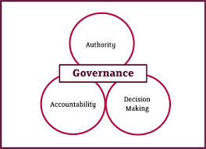

Slide 4
The Geoscience Act (Act 100 of 1993) The Geoscience Amendment Act (Act 16 of 2010)
The systematic onshore and offshore geoscientific mapping of South Africa
Basic geoscience research into the nature and origin of rocks
The collection and curation of all geoscience data and act as a National Geoscience Repository
Rendering of geoscience knowledge services and advice to the State
Manage a number of national geoscience facilities on behalf of the country
Render commercial geoscience services and products to national and international clients

Slide 5
CGS ORGANOGRAM
CGS Board
CGS Acting CEO
Mr S Sikhosana
CFO
Mr L Matsepe
COO
Dr M Makgae
CSS
Mr F
Ramagwede

Slide 7
Corporate Performance
BSC Perspective: Market (Stakeholder/Customer) Focus
Measure | Target 2014/15 | Performance 2014/15
Annual Technical Programme performance index | 85% | 76%
% satisfied customers | 85% | 86.36%
No. of geoscience maps, map explanations and related manuscripts published in-house | 18 | 25

Slide 8
Corporate Performance (cont.)
BSC Perspective: Market (Stakeholder/Customer) Focus
Measure | Target 2014/15 | Performance 2014/15
# of rural development project reports completed | 14 | 55
# of Regional and African Development Project reports completed | 27 | 17
# of Environment related project reports completed | 8 | 7

Slide 9
Corporate Performance (cont.)
BSC Perspective: Market (Stakeholder/Customer) Focus
Measure | Target 2014/15 | Performance 2014/15
Articles published in the popular press | 2 | 9
Articles published in industry publications | 4 | 3

Slide 10
Corporate Performance (cont.)
BSC Perspective: Economic (Financial) Growth
Measure | Target 2014/15 | Performance 2014/15
Total Revenue | R378.8m | R305.7m
Contract Revenue | R87.9m | R35.7m

Slide 11
Corporate Performance (cont.)
BSC Perspective: Economic (Financial) Growth
Measure | Target 2014/15 | Performance 2014/15
Ratio of External Revenue to Total Revenue | 24% | 19.52%
# of large tenders and proposals submitted (>R1m) | 24 | 17
Tender success rate # | 10% | 22%

Slide 12
Corporate Performance (cont.)
BSC Perspective: Economic (Financial) Growth
Measure | Target 2014/15 | Performance 2014/15
Ratio of overhead costs to total cost (%) | 60% | 56.73%
Ratio of personnel costs to total costs | 59% | 55.71%

Slide 13
Corporate Performance (cont.)
BSC Perspective: Effective Systems (Organizational)
Measure | Target 2014/15 | Performance 2014/15
Preferential (BEE/HDI) procurement as % total procurement | 40% | 51%
# of audit qualifications | 0 | 0
# of policies written and/or reviewed | 7 | 11

Slide 14
Corporate Performance (cont.)
BSC Perspective: World Class People (Learning and Growth)
Measure | Target 2014/15 | Performance 2014/15
Net staff turnover | 0% | 1.97%
# of staff enrolled for MSc and PhD degrees | 36 | 35
# of papers and articles published | 70 | 140

Slide 15
Corporate Performance (cont.)
BSC Perspective: World Class People (Learning and Growth)
Measure | Target 2014/15 | Performance 2014/15
# of projects with external collaborators | 55 | 46
# of strategic science partnerships | 22 | 17

Slide 16
Corporate Performance (cont.)
BSC Perspective: World Class People (Learning and Growth)
Measure | Target 2014/15 | Performance 2014/15
Scientists as a % of total staff | 50% | 37.25%
% of scientific staff wit PhD and MSc degrees | 60% | 45.95%

Slide 17
Corporate Performance (cont.)
BSC Perspective: World Class People
Measure | Target 2014/15 | Performance 2014/15
EE Statistics (Consolidated) (W:B) | 32:68 | 30:70
EE Statistics (Gender) (M:F) | 54:46 | 56:44
% satisfied staff | 65% | 60.6%

Slide 18
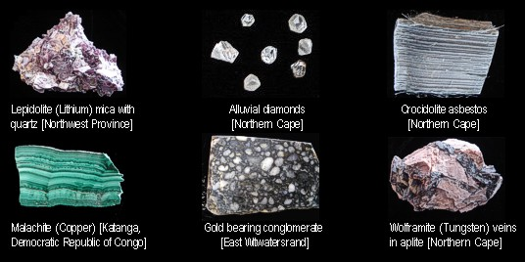
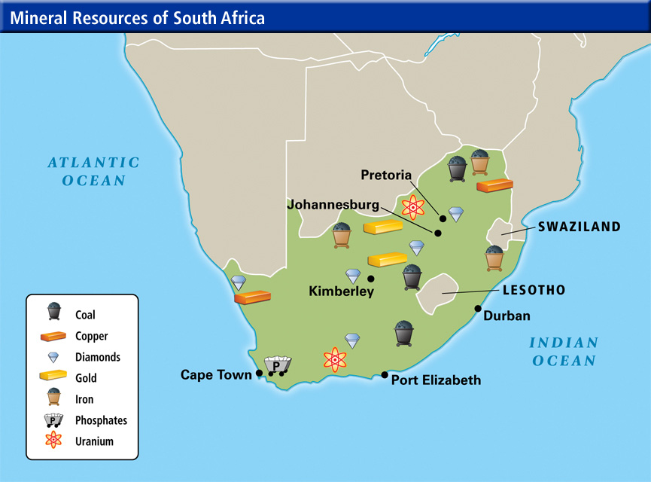

Slide 19
Highlights of National Projects
The management of the Derelict and Ownerless mines
Target generation
Microzonation
Water Project

Slide 20
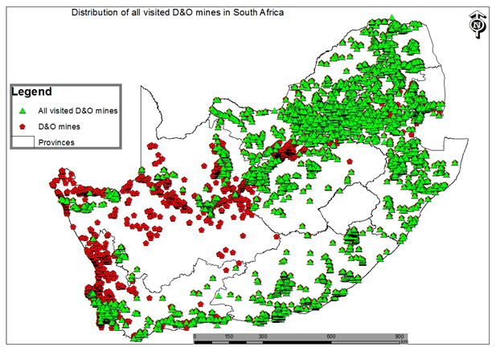
Derelict &Ownerless Mines

Slide 22
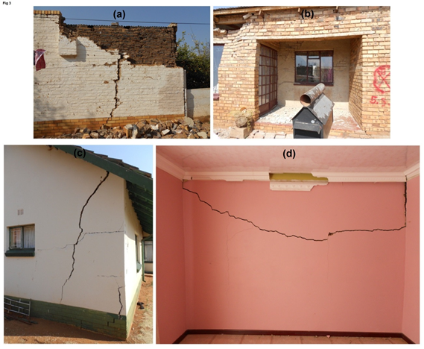
Macroseismic survey of the magnitude 5.5, 2014 Orkney earthquake

Slide 23
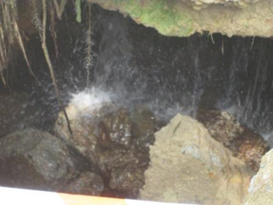
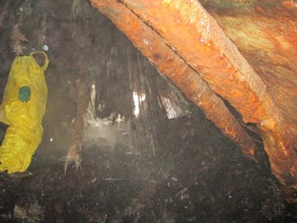
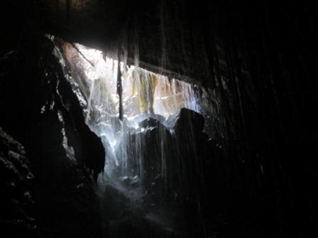
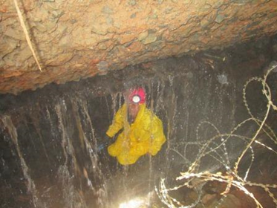
Water Project
Photographs taken inside the New Kleinfontein opening, clearly showing the ingress of water (Courtesy of Gold One)

Slide 24
Some of the Statutory Projects
South African Commission of Stratigraphy (SACS) - secretarial functions
The Task Groups of the SACS review descriptions of the stratigraphic units of S.A. geological map
SACS Lithostratigraphic Description
Provides definitive descriptions of the stratigraphic units of South Africa
Africa Minerals database
Maintenance of this database assist exploration by Junior and Senior Mining Companies resulting in several new prospects and projects.
SAMINDABA Database
Coal and Core Data Database
South African National Seismograph Network
National Geotechnical Report Reviews

Slide 25
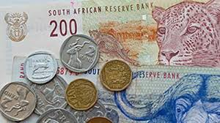
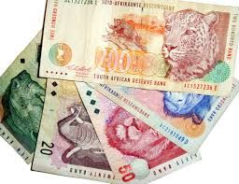
FINANCES

Slide 26
Audited Actuals 2014/15 and Budgets 2014/15 – 2016/17
Income
Income (Rands) | 2014/15 Audited Actuals x 1000 | 2014/15 Budget x 1000 | 2015/16 Budget x 1000 | 2016/17 Budget x 1000
Government grant | 250 237 | 292 839 | 325 914 | 357 627
Sales and contracts | 37 029 | 63 919 | 70 311 | 77 342
Sundry income | 22 769 | 3 039 | 3 191 | 3 350
TOTAL INCOME - A | 310 035 | 359 797 | 399 415 | 438 319

Slide 27
Audited Actuals 2014/15 and Budgets 2014/15 – 2016/17 cont.
Expenditure
Expenditure (Rands) | 2014/15 Audited Actuals x 1000 | 2014/15 Budget x 1000 | 2015/16 Budget x 1000 | 2016/17 Budget x 1000
Personnel costs | 175 585 | 182 787 | 186 148 | 204 763
Bursaries | 1 259 | 2 300 | 2 530 | 2 783
Commercial project costs | 20 875 | 28 764 | 31 640 | 34 804
Overheads and operating costs | 126 971 | 118 946 | 136 947 | 150 115
SUBTOTAL - B | 324 690 | 332 797 | 357 265 | 392 465
CAPITAL EXPENDITURE - C | *31 741 | 27 000 | 42 150 | 45 854
TOTAL EXPENDITURE = (B+C) | 356 431 | 359 797 | 399 415 | 438 819
Surplus (Loss) | (14 655) | -- | -- | --
* Balance Sheet

Slide 28
ANALYSIS OF GOVERNMENT GRANT ALLOCATION FOR 2014/14 TO 2017/18
ITEM | 2014/15 R | 2015/16 R | 2016/17 R | 2017/18 R
Baseline allocation | 156.1m | 165.4m | 184.6m | 198.4m
Mine Rehabilitation | 25m | 20.9m | 22m | 21.1m
Water Ingress Project | 21.8m | 22.8m | 23.9m | 23m
Shale Gas | - | 16.8m | 21.6m | 26.4m
Stimulation of investment in the Mineral Sector | 65m | 68m | 71.6m | 68.7m
Laboratory & infrastructure (AC) | 25m | 32.1m | 33.9m | 22m
Total Government Grant (Grant for 2017/18 to be confirmed) | 292.8m | 325.9 | 357.6m | 348.9m
Other – Budget Support Program – Microzonation “Donor Funding” | 3.7m | 14.8m | 11.5m

Slide 29
GOVERNMENT GRANT (BASELINE ALLOCATION) VS. PERSONNEL EXPENDITURE
 | R’000 | R’000 | R’000 | R’000
 | Budget 2014/2015 | Budget 2015/2016 | Budget 2016/2017 | Budget 2017/2018
Government grant (Baseline) | 156 087 | 165 301 | 184 592 | 198 430
Personnel Costs | (182 787) | (186 148) | (204 763) | (225 239)
Funds for Operational Costs | (26 700) | (20 847) | (20 171) | (26 809)

Slide 30
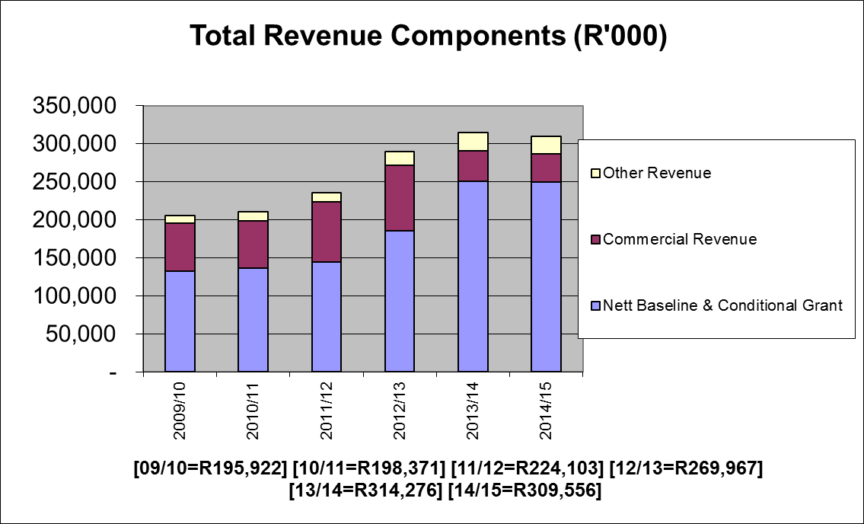

Slide 35
Auditor General Reports
The CGS has continuously obtained unqualified audit opinion from AG for period longer than 12 years.
In the reported year, an amount of R1.3m is disclosed as irregular expenditure. The financial system support service provider was appointed through a deviation mechanism i.e. without testing the market.
This was done for continuity of services and for risk mitigation as the system was modified and the service provider who did the modifications was presumed sole service provider.
AG had a different view.
The market is being tested going forward

Slide 36
Financial Outlook For 2015/16
Liquidity Ratio is 1.8:1. This means that the CGS will meet its financial obligations as they become due.
A steady balance sheet position is maintained with total asset of more than R495m
Income generation expected to exceed R492m. This includes Baseline allocation, Ringfenced MTEF projects and Commercial Revenue

Slide 38
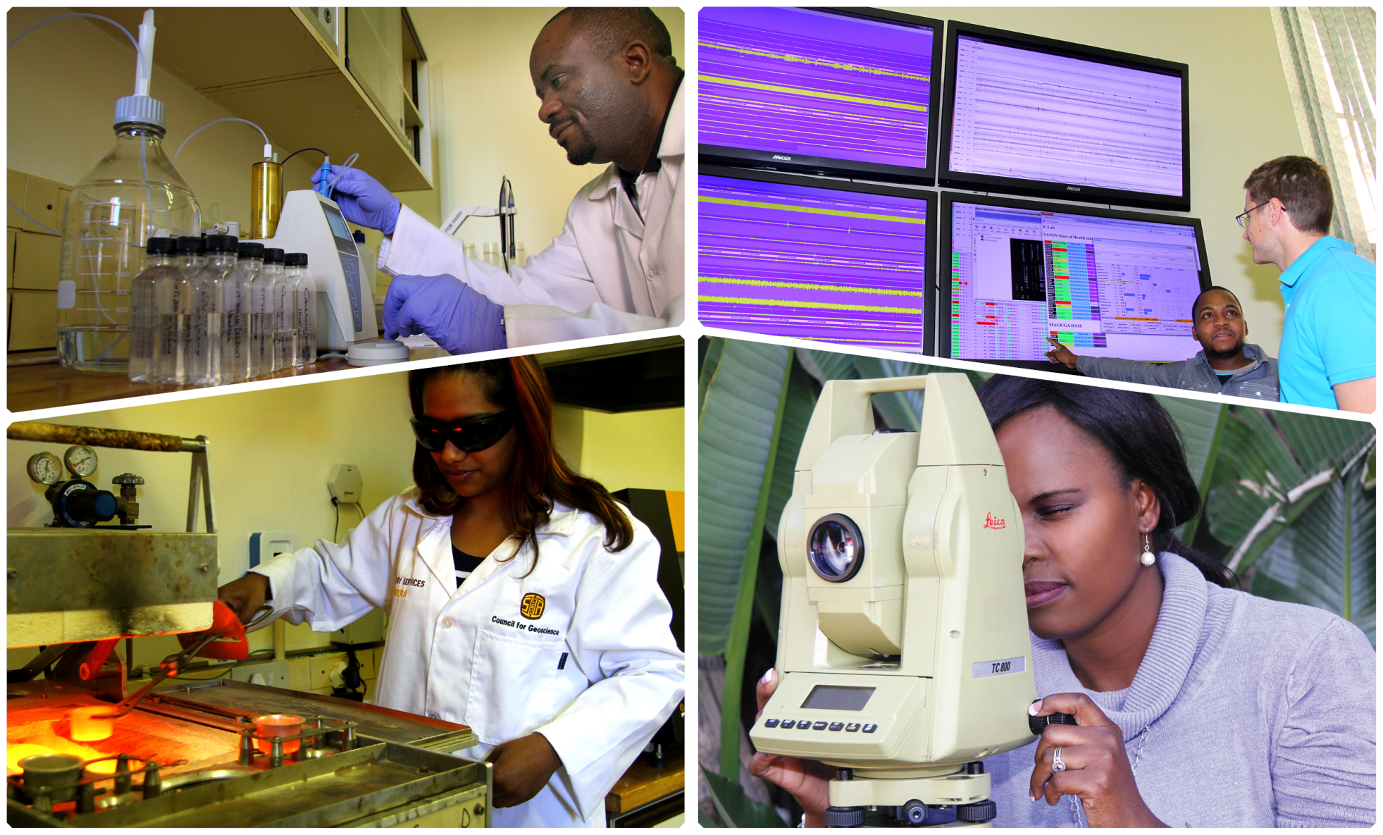
Our Employees

Slide 39
Human Resources
Our strategy is anchored on the following pillars:
Continue to transform the organisation
Retaining skilled scientists
Developing young scientists especially previously disadvantaged
Our Training Programmes are:
Bursaries (Part-time and fulltime)
Internship Programme (In collaboration with MQA)
Mentorship Programme
Geological Mapping Field School
39

Slide 40
Overall Demographic Profile by Race
Staff Profile as at 31 March 2015
40

Slide 41
Staff Profile by Race
Period – 2011 to 2015
41

Slide 42
Staff Profile by Gender
Period – 2011 to 2015
42

Slide 43
Demographic Composition of Bursars by Race
43
Bursars Profile as at 31 March 2015

Slide 44
Demographic Composition of Bursars by Gender
Period - 2011 to 2014
44

Slide 45
Bursary Intake Analysis
Number of Bursars - 2011 to 2015
45

Slide 46
Internship Programme
Number of Interns – 2011 to 2015
46

Slide 47
Gender Profile 2014-2015 Internship
47

Slide 48
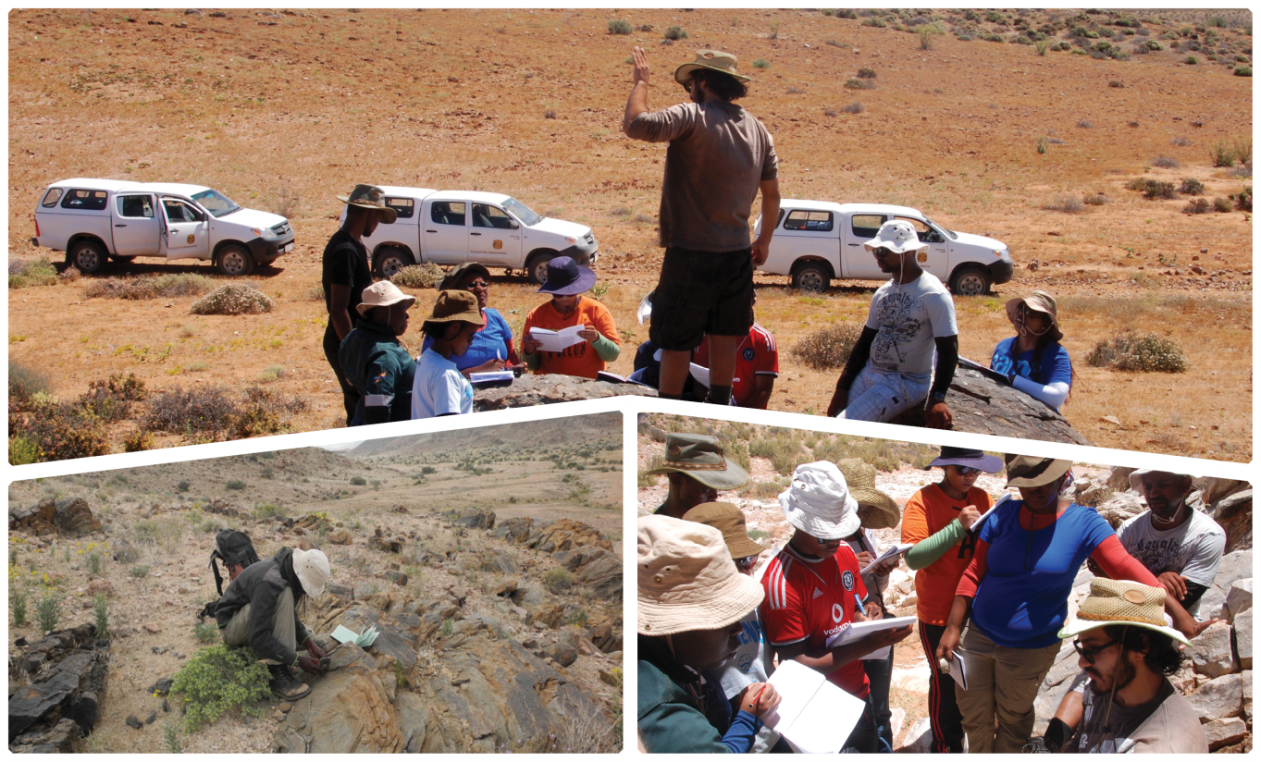
Geological Field School
Initiated in 2005, based in Limpopo
Now a one-year modular programme:
CGS trainees full-time for one year
Introductory short course
In the process of acquiring accreditation from MQA
48

Slide 50
Challenges
Low baseline funding not covering personnel and overheads costs
MTEF funding cycle 3 years appointment of short term contracts for scientists
Leads to lack of critical skills attraction and retention, lack of continuity of technical expertise
Leads inadequacies in fulfilling the CGS mandate in this case government.

