Slide 1
South Africa’s Intended Nationally Determined Contribution
Greenpeace is an independent, global campaigning organisation that acts to change attitudes and behaviour, to protect and conserve the environment and to promote peace.
Greenpeace campaigns for an Energy [R]evolution in South Africa.
www.greenpeaceafrica.org

Slide 2
Background
5th Assessment Report of the IPCC: 655 – 815 Gt CO².
Just transition to a low-carbon, climate-resilient economy.
INDC must provide clear outline for transformation.
Champion a renewable energy future.
Common vision for 2050 required.
Development objectives beyond NDP time-frame.
National long-term goal – zero emissions by 2050-2060.
www.greenpeaceafrica.org

Slide 3
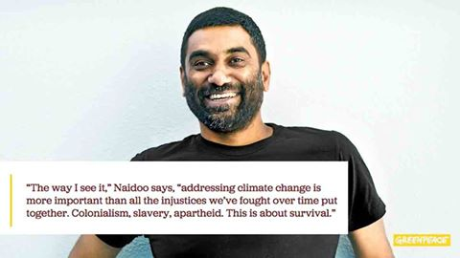

Slide 4
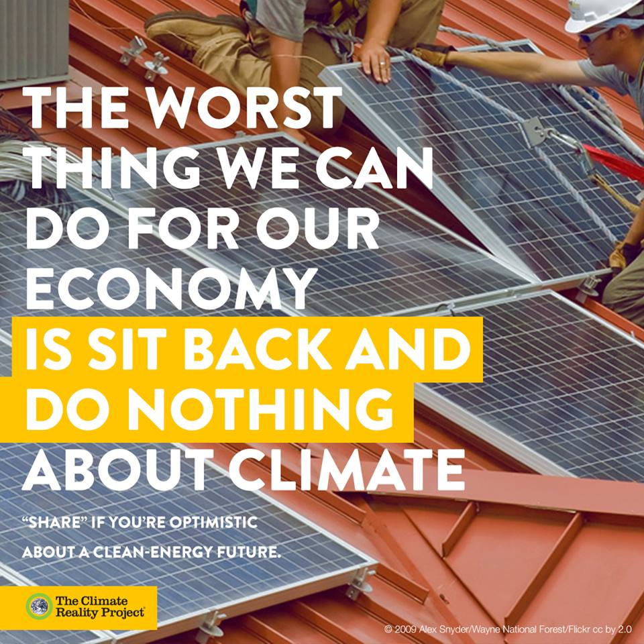
South Africa’s proposed INDC submission
Avoids quantifying any contribution to mitigation.
Undermines South Africa’s credibility.
Current aspiration: 212 – 428 Mt CO²-eq by 2050.
Not sincerely committed to global goal.
Africa Group Position.
Provide an absolute number as the ceiling on emissions.
www.greenpeaceafrica.org

Slide 5
Significant Lack of Ambition
Carbon budget approach currently proposed is unacceptably large (2016 – 2050).
“Analysis by SA experts” – Full analysis referenced.
20 – 22Gt CO²e is unacceptably large.
Twice as much as SA could justify as equitable.
Carbon budget approach should be rejected.
SA ambition should be to get to the lower PPD range.
Past inadequacies cannot drive future ambition.
SA must lead by example – National claim of entitlement.
SA responsibility to not aim to emit at the top of the range.
www.greenpeaceafrica.org

Slide 6
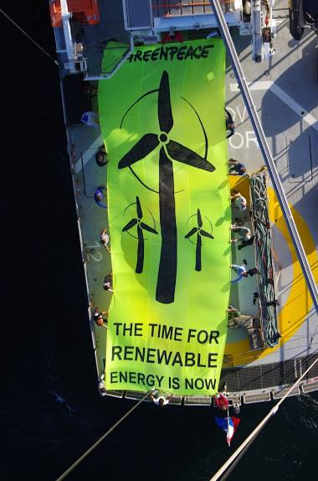
Flagship Programmes – Commitment to RE
Programmes listed inadequate – Urgently accelerate and scale up.
Massive increase in energy efficiency measures – 12 000MW
Major expansion of REI4P – long term goal of 94% by 2050.
Remove barriers to RE, create enabling framework & remove caps.
CSIR – Two independent studies
Significant financial and socio-economic benefits.
www.greenpeaceafrica.org
Notes:
Meaningful consultation – comments that have been made must incorporate comments in final draft.
Go into detail around level of emmission is at least double what it should be.
Nuclear not included as low carbon option. Too little too late.
Barriers to RE = CSIR study findings & still no regulations for Small scale embedded generation. Win win argument for RE, economy, jobs.

Slide 7
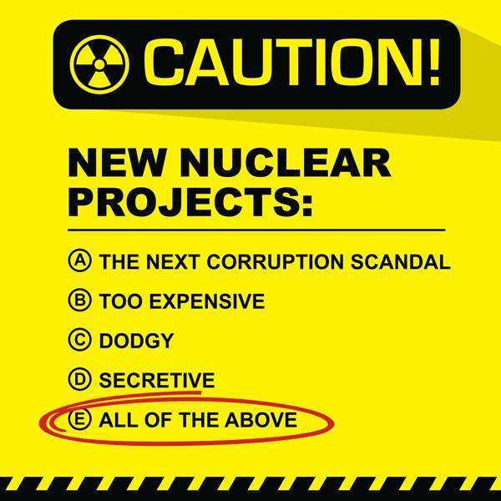
Nuclear – False Solution
SA listing nuclear as “low-carbon” option is disingenuous.
IRP update – No need for investments before 2025
Life-cycle analysis – Nuclear energy is carbon intensive.
Nuclear to be removed in favour of clear alternatives like RE.
www.greenpeaceafrica.org

Slide 8
Conclusion
Opportunity & responsibility to lead by example.
SA = 11th largest emitter globally.
Medupi & Kusile
Equity Principle – Avoid taking required domestic action.
Increase ambition in line with lower PPD range.
Meaningful process – Significant changes to draft INDC
Greenpeace calls on SA to show climate leadership domestically.
www.greenpeaceafrica.org

Slide 9
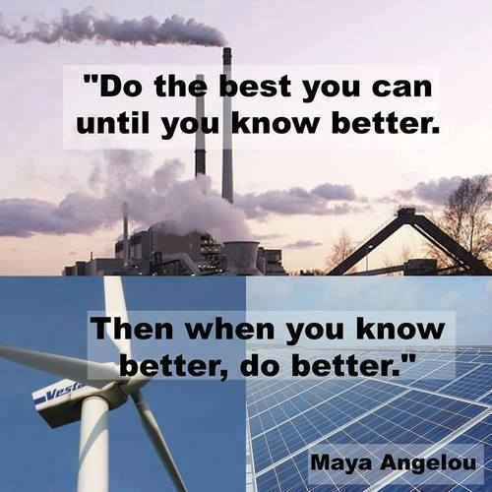
www.greenpeaceafrica.org

