Slide 1
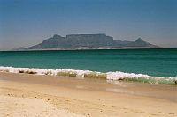
State of the Western Cape Province
Presented to: Portfolio Committee on Home Affairs
Presented by: Provincial Manager: Yusuf Simons
Date: 08 September 2015
Notes:
1

Slide 2
Table of Content
Overview of the Province : | Slide nr:
Geographical outlay WC Demographics and socio economic indicators What is unique about DHA in the WC WC Management Team Governance structure
2. WC Footprint and office demarcation Operational Office Modernized Offices Modernization planned for 2015/2016 (readiness) Health Facilities and Health Facility Optimization Plan Mobile Offices Accommodation Report
3. Capacity Information Capacity levels Employment equity Counter Corruption and Vetting Training and capacity building Employee Wellness Programmes
4. Resources and Budget State of Expenditure as at end June 2015 Revenue Collected per District and Cash in Transit services Asset Management
Notes:
2

Slide 3
Table of Content continued
Overview of Provincial Performance in relation to operations and Annual Performance Plan | Slide nr:
5. Progress Refugee Centre 6. Progress Cape Town Port Control Centre 7. Progress APP targets 2015/2016
Provincial Specific Projects: | Slide nr:
8. Query Management 9. Telephone Monitoring Project 10. Provincial implementation and monitoring plan for Moetapele Initiative 11. LRB outreach Programmes for farming communities Outreach programmes co-ordinated by DHA Youth Forum 12. Public Service Week Plan of Action – September 2015
Notes:
3

Slide 4
Vision
A safe, secure South Africa where all of its people are proud of, and value, their identity and citizenship.
Mission
The efficient determination and safeguarding of the identity and status of citizens and the regulation of immigration to ensure security, promote development and fulfill our international obligations.

Slide 5
Overview of the Province

Slide 6
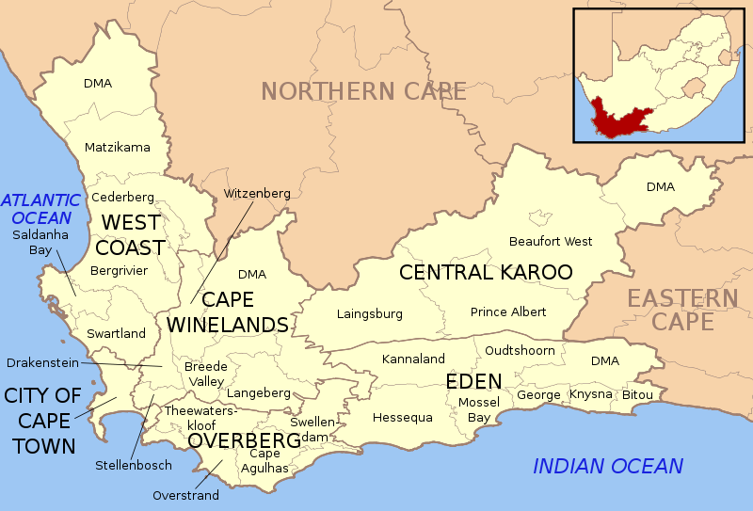
1. Geographical outlay:
1x Metro: City of Cape Town, 5 x District Municipalities (West Coast, Cape Winelands, Central Karoo, Overberg, Eden), 1 x Refugee Office , 3 x Sea Ports: (Cape Town, Saldanha, Mosselbay), 1 x International Airport: Cape Town (National key point).
Note: Refugee Office, Ports of Entry - direct reports to Head office w.e.f 01 April 2015

Slide 7
WC * Demographics Socio Economic indicators:
WC Province is the fourth largest of the nine Provinces in terms of :
Area ( 129 449 square kilometers) and
Population 5.8 m inhabitants (two thirds live in metropolitan areas of the Metro)
Cape Metro has the highest population of 62%, Cape Winelands the second highest with 14%, Eden at 9,8% and Central Karoo and Overberg being the smallest with 1,5 and 3.8 respectively.
Coloured people are 61% , Africans 26,7% and White people 18,4% represented in the WC.
89,6% of the population in the WC live in urban areas (relatively high as national average is 63/37 % urban-rural split)
* Data source: Stats SA Statistical Release P0302

Slide 8
WC Demographics * Socio Economic indicators continued:
Poverty Inequality and unemployment:
WC GDP contributes 14% to national GDP
WC poverty rate is 20,8% with Cape Metro lowest poverty rate of 16,7%, followed by West Coast at 19,4%, Overberg 23%, Cape Winelands 26,7% , Eden 35,6%. Central Karoo has the highest poverty rate at 41,3%.
Poverty vary greatly between racial groups with virtually no poverty amongst white people (0,6%).
Prevalent industries:
Real estate,
Tourism
Manufacturing
Agriculture
Fishing
Unemployment levels:
Over all for WC = 21,7%
Amongst youth between 32-35% in 2015
* Data source: Stats SA Statistical Release P0302

Slide 9
What is unique about Western Cape Province
Annual Valentines day Marriage Ceremony conducted by DHA on Robben Island
Prone to fire disasters – DHA response unit working in close co-operation with Disaster Management
Cape Town Port Control Office pilot site for BMA and first Modernized Port in the Country
Hospital Optimization Plan – 1st Province to refer clients to Health Facilities within 5km radius for birth registration
Strengthened working relationship with Department of Local Government and managed to secure space and open 6 DHA Offices in Thusong Centres during 2014/2015 FY- Developed own office layouts
WC Province over achieved with 3,33% against the employment equity target of 2% for persons with disability.

Slide 10
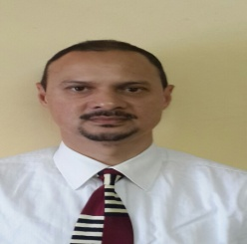
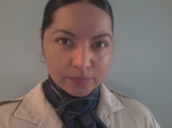
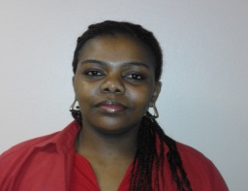
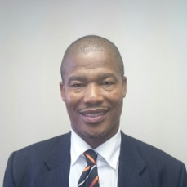
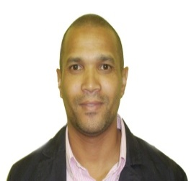
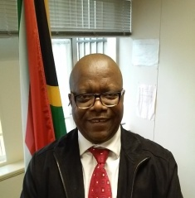
Western Cape Senior Management Team:
Provincial Manager: Western Cape
Mr. Y Simons
Cape Town Refugee Centre
Ms. T Ndlovu
Cape Town Harbour: Port Control Centre
Ms. C Hewitson
(A) Director: F&S : Ms. A vd Berg
(A) Provincial Co-ordination
Ms. N Kamana
(A) DMO: Cape Metro
Mr. I Mokgele
(A) DMO: Cape Winelands, West Coast Mr. R Gabriels
DMO: Central Karoo, Eden, Overberg :Mr.M Ngaka
Note: Funded vacant posts for : DMO Cape Metro and West Coast in process of being filled

Slide 11
WC Governance structure
Meeting type | Membership | Purpose | Frequency
EXCO | PM, DMO, D:F&S | Progress reports on APP targets, Information sharing Planning Action log | Weekly
EXT EXCO | PM, DMOs, D:F&S, Business Unit Heads | Progress reports on APP targets, Information sharing Action log | Monthly
EXT Management Meeting | PM, DMOs, D:F&S, All ASDs and Office Managers irrespective of rank, Finance staff, representatives from organized Labour, Youth and gender forums. | Progress reports from business units Accolades for Motapele employees Feedback sessions from other meetings i.e. DMC, CS Branch meeting etc. | Monthly
Staff Meetings | All staff on the last Wednesday of each month | Progress reports Issues hampering service delivery Staff issues | Monthly
Provincial Consultative Forum | Elected members from management and organized Labour | Discuss matters affecting staff at local office level Information sharing on matters discussed at Department Bargaining Council
Smart Card Steerco | Provincial Smart Card Co- coordinator, PM & DMOs | Report and discuss progress in relation to targets Monitor impact of load shedding, off line mode, challenges on performance and report to National Steerco | Weekly

Slide 12
2. Western Cape Footprint & Infrastructure
SUMMARY OF ACTIVE/ ONLINE CLIENT CONTACT POINTS:
TYPE CLASSIFICATION | DHA CURRENT FOOTPRINT
LOCAL OFFICE LARGE | 4
LOCAL OFFICE AVERAGE | 9
LOCAL OFFICE SMALL | 3
REFUGEE CENTRE | 1
PORTS OF ENTRY | 2
PROVINCIAL OFFICE | 1
THUSONG SERVICE CENTER (TSC) | 11
MOBILE OFFICES | 11
HEALTH FACILITIES | 32
TOTAL | 74
* 16 out of 27 (59%) front offices were modernized as at August 2015

Slide 13
WC Footprint per office classification:
TYPE OF OFFICE | DHA CURRENT FOOTPRINT | MODERNISED OFFICE | COMMENTS
 | BELLVILLE | Yes | Relocation to alternative accommodation in Q 3.
 | CAPE TOWN | Yes | Moetapele Office. High client volumes
 | KHAYELITSHA | Yes
 | PAARL | Yes | Additional space required. DPW in process of acquiring additional space at current building.
 | GEORGE | Yes
LOCAL OFFICE LARGE | 4
 | NYANGA | Yes
 | WYNBERG | Yes | High client volumes
 | CALEDON | No | Earmarked for Moetapele initiative. Relocation to alternative accommodation Q3, Hand over envisaged for 30/09/2015
 | STELLENBOSCH | No | Land Restitution claim
 | WORCESTER | Yes
 | MALMESBURY | Yes | High client volumes
 | OUDTSHOORN | Yes
 | BEAUFORT WEST | Yes | Limited office space
 | MITCHELLS PLAIN | Yes | Limited office space. Alternative building has been identified. Awaiting DPW processes.
LOCAL OFFICE AVERAGE | 9

Slide 14
WC Footprint per office classification:
TYPE OF OFFICE | DHA CURRENT FOOTPRINT | MODERNISED OFFICE | COMMENTS
 | SOMERSET WEST | No | Earmarked for Moetapele initiative. Relocation to alternative accommodation Q2
 | MOSSELBAY | Yes
 | VREDENDAL | Yes | Relocated to new building in 2014
LOCAL OFFICE SMALL | 3
 | REFUGEE CENTRE |  | Closed for new asylum seeker cases w.e.f July 2012
REFUGEE RECEPTION CENTRE | 1
 | COWRIE HOUSE |  | BMA Pilot Site
 | CAPE TOWN INTERNATIONAl AIRPORT |  | Floor space inadequate.
PORTS OF ENTRY: | 2
 | PROVINCIAL OFFICE |  | Situated at Cape Town LO
PROVINCIAL OFFICE | 1

Slide 15
WC Footprint per office classification:
TYPE OF OFFICE | DHA CURRENT FOOTPRINT | MODERNISED OFFICE | COMMENTS
 | ATLANTIS | No
 | GRABOUW | No
 | BREDASDORP | Yes
 | SWELLENDAM | No | Refurbishment for modernisation in 2016/17
 | CITRUSDAL | No | Additional space being acquired for Modernisation
 | PLETTENBURG BAY | No | 2015/2016 Modernization roll out
 | LAINGSBURG | No | Additional space being acquired for Modernisation
 | CERES | Yes
 | ROBERTSON | Yes
 | PRINCE ALBERT | No | 2015/2016 Modernization roll out
 | VREDENBURG | No | Currently in temporary building awaiting Municipal Thusong centre.
THUSONG SERVICE CENTER (TSC) | 11

Slide 16
WC Footprint per District and Local Municipality:
METRO/DM | LM | DHA FOOTPRINT OFFICE | COMMENTS:
Cape Metro |  | Cape Town Large Office
 |  | Khayelitsha Large Office
 |  | Wynberg Large Office
 |  | Bellville Large Office
 |  | Nyanga Medium
 |  | Somerset West Small
 |  | Mitchells Plain Medium
 |  | TC Atlantis
 |  | Refugee Centre
 |  | Cape Town PCC
 |  | Provincial Office
West Coast | Swartland | Malmesbury Small
 | Matsikama | Vredendal Small
 | Cederberg | TC Citrusdal
 | Saldanha | Vredenburg
 | Bergrivier |  | * No DHA offices * visited once a month
 | Saldanha Harbour |  | * Not capacitated – services by CT Immigration
Cape Winelands | Drakenstein | Paarl Large Office
 | Bredevallei | Worcester Medium
 | Stellenbosch | Stellenbosch Small
 | Witzenberg | Ceres TSC
 | Brederiver | Robertson TSC

Slide 17
WC Footprint per District and Local Municipality continued:
METRO/DM | LM | DHA FOOTPRINT OFFICE | COMMENTS:
Central Karoo | Beaufort West | Beaufort West Small Office
 | Laingsburg | Laingsburg TSC
 | Prince Albert | Prince Albert TSC
Eden | George | George Large Office
 | Oudtshoorn | Oudtshoorn Medium
 | Kannaland |  | Ladysmith, Vanwyksdorp, Zoar, Calitsdorp visited with Mobile Truck twice a month
 | Knysna |  | Online Hospital w.e.f August 2011 Mobile Truck visit Waboomskraal, Cracks once a month
 | Mosselbay | Mosselbay TSC | Mosselbay Harbour Not capacitated, serviced by Immigration Officer seconded from Cape Town Port Control Office
 | Hessequa |  | Riversdale Hospital connected w.e.f March 2013 Serviced through Mobile service bi-weekly
 | Bitou | Plettenberg Bay TSC (Simunye)

Slide 18
WC Footprint per District and Local Municipality continued:
METRO/DM | LM | DHA FOOTPRINT OFFICE | COMMENTS:
Overberg | Theewaterskloof | Caledon Small
 | Swellendam | Swellendam TSC
 | Overstrand |  | Hermanus visited twice a month, 1 Hospital capacitated, Hawston, Kleinmond, Gansbay,Stanford,Baardskeerdersbos visited once a month
 |  | Grabouw Small | falls under Theewaterskloof, Office moved to new location closer to the community – Thusong precinct
 | Cape Agulhas | Bredasdorp TSC | Napier, Elim, Struisbay, Arniston visited once a month.

Slide 19
Mobile Offices status as at August 2015:
OFFICE | REG. NO | DRIVABLE YES/ NO | FUNCTIONAL YES /NO | CAPACITY
WORCESTER | CA 565 845 | YES | YES | 1xMobile Office Manger
PAARL | CA565152 | YES | YES | 1xMobile Office Manger
MALMESBURY | CA 562503 | YES | YES | 1xMobile Office Manger
KHAYELITSHA | CA 928364 | YES | YES | 1xMobile Office Manger
CALEDON | CA 562 301 | YES | YES | 1xMobile Office Manger
WYNBERG | CA 565113 | YES | YES | 1xMobile Office Manger
CAPE TOWN | CA565969 | NO | NO | 1xMobile Office Manger
OUDTSHOORN | CA 562973 | YES | YES | To be appointed
BEAUFORT WEST | CA 562677 | YES | YES | 1xMobile Office Manger
GEORGE | CA 565561 | YES | YES | 1xMobile Office Manger
BELLVILLE | CA 565 599 | NO | NO | 1xMobile Office Manger
Way forward :
Province developed a redeployment plan for Mobile Offices focused on birth registration in urban areas.
Mobile Office deployment in rural areas continued

Slide 20
List of connected Health Facilities in the WC :
Note:
32 (Urban 24, rural 8) health facilities connected out of 129 health facilities in the in WC
Roaming services rendered to 28 health facilities (not connected)
Dedicated capacity at 12 facilities (additional 4 funded vacant posts in process of filling)
The Province developed and implemented a Hospital Optimization Plan in order to achieve the annual APP target of 85 776.
DISTRICT | NUMBER OF CONNECTED FACILITIES
Cape Metro | 20
Cape Wine Lands | 4
West Coast | 1
Eden | 6
Overberg | 1

Slide 21
List of connected Health Facilities in the WC :
DISTRICT | OFFICE | NAME OF HEALTH FACILITY | CHALLENGES WITH CONNECTIVITY
CAPE METRO | Bellville | Tygerberg MOU | Yes – VPN system unstable – IS investigating alternative connectivity
 | Bellville | Vanguard MOU | Yes – VPN system unstable – IS investigating alternative connectivity
 | Bellville | Kuilsriver Private Hospital | Yes – VPN system unstable – IS investigating alternative connectivity
 | Bellville | Melomed Private Hospital
 | Bellville | Karl Bremmer MOU | Yes – VPN system unstable – IS investigating alternative connectivity
 | Bellville | Cape Gate Private Hospital | Yes – VPN system unstable – IS investigating alternative connectivity
 | D/O Bellville | Durbanville Private Hospital | Yes – VPN system unstable – IS investigating alternative connectivity
 | Cape Town | Groote Schuur Hospital
 | Cape Town | Somerset Hospital

Slide 22
List of connected Health Facilities in the WC :
DISTRICT | OFFICE | NAME OF HEALTH FACILITY | CHALLENGES WITH CONNECTIVITY
CAPE METRO | Khayelithsa | Khayelithsa District Hospital
 | Khayelithsa | Micheal Maphongwana
 | Khayelithsa | SITE B Hospital
 | Somerset West | Macassar | Yes – VPN system unstable – IS investigating alternative connectivity line verification to be installed
 | Nyanga | Gugulethu MOU
 | Nyanga | Hanover Park | Yes – VPN system unstable – IS investigating alternative connectivity
 | Nyanga | Gatesville Medical Centre
 | Wynberg | Constantia Medi-clinic | Yes – VPN system unstable – IS investigating alternative connectivity
 | Wynberg | Mowbray
 | Mitchells Plain | Mitchells Plain MOU
 | Mitchells Plain | Mitchells Plain District Hospital

Slide 23
List of connected Health Facilities in the WC :
DISTRICT | OFFICE | NAME OF HEALTH FACILITY | CHALLENGES WITH CONNECTIVITY
EDEN | Oudtshoorn | Oudtshoorn Provincial Hospital
 | Oudtshoorn | Uniondale Hospital
 | Plettenbergbay | Knysna Provincial Hospital | Yes – VPN system unstable – IS investigating alternative connectivity
 | George | George hospital
 | George | Mossel bay hospital | Yes – VPN system unstable – IS investigating alternative connectivity
 | George | Riversdale Hospital
OVERBERG | Caledon | Hermanus Hospital

Slide 24
List of connected Health Facilities in the WC :
DISTRICT | OFFICE | NAME OF HEALTH FACILITY | CHALLENGES WITH CONNECTIVITY
CAPE WINELANDS | Paarl | Paarl Hospital
 | Worcester | Medi-Clinic
 | Worcester | Worcester hospital
 | Stellenbosch | Stellenbosch Hospital | Yes – VPN system unstable – IS investigating alternative connectivity
WEST COAST | Malmesbury | Swartland Hospital | Yes – VPN system unstable – IS investigating alternative connectivity

Slide 25
HOSPITAL OPTIMISATION PLAN:
Optimized at 18 Health Facilities for 2014/15 to increase birth registration within 30 calendar days of the birth event
OFFICE/HEALTH FACILITY | Cape Metro | 2014/15 QUARTER 1 ACTUALS | 2015/16 QUARTER 1 ACTUALS | DIFFERENCE BETWEEN 2014/15 & 2015/16 QUARTER 1
GROOTE SCHUUR HOSPITAL | Cape Metro | 283 | 434 | 151
GUGULETHU MOU | Cape Metro | 401 | 898 | 497
HANOVER PARK CHC | Cape Metro | 245 | 340 | 95
KHAYELITSHA CHC | Cape Metro | 396 | 347 | -49
KHAYELITSHA MOU SITE B CHC | Cape Metro | 400 | 472 | 72
MACASSAR CHC | Cape Metro | 0 | 219 | 219
MITCHELLS PLAIN MEDICAL CENTRE | Cape Metro | 54 | 128 | 74
MITCHELLS PLAIN MOU | Cape Metro | 401 | 1007 | 606
MOWBRAY MATERNITY HOSPITAL | Cape Metro | 1448 | 595 | -853
SOMERSET HOSPITAL | Cape Metro | 818 | 954 | 136
TYGERBERG HOSPITAL | Cape Metro | 314 | 203 | -111
WESFLEUR HOSPITAL | Cape Metro | 19 | 0 | -19
PAARL HOSPITAL | Cape Winelands | 403 | 697 | 294
WORCESTER HOSPITAL (EBEN DONGES) | Cape Winelands | 148 | 61 | -87
GEORGE HOSPITAL | Eden | 208 | 702 | 494
KNYSNA HOSPITAL | Eden | 276 | 304 | 28
OUDTSHOORN PROVINCIAL HOSPITAL | Eden | 56 | 90 | 34
SWARTLAND HOSPITAL | West Coast | 97 | 68 | -29
Total 18 Optimized Health Facilities |  | 5967 | 7519 | 1552

Slide 26
Reasons for not achieving
Action Plan developed for last quarter of 2014/15 – only had 2 weeks in March 2015 for practical implementation
Mobile Offices deployed at Health Facility were discontinued
DHA evicted at health facilities i.e. Vredendal Hospital connected 2013/14
Some health facilities could not provide DHA with office space i.e. Stellenbosch
and Kingsbury Hospitals
There was no replacement for hospital clerk on maternity leave i.e. Worcester Mediclinic, Worcester (Eben Donges) and Montagu Hospital
Notes:
26

Slide 27
Provincial Action Plan to mitigate challenges:
Staff report directly at on-line health facilities
Management to monitor processes to ensure follow up on with clients that have been discharged from health facilities without registering birth of child.
Improve awareness programmes at health facilities and clinics
In areas where health facilities are in close proximity of offices (5 km radius), clients are advised/requested to register at those health facilities.
Permanent hospital clerk to be appointed as soon as possible
Handed out pamphlets at mobile venues and other business units.
Promote the importance of birth registration within 30 days at Stakeholder meetings for further dissemination to communities.
Request office space, within health facilities, closer to maternity ward.
Official to visit health facilities on Saturdays to register babies.
Managers to monitor Hospital Maternity Register in order to remind clients about birth registration that must still be done within 30days.

Slide 28
PROPOSED HEALTH FACILITIES OPTIMIZED FOR 2015/16 FY
6 HEALTH FACILITY OPTIMIZATION 2015/16 | COMMENTS
HERMANUS PROVINCIAL HOSPITAL | Permanent level 5 hospital clerk
STELLENBOSCH HOSPITAL | Permanent level 5 hospital clerk
MICHAEL MAPONGWANA CHC | Permanent level 6 FOC
DELFT MOU (Cape Metro) | Hospital Code to be requested by the DMO
KRAAIFONTEIN HOSPITAL (Cape Metro) | Hospital Code to be requested by the DMO
MITCHELLS PLAIN DISTRICT HOSPITAL (LENTEGUER) (Cape Metro) | Hospital Code to be requested by the DMO
Notes:
28

Slide 29
Accommodation Status Report on leases:
WC Province –currently occupy :
21 private properties and
3 state owned (Stellenbosch, Customs House, Khayelithsa Office)
Challenges:
Landlords refusing to do maintenance and repairs as per lease agreements – OHS risks, buildings becoming dilapidated i.e. Mitchells Plain and Bellville Office
Insufficient office space at Citrusdal, Laingsburg, Cape Town International Airport and Paarl Offices – processes started for procurement of increased office space.
Going forward:
Relocation of the Mitchells Plain Office to alternative premises
Refurbishment of Stellenbosh Office - land restitution claim resolved.

Slide 30
3. Capacity Information

Slide 31
PROVINCIAL CAPACITY AS AT END AUGUST 2015 – FILLED AND VACANT FUNDED POSTS
TOTAL ESTABLISHMENT | TOTAL FILLED | VACANT FUNDED
668 | 628 | 40
Capacity Rate | 94.01% | 5.99%
Recruitment stats for Q 1
Promotions | 22
New appointments | 25
The Provincial Management acknowledged the need for Immigration capacity in all Districts and therefore reprioritized posts to areas where capacity constraints was experienced:
2x Immigration Officer posts from Paarl Office to George Office.
The Province was allocated with an additional 13 x Immigration Officer and 2 x ASD: Immigration posts.
9 x Immigration Officers (2 declined) and 2 x ASD: Immigration posts were filled in areas where no capacity existed i.e. Caledon, Worcester, Beaufort West, Mosselbay and Vredendal.

Slide 32
Staff profile as at end June 2015:
OFFICE PER SALARY LEVEL | AFRICAN |  |  | COLOURED |  |  | INDIAN |  |  | WHITE |  |  | PEOPLE WITH DISABILITY
 | FEMALE | MALE | TOTAL | FEMALE | MALE | TOTAL | FEMALE | MALE | TOTAL | FEMALE | MALE | TOTAL
WESTERN CAPE | 212 | 127 | 339 | 118 | 78 | 196 | 3 | 1 | 4 | 45 | 16 | 61 | 20
Percentage Representation |  |  | 56.50% |  |  | 32.67% |  |  | 0.67% |  |  | 10.17% | 3.33%
Gender: Female: 378 (63%) Male: 222 (37%)
Staff profile persons with disability:
Comparative analysis of EE targets from June 2012 to June 2015
 | June 2012 data | June 2013 data | June 2014 data | June 2015 data
Disabled: | 8 persons = 1,4% | 11 persons = 1,94% | 14 persons =2.3% | 20 persons = 3.33%
Distribution per post level
Level | Nr
3 | 1
5 | 3
6 | 10
7 | 4
8 | 1
9-10 | 1
TOTAL | 20

Slide 33
Training & Capacity building
SKILLS GAPS:
Report Writing = 1
Conflict Management = 39
Diversity Training – planned for September 2015
OPSCO Training for all Office and line managers = 28
Soft Skills Training = 12
CIP = 39
Risk Management = 39
Computer skills – advanced Excel – Computer Training Centre in process of being established at Cape Town Office

Slide 34
Employee Wellness Programmes:

Slide 35
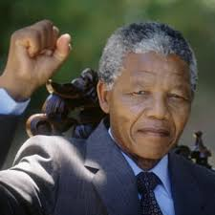
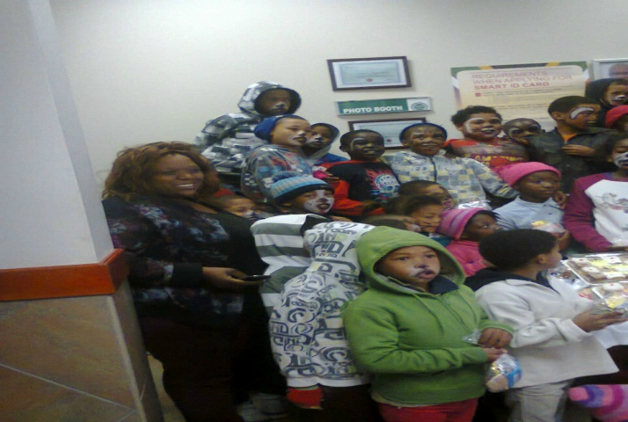
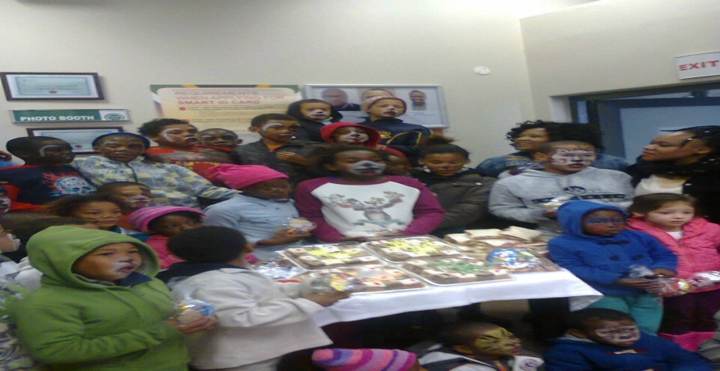
Wellness Programmes concluded Q 1: 2015/2016
Wellness Activity | Programme | Targeted group
Men's Health | * HIV, TB and chronic disease management | 123 males attended
Candlelight Ceremony | * Beaufort West in commemoration of people affected by HIV | 21 employees from various offices
Women's Outreach Programme | * Awareness on birth registration, * Not getting involved in marriages of convenience to communities in Plettenberg bay area | 35 Community members and 10 employees from surrounding offices attended
Women's Day Event & Celebration | * Women empowerment | 185 Employees
Madiba day Projects were conducted at all offices within Districts.

Slide 36
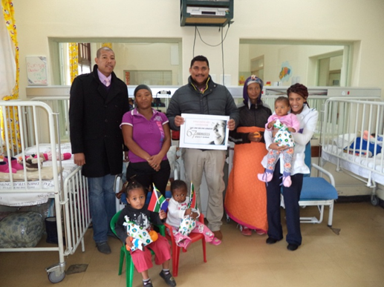
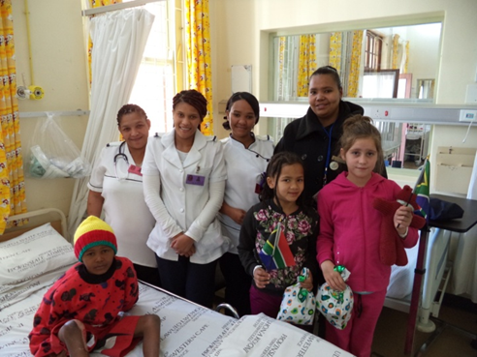
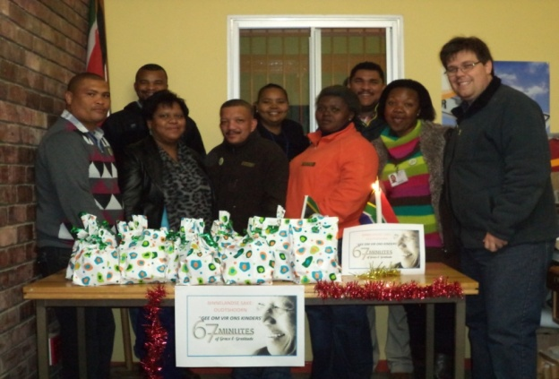
Wellness Programmes concluded Q 1: 2015/2016
Madiba day Projects were conducted at all offices within Districts.

Slide 37
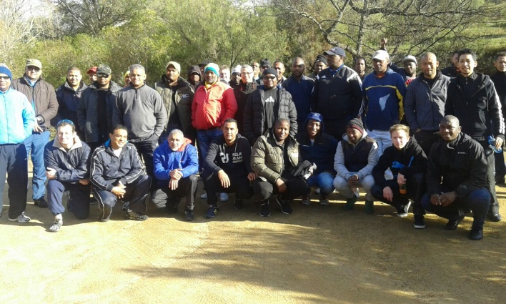
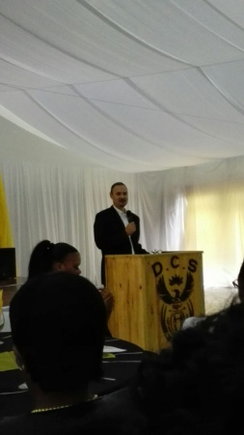
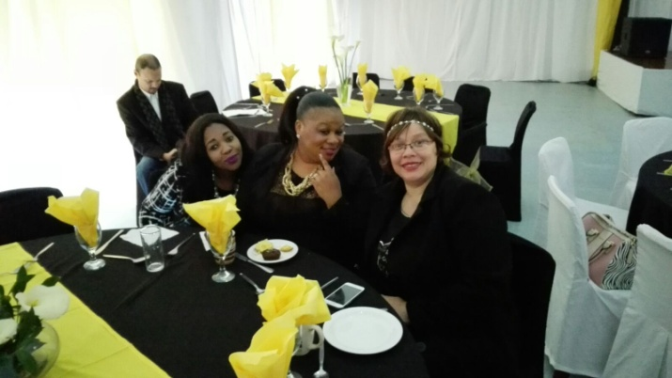
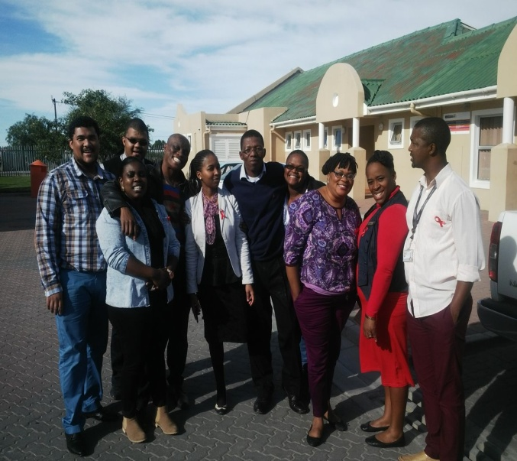
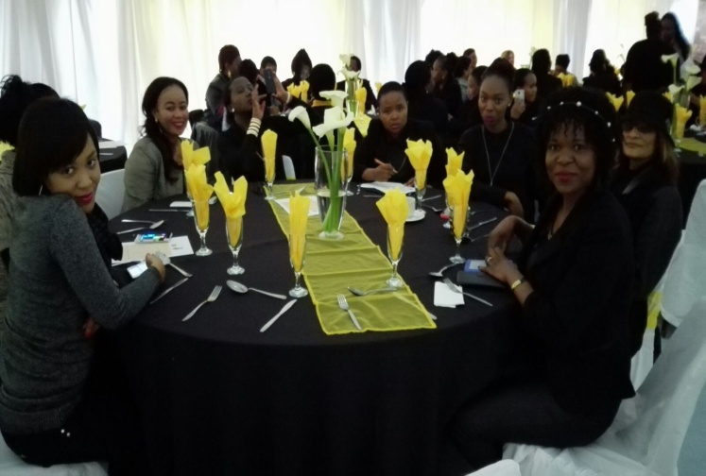
Wellness Programmes: Q 1
Mens Health Programme
Womensday Celebration & Empowerment Programme
Candlelight Ceremony Beaufort West
Womensday: Voorberg Prison

Slide 38
Eradication of Corruption & Vetting

Slide 39
WC INVESTIGATION OVERVIEW Q1 2015/16

Slide 40
COMMENTS: Q1-2015/16
Investigation target for 2015/16 is to finalize 62% of all cases received within 90 days.
DD: Investigation also assisted at Head Office with investigations not relevant to W/Cape.
Q1 = Unit finalized 9 out of 12 (2015/2016 FY) cases (75%)
11 out of 12 (2014/2015 FY) cases referred to D/Management pending finalization

Slide 41
INVESTIGATIONS / DISTRICT Q1 2015/16

Slide 42
Vetting Unit:
Progress : Vetting- Quarter 1 2014/2015 performance:
Target | Actual Performance Q1 | Comments
24 Clearance reports submitted to Sate Security Agency | Secret = 6 Confidential = 18 TOTAL: 24 | Target achieved
Current status on clearances issued:
Clearances | Total
Confidential clearances | 201
Secret Clearances | *78
Top Secret | 7
Total valid clearances | 286
Clearances in process | 243
No clearances | 193
Note:
* Inclusive of CTIA staff

Slide 43
Resources & Budget

Slide 44
SUMMARY OF BUDGET 2015/2016 1st Quarter
Classification | Voted R’ 000 | Expenditure on BAS as at 30 June 2015 R’ 000 | Commitments pending R’000 | % Spend as at end June 2015 | Projected expenditure R’ 000
Comp of Employees | 159,642 | 39,745 | 0 | 25% | 119,897
Goods & services | 13,647 | 1,896 | 2,035 | 14% | 9,716
Transfer & Subsidies | 224 | 496 | 0 | (222%) | (272)
Machinery & Equipment | 0 | 0 | 0 | 0 | 0
Total | 173,513 | 42,137 | 2,035 | 24% | 129,342
Funding pressures:
Payment of 2014/2015 Accrual (R 1m) : BAS R 685 000 (copy machines, monitoring etc.), LOGIS: R 342K (orders closed 14/15 FY to release funding).
G-Fleet – funding available to pay for another 4-5 months
Traveling line items – Accrual listing 2014/2015 and unfunded mandates i.e. HR Cadre employees, Peer educators, Chairpersons for disciplinary hearings etc.)
Estimated short fall of R7m foreseen

Slide 45
REVENUE MANAGEMENT:
Bank exception reduced from
R 3,3m in June 2015
R1,6m in July 2015
R 271 500 August 2015
Actions to address exceptions and audit queries:
Meeting with Fidelity to strengthen working relationship and improve contact management
Revenue collected per District Q 1
District: | Value
Cape Metro | 12,161,289.00
West Coast | 2,187,380.00
Cape Winelands | 3,427,795.00
Overberg | 744,095.00
Central Karoo | 104,255.00
Eden | 1,769,990.00
GRAND TOTAL | 20,394,804.00

Slide 46
Asset Management & SCM Functions:
Nr of Assets on Province FAR | Additional Assets not on Register | Leased assets | F/L Assets | Not verified
15,357 | 171 | 3 | 1028 | 199
Audit concluded at Cape Town International Airport:
Findings:
Discrepancies in serial numbers
Discrepancies in descriptions

Slide 47
Payment of invoices progress compliance to regulatory framework:
Key activity | Target | Actual Performance | Reasons for delayed payments
Payment of invoices within 30 days | 100% paid within 30 days | April: 94% | Receipt date of invoice erroneously captured, Wrong allocation used at SCM
 |  | May: 100%
 |  | June: 93,92% | Receipt date of invoices captured erroneously Previous payments not finalized Payments hanging in the system
 |  | July: 96% | Previous payments with queries could not be finalized
Revised strategy developed and implemented
Consequence management for erroneous capturing
Early warning process to alert SCM to invoices- Age analysis report & classifying
Disputes Register implemented for recording of such invoices – will not be captured on the system until resolved.

Slide 48
Provincial Fleet as at June 2015:
District | Sedans | Bakkies | IMS | Trucks | Total
Metro | 20 | 4 | 5 | 4 | 33
Cape Winelands | 5 | 4 | 2 | 2 | 13
West Coast | 3 | 3 | 2 | 1 | 9
Overberg | 2 | 0 | 0 | 1 | 3
Eden | 5 | 2 | 3 | 2 | 12
Central Karoo | 2 | 1 | 0 | 1 | 4
Port of Entries | 5 | 3 | 0 | 0 | 8
Refugee | 2 | 1 | 2 | 0 | 5
 | 44 | 18 | 14 | 11 | 87
G-fleet (Bedfordview) | 9
GMT (Cape Town) | 25
Departmental | 53
 | 87

Slide 49
Overview of Provincial Performance in relation to operations and Annual Performance Plan

Slide 50
Status of Refugee Offices: Cape Town as at end of June 2015
Capacity information:
Filled | 44
Vacant | 0
Summary per level
Level 13 | Level 10 | Level 8 | Level 6
1 | 3 | 20 | 20

Slide 51
5. Status of Refugee Offices: Cape Town as at end of June 2015
Statistical data:
RSDO BACKLOGS: BREAKDOWN
Total case files in RRC | Pending files to be adjudicated by RSDO
205 131 | 71 833
11 x RSDO's focused on full time adjudication @ 7 cases each per day (envisaged closure date 2017 – but due to delayed turn up for scheduled interviews the period might be prolonged)
7 x RRO extending asylum seeker permits for clients awaiting RAB and SCRA results
4 Staff dealing with Travel Documents and ID applications based in Belleville Office because of space limitations at RRC.

Slide 52
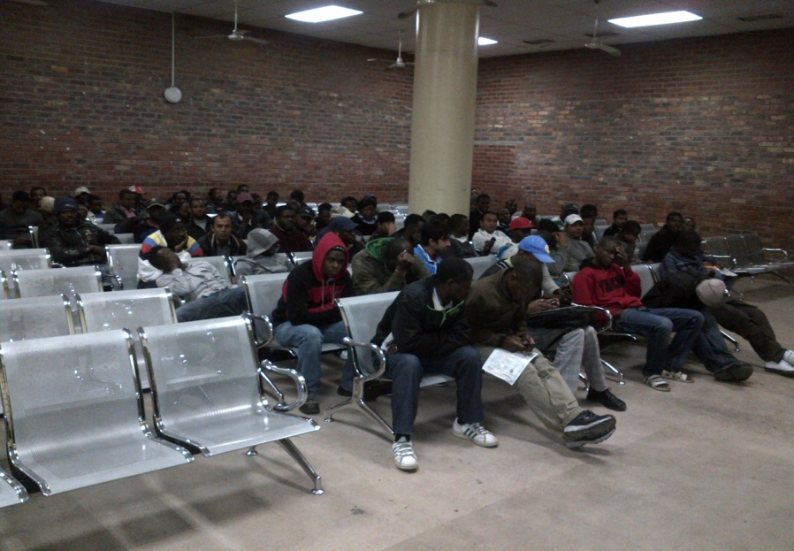
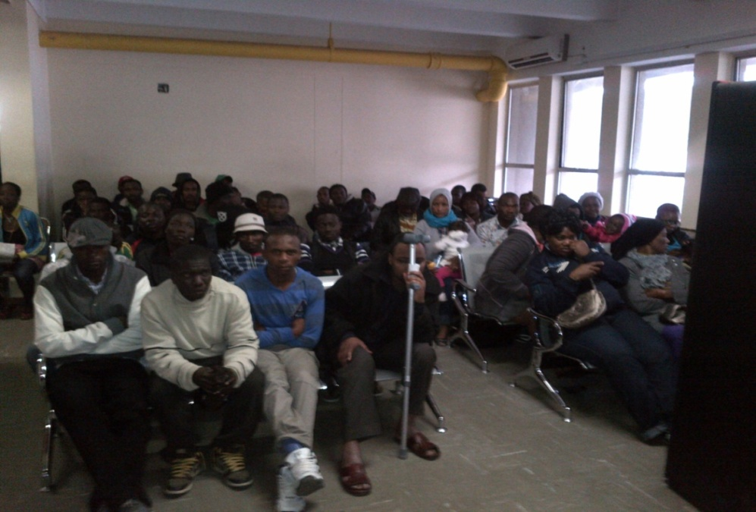
Temporary Refugee Office Cape Town: Waiting areas
Waiting area for extension Sec 22 Permits –
Ground Floor
Waiting area RSDO interviews and adjudication –
Mezamine Floor

Slide 53
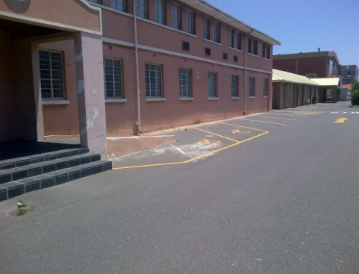
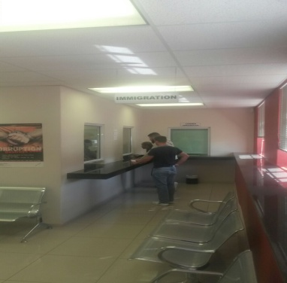
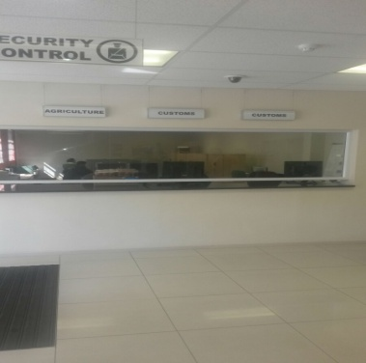
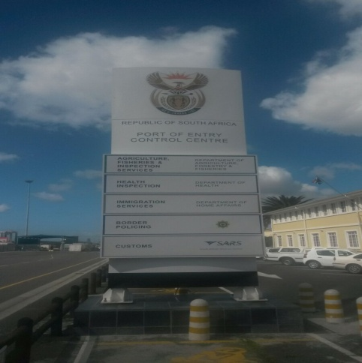
Cape Town Harbor Modernization Project: Cowrie Place
Background:
The Cape Town Harbour Office was situated on the 5th floor
of the Customs House.
The Office was situated outside of the Harbour perimeter and for operational reasons location was reviewed
Cowrie House inaugurated by former Minister of Finance, Mr. Praveen Gordon on 2 May 2014
Staff compliment was increased from 8 (2010) employees to 36 (2014)- including employee seconded to Mosselbay.
Management and leadership capability strengthened with the appointment of the Centre Manager Ms. C Hewitson and 2 x ASD for passenger admission and departure and inspectorate respectively.

Slide 54
PORTS OF ENTRY : CAPE TOWN HARBOUR 1st Quarter 2015
Cape Town Port Control Office
 | Arrivals | Departures | Grand Total
Cape Town Harbour | 7940 | 16486 | 24426
April | 1518 | 10278 | 11796
May | 2245 | 2894 | 5139
June | 1808 | 1792 | 3600
July | 2369 | 1522 | 3891
Grand Total | 7940 | 16486 | 24426
Saldahna bay and Mosselbay – crew changes, data captured under Cape Town Port Control Office

Slide 55
2014/2015 1st Quarter APP Targets
and Outreach Programmes

Slide 56
APP Performance 2014/2015 reporting cycle:
During Q 1 - WC Province achieved 3 out of 5 targets (60%) of its APP targets for 2014/2015
DHA Annual Target | APP Target 2015/16 FY | Q1 Target | Q1 Actual Achievement | % Achieve | Factors impacting on Provincial ability to achieve | Revised strategy going forward
Birth Registration within 30 Days | 85776 | 20833 | 19907 | 96% | Connectivity challenges at health facilities as noted in previous slide Children born over weekends- mothers do not return to register births Accommodation withdrawal | Investigate reliable network options i.e. 3G, WiFi Refocus and expand on Optimization Strategy Discontinue the intake of applications at offices within a 5km radius from an office Continuous advocacy and engagement with stakeholders

Slide 57
APP Performance 2014/2015 reporting cycle continued:
DHA Annual Target | APP Target 2015/16 FY | Q1 Target | Q1 Actual Achievement | % Achieve | Factors impacting on Provincial ability to achieve | Revised strategy going forward
Smart ID Cards Issued | 235200 | 42506 | 58463 | 138% | Staff capacity improved with training and strict adherence to SOPs
High Impact Outreach Campaigns | 1 | 0 | 0 | 0% | (Programmes scheduled for October 2015)
Transgressors charged | 800 | 199 | 387 | 138% | Improved performance as a result of Operation Fiela.
Direct Deportation within 30 Days | 100% | 100% | 21/21 | 100%
Fraudulent Marriages | 100% | 100% | 1/1 | 100%

Slide 58
APP Performance 2014/2015 reporting cycle continued:
DHA Annual Target | APP Target 2015/16 FY | Q1 Target | Q1 Actual Achievement | % Achieve | Factors impacting on Provincial ability to achieve | Revised strategy going forward
Fraudulent Marriages | 100% | 100% | 1/1 | 100%
Employers Charged | 45 | 14 | 10 | 71% | Letters of good cause investigation results in shifting of focus from normal operations Deployment of officials to Operations Fiela resulted in insufficient capacity to survey local businesses | Enhance business surveys approach through improved stakeholder engagements
Transfers to Lindela within 20 days | 100% | 100% | 138/138 | 100%

Slide 59
APP Performance 2014/2015 reporting cycle continued:
DHA Annual Target | APP Target 2015/16 FY | Q1 Target | Q1 Actual Achievement | % Achieve | Factors impacting on Provincial ability to achieve | Revised strategy going forward
Payment of invoices within 30 days | 100% | 100% | 170/181 | 94% | Incorrect capturing of invoice received dates on BAS. Capacity (segregation of duties) not aligned to the volume of invoices received | Consequence management. Officials capturing invoice received dates incorrectly on BAS to be disciplined Feasibility Study on capacity and segregation of duties

Slide 60
Provincial Smart Card and Birth Registration monitoring teams established and weekly progress reports discussed at weekly EXCOs
Number of smart ID cards issued to citizens 16 years and above | BASELINE for APP Target 2014/15 FY | APP Target 2015/16 FY | Q1 TAGERT | Q1 (Actual) | Actual % Achieve
Cape Metro | 107994 | 144960 | 24946 | 34154 | 137%
Cape Winelands | 17535 | 40320 | 7280 | 9759 | 134%
West Coast | 15343 | 16800 | 3920 | 3871 | 99%
Overberg | 3515 | 4320 | 800 | 1085 | 136%
Eden | 20944 | 24000 | 4760 | 7802 | 164%
Central Karoo | 445 | 4800 | 800 | 1792 | 224%
TOTAL | 165776 | 235200 | 42506 | 58463 | 138%
Challenges:
Passport applications not taken into account with FLO performance monitoring
System down time impacting on office performance – Challenge with SITA in process of being resolved

Slide 61
Birth Registration Monitoring team and hospital optimisation:
births registered within 30 calendar days of the birth event | Annual Target 2015/16 | Target Q1 | Actual Performance Q1 | Variance | Quarter 1 % Year to date
Cape Metro | 57000 | 13,639 | 13,091 | -548 | 96%
Cape Winelands | 12125 | 3,031 | 2,735 | -296 | 90%
West Coast | 3376 | 844 | 789 | -55 | 93%
Overberg | 3475 | 869 | 740 | -129 | 85%
Eden | 8500 | 2,125 | 2,311 | 186 | 109%
Central Karoo | 1300 | 325 | 241 | -84 | 74%
TOTAL | 85776 | 20,833 | 19,907 | -926 | 96%
* Optimization strategy developed and implemented

Slide 62
Provincial Specific Project:

Slide 63
Query Management:
Query Management system developed and functional
Clients must provide the Office complaint reference number
Query turn around times for resolution – 3 days at Office level
Dedicated Counters for Query Management
2 day resolution turn around time at DMO level
Escalated to Provincial Complaints Office for intervention. Queries analysed to identify root causes.
Created an dedicated email for queries (westcoast.enqueries@dha.gov.za, capewinelands.enqueries@dha.gov.za, capemetro.enqueries@dha.gov.za, overberg.enqueries@dha.gov.za, eden.enqueries@dha.gov.za, centralkaroo.enqueries@dha.gov.za.
Clients have a dedicated desk in PM’s Office dealing with enquiries

Slide 64
Query Management extract from WC Query Management Register :
NO | DATE | Description of compliant | Details of complainant | Method used to complain? i.e. tel, sms, complaints line. | Referred by: Ministry, official (name) | Contact number of complainant | Unit: Civics/IMS/Refugees | Document applied for | ID Number | Office of application | Date of application | Action | reply from head office
1 | 21.07.2015 | unabridged and vault copty of m/c | Claire Elizabeth Goode | Mr Simons cellphone | Mr Simons | claireshoutbay@gmail.com / 0833850915 | civic | client applied in April 2015 for vault and unabridged marriage certificate | 7302250190082 | Wynberg | 24-Apr-15 | 21/07 - emailed marriage , 22/7- emailed client requesting ID number of husband | 22/7- delford email requesting ID number of husband
2 | 21.07.2015 | urgent child passport | Millie Jane Blyth | Mr Simons Email | Mr Simons | emma@vanilaevents.co.za | civic | client is traveling on the 23.07.2015 amd applied for passport on the 12.07.2015 | 1002150918089 | Wynberg | 16.07.2015 | 22/07- emailed passport section to assist
3 | 22.07.2015 | passport application | R Scroeder | Mr Simons Email | Mr Simons |  | civic | passport | 7207210148080 | Cape Town | 15.07.2015 | emailed riana
4 | 22.07.2015 | passport application | F Saiet | Mr Simons Email | Mr Simons |  | civic | passport | 6505075783086 | Cape Town | 16.07.2015 | emailed riana
5 | 09.04.2015 | unabridge bc | B Vye | Public Protector | Public Protector | Luckyp@pprotect.org | civic | client applied in Jan 2014 but did not receive her ubc | ? | Cape Town | Jan-14 | emailed lucky to send me ID
6 | 23.04.2015 | spousal permit | BG Antonio | Public Protector | Public Protector | Luckyp@pprotect.org | permitting | spousal permit | CPT16003/11/TRP | Cape Town | 25.06.2014 | emailed lucky to inform that the permit was reslved | resolved

Slide 65
9. Telephone Monitoring Project :
After complaints were received w.r.t unanswered telephones the Province developed a telephone management and telephone answering protocol
A standard way for answering of phones were developed and circulated to all offices for implementation
A telephone monitoring team was established and phone offices randomly daily to measure compliance – Monitoring Tool developed * extract attached
Reports discussion at weekly Provincial Executive meetings for feedback and corrective action
Web site details for WC updated with alternative contact details for every office as well as the contact details of the office manager.

Slide 66
9. Telephone Monitoring Project example of monitoring tool:
OFFICE | TELEPHONE NUMBER (as indicated on DHA website) | DATE: MORNING AND AFTERNOON | DATE: MORNING AND AFTERNOON | DATE: MORNING AND AFTERNOON
Bellville | (021) 944 - 6200 | engaged | Answered | answered
 | (021) 944 - 6240 | answered, Home Affairs Good day | No answer | engaged tone
 | EXT. 6250 |  | No answer | engaged tone
Mitchells Plain | (021) 370 - 3102 | Answered | Answered | No answer
 | (021) 370 -3104 | Answered | Answered | Answered
 | (021) 370 -3109 | Answered | No answer | Answered
 | Ext. 3105 |  | No answer | No answer
 | Ext. 3106 |  | Answered | Answered
Nyanga | (021) 380 - 5140 | Answered, Home Affairs Good day | Answered | Answered
 | Ext. 5137 |  | Answered | Engaged tone
Extract from Telephone monitoring tool
Discussed at monthly EXCOs and progress noted

Slide 67
10. Provincial Action Plan for implementation and monitoring Moetapele
Leadership responsibility to ensure buy in at the lowest level
Action | Method | Desired outcome
Instill the concept of Moetapele at the lowest level | Workshop to: Identify the characteristics of each occupational level in relation to the job profile and responsibilities attached to the post (2) Agree on set standards/ criteria for Moetapele Offices in terms of cosmetic, front office processes, administration and leadership functionality. | Buy in at all levels through inclusive participation
Establish Moetapele Monitoring Forums (MMF) | Establish Local Office, District and Provincial Monitoring Forums through nomination. Developed a Constitution/ Terms of Reference for the formulation and operation of the MMF. Issue appointment letters to the Moetapele Teams members to ensure accountability. Design a measurement process and M&E tools on agreed standards/criteria (weighted) | Full implementation, accountability and management reports on a share drive Sharing of best practices- value creation Identification of cross cutting service delivery issues

Slide 68
Leadership responsibility to ensure buy in at the lowest level continued
Action | Method | Desired outcome
Establish Moetapele Monitoring Forums (MMF)- continued | (5) Design a practical report format / * score card for each office evaluated/ visited. (6) Develop a programme of action and present to executive for approval, funding and roll out | Gap analysis and mitigation strategies implemented Skills transfer
Recognition and award | Best performing offices per District promoted in Ikhaya Magazine (2) Accolades to outstanding employees during Provincial Executive monthly meetings (3) Recognition of Employee of the Month – “Moetapele Wall of Fame” in local front offices | Best performing offices and employees recognized
Office Score Card content:
Operations
Facility Management
Basic administration (Leave & Asset Management)
Customer care

Slide 69
M&E Methodology and governance :
By whom | Method | Governance
Provincial MMF | Physical inspection, Interviews, Observations, Analysis of data from system reports | Monthly MMF reports to Provincial EXCO District Managers to mitigate issues raised Provincial Manager to table unresolved matters at Branch Meeting/ OPSCO

Slide 70
Action Plan for implementation at local office level:
Focus areas | Method | Responsibility
Improve client experience through | Front Office Toolkit implemented and maintained | Office Manager
 | To enhance client experience through improved client contact principles: “Service with a Smile” concept (official to greet & introduce themselves) Look presentable (Inputs made for uniforms) Confirm which service client want to access. Explains services details (turnaround times, requirements, etc.) Confirm which service client want to access. Explains services details (turnaround times, requirements, etc.) | Line Managers and Front Office Staff
 | Client required to complete customer survey before leaving the office Rate office through whats-app (Office Managers Official Phone) Phone back clients the following day to make enquiry about experience and rate service levels | Office Manager and Moetapele Champion nominated for the Office

Slide 71
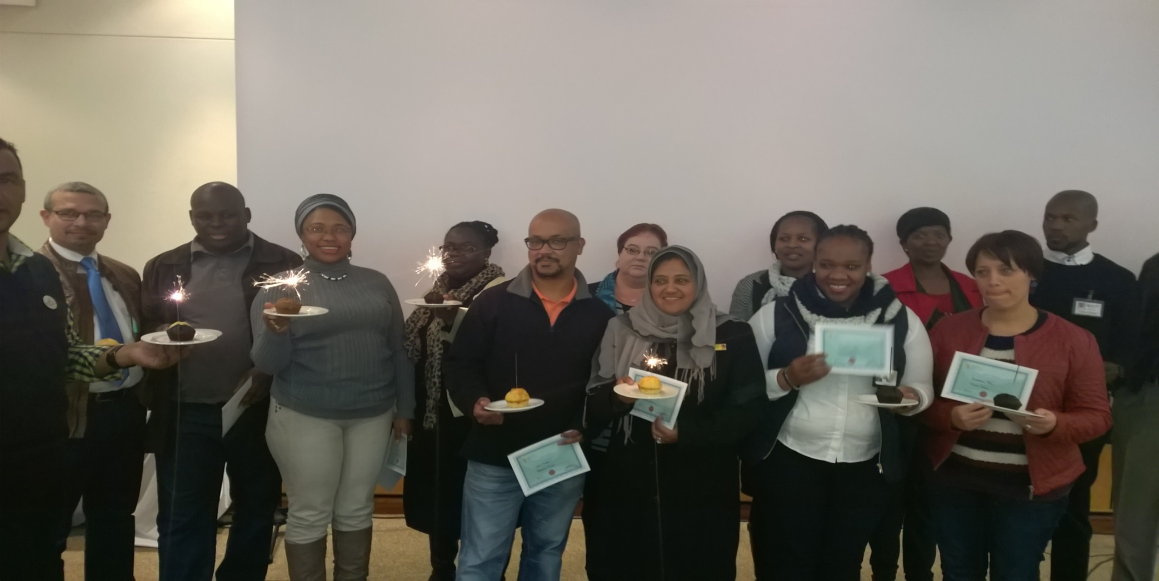
Acknowledging Employees during
Management Meetings

Slide 72
Purpose of the outreach programmes: Cape Metro (Witsand, Atlantis Llwandle – February 2015)
11. LRB OUTREACH PROGRAMMES IN FARMING COMMUNITIES:
Mop up for Late Registration of Birth in rural inaccessible areas
To bring services closer to communities
To promote Birth Registration within 30 days from Birth
To encourage all pupils to apply for Identity Documents when turning 16 years of age
To educate communities about DHA services
To encourage citizen to verify their status online
ID distribution (house to house)
To ensure stakeholder participation and bring services and information closer to communities

Slide 73
Programmes conducted: Cape Metro (Witsand, Atlantis Llwandle – February 2015)
11. LRB OUTREACH PROGRAMMES IN FARMING COMMUNITIES:
Method of service delivery:
Community members of the identified areas were transported to the Lwandle Sports field – Macassar, Monkey Town, Sir Lowry’s Pass, Nomzamo
Local Government transported 87 persons to Khayelitsha Office to apply for ID Smart Cards
Stakeholders participation:
SASSA, Agriculture, Department of Human Settlements, Community Safety

Slide 74
STATISTICS ON APPLICATIONS TAKEN IN:
Date | Ist ID 15 years |  | Ist ID 16 years |  | Ist ID 17 and above |  | Re ID | LRB 15 years |  | LRB 16 years |  | LRB 17 and above |  | BI-24 (30days) |  | BI-24 (30days to 1 year) |  | BI-24 (1 to 14 years) |  | DHA-1688 | BMD cert | Amend | Rec | TIC | PPT | Id col | F/P | Enq | KM | Revenue | Venue
Gender | M | F | M | F | M | F |  | M | F | M | F | M | F | M | F | M | F | M | F
2015.02.23 |  |  |  |  | 3 | 3 | 7 |  |  |  |  |  | 1 |  |  |  | 1 |  |  | 1 | 4 | 1 |  | 1 |  |  | 7 |  | 137 | 1,180.00 | WITSAND (OUTREACH)
2015.02.24 |  |  |  |  | 4 | 6 | 5 |  |  |  |  | 1 | 1 |  |  | 3 | 3 |  |  |  | 5 | 1 |  | 1 |  |  | 12 |  | 137 | 850.00 | LWANDLE (OUTREACH)
2015.02.25 |  |  |  |  | 13 | 13 | 6 |  |  |  |  | 5 | 5 |  |  | 10 | 15 |  |  | 10 | 17 |  |  | 2 |  |  | 36 |  | 214 | 1,280.00 | LWANDLE (OUTREACH)
2015.02.26 |  |  |  |  | 24 | 27 | 2 |  |  |  |  | 5 | 5 |  |  | 5 | 6 |  |  |  | 12 | 2 |  | 1 |  |  | 61 |  | 136 | 730.00 | LWANDLE (OUTREACH)
2015.02.27 |  |  |  |  | 10 | 18 | 4 |  |  |  |  | 1 | 2 | 1 | 1 |  |  |  |  |  | 9 | 1 | 1 | 9 |  |  | 30 |  | 137 | 1,540.00 | ATLANTIS ( OUTREACH)
TOTAL |  |  |  |  | 54 | 67 | 24 |  |  |  |  | 12 | 14 | 1 | 1 | 18 | 25 |  |  | 11 | 47 | 5 | 1 | 14 |  |  | 146 |  | 761 | 5,580.00

Slide 75
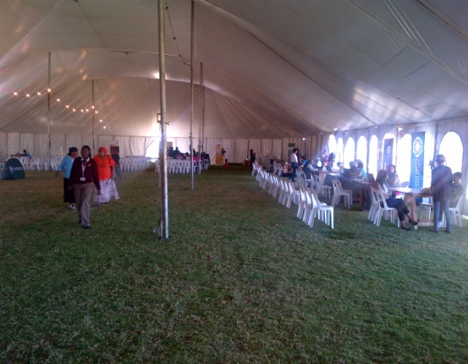
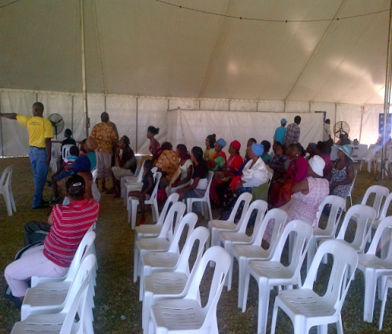
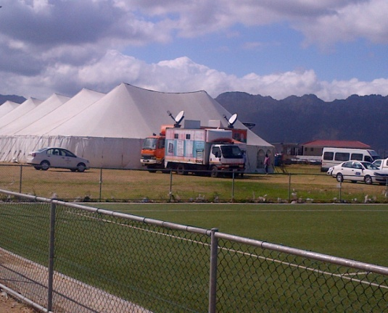
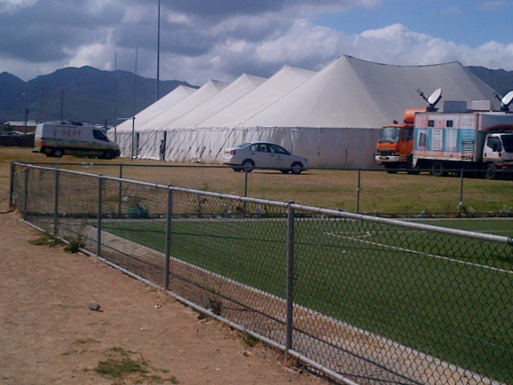
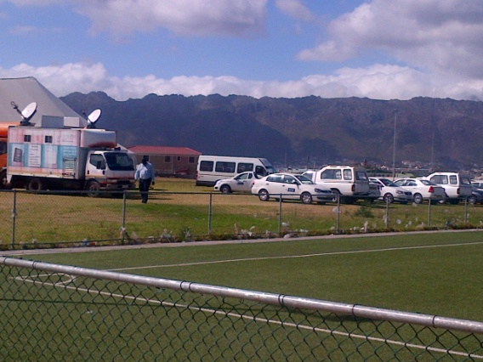
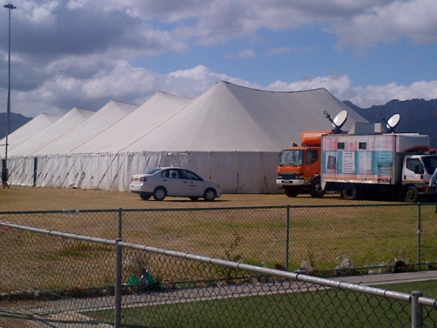
Witsand, Llwandle, Atlantis Outreach Programme

Slide 76
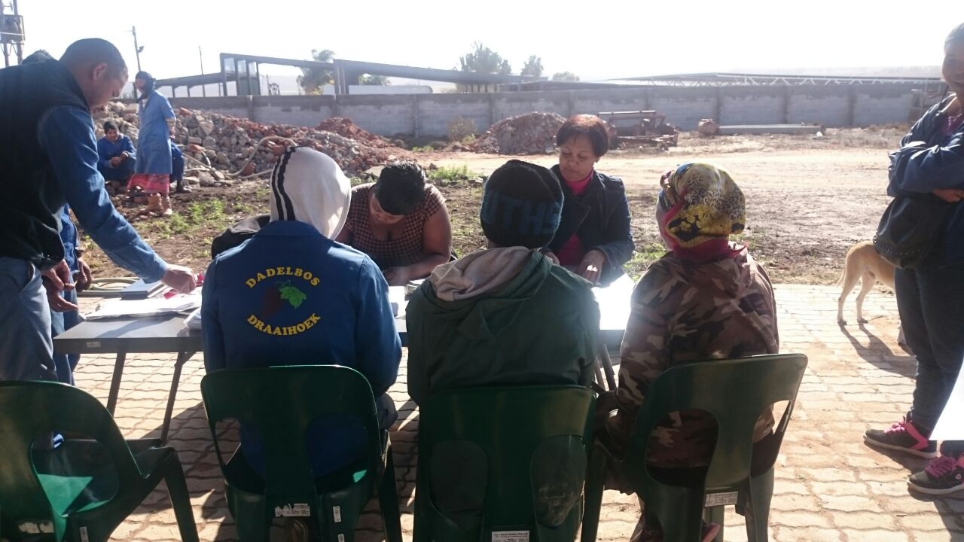
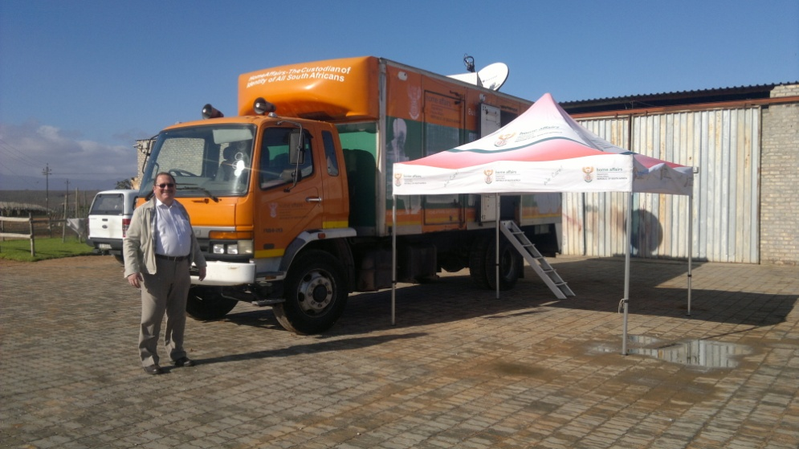
LRB outreach by DHA Youth development Forum members in Vredendal area
DATE | TARGETED AREA | VENUE | SERVICES DELIVERRED | STATISTICS
04.06.2015 | Vredendal | Dadelbos Farm | Processing of Application LRB, BMD, Amendments and ID Applications | 25 ID applications taken in 7 LRB applications 7 Birth registration 25 IDs distributed to their rightful owners
05.06.2015 | Vredendal | Dadelbos Farm | ID Distribution
 |  | Clanwilliam
 |  | Lambertsbay
05.06.2015 | Vredendal | Vredendal Town | Immigration inloco inspections on farms
 |  | Clanwilliams
 |  | Klawer

Slide 77
11. LRB outreach Programmes going forward: October 2015
Plan of Action Developed and Outreach Task Team mandated to start mobilizing communities and stakeholders.
District Municipality | Office | Town or Farming Area
Cape Metro | Somerset West | Strand (Lwandle, Nomzamo), Macassar and Sir Lowry’s Pass
 | Atlantis | Witsand and Atlantis
 | Mitchells Plain | Tafelsig, Heinz Park and Philippi
 | Nyanga | Barcelona, Sweet Home(farming area), Thabo Mbeki (Philippi)
 | Wynberg | Lavender Hill, Lotus River , Masiphumelele, Ocean View
 | Cape Town | Du Noon, Langa(Joe Slovo)
 | Khayelitsha | Site c, Site B(BM section), Ndlovini and Harare
 | Bellville | Walacedene, Mfuleni, Delft, Fisante kraal, Bishop Lavis, Belhar, Elsiesriver and Bonteheuwel, Kraaifontein
Cape Winelands | WORCESTER, CERES AND ROBERTSON | WITZENBERG( TULBAGH, DE DOORNS AND WOLSELEY) AND LANGEBERG (ASHTON AND MAGGAG)
 | STELLENBOSCH AND PAARL | FRANSCHHOEK AND KLAPMUTS
West Coast | Malmesbury | CEDERBERG (HEXRIVIER and PALEISHEUWEL)
 | Malmesbury | Saldanha Bay (Diazville,Witteklip)
 | Malmesbury | Bergrivier (Piketberg, Redelinghuys, Velddrif )
 | Malmesbury | Swartland (Moorreesburg) and Matzikama LM
Eden | Oudtshoorn | De Rust and Dysselsdorp
 |  | Klipdrif farming areas and Zebra farming area
 | Kannaland | Ladismith, Zoar,
 | George | Uniondale, Haarlem, Avontuur and Noll
 |  | Heroldsbay, Waboomskraal and Hoekwill
 | Plettenbergbay and George | Bitou, Riversdale and Hessequa Farming Areas
 | Mosselbay | Grootbrak, Freemensheim, Herbertsdale, Sunshine valley, Brandwag
 | Knysna | Karatara, Rheenendal, Sedgefield, Hornlee and Damsebos

Slide 78
11. LRB Programmes going forward:
District Municipality | Office | Town or Farming Area
Central Karoo | Beaufort West | Murraysburg
 | Laingsburg | Matjiesfontein
 | Prince Albert | Leeu Gamka and Klaarstroom
Overberg | Cape Agulhas | Struisbaai
 | Grabouw | Villiersdorp
 |  | Riviersonderend
 |  | Genadendal
 | Swellendam | Swellendam Farming Area and Barrydale Farming Area
 | Caledon | Hermanus, Kleinmond, Hawston

Slide 79
12. Public Service Month – Programme of Action
ACTIVITY | SUB-ACTIVITY | OBJECTIVES
Information sharing sessions | Informing public about DHA services at: 1.Local taxi ranks 2. Old age homes 3. Local prenatal clinics "MOM Connect" 4. Department of Health vaccination days 5. SASSA grant pay points 6. Visit Malls (handout pamphlets on Saturdays) | To inform the general public about DHA services and campaigns
Birth Registration - Optimazation of Birth Registration at Health Facilities | 1.Visiting MOU and Hospitals to encourage mothers to register their babies within 30 days 2.intensifying birth registration at high volume birth rate hospitals by deploying staff on a daily basis in September | To encourage mother to register their babies within 30 days
LRB Campaign |  | To inform the general public about the LRB Mop up campaign ending in December 2015 (October venues - National intervention)
High Schools | Visit high schools to invite learners to apply for ID Smart Cards | To invite learners to apply for ID Smart Card
ID distribution | Distribute all uncollected ID books | To distribute all uncollected ID books(7479): Cape Metro = 3243 Eden and Central Karoo = 910 West Coast = 757 Overberg = 940 Cape Winelands = 1629
Farming areas | Visit farms to inform citizens about the LRB Outreach Program in October 2014 | To bring DHA services closer to far laying areas

Slide 80
12. Public Service Week – Programme of Action
ACTIVITY | SUB-ACTIVITY | OBJECTIVES
Deployment of SMS members to front line offices | SMS members to deployed to the frontline offices/hospitals | To lead services delivery initiatives within their service areas(non performing ID Smart Card offices) To publicize DHA services via local radio stations To strengthen relations with Department of Health by having one on one meetings with Hospital CEO's where there are DHA offices To distribute ID books door to door Cold face deployment 2-3 days
Voluntary opening of one office on a Saturday in the Province | Open office between 08h30 - 12h30 | To offer all DHA services to clients
One outreach program per Province | Conduct one outreach program focusing on a very neglected area | To offer all DHA services to clients

Slide 81
Thank you

