Slide 1
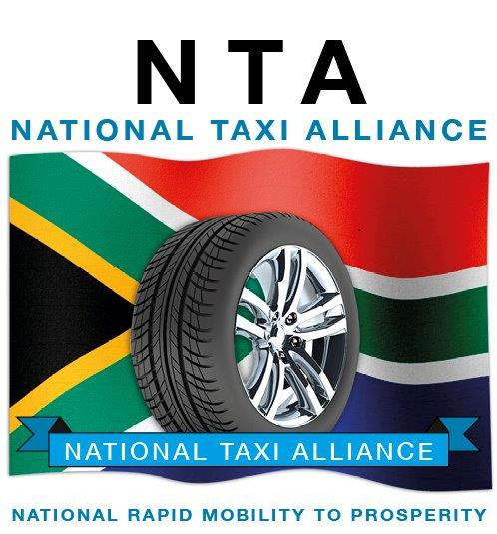
Presentation by
National Taxi Alliance
To
Parliamentary Portfolio Committee on Transport
4 August 2015

Slide 2
THE MINIBUS-TAXI
IN
INTEGRATED PUBLIC TRANSPORT NETWORKS

Slide 3
Introduction (1)
The National Taxi Alliance (NTA) fully supports the principle of Integrated Public Transport Networks (IPTNs).
However, the reality of the present situation must be accepted.
The taxi will be with us for many years to come.

Slide 4
Introduction (2)
Changes to the present situation can both :
greatly improve conditions for both operators and commuters, and
prepare the way for taxi participation in IPTNs.

Slide 5
Overview
This presentation will concentrate on :
The Reality (of the present situation)
The Regulatory System
The National Public Transport Regulator
Modal Integration
NATIONAL TAXI ALLIANCE

Slide 6
The Reality (1)
The taxi in its present form will be with us for many years to come.
The spatial distortions created by Apartheid still exist.
Low-income earners must still travel long distances from the townships to their places of work; the taxi has for many decades provided the transport for these commuters.
NATIONAL TAXI ALLIANCE

Slide 7
The Reality (2)
The implementation of IPTNs has been very slow.
Questions are now being asked about the viability of networks based on Bus Rapid Transit (BRT).
Whilst the implications are being assessed, the taxi will continue to provide the bulk of public transport in our cities.
NATIONAL TAXI ALLIANCE

Slide 8
The Reality (3)
Violence in the taxi industry is increasing.
It must stop, in the interests of the operators, the commuters, government, and the community as a whole.
The problem has become so widespread that it justifies the establishment of a Judicial Commission of Inquiry into Taxi Violence.
NATIONAL TAXI ALLIANCE

Slide 9
The Regulatory System (1)
The NTA believes that the root causes of violence lie in the regulatory system, both :
the legislation – the National Land Transport Act 2009 (NLTA); and
the administration – the Provincial Regulatory Entities (PREs).
NATIONAL TAXI ALLIANCE

Slide 10
The Regulatory System (2)
The core of the problem is that municipalities act as both referee and player :
They are responsible under the NLTA for planning public transport.
They are also, effectively, the entity which decides who should be allowed to operate, and for how long.
NATIONAL TAXI ALLIANCE

Slide 11
The Regulatory System (3)
The uncertain lifespan of an Operating Licence (OL) inhibits investment in the taxi industry.
Financial institutions treat the taxi owner as a private citizen rather than the owner of a business which generates income.
OLs should be issued for an indefinite period.
NATIONAL TAXI ALLIANCE

Slide 12
The Regulatory System (4)
The National Land Transport Transition Act 2000 (NLTTA) recognised the role of taxi associations and provided for them to be part of the regulatory system.
These provisions were dropped from the NLTA 2009.
This has resulted in confusion about the legal position, and is the main reason for disputes over routes.
NATIONAL TAXI ALLIANCE

Slide 13
The Regulatory System (5)
The situation is made worse by the facts that :
the e-Natis and the OLAS systems do not talk to one another in a properly coordinated way; and that
both systems are regularly off-line.
NATIONAL TAXI ALLIANCE

Slide 14
The Regulatory System (6)
When the NLTA Amendment Bill is published for public comment, NTA will :
submit proposals in respect of changes to the regulatory system, and
seek to make a submission to this Committee.
NATIONAL TAXI ALLIANCE

Slide 15
The National Public Transport Regulator (1)
The PREs were introduced into the NLTA 2009 to overcome the maladministration and corruption present in the former Operating Licensing Boards (OLBs).
The National Public Transport Regulator (NPTR) was introduced at the same time to provide oversight of the PREs.
NATIONAL TAXI ALLIANCE

Slide 16
The National Public Transport Regulator (2)
In the view of NTA, the PREs are if anything worse in respect of maladministration and corruption than were the OLBs.
The NPTR has the duty to :
monitor and oversee the activities of the PREs; and
receive and decide on applications delayed by PREs.
NATIONAL TAXI ALLIANCE

Slide 17
The National Public Transport Regulator (3)
NTA will approach the Minister and ask her to direct the NPTR to :
institute an inquiry into, and report on, the workings of the PREs
implement a system by which the NPTR can receive and decide on OL applications where a decision has been delayed by a PRE.
NATIONAL TAXI ALLIANCE

Slide 18
Modal Integration (1)
NTA fully supports the principle of modal integration.
We wish to see the introduction of an all-mode smartcard based on the EMV system prescribed in the Regulations issued by the Department of Transport in 2011.
This will enable the public transport user to make use of any form of service – taxi, bus, BRT, and in due course, rail.
NATIONAL TAXI ALLIANCE

Slide 19
Modal Integration (2)
The Committee should disregard proposals by sections of the taxi industry for a ‘dedicated’ farecard (non-EMV compliant) for use only on some taxis.
This type of fare-card will make no contribution to modal integration.
It is also not safe. The total taxi industry cash takings in as little as a week amount to hundreds of millions of Rands. This must not be put at risk.
NATIONAL TAXI ALLIANCE

Slide 20
Modal Integration (3)
The all-mode smartcard will enable the taxi owner to receive all the income paid by passengers.
This will in turn make possible a higher standard of operation – for example, to meet the costs of scheduled maintenance in accordance with the vehicle maker’s specification.
It will also enable the taxi to participate in the public transport subsidy system.
NATIONAL TAXI ALLIANCE

Slide 21
Modal Integration (4)
It is essential that the ‘mobility’ of the taxi be increased.
NTA proposes that rather than BRT-lanes, cities should implement Public Transport Priority (PTP) lanes.
These would be used by all public transport vehicles, including buses (not merely BRT buses) and of course, taxis.
NATIONAL TAXI ALLIANCE

Slide 22
Modal Integration (5)
PTP lanes would lower the costs of operation and improve travel times for commuters.
If in due course it appears that a particular route justifies a BRT-type operation, this can be introduced, with :
taxi owners participating as shareholders, and
guarantees against loss of income as a result of the changes.
NATIONAL TAXI ALLIANCE

Slide 23
Thank you

