Slide 1
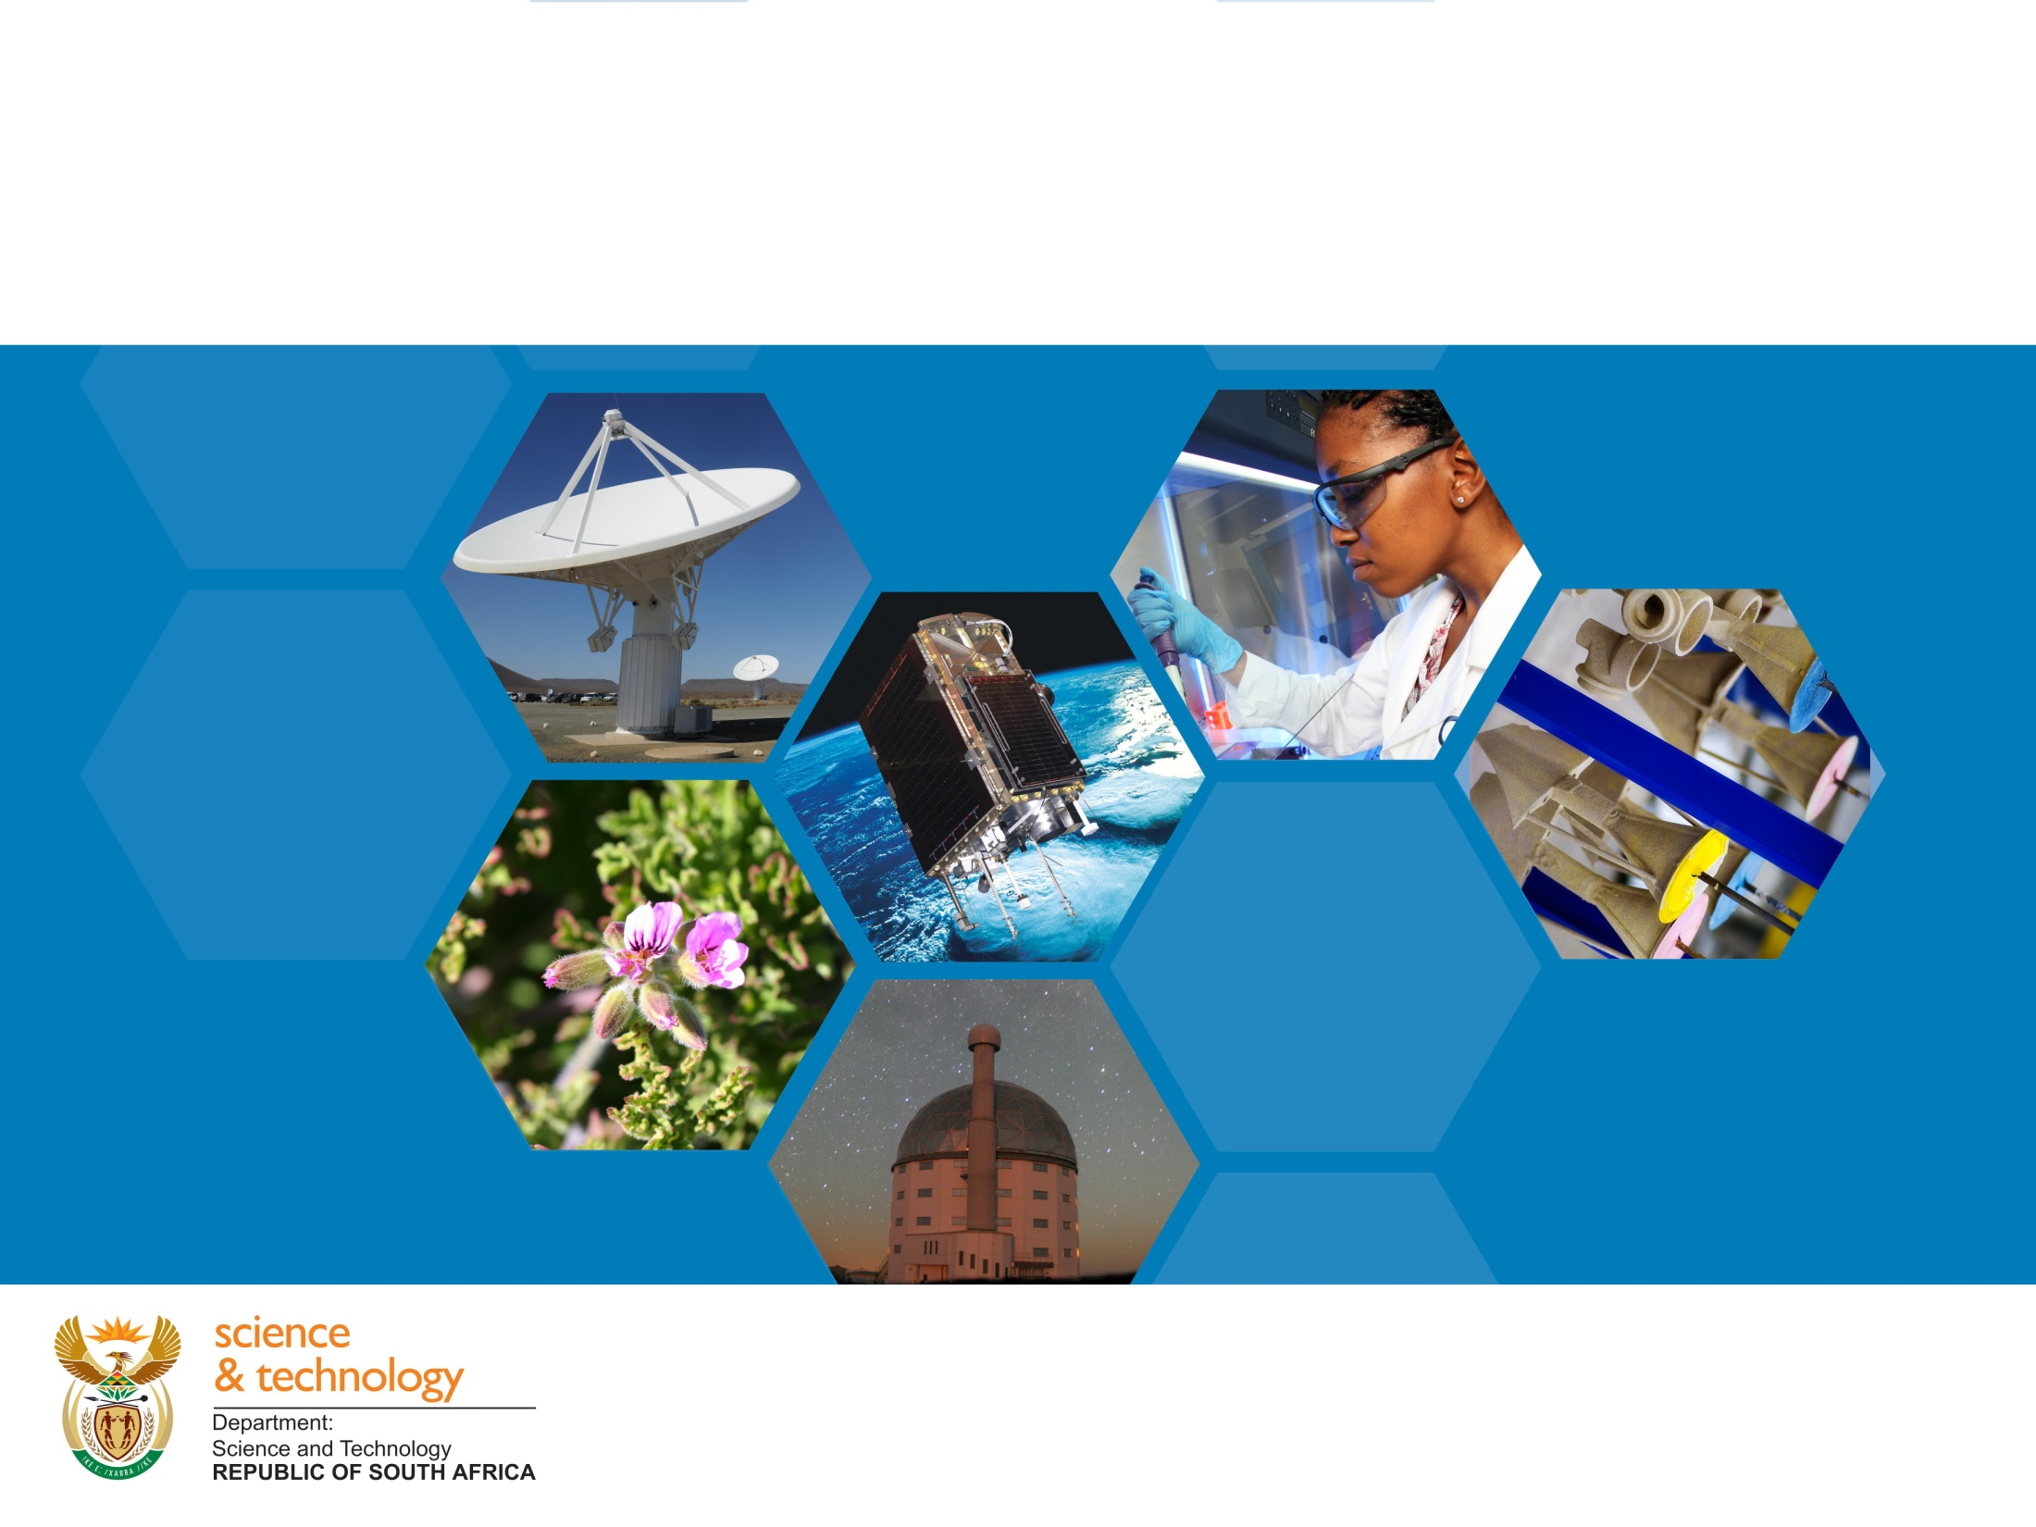
DST Strategic Plan
(2015-2020)
Presentation to the Portfolio Committee
22 April 2015 by
DG Dr Phil Mjwara

Slide 2
Outline of the Presentation
Vision, mission, values
National Development Plan (NDP and the role of Science Technology and Innovation (STI);
  STI’s contribution to eradication of inequality, poverty and unemployment;
The situational analysis
  STI’s contribution to socioeconomic development.
  Knowledge generation and exploitation.
The strategic outcome-oriented goals.
Financing.
Conclusion.
.
esentation

Slide 3
Vision and Mission
  Vision
Increased well-being and prosperity through science, technology and innovation
  Mission
To provide leadership, an enabling environment, and resources for science, technology and innovation in support of South Africa's development.

Slide 4
NDP and the role of STI (1)
The NDP acknowledges economic development is a longer-term project and that innovation should grow in importance over time.
Identifies three phases:
  The first phase (2012-2017), the focus should be on 'intensifying research and development spending, emphasising opportunities linked to existing industries‘ .

Slide 5
NDP and the role of STI cont. (2)
Second phase (2018-2023), where the country should lay the foundations for more intensive improvements in productivity' where 'innovation across state, business and social sectors should start to become pervasive‘; and
Third phase (2023-2030), the emphasis should be on consolidating the gains of the second phase, with greater emphasis on innovation, improved productivity, more intensive pursuit of a knowledge economy and better exploitation of comparative and competitive advantages in an integrated continent'

Slide 6
NDP and the role of STI (3)
In translating these NDP intentions into STI implementable actions, the following is proposed:

Slide 7
South Africa’s STI: Where to Go?
Phase One (2012-2017)
Use of knowledge for efficiency gains in the economy- Drawing on progress achieved thus far, the NSI will expand research capacity (human capital development) and institution building, build on what it has learnt about commercialising ideas from research, and continue to support existing economic sectors (such as agriculture, forestry, agroprocessing, aquaculture, manufacturing and mining) and emerging sectors (such as minerals beneficiation, greener energy (hydrogen and fuel cells), and active pharmaceutical ingredient manufacturing) through technological innovation.

Slide 8
South Africa’s STI: Where to Go?
Phase Two (2018-2023)
  Industrialisation enhanced by knowledge-the NSI will continue to accelerate the transformation of the STI sector (i.e. demographic representivity) and enhance efficiency in the economy through knowledge. The government will continue to increase R&D investment and commercialisation, and optimise the utilisation of inbound technology

Slide 9
South Africa’s STI: Where to Go?
Phase Three (2023-2030)
  knowledge-based economy-The number of knowledge workers and high-technology industries will have increased and boosted exports and increased the capacity to commercialise indigenous or local technologies. Efforts will be directed at sustaining and expanding this progress.

Slide 10
STI and triple challenge of inequality, poverty and unemployment
STI Contribution | Inequality | Poverty | Unemployment
Direct | Transformation of scientific workforces in terms of race and gender Innovations to enhance standards of living: In partnership with the Department of Basic Education, leverage innovative technologies to improve access to basic education for children with special needs, prioritising the visually and hearing impaired In partnership with the Eastern Cape Department of Education, the Department of Water and Sanitation, and the Bill & Melinda Gates Foundation, provide innovative and appropriate off-grid sanitation technologies for rural and peri-urban areas | Innovation-enabled local economic development: Pilot three community-based agro-processing plants (traditional medicines, cosmeceuticals and nutraceuticals) by 2016 Ensure that STI poverty alleviation initiatives are demand driven and informed by local economic development priorities in at least three provinces Mainstream applied indigenous knowledge-based R&D (traditional medicines, cosmeceuticals and nutraceuticals), including innovation and local manufacturing to support commercialisation models for sustainable livelihoods | Internships Researchers Postdoctoral support Economic growth: Help grow companies’ turnover Reduce technology balance of payments contribution to current account deficit Support SMEs through technology localisation and station programmes Grow local industries through the Emerging Industries Action Plan Initiatives to improve the technology-based competitiveness of the established primary economic sectors New industry development initiatives such as Hydrogen South Africa, the Fluorochemicals Expansion Initiative, the Titanium Beneficiation Initiative and the Advanced Manufacturing Technology Strategy

Slide 11
STI and triple challenge of inequality, poverty and unemployment
STI Contribution | Inequality | Poverty | Unemployment
Indirect | Targeted postgraduate bursaries (for black people and women) and funding to support young and emerging researchers. Use of technology to improve service delivery or demonstrate better living standards, such as through the use of wireless mesh networks to bridge the digital divide. | Targeted postgraduate bursaries (for black people and women) and funding to support young and emerging researchers. South African Research Chairs Initiative (SARChI), centres of excellence (CoEs) such as CoE on Food Security. Providing and packaging information to enhance policy decision making (from COE’s, SARChI). | Postgraduate bursaries, SARChI, CoE’s (agreement +/- 20% uptake of PhD graduates with institutions) Research and development infrastructure-such as MeerKAT/Square Kilometre Array (SKA) radio astronomy telescope.

Slide 12
Situational analysis

Slide 13
STI and socio-economic development
The role of STI in socio-economic development is recognised internationally.
STI are seen as:
  a source of new and sustainable growth and competitiveness and engine for addressing social challenges;
  Holding the key to job creation and enhanced productivity.

Slide 14
STI and socio-economic development (2)
Organisation for Economic Cooperation and Development (OECD) sees innovation as central in lifting economies out of the global economic crisis.
Both developed and developing countries prioritised innovation in response to the 2008 global economic downturn.
  Put stimulus packages for investment in infrastructure and extended support for research, development and innovation, human capital development, green technology and the fostering of entrepreneurship.
The NDP’s vision for 2030 takes similar approach.

Slide 15
High-level critical review - Knowledge Generation
Publications and students up as a result of Research Chairs, bursary values and COE’s.
Productive and efficient researcher community.
Lack the required critical mass for social and economic transformation → we need large-scale focused interventions.
Notes:
Still need to debate whether we combine SO2 and SO4

Slide 16
Way forward - Knowledge Generation
Deepen and scale-up implementation of successful programmes (Chairs, COE’s).
Mobilise resources for infrastructure (equipment and cyber) – includes access to international infrastructure.
Strengthen efforts to grow the next generation of researchers-especially black and women.
Implement revised strategies to build the pipeline for research and innovation.
New arrangements for scaled-up research efforts (building focused large-scale initiatives).
Notes:
Still need to debate whether we combine SO2 and SO4

Slide 17
4 dimensions of knowledge exploitation
Build New Industries
Strengthen the
competitiveness of existing industries (like mining and agriculture)
Support localisation oppor-tunities
Support priority social outcomes (education, health, rural develop-ment)
Strategic use of local procurement opportunities
Notes:
Still need to debate whether we combine SO2 and SO4

Slide 18
High-level critical review - Knowledge Exploitation
Substantially strengthened the KE architecture (IPR Act, TIA, NIPMO).
Important large-scales pilot/ demonstrator initiatives that can support new industry development (FEI, Titanium, HySA, Bioeconomy).
Build a reputation as a strategic and credible economic partner – industry, IDC, dti.
Notes:
Still need to debate whether we combine SO2 and SO4

Slide 19
High-level critical review - Knowledge Exploitation
Generated significant learning on R&D-led industrial development and S&T for social impact.
Have not always packaged our work effectively.
Notes:
Still need to debate whether we combine SO2 and SO4

Slide 20
Way forward - Knowledge Exploitation
Build and learn from experience on how to commercialise ideas from R&D
Introduction of an Emerging Industries Action Plan (to consolidate efforts to build new industries)
Stronger partnership with industry and other government departments, especially existing industrial areas such as agriculture, mining, forestry, etc.
Targeted innovation support for key social impact outcomes (education, health, etc.) → Innovation for Inclusive development initiatives.
Notes:
Still need to debate whether we combine SO2 and SO4

Slide 21
International partnerships
Continue to secure international and national STI funds in support of the NSI;
To increase SA’s international exposure to knowledge and STI networks;
To use science diplomacy to represent SA’s interests
To support STI capacity in the rest of the African continent;
To increase SA’s participation in international human capital development opportunities.

Slide 22
STI Policy Package, strategic outcome-oriented goals and selected initiatives

Slide 23

Policy Overview
S&T
White Paper
R&D
Strategy
Strategic Management Model
10 Year Innovation Plan
Policy Implementation
OECD Review of
SA NSI
New Public S&T missions
Biotechnology
ICT
Advanced Mnfg
Astronomy
Creation
of DST
TIA
SANSA
IPR
Developing the NSI
Knowledge-based economy
Grand challenges
Human capital development
S&T
Missions
1996
2002
2004
2007
2009+
23

Slide 24
Strategic outcome-oriented goal (1)
To build on previous gains in building a responsive, coordinated and efficient NSI;
Proxy Indicator 1: Cabinet approval secured for the first comprehensive decadal plan for STI aligned to the NDP by 2019.
Proxy Indicator 2: Budget coordination and legislative instrument for coordination finalised by 2019.
Proxy Indicator 3: Improved systems in place by 2019 for a more rational and strategic deployment of public funding for STI activities.
Proxy Indicator 4: By 2019, a 300% increase in the rand value of investment by government and the private sector in R&D partnerships as compared to 2013 achieved (MTSF Outcome 4, sub-outcome 10).

Slide 25
Strategic outcome-oriented goal (2)
To maintain and increase the relative contribution of South African researchers to global scientific output;
Proxy Indicator 1: 22 032 researchers supported by 2019.
Proxy Indicator 2: Publication of at least 33 700 ISI-accredited research articles supported by 2019.
Proxy Indicator 3: Number of articles co-published with researchers on the African continent doubled.

Slide 26
Strategic outcome-oriented goal (3)
To increase the number of high-level graduates and improve their representivity;
Proxy Indicator 1: 70 960 postgraduate students supported by 2019.
Proxy Indicator 2: 4 200 graduates and students placed in science, engineering, technology and innovation (SETI) institutions by March 2019.
Proxy Indicator 3: 5 521 160 people reached through science engagement activities by 2019.
Proxy Indicator 4: Three times the number of master's and PhDs in areas of priority identified in the NRDS and TYIP by 2019 (measured on a 2012 baseline).

Slide 27
Strategic outcome-oriented goal (4)
To derive a greater share of economic growth from R&D-based opportunities and partnerships;
Proxy Indicator 1: By 2019, new commercial and industrial financing of R2bn secured for a portfolio of R&D-led industrial development initiatives funded by the DST.
Proxy Indicator 2: By 2019, additional revenue of R500m generated from firms and companies that are or have received support from DST-funded instruments since 2010.
Proxy Indicator 3: By 2019, performance of 10 000 SMEs improved through technology interventions.

Slide 28
Strategic outcome-oriented goal (5)
To accelerate inclusive development through scientific knowledge, evidence and appropriate technology.
Proxy Indicator 1: By 2019, decision-support provided that strengthens or improves the delivery of at least 10 government services or functions.
Proxy Indicator 2: Between 2014 and 2019, contribution of technology-based opportunities for local economic development introduced or strengthened in at least five distressed municipalities.
Proxy Indicator 3: By 2019, opportunities for improving the standard of living of at least 500 000 people in South Africa and/or 12 communities unlocked through S&T interventions funded by the DST.

Slide 29
Strategic outcome-oriented goal (3)
To increase the number of high-level graduates and improve their representivity;
Proxy Indicator 1: 70 960 postgraduate students supported by 2019.
Proxy Indicator 2: 4 200 graduates and students placed in science, engineering, technology and innovation (SETI) institutions by March 2019.
Proxy Indicator 3: 5 521 160 people reached through science engagement activities by 2019.
Proxy Indicator 4: Three times the number of master's and PhDs in areas of priority identified in the NRDS and TYIP by 2019 (measured on a 2012 baseline).

Slide 30
Strategic outcome-oriented goal (3) proposed interventions
To increase the number of high-level graduates and improve their representivity;
The Department will design and implement a system to track graduates;
Internship programme will be expanded;
More funding for researchers and students will be mobilised;
To ensure equity and transformation of HCD-bursary beneficiaries will consist of 80% black, 55% women and 4% disabled.
Science engagement strategy to be implemented.

Slide 31
Strategic outcome-oriented goal (4)
To derive a greater share of economic growth from R&D-based opportunities and partnerships;
Proxy Indicator 1: By 2019, new commercial and industrial financing of R2bn secured for a portfolio of R&D-led industrial development initiatives funded by the DST.
Proxy Indicator 2: By 2019, additional revenue of R500m generated from firms and companies that are or have received support from DST-funded instruments since 2010.
Proxy Indicator 3: By 2019, performance of 10 000 SMEs improved through technology interventions.

Slide 32
4 dimensions of knowledge exploitation
Build New Industries
Strengthen the
competitiveness of existing industries (like mining and agriculture)
Support localisation oppor-tunities
Support priority social outcomes (education, health, rural develop-ment)
Strategic use of local procurement opportunities
Notes:
Still need to debate whether we combine SO2 and SO4

Slide 33
Economic Impact
GDP; Current Account Deficit; Economic competitiveness
Impact
Revenues from licensed technologies commercialised
No. of spin out companies from commercialised ideas
TBP
Increase companies turnover
Improved productivity in SMEs
Outcomes
Proxy output-orientated indicators
No.and impact of ideas commercialised from research
Industrial finance secured for DST funded initiatives (TIA, CSIR)
Private equity funds
Programmes to be upscaled and rolled out
National System of Innovation
AMTS
AMI
Biocomposites, RBI; ICT Roadmap
EIAP
SIF (ECSP)
TSP
TLP
NSI initiatives
FEI
HYSA
Sectoral interventions (Mining; manufacturing; forestry; etc.)
Projects funded at OTTs

Slide 34
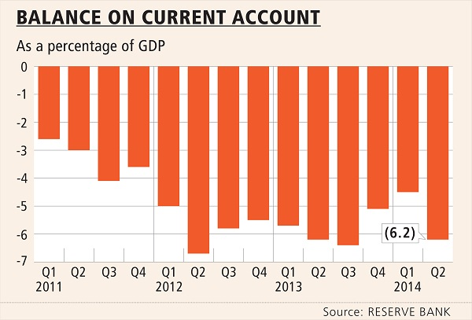
SA’s current account deficit
Current Account Deficit
Notes:
Dear DG, you asked about the contribution of technology exports to the current account deficit:
The rands/cents information is not readily available in a credible format (an official calculation or a published research report) and there are a number of issues one would have to take into consideration if one wanted to do that calculation ourselves (e.g. exactly what is reported by the Reserve Bank and the dti). So we did not want to make shallow statements. In consultation with the NACI secretariat, Godfrey, Beeuwen and Kgomotso, we are proposing that we can in stead use the trends.
The contribution of technology exports to the current account deficit will be mostly related to (a) the Technology Balance of Payments (TBP) and (b) the export of medium- to high-technology goods.
This slide shows that the deficit (which is generally growing, although there was slight recovery) is attributable to a number of issues where the DST can play a role, namely HCD, infrastructure and building local export capability.

Slide 35
Disembodied and Embodied Technologies
Disembodied technologies : TBP (royalties and licensee fees):
  TBP balance as % of total current account balance stood at 9.7% (2012);
  As % of GDP moved from 0.3 % in 2003 to 0.5% in 2012.
Embodied technologies :
  High-technology manufacturing imports and exports
  Stood at 3.4 % of .GDP in 2011
Notes:
however a critical limitation for the purpose of TBP as an innovation indicator , is that the data is aggregated and does not separate between technological and non-technological components

Slide 36
SA Technology Balance of Payments
SA is a net importer of technology;
The gap between imports and exports has been increasing;
Points to increasing local demand for technology.

Slide 37
Rising SA technology exports
SA technology exports have been increasing;
Points to growing capacity in the knowledge sectors of the SA economy;
Hence there is potential to boost SA exports and support local industry with locally grown technologies.

Slide 38
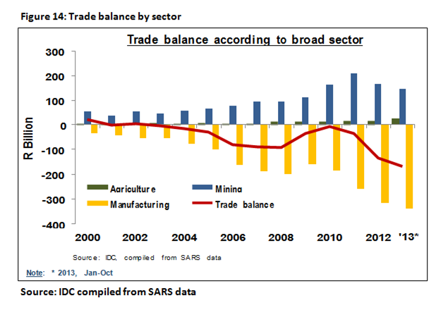
SA’s current account deficit
Manufacturing Trade Deficit
SA’s growing trade deficit in the manufacturing sector is a structural concern for the economy.

Slide 39
SA High-Technology Manufacturing Trade Deficit Trend (Million Current USD)
Rate of trade deficit growth differs depending on the industry:
Electronics sector 14.5% per year
Pharmaceuticals 12.7% per year
Scientific instruments 11.0% per year
Office, accounting and computing machinery 10.7% per year
Aerospace 3.5% per year

Slide 40
Current Account Deficit
  Current Account Deficit
  Agriculture; Current Account deficit
  Aerospace
  Manufacturing
  Electronics sector
  office equipment, accounting and computing machinery
  Pharmaceutical
  Indicators
  Bioeconomy, GDP ⁺, CCA
  Animal cluster (TIA) ⁺ GDP
  UAS, GDP ⁺
  Biocomposites ⁺ GDP
  AMTS, SIF, Nanotechnology Centers
  Bioeconomy (Industry) ⁺ (CAD), GDP
  ICT Roadmap;
  ⁺ CAD, GDP
  SHIP
  Bioeconomy (Health)

Slide 41




HySA Centres of Competence
DST
NWU / CSIR
UCT / MINTEK
UWC

Slide 42
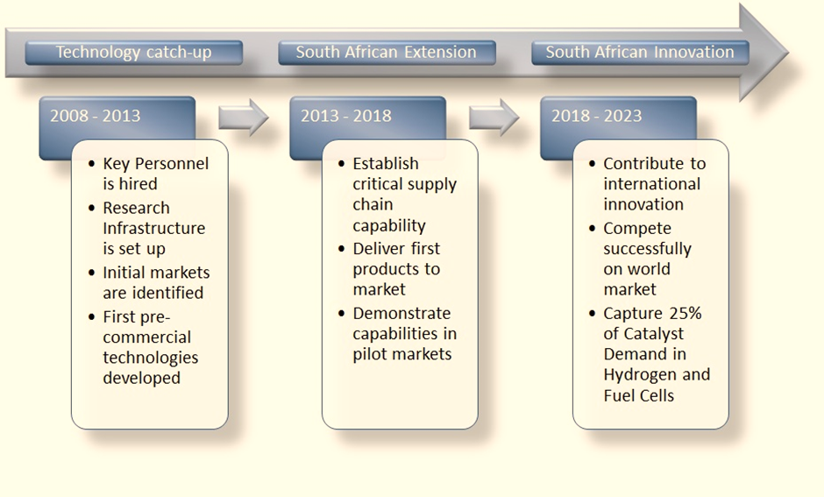
HySA Timelines

Slide 43
Market for HySA Components
1. Catalyst Market
2. Membrane Electrode Assembly (MEA): Current costs are at ZAR1500/MEA
Assuming we produce 1000 000 MEA units per year sold at ZAR1200/MEA would result in Revenue of ZAR1.2 billion/yr.
3. Metal Hydride (MH) hydrogen storage material: Current costs are at ZAR1400/kg
Assuming we produce 1000 kg of MH per year sold at ZAR1 200/kg would result in Revenue of ZAR1.2 mil/yr.
4. Combined Heat and Power (CHP) Units: Current costs are at $30 000/kW
Assuming we produce 1000 x 1kW units per year sold at $15 000/kW would result in Revenue of $15 mil/yr.

Slide 44
Cheaper Titanium Powder –
Changing the Industry
Typical prices
Ti Powder
10 USD/kg Ti
Ti Powder
40 USD/kg Ti
Final Products/Components: USD/kg 150 – 20,000
Ti Mill Products
50 USD/kg Ti
Ti Ingot
20 USD/kg Ti
Ti Sponge
10 USD/kg Ti
TiCl₄
4.4 USD/kg Ti
TiO₂ Pigment
5.3 USD/kg Ti
TiO₂ Slag
1.45 USD/kg Ti
Product | Vol | Price | Gross value 2015 | Gross value 2020 | Gross value 2025
TiO2 slag |  | 1.45
TiCl4 |  | 4.4
TiO2 pigment |  | 5.3
Ti powder |  | 10
Ilmenite
1 USD/kg Ti
Current SA industry

Slide 45
Sector’s Contribution To GDP
9 SIFs established by end 2014/15
SA’s GDP
SAMMRI (8.8%)
MIASA
WINETECH (2.2%)
CRI (0.16%)
FPEF (1%)
SMRI (0.7%)
MFFASA (0.026%)
PAMSA (0.6%)
FSA (1.2%)

Slide 46
Improvement on GDP Resulting from SIF R&D Intervention
Sectors supported by SIF constitute ±15% of GDP
Primary Sectors | Secondary Sectors | % GDP
 | SAMMRI | 8.8
CRI |  | 0.16
MFFASA |  | 0.026
FSA |  | 1.2
 | PAMSA | 0.6
 | SMRI | 0.7
 | FPEF – PHI | 1
 | MIASA | -
 | WINETECH | 2.2
 | TOTAL | 14.69

Slide 47
Improving Technological
Capability of Local Firms
Technology Localisation Programme (TLP) Goal:
Improve the technological capability of local firms leading to
  Increased competitiveness (quality, cost, customisation)
  Expanded capability (new products, services)
  Expanded market (local and global)
South African industry is in need of technology renewal
  Catch-up – valves, foundries
  Retain and improve competitiveness, reclaim & market share
Continued technology development
  Maintain and expand indigenous knowledge base
  Create and sustain skills pipeline
Technology
People & skills
Science
Intangible
Tangible
Plant & equipment
Organisation & procedures
Notes:
TLP focuses on improving the technological capabilities which will assist in moving the company from the lower level of competitiveness to the next level.
The programme could by default lead to moving the company from a lower tier to a higher tier level in the supply chain.
The programme emphasis is on technology which includes intangible and tangible aspects.

Slide 48

TLP Focus Areas
Provincial Footprint
OEM
SECTOR SUB-SECTOR INTERVENTIONS
PUBLIC PROCUREMENT / INFRASTRUCTURE PROGRAMMES
Industrial Transformation and SME development
Mega-science / Strategic Integrated
Projects
Benchmarking
Aerospace&Defence
Foundries
Energy
Transport
Designated areas
Coal based Power Generation
Rolling stock
Solar-Water Heaters
Meerkat
Port equipment
Nuclear Power Generation
Renewable Energy
Oil & Gas
48
Notes:
To note is the focus on working much closer with OEMs.
Use the programme to achieve industrial transformation and SME development.
Addition of Aerospace and Defence.
Ensuring that Provincial footprint (Build on the Provincial Benchmarking Capacity Development that was funded by DST)

Slide 49
Comprehensive Approach to Technology Localisation
Implementation:
Technology Localisation Implementation Unit (TLIU), hosted by the CSIR
Technology Assistance Packages (TAPs)
Technology Development Support Packages
Profiling and Benchmarking database
Firm Level TAP
Industry / sub-sector TAP
Technology Development Grants
Other supplier dev
Human Capital Development - Internships Programme
Technology Stations (Ring fenced funding to TIA)
Notes:
New approach going forward with the integration of the UNIDO programme in the TLIU.
More integration of the internship programme as an element of TAP.
More involvement of the TS and IATs in the implementation of the TAPs

Slide 50

Highlights of Overall
Impact of TAPs
Description | Quantity
Projects where IP was created | 6
Jobs created | 136
Tier upgrade of supplier | 20
Export capability achieved | 15
Import substitution achieved | 13
Productivity improvement achieved at company | 28
Scrap reduction achieved at company | 25
Companies where SOC work has been gained | 20
Companies where SOC work was retained/strengthened | 10
Notes:
Get figures of average productivity improvement, and scrap reduction

Slide 51
Strategic Outcome-oriented Goal (5)
To accelerate inclusive development through scientific knowledge, evidence and appropriate technology.
Proxy Indicator 1: By 2019, decision-support provided that strengthens or improves the delivery of at least 10 government services or functions.
Proxy Indicator 2: Between 2014 and 2019, contribution of technology-based opportunities for local economic development introduced or strengthened in at least five distressed municipalities.
Proxy Indicator 3: By 2019, opportunities for improving the standard of living of at least 500 000 people in South Africa and/or 12 communities unlocked through S&T interventions funded by the DST.

Slide 52
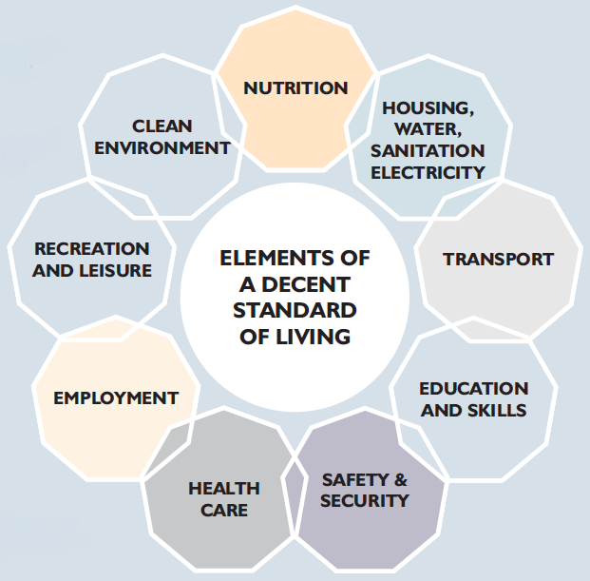
Elements of Standard of Living

Slide 53
Improvement in development indicators equal or greater than peers
Impact
Standard of living of [xxx] individuals improved through DST-funded S&T interventions
[xxx] communities benefiting from DST-funded S&T interventions
Capacity of [xxxx] agencies improved to effectively use S&T to improve standard of living
Outcome
Increased in evidence-based reports on development
# of users of DST-funded decision support systems
# of high-impact catalytic innovation projects
Increase in the use of data for policy and practice
Outputs
Increased generation of knowledge on development generation (Research Chairs, Centres of Excellence, HSRC, CSIR, international research partnership)
Demonstration Projects
(sanitation, e-education, human settlements, e-agriculture)
Generation of Data and modelling (including longitudinal studies)
Capacity building on technology and innovation management
Development and adaptation of promising technologies
NSI initiatives informed by DST strategies

Slide 54
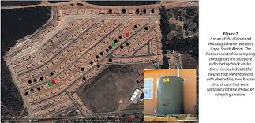


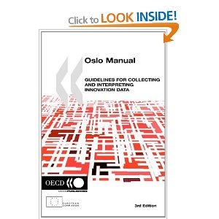
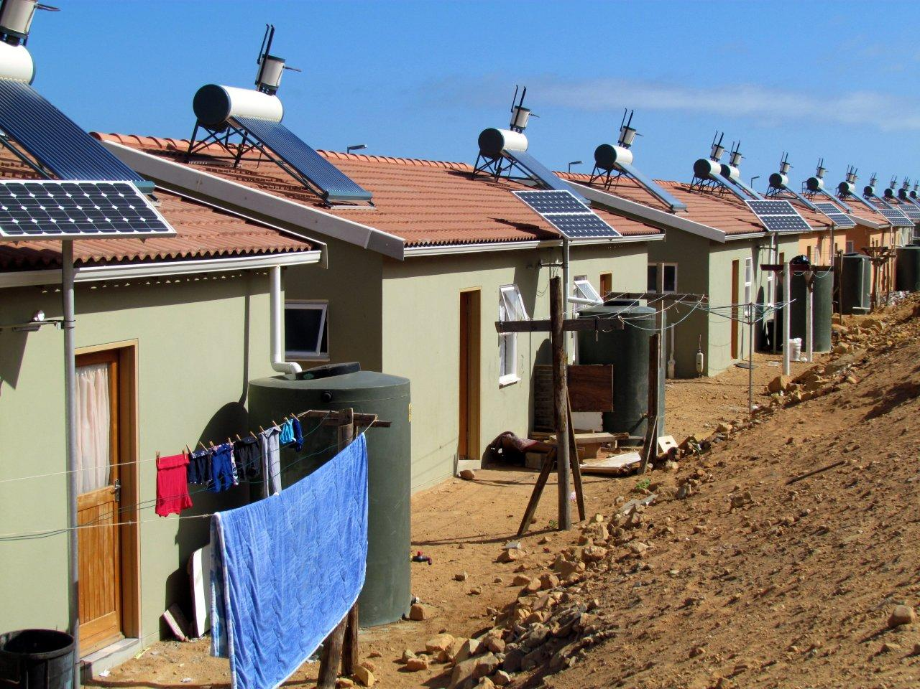
Improved Standard of Living

Slide 55

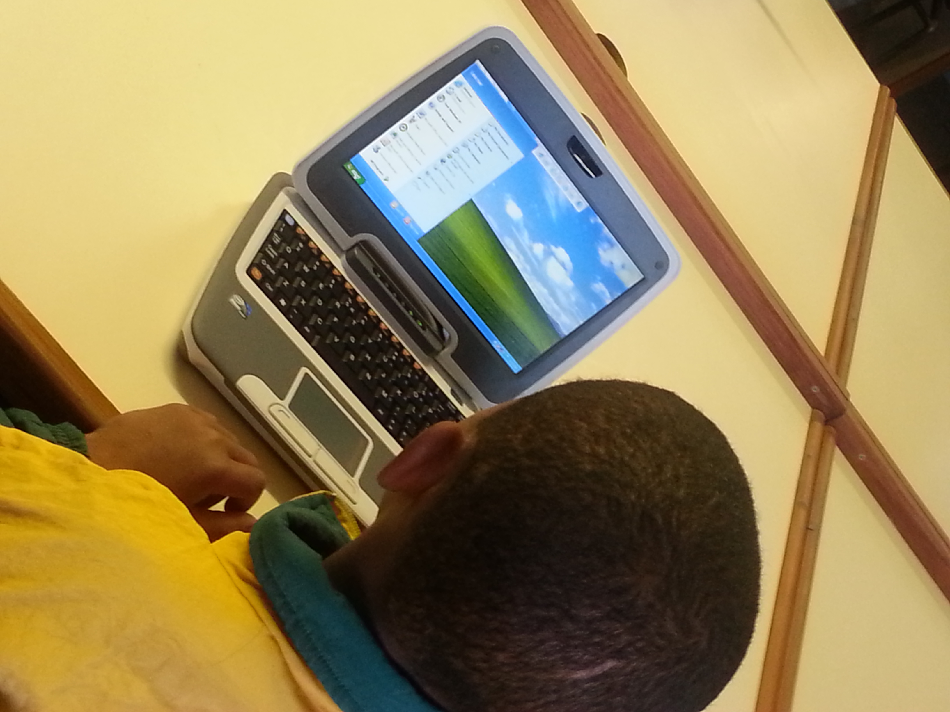
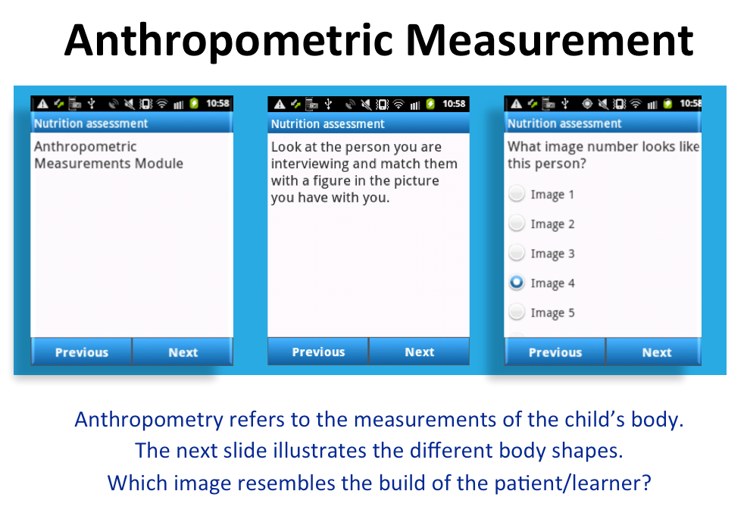
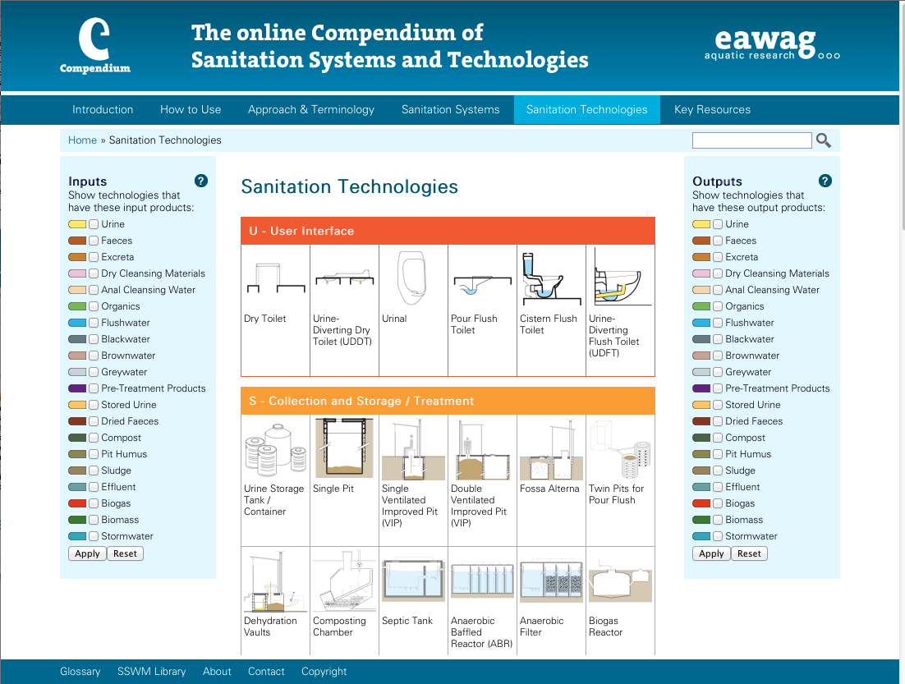
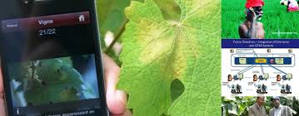
Decision support for improved service delivery: outputs and outcomes
DRDLR, DHS, COGTA: Spatial planning policy
BE: e-Education WP
DoH and DBE: school health policy
DWS & Municipalities
DAFF: extension recovery
Decision support intended to improve planning and implementation of services

Slide 56
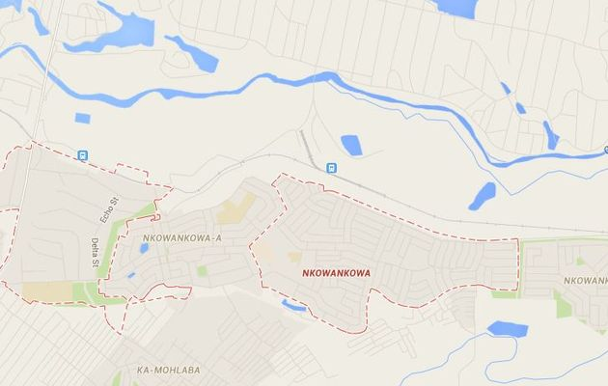
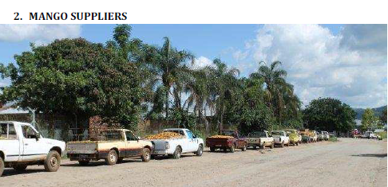
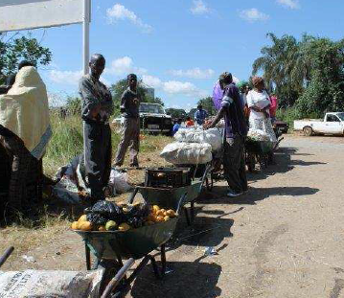
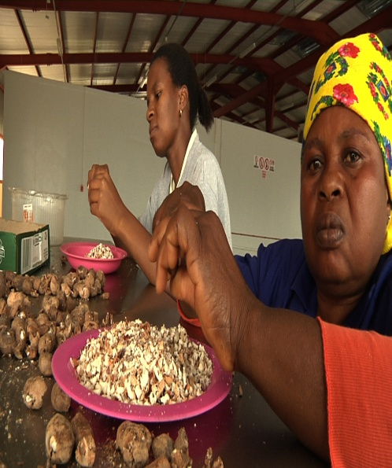
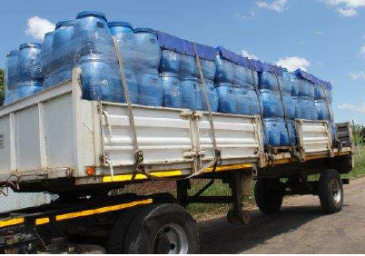
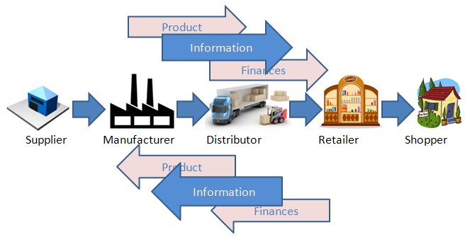
ILED: next five years (isolated projects to systemic interventions)
Provincial and Local development plan
Provincial
Higher Education
Universities
Private enterprises
Non-Profit Organization
Local
Research institutions

Slide 57
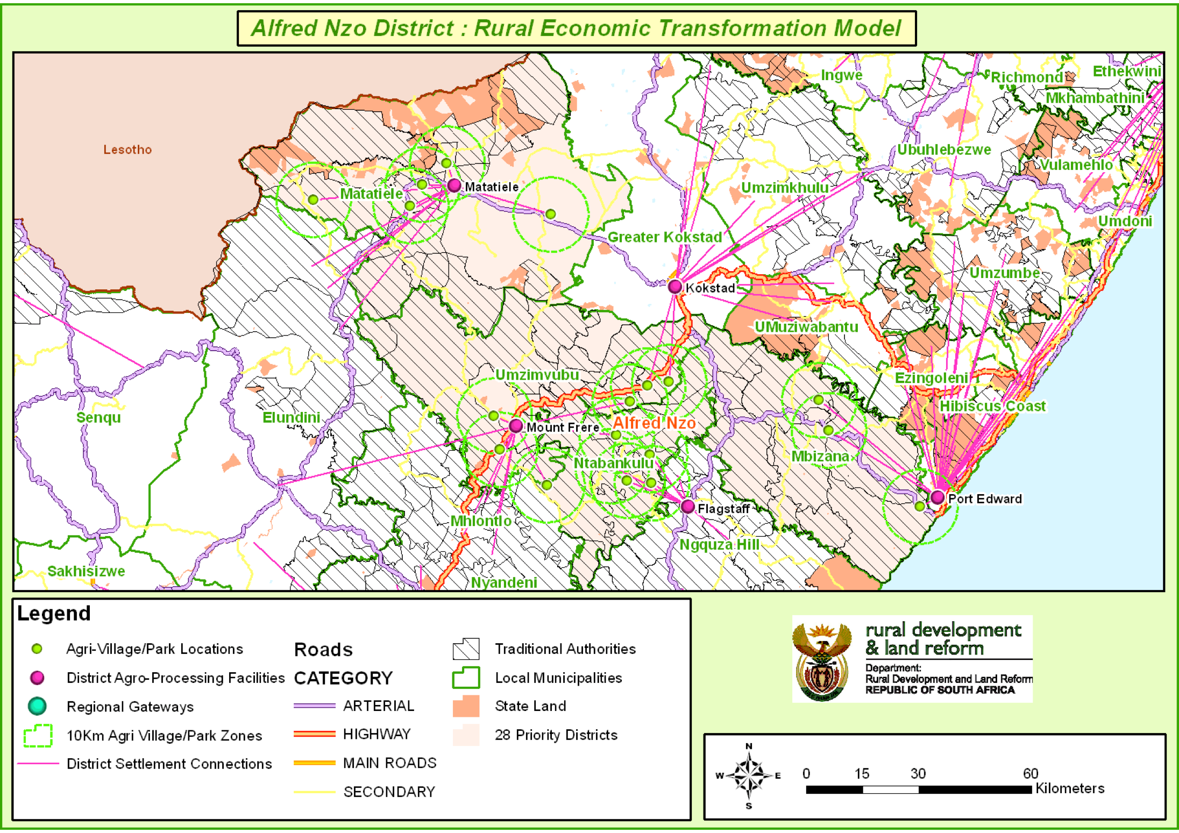
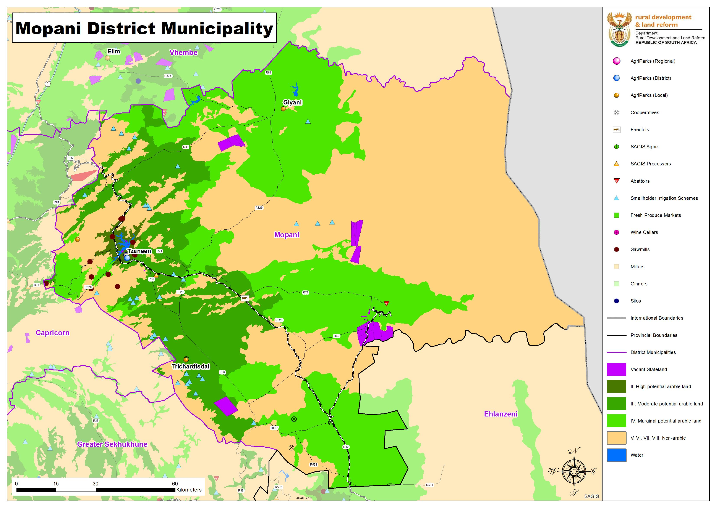

Slide 58
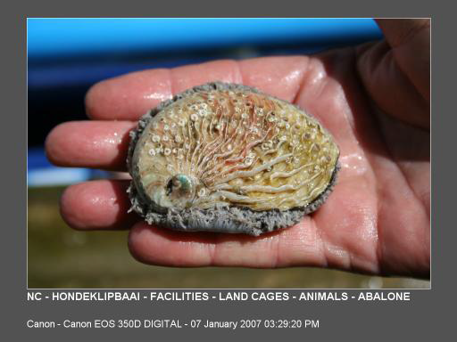
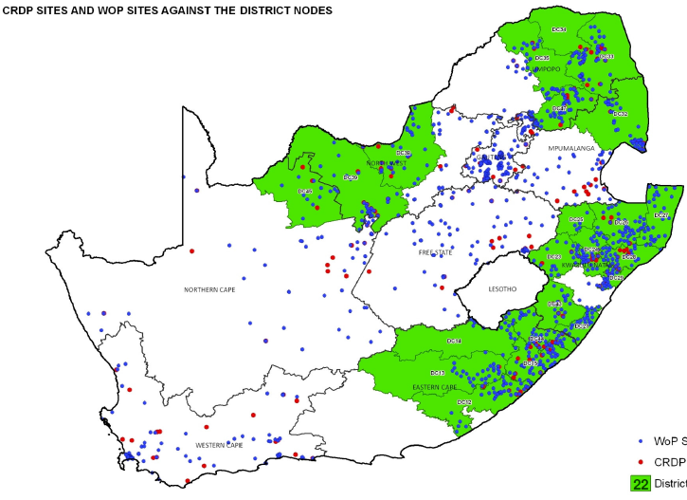

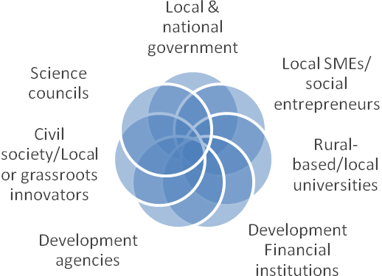
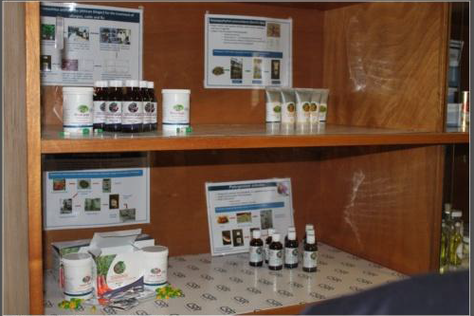
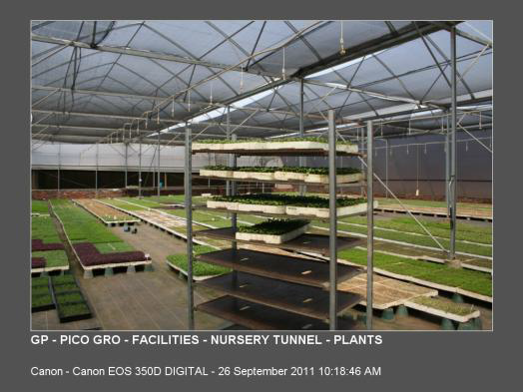
ILED: Aquaculture and Essential Oils

Slide 59
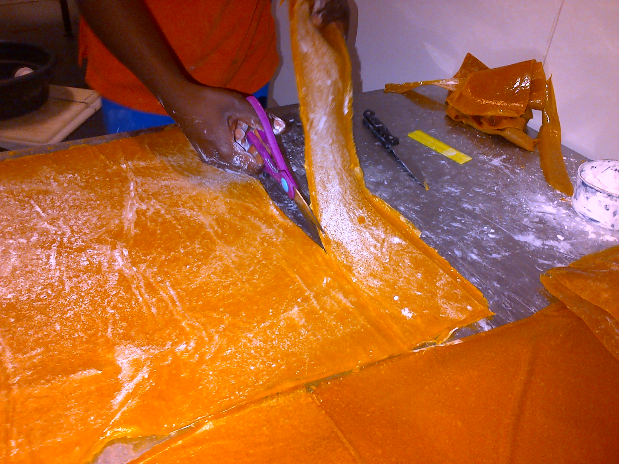
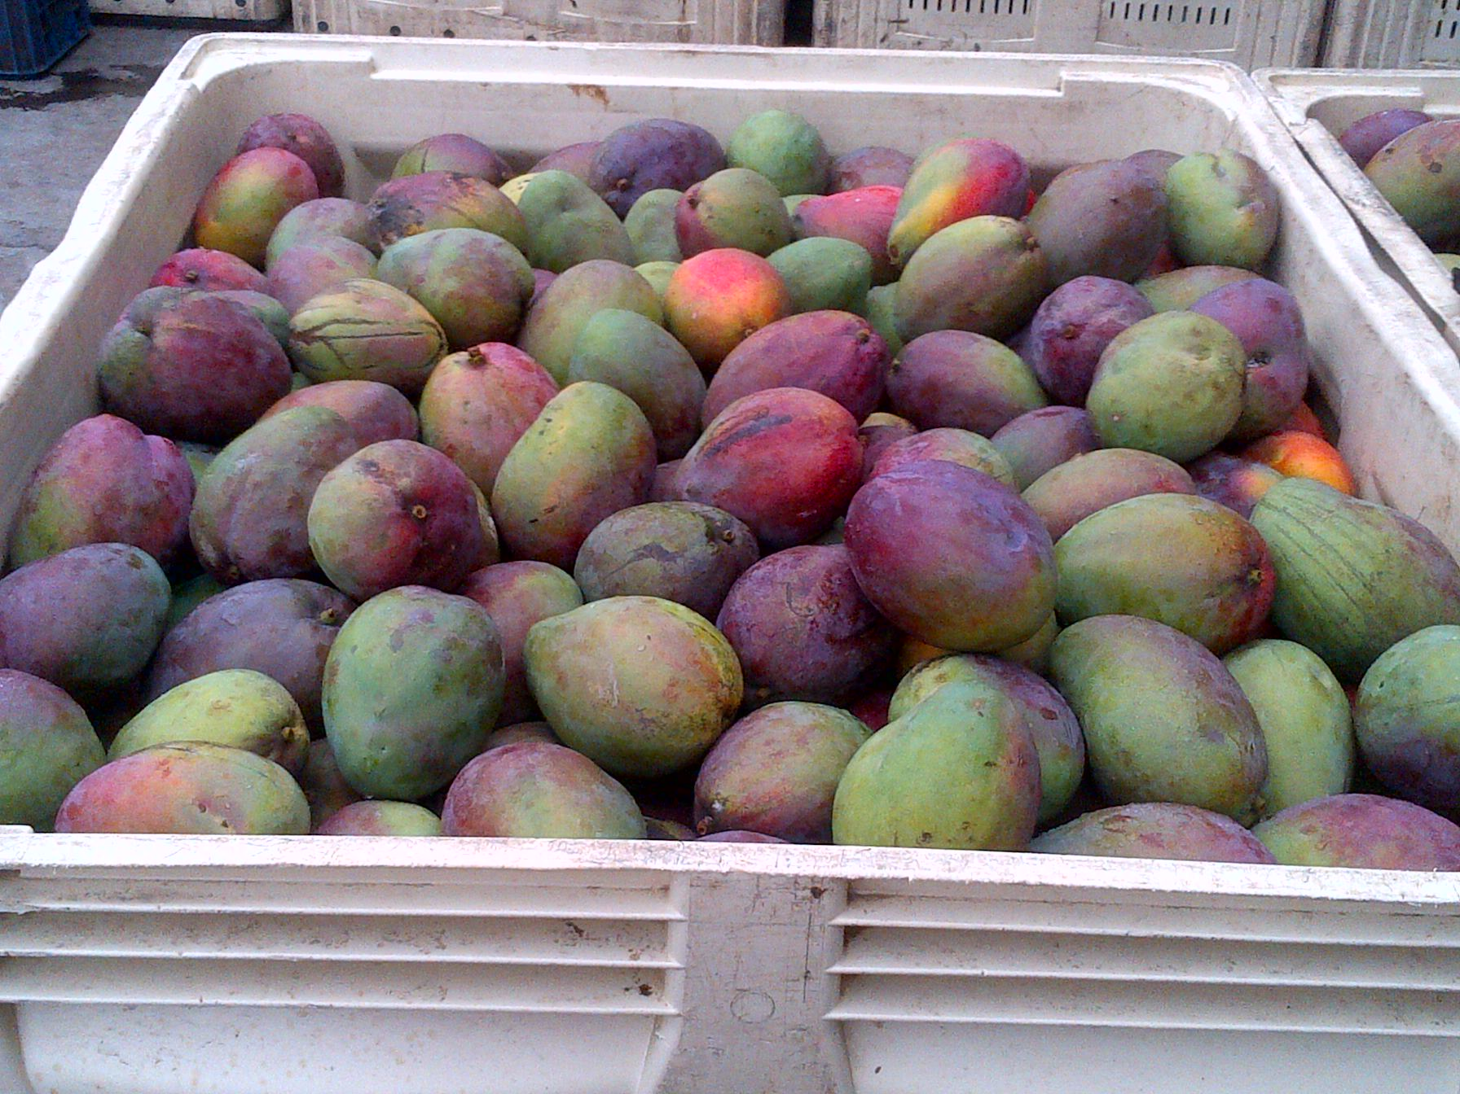
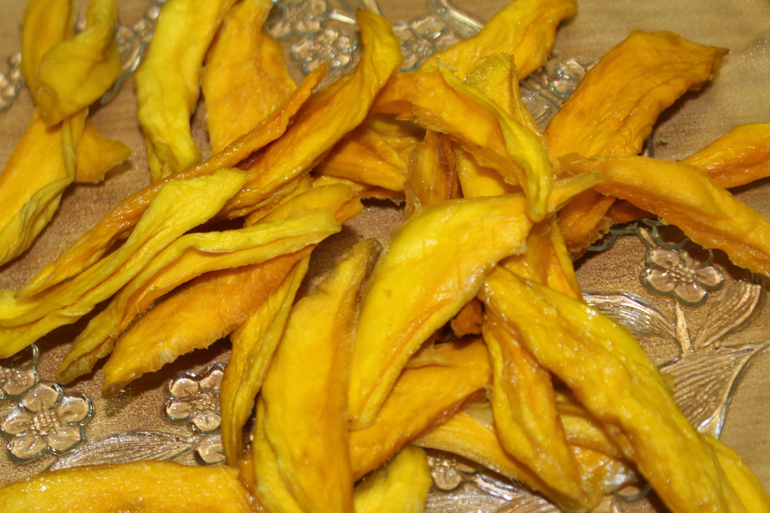
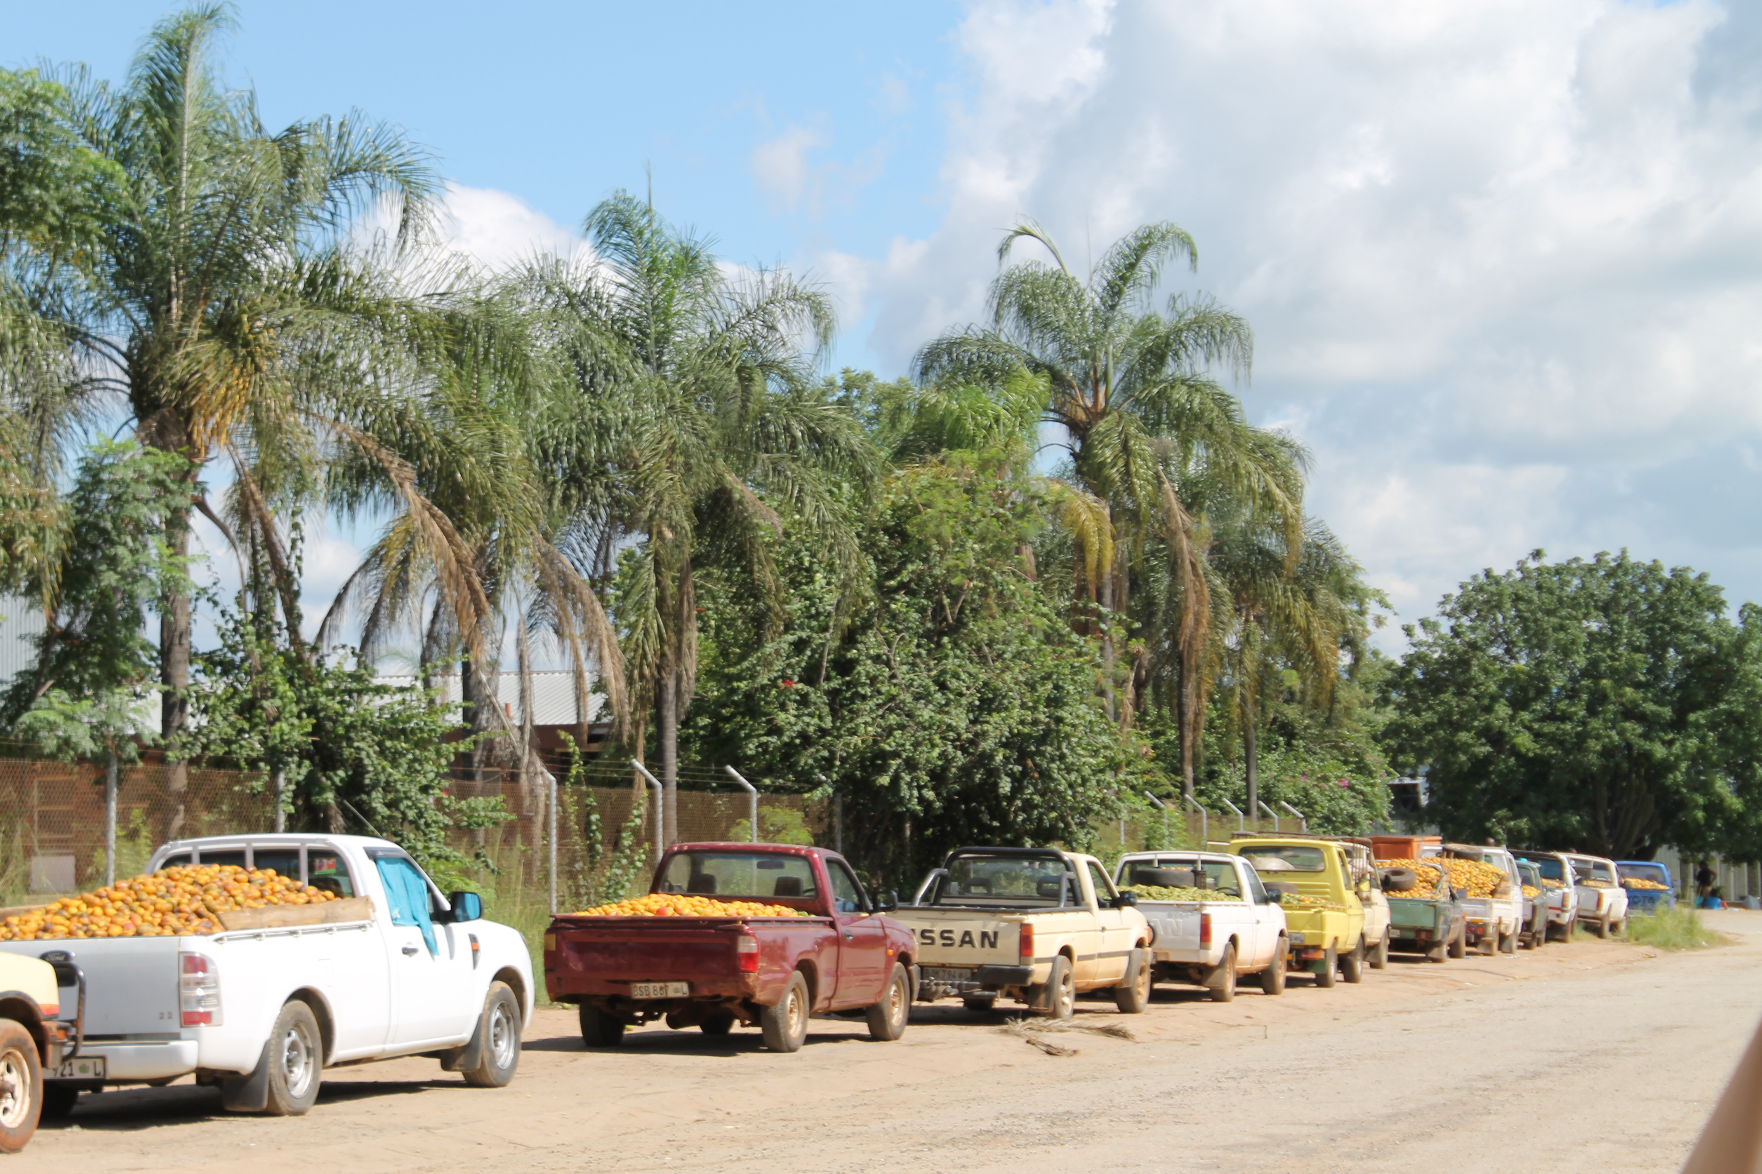
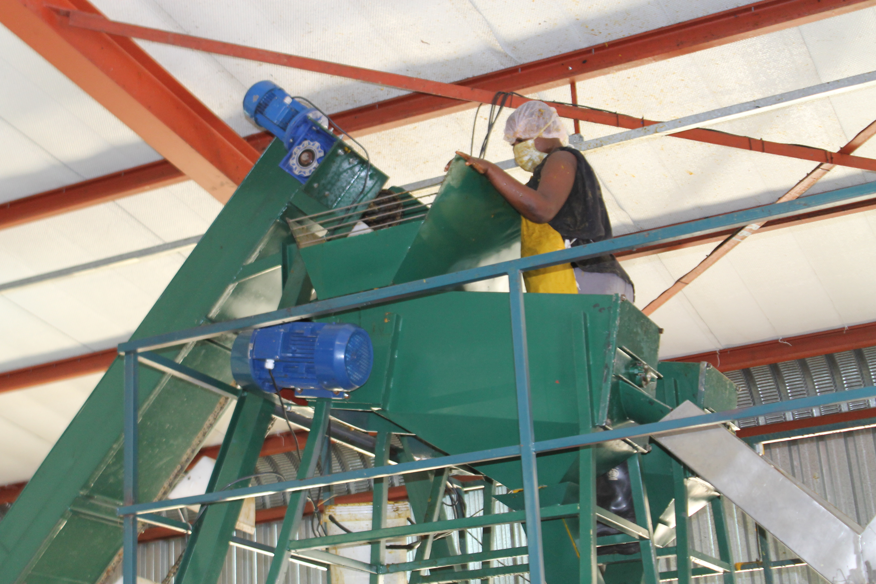
Agroprocessing

Slide 60
    The valued derived from Sumbandila
    Satellite Programme
SumbandilaSat, an Earth observation microsatellite, was launched in 2009, at a cost of about R63 million. It represented South Africa's re-entry into an active space programme. It was primarily a technology demonstrator satellite, which carried a number of experimental payloads from the research community. The direct value or quantifiable portion of the return on investment for the Sumbandila programme indicated financial savings and gains amounting to about R136,4 million through the following:
  developing the satellite locally (saved at least R44,6 million).
  gains through the postgraduate degrees obtained (estimated as being worth R45 million).
  acquiring imagery from SumbandilaSat instead of purchasing images from other countries (R35,6 million).
  job creation and earnings of suppliers (R11,4 million).

Slide 61
Selected APP performance indicators and targets (MTEF)

Slide 62
Selected performance indicators and targets (1)
Performance indicator | MTEF targets
Percentage alignment of DST planning documents (Strategic plan, APP and ENE) | Minimum of 90% alignment across DST planning documents by 31 March 2018
Number of DST public entities’ annual reports submitted to Parliament | 24 DST public entities’ annual reports submitted to Parliament by 31 March 2018
Notes:
Still need to debate whether we combine SO2 and SO4

Slide 63
Selected performance indicators and targets (3)
Performance indicator | MTEF targets
Number of disclosures received from publicly-funded institutions | 900 disclosures received from publicly-funded institutions by 31 March 2018
Number of policy directives developed and adopted by government | 10 policy directives developed and adopted by government by 31 March 2018
Number of knowledge products (patents and publications in space science, energy and bioeconomy) generated | 377 knowledge products (patents and publications in space science, energy and bioeconomy) generated by 31 March 2018
Notes:
Still need to debate whether we combine SO2 and SO4

Slide 64
Selected performance indicators and targets (4)
Performance indicator | MTEF targets
Number of trainees supported (through bursaries, internships, high-end-skills development initiatives, conferences and workshops) in strategic and emerging research areas | 600 trainees supported in strategic and emerging research areas by 31 March 2018
Number of new technology products, processes and/or services commercialised | 11 new technology products, processes and/or services commercialised by 31 March 2018
Notes:
Still need to debate whether we combine SO2 and SO4

Slide 65
Selected performance indicators and targets (4)
Performance indicator | MTEF targets
Number of trainees supported (through bursaries, internships, high-end-skills development initiatives, conferences and workshops) in strategic and emerging research areas | 600 trainees supported in strategic and emerging research areas by 31 March 2018
Number of new technology products, processes and/or services commercialised | 11 new technology products, processes and/or services commercialised by 31 March 2018
Notes:
Still need to debate whether we combine SO2 and SO4

Slide 66
Selected performance indicators and targets (5)
Performance indicator | MTEF targets
Amount of international funds directly invested in research, innovation and STI HCD programmes in South Africa | R2 billion of international funds directly invested in research, innovation and STI HCD programmes in South Africa by 31 March 2019
Number of leadership positions occupied by South Africa in international STI governance structures | 15 leadership positions occupied by South Africa in international STI governance structures by 31 March 2019
Notes:
Still need to debate whether we combine SO2 and SO4

Slide 67
Selected performance indicators and targets (6)
Performance indicator | MTEF targets
Number of South African students accepted into international training programmes offering a postgraduate qualification | 550 of South African students accepted into international training programmes offering a postgraduate qualification by 31 March 2018
Number of approved AU or SADC STI initiatives endorsed at AU or SADC ministerial level supported (financially or in-kind) | 30 approved AU or SADC STI initiatives endorsed at AU or SADC ministerial level supported (financially or in-kind) by 31 March 2018
Notes:
Still need to debate whether we combine SO2 and SO4

Slide 68
Selected performance indicators and targets (7)
Performance indicator | MTEF targets
Number of research, innovation and STI HCD cooperation projects co-funded or supported in-kind by DST and other African partners | 100 research, innovation and STI HCD cooperation projects co-funded or supported in-kind by DST and other African partners by 31 March 2018
Total number of graduates and students placed in DST-funded work preparation programmes in SETI institutions | 2 700 graduates and students placed in DST-funded work preparation programmes in SETI institutions by 31 March 2018
Notes:
Still need to debate whether we combine SO2 and SO4

Slide 69
Selected performance indicators and targets (8)
Performance indicator | MTEF targets
Average amount of bandwidth per SANReN site per year | 5 000 Mbps average bandwidth capacity available per SANReN site by 31 March 2018
Number of biennial reports on the state of climate change in South Africa approved by Cabinet | First report on the state of climate change in South Africa submitted to Cabinet for approval and process of compiling second biennial report initiated by 31 March 2018
Notes:
Still need to debate whether we combine SO2 and SO4

Slide 70
Selected performance indicators and targets (9)
Performance indicator | MTEF targets
Number of research infrastructure grants awarded as per award letters | 200 research infrastructure grants awarded as per award letters by 31 March 2018
Number of regulations on Astronomy Advantage Areas (AAAs) gazetted | 3 regulations on AAAs (frequency spectrum, electronic magnetic interference and SKA procedural matters and financial compensation) gazetted by 31 March 2018
Notes:
Still need to debate whether we combine SO2 and SO4

Slide 71
Selected performance indicators and targets (10)
Performance indicator | MTEF targets
Number of knowledge products on innovation for inclusive development published | 14 knowledge products on innovation for inclusive development published by 31 March 2018
Number of reports and policy briefings on the innovation system and innovation policy approved Exco/ published | 17 reports and policy briefings on the innovation system and innovation policy approved Exco/ published by 31 March 2018
Notes:
Still need to debate whether we combine SO2 and SO4

Slide 72
Selected performance indicators and targets (11)
Performance indicator | MTEF targets
Number of instruments funded in support of increased localisation, competitiveness and R&D-led industry development | 11 instruments funded in support of increased localisation, competitiveness and R&D-led industry development by 31 March 2018
Turnaround time in providing pre-approval decisions on applications for the R&D tax incentive | Pre-approval decisions provided within 90 days of date of application for the R&D tax incentive by 31 March 2018
Notes:
Still need to debate whether we combine SO2 and SO4

Slide 73
Selected performance indicators and targets (12)
Performance indicator | MTEF targets
Number of high-level research graduates (master’s and doctoral) fully funded or co-funded in designated niche areas (advanced manufacturing, aerospace, chemicals, mining, advanced metals ,ICTs and sector innovation funds) | 863 high-level research graduates (master’s and doctoral) fully funded or co-funded in designated niche areas (advanced manufacturing, aerospace, chemicals, mining, advanced metals ,ICTs and sector innovation funds) by 31 March 2018
Notes:
Still need to debate whether we combine SO2 and SO4

Slide 74
Gross Expenditure on Research and Development (GERD) in current and constant 2005 Rand values
GERD | Comment
R23.871 billion | The 2012/13 survey registered an increase of R1.662 billion or 9.7% from R22.209 billion reported in 2011/12. The GERD has increased from 2011/12 to 2012/13 in both nominal and real terms, after the decrease in 2008/09 to 2010/11.

Slide 75
GERD as a % of GDP
GERD/GDP | Comment
0.76 % | In the three consecutive years, 2010/11 to 2012/13, GERD/GDP remained constant at 0.76%. At constant 2005 prices, GERD growth rate was at 2.6% from 2011/12, which is almost the same as GDP at 2.5% in 2012

Slide 76
DST MTEF Budget Estimates
R’ thousand | 2015/16 | 2016/17 | 2017/18
Programmes
Administration | 299 776 | 304 136 | 320 816
Technology Innovation | 1 008 817 | 1 011 636 | 1 044 314
International Cooperation and Resources | 121 997 | 123 874 | 130 779
Research Development and Support | 4 247 066 | 4 265 269 | 4 448 474
Socio-Economic Innovation Partnerships | 1 804 464 | 1 857 270 | 1 664 259
Total | 7 482 120 | 7 562 185 | 7 608 642
Compensation of employees | 291 302 | 302 433 | 321 334
Goods and services | 205 076 | 205 459 | 215 101
Transfers and subsidies | 6 983 433 | 7 051 984 | 7 069 789
Payments for capital assets | 2 309 | 2 309 | 2 418
Payments for financial assets | - | - | -
Total | 7 482 120 | 7 562 185 | 7 608 642

Slide 77
Entities MTEF Allocations
Institution | 2015/16 | 2016/17 | 2017/18
 | R’000 | R’000 | R’000
Academy of Science of South Africa | 22 991 | 23 106 | 24 261
Council for Scientific and Industrial Research | 827 704 | 872 043 | 915 645
Human Sciences Research Council | 288 706 | 290 149 | 304 656
National Research Foundation | 885 899 | 882 805 | 925 964
South African National Space Agency | 124 355 | 124 977 | 131 226
Technology Innovation Agency | 385 188 | 387 364 | 406 732

Slide 78

Organogram
The
Director-General
DDG:
Research,
Development
and Innovation
DDG:
International
Cooperation
and Resources
DDG:
Human Capital
And Knowledge
Systems
DDG:
Socio-Economic
Partnerships
DDG: Corporate service and Governance
Chief Operating Officer

Slide 79
Conclusion
Need to build, grow and strengthen a National System of Innovation that is efficient, productive and beginning to be responsive to national priorities.
Need to engage public entities and university to orient them on our approach to intended outcomes.
Enhance efforts at transformation and the building of a strong academy.
Institutional plans to accommodate and support young researchers.
Notes:
Still need to debate whether we combine SO2 and SO4

Slide 80
Conclusion (2)
Deepen implementation from lesson’s learnt in the past:
Moving pilots to semi pilots and full plants
Support government in areas requiring technology solutions
Communicate more strategically.
Develop and enhance planning, analytical and evaluation capability.

Slide 81
Thank you

Slide 82
Appendix: STI Impact Case
Studies

Slide 83
4 types of STI contributions/impacts
Economic growth and competitiveness;
Improved social development/quality of life/standard of living;
Cost savings by government departments through the use of STI decision support;
Enhanced government decision-making informed by STI policy.

Slide 84






Bio-economy
Target: 5% GDP attributed to bio-economy by 2050 (~ R175 billion in today’s terms).
R2 billion invested by BRICs / TIA into biotech innovation (2003-10).
By 2014, the top 7 biotech companies had a combined annual turnover of nearly R1 billion (from a direct investment of R63million).
Taxes, jobs, wealth creation, export earnings, improved QoL.
Notes:
NACI currently undertaking project to develop bio-economy indicators & benchmark current bio-economy.
This is only the BRIC / TIA investment, does not equate to all public or private investment into RD&I
Noting that turnover does NOT equate to GDP.

Slide 85

Bio-innovation Case Studies
Sterile False Codling Moth
R10 million invested
Sterile male moth released and dramatically reduces FCM population;
Approximately 15tonnes/ha additional fruit due to XSIT, equating to R40 000/ha;
Currently 13 000 hectares under SIT equating to R520 million additional income;
If expanded to 64 000 ha under citrus, this equates to an additional income of R1.9billion;
75% of all export markets have zero tolerance to FCM.
Notes:
This is only the DST investment.
Noting that farmers would be / are spraying their fields, so the additional income is potentially already received, less insecticide spraying costs.
Citrus industry contributes about R8billion to GDP.

Slide 86
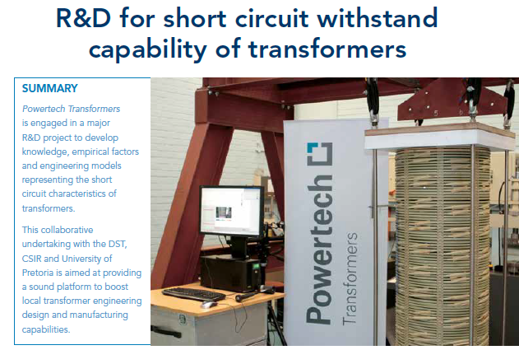
Powertech Transformers
The TLIU assisted Powertech Transformers (PTT) with the development of a Finite Element Model (FEM).
The FEM was used to determine the short circuit integrity in transformer windings caused by lightening.
This project was done in collaboration with the University of Pretoria and a variety of international subject matter experts.
Notes:
-Received an additional R 16 million rand worth of order and is expected to grow to 24 million

Slide 87
Powertech Transformers (cont.)
This project has resulted in the development of local design capability for transformer windings.
This project has assisted PTT to retain and gain orders with Eskom as well as gain orders into Nigeria.
Notes:
-Received an additional R 16 million rand worth of order and is expected to grow to 24 million

Slide 88
Sector Innovation Funds
Economic Competitiveness funding enabled DST to broaden the SIF’s;
Initiated an open competitive process in 2013-resulted in nine successful applications (including PHI and SAMMRI). Establishment of the nine SIF’s at various stages
The SIF is co-designed and managed with industry but industry takes the lead in determining priorities and criteria for selecting projects to be funded
Negotiated a detailed and mutually beneficial performance and delivery framework. A key contractual requirement is increased funding from the private sector into the partnership but also more investment in R&D in general

Slide 89

Sector Innovation Funds
Build on two successful partnerships:
  Post-Harvest Innovation programme initiated in 2007. Second 3-year phase ending in March 2015;
  South African Metals and Minerals Research Initiative (SAMMRI) – initiated in 2009, first DST funding support in 2011.
Ministerial Review Committee report recommends the establishment of co-operatively managed sector funds.

Slide 90

Highlights
POST HARVEST INNOVATION PROGRAMME:
2006: Study commissioned by the Department of Science and Technology into Post-Harvest and Cold Chain Technologies in the SA Fresh Fruit Industry;
2007: The First phase of PHI programme was launched with a Programme Management Unit driving the Programme;
2011 - 2014: Phase Two launched.
2014 - 2017: Beginning of Sustainability Phase (R30m)
R30m

Slide 91





FRUIT SA

Slide 92
Project with Emerging Farmers
Despite numerous challenges, the project achieved the following:
1 farmer exported 2 containers of Granny Smith apples directly to UK (not via an export agent.)
Another farmer exported 2 containers of fruit to the Far East.
4 more farmers to access formal local markets, which they now supply directly.

Slide 93
Case studies showing potential
STI derived cost savings

Slide 94
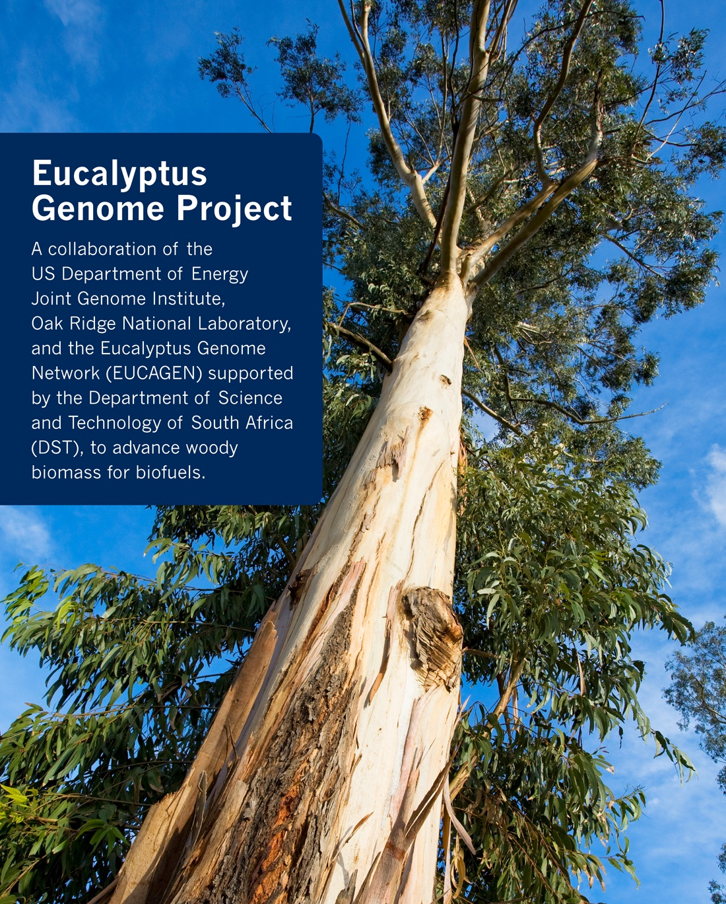
Bio-innovation Case Studies
Eucalyptus Genome Programme (UP)
R5.5+million invested
Sequenced the Eucalyptus Genome.
Identification of genetic markers for desirable traits, which speeds-up, and allows for more accurate, breeding.
Estimated that the benefits of Marker Assisted Breeding over conventional breeding will save R81million over 15yrs per 30 000 ha.
Translated to the 1.2million ha total plantation in SA: equates to a potential saving of R3.4billion over 15 yrs.
Notes:
This is only the DST investment. DST is investing further towards GM trees.
Noting that unlikely to transfer in the short term to all plantations

Slide 95
SPACE ECONOMIC BENEFITS
Quantitative (Rands and Cents,hard stats/ratios)
Qualitative (Broad, soft, social outcomes)
Economic Returns
Financial gain /
Profit
Social Welfare
GDP
Poverty alleviation
Employment
Externalities or extra benefits
Attracting more/private investment
Efficiencies
Economic Benefit
Economic Impact
Return on Investment
Cost Benefit Analysis

Slide 96
Space applications (1)
AFIS
  In South Africa, approximately 20% of power supply disruptions are caused by fires that burn under Eskom’s transmission lines causing transient faults;
  Approximately 3500 wild fires on average are detected close to ESKOM’s annualy;
  Electricity disruptions can thus cost the South African economy as much as R15 million an hour, in direct costs, excluding the effects to other industries who rely on the power sector;
  If the assumption is that wild fires contributes R1m of the R15m electric disruptions, and AFIS detecting 3500 fires, the savings due to this system is estimated at R3,5 billion.

Slide 97
Space applications (2)
StatsSA Building Count and Census
  SPOT 5 imagery has enabled Stats SA to prepare more accurate locality maps and listing maps for surveys and census field work;
  It is estimated that if Stats SA were to use human resources to collect this data it would cost them about R300 million.

Slide 98
STI support to
decision-making
and saving of lives

Slide 99

Bio-innovation Case Studies
Health: Currently costing ~8.9% GDP
Generally, govt. health science investments are not likely to result in a financial return, but rather a cost reduction and improved healthcare.
Govt’s HIV/AIDS ART programme cost R5.4 billion in 2011.
An HIV vaccine, or local manufacturing of ARVs, is surely a worthwhile venture?
Notes:
Government exploring localised production of ARV’s. Has HIV vaccine work ongoing.

Slide 100
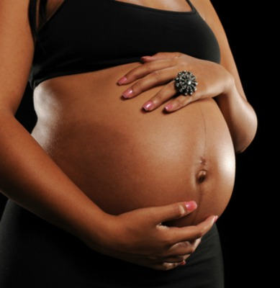
Bio-innovation Case Studies
Umbiflow – Doppler ultrasound device for determining placental competence
R2million+ invested
Designed for Primary Health Care in remote and low-resource settings.
Reduces dramatically the need for referrals to 2⁰ hospitals. In rural setting, a substantial patient benefit.
Cost savings of 14x that at 2⁰ hospitals.
Improved healthcare at reduced costs.
Notes:
This is only the DST investment (just approved a further R8mill from SHIP for trials to prove efficacy)
Umbiflow is a non-specialist instrument that can be deployed at primary health care settings – a benefit to the patient.
Far more accurate than current (non-specialist, 2⁰ hospitals) techniques.
2⁰ Hospital doppler instruments require specialist training to operate.

Slide 101


Bio-innovation Case Studies
mTriage – mobile app for assessing urgency of medical treatment.
R1.2+ million invested
Triage - currently a paper-based system that is not completed >25% of the time, and incorrectly triages up to 25% of patients.
Tablet-based app that is simpler, quicker and easier to triage.
Cost savings in time and forms completed, potential lives saved.
Improved healthcare at reduced costs
Notes:
This is only the DST investment. A further R4.5mill for further trials.

Slide 102
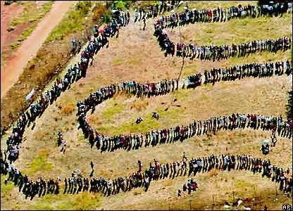
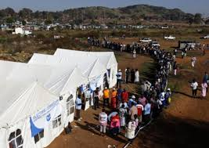
Geospatial information for election management

