Slide 1
Five year strategic plan 2014/19
Annual performance plan 2015/16

Slide 2
Who we are
The HDA was established in 2009 as a public development agency to address the land acquisition and assembly process so as to accelerate housing delivery and human settlement development. The two main objectives of the Agency, according to the HDA Act, are to:
Identify, acquire, hold, develop and release well-located land and buildings
Provide project management support and housing development services
The HDA collaborates with provinces and municipalities to provide the following services: Land identification, assembly and planning; Project Pipeline development; Project management; Informal settlement upgrade; IGR support; and Geo-spatial information

Slide 3
Expansion
Geographic spread: 1 head office in Johannesburg to 2 project offices (EC and WC) and four regional offices (Limpopo, FS, NC and KZN), with Mpumalanga and North West to follow in new financial year
Staff numbers: from 1 to 112 today, with a total of 182 planned for over the next three years
Activities: from mandate and S 29 projects to MTOPs to support to national priority programmes, to national developer
Grant income: From approximately R63 m to R186m and diversification of income
Organisational Stability: Clean Audit: established HR and Operational Procedures

Slide 4
Achievements
Initial focus at inception was the establishment of the Agency and the management of N2 Gateway and Zanemvula projects
Focus shifted from delivery from a head office, to a strong presence in the regions and MTOPs were negotiated
In addition to the project offices in the WC and EC, regional offices were established in Limpopo, NC and FS
Recently the primary focus has been increasingly on land assembly
We have developed a MSP supported by LAPSIS and NaHSLI
Over the 5 years we have met and exceeded the targets set, particularly in land acquisition
We have also accumulated extensive knowledge of project and pipeline development, mega-project management ISU
The foundation is laid to continue to support human settlement development and to fulfil the new targets that have been set

Slide 5
THE N2 GATEWAY PROJECT IN RELATION TO OTHER PROJECTS
PROJECT NAME | START DATE | UNITS YIELD | UNITS COMPLETED TO DATE
N2 GATEWAY | February 2005 | 16,083 | 11,986
ZANEMVULA | October 2007 | 13,718 | 6,030
CORNUBIA | July 2010 | 15,000 | 482
COSMO CITY | January 2005 | 12,300 | 8,241

Slide 6
Expectations of the Minister
The HDA will be responsible for the revitalisation programme for 23 mining towns.
HDA will be part of a team responsible for identifying and implementing 50 mega projects over the next five years.
N2 Gateway to be refocused as a national priority project – and lessons learnt document and the project closed.
A credible housing database covering both housing and land needs to be established.
The HDA should be restructured so as to become a fully-fledged developer whose job is not only to acquire and prepare land, but to facilitate the development and project manage agreed projects.
The HDA is responsible for developing a strategic (master) spatial plan which will create a framework within which project funding will flow.

Slide 7
Medium-term Strategic Framework
On the basis of the new Medium Term Strategic Framework (2014) the HDA anticipates being responsible for and/or contributing to:
The acquisition of 10 000 hectares of well-located publicly owned land and buildings released for human settlement development
The provision of 1.5 million housing opportunities in quality living environments by 2019
The implementation of 50 catalytic projects/mining towns

Slide 8
Revised functional structure
HDA
Programme 1: Administration
Programme 2 : Planning & Information
Finance
Corporate Services
National Programme Support
Policy, research, monitoring & information
Programme 3: Land & Housing Services
Region 1: MP, WC, EC, NC (as per MTOPS)
Region 2: KZN, NW, LIM, FS, GP (as per MTOPS)

Slide 9
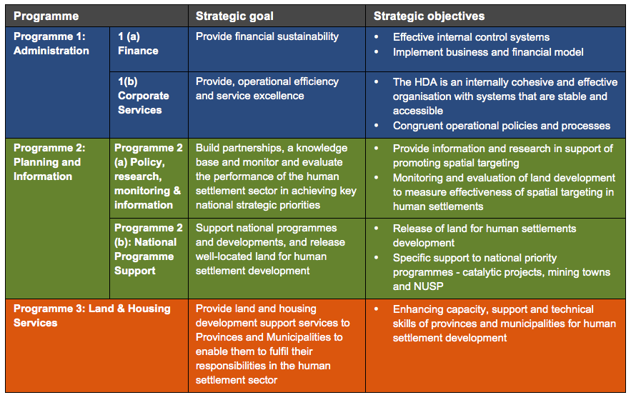
Strategic goals and objectives by project

Slide 10
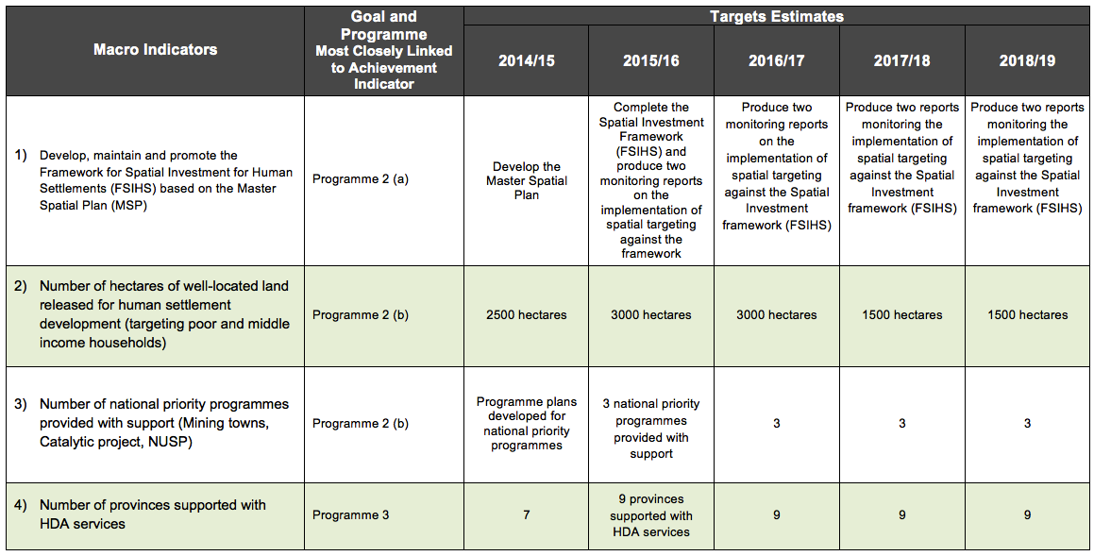
Macro performance indicators

Slide 11
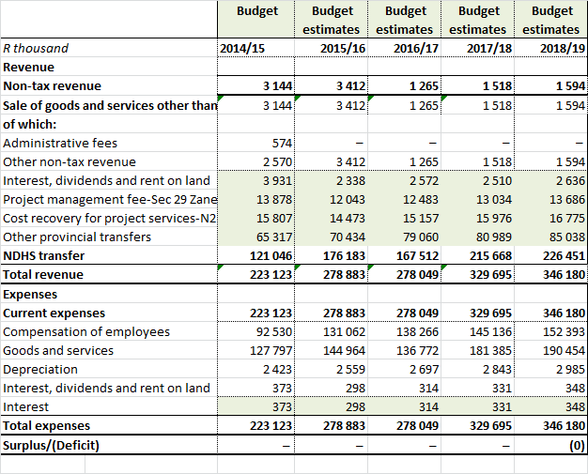
Housing Development Agency
Statement of Financial Performance

Slide 12
Thank you

