Slide 1

Update on the DST Centres of Competence (CoCs)
Notes:
1

Slide 2
Problem statement
The term Centre of Competence (CoC) is being overused, to the point that it is losing its impact.
To investigate this further, this presentation considers:
  How does the CoC concept, as provided for in the DST CoC Framework (2010), compare with similar programmes internationally (Australia and the EU are considered very briefly here as indicative examples of future research)?
  What is the current status of DST initiated CoC projects since 2010?
  What are the implications for the way forward in South Africa (SA)?

Slide 3

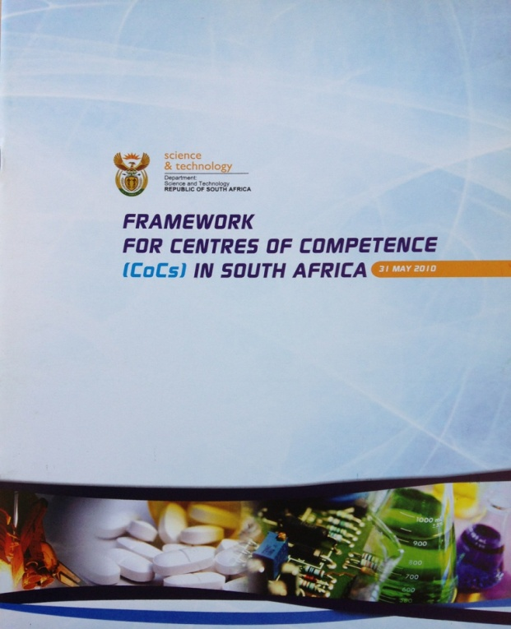
DST CoC Framework –
31 May 2010
3
Framework developed as a high-level guideline for the establishment and management of CoCs in SA.
CoCs envisaged as collaborative entities established, and preferably led, by industry, and resourced by highly qualified researchers associated with research institutions who are empowered to undertake market-focused strategic research and technology development (RTD) for the benefit of industry and the economy at large.

Slide 4
DST CoC Framework (cont.)
4
Framework assumptions:
There is no single rigid structure that will be appropriate to all CoCs. Instead, these may evolve in a number of different ways (depending on sectors, technology focus, participating companies etc).
Most CoCs will be set up either:
  By the development of an industry cluster that subsequently engages a research provider
  Stimulated by a need to take advantage of a market opportunity, or,
  In order to solve a social challenge

Slide 5
DST CoC Framework (cont.)
5
Framework assumptions cont:
CoCs will help SA industry gain competitive advantage by using the innovative capacity of universities and research communities, while contributing towards human capacity development.
Funding will reflect the unique requirements of each CoC. The combined industry contribution should represent around 30% of total costs, which could be made up of in-kind contributions.

Slide 6
CoC Programme Comparisons
6
 | SA | Australia | EU
Definition | CoCs: Formal, contractually secure, physical or virtual platform upon which to establish collaborative technology development partnerships between government, industry, HEI and SCs, with the explicit aim of technology commercialisation | Cooperative Research Centres (CRC) Programme: Established in 1991 in response to a number of perceived weaknesses in the institutional framework for Australia’s R&D effort. Programme objective is to encourage collaboration in research between the private and public sector research bodies. | Competence Centres (CCs): are investments by Member States made to encourage greater efficiency in the interaction between researchers, industry, and the public sector, in research topics that promote economic growth by their direct relevance to industry agendas
Sources: | DST CoC Framework, May 2010 | V Lingela, CD: ICR, DST, July 2013 | Report of the CREST Working Group, 2008 and 2009 (Comitie de la Recherche Scientifique et Technique)

Slide 7
CoC Programme Comparisons (cont.)
7
 | SA (CoC Framework, 2010)
Features | Four broad models envisaged: CoC formed with known/desired outcome driven mainly by market pull. Assumes capabilities available in the system that only need to be brought together in a [local] consortium. CoC arises from identification of excellence in individual R&D efforts. Commercialisation enabled through establishment of spin-offs and/or SPVs. CoC serves as clustering of individual R&D efforts that will lead to a number of product streams. Requires longer-term R&D efforts to fill capability gaps as identified. CoC enables tech transfer and inbound IP transactions. Local R&D programmes develop around inbound tech to enable skills development and adaptation in SA.

Slide 8
CoC Programme Comparisons (cont.)
8
 | SA (CoC Framework, 2010)
Features | Typically envisaged to have a lifespan of three to eight years, pending on the commercialisation path of particular projects and subject to review / renewal every three years. Early years of research collaboration may not qualify for classification as CoC, and a programme may only become a CoC once there are existing IP capabilities and market entry is approached.

Slide 9
CoC Programme Comparisons (cont.)
9
 | Australia (Lingela, 2013)
Features | CRC must comprise at least one Australian end user (from public, private or community sector) and one Australian HEI. Government contributed more than $3.4bn and participants $10.9bn (cash and in-kind) since 1991. A total of 19 012 CRCs have been funded by govt as at June 2012.

Slide 10
CoC Programme Comparisons (cont.)
10
 | Australia (Lingela, 2013)
Features | Three broad models: CRCs as national benefit centre focusing on public good research. CRCs focusing on collective industry outcomes in mature, commodity based research (productivity and competitiveness). CRCs focusing on creating new business based on IP transfer and/or sale. In 2011-2012, there are 44 CRCs classified by industry orientation: Agriculture, forestry and fishing (11) Mining (4) Manufacturing (5) Services (24).

Slide 11
CoC Programme Comparisons (cont.)
11
 | EU (CREST Group, 2009)
Features | The level of investment in CC Programmes across Europe is conservatively estimated at over €1Bn. As long-term, high investment initiatives, CCs are varied and complex. All Centres expected to be “industry led”, but different approaches to making this operational (depending on the balance between the academic and business worlds). Investment by Member States and commitments stretch over 5-10 years.

Slide 12
CoC Programme Comparisons (cont.)
12
 | EU (CREST Group, 2009)
Features | Prescribing ‘self-financing’ status as an aim for CCs not advisable. This is to maintain the correct type of research activity, addressing a market failure. Recommendations on best practice for EU CCs from CREST include: Centre should develop and evolve, renewing the Research Agenda and the operational model over time Centre Governance models must reflect policy context and allow the Centre to develop its performance [metrics] in line with policy goals

Slide 13
CoC Programme Comparisons (cont.)
13
 | EU (CREST Group, 2009)
Features | Recommendations on best practice for EU CCs from CREST cont.: A mix of ‘top-down’ metrics and indicators reflecting policy goals and ‘bottom-up’ metrics and indicators reflecting a Centre’s own view of it’s success is recommended. Metrics and Indicators should evolve over time as the Centre develops and grows – expectations of this need to be managed from the outset.

Slide 14
DST CoC Stat14us 2013
14
An internal assessment of the DST initiated CoCs in 2011 and in 2013 revealed:
Status
Number of CoC-type projects initiated since 2010 | 28 in 8 technology/industry areas: Space Science (4) Hydrogen and Energy (HySA) (3) Energy and Transport (8) Biotech and Health (7) Titanium (1) Advanced manufacturing (3) Fluorochemicals (1) Information Security (1)

Slide 15
DST CoC Status 2013 cont.
15
Status
Suspended (10) | 4 Space 1 Fischer Tropsch 1 Clean Fuels 1 Advanced Battery 1 Alternative Propulsion Systems 1 Renewable Energy Hub 1 UAVs
Conceptualisation Stage (3) | 1 Energy Efficiency 1 Solar Energy 1 Micro sensors
Consortium Formed (2) | 1 Titanium 1 Bio Composites

Slide 16
DST CoC Status 2013 cont.
16
Status
Research Platforms (9) | 1 Medical Devices Centre 1 SAMI 1 SARChI 1 SHARP 1 Sugar Beneficiation 1 Eucalyptus 1 Biofarming 1 Bio Similars 1 Information Security
Operational, but at differing stages towards commercialisation (4) | 3 (HySA) 1 Fluorochemical
Research Platforms | 3 (HySA) 1 Medical Devices Centre 1 SAMI 1 SARChI 1 SHARP 1 Sugar Beneficiation 1 Eucalyptus 1 Biofarming 1 Bio Similars 1 Information Security
Operational towards Commercialisation Stage | 1 Fluorochemical

Slide 17
Preliminary Conclusions
17
  Most CoCs initiated and funded by DST
  Some CoCs still at conceptual stage (i.e. finalising “Roadmaps” to determine future research trajectory and research partnerships)
  Most CoCs currently focused on formalising research collaboration partnerships and have taken the research platform route (e.g. Strategic Health Innovations Platforms/Partnerships)
  Fluorochemical CoC near commercialisation and already completed phase 1 & 2 of Multipurpose Fluorination Pilot Plant (NFPP) at Necsa in 2012. Phase 3 & 4 completed in 2013. Business plan development undertaken during 2014.

Slide 18
Implications for Way Forward in SA
18
  Options may include, for example:
    Conversion of the CoC Framework to a CoC Programme that is resourced through a dedicated CoC fund as government’s portion of the overall Programme contribution.
    Reclassification of some of the ‘existing’ CoCs (e.g. as research projects / platforms or research partnerships – CoEs).
    Graduation of individual CoC initiatives on a case-by-case basis to qualify for top-up funding, where appropriate and/or transfer to EIAP, TIA or appropriate incubator programme.

Slide 19
Today (February 2015)
19
External assessment of the Framework underway:
Evaluation of the assumptions in the Framework
Comparative assessment of the Framework aims and objectives with those of similar, as well as alternative, knowledge triangle partnership programmes nationally and internationally.
Final Report expected early May 2015.

Slide 20
Existing DST CoCs
20
Hydrogen South Africa (HySA):
  HySA Catalysis
  HySA Infrastructure
  HySA Systems
Titanium CoC

Slide 21
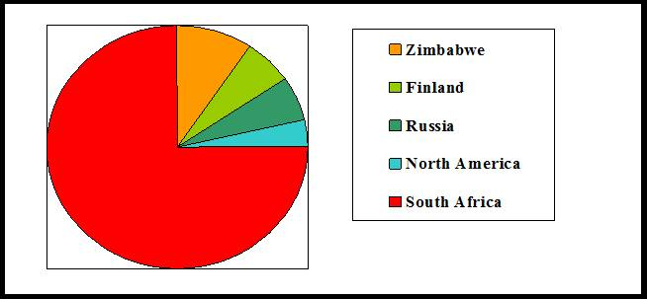
Why Hydrogen South Africa?
World Platinum Reserves: Cawthorn, 1999
Zimbabwe
Finland
Russia
North America
South Africa
Cabinet Approved 15 year Research, Development and Innovation Programme-HySA Strategy
Vision
“To create knowledge and human resource capacity that will develop high value commercial activities in hydrogen and fuel cell technologies, utilising local resources and existing know-how”
Overall Objective
Value added manufacturing for PGM catalysis value chain, with the aim to capture 25% global market share by 2020

Slide 22
Strategic Goals
Wealth Creation through value added manufacturing and development of PGM catalysis value chain with a goal of supplying 25% of the global hydrogen and fuel cells market by 2020
Build on existing knowledge and capabilities to develop local cost-competitive hydrogen generation solutions based on renewable resources
Promote equity and inclusion in the economic benefits of South Africa’s resources

Slide 23
Key Drivers of Hydrogen and Fuel Cell Technologies (HFCT)
Energy Security
  Reduces the threat caused by geographical location of fossil fuels
  Fossil based fuels come from finite resources
  Distributed Energy Generation
Decarbonisation of the Energy System
  Emissions reduction, particularly CO2, in various sectors,
  CO2 reduction is pushing the vehicle manufacturers to search for alternative fuels
Fuel cell vehicles have the potential for:
  zero emissions
  long range
  fast refuelling (compared to battery electric vehicles)
Applications in the Power to Gas market
  Provides means for energy storage, grid support and balancing
  Opportunity for decarbonising heat, transport and chemicals

Slide 24
Implementation Phase
2008 - 2013
2013 - 2018
2018 - 2023
Commercialise South African Innovation
Demonstrate
and Validate
Technology
Establish
R&D Capability at the CoCs
Recruit mission-critical staff
Identify initial markets
Develop first-pre commercial technologies
Establish critical supply chain capability
Deliver first products to market
Demonstrate capabilities in pilot markets
Contribute to international innovation
Compete successfully on world market
Capture 25% of Global Hydrogen and Fuel Cells market

Slide 25




HySA Centres of Competence
DST
NWU / CSIR
UCT / MINTEK
UWC

Slide 26







HySA R&D Programmes
Materials and Components
Components and
Systems
Systems
and Infrastructure
Key Programme 1: Combined Heat and Power
Key Programme 2: Portable Power Systems
Key Programme 3: Hydrogen Fuelled Vehicles
Key Programme 4: Hydrogen Filling Stations
Key Programme 5: Renewable H₂ Production
Value Chain

Slide 27
Effective R&D delivers technologies from labs to market…
Outcomes and Impact-driven R&D and Technology Transfer
Basic
Research
Applied Research
Develop, Test
Demonstrate
Concept
Engineering,
Pilot
Upscale,
Commercialise
DST’s RDI Programmes are explicitly directed towards market
from the outset, and focused delivering on socio-economic impact
Technology Readiness Level (output) at each stage is of relevance and value to particular research or commercialisation units
Early identification and active targeting of partners with structured participation opportunities at each stage: IP creation, technology
co-development, investment in pilots and scale-up, licensing, ventures
Partnerships at National, International and Inter-Government levels
(South Africa is a member of IPHE, which promotes development and use of HFCT)
Technology transfer initiatives harmonised with mandates and scope of other channels to market (commercialisation, investment)

Slide 28
Performance Indicators
Technology Development
  Demonstrators and Prototypes
Knowledge Generation
  Publications, Patents
Human Capital Development
  PhDs and MSc graduates
Strategic Partnerships
  Public and Private Sector Investments, collaborations
Commercialisation
  Pilot Plants
  Spin-off companies

Slide 29
National Investments
Budgets
Govt has spent about R500 million since inception of Programme
Current budget for the 2014-15 FY is R74.8 million
HySA Public Awareness, Demonstration and Education Platform: ZAR 1.8 million
Role of other government departments
the dti – Creation of an enabling environment for the deployment of fuel cells focusing on fuel cell component manufacturing in the special economic zones (SEZs)
DST – Gives advice regarding the efficacy of hydrogen and fuel cell technologies based on the RDI initiatives e.g. HySA
DoE – To provide the relevant policy environment and incentives for the uptake of fuel cells similar to those already in place for renewable energy
DMR – Ensures there are appropriate policies and strategies in place regarding minerals extraction and beneficiation
DRDLR – Provides information and guidance regarding communities that need to be prioritised for energy access
NT – Provides the finances required to support the development and uptake of fuel cells

Slide 30
HySA Highlights (Quater 2 and 3 FY 2014-15)-1
Technology Development:
  Advanced stack incorporating HySA K-40 Catalyst
  Metal Gas diffusion layer in a single cell
  Catalyst coated membrane
  250 W low temperature stack scalable to 2 kW
Publications:
  A total of 12 publications on hydrogen and fuel cells were produced from the CoCs
Patents:
  University of the Western Cape: Metal hydride bed, Metal hydride container, and Method for the Making thereof: Date of Application 09 June 2014 (Pending).
  A hydrogen storage and supply system integrated with fuel cell power pack that comprises of liquid- or air-cooled fuel cell power pack with an integrated heat exchanger system. Date of application: 26 November 2014.

Slide 31
HySA Highlights (Quater 2 and 3 FY 2014-15)-2
Prototypes:
  University of the Western Cape: HySA single cell tester (Commissioned 14 September)
  Fuel cell forklift with a metal hydride hydrogen storage extension tank;
  Electric bicycle with fuel cell power module and metal hydride hydrogen storage unit; and
  A 2.5 kW hydrogen and fuel cell power generator.
Human Capital Development:
  Two students went on exchange visits: Rhiyaad Mohammed went to PSI (Switzerland) to continue work on conductive oxides; and Thulile Khoza went to SINTEF in Norway to learn the preparation of inorganic supports and electrochemical analysis thereof
  MSc students; Thulile Khoza, Colleen Jackson, David Tsui and Greg Crymble graduated from HySA Catalysis
  Ms Thulile Khoza will be employed by HySA Catalysis as scientific officer.

Slide 32
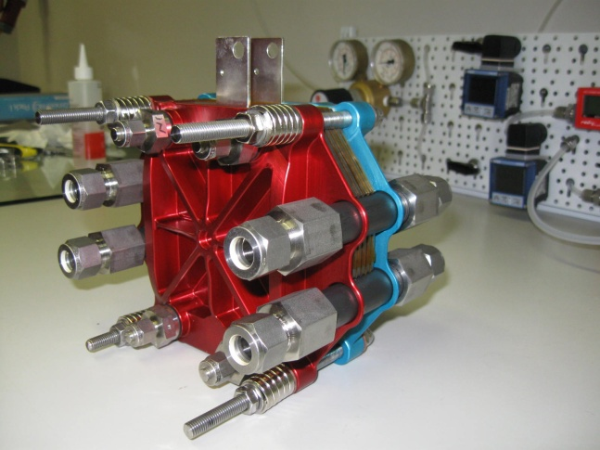
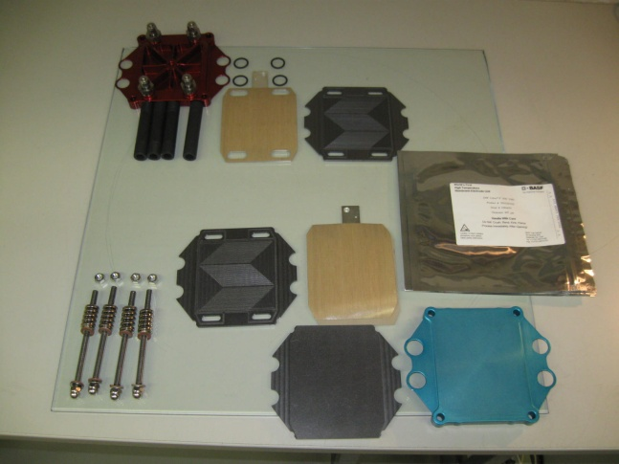
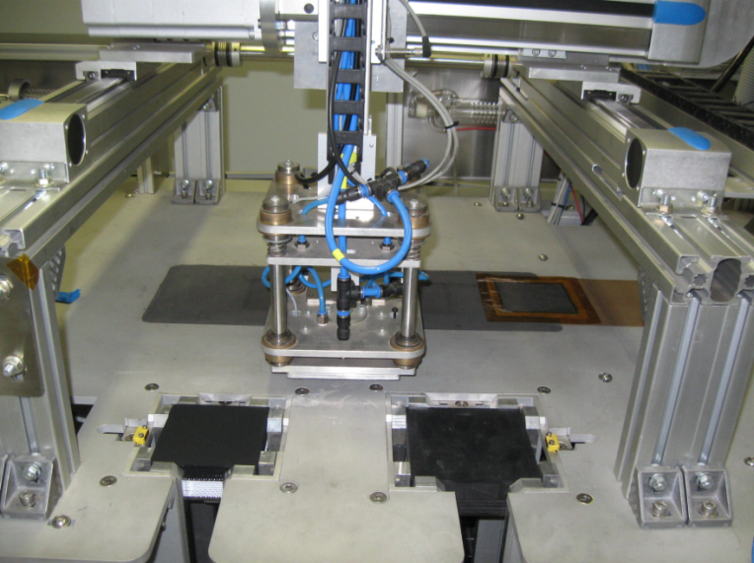
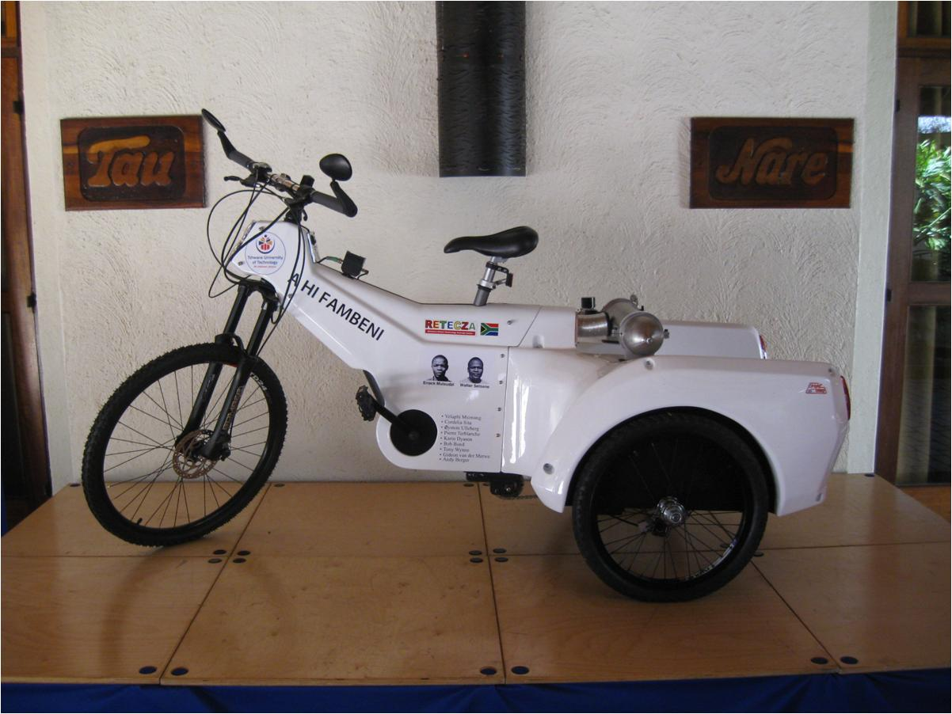
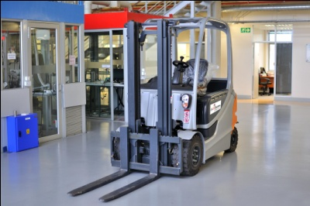
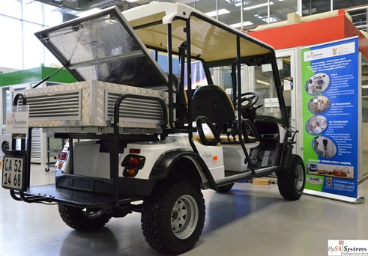
Technology Demonstration
PEM fuel stack (HT) and Bipolar Plates
MEA manufacturing line
Fuel cell powered tricycle
Fuel cell powered forklift
Fuel cell Golf Cart

Slide 33
Potential Market for HySA Components
1. Catalyst Market
2. Membrane Electrode Assembly (MEA): Current costs are at R1 500/MEA
Assuming we produce 1000 000 MEA units per year sold at R1 200/MEA would result in Revenue of R1.2 billion/yr.
3. Metal Hydride (MH) hydrogen storage material: Current costs are at R1 400/kg
Assuming we produce 1000 kg of MH per year sold at R1 200/kg would result in Revenue of R1.2 mil/yr.
4. Combined Heat and Power (CHP) Units: Current costs are at $30 000/kW
Assuming we produce 1000 x 1kW units per year sold at $15 000/kW would result in Revenue of $15 mil/yr.

Slide 34
CoC Collaboration with Industry-1
Clean Energy
  Installation of a 5kW hydrogen fuel cell at Windsor East Clinic in Randburg, in collaboration with Anglo Platinum, Air Products and Gauteng Provincial Department of Health.
  Fuel cell will provide back up power during power outages in order to preserve TB vaccines at the clinic
  Plans are underway for the Minister of Science and Technology to officially launch the project.
Impala Platinum
  Project with HySA Systems looking at the development of a hydrogen fuel cell powered forklift
  Impala Platinum has co-funded the project to the value of R6 million over three years.
Anglo American Platinum
  Anglo is interested in the metal hydride material for hydrogen storage for possible use in their fuel cell powered locomotive as well as for HySA systems to assist with systems integration
Air Products and Clean Energy
  Development of bulk hydrogen filling solution to address the challenges around hydrogen distribution logistics
  Cost effective hydrogen distribution will enable hydrogen fuel cells to be cost competitive with diesel generators in providing back up power for the telecommunications base stations.

Slide 35
CoC Collaboration with Industry-2
South African Post Office (SAPO)
  SAPO is interested in HySA Systems’ capability to extend the range of SAPO’s electric scooters using fuel cells.
  HySA Systems has already demonstrated the range extension capability in a golf cart.
  The DST has signed an MoU with SAPO to facilitate the collaboration of SAPO with HySA Centres of Competence on broader clean energy initiatives.
Transnet
  The DST has signed an MoU with Transnet that will facilitate the collaboration of Transnet with HySA Centres of Competence on clean energy initiatives.
  Transnet is particularly interested in energy storage, electrolyser technology and fuel cells.
  Hot Platinum
  Collaboration with HySA Systems led to the development of the 2.5 kW hydrogen fuel cell power generator. HySA Systems and Hot Platinum require financial support to manufacture and deploy more of the units.

Slide 36
Recommendations
Companies like Ballard who are demonstrating but still pursuing further development of their technology, need to be encouraged to collaborate with the HySA CoCs. Initial discussions, facilitated by the DST, have already been held with AAP/Ballard and the HySA CoCs regarding the potential collaboration;
Government would like to see active public private partnerships (PPPs) develop in the emerging HFCT sector. PPPs are critical in supporting the uptake of emerging technologies as shown by the success stories from other countries e.g. Japan;
Government needs to be encouraged to be the first customer in procuring its own technology e.g. replacement of diesel generators in government buildings with hydrogen fuel cells;
Further piloting of fuel cell technology is required especially in areas that are not connected to the grid e.g. in the 24 distressed district municipalities, as already identified by government;
Apart from local manufacturing, international fuel cell companies looking to do business in South Africa should agree to incorporate HySA developed technologies (catalysts, MEAs, bipolar plates, metal hydrides etc) into their fuel cell products;
Development Finance Institutions (DFIs) such as the IDC and the PIC need to support local manufacturing of fuel cell components within the special economic zones (SEZs) as designated by the Department of Trade and Industry (the dti); and
Fuel cells need to be seen as a possible way of alleviating the current challenges with the Eskom Grid. Although the system cost may be high initially, economies of scale will eventually bring the cost down, as demonstrated through the CHP Project in Japan.

Slide 37
Titanium CoC Overview
Titanium deposits in South Africa
Importance of titanium
Titanium market
Opportunity for Beneficiation
Titanium Centre of Competence (TiCoC)

Slide 38
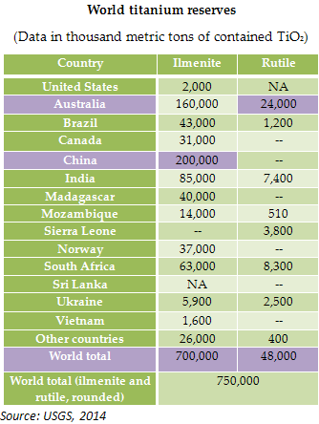
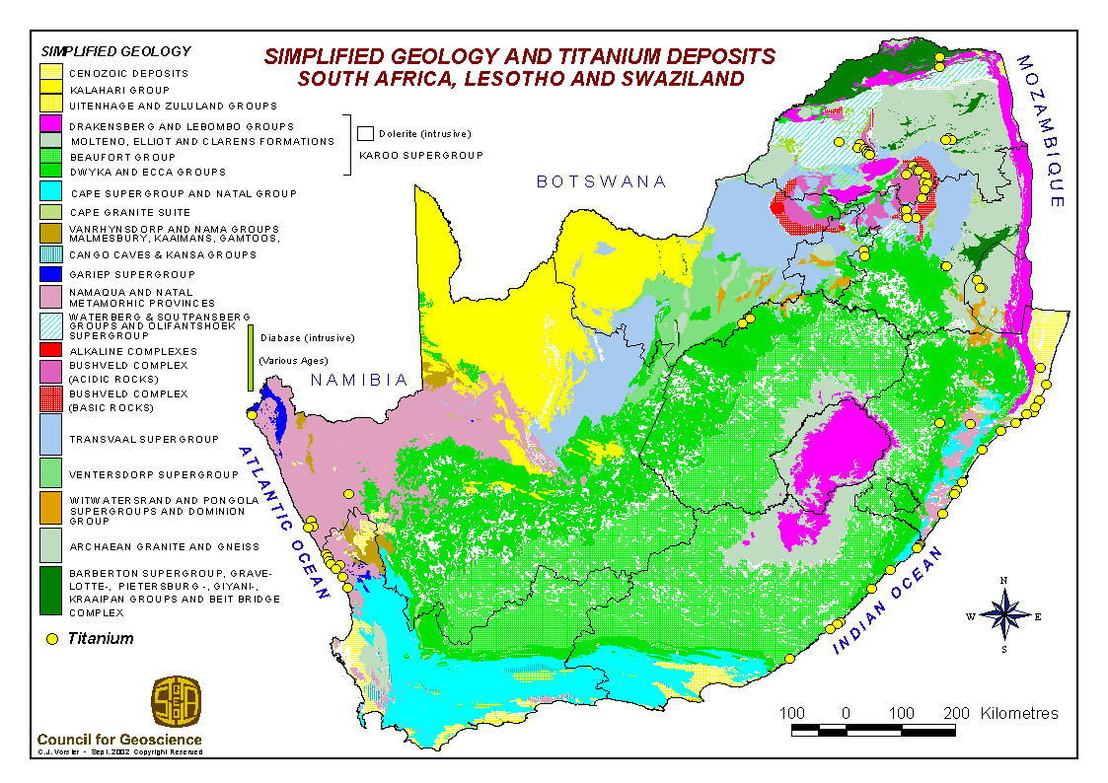
Titanium deposits in South Africa
Source: http://www.geoscience.org.za/images/stories/titanium.gif
Importance of titanium

Slide 39
Why is titanium special?
Density of titanium is only about 60% of steel or nickel-based superalloys
Titanium’s strength is similar to stainless steels and superalloys
Specific Strength (strength to density ratio) is the best of all metals
Titanium alloys and titanium aluminides are useful to temperatures of about 600ºC up to 750ºC
Titanium is exceptionally corrosion resistant - it does not corrode in seawater; is biocompatible; is compatible with carbon fibre composites
  Use of composites in aerospace increasing drastically
It finds application in Aerospace, Medical Implants and Marine industries
Importance of titanium

Slide 40
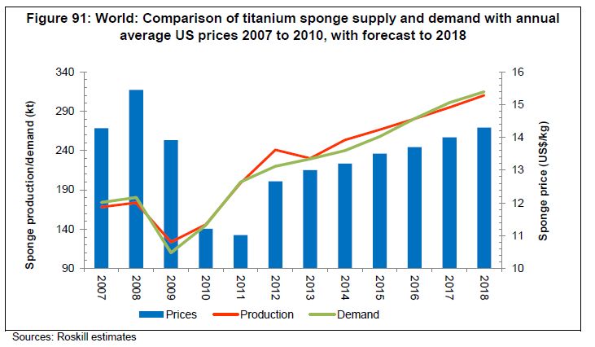
Steady growth forecast in demand for titanium metal (sponge)
40
Importance of titanium

Slide 41
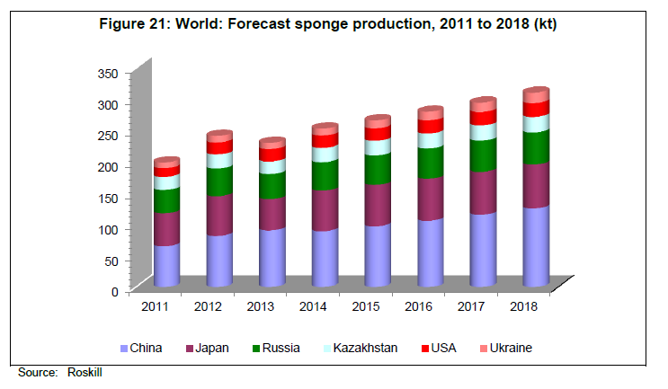
Main sponge producers are China, Japan, Russia, and USA
41
Importance of titanium

Slide 42
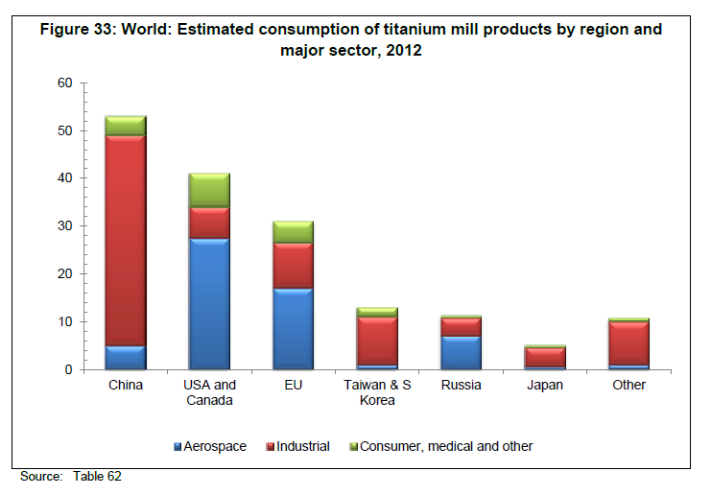
Titanium: regional consumption, dominated by commercial aerospace, industrial, and consumer/medical sectors
42
Importance of titanium

Slide 43
Titanium: South African Innovation Opportunity
Significant
Ti Ore
Reserves
Existing Markets:
Aerospace
Automotive
Medical
Recreational
Industrial
(e.g. Power Plants)
Chemical
Primary
Metal and Mill
Product
Technologies
Component
Manufacturing
Technologies
Raw Material
Processes & Technologies
Market
New, proprietary SA technologies for primary Ti metal powder production
Lower cost than current Ti powder (USD40/kg) or sponge (USD9/kg)
Structural advantage relative to global competitors
Favourable platform for downstream expansion of value chain
Established a Titanium Centre of Competence to
Integrate and Coordinate R&D for upstream and downstream Supply Chain development
Case for Beneficiation
Notes:
SA has the second largest titanium ore reserves in the world (2nd to Australia).
There are existing lucrative markets, such as aerospace, automotive, using titanium metal components and which are priority sectors for SA, however we are not producing Ti metal locally.
Therefore, if we can develop the processes and technologies for Primary Metal and Mill Product (basic shapes: bar, sheet, tube) and for Component Manufacturing, we could create new industry establishment and development opportunities for SA.
The Titanium Centre of Competence was established as the national vehicle for integrating and coordinating the R&D for developing the processes and technologies needed for upstream and downstream supply chain establishment.
Competitive new proprietary SA technologies for primary Ti metal powder production have been developed and taken to bench-scale pilot plant stage. These deliver Ti powder at significantly lower cost than currently available Ti powder and comparable to current Ti sponge cost. This achievement would provide SA with a structural advantage relative to global players in the titanium metal value chain and provide a favourable platform for local establishment of the downstream value chain.

Slide 44
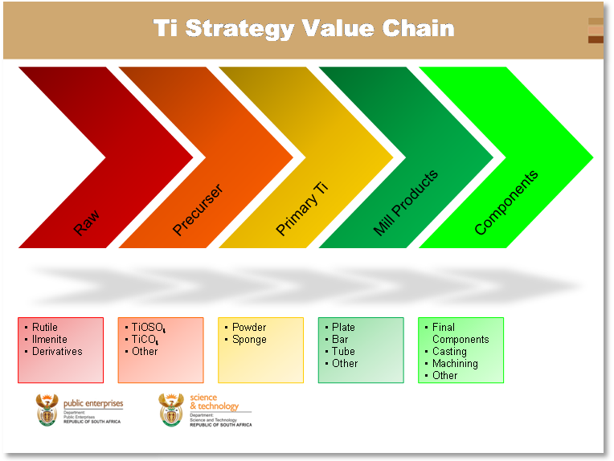
SA Titanium strategy framework formulated to deliver titanium related competencies across the Ti value chain (production of Ti to final product)
Case for Beneficiation

Slide 45
SA
Ti Industry
Titanium Centre of Competence
Developing and Commercialising
the Technology Building Blocks
of the South African
Titanium Industry
Chemical Processing
Aerospace
Automotive
Health
Leisure
Supplier Development
Industrialisation & Commercialisation
Titanium Technology Development
Primary
Metal
Production
CSIR
Mintek
Mill
Products
CSIR
Powder
Processing
CSIR
US
NIMS
Mintek
Southern Implants
Investment
Casting
CSIR
UCT
Aerosud
ALD
Machining
US
Fh IWU
UJ
UCT
Aerosud
CSIR
Additive
Manufacturing
NLC
Aerosud
CUT
VUT
MMP
Welding
NMMU
NLC
Forming
&
Forging
Physical Metallurgy: UCT, UP
Simulation and Modelling:
ULim(Ab Initio), CSIR(FEM, ProCast, Ab Initio), UCT(FEM)
Laboratories & R&D Facilities: CSIR, UCT, UP, US, NMMU, CUT, NLC, Mintek, Necsa
R&D Platforms
R&D Platforms
TiCoC
Notes:
This slide shows the framework of the Titanium Centre of Competence activities.
Its mission is to develop and commercialise the technology building blocks needed to establish a SA titanium metal industry spanning the whole value chain.
The technology building blocks being developed for local industrialisation and commercialisation to establish SA suppliers are shown from Primary Metal Production through to Forming & Forging.Local suppliers could supply into end user industries, such as Chemical Processing, Aerospace, Automotive, Health and Leisure.
Underpinning these from the more fundamental scientific knowledge side, are three R&D Platforms that feed into all of the technology building blocks as and when needed.
The acronyms in the technology blocks and R&D platforms show the different universities, science councils and companies that are all participating in this national programme.
The Titanium Centre of Competence is also responsible for pursuing the industrialisation and commercialisation of the developed technologies by identifying and incorporating players in this area who will collaborate with the Centre to realise these and take over the leadership of such activities at the appropriate stage. An example of this is the Primary Metal Production, where commercial players (funder and operator) are already working with the Titanium Centre of Competence in a Commercialisation Task Team.

Slide 46
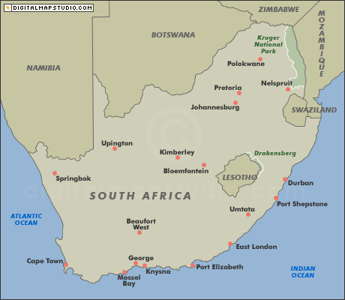










Titanium Centre of Competence Collaborators
46
International
R&D Institutions:
NIMS (Japan)
Univ California Davis (USA)
ESRF (France)
Fraunhofer IWU (Germany)
Univ of Plymouth (UK)
Companies:
Airbus (France)
Boeing (USA)
Snecma (France)
ALD (Germany)
ULim
UP
Aerosud
Necsa
CSIR
Mintek
NLC
UJ
Wits
VUT
CUT
UKZN
UCT
SU
NMMU
CPUT
TiCoC
Notes:
46

Slide 47
A New South African Titanium Industry
Economic and Job Creation Opportunity
Primary Titanium Metal Industry
Titanium Mineral
Titanium Metal Powder
CSIR-Ti Process
Pilot Plant
Semi-Commercial (Demo) Plant
Full Commercial Plant
Powder consolidation
300 - 400
Titanium Mill Products
Ferrotitanium
Powder spheroidisation
Bar
Sheet
Tube
Alloying
140 - 180
Downstream Titanium Manufacturing Industry
Additive Manufacturing Products
Near-net &
Net Shape Products
Fabricated Products
Cast
Products
Steel
Making
Estimated direct jobs
700 - 950
Forming
Machining
Joining
Crucible melting
Skull melting
Aeroswift
Umuvi
Medical
Metal Injection Moulding
Press & Sinter
40 - 70
20 - 50
180 - 220
15 - 20
TiCoC

Slide 48
Cheaper Titanium Powder – Changing the Industry
Typical prices
Ti Powder
10 USD/kg Ti
Ti Powder
40 USD/kg Ti
Final Products/Components: USD/kg 150 – 20,000
Ti Mill Products
50 USD/kg Ti
Ti Ingot
20 USD/kg Ti
Ti Sponge
10 USD/kg Ti
TiCl₄
4.4 USD/kg Ti
TiO₂ Pigment
5.3 USD/kg Ti
TiO₂ Slag
1.45 USD/kg Ti
Ilmenite
1 USD/kg Ti
Current SA industry
South Africa possesses the 2nd largest reserves of unbeneficiated Titanium dioxide
TiCoC

Slide 49
Powder vs Sponge Technology
Reduced Costs
  Limited/no waste of Ti material
  Near net shape
Characteristics not achievable by ingot metallurgy
  Unique property combinations
  Fabrication of difficult alloys
Sponge Technology
Mill Process
Fabricate Part
Sponge
Blend
Melt 1
Melt 2
Powder Technology
Fabricate Part
Powder
Blend
TiCoC
Notes:
This slide illustrates the advantages of directly producing titanium powder from the mineral, which can be converted into final products, versus the current commercial process chain.
In the current commercial process (the Kroll process) the primary metal production process delivers a Ti sponge that has to be refined at least twice in vacuum to provide a solid titanium ingot. This ingot is then converted through further processing into typical mill products, such as bar, sheet or tube. Mill products are processed by forming, machining, joining, etc to get to fabricated parts.
With the SA technology the primary titanium is produced as a pure Ti powder, which can be blended with powder of alloying elements and then densified through compression and sintering (fusing of the powder particles) to directly deliver dense, solid metal components. In other words, a number of intermediate processing steps can be avoided, which could result in reduced part production costs.
If the Additive Manufacturing process is used to turn the Ti powder directly into final parts, very little wastage of the expensive titanium metal occurs, which is not the case if a part has to be machined from a solid block of Ti.In the latter case as much as 80 – 90% of the material could be machined away (and become waste) to produce a thin-walled aircraft part.

Slide 50
Road Map
Primary Titanium Commercialisation
SA Titanium Industrialisation Plan
2011
2012
2013
2014
2015
2016
2017
2018
2019
2020
2021
2022
Demonstrate 2 kg/h production by Aug ‘15
Design 500 tpa semi-commercial plant by Mar ‘16
Fatal Flaw analysis
MoA
Primary Ti powder Production (CSIR Process)
Basic Development
Pilot Phase (2kg/h)
Feasibility Phase
Demonstration Plant
500 tpa
Commercially Pure (CP) Ti
World-Class Plant
Production: 20 000 tpa
first: CP Ti ; then Ti Alloy
Completed
In progress
R~500m
MTEF bid
(~50% of cost)
TiCoC
Notes:
The road map for the industrialisation and commercialisation of the SA patented primary Ti production technology is shown.
The basic (laboratory scale) development has been completed successfully and it has been demonstrated that pure Ti can be produced on laboratory scale (grams to a few kilograms of powder).
Subsequently, a Bench-scale Titanium Pilot Plant has been constructed and was officially opened on 7 June 2013. The commissioning of the plant is currently underway. This plant will produce titanium powder on the scale of 2 kg per hour in production campaigns of typically 5 days, 24 hours per day.
The operation of this pilot plant over 18 months to 2 years will provide further insight into the requirements for up-scaling the technology to commercial scale.
Given the successful outcome of this stage, the commercial partners will perform feasibility studies that will enable them to proceed to the semi-commercial Demonstration Plant, or test facility, which would produce up to 500 tons per year of Ti powder.
Following on the successful operation of the Semi-commercial Plant and positive results of the feasibility studies, the further upscaling to a world-class scale commercial plant will proceed.

Slide 51
Stages and gates for Ti metal
Stage 1
Concept screening and development
Successfully completed
Stage 2
Basic development/
Preliminary assessment
Successfully completed
Stage 3
Pilot scale development/
detail assessment
Design and costing of pilot plant
Stage 4
Semi-works scale development and validation (500tpa)
Stage 5
Commercial Implementation (Plant design and construction)
Comprehensive feasibility
Hazop and location
Construction
SOP and training
Commissioning
Operation
Analysis
Concept design and costing
Preliminary site selection
Preliminary EIA
Technical inputs to the business plan to build and operate the semi-works plant.
Commercial partners
MoA with IDC/
Industrial Partner
TiCoC

Slide 52
Summary
Titanium deposits in South Africa are substantial; largely exported with limited value addition
Focused R&D led industry development, ‘titanium Centre-of-Competence’ is ensuring that increased value addition is done in South Africa, focusing
  Primary titanium production
  Downstream processes
Ti-metal powder production process is a radical innovation, expected to make a substantial change to the ti-metal powder market
The CoC approach has been found to be effective

Slide 53
Dankie
Enkosi
Ha khensa
Re a leboga
Ro livhuwa
Siyabonga
Siyathokoza
Thank you

