Slide 1


Slide 2
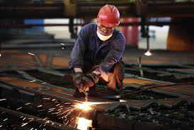
Presentation to the Parliamentary Portfolio Committee – Trade and Industry.
Perspectives of Industrial Policy and the Industrial Policy Action Plan. (IPAP)
4th March 2014.
Broaden participation

Slide 3
Contents
    Some context and background
    The Industrial Policy Action Plan.
    Constraints and opportunities
    Key themes IPAP 2015/16

Slide 4
Global historical context
The manufacturing sector lies at the core of industrialisation – highest economic and employment multipliers and linkages, including to other productive sectors – mining and agriculture.
OECD economies achieved high income per capita levels through industrialisation
Developing economies that achieved high and sustained growth after WWII did so through industrialisation – ‘late industrialisers.’
Common strategies of developing country successes
  Rapid growth of agriculture
  State-supported industrialisation
  Infrastructure directed towards value-added production and exports
  Finance directed towards long term investment in industry and infrastructure, with short term and speculative activities discouraged
  Supportive macro-economic policies
Notes:
Notes:

Slide 5
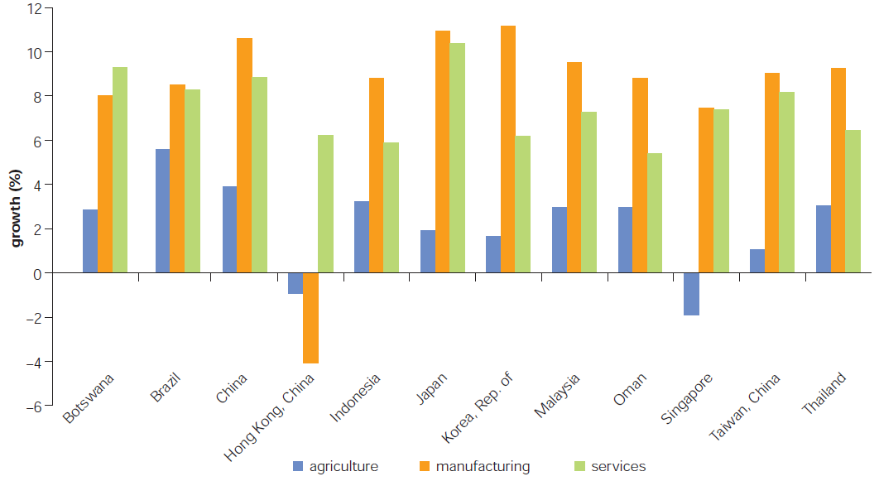
Growth rates by sector: countries post WWII experiencing high and sustained growth.
Postwar “success stories”: The salience of manufacturing
Source: Growth Commission. World Bank

Slide 6
Evolution of the South African economy
Apartheid system of economic development failed in the main to develop value-adding industries out of a mining and heavy industry base
  In the context of a system based on racial domination, growth was driven by mega-project investments in mining, related infrastructure and capital and energy intensive processing industries.
  Downstream engineering sectors contracted when mega-project investment dried up
  There were no coherent sector strategies based on domestic and new export markets
  Domestic economy characterised by deep structural problems
Notes:
Notes:

Slide 7
Evolution of the South African economy
Post-apartheid economy: structural problems of the economy remained largely intact and in some cases grew worse.
  Increased reliance and volatility on short term capital flows
  Rapid trade liberalisation, quickly undermined manufacturing base
  Low public infrastructure investment, including with respect to economic infrastructure
  Strengthened monopolistic private control of various sectors (e.g. steel and chemicals)
  Increasing shift of private investors to short term portfolio approach; limited investment in ‘bricks and mortar’ long term investment in productive sectors
Notes:
Notes:

Slide 8
Example - SA’s tariff reductions
Source: ITAC

Slide 9
Private credit extension, Rm (2005)
Source: SARB

Slide 10
Evolution of the SA economy
Economy has not grown fast enough for long enough. Between 1993 and 2014, quarterly GDP exceeded 5% in only 16 of the 84 quarters. Primary source of SA’s GDP growth of 5% in mid-2000s was the commodity ‘super-cycle’ (as China industrialised, commodity prices boomed) and credit fuelled consumption. Strong GDP growth in this period masked deep structural problems in the economy
Post-apartheid consumption-led growth path
  Consumption-based sectors of the economy grew at double the rate of production-based sectors
  This was based on increasing levels of household debt and is unsustainable in longer term
Growth and employment gains in service sectors such as retail cannot be sustained if the production side of the economy does not grow
Growth narrow, not inclusive and characterised by :
  Declining share of productive sectors (Mining, Agriculture and Manufacturing) in GDP
  Nature of growth was both import- and skills-intensive
  Dependence on commodity exports and capital inflows has impacted on exchange rate and made economy vulnerable to global sentiment
Notes:
Notes:

Slide 11
Source: Quantec

Slide 12
Industrialisation and the interlinked nature of the SA economy
Manufacturing is central to growth and job creation and its contribution to GDP has declined steadily.
  Directly
  Backward linkages: demand for agricultural, mining and service sector inputs
  Forward linkages: development of new sectors and products
Agriculture is a critical sector and it has also declined
  Potential as a much more important source of jobs
  Provides critical feedstocks to manufacturing
  Potential to contribute far more to exports and balance of payments
Notes:
Notes:

Slide 13
Manufacturing sector contributions to SA economy
Manufacturing sectors % contribution to SA GDP and employment has declined over time, with 2013 ratios substantially lower than in the 1980s.
Manufactured exports are highly concentrated, with a few sectors such motor vehicles & components, basic iron & steel, basic chemicals, basic non-ferrous metals and petroleum products dominating the export basket.
Source: IDC

Slide 14
Contribution by Agriculture to the SA economy
Contribution of agriculture to GDP has declined over time with the contribution in 2013 reaching a new low.
The sectors contribution to exports is also low although it has started to recover over the last few years.
Source: IDC

Slide 15
Mining sector contributions to SA economy
Mining sector contribution to SA economy declined across a number of key economic indicators. Exports have risen driven by demand, mainly from the PRC.
Mining sector is still of vital importance to SA economy.
Source: IDC

Slide 16
Mining is a critical source of demand for manufacture
A number of sectors rely on the mining sector as a key source of demand for their respective products/services.
In manufacturing, sub-sectors such as rubber, machinery & equipment, other transport equipment, wood, as well as many other sectors supply a substantial portion of their output to the domestic mining sector.

Slide 17
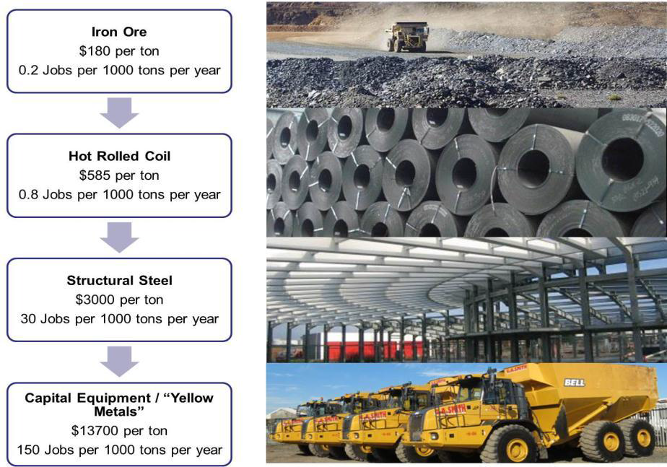
Correlation between resource-based value addition and job creation

Slide 20
Industrial Policy Action Plan (IPAP): Inter-locking cross-cutting and sector specific policies
1. Macro-economic policies which support more competitive and stable real exchange and interest rates
2. Industrial financing channelled to more labour-intensive and value-adding sectors
3. Leveraging procurement to raise domestic production and employment in a range of sectors
4. Developmental trade policies such as tariffs and standards deployed in a selective and strategic manner
5. Competition and regulation policies: competitive input costs for productive investments and affordable goods and services for poor and working-class households
6. Skills, technology and innovation policies better aligned to sectoral priorities
7. Deploying these policies in general and in relation to more ambitious sector strategies, as set out in detailed Cross-cutting and Sector KAPs

Slide 21

Underlying principles and outcomes
Context and underlying principles: 1
IPAP is aligned with the vision of the NDP and the key growth drivers of the NGP. It seeks to:
  Enable a restructuring of the economy and reverse the threat of deindustrialisation;
  Place it on a more value-adding, labour-intensive and environmentally sustainable growth path - especially in globally competitive non-traditional tradable goods and services;
  Produce a decisive shift of focus towards historically disadvantaged people and regions of SA;
  Contribute towards regional industrial integration in Africa,

Slide 22
IPAP: value-added sectors with high employment and growth multipliers
Source: DTI

Slide 23
Context and underlying principles: 2
IPAP is fundamentally committed to:
  Sound research;
  Intensive stakeholder engagement;
  Intra-governmental coordination and integration;
  Identification of key areas of market failure;
  Industrial ‘self-discovery’ and learning-by-doing.
IPAP asserts state leadership in strategic areas of the economy by ‘steering but not rowing.’
It is also committed to internal process improvement and capacity building, both within the dti and in support of its partner institutions.

Slide 24
Context and underlying principles: 3
Key Action Plans:
  Over the past 6 years, IPAP has developed a wide range of transversal and sector-specific Programmes and Key Action Plans (KAPs).
  IPAP KAPs are designed around time-bound milestones and the allocation of lead and supporting responsibilities to specified departments and institutions.
Methodology:
  The IPAP has proven to be an important tool for:
    Planning and management;
    Monitoring and evaluation;
    Oversight;
    Intra-governmental coordination and integration.

Slide 25
Context and underlying principles: 4
Provision of targeted, conditional support to industry:
  IPAP increasingly requires strong quid pro quos from recipients of its targeted investment and incentive schemes. (Reciprocal responsibility and accountability).
  Recipients are particularly required to make clear improvements in the key areas of:
    Plant and process upgrading;
    Competitiveness and export orientation;
    Employment retention and new job creation.

Slide 26
Context and underlying principles: 5
Consolidating the foundation:
  The new platforms created by IPAP have built a foundation upon which industrial policy can be deepened and extended.
  These include:
    Procurement;
    Infrastructure and localisation;
    Industrial financing and incentives;
    Stronger and more focussed export support and promotion.
All the above need to be combined with greater efforts to overcome cross-cutting constraints and intensify intra-governmental integration and co-ordination and build a much stronger relationship between the public and private sector.

Slide 27
Context and underlying principles: 6
“Industrial policy works”
  Demonstrable progress and results illustrate that industrial policy can and has worked when it is firmly based on these principles and adequately resourced.
  Clear examples of IPAP-assisted success can be seen in the automotive sector, clothing and textiles, business process services and the film industry.
It is important to emphasise that the progress achieved to date has been in the face of extremely unfavourable global economic conditions and considerable domestic constraints.

Slide 28
CONSTRAINTS & THREATS
  Protracted recession and decreased demand for SA exports in our traditional export markets in the US and Euro Zone. Difficulties associated with changing our export paradigm.
  Weakened domestic demand as the credit-fueled boom of 2005-2007 continues to prove unsustainable.
  Financial market failure and lack of investment in productive sector: requiring a much more strategically focussed set of investment instruments and incentives across all DFIs and departments.
  Monopolistic pricing of privately owned key intermediate inputs into the manufacturing sector – especially steel and plastics.
  Continuing currency volatility.
Constraints
  Electricity supply problems and sharply escalating and ‘bunched up’ administered prices - most notably double digit electricity municipal price increases.
  Weaknesses in intra-governmental coordination.
  Regulatory ‘red-tape’ burden across government
  Continuing high port charges and freight and logistics inefficiencies for export of value-added goods.
  Continuing skills deficits and mismatches across the economy – an especially critical problem for the new growth sectors.
  Labour relations volatility.
Threats

Slide 29
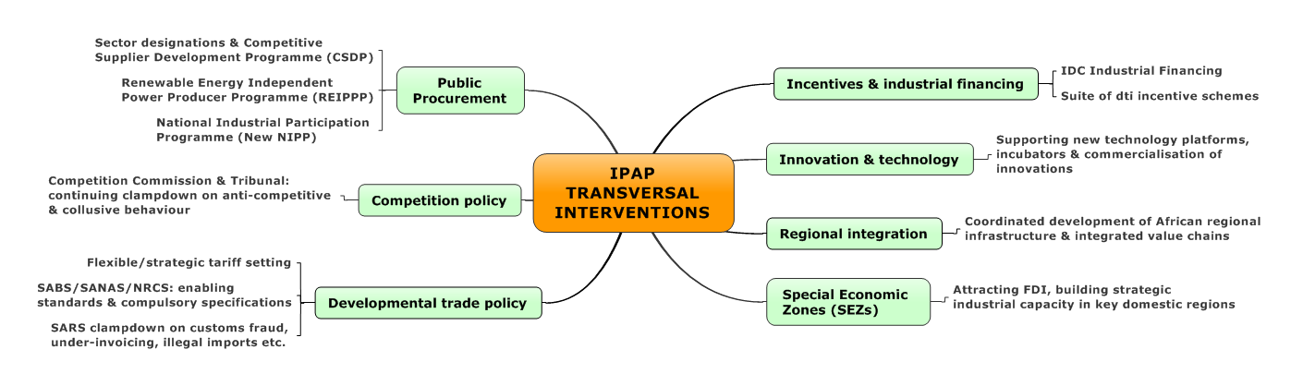
IPAP TRANSVERSAL FOCUS AREAS

Slide 30
Underlying principles and outcomes
IPAP 2014-17: KEY AREAS OF TRANSVERSAL INTERVENTION: 1
Economy-wide
Better, more coherent articulation of macro- and micro-economic policies.
Stronger intra-governmental coordination and better implementation.
Ongoing effort to overcome key constraints – electricity supply/high administered prices and regulatory –’red tape’ requirements.
Stronger alignment of industrial policies and programmes with investment and export promotion programmes designed to drive up export performance and reduce the current account deficit.
More ‘deep-dive’, granular research and analysis at sector, industry and individual firm levels, with stronger stakeholder dialogue, engagement and long term partnership development.

Slide 31
Underlying principles and outcomes
IPAP 2014-17: KEY AREAS OF TRANSVERSAL INTERVENTION: 2
Procurement
Sustained effort to secure compliance with existing public procurement policies and strategic sourcing/supplier development measures (Compliance/training and capacity building and strategic sourcing.)
Strong persuasive efforts to secure private sector support for local manufacturing – a contribution that large companies in particular are well placed to make, given their significant procurement spend.

Slide 32
Underlying principles and outcomes
IPAP 2014-17: KEY AREAS OF TRANSVERSAL INTERVENTION: 3
Industrial financing
Stronger alignment and progressive strengthening of industrial financing & incentives – a system of industrial financing, incentives and support for exports.
An optimal mix of public and private sector funding that can progressively strengthen investment in the productive - especially manufacturing - sectors of the economy.
Support for industrialists committed to long term participation in manufacturing through a combination of majority ownership and active management.
Development of targeted industrial financing instruments for black industrialists to acquire majority control of manufacturing enterprises, either through new investments or acquisition.

Slide 33
Underlying principles and outcomes
IPAP 2014-17: KEY AREAS OF TRANSVERSAL INTERVENTION: 4
Developmental trade policy
Ongoing strengthening of developmental trade policies - with the following key components:
  Deployment of selective and strategic tariffs and their improved alignment with industrial policy objectives.
  Close cooperation with the International Trade Administration Commission (ITAC) - whilst recognising its necessarily independent role.
  Closer cooperation with the Customs Division of the South African Revenue Services (SARS) to combat the ever-present (and steadily growing) problem of illegal and fraudulent imports – one of the key pillars of the illicit economy.
  Steady and incremental strengthening of the capacity and capabilities of the Standards, Quality Assurance, Accreditation and Metrology (SQAM) institutions, which provide an indispensable support framework for a modern and competitive economy. (e.g. the new Legal Metrology Act).

Slide 34
Underlying principles and outcomes
IPAP 2014-17: KEY AREAS OF TRANSVERSAL INTERVENTION: 5
Competition policy
Strengthened interventions to combat anti-competitive and collusive behaviour in both the private sector and State Owned Companies (SOCs) in order to lower the cost of procurement to the national fiscus and of wage goods to working families.
.
Innovation and technology
New policies and programmes to ramp up competitive capabilities in the production and services sectors of the economy, taking advantage of every opportunity to leverage the quantum advances on offer in the sphere of digital, additive and other globally emergent advanced technologies.
Notes:
This approach derives from the recognition that the manufacturing sector has the highest economic and employment multipliers in the economy - making it the principal driver of innovation and technological advancement, with multiple spill-over effects. IPAP is predicated on the state supporting, nurturing and defending these core objectives: seeking to assert state leadership in strategic areas of the economy by ‘steering but not rowing.’ To this end, it identifies a complex range of complementary, interlocking policies that require systematic alignment and integration across departments.

Slide 35
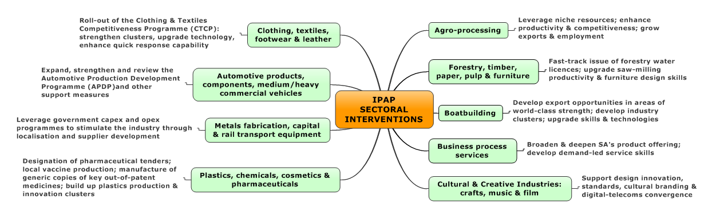
IPAP SECTORAL FOCUS AREAS
CLUSTER I

Slide 36
IPAP 2014 : KEY AREAS OF SECTORAL INTERVENTION : I
Clothing, textiles, leather and footwear (CTLF):
  Working with IDC secure better turn-around on incentive deployment; rebate provisions for textiles into downstream clothing manufacturers and opportunities in leather.
Automotives:
  Review the Automotive Production Development Programme (APDP)
  Secure stronger localisation.
Metal Fabrication, Capital and Rail Transport Equipment:
  Designations;
  Cluster enhancement;
  Capital goods value chain analysis;
  Deepening the Competitive Supplier Development Programme (CSDP) with Transnet and Eskom.

Slide 37
IPAP 2014: KEY AREAS OF SECTORAL INTERVENTION : 2
Plastics, Chemicals, Cosmetics and Pharmaceuticals:
  Designations and roll-out of new sector strategies in plastics and cosmetics and clusters.
Agro-industries:
  New opportunities in value chain – cassava; milling; forestry, paper/pulp and furniture.
Business Process Services (BPS):
  Scale-up incentive and new incentive guidelines; strengthened Monyetla training programme.
Creative industries:
  New strategies/programmes for music, film and craft.

Slide 38
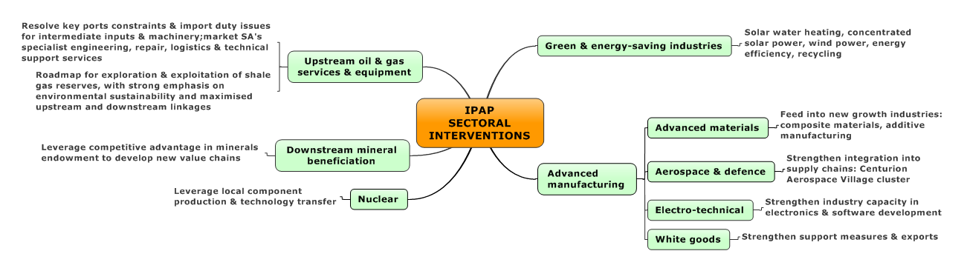
IPAP SECTORAL FOCUS AREAS
CLUSTER II

Slide 39
IPAP 2014: KEY AREAS OF SECTORAL INTERVENTION : 3
Green Industries:
  Industrial policy roadmap for low carbon manufacturing; revision of localisation for REIPPPP; Designations and Waste Management and Recycling Strategy.
Aerospace:
  Strengthen support instruments and strategy: cluster development, Centurion Aerospace Village (CAV) and Export Council.
ICT and electro-technical:
  Designations; localisation in broadband roll-out.
White Goods:
  Export strategy in support of local manufacturers and tariff regime improvement.

Slide 40
IPAP 2014 : KEY AREAS OF SECTORAL INTERVENTION : 4
Beneficiation:
  Develop roll-out of key beneficiation projects with the Industrial Development Corporation (IDC)
Oil and Gas:
  Strategic plan for up and downstream oil and gas from an industry perspective.

Slide 41
SUMMARY: IMMEDIATE OPPORTUNITIES: 1
Industrial policy
Identify and support dynamic export-oriented companies - especially in sectors where SA enjoys competitive advantages/opportunities.
Stronger focus on performance conditionalities.
More effectively targeted industrial financing particularly for key sectors such as Mining and Transport Capital Equipment.
Stronger partnerships between industry and government.
Infrastructure development
Optimise state infrastructure investment programmes as a powerful stimulus to industrialisation leveraged off the localisation of a wide range of manufactured inputs into the infrastructure build.
Particular focus on construction, metals, capital and rail transport equipment and renewable energy.

Slide 42
SUMMARY: IMMEDIATE OPPORTUNITIES: 2
Regional integration and new export markets
Sustained and concerted regional growth is arguably the biggest stimulus to long-term growth in South Africa. In the short to medium term, regional integration offers continuous opportunities for SA to grow its exports base.
Dynamic SA manufacturing companies have already seized the opportunity to increase exports, intensify marketing initiatives and establish after-sales servicing capacity.
A number of ongoing and scaled-up interventions are in the pipeline. These include: planning cross-border infrastructure; effective articulation of up- and downstream linkages in resource exploitation; and the realisation of massive construction opportunities.
BRICS
South Africa’s participation in the BRICS provides important opportunities to build its domestic manufacturing base, enhance value-added exports, promote technology sharing, support small business development and expand trade and investment opportunities.
Development of complementarities and integrated value chains should be underpinned by an overall approach that puts industrialisation at the core of the engagement.

Slide 43
Source: Quantec

Slide 44
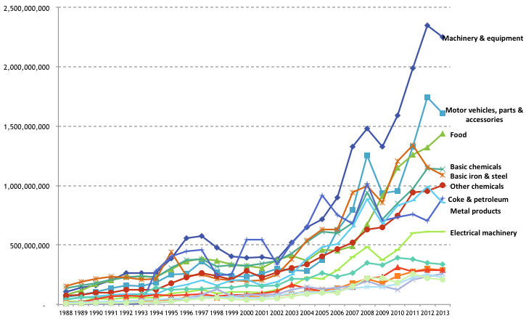
Major SA exports to the rest of Africa, US$, 1988-2013, by major manufacturing sector

Slide 45
Key themes for IPAP 2015
Infrastructure-driven industrialisation: through sustaining and building the infrastructure programme with stronger support for local manufacturing
Resource-driven industrialisation: which enables the leveraging of mineral resources for greater downstream beneficiation and value addition and maximises upstream linkages
Maximising opportunities to the domestic economy by a growing market on the African continent and regional industrial integration
Rolling-out of the intra-governmental Operation Phakisa for the marine economy
Advanced manufacturing-driven industrialisation: in key ‘spill-over’ sectors with stronger conditionalities for public sector support (Support for emerging black industrial entrepreneurs)
Strengthening the localisation of public procurement, including compliance, capacity building and strategic sourcing.

Slide 46
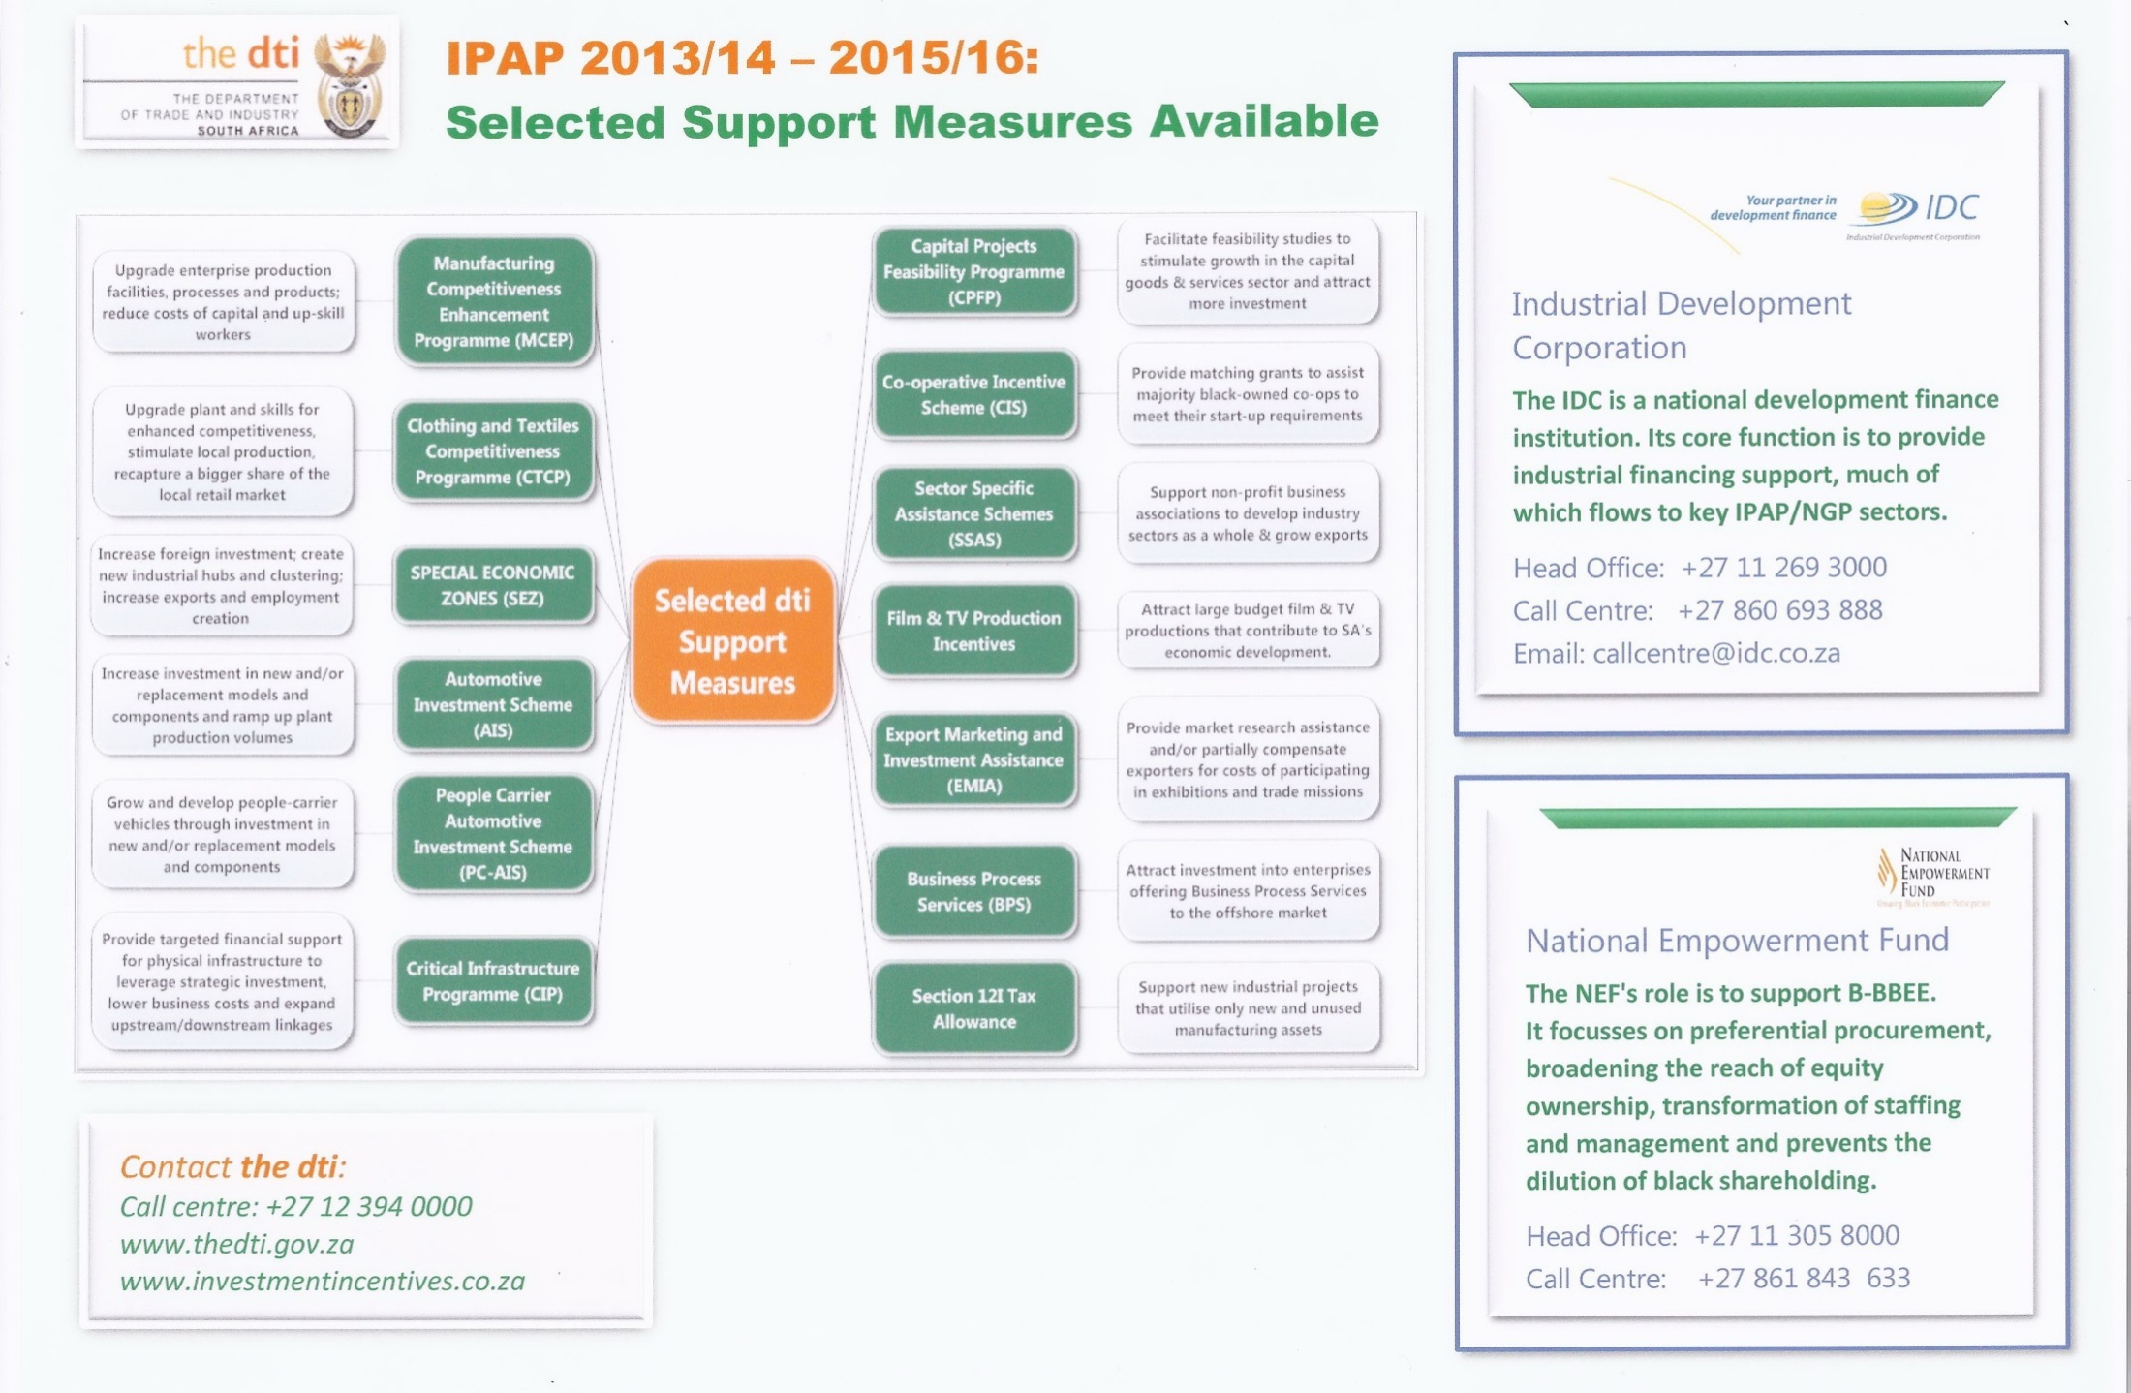

Slide 47
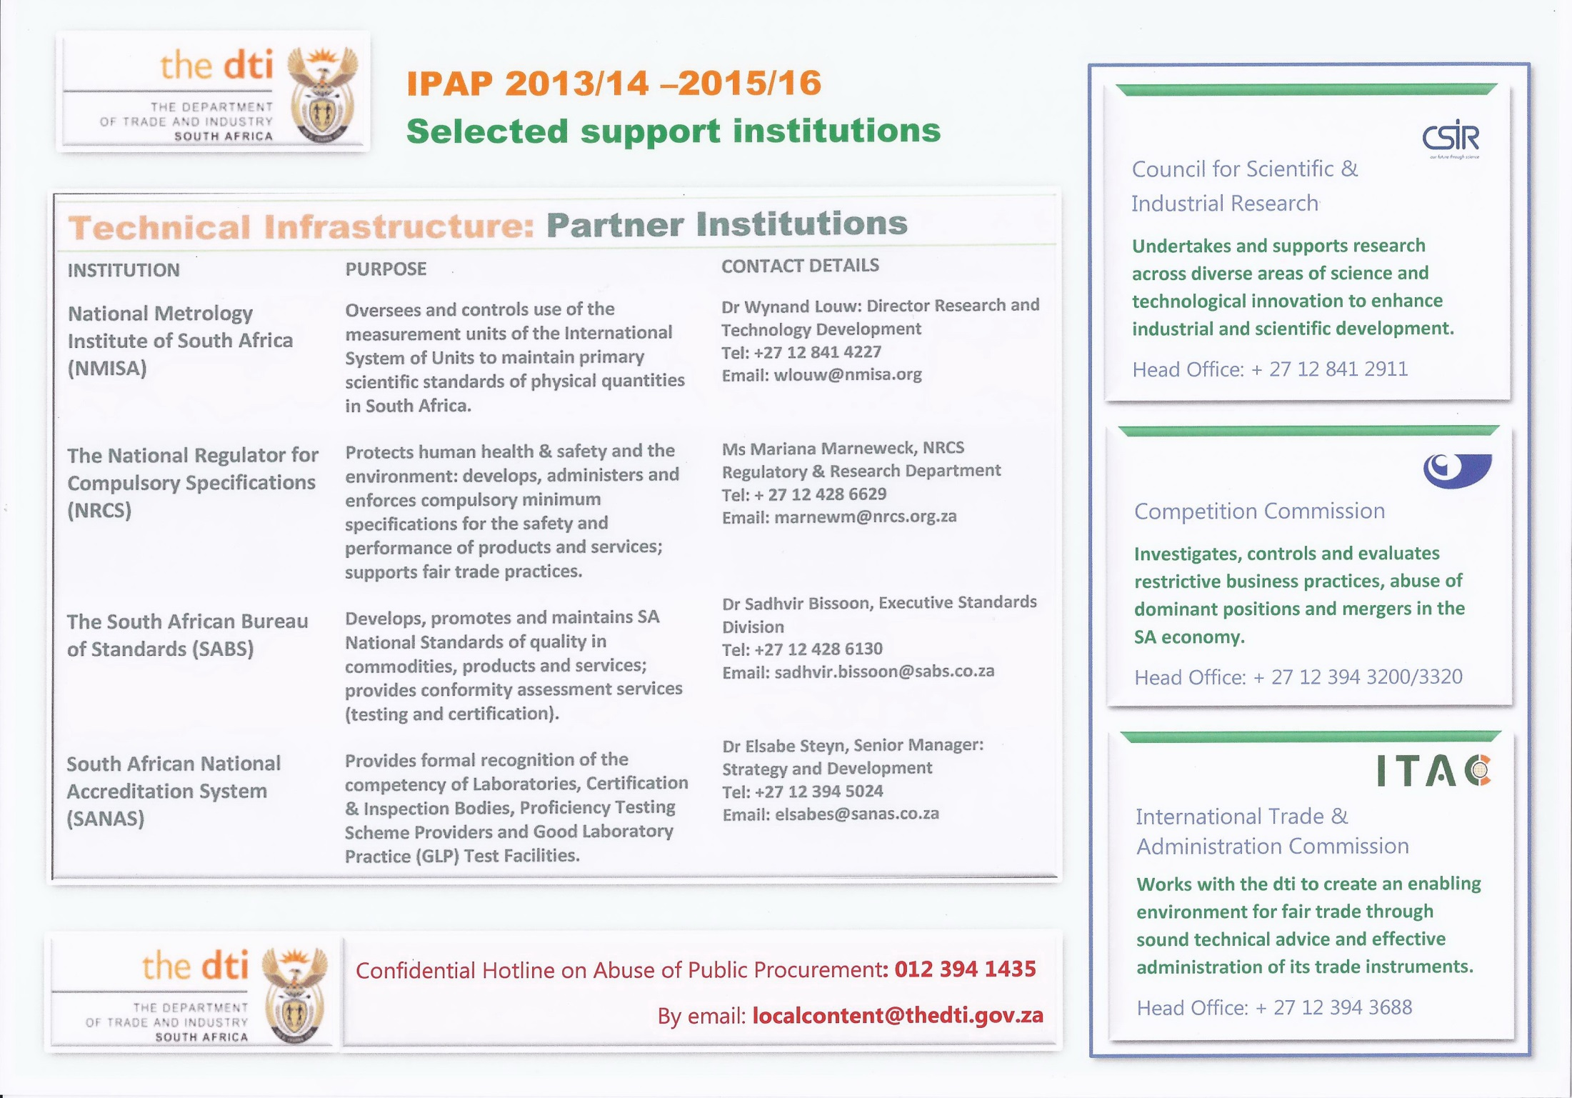

Slide 48
Some Readings
Industrial Policy in a Harsh Climate: the Case of South Africa. Nimrod Zalk – Strategic Advisor: Minister of Trade and Industry.
Industrial Policy Action Plan (IPAP) – The Department of Trade and Industry.
Trade and Development Report 2014 – UNCTAD
The rise of ‘The Rest’ – Challenges to the late industrializing economies – Alice Amsden
How rich countries got rich and how poor countries stay poor – Erik Reinert
Rents, rent seeking and economic development: Theory and Evidence in Asia – Mushtaq Khan

Slide 49
Some Readings
How Asia works: success and failure in the worlds most dynamic region - Joe Studwell
Governing the Market: Economic theory and the role of government in East Asian industrialisation – Robert Wade
Bad Samaritans: Ha Joon Chang
The Rhetoric of Reaction: Perversity, Futility, Jeopardy – Albert O Hirschman
State-directed development: Political power and industrialization in the periphery – Atul Kohil
Pathways to Industrialisation in the 21st Century - Szirmani, Naude and Alcorta Eds.

