Slide 1

PRESENTATION TO THE PORTFOLIO COMMITTEE ON HOME AFFAIRS
STATUS OF THE AMENDMENTS TO THE REFUGEE ACT AND RELOCATION OF REFUGEE RECEPTION OFFICES CLOSER TO THE BORDERS.
03 MARCH 2015

Slide 2


PRESENTATION OUTLINE
Purpose of the Presentation
Status of the Amendments to the Refugee Act
Update on opening of the Refugee Reception Office RRO in Lebombo, Mpumalanga

Slide 3
PURPOSE
To provide latest status on the status of the Amendments to the Refugee Act and on the establishment of a Refugee Reception Centre in Mpumalanga, Lebombo.

Slide 4
THE REFUGEES AMENDMENT ACT, 2008
(BACKGROUND)
The Refugees Amendment Act, 2008 (Act No. 33 of 2008) (the “2008 Amendment Act”) sought to dissolve the existing Standing Committee for Refugee Affairs(SCRA) and the Refugee Appeal Board(RAB) and replace them with the Refugee Appeals Authority which was initially to deal with both the functions of SCRA and RAB. However, Parliament (Portfolio Committee on Home Affairs) rejected the proposal and indicated that the functions should be separated though agreeing that SCRA must be dissolved, instead the Director-General be the one to review the manifestly unfounded, abusive and fraudulent applications.
In effecting the proposal by the Portfolio Committee, there was a technical error of reference to appeal and review in the powers of the Refugee Appeals Authority – see section 24B(1) - An applicant who is aggrieved by the decision of the Refugee Status Determination Officer (“RSDO”), either in terms of section 24(3)[(b) or] (c), may now lodge an appeal to the Appeals Authority.

Slide 5
THE REFUGEES AMENDMENT ACT, 2011
The Refugees Amendment Act, 2011 (Act No. 12 of 2011) (the “2011 Amendment Act”) was enacted to correct the technical error contained in the Refugees Amendment Act, 2008 (previous slide) granting the Refugee Appeals Authority the power to deal with both applications rejected as manifestly unfounded, abusive and fraudulent and unfounded as appeals instead of the reviews being dealt with by the Director General.
The need was further established that the current RAB was challenged on quorum and since the Amendment Act 2008 was not addressing that, the 2011 Amendment introduced the concept of a single member determination of appeals.
The concept of the Status Determination Committee was also introduced to replace the Refugee Status Determination Officer. The rationale for the replacement was that the caliber of persons responsible for granting refugee status should be at an appropriate level, including quality assurance imperatives.

Slide 6
THE REFUGEES AMENDMENT ACT, 2011 CONT.
In effecting the proposal, the model of the Status Determination Committee was elevated beyond the initial thinking by introducing sub-committees.
The final model has an impact on several issues, including-
    Efficiency of the committees vis-à-vis a single person status determination.
    Funding (required more funds than anticipated).
Following internal discussions, including discussions with National Treasury, on how to implement the SDC model (in the process of drafting the Regulations) it was realised that there is a need to revert to a single RSDO model.

Slide 7
THE REFUGEES AMENDMENT BILL, 2015
The 2015 Bill will enable the Department to implement the 2008 and 2011 Amendment Acts excluding the SDC’S and reinstate the RSDO’S.
A draft Refugees Amendment Bill, 2015 has been prepared and is being taken through legislative processes before actual introduction into Parliament.
The Bill will also effect the Constitutional Court’s decision in the Mail and Guardian case regarding the accessibility of the Refugee Appeal Board hearing.
The Draft Bill will be introduced into Parliament during 2015. as indicated in the legislative programme of the Department for 2015.

Slide 8
ESTABLISHMENT OF A REFUGEE RECEPTION CENTRE IN LEBOMBO
In February 2012 the Department of Public Works (DPW) was approached for assistance in acquiring a site for a Refugee Reception Centre.
During February 2012 a site viewing meeting was held at the Lebombo port , between DPW and DHA. Three sites were viewed in and around the Lebombo area, namely (i) a military base (about 20km from the port), (ii) vacant land adjacent to the port and (iii) vacant site 7 kilometres from the port. Of the 3 (three) sites DPW advised that the vacant portion of land 7 kilometres from the port was most suitable for the establishment of the centre. The site was also later discarded (November 2012) due to the legal process around land ownership.

Slide 9
ESTABLISHMENT OF A REFUGEE RECEPTION CENTRE IN LEBOMBO
Following the failure to secure one of the three previously identified sites, DPW continued looking for the site in 2013.
DPW presented a report in July 2013 indicating that 4 (four) sites had been identified in the area and only 2 (two) met criteria and were suitable for the establishment of a Refugee Reception Centre (Sites B2 and B3). The sites are located 6 (six) kilometres from the Lebombo port of entry)
A DHA/DPW site inspection was undertaken on the 12 June 2014 and DHA confirmed that the selected sites B2 and B3 were suitable for the centre.

Slide 10
ESTABLISHMENT OF A REFUGEE RECEPTION CENTRE IN LEBOMBO
In their letter dated 12 September 2014, DPW confirmed that the following processes needed to take place before the centre can be established;
Planning and design 4 to 6 months (March 2016)
Site Clearance – estimated 8 to 18 months (September 2016)
Tender and construction 24 months (September 2018)
According to the above, DPW have advised that the process will take four years before completion.

Slide 11
ESTABLISHMENT OF A REFUGEE RECEPTION CENTRE IN LEBOMBO
In a further letter dated of 24 November 2014, DPW have confirmed that the land is state owned and advised that the site is zoned agricultural use and as such it must be rezoned to administrative use. The zoning application was lodged with the municipality in August 2014. The outcome of the application is expected by the 6th of March 2015
DHA OPTION
Once the zoning application is approved, DPW will be approached to explore the possibility of establishing an interim structure whilst construction of the permanent structure is underway.

Slide 12
Thank you !
End

Slide 13
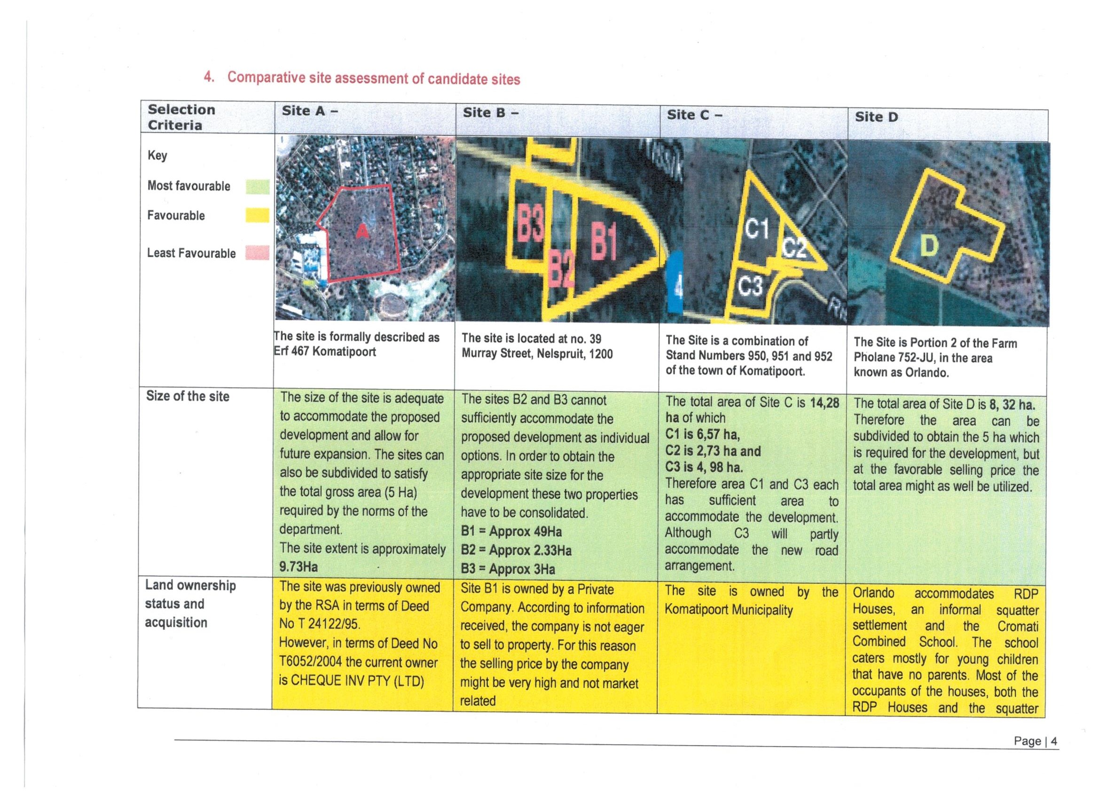
ESTABLISHEMENT OF A REFUGEE RECEPTION CENTRE IN LEBOMBO

Slide 16
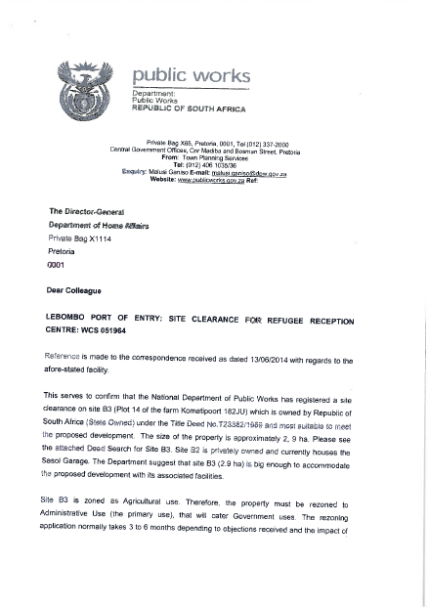

Slide 17
