Slide 1

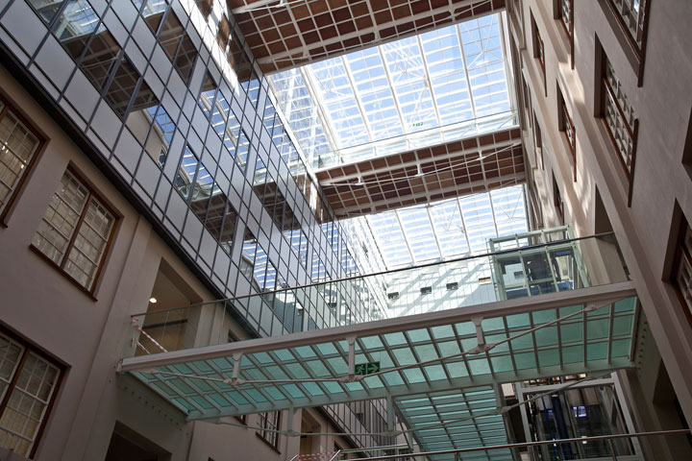
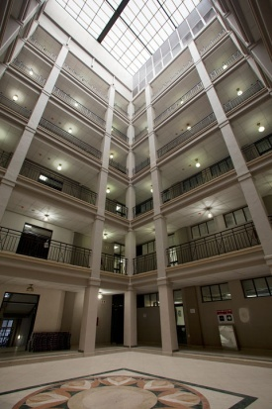

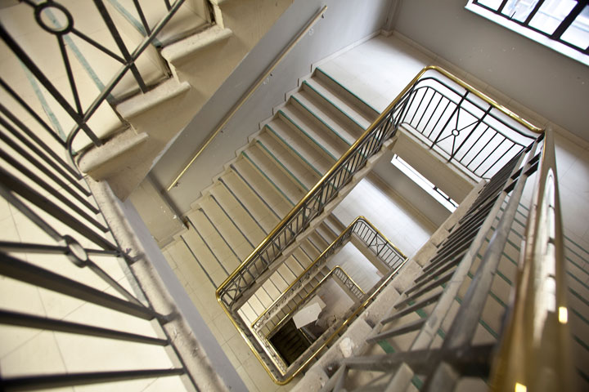
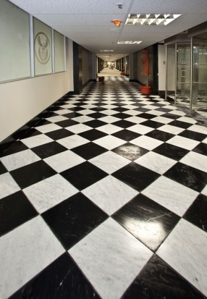

BRIEFING ON PROPERTY MANAGEMENT TRADING ENTITY (PMTE) AND LEASE PORTFOLIO
Portfolio Committee 3 March 2015
DG: DPW
Mr M Dlabantu

Slide 2
1. INTRODUCTION
DPW Key Mandate: custodian & manager of Government’s immovable assets => directly impacts efficiency and effectiveness of all client departments and service delivery.
Corruption, mismanagement and poor performance led to DPW failing to deliver on its mandate.
Turnaround Strategy (7 Year Business Improvement Plan) was launched Jan 2012 (Ownership with DPW).
Prior attempts at change failed due to leadership instability and ineffective change management.
Core of the strategy (2 pillars) =>
  Zero tolerance of fraud & corruption
  Improving business (Property Management)

Slide 3
2. PMTE TIMELINE
In 1999, Cabinet approved establishment of a State Property Agency
In 2002, a joint NT/ DPSA Technical Committee recommended a trading entity approach.
In 2006, NT approved PMTE (subject to specified conditions)
  Budgets were devolved to user departments to fairly reflect the cost of Government services.
  PMTE => became vehicle to effect user charges on accommodation.
NT directive not fully complied with => 8 years under performance culminating in adverse audit findings, (2 consecutive disclaimers by AG largely due to failure to operationalize the PMTE).
In 2012 Minister launched Turnaround Strategy with the operationalization of PMTE at core of strategy.
In 2014 Cabinet Approval => Phased Implementation Plan to establish PMTE as a Government Component.

Slide 4
3. PROBLEM STATEMENT
3.1 PROPERTY MANAGEMENT
    The State’s property portfolio is underutilised and neglected leaving numerous properties vacant, and susceptible to theft, vandalism, vagrants and illegal occupation. Services and security are still being paid for.
    PORTFOLIO SIZE:
          32 000 registered and unregistered land parcels
          108 000 improvements (structures)
    Narrowly focuses on leasing-in (approx 2700 @ R3.2 bill).
    Leasing out only approx 1000 to private
    Approx 73 000 buildings deployed for state use – minimal cost recovery => lack of funds for maintenance. (Issue = Rates & Tariffs charged)

Slide 5
3. PROBLEM STATEMENT (Cont..)
3.2 ASSET INVESTMENT MANAGEMENT
    Inability to optimise the State’s Immovable Asset portfolio owing to absence of an integrated immovable asset management framework underpinned by clear investment guidelines, strategies, processes and capacity.
    Properties are derelict => Not improving value or optimising potential (Lack improvement and maintenance)
    Draining state resources - Purchase & leasing in.
3.3 FACILITIES MANAGEMENT
    No proper systems to maintain facilities.
    Lack resources & capacity for planned & day-to-day maintenance - E.g. Funding available for maintenance divided by number of buildings = average R37,500 per building.

Slide 6
3. PROBLEM STATEMENT (Cont..)
  3.4 CONSTRUCTION MANAGEMENT
          Insufficient professional capacity and skills, infrastructure backlog, under spending of capital/current budgets, non-compliance with laws/regulations and inability to deliver within time, cost and quality.
          STATUS
          528 Projects in Planning Stage
          176 Projects in the Tender Stage have not progressed to the Award Stage
          136 Projects are in the Contract Closing Stage
  Requires:
    business process re-engineering,
    technical and professional capacity development, and
    improved ICT systems.

Slide 7
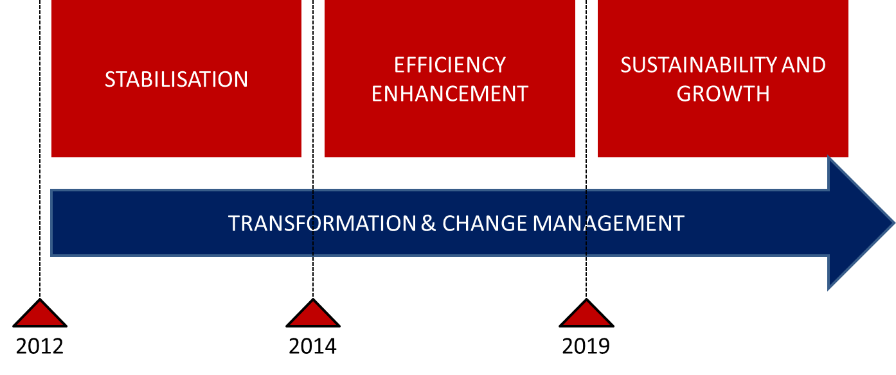
4. TURNAROUND IMPLEMENTATION PLAN & THE PMTE
  4.1 Stabilisation (2014) – focused on immediate challenges and stabilising areas to create potential for fundamental change => large efficiency gains for PMTE (Lease Review/Asset Register/Clean Audit)
  4.2 Efficiency Enhancement (2019) – systematic improvements - redesign processes, systems and structural elements. Focus on key strategic areas to improve efficiencies and effectiveness => Property Management Improvement Programme through PMTE operationalization.
4.3 Sustainability & Growth – policy review (refresh mandate of DPW family) – Public Works Act. Focus on sustainability & growth.

Slide 8
4. TURNAROUND IMPLEMENTATION PLAN & THE PMTE (Cont…)
Phase 2: Efficiency Enhancement has been designed to include the 7 key areas identified as priorities for PMTE & DPW

Slide 9
9

Slide 10
5. PMTE FOCUS FOR TURNAROUND PHASE 2 - EFFICIENCY ENHANCEMENT
  To improve service delivery in the context of Government’s priorities and to save costs to the Department and the fiscus by:
  Maintaining the value of Government’s assets
  Improving access to and quality of Government’s assets
  Optimal utilisation of State stock and move away from leasing-in
  Utilise State’s vacant properties productively to create a funding stream for capital maintenance and improvements to extend the life-cycle of existing state properties;
To reclaim mandate of Public Works
  develop small proclaimed and unproclaimed harbours
  develop Government precincts in small towns and rural areas
  safeguarding the State’s assets from vandalism, theft and invasion
  reclaiming all misappropriated State land
  preserve Government assets, structures, building, land parcels

Slide 11
6. PMTE ANTICIPATED OUTCOMES (NDP)
Leverage the State’s property portfolio to contribute towards skills development – FM Service Centres (Workshops)
Leverage the State’s property portfolio to create employment (FM Service Centres, COOPS, Turnkey Solutions procurement);
Leverage the State’s property portfolio to empower emerging black business (REMS & FM divisions - targeting SMMEs for unutilised state owned properties and/or maintenance/refurbishment projects)
Ensure water & electricity supply security through sound investment decisions that meets conservation and renewable energy targets
  Smart Meter Installations,
  Renewable energy (e.g. solar geysers)
  Energy audits, monitoring, reporting and verification
  Capacity Building and Training – Energy Efficiency Basics
  Retrofitting

Slide 12
7. PMTE PROGRESS & TARGETS
7.1 Organisational
  An Acting Head of the PMTE has been appointed to drive the full operationalization of the PMTE.
  Key property management specialists have been appointed on the transitional management structures
  Functions and immovable assets were transferred from DPW to the PMTE.
  Draft PMTE structure is being developed with DPSA.
  Working with National Treasury in developing the PMTE budget Programme Structure.
  The Physical Verification of Immovable State Assets towards the development of an Immovable Asset Register for the State, is 98% complete.
  PMTE Account, moved from a disclaimed to a qualified audit opinion.

Slide 13
7. PMTE PROGRESS & TARGETS
7.2 Energy & Water Savings
Pilot energy savings contracts have yielded the following results in DPW
  Over the last three years
    Cape Town Region - R60, 535, 286
    Durban - R10, 176, 000
    Pretoria Region - R839, 000, 000
  Polokwane (2014/15) - R2, 124, 906
  Mmabatho (since Oct 2014) - R71, 771
FM APP 2015/16 PERFORMANCE INDICATOR |  | AUDITED/ ACTUAL PERFORMANCE |  |  | ESTIMATED PERFORMANCE 2014/15 | MEDIUM-TERM TARGETS
 |  | 2011/12 | 2012/13 | 2013/14 |  | 2015/16 | 2016/17 | 2017/18
1 | Reduction in kilowatt-hour (Kwh) usage achieved on energy consumption* | 122 mil Kwh | 172 mil Kwh | 188 mil Kwh | 190 mil Kwh | 220 mil Kwh | 250 mil Kwh | 350 mil Kwh
2 | Reduction in kilolitre -(kl) usage achieved on water consumption* | 2,1 mil kl | 517,463 kl | 1,3 mil kl | 3,5 mil kl | 3,9 mil kl | 4,3 mil kl | 4,7 mil kl

Slide 14
7. PMTE PROGRESS & TARGETS
7.3 Empowerment, Skills Development & Job Creation
In leveraging the State’s property portfolio to contribute towards skills development, employment, and empowering emerging black business through Construction, Real Estate and Facilities Management divisions, the PMTE has set the following targets.
PMTE APP 5 YEAR TARGET |  | ESTIMATED PERFORMANCE 2014/15 | MEDIUM-TERM TARGETS
 |  |  | 2015/16 | 2016/17 | 2017/18
1 | 75 000 work opportunities created through construction projects (through EPWP) | 1482 | 15000 | 15000 | 15000
2 | 60% of construction projects allocated towards BBBEE contractors | 30% | 35% | 40% | 45%
3 | 5000 job opportunities created through maintenance programmes |  | 1000 | 1000 | 1000
4 | 325 interns registered for an artisan training program |  | 65 | 65 | 65
5 | Percentage of Facilities Management contracts allocated towards BBBEE |  | 65% | 65% | 65%

Slide 15
7. PMTE PROGRESS & TARGETS
7.4 Property Management Targets
In better utilising the State’s vacant properties productively and extend the life-cycle of existing state properties; as well as reduce the cost of leasing-in, the PMTE has set the following targets.
5 YEAR TARGET |  | ESTIMATED PERFORMANCE 2014/15 | MEDIUM-TERM TARGETS
 |  |  | 2015/16 | 2016/17 | 2017/18
1 | Occupancy rate of freehold property increased by 50 % for partially occupied properties |  | 5% | 10% | 15%
2 | 2142 land parcels secured to let out for economic development initiatives |  | 100 | 200 | 300
3 | 3000 surplus freehold properties let out for revenue |  | 600 | 600 | 600
4 | R300 million saved by revised rent (carry through cost) | Estimated R 33 million | R60 million | R60 million | R60 million

Slide 16
7. PMTE PROGRESS & TARGETS
7.5 Establishment of Government Component (Not privatisation)
The feasibility study for the establishment of a Government Component for the DPW’s Property Management Business => endorsed by Cabinet in August 2014.
Value proposition - establishment as a Government Component:
  Autonomous ring-fenced, but remains integral part of the public service = > committed to public service objectives
  Role to play in the State’s developmental agenda and the potential catalytic part of state immovable assets in ensuring more equitable spatial development, balanced urbanisation, and user-friendly government precincts and buildings.

Slide 17
7. PMTE PROGRESS & TARGETS
7.5 Establishment of Government Component (Not privatisation)
Sound reasons for the DPW to implement an alternative institutional form for its Property Management services, include:
  Componentising and ring-fencing the PMTE to separate the DPW as the regulator from the PMTE as the implementer.
  Flexible/customised administrative and operational arrangements to suit the property management environment
  GRAP- enabled financial systems / itemised billing.
  Revenue generation and retention
  Direct oversight by the Executive Authority
  Improved governance through direct accountability and decision-making as close as possible to the point of service delivery.
  Attracting and retaining skills = market related compensation packages.

Slide 18
7. PMTE PROGRESS & TARGETS
7.5 Establishment of Government Component (Not privatisation)
 | DPW | TRADING Entity | Government Component | Public Entity
Revenue | Unable to retain surplus funds from operations | Ability to generate, retain and redeploy surplus funds from operations (approval by NT) | Ability to generate, retain and redeploy surplus funds from operations | Ability to generate, retain and redeploy surplus funds from operations
GRAP | No | Yes | Yes | Yes
STATUS
Governance | Executive Authority Accounting Officer |  | Executive Authority | Has Governing Board
Independence | - |  | Separate from Department but linked to policy | Autonomous from Department
Accountability to Executive Authority | Constitution and Legislation |  | Direct accountability to Executive Authority | Regulated by the Act establishing the entity
Accountability to Department | - |  | None, but have reporting duties | None
Mandate | Constitution, Legislation and PSA |  | Derived from delegation or assignment from the Executive Authority | Derived from Act establishing the entity
Main Funding | Parliament via Department |  | Parliament via Department & own revenue | Parliament via Department & own revenue
PFMA | Applicable DG is Accounting Officer |  | Applicable Head of GC is Accounting Officer | Applicable Board is Accounting Authority

Slide 19
7. PMTE PROGRESS & TARGETS
7.5 Establishment of Government Component (Not privatisation)
 | DPW | TRADING Entity | Government Component | Public Entity
EMPLOYEE CONDITIONS
PSA | Applicable |  | Applicable | Not Applicable
Law Governing employees | PSA and regulations, and sectorial determinations |  | PSA and regulations, and sectorial determinations | Act Establishing the entity LRA, and other
Conditions of Service | PSA and Public Service Regulations |  | Public Service Regulations | Policies as determined by entity
Remuneration | PSA and Public Service Regulations |  | Determined by bargaining processes, but occupation specific dispensation is possible | Determined by entity’s board, subject to NT and DPSA guidelines
Pension fund membership | GEPF |  | GEPF | Depends on entity GEPF may apply
Employee Relations | Governed by Public Service Regulations |  | Governed by Public Service Regulations | Governed by entity’s policies
Deployment | Anywhere within Public Service |  | Anywhere within Public Service | Only within entity

Slide 20
7. PMTE PROGRESS & TARGETS
7.6 Lease Review Initiative
2012 => review of 2 162 leases from private sector – findings:
  112 properties “vacant”
  29 properties “occupied by non DPW clients”
  578 lease with no lease agreements
  1176 Backlog leases identified
2013/14 => An application for special procurement conditions was made to National Treasury
  Special Dispensation for Lease Renewals approved (5 September 2013) applied to leases that had expired before and by 31 December 2013.
  It was further extended to include leases expiring financial year ending 31 March 2014
  new number of lease = 1566

Slide 21
7. PMTE PROGRESS & TARGETS
7.6 Lease Review Initiative
 | LANDLORD | PROPERTY | RESPONSE | ACTION RECOMMENDED
1 | Dipula Property Investments | Portion 4 erf 60 | Kindly note that we have supplied the bid offer to your offices in KZN. | Trace document from region and finalize signing of lease agreement EMAIL SENT TO REGION
2 | Superbia Four | Orange Nassau Building | Kindly clarify which leases are exactly needed | Respond to the Landlord, giving client department/ tenant name DHET
3 | Superbia Four | Orange Nassau Building | Kindly clarify which leases are exactly needed | Respond to the Landlord, giving client department/ tenant name DPW
4 | Summermania Seven (pty) ltd | Sanlam Plaza West | Kindly clarify which leases are exactly needed | Respond to the Landlord, giving client department/ tenant name WATER AFFAIRS
5 | ACSA | Lot 1 airport air wing | Correspondence between DPW and ACSA regarding renewal of lese has been sent | Follow up on progress of renewal E-MAIL SENT TO RM KIMBERLY
6 | ACSA | Kimberly Airport Conference | Correspondence between DPW and ACSA regarding renewal of lese has been sent | Follow up on progress of renewal E-MAIL SENT TO RM KIMBERLY
7 | Eskom Belville | Stand 42 | 1. We need to know what type of lease this is 2. The current lease period 3. Who was the Eskom contact on your lease/negotiations 4. Full description of the leased property | Responses to the questions raised
8 | Rabie Property Administrators | Reeds House/ Parking | Notice to vacate the premises was given to DPW in July 2013 to ensure that the premises is vacated by September 2014 | Building be taken off PMIS
9 | Raubenheimer Family Trust | 44 Victoria Street Dundee/ ABSA Building | DPW clients vacated the building in June 2013. The department refuses to make restoration payments to landlord – the landlord has refered the matter to the office of the public protector | Responsible region to confirm the truth in the report received from landlord. Regional legal office to investigate the matter and give advice to the Department should the Landlords claims of reporting the Department to the Public Protector be valid/ true
10 | Territorial Estates | Steve Motors | Old lease agreement attached – expired 2010. New agreement will be signed in a few months | Confirm the validity of this statement with regional office. If there is a renewal in the pipeline, how long will it take
11 | Emya Investments | Erf 132 Harding Street | Old lease agreement attached 3 year period from date of occupation | Establish date of occupation from regional office. Establish current leasing scenario from regional office
12 | Redefine | Nedbank Centre | Contract attached – contract period is from September 2013 to August 2016 | Contract in place – region to re-verify tenant occupancy
13 | Janvenade | Old Standard Bank Building | Letter sent to landlord detailing DPW’s willingness to renew the lease. | Letter signed on behalf of DG DPW. Investigation on who in the region signed the letter and whether they were delegated to do so at that particular time. (letter dates 18/11/2013)
14 | Growthpiont | The 5th avenue, springs | Contract attached – contract period is from October 2013 to September 2016 | Contract in place – region to re-verify tenant occupancy
15 | Ekurhuleni municipality | Erf 2171 admin triangle | The landlord responded, they cannot trace the lease agreement | Establish from the regional office whether there is a copy of the lease agreement with the department as well as the status of the vacancy of the property
16 | Growthpoint | 130 Beatrix street, Arcadia Centre | The Client department vacated the premises in December 2012 – no lease agreement attached | Establish if the contract was terminated following the tenants vacation
17 | Agriculture Research Council | ARC/ITSC 3 River Street Nelspruit | Contract attached – Contract period is from September 2012 to August 2013 | Region to advise why the lease was still registered on PMIS
18 | Metropolitan Properties | 5- 7 George Street | Contract attached – contract period is from July 2012 to June 2015 | Contract in place – region to verify tenant occupancy
19 | Eskom | Eskom Plaza, Nelspruit | The Plaza was demolished and DPW tenant moved out in November 2012. The landlord has confirmed that the account was settled and no further payment was received | Confirm with the region why PMIS was not updated accordingly
20 | Blue Beacon Investments | Trust Bank Building | Contract Attached – contract period is from April 2011 to March 2014 | Contract was in place until March 2014– region to verify tenant occupancy and or whether the lease has been renewed
STATUS ON 112 “UNOCCUPIED” & 29 “OCCUPIED BY OTHER”
1st phase - Letters to Landlord requesting proof of active lease
  6 x properties confirmed as occupied by DPW tenants
  6 x properties flagged for further investigation by SIU
  8 x properties flagged for further investigation at regional level
2nd Phase – Physical Verification (82 x verified /10 x no access)
  20 x properties confirmed as occupied by DPW tenants
  18 x properties flagged for further investigation by SIU
  44 x properties flagged for further investigation at regional level
3rd Phase – consolidation of information and handover to SIU
  41/112 cases resolved by either confirmation of occupation, or confirmation of last payment made vs. termination dates
  6/29 cases resolved by either confirmation of occupation, or confirmation of last payment made vs. termination dates
ALL OTHER CASES HANDED OVER TO SIU FOR FURTHER INVESTIGATION

Slide 22
7. PMTE PROGRESS & TARGETS
7.6 Lease Review Initiative
A Lease Review Accountability Management Committee was established to monitor Backlog Lease renewals: Chaired by DG
As at February 2015, 1443 (92%) out of 1566 leases have been renewed through the NT Dispensation
Projected annual saving of over R33 million due to (99 million over 3 years) implementation of NT Special Dispensation
Drafting of Real Estate Management business processes (2014/15)
  Establishing resource requirements at Head office and regional offices
  Effective allocation of property portfolios to portfolio managers
  Identify key performance areas
  Streamlining and standardizing property management functions
  Identifying and allocating tasks, responsibilities and delegations

Slide 23
7. PMTE PROGRESS & TARGETS
7.6 Lease Review Initiative
2014/15 => Expenditure and Performance review of Government leases (with NT and DPSA) to:
  Identify key risk areas for DPW and Client departments
  Determine expenditure trends
  Recommend better service delivery through:
    Policy reviews and amendments
    Standardised departmental documentation
    Revised business processes
    Proposed skills development
SCM reform with the office of the Chief Procurement Office at NT (PILOT project: JHB regional office):
  Assist in standardizing procurement processes
  Review and revise forms and templates
  Reduce DPW/Client financial obligations when leasing in
  Break down and clarify leasing in costs for better budgeting and to increase landlord accountability

Slide 24


End
National Department of Public Works (NDPW)
Head Office: Public Works
CGO Building
Cnr Bosman and Madiba
Pretoria Central
Private Bag X65
Pretoria
0001
Website: http://www.publicworks.gov.za
  THANK YOU

