Slide 1

OVERVIEW OF THE HUMAN RESOURCE DEVELOPMENT
Presented by Sandile Ntanzi
Acting DDG: Corporate Services
03 March 2015

Slide 2

MANDATE, MISSION AND VISION
MANDATE
Ensure secure and sustainable provision of energy for socio-economic development.
MISSION
To regulate and transform the sector for the provision of secure, sustainable and affordable energy.
VISION 2025
Improving our energy mix by having 30% of clean energy by 2025.

Slide 3
STRATEGIC OBJECTIVES
Ensure Energy Security
Achieve Universal Access And Transform The Energy Sector
Regulate The Energy Sector
Effective And Efficient Service Delivery
Optimal Utilisation Of Energy Resources
Ensure Sustainable Development
Enhance Doe Culture Systems And People
Promote Corporate Governance

Slide 4
DEPARTMENTAL TRAINING NEEDS
TRAINING NEEDS
Energy Efficiency Management
Renewable Energy Technology
Nuclear Engineering
Economic Analysis
Energy Sector Statistics
Advanced Statistical Analysis
Energy Modelling & Analysis
Substation and Electrification Design
Advanced Management Development Programme
Project Khaedu
Legislative Drafting

Slide 5
DEPARTMENTAL TRAINING NEEDS
TRAINING NEEDS
Emerging Management Development Programme
Project Management
Mentoring and Coaching
Bid Adjudication Committee
Leadership Development Programme
Presentation Skills
First Aid
Project Management Learnerships
Public Administration Learnerships
AET Programme
Business Writing

Slide 6
TRAINING PROGRAMMES IMPLEMENTED
PROGRAMME | TOTAL TRAINED | TARGET | GENDER |  | ACHIEVEMENTS
 |  |  | M | F
Energy Efficiency Management | 6 | 6 | 3 | 3 | Portfolio of evidence submitted to Terra Firma , delegates were found competent
Substation Maintenance, Reliability And Operations | 12 | 12 | 8 | 4 | All delegates received the certificate
Grab 17 | 3 | 3 | 2 | 1 | Certificate of competence issued to officials
Radiation And The Environment | 2 | 3 | 2 | 0 | Certificate of attendance were issued to officials
Shale Gas Exploration Technology & Environment | 2 | 2 | 1 | 1 | Certificate of attendance were issued to officials
Introduction To Petroleum Industry | 13 | 15 | 5 | 8 | Completed
O

Slide 7
TRAINING PROGRAMMES IMPLEMENTED
PROGRAMME | TOTAL TRAINED | TARGET | GENDER |  | ACHIEVEMENTS
 |  |  | M | F
Advanced Certificate In Management For Oil And Gas (Sponsored by SAPIA) | 7 | 7 | 0 | 7 | Certificate of competence issued to officials
Environmental Impact Assessment EIA and EMP | 2 | 2 | 0 | 2 | All delegates received the certificate
Energy Law | 1 | 1 | 1 | 0 | Still in Progress
Advance d Project Management | 34 | 34 | 21 | 13 | Portfolio of evidence submitted to Cranefield College and awaiting results
Advanced Management Development Programme | 11 | 11 | 9 | 2 | Portfolio of evidence submitted to National School of Government and awaiting results
O

Slide 8
TRAINING PROGRAMMES IMPLEMENTED
PROGRAMME | TOTAL TRAINED | TARGET | GENDER |  | ACHIEVEMENTS
 |  |  | M | F
Management Advanced Programme | 1 | 1 | 0 | 1 | Completed
Programme in Project Management | 10 | 10 | 4 | 6 | Still in Progress
Basic Project Management | 8 | 8 | 4 | 4 | Portfolio of evidence submitted to National School of Government and awaiting results
Business Writing skills | 7 | 7 | 0 | 7 | Portfolio of evidence submitted to LeMark Training & Development and awaiting results
CCTV Control Room | 1 | 1 | 1 | 0 | Still in Progress
Contract Management | 3 | 3 | 2 | 1 | Still in Progress
O

Slide 9
TRAINING PROGRAMMES IMPLEMENTED
PROGRAMME | TOTAL TRAINED | TARGET | GENDER |  | ACHIEVEMENTS
 |  |  | M | F
Demand Management | 2 | 2 | 1 | 1 | Portfolio of evidence submitted to National School of Government and awaiting results
Emerging Management Development Programme | 3 | 3 | 2 | 1 | Portfolio of evidence submitted to National School of Government and awaiting results
Financial Management | 3 | 3 | 2 | 1 | Portfolio of evidence submitted to Pro-Active College and awaiting results
First Aid | 44 | 44 | 26 | 18 | Completed
Fleet Management | 3 | 3 | 2 | 1 | Portfolio of evidence submitted to Pro-Active College and awaiting results
Implementation of the Promotion of Access to Information Act | 5 | 5 | 2 | 3 | Completed
O

Slide 10
TRAINING PROGRAMMES IMPLEMENTED
PROGRAMME | TOTAL TRAINED | TARGET | GENDER |  | ACHIEVEMENTS
 |  |  | M | F
Legislative Drafting | 4 | 4 | 0 | 4 | Still in Progress
Mentoring and Coaching | 17 | 17 | 5 | 12 | Portfolio of evidence submitted to National School of Government and awaiting results
Minutes Taking | 1 | 1 | 0 | 1 | Portfolio of evidence submitted to LeMark Training & Development and awaiting results
Microsoft Excel Advanced | 24 | 24 | 13 | 11 | Completed
Microsoft Project | 2 | 2 | 1 | 1 | Completed
Orginisational Design | 3 | 3 | 1 | 2 | Portfolio of evidence submitted to National School of Government and awaiting results
O

Slide 11
TRAINING PROGRAMMES IMPLEMENTED
PROGRAMME | TOTAL TRAINED | TARGET | GENDER |  | ACHIEVEMENTS
 |  |  | M | F
PFMA & Bid Adjudication Committee | 10 | 10 | 4 | 6 | Portfolio of evidence submitted to University of Pretoria and awaiting results
Presentation Skills | 15 | 15 | 8 | 7 | Portfolio of evidence submitted to Pro-Active College and awaiting results
Application of Policy and Procedure on Incapacity Leave and Ill Health Retirement in the Public Service | 44 | 44 | 4 | 40 | Still in Progress
Departmental Induction | 117 | 148 | 50 | 67 | Completed
Compulsory Induction Programme | 43 | 68 | 23 | 20 | Still in progress, they only attended module 1 and still to attend modules 2-5
Total : | 463
O

Slide 12
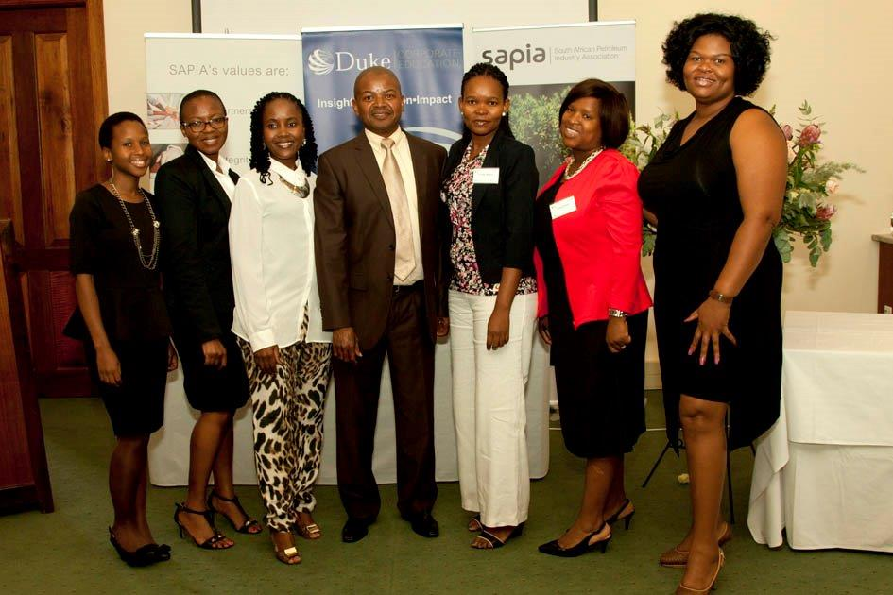
DoE/SAPIA PARTNERSHIP
SAPIA Graduation Ceremony in the Advanced Certificate in Oil and Gas, 18 February 2015.

Slide 13
WORKSHOPS/CONFERENCES IMPLEMENTED
PROGRAMME | TOTAL TRAINED | TARGET | GENDER |  | ACHIEVEMENTS
 |  |  | M | F
Gas- The Game Changer for South Africa | 1 | 1 | 0 | 1 | Completed
Nuclear Power Projects | 5 | 5 | 4 | 1 | Completed
Africa Refining Summit | 3 | 3 | 1 | 2 | Completed
Women In Energy Africa | 4 | 4 | 0 | 4 | Completed
Africa Energy Indaba | 4 | 4 | 0 | 4 | Completed
Legal Compliance Of Tendering Process | 9 | 9 | 2 | 7 | Completed
Shale Gas Conference | 3 | 3 | 1 | 2 | Completed
O

Slide 14
WORKSHOPS/CONFERENCES IMPLEMENTED
PROGRAMME | TOTAL TRAINED | TARGET | GENDER |  | ACHIEVEMENTS
 |  |  | M | F
17th South African Internal Audit | 4 | 4 | 3 | 1 | Completed
5th Annual Rural Development | 1 | 1 | 0 | 1 | Completed
Advanced Strategy Development and Implementation | 1 | 1 | 1 | 0 | Completed
Africa Disability HIV/AIDS | 1 | 1 | 0 | 1 | Completed
Amendments of the employment Equity Act | 1 | 1 | 1 | 0 | Completed
CIA Learning Systems | 1 | 1 | 1 | 0 | Completed
O

Slide 15
WORKSHOPS/CONFERENCES IMPLEMENTED
PROGRAMME | TOTAL TRAINED | TARGET | GENDER |  | ACHIEVEMENTS
 |  |  | M | F
Dealing with Media | 34 | 40 | 24 | 10 | Completed
HR Standards Roll out by SABPP | 1 | 1 | 1 | 0 | Completed
Implementing EPWP Projects | 2 | 2 | 1 | 1 | Completed
Public Sector Trainers Forum | 4 | 4 | 2 | 2 | Completed
The Asset Management and Disposal | 1 | 1 | 1 | 0 | Completed
The National Development Plan Indaba on Government Wide Integrated National Planning | 1 | 1 | 0 | 1 | Completed
Total : | 81
O

Slide 16
INTERNATIONAL TRAINING/WORKSHOPS IMPLEMENTED
PROGRAMME | TOTAL TRAINED | TARGET | GENDER |  | ACHIEVEMENTS
 |  |  | M | F
Design, Erection and Operation of EHV Substation | 1 | 1 | 1 | 0 | Certificate of attendance issued to official (Donor Funded)
Power Purchase Agreement | 1 | 1 | 1 | 0 | Certificate of attendance issued to official
Shell DoE Scenario | 3 | 3 | 1 | 2 | Workshop completed
Argus Africa Storage and Logistics | 2 | 2 | 2 | 0 | Workshop completed
Renewable Micro Hydro Power | 1 | 1 | 1 | 0 | Certificate of attendance issued to official (Donor Funded)
O

Slide 17
INTERNATIONAL TRAINING / WORKSHOPS IMPLEMENTED
PROGRAMME | TOTAL TRAINED | TARGET | GENDER |  | ACHIEVEMENTS
 |  |  | M | F
22nd Women in Nuclear Annual Global Conference | 2 | 2 | 0 | 2 | Workshop completed
Jodi 10th Regional Workshop Training | 2 | 2 | 0 | 2 | Workshop completed
Nuclear Human Capital Development Exchange Programme | 2 | 2 | 1 | 1 | Two South African Students were awarded the two-year Masters Degree in Nuclear Engineering. (The South Africa- South Korea student exchange programme)
IEA Energy Statistics Training | 2 | 2 | 2 | 0 | Still in progress
Civil Nuclear Energy | 3 | 3 | 1 | 2 | Still in progress
Total: | 19
O

Slide 18
FINANCIAL IMPLICATIONS
TRAINING EXPENDITURE FOR 2014/2015
Training Budget for 2014/2015 Financial Year: R5, 615, 000.00 Training expenditure to date: R3, 061, 556.99 Bursaries expenditure to date (Permanent employees): R559, 305.60 Levy payment to SETA’s: CHIETA R372 000.00 EWSETA R372 000.00 PSETA R 68 242.15

Slide 19
DoE INTERNAL BURSARY PROGRAMME
THE DoE Has 76 BURSARY HOLDERS PURSUING THE FOLLOWING QUALIFICATIONS:
Study Fields | NUMBER
Human Resource & Social Science | 8
Security Management | 3
Public Management & Administration | 17
Energy Studies | 7
Economic, Accounting & Auditing | 15
Law | 9
Transport And Fleet Management | 4
Supply Chain Management | 1
MBA | 5
Project Management | 5
Electrical Engineering | 1
Policy Studies | 1

Slide 20
YOUTH DEVELOPMENT PROGRAMMES 2014/2015:
MALAYSIAN SCHOLARSHIP
The Malaysian scholarship programme commenced in 1999 as a joint venture between the then Department of Minerals and Energy and the Malaysian government. The target group is matriculants from disadvantaged communities and the main intention of the programme is to bridge the scarce skills gap in Engineering and Information Technology.
2 Students currently participating in a scholarship programme sponsored by the DoE, PETRONAS and the Malaysian government.
Students in this programme are expected not only to learn the theoretical knowledge but must go under practical work in terms of industrial internship prior to the completion of their studies.
89 Students graduated from Malaysian Scholarship programme to date in the following study areas- IT, Chemical Engineering, Electrical Engineering, Petroleum Geoscience and Civil Engineering.

Slide 21
YOUTH DEVELOPMENT PROGRAMMES 2013/2014:
LEARNERSHIP AND INTERNSHIPS PROGRAMMES
THE DEPARTMENT IMPLEMENTED THE FOLLOWING PROGRAMMES
12 Learners in Public Administration learnership (the programme comprised of 7 employed (18.1) and 5 unemployed (18.2). The programme is completed. 20 Learners in Project Management learnership (10 employed (18.1) and 10 unemployed (18.2). The programme is completed. 11 Learners in Internal Audit learnership (6 employed and 5 unemployed) the programme is not completed as it is a two year programme and the completion date is June 2015. 5 Students offered bursaries to study Chemical Engineering, students still continuing and the expected year of completion is 2017.
The department appointed 27 interns, 2 interns were youth with disabilities.
13 Interns were permanently employed. 2 out 13 were employed on contract positions basis by the DoE and 6 interns were appointed in permanent positions. 5 Interns were employed by other entities and government departments.

Slide 22
YOUTH DEVELOPMENT PROGRAMMES 2013/2014:
LEARNERSHIP AND INTERNSHIPS PROGRAMMES
GENDER
 | UNEMPLOYED (18.2) |  |  | EMPLOYED (18.1)
 | Female | Male | Disability | Female | Male | Disability
Public Administration | 4 | 1 | 1 | 5 | 2 | 0
Project Management | 6 | 4 | 1 | 7 | 3 | 0
Internal Audit | 3 | 2 |  | 2 | 4 | 0
Internship | 18 | 9 | 2 | 0 | 0 | 0

Slide 23
YOUTH DEVELOPMENT PROGRAMMES 2014/2015:
LEARNERSHIP PROGRAMME
Learnership is a structured learning programme which combines theoretical learning and practical workplace integrated learning that leads to a formal registered qualification for the duration of twelve months. The learnership programme targets the unemployed South African youth seeking qualifications which will at the end uplift them to become employable.
19 Learners are currently participating in a learnership programme funded by CHIETA in Public Administration and Internal Audit.
Gender: Public Administration - 12 females and 3 males (1 disability) Internal Audit - 2 females and 2 males.

Slide 24
2014/2015 LEARNERSHIP PLACEMENT/EMPLOYMENT
Two unemployed learners appointed permanently within the department.
One unemployed learners appointed permanently outside the department.
Two unemployed disabled learners appointed permanently within the department.
Five unemployed learners appointed on contract within the department.

Slide 25
YOUTH DEVELOPMENT PROGRAMMES 2014/2015: EXTERNAL BURSARY PROGRAMME
The Department currently have 13 bursars who are funded by CHIETA studying Chemical Engineering in different South African institutions of higher learning.
13 Bursars will continue with their studies in 2016 academic year.

Slide 26
YOUTH DEVELOPMENT PROGRAMMES 2014/2015: INTERNSHIP PROGRAMME
The Department has 32 interns, 2 are interns with disabilities and the other 2 interns are placed at Total South Africa pursuing practical work-based in Chemical Engineering . The internship programme is ending on 31 March 2015. Gender:
To date the department have 24 interns.
8 interns have been employed in different public and private sectors.
32 Interns will be starting on 1 April 2015 and 2 interns with disabilities are targeted to be part of this intake.
FEMALE | MALE | DISABILITY
12 | 20 | 2

Slide 27
PLANNED DEVELOPMENT PROGRAMME 2015/2016 FINANCIAL YEAR
LEARNERSHIP AND WORK INTEGRATED LEARNING
5 -Project Management learnership programme (18.1, 2 employees targeted/18.2, 3 youth targeted).
10 - Public Administration learnership programme (18.1, 5 employees targeted /18.2, 5 youth targeted).
5 - Work Integrated Learning (WIL) (youth (18.2), in Chemical Engineering, SCM, ICT and Finance.

Slide 28
ENERGY SECTOR HRD PARTNERSHIP
The Department of energy has established an HRD Forum comprising of all state owned entities(SOE’s) reporting to the Minister of Energy.
The following entities are part of the HRD Forum: NECSA CEF SANEDI NERSA PETROSA , and NNR.
The purpose of the HRD Forum is working together within the energy sector to promote and share social, economic and skills base growth for the broader energy sector at large.

Slide 29
ENERGY SECTOR HRD PARTNERSHIP
The HRD Forum will create a platform for negotiation and representation to SETA’s, institutions of higher learning as well as international and local funding as a collective.
The HRD Forum has made inputs to the EWSETA and CHIETA 2014 sector skills plans review and update.
The Forum will also be a platform to exchange ideas, benchmark HRD needs and skills development trends and information.

Slide 30
ENERGY SECTOR HRD INTERNATIONAL PARTNERSHIP
The Department of Energy participates in all IAEA nuclear energy related training programmes and workshops.
The Department of Energy has partnership (through bilateral agreements) on Human Capital Development with international donors such as Malaysia, Australia, China, Qatar, Korea, India, France, Indonesia, Japan, Russia , USA and Germany.
In the current financial year (2014/15) the department approved 19 officials to attend workshops, seminars and training courses funded by international donors.
Donor funded opportunities are shared with other role players in the country such as ESKOM, NECSA, Department of Science and Technology, Department of Public Enterprises, Department of Trade and Industry.

Slide 31
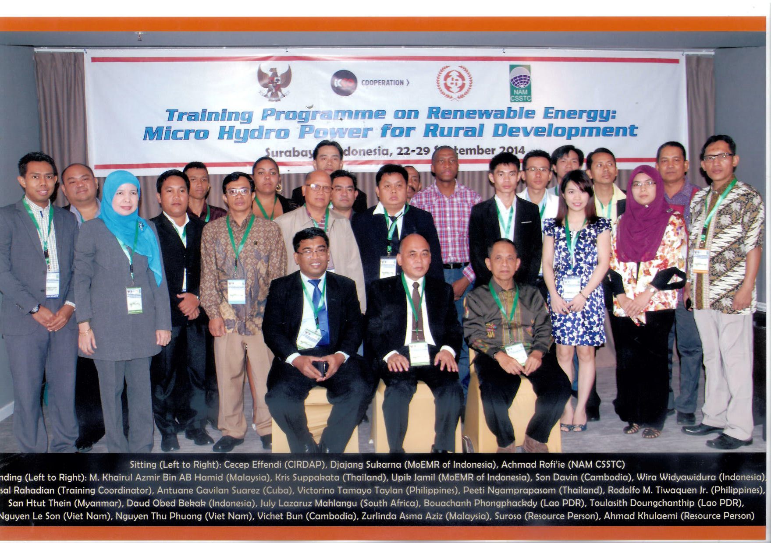
ENERGY SECTOR HRD INTERNATIONAL PARTNERSHIPS
Mr Lazarus Mahlangu attended Training Programme on Renewable Energy: Micro Hydro Power for Rural Development at Indonesia, 22-29 September 2014.

Slide 32
ENERGY SECTOR HRD INTERNATIONAL PARTNERSHIP
KINGS NUCLEAR SCHOLARSHIP PROGRAMME
The South Africa- South Korea student exchange programme forms part of the skills development initiatives of the South African government to enhance the capabilities of the nuclear energy sector especially in the context of the Integrated Resource Plan (IRP 2010).
Within this exchange programme, two SANHARP students (a male and a female), who are Graduates-In-Training for NECSA, pursued a two-year Masters Degree in Nuclear Engineering at the KEPCO International Nuclear Graduate School (KINGS) in Busan from 2013 to 2014. These students returned to South Africa in February 2015 after graduating.
In addition three students, employed and primarily sponsored by NECSA, will be departing for the same programme on 20 February 2015.
On 17 February 2015, The Department of Energy, the Department of Science & Technology, NECSA and the National Research Foundation (NRF) hosted an induction and orientation programme for new students who will be starting the same degree in 2015.

Slide 33
ENERGY SECTOR HRD INTERNATIONAL PARTNERSHIP
KINGS NUCLEAR SCHOLARSHIP PROGRAMME
Returning students: Bheka Khumalo & Lebogang Maseko (Standing)
New students: Nthatho Raboshaga, Akhona Tshangela and Okaeng Rakereng (Sitting), 17 February 2015.

Slide 34
ENERGY SECTOR HRD INTERNATIONAL PARTNERSHIP CHINA NUCLEAR TRAINING PROGRAMME
The South African government and the Chinese government recommended led by State Nuclear Power Technology Corporation (SNPTC), signed an agreement in order to support nuclear power development in South Africa and promote Nuclear Power Cooperation between China and South Africa also to participate in South African nuclear power project and to mainly promote the advanced passive Gen III nuclear power technology.
The Department of Energy and NECSA will be training 50 South Africans on the China Nuclear Programme.
The 50 trainees, 19 females and 31 males are from the Department of Energy, National Nuclear Regulator(NNR), Eskom, NECSA, COEGA Development Corporation and the Department of Economic Development, Environmental Affairs and Tourism and Nelson Mandela Bay Municipality.
The training will take place from 22 April – 22 August 2015.

Slide 35
PARTICIPATION IN SETA’S ACTIVITIES
The Department of Energy have appointed representatives on the EWSETA and CHIETA governing boards.
Four (4) officials of the Department of Energy are participating in the following EWSETA board subcommittees, namely, Learning Programmes committee, Learnership committee, Skills Planning committee, and Quality Assurance committee.

Slide 36
PARTICIPATION IN SETA’S AND DPSA ACTIVITIES
3 Officials of the Department are members of the CHIETA Board Chamber: Base Chemicals and Petroleum.
The Department have submitted the 2014/2015 Workplace Skills Plan(WSP), Annual Training Report(ATR) to the PSETA , EWSETA and CHIETA.
The Department have submitted the HRD Strategy Framework and Implementation Report to the Department of Public Service and Administration (DPSA) for 2014/2015.

Slide 37
APPROVED CHIETA FUNDING
CHIETA has approved the following discretionary grant to be implemented in 2015/2016 financial year:
5 Project Management learnership 10 Public Administration learnership 10 Bursaries 5 Work Integrated learning
The CHIETA approved R 1 035 000,00 to implement the above-mentioned programmes.

Slide 38
EWSETA DISCRETIONARY GRANT APPLICATIONS
In April 2014 the Department has applied for the following discretionary grants:
- work integrated learning in electrical engineering - 50 students solar water heater systems - 600 trainees bursaries - 10 students
In July 2014 the Department has applied for the following discretionary grants:
5 students for bursaries in energy studies 5 students for bursaries in nuclear science & technology 5 learners in AET 75 mentorship 50 students for work integrated learning.
The Department is still awaiting feedback and response from the EWSETA.

Slide 39
PSETA DISCRETIONARY GRANT APPLICATION
In January 2015 the Department has applied for the following discretionary grants:
- 5 Public Administration learnership - NQF level 6
- 10 Public Administration learnership - NQF level 5.
The Department is still awaiting feedback and response from the PSETA.

Slide 40
“TURNING THE DoE INTO A TRAINING SPACE”
THANK YOU!!

