Slide 1
Portfolio Committee on Agriculture Integrated Spatial Analysis on land capability and land use for Agriculture and Forestry
Cape Town
27 February 2015

Slide 2
Table of Contents
Introduction
Food security: The production challenge
Land capability assessment
2002 - Classification
2014 - Evaluation
Preservation and Development of Agricultural Land
Conclusion
Notes:
Limited extent of Classes I-III
* 13.7 mil ha
* 2 million ha already permanently converted to other land uses
Class IV – subject to downgrading due to climate change (15 mil ha)
Free State maize suitability analysis
High:15 000
Suitable: 150 000
Marginal: 931 000

Slide 3
The sa food production challenge decline in land available for crop production
Continues & steep decline in the area of High Value Agricultural Land available for crop production in South Africa
FAO Recommended
Current DAFF estimate is less than 0,25 ha per person per annum
Notes:
Major drivers:
Urbanisation
Population growth
Mining

Slide 4
The sa food production challenge granted prospecting and mining rights PER PROVINCE
Province | Mining rights (ha) |  |  | Prospecting rights (ha)
 | HVAL | Class IV | Total area | HVAL | Class IV | Total area
Eastern Cape | 227 | 296 | 1 910 | 20 706 | 18298 | 341 799
Free State | 8 179 | 61 055 | 83 599 | 157 987 | 643472 | 1 305 451
Gauteng | 49 453 | 252 | 81 125 | 206 879 | 13288 | 357 368
KwaZulu-Natal | 15 613 | 14 200 | 84 357 | 179 266 | 82771 | 758 284
Limpopo | 41 720 | 35 502 | 153 422 | 744 974 | 544937 | 4 415 344
Mpumalanga | 252 079 | 49 469 | 350 908 | 1 207 724 | 492630 | 2 697 521
Northern Cape | 0 | 0 | 451 647 | 0 | 0 | 5 150 556
North West | 78 041 | 38 220 | 189 483 | 435 653 | 767502 | 2 652 745
Western Cape | 3 235 | 1 105 | 22 782 | 11 365 | 2671 | 871 987
RSA Total | 448 547 | 200 099 | 1 419 233 | 2 964 554 | 2 565 569 | 18 551 056
HVAL – High Value Agricultural Land (Land Capability Classes I – III)
DAFF spatial analysis based on 2012 mining data & 2002 Land Capability Data

Slide 5
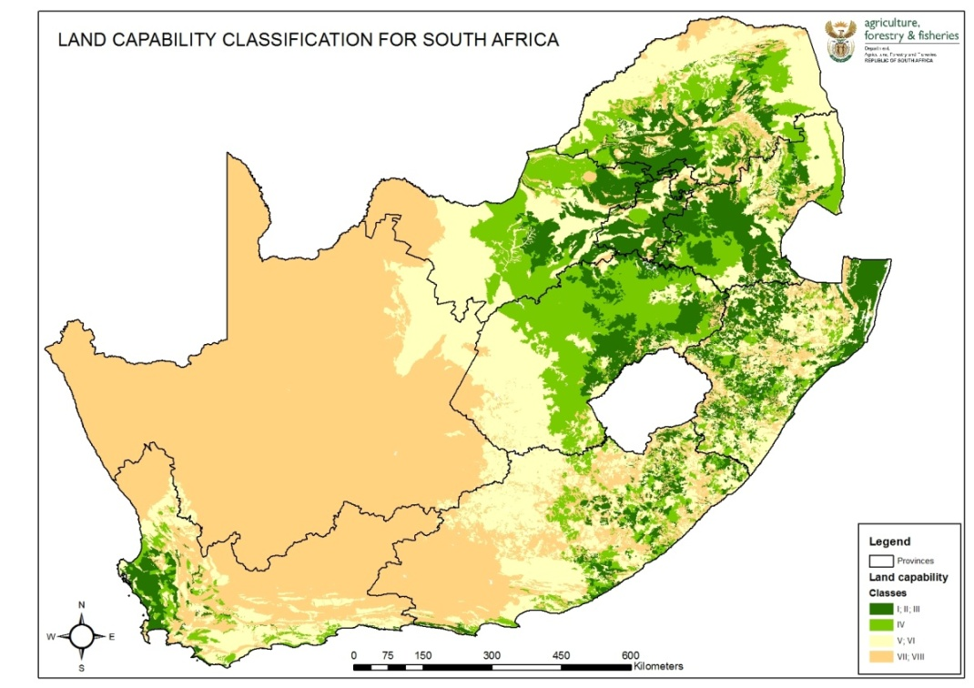
The sa food production challenge SPATIAL LOCATION OF granted prospecting and mining rights

Slide 6
Land Capability Classification
Land Capability Definition
The extent to which land can meet the needs of one or more uses, under defined conditions of management, without permanent damage.
Expression of effects of physical factors on the total suitability and potential for use for:
Crops that requires regular tillage;
Grazing;
Forestry; and
Wildlife.
Land capability involves consideration of:
The risks of damage from erosion and other causes;
The difficulties in land-use caused by physical factors, including climate (rain-fed production); and
The production potential.
A System for Soil and Land Capability Classification for Agriculture in South Africa;
March 1987 & revised January 1991 (Scotney, Ellis, Nott, Taylor, v Niekerk, Verster & Wood)

Slide 7
2002 Land Capability Classification (ARC - ISCW) spatial distribution of LAND CAPABILITY CLASSES
Land Capability Classes
High value cropping land
Class I - 2 733 ha
Class II - 1 878 597 ha
Class III - 14 003 339 ha
Marginal potential cropping land
Class IV - 16 447 446 ha
Limitations
Scale: National level
Source data: Land Type Survey
Methodology: Assessment /
land type record
Classification system

Slide 8
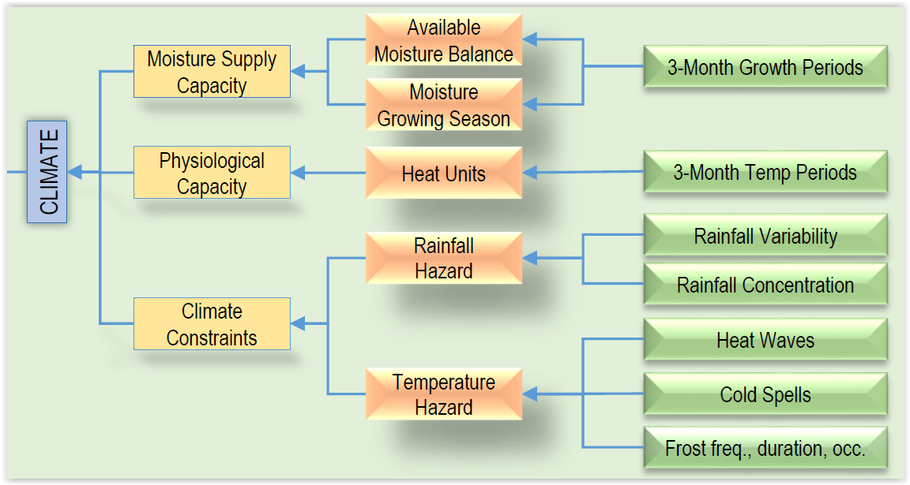
2014 Land Capability EVALUATION SYSTEM
Research papers by ARC-ISCW
Approach & methodology
Gauteng
Limpopo
Tender
EnvirogGis Pty Ltd & UniVen
Schedule & progress
Started April 2014
2014 / 15 financial year
National climate, soil, terrain and land capability models
Mpumalanga
Western Cape
Eastern Cape
2015 / 16 Financial year
Outstanding 4 + 2 provinces
Integrated Geo-database

Slide 9
Advantages – 2014 Land Capability Evaluation
Data
Full access to all data
Input, intermediate and final datasets
Seamless raster datasets
15 Classes
Scale
Suitable for use at local municipal level (50-100 000 scale)
Demarcation per local municipality
Models
Resides with DAFF
Refine, adapt & re-run
Products
Novice
User manual
Super user
Complete documentation

Slide 10
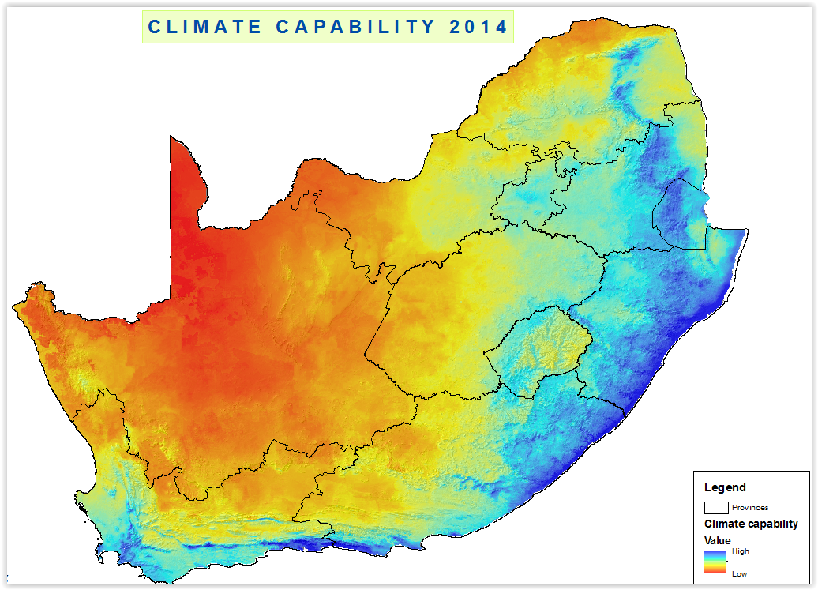
2014 Land Capability EVALUATION SYSTEM draft results: agro-climate capability

Slide 11
Agricultural potential zones CONCEPTUAL DIAGRAM
FULLY INTEGRATED NATIONAL GEO-REFERENCED DATABASE
Environmental Database: Climate;
Soil and Topographical data
Geodatabase
Climate-; Soil- and
Terrain capability
Field verification
Land capability
Crop-; Irrigation and
Livestock suitability
Land suitability
Land cover- and Land use
data, incl. wetlands, etc.
Agricultural Zones
Provincial &
Local systems: BRU’s, etc.
Ancillary Data: Protected areas;
Permanently transformed-
Buildings, roads, etc.
Production Guidelines & Land-use Regulations
Reports: Research
and Technical
Models: Spatial,
Non-spatial, etc.
Data: Spatial, attribute-,
metadata and
data-dictionary
Reporting Facility
Technical training:
ArcReader, Technical
manuals
All facets of agricultural land use planning- crops, forestry, animal adaptability, agro-ecosystems management, environmental risk and impact assessments, land degradation risk assessment, framework for future monitoring- climate change, etc.

Slide 12
PRESERVATION AND DEVELOPMENT OF AGRICULTURAL LAND
Draft Framework Policy and Bill on the Preservation and Development of Agricultural Land
Spatial planning
Suitability modelling
Crop suitability
Livestock suitability / adaptability
Irrigation suitability
Spatial zoning and associated regulations
Primary Food Production Zones
Primary Crop Production Zones
Primary Livestock Production Zones
Best available
Good
Moderate
Poor
Very poor

Slide 13
CONCLUSION
Continues decline in High Value Agricultural Land
Major Drivers
Population growth
Urbanisation and related infrastructure
Mining
Advantages of spatial analysis & modelling related to Land Capability, Land Suitability and Land Use
Quantify spatial impacts in relation to food production
Provide a more refined spatial dataset for integrated planning
Primary Food Production Zones and associated regulations per zone will guide development patterns in a proactive manner
Thank You!

