Slide 1
TITLE RESTORATION PROJECT
Briefing to Select Committee on
Social Services
February 2015

Slide 2
Presentation Index
Introduction
Mandate
Vision, Goal, Purpose
2. Value Proposition
Why is titling important?
Benefits, Threats and Consequences
3. Current Conjecture
Nature and Extent of Problem
Why isn’t Titling happening?
4. Project Proposal
What is to be done?
Timeframes
Delivery Channels and Institutional Arrangements
Critical Success Factors

Slide 3
Introduction
Both legislation and policy confirms the need to ensure access to title;
Key component of Human Settlements Programme that title deed should be provided – in instances of ownership;
However, recent studies show an increasing number of beneficiaries not receiving Title upon occupation, if ever;
While the Department is aware of and has previously taken steps to remedy the problem, a more co-ordinated response is required.
Notes:
Read from slide.
Dept has attempted to make inroads into especially pre-94 stock:
We note MinMec resolutions taken in Sept 2013 regarding the eradication of title backlog of pre-94

Slide 4
Mandate
2014 ANC Election Manifesto
“We will eliminate the backlog of title deeds. New home owners in the subsidy market will be issued with a title deed upon occupation.
MTSF Workshop – May 2014
Review and /or Develop Policy and Programme i.r.o. Title Deeds; and
Establish institutional capability to:
Deal with current backlog; and
Monitor the issue of new title
2014 Human Settlements Budget Vote
…. “Prioritise the issuing of title deeds for the pre-1994”
….”For the post 1994 stock, again we have dead assets”
“The Estate Agency Affairs Board has been tasked to prioritise this”

Slide 5
Value Proposition
Research by Urban LandMark, 2011:
Some 1.44 million beneficiaries have Title Deeds to their properties,
Of the 1.44 million:
91,000 (6%) have since been sold:
generating R12 billion in value
50,000 of said sales involved loan finance
Average sales price:
R54,000: 1994 – 2000
R161,000: 2004 - 2009
Prices for informal sales found to be significantly lower!!!
Notes:
The slide, rather than focus on the negatives, attempts to illustrate what should have or ought to have been…
So, by way of example … read from slide
Conversely, the research also showed that, where transactions have occurred informally, prices of houses have been significantly lower.

Slide 6
Value Proposition
Value and Benefit of Title
Protects rights to property
Records changes in ownership
House as an asset
Facilitates property & financial transactions
Expands municipal rates base
‘Dead Capital’ - Opening new ‘township’ and ‘secondary’ markets to Estate Agents
Banks & lenders have access to new markets
Est. Agents able to service those new to property market
MTSF Commitments
Provide market information to facilitate property transactions.
Intensify homeownership education programmes.
Financial
Economic
Social
91,000
Units
50,000
Units
Notes:
House as an Asset:
Financial:
It can be sold & used to leverage loan funding
Property appreciates in value
Home improvements translates into greater financial value
Economic or Productive:
Can be used for rental
Or as a base for business
Social:
An address
A place of belonging
A base for social networks
Dead Capital:
the absolute potential of new markets, but the trickle-down (& vice-versa) effects as well as buying up.
Create increasing demand for new stock.
Job Creation opportunities for new estate agents.
Loans:
Increased opportunity for DFIs and Banks, in respect of FLISP.

Slide 7
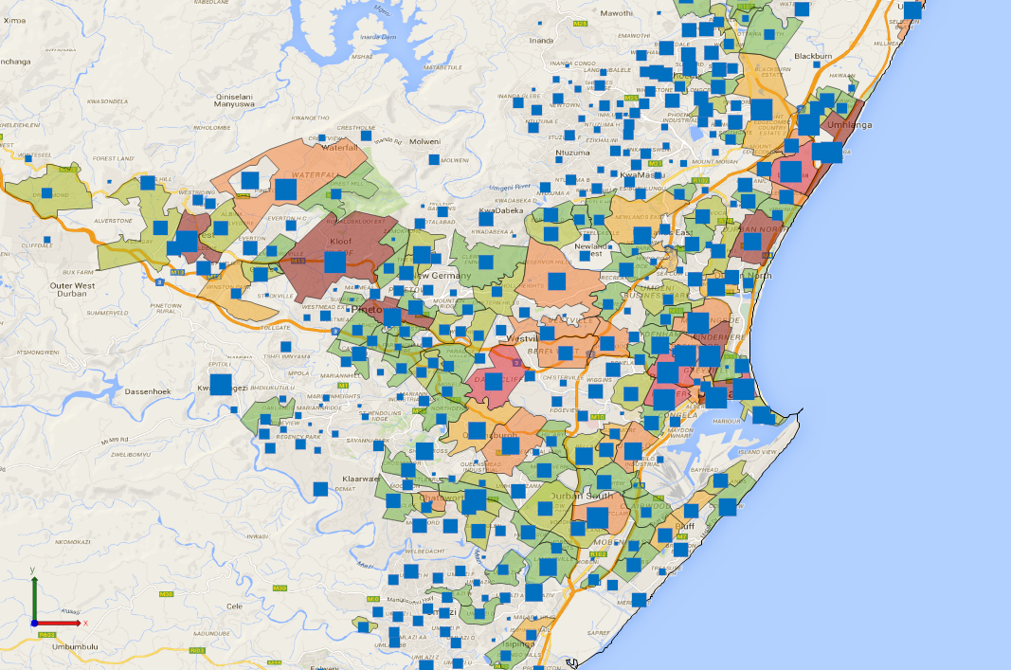
Current Position: Durban
Notes:
The light green line shows the number of registrations each year as a percentage of the number of houses completed and under construction.
The darker green line shows number of registered properties as a proportion of all houses delivered up until that year.
The proportion steadily improves between 1994 and 1999, remains fairly consistently above 70% between 1999 and 2003, and then from 2004 begins to drop significantly.
2002: Pre-emptive Clause
Prov withheld Title Deeds as attempt to enforce pre-emptive clause;
Because of pre-emptive clause, there is no longer any urgency to register Title
2004: Policy Amendment:
Removal of Sequential Milestone payment
Delinking of Subsidy from Beneficiary List.
Since the implementation of policy revisions, registrations dropped from 75% to 50%

Slide 8
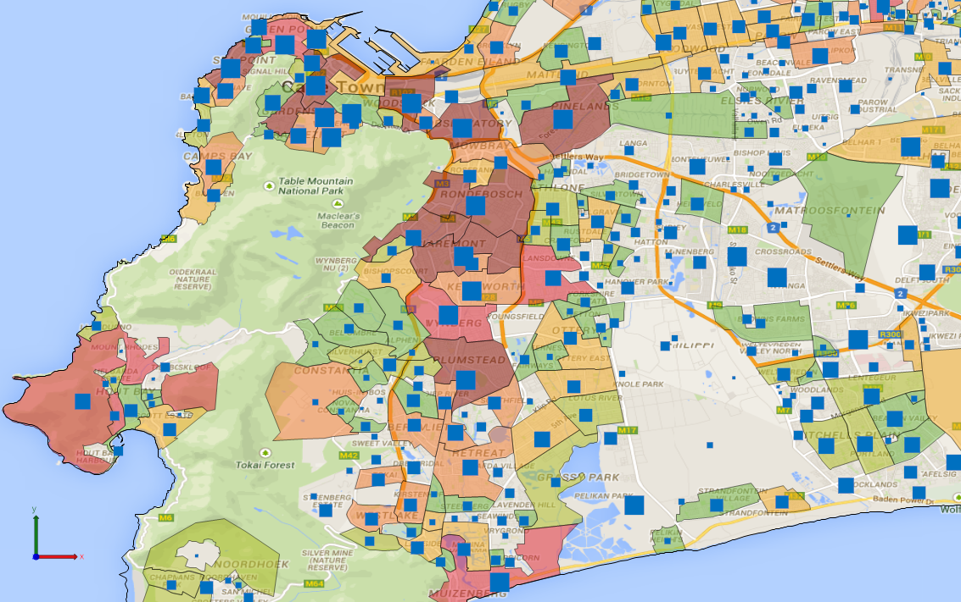
Current Position: Cape Town
Notes:
The light green line shows the number of registrations each year as a percentage of the number of houses completed and under construction.
The darker green line shows number of registered properties as a proportion of all houses delivered up until that year.
The proportion steadily improves between 1994 and 1999, remains fairly consistently above 70% between 1999 and 2003, and then from 2004 begins to drop significantly.
2002: Pre-emptive Clause
Prov withheld Title Deeds as attempt to enforce pre-emptive clause;
Because of pre-emptive clause, there is no longer any urgency to register Title
2004: Policy Amendment:
Removal of Sequential Milestone payment
Delinking of Subsidy from Beneficiary List.
Since the implementation of policy revisions, registrations dropped from 75% to 50%

Slide 9
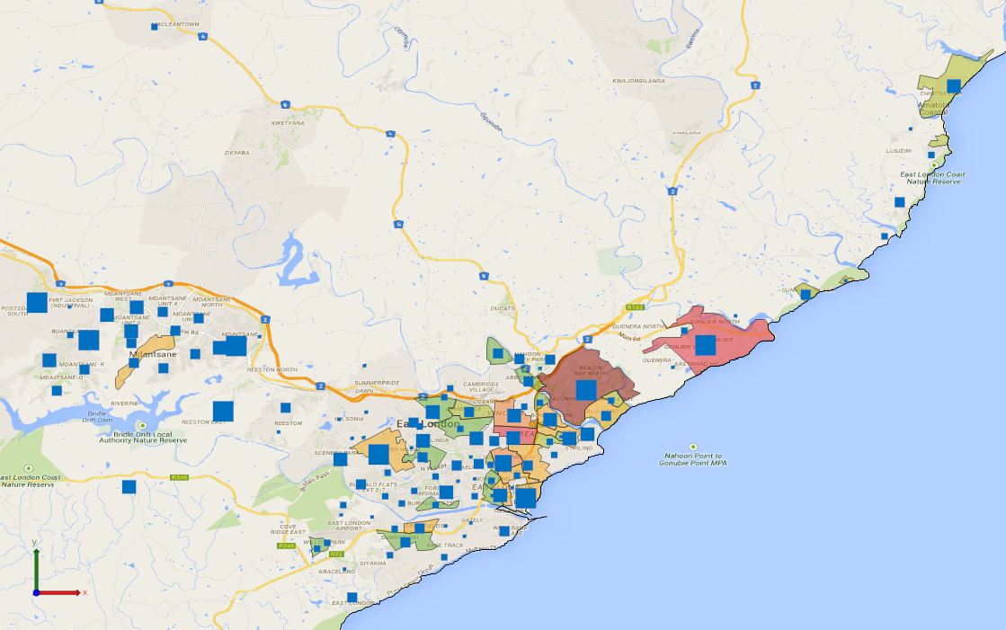
Current Position: East London
Notes:
The light green line shows the number of registrations each year as a percentage of the number of houses completed and under construction.
The darker green line shows number of registered properties as a proportion of all houses delivered up until that year.
The proportion steadily improves between 1994 and 1999, remains fairly consistently above 70% between 1999 and 2003, and then from 2004 begins to drop significantly.
2002: Pre-emptive Clause
Prov withheld Title Deeds as attempt to enforce pre-emptive clause;
Because of pre-emptive clause, there is no longer any urgency to register Title
2004: Policy Amendment:
Removal of Sequential Milestone payment
Delinking of Subsidy from Beneficiary List.
Since the implementation of policy revisions, registrations dropped from 75% to 50%

Slide 10
Value Proposition
Risks/Threats
Informality undermines Deeds Registration Systems.
Potential of expanding end-user finance in secondary housing market curtailed.
In turn, ability of banks and lenders to operate at lower end of market severely limited.
Legal Consequences
Informal sales: Discrepancy between current occupants and owners.
Difficulty in Title Correction.
Difficulty in confirming ownership.
Unresolved estates.

Slide 11
Value Proposition
Confirming Ownership
Not an end in itself ….
… but a means to a greater end.
Asset Bldg and Creation
Improve Livelihood Strategies
Traction to Secondary Market
Changing Ownership Patterns
Active Citizenry
Transform and Expand Real Estate Sector
Notes:
The objectives of this Project, therefore, are manifold:
The transfer of deeds to rightful owners who have not been issued with their papers is not only an end in itself. It is also a means to achieving a series of other ends. An effective system where all residents have access to their title deeds (and are aware of their usefulness):
maximises the housing programme's impact by creating assets and allowing people to build the value of their assets over time;
potentially opens up more personal investment to residents thereby physically transforming housing into homes, and townships into neighbourhoods;
distributes property ownership more equitably in the country thus achieving more balanced patterns of ownership;
gives households their first entry into the property market, which can lead to improved housing conditions over generations as individuals and households trade up in the housing ladder;
creates more active citizens, as envisaged in the National Development Plan; and
Becomes a catalyst in transforming and expanding the real estate sector..

Slide 12
Project Objectives
Vision
Secure tenure and clear property rights;
Improved participation in property market, as means of poverty alleviation and wealth creation.
Goal
Rightful occupiers of state housing receive legal proof of property ownership in a timely and affordable manner.
Purpose
Households able to use Title to raise finance, and transact with their property;
State to maintain a cadastre and Deeds Registry which has integrity;
Municipalities can effectively manage land use, installation and maintenance of services and amenities, and maintain a rates base.
Notes:
In the design of the strategy, the project sets itself the following objectives …
Read from slide …

Slide 13
Current Conjuncture
Since 1994, we’ve delivered some 3,8 million units;
2011 Urban LandMark Report shows that we can account for some 1,44 Titles in Deeds Registry;
Some subsidies would have gone into Programmes such as Rental, Communal Areas, estimated at some 400,000 units
Mainstay of subsidies relate to ownership;
Nature & Extent of the Problem:
Few Provinces have a clear picture
Guestimates, at best

Slide 14
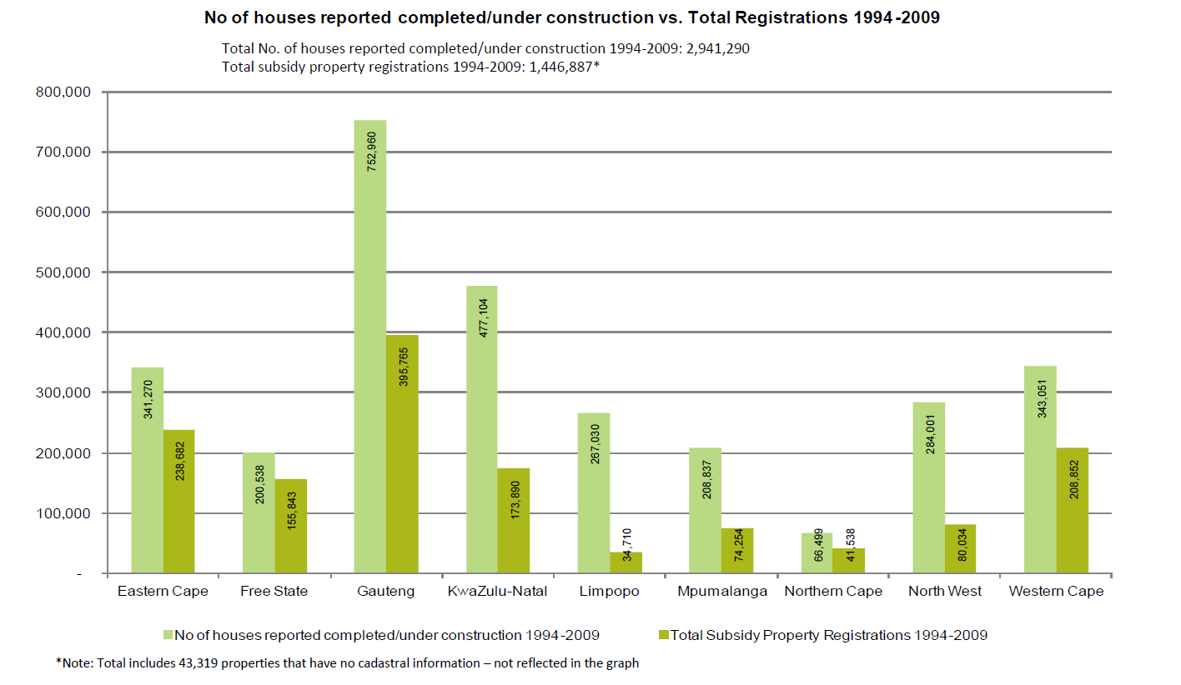
Current Conjuncture
Notes:
Slide shows total registrations per Prov.
For the period in question:
2,9 million houses completed
1,44 million (50%) registrations
49% of total registrations occurred in Metros.
So, where’s the remainder??
Note that discrepancy could in certain instances be ascribed to subsidies on Communal Land, Rental Progr, etc..
Communal Land & PTOs: KZN, Limpopo, Mpu,

Slide 15
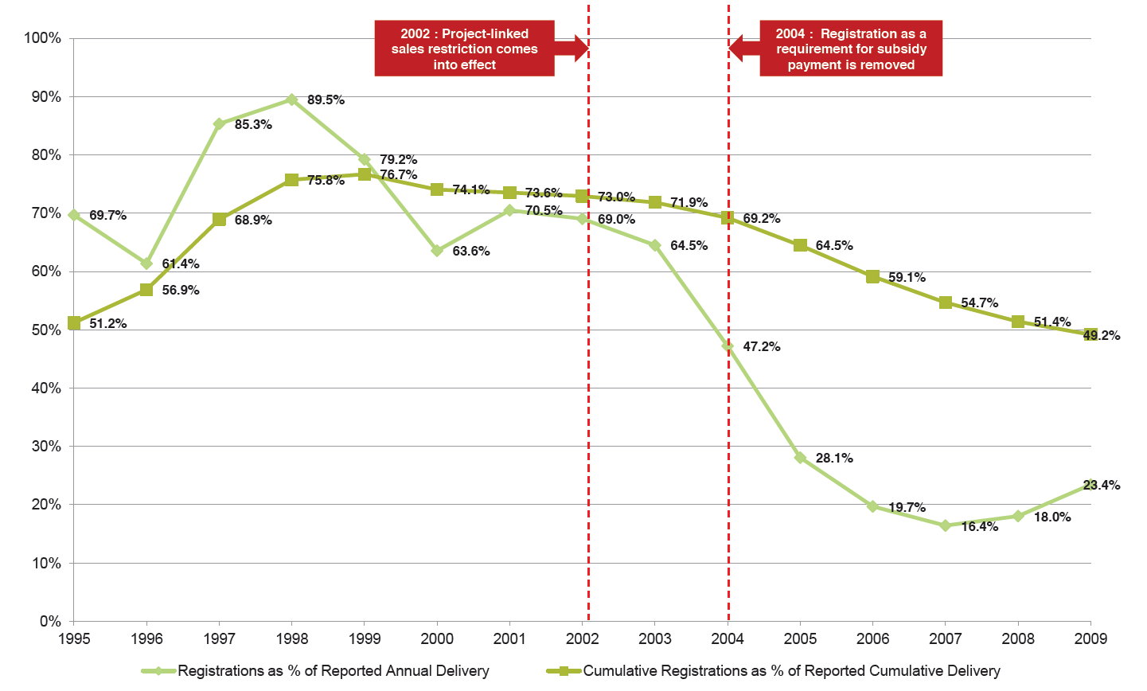
Current Conjuncture
Registrations vs Reported Delivery
Notes:
The light green line shows the number of registrations each year as a percentage of the number of houses completed and under construction.
The darker green line shows number of registered properties as a proportion of all houses delivered up until that year.
The proportion steadily improves between 1994 and 1999, remains fairly consistently above 70% between 1999 and 2003, and then from 2004 begins to drop significantly.
2002: Pre-emptive Clause
Prov withheld Title Deeds as attempt to enforce pre-emptive clause;
Because of pre-emptive clause, there is no longer any urgency to register Title
2004: Policy Amendment:
Removal of Sequential Milestone payment
Delinking of Subsidy from Beneficiary List.
Since the implementation of policy revisions, registrations dropped from 75% to 50%

Slide 16
Current Conjuncture
Notes:
The light green line shows the number of registrations each year as a percentage of the number of houses completed and under construction.
The darker green line shows number of registered properties as a proportion of all houses delivered up until that year.
The proportion steadily improves between 1994 and 1999, remains fairly consistently above 70% between 1999 and 2003, and then from 2004 begins to drop significantly.
2002: Pre-emptive Clause
Prov withheld Title Deeds as attempt to enforce pre-emptive clause;
Because of pre-emptive clause, there is no longer any urgency to register Title
2004: Policy Amendment:
Removal of Sequential Milestone payment
Delinking of Subsidy from Beneficiary List.
Since the implementation of policy revisions, registrations dropped from 75% to 50%

Slide 17
Current Conjuncture
Registered bonds
Notes:
The light green line shows the number of registrations each year as a percentage of the number of houses completed and under construction.
The darker green line shows number of registered properties as a proportion of all houses delivered up until that year.
The proportion steadily improves between 1994 and 1999, remains fairly consistently above 70% between 1999 and 2003, and then from 2004 begins to drop significantly.
2002: Pre-emptive Clause
Prov withheld Title Deeds as attempt to enforce pre-emptive clause;
Because of pre-emptive clause, there is no longer any urgency to register Title
2004: Policy Amendment:
Removal of Sequential Milestone payment
Delinking of Subsidy from Beneficiary List.
Since the implementation of policy revisions, registrations dropped from 75% to 50%

Slide 18
Current Conjuncture
Pre-94 Challenge
Municipal capacity | Municipalities not capable or equipped to assume ownership and admin. responsibility for relevant housing assets;
Municipal resistance | Municipalities refused to accept the transfer of the properties, given the perception as ‘liabilities’; Prov. Depts currently paying rates and taxes to. Hence transfer of assets will result in loss of income for the municipality;
Provincial capacity | Transfer of properties delayed due to lack of the necessary skills;
Other | Rectification of pre-1994 houses (mud-houses) Arrears on rates delaying transfers; Delays with State Attorney’s Office;

Slide 19
Current Conjuncture
Post-94 Challenge
Township Est. and Proc. | Delays in Proclamation & Township Register Proliferation of Informal Settlements
Delays in Conveyancing | Failure to value municipal properties Issuing of clearance certificates Collection of documents
Project Management | Failure to close-out projects Supply-chain processes Beneficiary Administration
Key Stakeholders | Deeds Registry State Attorney’s Office Municipalities: Beneficiary Admin
Human Settlement Policy | Pre-emptive Clause Delinking of subsidy from beneficiary Removal of sequential milestone payment

Slide 20
Current Conjuncture
Argument
Home ownership is a key pillar of the government's poverty alleviation programme
Bottom-line
The backlog, and ever-decreasing registration of Title Deeds, significantly undermining the performance of subsidised housing assets, and represents serious challenge to housing asset quality.
Single Biggest Problem
No handle on Extent and Nature of the Problem

Slide 21
Project Proposal
Confirm backlog & various categories.
Confirm challenges to tfr
Develop Prov. Specific Impl. Teams.
Confirm funding commitments.
Scoping Phase: to determine nature & extent of problem
Proposals & Strategies to resolve various categories.
Phasing: Pilot & Full Roll-out.
Funding, over MTEF.
Pre-94 Stock
Post-94 Stock
Current and Pipelined Projects
Policy and Law Reform
Policy & Progr.
Beneficiary Delinking
Sequential milestone payment
Pre-emptive clause
Quantum & Inst. Capacity
Planning & Reporting
Bulk Registrations
Less Complex Surveying
Alt. Tenure Forms
Notes:
Rolls-Royce systems for less than sophisticated clients
In this area of policy and law reform, the recommended strategic actions are as follows:
investigate international examples of alternative systems of lower cost property registration
develop more streamlined systems of bulk registration of properties
investigate and make proposals for less complex methods of land surveying
understand and establish alternative forms of secure tenure which could apply in settlement upgrades, on rural land and on farms
give particular attention to more affordable forms of transfer of deeds where households are buying or selling residential property
convene a National Indaba or round table to discuss longer term policy reforms.

Slide 22
Title Restoration Project: Progress to Date
Minister’s announce-ment:
Prioritize Eradication of Title Registration Backlog
15 July
(Budget Speech)
Inception Report submitted
Propose Impl. Strategy
Natl Briefing
Stakeholder Engagements
Dec 2014
Testing Phase
Scoping Exercise
Information Update, Implementation Plan & Cost of Implementation
May 2015
Monitoring and Evaluation
Full Roll-Out Phase
SCOPING EXERCISE
Numbers Audit
Exact backlog
Defined categories
Causal Factors
Per Province
Institutional Audit
Capacity Constraints
Skillset Constraints
Implementation Plan
Cost of Implementation
May 2015
Legend
Done
In process
To be completed

Slide 23
SCOPING EXERCISE
Nature & Extent of the Problem:
Few Provinces have a clear picture
Guestimates, at best

Slide 24
SCOPING: Specific Brief
PERFORMANCE/ REGISTRATION AUDIT | Exact backlog, broken down per category, per project/ neighbourhood, per municipality; Root causes of each type of blockage which have led to the overall backlog; Nature & extent of each type of blockage (i.e. how many title deeds are delayed at which point in the process, and for how many months or years);
CAPACITY AUDIT | Capacity and institutional constraints that currently impede the issue of title deeds.
IMPL. STRATEGY | Implementation plan to eradicate the registration backlog, including: estimated costs; and timeframes for addressing each type of blockage

Slide 25
STEERING COMMITTEE
Project to be managed by EAAB, under aegis of NDHS.
Overall Objectives:
National, supported by 9 Provincial Steering Committees, will be the central guiding body for the project.
Oversight of- & monitor the achievement of project goal & delivery targets and propose corrective actions during the key phases of the project.
Facilitate vertical knowledge sharing across whole project structure, so that learning can be shared at key points during project implementation.

Slide 26
Steering Committee Composition
Proposed that Committee/s have representation from:
NDHS & PDHSs
SALGA & Metros
Relevant housing institutions
Relevant Govt Depts:
DRDLR,
COGTA
other organisations:
Black Conveyancer Assoc.
CSIR

Slide 27
Delivery Channels
MinMec
Tech. MinMec
Estate Agency Affairs Board
Logistic Support
Contract Mgt
IT Support
Admin. Support
Steering Committee
NDHS & PDHS
SALGA
Hsg Inst.
etc..
Inst. Support
Govt Depts
Prof. Inst.
Reg. Bodies
Research Inst.
Advisory Support
Plng Law
Conveyancing
Research
Contract Mgt
Implementation Teams
Prov.
Munic’s
PRTs
Notes:
EAAB
provide leadership and support to achieve the project goal
During the project duration it will provide logistical support (e.g. contract management, IT support and administrative support) to guide, monitor and oversee the planning and implementation processes, and will disburse national funds in line with the project mandate.
sign implementation protocols with each province
appoint additional capacity where needed, and in line with the protocols and budgets available.
report to Technical MinMec and MinMec on strategy, project progress and project expenditure. The EAAB will report on a quarterly basis on transfers made, challenges encountered, and strategic-level corrective actions
STEERING COMMITTEE
central guiding body for the project, with representation from national and provincial de
partments of human settlements, SALGA, relevant housing institutions
oversight of (and monitor) the achievement of the project goal and delivery targets, and propose corrective actions during the key phases of the project
IMPLEMENTATION TEAMS
Capacity, while varying across Prov, are in place.
These teams will be supported by appointed Professional Resource Teams which will provide the types of advisory expertise needed to address the specific challenges in each province and municipality.
report directly to the EAAB, and present strategies, plans and progress reports to the Steering Committee.

Slide 28
Critical Success Factors
Total cost of restoration | Cannot be determined until scale & nature of backlog is calculated; Absolute commitment to policy clarifications and implementation guidelines;
Policy and Programmes | Pre-emptive Clause; Delinking of subsidy from beneficiary; Removal of sequential milestone payment; Individual property rights on Communal Land;
Beneficiary Administration | Disputes between occupiers and legal owners; Incorrect information on Title Deed; Applicability of PIE; Resistance to accept transfer of (pre ‘94) houses, given the obligation to pay rates and bills.

Slide 29
Critical Success Factors
Project Management | Attention should be given to streamlining current processes to prevent an undue slow-down in delivery of Title.
Professional Bodies | Essential that professionals included in discussions of possible reforms, and challenged to offer solutions around bringing down the costs and timeframes of township establishment and property registration.
Broader Human Settlement Policy | Project runs risk of drawing too attention to the private ownership model, and by so doing, draw focus away from equally pressing need for other products & tenure solutions.
Institutional Resilience | Requisite human resources, skillsets and budget need to be made available to negate continued backlog. Degree of willingness on the part of National, Provincial and Local Government

Slide 30
Critical Success Factors
Political Will & Intervention | Degree of willingness on the part of National, Provincial and Local Government Project relies on achieving common focus towards defined outcome, viz. allocation of title deeds to rightful owners & fixing flaws in current system.
 | DRDLR | Complexity of conveyancing for small transactions. Fast-tracking of applications to SG’s Office & Deeds Registry.
 | Justice | Capacity of the State Attorney’s Office.
 | COGTA | Roles, capacity & risks to municipalities. Rates Clearance Certificates.
 | Treasury | Funding commitments over MTEF.

Slide 31
Timeframes
Pre-94 Stock
Backlog Confirmation: May ’15
Implementation: November ’15
Conclusion: March ’17
Current and Pipelined Projects
Policy Confirmation: Done.
Reporting: June ‘ 15
Streamlined Implementation: June ’15
Scoping Phase:
Backlog Analysis and Gap Identification – March ’15
Proposals: June ’15
Pilot Phase 2 Prov. – May ’15
Full Roll-out: Conclusion – March ’18
Post-94 Stock
Policy and Law Reform
Round Table/Indaba
Titling: Towards Possessing
the Land

Slide 32
WAY FORWARD
Scoping Exercise | Confirming, in detail, nature & extent of registration backlog. Detailed implementation & costing for eradication.
Steering Committee | Oversight to occur by way of Natl & 9 Provincial Steering Committees. Natl Steering Committee to be scheduled in Feb. 2015.
Beneficiary Info. | Dept currently in process of reconciling beneficiary information with data from Deeds Office.
Institutional Engagements | Registrar of Deeds: Fast-tracking conveyancing “fast-link” for EAAB/DHS Office of Surveyor-General: Fast-tracking General Plan applications Black Conveyancers Association EAAB/DHS empowerment initiative Housing Development Agency; and Centre for Affordable Housing Finance
Planning & Monitoring | Dashboard Reporting: Registration backlog Current projects Ongoing trends in respect of conveyancing
Pilot Initiatives | KZN PDHS: Sectionalizing pre-94 Hostels Free State: Transfer of pre-94 stock in Qwa-Qwa EAAB/CAHF/NHFC/FNB Initiative: Stimulating Township Market

Slide 33
Thank you

