Slide 1
Trade, Investment and Exports
Presentation to the Parliamentary Portfolio Committee on Trade and Industry
Cape Town

Slide 2
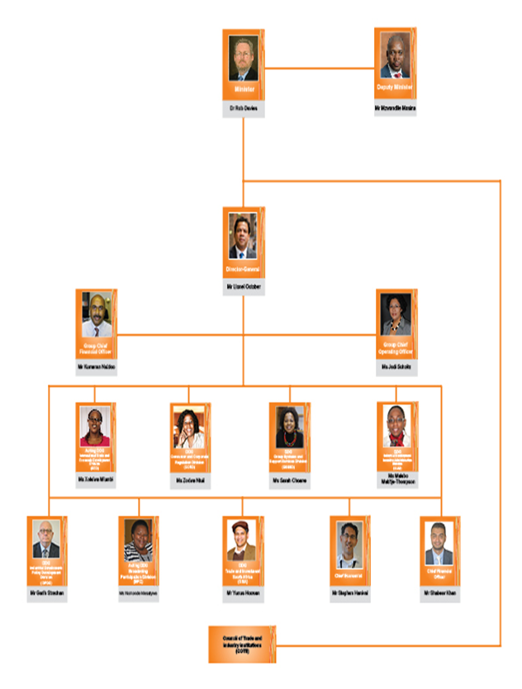
Trade, Investment and Exports

Slide 3
International Trade
and Economic Development (ITED)

Slide 4
The Structure of ITED
Chief Directorate: Africa Bilateral Economic Relations
Chief Directorate: Africa Multilateral Economic Relations
Chief Directorate: Non-Proliferation
Chief Directorate: Office of the DDG
Chief Directorate: Trade Negotiations
Chief Directorate: Bilateral Trade Relations (Rest of World)
Chief Directorate: Office of the COO

Slide 5
Purpose and Mission
Purpose: To provide leadership on trade policy in South Africa to promote economic development by working to build an equitable multilateral trading system that facilitates development, by strengthening trade and investment links with key economies, and by fostering African development including through regional and continental integration, and development cooperation in line with NEPAD.

Slide 6
Functions
African economic integration and development (bilateral, regional and multilateral)
Bilateral trade engagements (Rest of World)
Trade and Investment negotiations
Policy development and research
Divisional leadership and support
Non Proliferation administration

Slide 7
SA Policy Context
SA Policy Context
SA Government’s broad national development strategy aims to accelerate growth along a path that generates sustainable, decent jobs to address apartheid legacies.
Elaborated in the National Development Plan and New Growth Path.
National Industrial Policy Framework (NIPF) and Industrial Policy Action Plan (IPAP) are central components of this strategy and seek to encourage and upgrade value-added, labour-absorbing industrial production.
Trade Policy and Strategy Framework (TPSF) was adopted in 2010 following a review and extensive consultations, including Parliament.
TPSF sets out that trade policy is an instrument of industrial policy and trade policy must support industrial development and upgrading, employment growth and increased value-added exports.

Slide 8
Trade Policy: Setting the Scene
SA is a relatively open economy, only “moderately” protected by tariffs.
Simple average MFN applied tariff: 7.7% (down from 23% in the 1990s).
56% duties are set at 0%
Compared to our trading partners, the tariff regime is transparent and not overly complex (e.g. no NTBs).
WTO Services commitments on par with OECD countries.
SA ranks amongst the most open jurisdictions for FDI in the world and provides strong protection to investors in line with high international standards.

Slide 9
SA Trade Reform Experience
Extensive tariff liberalisation since 1994.
BUT while SA exports increased significantly, the basket of export goods, with some notable exceptions, remains largely unchanged.
SA exports continue to be dominated by commodities, except in African markets.
Labour-intensive production has contracted due to imports.
Bias towards capital and high skill-intensive growth.
Hence NDP, NGP and IPAP call for “developmental” trade policies” to encourage and upgrade value-added, labour-absorbing industrial production.
Improving SA’s export performance requires greater attention to exporter development as well as export promotion and marketing.

Slide 10
ITAC and SA Approach to Tariff Reform
International experience demonstrates the importance of a strategic approach to tariff policy (i.e. as part of industrial policy, and pursued gradually and selectively to support industrial development).
An evidence-based, case-by-case assessment will inform tariff changes in SA (no a priori position).
Vital role for ITAC.
Tariffs on mature upstream input industries could be reduced or removed to lower the costs for downstream, labour-creating manufacturing.
Tariffs on downstream industries with employment or value-addition potential could be retained or raised to ensure sustainability and job creation.

Slide 11
SA’s Trade Strategy Priorities
Priority is to focus on African development, industrialisation and integration.
Africa needs to shift its current consumption and commodity-driven growth path onto a more sustainable industrial development path.
Pursue “development integration” in SACU, SADC, T-FTA and C-FTA: market integration; industrialisation and regional value-chains; and infrastructure development.
Maintain trade and investment relations with industrial economies, extend AGOA and conclude the EPA.
Work to build industrial complementarities and shift structure of trade with dynamic economies of South.
Work to ensure a development-outcome to the WTO’s Doha Round, including finalising the post-Bali work programme that prioritises the non-binding decisions of the Bali Ministerial Conference.

Slide 12
Trade and Investment South Africa (TISA)

Slide 13
The Rationale for Investment & Trade Promotion Agencies
What is Investment Promotion
It involves several coordinated activities designed to attract, grow and retain new foreign and mobile domestic investment. Broadly speaking, it also deals both with improving the investment climate (product development) and marketing the location’s potential to private investors.
Investment promotion is a Government activity and most IPAs, national or subnational,
are financed by the public sector.
The establishment of a national IPA is a choice a national government can make when deciding on an investment promotion strategy.
2. Why is Investment Promotion Important?
Intense and increasing competition for foreign direct investment (FDI)
To compete for the FDI, governments need a national agency with specialized promotional skills
Information for investors in decision making, as this is generally lacking and can be appropriately provided and packaged by an agency
Source: World Bank

Slide 14
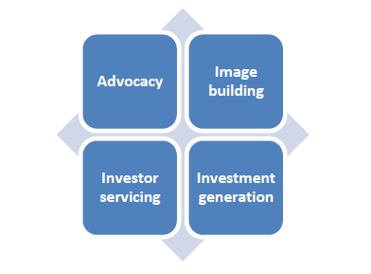
What is an Investment Promotion Agency (IPA)
DEFINITION
The International Trade Centre (ITC) defines an IPA as an institution whose purpose is to attract investment to a country, region or city.
MAIN SERVICES
Source: ITC

Slide 15
What is a Trade Promotion Organisation (TPO)
TPOs are established to assist Exporters in developing new and expanding existing markets and provide the following main categories of services:
Market Research, Global Business Trends, Growth Industries and In-Market Support for Market Developments
Organising foreign business missions, seminars, exhibitions and consulting services
Mentoring
Outward FDI services
Source: ITC

Slide 16
What is the relation between an IPA and a TPO?
According to the World Bank, the direct relation between an IPA and a TPO is that “investment plays a key role in attracting foreign direct investment (FDI) thus improving the export competitiveness of developing countries by providing capital, technology, industry expertise as well as access to international markets and MNC supply chains.
Source: ITC

Slide 17
Main Operational Differences
Domain | Trade Promotion | Investment Promotion
Funding | Public/Private | Mostly Public
Resources (if joint) | Often largest share of Budget | Smaller Share of Budget
Support
Business Intelligence | Country Production and Suppliers | Investment Climate, Operational Conditions and Suppliers
Client Targets | Exporters (often SMEs) | Global/Regional TNC HQs
Business Cycle | Purchase Decisions (Short-Term) | Strategic Decisions (Long-Term)
Mode of Engagement | Trade Shows/ Exporter Missions | One-to-One Company Meetings
Staff Skills | Sales and Marketing Officers | Location and Industry Advisors
Performance Indicators | Export Volumes/ Access to New Markets/ Number of Clients | FDI Volume/Jobs/Project Numbers (Type & Sectors)
Source: ITC

Slide 18
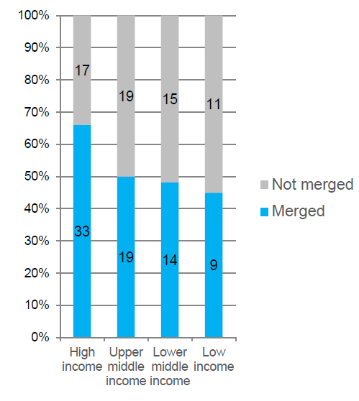
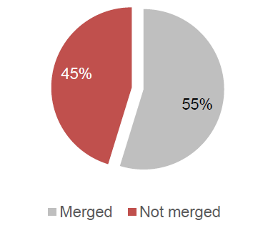
Are IPAs and TPOs Merging: International Best Practice
WTO provides the names of 178 TPOs, of which 41 are ministries.
Out of 137 TPOs, 75 are merged
Source: ITC

Slide 19
Pros and Cons for a Merged Setup
ADVANTAGES | DISADVANTAGES
Better policy coherency in investment and trade issues | Often different objectives and core activities
Shared Support Services | Risk of increased bureaucracy
Knowledge-sharing | Different time-frames, with generally a longer time perspective in investment promotion
Potentially more continuity in service delivery | Often different clients and contact points in companies
Potential synergies in overseas promotion (country branding) | Largely different skills requirements for staff
Source: ITC

Slide 20
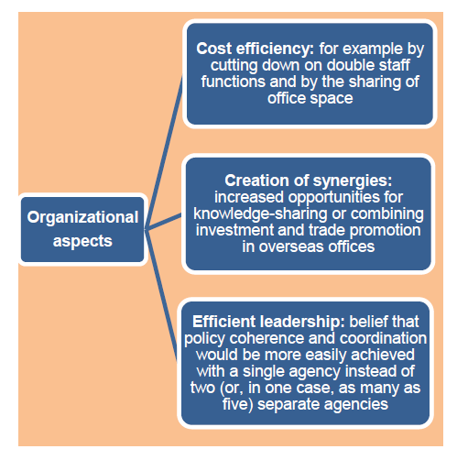
Reasons for Merging: Operational Perspective
Source: ITC

Slide 21
Reasons for Merging:
Economic Goals Perspective
The economic strategy of a country influences the merger of TPOs with IPAs:
If a country aims to increase export –oriented FDI inflows, trade analysis can be useful for planning export-oriented investment targeting enterprises
A small domestic market requires investment promotion strategies on enterprises that manufacture goods for export
Source: ITC

Slide 22
The Structure of TISA
Office of the DDG
Divisional Budget: R360 748 million
Export Credit Insurance Corporation
Budget: R110 370 million
Export Development and –Support
Budget : R27 558 million
Export Promotion and –Marketing
Budget: R49 892 million
Investment Promotion and –Facilitation
Budget: R 52 201 million
Network of Foreign Economic Offices
Budget: R123 408 million

Slide 23
TISA Purpose and Mission
Purpose: Support export development, promote exports and direct inward foreign and domestic investment as well as outward investment into Africa through targeted strategies. Effectively manage a network of foreign economic offices.
TISA’s primary mission is to:
  Increase South Africa’s capability and capacity to promote exports of products and services into targeted high growth markets;
  Increase and retain the level of direct foreign and domestic investment flows and;
TISA’s secondary mission:
  Management of the Department’s network of foreign offices
  Contribute towards the effectiveness of TISA, encouraging strategic alignment, policy coherence and leadership

Slide 24
TISA Strategic Goals
Increase the quality and quantum of foreign and domestic direct investment;
Undertake effective investment recruitment campaigns;
Provide an efficient facilitation and information service and one-stop shop initiative; in order to retain and expand investment into South Africa and Africa
Develop new and expand existing South African exporters' capabilities, in order to grow exports globally (goods, services and capital);
Promote value added exports to both the traditional and the high growth emerging markets in support of the country’s industrialisation programme.
Provide appropriate information, financial support and practical assistance to sustain growth in traditional markets and penetrate new high growth markets;
Effectively manage and administer the dti's Foreign Office network.

Slide 25
Export Development and -Support
Export Development and Support champions the National Exporter Development Programme, which is designed to contribute towards the positioning of South Africa as a reliable trade partner by expanding the exporter base and enhancing the export culture of the country.
The programme prioritises the extensive capacity building of potential and established exporters by taking these companies through a rigorous export training which is underpinned by Global Exporter Passport Programme, supported by the national trade information system to enable ease of access to trade information and export advice; creating opportunities for international exposure supported by export village initiatives which will ensure pooling of resources to jointly strive to penetrate the international markets.
25

Slide 26
National Exporter Development Programme
The National Exporter Development Programme is designed to enhance export readiness of companies at different levels of development through a rigorous export training programme focusing on the following pillars:
  Enhancement of export culture in South Africa through activities entailing outreach campaigns, export awareness and other identified appropriate platforms
  Provision of trade information and export advice through an export helpdesk
  Export training and capacity building supported by mentorship underpinned by Global Exporter Passport Programme
  Special projects such as export villages geared to facilitate access to international markets through the pooling of resources
26

Slide 27


Export Development Service Offerings
  Matching trade opportunities with exporters, placing a strong emphasis on exploiting opportunities in BRICS, Africa and high growth markets.
  Provider and source of Business Intelligence and trade information
  Leading and coordinating stakeholders involved in the Export Development value-chain, around a common vision
  Export training and capacity building of potential and established exporters through the implementation of the Global Exporter Passport Programme which is underpinned by 5 phases supported by mentorship
Global
Exporter
Export
Ready
Export
Aware
Explorer
Domestic
Enterprise

Slide 28
Export Promotion and -Marketing
The mandate of Export Promotion is to promote South African value added goods and services abroad by broadening the export base and increasing market share in targeted high growth markets and sustaining market share in traditional markets.
The finalisation and launch of the National Export Strategy which considers issues of competitiveness; market access; the current export development initiative; export promotion mechanisms; financing mechanisms; stakeholder alignment as well as monitoring and evaluation requirements through the following key pillars:
  Improving the enabling export environment
  Strengthening the export institutional framework
  Increasing the demand for South African goods and services through market diversification
  Enhancing the Country Value-Proposition and Sector Branding
  Broadening the Export base as outlined in the National Exporter Development Programme
  Enhancing Export Incentives and Trade Financing Instruments
.
28

Slide 29
Export Promotion and Marketing
Facilitating export sales of R3.5 billion in the 2015/2016 period.
On-going implementation of the Product and Marketing Diversification strategy through National Pavilions, Group Missions and other export promotion tools
Conducting studies to determine the integration of South African value- added products and services into these networks.

Slide 30
Overview of Target Markets
Central to the NES is the Product and Market Diversification strategy which aims to leverage opportunities in targeted markets in order to benefit South Africa’s economic development priorities and to ensure that South Africa’s exports to traditional markets stabilise and higher export growth are facilitated to emerging markets in support of the country’s industrialisation programme. The markets that have been prioritised are indicated below.
Sub-Saharan Africa | North Africa | Asia | Latin America | North America | Middle East | Europe
Angola Cameroon DRC Ethiopia Ghana Kenya Mozambique Nigeria Senegal Tanzania Uganda Zambia Zimbabwe | Algeria Egypt Libya Sudan Tunisia | China Hong Kong India Indonesia Japan South Korea Malaysia Philippines Singapore Thailand Vietnam | Argentina Brazil Chile Peru Colombia Venezuela Uruguay | Canada Mexico USA Cuba | Iraq Iran Kuwait Oman Qatar Saudi Arabia UAE | EU27 Russia Turkey

Slide 31
Export Promotion and Marketing Service Offerings
The services and offerings provided by the unit include:
Gathering of market intelligence
Identify markets with potential and export opportunities through the Market Diversification Strategy
Matching potential exporters with foreign buyers and providing in-market support
Providing export advisory services and export market information
Provision of market access through National Pavilions, Outward Selling Missions, Inward Buying Missions as well as Investment and Trade Initiatives
Providing financial assistance through the Export Marketing and Incentive Assistance (EMIA)
31

Slide 32
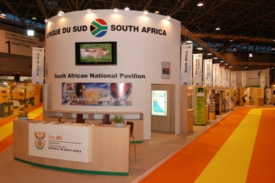
Export Marketing & Investment Assistance (EMIA)
Partially compensation is provided to exporters for certain costs incurred marketing their products and services in foreign markets when they make use of the following offerings.
Group Offerings
National Pavilions
Outward-Selling Trade Missions
Outward Investment Recruitment Missions
Inward-Buying Trade Missions
Inward Investment Missions
Individual Offerings
Primary Export Market Research
Foreign Direct Investment Research Scheme
Individual Inward-Bound Mission
Individual Exhibitions and In-store Promotions
Sector-Specific Assistance Schemes:

Slide 33
Export Credit Insurance Corporation Soc Limited (ECIC)
ECIC’s Vision
To be leaders in the medium and long-term export credit and investment insurance business, focusing on customer needs and sound risk management.
ECIC’s Mission
The mission is to facilitate and encourage South African export trade by underwriting export credit loans and investments outside the country in order to enable South African contractors to win capital goods and services contracts in countries outside of South Africa.
Key Strategic Objectives of the ECIC
In the effort to achieve its mission, the ECIC will be driven by six (6) guiding strategic objectives:
Facilitate export trade and investments outside South Africa.
Strategic Alliances: build mutually-beneficial local, regional and global relations to advance South Africa’s trade and economic development objectives.
Raising the profile of ECIC: Develop and promote awareness of the ECIC brand. Build, manage and maintain positive stakeholder relations.
Promote a professional, competitive and customer focused workforce that ensures an effective and efficient service to our customers.
Fostering risk orientation: Create an enterprise wide risk awareness and effective corporate governance and risk management practices.
Effective stewardship: Consistently utilise sound business environment and social principles by applying international best practice.

Slide 34
Planned Impact of the ECIC programmes:
Facilitate export trade and investments outside South Africa:
USD864m export credit/investment insurance applications to be approved by the ECIC Board.
Strategic Alliances:
Co-operation engagements in knowledge sharing and training initiated by the ECIC in terms of existing Co-operation agreements or arrangements with international stakeholders.
Raising the profile of ECIC
Promote a professional, competitive and customer focused workforce that ensures an effective and efficient service to our customers
Fostering risk orientation
Weighted risk exposure level of medium.
Effective stewardship:
Achieve a Level 3 BBBEE Score;
15 SMEs participating in ECIC sponsored enterprise development program

Slide 35
Investment Promotion and -Facilitation
Investment Promotion and Facilitation facilitates the increase in the quality and quantity of foreign and domestic direct investment by providing an investment recruitment, problem-solving and information service in order to retain & expand Investment in South Africa and into Africa. The sub-programme is promoting South Africa as an investment destination, with a target of R140 billion over the next three years. The target for the investment pipeline for 2015/16 is
R 45 bn.

Slide 36
National Investment Promotion and Facilitation Strategy Phase 2
The objective of the project is as follows:
To develop an investment strategy and methodology for investment promotion, facilitation, aftercare and policy advocacy.
To align TISA’s Investment Strategy with all Government programmes
To develop investment related products and service offerings
To design and develop a customised investor service and the implementation of a one-stop-shop service for investors.
To develop sector specific promotional strategies by focusing activities and initiatives to targeted markets.
To improve the investment climate.
To develop a 3-5 year operational plan to achieve the strategic objectives of TISA.
To develop a strategy for outward investment into Africa. (Phase3)
To develop a strategy for the African Gateway concept. (Phase 3)

Slide 37
Key Targets for Investment Promotion and Facilitation
To make South Africa a Top Ten investment destination
To make TISA a top five world class investment promotion agency
Seek to attract an investment pipeline of R140 billion within the next 3 years
Targeted and co-ordinated investment drive amongst all stakeholders. Diversify and increase investment flows from emerging markets. Retain and expand investment flows from developed markets.
Reduce the cost of doing business and administrative barriers. Improve SA investment climate and investment attraction.
Common messaging and brand identity. Marketing and Facilitation support for the SEZ program & to host the Annual Africa Dialogue Conference
Capacitate the unit to provide a dedicated investment promotion, facilitation and aftercare through a one stop shop service.

Slide 38
Investment Promotion and Facilitation Opportunities
Investment and Export Opportunities are identified by the DTI’s Industrial Policy Framework and the resultant Industrial Policy Action Plan, the NGP and the NDP
The above inter-alia has identified those sectors and industries which South Africa has a competitive or potential advantage in terms of economic sustainability.
It follows that the identified sectors are the opportune areas for investment and that the products and services resulting there from have a propensity to be globally competitive.
Manufacturing: Automotive, Agro-processing, Capital equipment & transport
Advance Manufacturing: Pharmaceuticals, bio-technology, aerospace
Mining and mineral beneficiation
Services: BPO, Oil and Gas, Infrastructure
Green economy: Renewable energy, waste management, nuclear components

Slide 39
Investment Promotion and Facilitation Service Offerings
Investment Recruitment
  Promotion of investment opportunities
  Marketing of investment projects
  Guidance with plant/site locations – Industrial Development Zones & Special Economic Zones
  Packaged Investment projects
  Input into policy formulation
Investment Information
  Information on the local economy and various investment opportunities within SA sectors and industries.
  Information on incentive packages
  Information on regulatory and legal environment
  Publications viz, investment opportunities, SA Fact Sheet and Investors Handbook
  Information of South Africa’s trade and investment policy.
  Information on government policy in strategic sectors

Slide 40
Investment Promotion Facilitations Service Offerings
Facilitation
  Facilitation of investment missions, including travel itineraries
  Introduction of investors to key stakeholders in private and public sectors
  Introduction of investors to potential joint venture partners and black economic partnerships
  Facilitation of finance and incentives
  Assistance with applications, company registration, EIA, etc
  Recommendations: Immigration Act – Business & Corporate Permit applications
  Fast Tracking regulatory, zoning, licensing & municipal connections for investors
  Logistical support for relocation
Aftercare
  Aftercare Forums , Workshops & investor surveys
  Aftercare Meetings & Site visits to retain & expand investments

Slide 41
Foreign Economic Offices
TISA is responsible for the effective management and administration of the Department's Foreign Offices based abroad.
The dti has 27 Foreign Economic Representatives and 48 Marketing Officers covering a footprint of 37 countries
In countries where TISA does not have Foreign Economic Representatives (FER’s), TISA works closely with DIRCO (Department of International Relations and Co-operation).

Slide 42
South Africa’s Current Global Footprint
Europe: Brussels, Geneva, London, Milan, Moscow, Stockholm, The Hague, Berlin, Madrid, Munich, Paris, Bern & Vienna
North America: Chicago, New York, Washington & Toronto
Asia: Beijing, Hong Kong, Seoul, Shanghai, Tokyo, Bangkok, Jakarta, Kuala Lumpur, Mumbai, New Delhi & Singapore
Middle East: Cairo, Dubai, Riyadh, & Tehran
Australia: Canberra
South America: Sao Paulo & Buenos Aires
Africa: Addis Ababa, Abuja, Harare, Kinshasa, Luanda, Maputo, Nairobi, Dakar, Kampala & Accra
Notes:
Not allocated: 11.38 %

Slide 43
Thank You

