Slide 1
PARLIAMENT OF THE REPUBLIC of SA
TRANSPORT PORTFOLIO COMMITTEE
19TH SEPTEMBER 2022

Slide 2
Contents
1.
Welcome and Introductions
2.
Purpose and Agenda of Meeting
3.
About SABRATA
The South African BRT Landscape and the 12 Year Contract
4.
5.
Recommendations
Notes:
Section to be presented by Chairperson of SABRATA

Slide 3
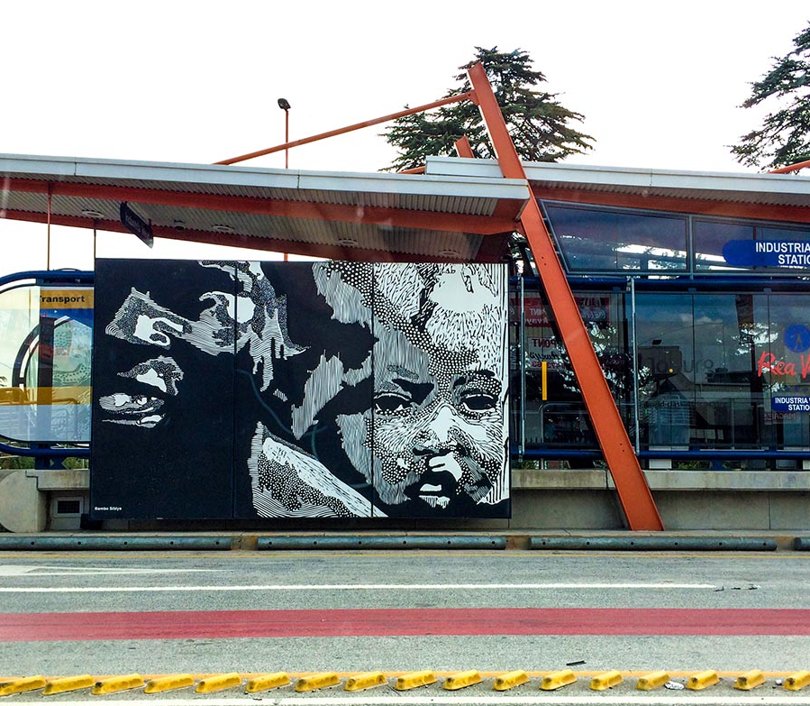
Welcome and Introductions
Notes:
PROTCOLS TO BE OBSERVED

Slide 4
Purpose of Meeting
Agenda for this meeting is as follows:
The Bus Operating Company Agreement (“BOCA”) duration of all Bus Operating Companies (“BOC’s”) also known as Vehicle Operating Companies (“VOC’s”);
Implementation of the current BOCA’s;
Bus Rapid Transit value added services and agreed undertakings; and
Lessons learnt locally and other jurisdictions.
Notes:
Reference to be made to Letter addressed to the Minister Honorable Fikile Mbalula on 15 November 2022

Slide 5
ABOUT SABRATA

Slide 6
Background of SABRATA
The South African Bus Rapid Transit Association and Academy NPC (“SABRATA”) was established in 2020 as a public transport association for bus rapid transit (BRT) bus operating companies and stakeholders.
SABRATA is a voluntary association registered as a Non-Profit Company not for gain.
Its purpose is to serve as an independent national body, that protects BRT operators, allied organisations and commuters, by representing and providing support to ensure the sustainability of BRT’s, whilst meeting governments’ policy and strategic objectives.
Members currently include 8 BRT bus operating companies.
Notes:
Presentation by Ms Nobuhle Mazolo

Slide 7
SABRATA Stakeholders
Integrated Rapid Public Transport Network Operators
National Taxi Associations
National Department of Transport
National Treasury
Minister of Transport
Municipalities
Provincial Department of Transport
Provincial MEC’s for Transport
Traffic Department
Safety and security
Bus representative bodies
PRASA
Commuters
Educational institutions and training providers
Transport Education Training Authority
SARS
Suppliers and services providers to the industry

Slide 8
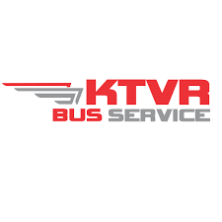
MEMBERS

Slide 9
Key Objectives of SABRATA
NETWORKING
COLLABORATION
TRANSFORMATION
EQUIP
Central to SABRATA’s vision and mission is bringing the BOC’s together for the purpose of uniting towards a common purpose of improving the public transport system and adding value to stakeholders
Building sustainable BOC’s and establishing a community that safeguards the interests of the shareholder. Central to this are the key communities around the BOC’s that will support and strengthen the BOC’s in advocacy, governance, operations, technical expertise and growth
Transforming the public transport sector, empowering the taxi industry and transforming the lives of shareholders
Equip members of SABRATA through training, development, capacity building initiatives, seminars, workshops and conferences, to enhance knowledge and expertise. Through this, members and their stakeholders will be empowered

Slide 10
SABRATA Goals & Priorities
The SABRATA strategic plan encompasses three priorities, which broadly define the key approaches the organisation will use during 2022-23 to accomplish its mission and drive towards the vision of Being the Leading Force in advancing metro and city bus rapid transit.
The three priorities are:
Champion the review of the12-Year Contract in collaboration with relevant stakeholders;
Cultivate strategic growth of SABRATA;
Leverage the collective strength of our member organisations.
Notes:
This is backed by SABRATA”s strategic plan 2022 – 2025
GOAL 1: FINANCIAL SUSTAINABILIY
1.1 Develop and implement a funding strategy/ plan
1.2 Develop and monitor long term strategies and plans to ensure financial viability
1.3 Identify and engage prospective funders for SABRATA activities and operations.
1.4 Develop, implement and monitor financial policies
1.5 Prepare AFS in terms of IFRS and GAAP
GOAL 2: COLLECTIVE MEMBERSHIP
2.1 Identify all BOC’s and relevant stakeholders and engage on SABRATA membership
2.2 Establish a CEO mobilisation committees
2.3 Road shows to raise awareness of BRT BOC’s in South Africa
2.4 Conduct targeted workshops with and for all BOC’s
GOAL 3: PROGRAMMES AND ACTIVITIES
3.1 Develop a researched programmes/activities plan and implementation plan
3.2 Implement, monitor and evaluate programmes 3.3 Prepare proposals to collaborative partners on programmes 3.4 Develop skills development initiatives through training, development, seminars, conferences
3.5 Engage relevant SETA’s and other relevant partners in skills development
GOAL 4: ADVOCACY
4.1 Ensure and protect the rights of BOC’s through policy reviews, particularly the NLTA
4.2 Champion section 41 NLTA review of 12 year contract
4.3. Develop a transformation strategy in the BRT Sector
4.4 Host SABRATA Indaba during transport month
GOAL 5: STAKEHOLDER ENGAGEMENTS
5.1 Prepare a comprehensive list of all stakeholders and engage
5.2 Engagements with individual BOC’s/Board/Taxi industries and related entities.
5.3 Engagements with government structures on transport policies, safety and economic development in BRT Sector
5.5 Empower the Taxi Industry through activities, social investment initiatives

Slide 11
South African
BRT
Landscape

Slide 12
OVERVIEW OF BRT OPERATIONS IN RSA

Slide 13
Overview of BRT’s in South Africa
With South Africa hosting the 2010 World Cup, BRT was the fastest and cheapest way to get a high-quality bus rapid transit connection between the townships, downtown, and the football stadiums, while leaving a lasting transit legacy.
This is how the BRT found its historical moment.
For over a decade now, the National Department of Transport (NDoT), and major cities like Cape Town, Johannesburg, Pretoria, Ekurhuleni, Polokwane and Gqeberha have embraced the BRT with Cape Town BRT system having been named the best public transport system in the country.
The BRT has provided a high-quality, affordable, safe and quick rapid transit system, while simultaneously transforming the taxi industry into modern bus companies.
Notes:
Presented by Ms Mazolo

Slide 14
Overview of BRT in South Africa
The past few years have seen a push back against the BRT with increased subsidies in the other public transport sectors with no clear plan for the support of the taxi industry.
Government is not supporting the BRT fully due to a number of factors, the main factor being affordability.
There is little to no evidence of integrated “rapid rail and BRT priority corridors” as was originally envisaged.
NDoT’s submission that selected cities have been required to implement a transformed BRT model which consists of downscaling of infrastructure, targeting high volume corridors, and adopting a hybrid model.
Current proposed changes in the design and rollout of BRT have affected progress.

Slide 15
Overview of BRT in South Africa
The BOCA’s have shown various problematic areas ranging from:
Implementation
Value chain services
BOC’s not determining fares
Governance with the BOC’s
Delayed expansion plans
Lack of resources by municipalities
Ridership volumes
Stakeholder negotiations and engagement
Shareholders of the BOC’s remain uncertain about their future, once the contract comes to an end.

Slide 16
Overview of BRT in South Africa
In essence, the BRT has failed to deliver a subsidy-free public transport system in record time and the taxi operators are in a worse off position than before. Some reasons include:
Lack of a BRT National Framework
Municipalities have not adhered to timelines
Funding challenges
Lack of BRT awareness and positive marketing
Lack of training of shareholders in the taxi industry mostly in governance change management and business management (transition)
Lack of infrastructure development and maintenance
Delayed payments to the BOC’s by municipalities.

Slide 17
BRT
BOCA Duration

Slide 18
QUOTES By the Affected Operators
“You take a black minibus taxi operator that had an indefinite operating licence. Then you put him on a 12-year contract. Then you expect that person to compete, at the end of the 12 years, with a bus company that has been in business for 150 years..... Now this becomes an issue and I can tell you in 12 years’ time it is going to be very difficult for the minibus taxi operators to tender and be successful in that tender, if they must still be competing with bus companies that have been operating for more than 100 years. This must be reviewed.”
Mr Ndugandabe

Slide 19
BOCA Duration
The current12-year contract BOC model, is such that operators that opt to be part of the BRT system are required to conclude 12-year contracts.
This model is based on Section 41(3) of the NLTA which states that “A negotiated contract contemplated in Subsection (1) or (2) shall be for a period of no longer than 12 years.”
S41 is at odds with the key components and objectives of the BRT system.
We note the proposed amendments to the NLTA on negotiated contracts and “stopgap contracts”, specifically s41A.
SANTACO, NTA and SABRATA believes that government has used the legislation to dismantle the taxi industry
Affected parties are worse off
After 12 years is dispossession

Slide 20
NLTA Proposed Amendments
Clause of Bill | Section of Act | Amendment | Purpose of amendment
21 | 41 | Clarifies the meaning of “once off” in relation to negotiated contracts Procedural provisions currently in the Contracting Regulations are moved into the Act Contracting authorities are only obliged to negotiate with affected operators, i.e. those on the relevant routes The provision that the Minister may publish model contract documents is extended to negotiated contracts | Gives effect to comments received This is done on advice from the SLA Deals with problems currently experienced by contracting authorities The Minister should be able to make the documents compulsory for negotiated contracts as well
22 | 41A | Empowers contracting authorities to conclude stopgap contracts for not more than 3 years while they are conducting negotiations for a negotiated contract or establishing a network, to provide continuity of services | Will provide continuity of services while the contracting authority negotiates with operators or establishes its integrated network

Slide 21
Lessons Learnt & Recommendations

Slide 22
BRT Lessons Learnt
The BRT system has assisted in the formalisation of the taxi industry through the formation of BOCs.
The 12-year contract BOC model in its current form has led to the disempowerment of the taxi industry.
When the 12-year term of each contract lapses, the operators that are shareholders in the affected BOC will be forced to exit the market if their BOC is not the successful bidder when the contract is put out on tender.
This will have a negative effect on the transformation and empowerment of the taxi industry.
Inclusion of bus companies in the BRT contract has created unfair competition.
The Bogota Model has to be revisited in relation to the South African BRT model.
Notes:
Presentation and Inputs by BOC CEO’s
Trevor: In the first cycle the commercial opportunity is limited on the route / territorial basis following the existing territorial operations of the minibus-taxi industry. This means that all newly formed companies would be limited to a single commercial contract for some time as each territory (set of routes) would require formation of a new operating company. This limitation could perhaps justify an extended commercial contracting beyond 12 years to allow for business growth of the companies until market conditions are established on a broader basis

Slide 23
BRT Lessons Learnt
Extreme cash flow problems in the context of the current largely cost recovery contract. The 85% of the revenue based on the cost recovery is basically impossible to implement and manage sustainably if the cash-flow is not perfect.
Number of cost items not clearly addressed in the contractual arrangements and also cost escalations not attended to timeously.
Other BOC’s i.e. NMBM not providing facilities at depot. Workshops, offices, cleaning wash bays etc.
Amendments to BOCA and commercialisation of the company not addressed years of the operations commencement.
Political leadership is lacking for what is considered ‘flagship projects’ in some municipalities.
Notes:
Presentation and Inputs by BOC CEO’s
Trevor: In the first cycle the commercial opportunity is limited on the route / territorial basis following the existing territorial operations of the minibus-taxi industry. This means that all newly formed companies would be limited to a single commercial contract for some time as each territory (set of routes) would require formation of a new operating company. This limitation could perhaps justify an extended commercial contracting beyond 12 years to allow for business growth of the companies until market conditions are established on a broader basis

Slide 24
BRT Lessons Learnt
Consumer buy-in not at expected levels.
General safety in South African public transport system creates lack of trust by potential commuters.
The coexistence of municipal bus services and BRT/IRPTN in certain cities has led to inefficiencies, in the form of duplicated infrastructure.
Service Plan of the BRT systems need to be revised taking into consideration the “trunk feeder system”.
Revisiting of the operational and enforcements between the BOC’s and municipalities.
Delay in signing of the negotiated contracts is not aligned with a 12-year commercial contract due to the interim periods which are endlessly extended.
The first cycle of the transformation of the public transport industry has been taking long and most likely to stay that way.

Slide 25
12 Year Contract &
Recommendations

Slide 26
12-Year Contract: Recommended way forward
Section 41A empowers the contracting authorities to conclude stopgap contracts for not more than 3 years while they are conducting negotiations for a negotiated contract or establishing a network, to provide continuity of services. This is to be implemented.
Competition Commission has recommended that the 12 year contracts be renewed without a tender, a central cause of the system’s deficits.
The BOC’s represented by SABRATA recommend a repeal of section 41 of the NLTA as it does not promote the envisioned transformation and empowerment.
Following the repeal during the proposed contract extension by 3 years an indefinite contract extension.
The impact of COVID-19 of almost 3 years should be considered
Notes:
It is the view of SABRTA that these policy conditions be reviewed with inputs from key stakeholders, especially the BOCs and VOCs. Their input is necessary if the BRT system is to survive. The review can be done in the context of benchmarking policies with successful systems elsewhere, Curitiba, Bogota etc. However, there is need to appreciate the history of the South African public transport history and also the need to incentivise new entrants to the industry and those already operating BRTs. The limited 12 year contracts are a death trap in the eyes of current operators as fleets are mostly acquired on hire purchase, normally on a 10 year loan term, which is the economic life of some vehicle models. The longest economic life of a bus is usually 12 years, exactly the duration of the current contract under the present conditions. It is SABRATA’s view that, this can be addressed through engagement between BOCs and the government where the two parties could find each other and find middle ground to address the problem. If this matter is not addressed urgently, the existing contracts could be the first and last of BRTs, judging by the perceptions of the public transport industry of the current BRT conditions of operation.

Slide 27
12-Year Contract: Recommended way forward
The NDoT, National Treasury in collaboration with SABRATA representing the BOC’s to conduct an evaluation of the current and future BRT projects of “lessons learned” and recommendations.
The review to include:
long-term fiscal and financial sustainability;
suitable models in smaller cities; and
inclusion and participation of the minibus taxi industry.
Understanding the mixed problems of the BOC will give NDoT a researched way forward particularly in attending to the operational and contractual problems faced by both the BOC’s and the Municipalities.

Slide 28
Thank You

Slide 29
Contact:
Email: info@sabrata.org.za
Tel: 010 009 5000
Website: www.sabrata.org.za

