Slide 1
DPME PRESENTATION
TO
HUMAN SETTLEMENTS PORTFOLIO COMMITTEE
ON
DHS ANNUAL PERFORMANCE (2021/22)
12 OCTOBER 2022

Slide 2
Table of Contents
Purpose
Methodology and Approach
Strategic Intent and Problem Statement
DHS Policy changes and Evaluations
Analysis of DHS Annual Report
MTSF 2019-2024 Performance
Key Achievements
Key Challenges
Binding Constraints
Recommendations

Slide 3
1. Introduction and purpose
The purpose of the presentation is to appraise the department of Human Settlements on the performance for the year ended 31 March 2022.
It focusses on the overview of Monitoring and Evaluation of the work of the Department of Human Settlements for 2021/22 financial year.
Assess Annual report on performance of DHS and against MTSF 2019 – 2024 targets
Outlines key achievements, persistent challenges, and binding constraints.
Recommends suggestions to be implemented towards improvement of the performance.

Slide 4
Methodology and Approach
The methodology and approach adopted in this report is anchored on results-based planning, monitoring and evaluation for evidence based decision-making. Results-based management and Theory of Change remain the foundations for impact-based planning, monitoring and evaluation and the achievement of development results. Monitoring and analysis of lower order performance data can predict the achievement of higher order results allowing for early intervention towards intended results. Data collection, verification, validation, analysis, interpretation, synthesis, evaluation etc. - collect the right data at the right time.
DPME uses a variety of data sources including data from government think tanks, research institutions, universities and multilateral organisations to analyse progress
Sources of data include evaluations, research reports, policy briefs, case studies among others
DPME also conducts verification visits to selected sites to understand impact of policy in the lived experience of users government services and from those implementing at ground level
In addition DPME analyses administrative data to track progress and resource usage to achieve MTSF outcomes
Recommendations are made on the basis of evidence. Remedial actions are informed by the weighing of options and risk analysis in terms of potential for implementability and impact
Regular engagements continue with departments, organs of the state and spheres of government to follow through on the implementation of the MTSF targets and Cabinet resolutions.
Performance information from depts
Other research & evaluations
Analysis of options & risks for remedial actions
Follow-up on Cabinet decisions

Slide 5
Methodology: Results-Based framework
Goal (Impacts)
Long-term, widespread improvement in society
RBM focuses on the achievement of outcomes and impacts (results)
Results
Intermediate effects of outputs on clients
Outcomes
Interventions, products and services produced
Outputs
Traditionally
only tracking inputs (resources, strategies), activities (what actually took place) and outputs (the products or services produced)
Tasks personnel undertake to transform inputs to outputs
Implementation
Activities
Financial, human, and material resources
Inputs

Slide 6
Human Settlements Theory of Change
Inputs
Activities
Outputs
Outcomes
Impacts
OPERATIONAL
STRATEGIC
IGR Funding/
Grants
Legal Framework and Regulations
Community governance Framework
Human Settlements
Institutional Framework
Housing Support programs/ projects
Planning, T/S establishment and urban management
Projects packing/ approval
Hierarchy of functional settlements/ neighborhoods
Property market ladder
Houses to own or rent to serve different income segments
Stable communities
with improved livelihoods
Changes in Ecosystem and Human Conditions re: inclusive, equitable economic growth
Integrated settlement functionality
Increased access to shelter
Urban economy
participation in the property market
2

Slide 7
3. Strategic Intent and Problem Statement
“Everyone has the right to have access to adequate housing”
Respond to Constitutional mandate defined in Section 26 and embedded rights in Sections 24,25 and 27 (Act 108 of 1996) and fulfillment of UN Habitat elements of ‘adequate housing’: security of tenure; access to services; affordability; habitability; accessibility and location.
Realise sustainable human settlements and improved quality of household life to address poverty, create employment, improve socio-economic conditions and creating sustainable future by ensuring spatial integration and ‘addressing the challenge of apartheid geography’- National Development Plan (NDP) 2030

Slide 8
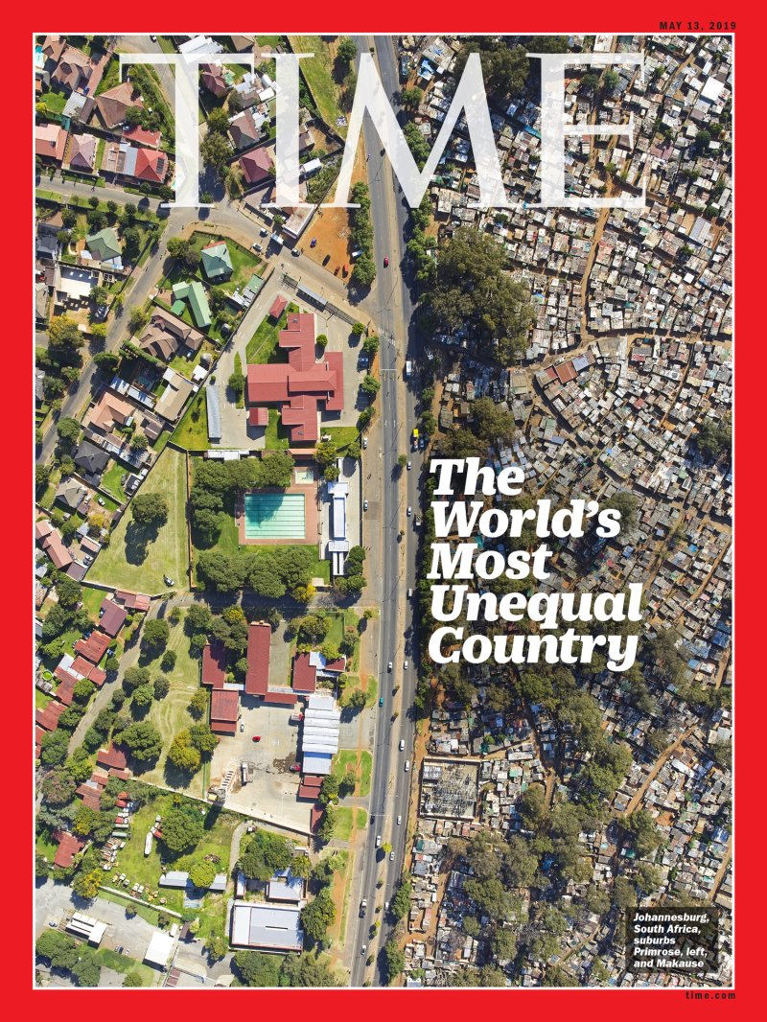
3. Strategic Intent and Problem Statement
Growing pressure
Accelerated urbanisation – expected that by 2030, almost three-quarters (71.3%) of South Africa’s population will live in urban areas and by 2050, 8 out of 10 people
Growing backlog of housing for much of the low-income population in South Africa: estimated to be between 2.3 and 3.7 million households and growing at 178 000 annually
Delivery of houses has dropped from a peak of 271 219 in 2007 to 109 887 in 2019
Escalation in citizen protests over housing, increasing land invasions
Effects of climate change: floods and fires – destruction of homes; loss of lives and displacement of people
Existing and growing inequality
Rural inequalities and urban inefficiencies have grown (NSDF, 2021)
Poor living conditions across urban and rural areas evident - located on the periphery of cities in informal settlements, backyard shacks in townships, overcrowded family homes or dilapidated inner city buildings

Slide 9
5. DHS Policy Changes and Evaluations
Adequate housing and improved quality living environment
Policies developed
Macro policy on Rental
Policy revisions
Evaluations
Department completed one (1) UISP baseline evaluation study, one (1) evaluation study on Rental Housing Tribunal, and one (1) on the Implementation of FLISP
Macro policy and strategy on land for human settlements
Macro policy on informal settlements
Policy on Property Transactional Support Centres
Policy on empowerment of designated groups
Policy on social facilitation
Change in social housing income bands to R22 000
Exemption of social pensions recipients from the income qualification criteria for housing
Revised Finance Linked Policy
Revised COVID-19 Residential Rent Relief Policy
Revised COVID-19 Debt Relief Policy
Increase of the subsidy quantum for all subsidy housing programmes
Impact
Spatial transformation through improved integrated settlement development and linking job opportunities
Impact
Impact

Slide 10
6. Analysis of Departmental Annual Performance as per tabled Annual Report 2021/22
Departmental Budget Programmes
Programme 1: Administration (ADMIN)
Programme 2: Integrated Human Settlements Planning and Development Programme (IHSPDP)
Programme 3: Informal Settlements Programme (ISP)
Programme 4: Rental and Social Housing Programme (RSHP)
Programme 5: Affordable Housing Programme (AFP)
Performance Measurement
 | Target Achieved (100%)
 | Partially Achieved (50% - 99%) Remedial action is needed to avoid this / there is progress, but the target is not yet achieved.
 | Not Achieved (0% - 49%) Certainty that the target will not be achieved or was not achieved in the planned timeframes – major remedial action and urgent intervention is required / the target is far from being reached or not going to be achieved at all
Financial performance
The Department’s total expenditure for the period ending 31 March 2022 was R30.9 billion, representing approximately 98% of the allocated funds.
Department received a clean audit on financial statements for the 2020 /2021 financial year.

Slide 11
Overall, 64% of the targets set in the Annual Performance Plan for 2021/22 were achieved, a 30% were partially achieved contributing towards improving better living conditions for households and 15% were not achieved resulting in households remain trapped in poverty and Department has to improve planning.
Of 53 targets, 34 had been achieved, 14 partially achieved and 5 not achieved by 31 March 2022 and department’s targets against MTSF 2019 – 2024 are likely to be achieved except title deeds
The Department’s Annual Report included an unqualified audit opinion with an emphasis of matter raised in the AGSA audit report relating to re-statement of corresponding figures for 31 March 2021, as a result of an error in the financial statements of the Department for the year ended, 31 March 2022.

Slide 13
MTSF Performance - Outcome 1: Spatial transformation through multi- programme integration in priority development areas
MTSF 2019-2024 TARGET | APP 2021/22 TARGET | ANNUAL MTSF PERFORMANCE 2021/22 | CUMULATIVE MTSF PERFORMANCE MARCH 2022
Invest in 94 PDAs | 30% of human settlements grants invested in PDAs | 136 declared 108 HSDG, 42 ISUPG invested in | 108
Complete 94 integrated implementation programme for 94 priority development areas | 47 | 0 | 7
Rezone 100% of acquired land in 2014- 2019 falling within the PDA’s for human settlement development | 30% of land acquired within the PDA’s rezoned | 0 | 2,7%

Slide 14
MTSF Outcome 1: Spatial transformation through multi-programme integration in priority development areas
Lack of suitable land for the development of low-cost houses has resulted in land invasion becoming increasingly rampant as an alternative for those in need.
Delays in transfer and rezoning of land, including government owned land, denies the poor households to improve their living conditions.
High cost of well-located land for human settlements development drives development to periphery; contributing to urban sprawl.
As a result of slow rezoning of strategically well-located land in PDAs, developments still implemented outside urban edge, adversely affecting poor households

Slide 15
MTSF Performance - Outcome 2: Adequate housing and improved quality living environments
MTSF 2019-2024 TARGET | APP 2021/22 TARGET | ANNUAL MTSF PERFORMANCE 2021/22 | CUMULATIVE MTSF PERFORMANCE MARCH 2022
Deliver 450 000 subsidised housing units | 52 405 BNG houses | 36 873 | 151 943 (50,6%)
Approve 20 000 applications to purchase FLISP units | 5 762 | 4 401 | 11 633 (58,2%)
Deliver 300 000 serviced sites | 39 664 serviced sites completed (HSDG) 55 000 Serviced sites completed (USDG) | 31 911 | 122 609 (40,9%)
Deliver 30 000 social housing/ rental housing units in PDAs | 100% of projects under implementation monitored in the Rental Housing Programme | 2 771 | 7 637 (42,4%)
Deliver 12 000 Community Residential Units (CRU)/ rental housing units in PDA’s | 975 | 669 new 0 upgraded | 1 675 new (33,5%) 68 upgraded
Upgrade 1 500 Informal Settlements to Phase 3 | 130 informal settlements upgraded to Phase 3 of UISP | 0% Phase 3 upgraded (90 under Phase 3 implementation) | 0% Phase 3 upgraded (90 under Phase 3 implementation)

Slide 16
MTSF Outcome 2: Adequate housing and improved quality living environments
Slow delivery of serviced sites delays the improvement of the living conditions of poor households.
Slow pace in delivery of social housing exacerbated by Covid 19 as tenants defaulted monthly rentals despite debt relief grant provided by government.
Community Residential Units (low income rental) performance remains sub-optimal - most municipalities reluctant to build more due to culture of non-payment and high costs in maintenance.
Lack of forward planning by provinces and poor contractor performance affects overall delivery of houses for the poor who suffer the consequences of inefficiency

Slide 17
MTSF Performance - Outcome 3: Eradicate backlog and issuing of title deeds
MTSF 2019-2024 TARGET | APP 2021/22 TARGET | ANNUAL MTSF PERFORMANCE 2021/22 | CUMULATIVE MTSF PERFORMANCE MARCH 2022
45 535 pre-1994 title deeds registered | Progress reported on 5 644 pre-1994 title deeds registered | 4074 | 8 201 (18%)
500 845 post- 1994 title deeds registered | Progress reported on 20 758 post-1994 title deeds registered | 24 238 | 48 936 (9,8%)
346 842 post- 2014 title deeds registered | Progress reported on 5 393 post-2014 title deeds registered | 2 455 | 3 694 (1,1%)
300 000 new title deeds registered | Progress reported on 6 733 new title deeds registered | 9 478 | 12 933 (4,3%)

Slide 18
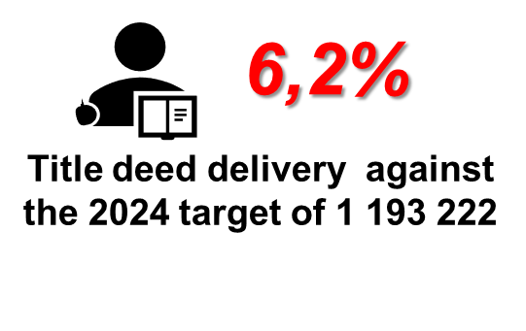
MTSF Outcome 3: Eradicate backlog and issuing of title deeds
Slow title deeds delivery
Underperformance, in particular delivery of post-2014 and new title deeds concerning
Title deed delivery on new projects not matching the annual output of new projects; adding to existing backlog
Dysfunctional property market
Subsidised houses have not significantly integrated into the housing market and not providing a financial lever for the poor household to realise market value when sold.
Number of households living in subsidised houses without a title –denied a right to access security of tenure
109 674 properties

Slide 19
8. Key Achievements
136 Priority Development Areas (PDAs) declared (100%) exceeding target of 94 with grants allocation (Human Settlements Development Grant and Informal Settlements Upgrading Grant
Increase number of areas targeted to address spatial transformation and more people will live closer to jobs.
Delivery of subsidized houses, serviced sites and rental units increased from 252 846 to 295 497 (46%) contributing towards improved living conditions for poor households.
Policy revision on Financed Linked Individual Subsidy Programme (affordable housing):
approval of an increase on the income bracket to R22 000.00
programme now accommodate a range of non-mortgage product offerings and alternative tenure options.
increased the number of first-time home buyers entering the market and climbing the property ladder.

Slide 20
9. Persistent Challenges
Slow progress on implementation programmes for Priority Development Areas with 7 completed of 94 targeted – not progressing the objectives of the NDP
No progress on land rezoning of 16,3395 ha acquired targeted for 21/22FY deprives poor households the opportunity to improve their living conditions; perpetuating social and economic exclusion
No progress with upgrading of informal settlements to Phase 3 (only 90 of 1 500 informal settlements being implemented to Phase 3) - living conditions remain unchanged

Slide 21
10 Binding Constraint
Poor delivery of title deeds of both historical backlog and new title deeds – a cumulative total of 73 764 (6,2%) against the MTSF target of 1 193 222 – not supporting the Constitution – Section 25: access to security of tenure
Systemic issues in value chain
Underlying issues of planning approvals (township establishment and proclamation)
Complex beneficiary administration (especially deceased estates, informal sales, sold many times disputes, deregistration process, double registrations, rates clearances)

Slide 22
11. Recommendations
Portfolio Committee on Human Settlements to support:
Release of strategically well-located public and privately-owned land for human settlements development to be prioritized; urgent rezoning of acquired land in PDAs
Unlock implementation and upscale upgrading of informal settlements by resolving outstanding policy issues - Attention to the implementation and programme management capacity at the different levels of government.
Establish a new set of operational and institutional arrangements to inform the development of an appropriate funding mechanism for HS programmes
Urgently address the systemic issues contributing to growing title deed backlog; consider best practice models.
Presidency/DPME to urgently coordinate intergovernmental Title Deed Summit and implementation of the recommendations be placed under the Inter-Ministerial Committee for Land

Slide 23
THANK YOU

