Slide 1
PORTFOLIO COMMITTEE BRIEFING ON HUMAN SETTLEMENTS IN LIMPOPO 7 September 2022

Slide 2
OVERVIEW OF PRESENTATION
1. Purpose
2. Asbestos Eradication
3. Mud houses
4. Blocked projects
5. Auditing and Upgrading of informal Settlements
6. Title Deeds
7. Rapid land release
8. Conditional Grants Expenditure
10. Challenges and Mitigations

Slide 3
1. PURPOSE
The presentation seeks to update the Portfolio Committee on:
Progress and plans by the Limpopo Department of CoGHSTA to address the various human settlements’ sector priorities; and
Spending on conditional grants

Slide 4
2. ASBESTOS ERADICATION
The Minister of Human Settlements, at a briefing in March 2021 that concluded visits to the nine provinces outlined that the department would implement a number of policy amendments in the new financial year which included eradication of asbestos roofs in the country.
In line with the directive, Limpopo CoGHSTA has commenced with a process aimed at eradicating the asbestos in the province.
The Department has partnered with the Housing Development Agency(HDA) to implement this strategic programme. Two main projects currently under implementation are (i)the eradication of asbestos roofs in Seshego township and (ii)the audit/assessment of all asbestos roof structures in the Province.
To this effect, the HDA has been appointed to eradicate one-thousand five hundred(1500) asbestos roofs in the township of Seshego within Polokwane Municipality.
The detail of the project is outlined below:

Slide 5
SESHEGO ASBESTOS ERADICATION - PROGRESS
Locality | Polokwane Municipality - Seshego
Start and Completion date | 18 Months Construction from the date of site Hand Over To be completed by March 2023
Developer | Provincial Department of Human Settlement
Implementing Agent | HDA
Target | 1500 (replacement of Asbestos Roofs)
Verifications | A list of affected beneficiaries was obtained from the municipality
PSC | Ongoing meetings virtually and physical locations.
Social Facilitator Appointment | The PRT is appointed for both Social Facilitations and Engineering services.
Relocations | No relocation will take place and all roof on units will be replaced in-situ
Allocated Budget | R34 923 6000. 00
Expenditure to Date | R3 729 297.91
Progress to Date | Three (3) contractors appointed. Asbestos Work Plan approved by Labour department. Building plans approved by Polokwane LM, Material delivered onsite for 800 units/roof replacement by the appointed contractors. HDA is concluding the appointment of the Asbestos Inspection Authority(AIA) which will then kick-start the actual replacements.

Slide 6
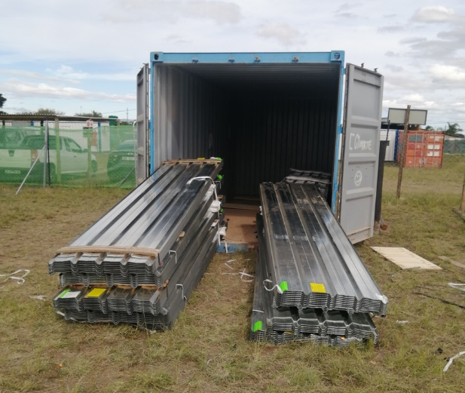
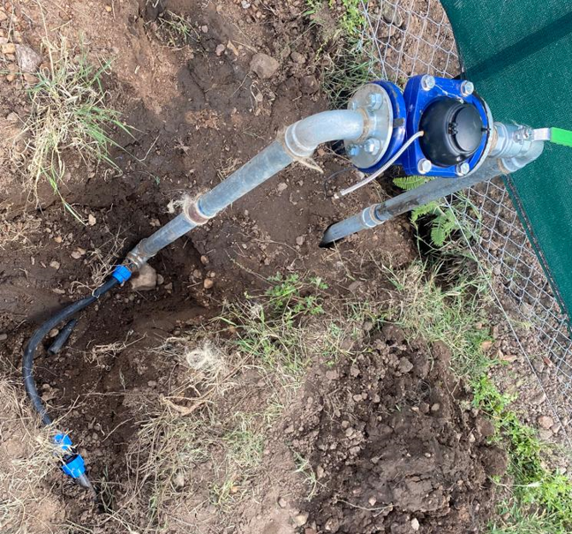
SESHEGO ASBESTOS ERADICATION - PROGRESS
Materials delivered to site | Facilities and Services Connections on Site Camp

Slide 7
ASBESTOS ERADICATION
The second priority is to develop a comprehensive Provincial Asbestos Replacement Programme by February 2023.
To this effect, the department is finalizing the appointment of the HDA to conduct and audit of all asbestos structures in the Province as per the project plan outlined below:
Audit/Assessment of asbestos structures
(Oct-Nov 2022)
First draft scoping report
Dec 2022
Final Report
Jan 2022
Work Programme
Feb 2022

Slide 8
2. ERADICATION OF MUD HOUSES
The Province continues to prioritise rural housing in order to improve the quality of life the vulnerable residents. Target for 2022/23 for rural housing in 3610
Since the province had not quantified the number of unhabitable mud houses, it has been a challenge to assess the impact of the rural housing programme.
To close this gap , the department will utilize Community Development Workers(CDWs) to conduct an audit/assessment/enumeration of all mud structures requiring replacement.
The audit will be completed by end November 2022, and the audit report will be concluded by December 2022.
The finalization of the development areas , and subsequently the 2023/24 Business Plan will have clear targets on this area.

Slide 9
3. BLOCKED HOUSING PROJECTS
Limpopo had 478 blocked projects on the Housing Subsidy Systems due to several reasons such as:
Non-performance by contractors
Contracts lapsed,
Terminations,
Balances still reflecting on projects
Following the intervention of the Ministerial War room on blocked projects, the HSS was cleansed, reducing the number of the projects from 478 to 161 due to some projects were confirmed to be closed .
NHBRC has been engaged to do structural integrity assessment on blocked projects older than 5 years , and this exercise will be concluded by December 2022.

Slide 10
LIST OF BLOCKED PROJECTS ON HSS
DM | No. of Projects from list as of June 2022(Before Cleansing) | Number of Blocked Projects after HSS cleansing | Number of Projects in the 2022/23 BP | TOTAL UNITS: | Progress to Date
Capricorn District | 85 | 24 | 5 | 70 | 70
Greater Sekhukhune | 93 | 34 | 5 | 347 | 180
Mopani District | 104 | 37 | 2 | 118 | 80
Vhembe District | 109 | 33 | 1 | 60 | 26
Waterberg District | 87 | 33 | 2 | 338 | 233
Total | 478 | 161 | 15 | 933 | 589

Slide 11
4. INFORMAL SETTLEMENTS AUDIT
In order to plan properly for the eradication of informal settlements, the Department has undertaken an audit of informal settlements in the Province during 2013/14.
The audit revealed that the Limpopo Province had 81 informal settlements , affecting approximately 47 783 households requiring different interventions from township establishment, tenure upgrade, relocation, etc.
The process of reviewing the Informal Settlement Development Strategy is currently underway.
The following map reflects the spread of the informal settlements per district: effect:

Slide 12
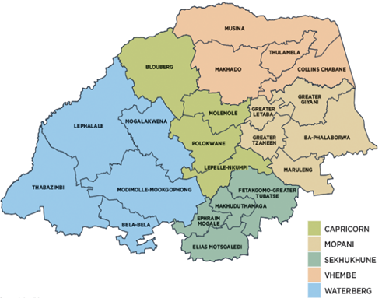
LIMPOPO ISU
Vhembe
IS=7
HH=1 340
Pop.=5 140
Capricorn
IS=5
HH=5 550
Pop.=22 200
Waterberg
IS=33
HH=23 032
Pop.=94 512
Mopani
IS=19
HH=9 485
Pop.=37 940
PROVINCIAL
IS = 81
HH=47 783
Pop.=197 698
Sekhukhune
IS=17
HH=8 376
Pop.=37 906

Slide 13
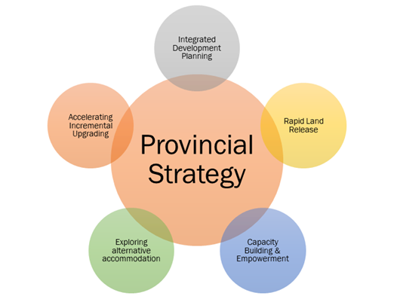
PROVINCIAL ISU STRATEGY
Pillar 1: Integrated Development Planning
Ensuring integrated informal settlement upgrading plans
Prevention of illegal occupation of land
Security of tenure
Densification
Pillar 2: Accelerating Incremental Upgrading
Pillar 3: Capacity Building & Empowerment
Community the centre of the upgrading process
Pillar 4: Exploring various forms of shelter provision
Rental housing strategy
Identification of sites
Feasibility of setting up institutions
Social Labour Plans & the role of mining sector should inform this strategy going forward
Pillar 5: Land release strategy & programme for informal settlement upgrading programmes

Slide 14
Project Prioritization
Priority Project 1
Priority Project 2
Priority Project 3
Priority Project 4
Category A Settlement
Municipal owned land
Feasibility study complete
Township established
Category B1 Settlement
Land acquisition
Water/sanitation (basic interim services)
Category B2 Settlement
Land acquisition
Water/sanitation (emergency services
Category C Settlement
Site not viable for upgrading
Urgent need for relocation
Immediate upgrading
Township est
Interim bulk services
Emergency services
Land acquisition
Relocation
The following slides provides a summary of progress made on the implementation of the strategy:

Slide 15
INFORMAL SETTLEMENTS LIMPOPO
CATEGORY A – INFORMAL SETTLEMENTS (Township establishments completed, permanent services installed, top Structures completed and Only Title deed transfers outstanding
DM | No. of Projects Informal settlements | Estimate Number Of Households Within The Settlement | Number of Projects in the BP | Status
Capricorn District | 3(Polokwane) | 3216 | 3 | Projects completed for Polokwane Ext 78, Seshego Zone F & Freedom Park
Greater Sekhukhune | 0 | 0 | 0 | No completed projects, most projects either in Category B1, B2 and/or C.
Mopani District | 0 | 0 | 0
Vhembe District | 0 | 0 | 0
Waterberg District | 1(Modimolle Mookgophong) | 1200 | 1 | Projects completed for Phagameng AirField
Total | 4 | 4416 | 4 | 0

Slide 16
INFORMAL SETTLEMENTS LIMPOPO
CATEGORY B1 – INFORMAL SETTLEMENTS (Township establishments in progress, interim services installed, Top Structures and Title deed transfers outstanding)
DM | No. of Projects Informal settlements | Estimate Number Of Households Within The Settlement | Number of Projects in the BP | Status
Capricorn District | 3 | 1178 | 3 | Planning underway in Lepakeng, Mankweng F&D and Emdo Park
Greater Sekhukhune | 10 | 7610 | 10 | Planning underway in all 5 local municipalities
Mopani District | 17 | 6317 | 02 | Planning underway in one local municipality under phase 2
Vhembe District | 6 | 1057 | 0 | prefeasibility study under way
Waterberg District | 17 | 13679 | 01 | Planning underway in Bela-Bela municipalities which is insitu upgrading.
Total | 53 | 29841 | 16 | 0

Slide 17
CATEGORY B1 – INFORMAL SETTLEMENTS (Township establishments in progress, interim services installed, Top Structures and Title deed transfers outstanding)
MUNICIPALITY | PROJECT | TARGET | PROJECT STATUS
THABAZIMBI | Skierlik IS | Formalization of the informal settlement | Opening of township register and proclamation completed. Project Closed.
THABAZIMBI | Raphuti IS | Formalization of the informal settlement | The application was circulated internally for technical comments. A Tribunal sitting date will be confirmed once all comments are received.
LEPHALALE | Mamojela Park | Formalization of the informal settlement | Delays encountered on implementation of the project due to outstanding Power of Attorney from Public Works
ELIAS MOTSOALEDI | Motetema A Erf 677 | Formalization of the informal settlement | Application referred back by Sekhukhune MPT to incorporate Motetema Town in to the Town Planning Scheme.

Slide 18
4. RAPID LAND RELEASE
The overall objectives of the Rapid Land Release Programme is to:
Provide for the release of land and land tenure to ensure that individuals and communities are able to take advantage of the available housing opportunities.
Provide communities with the ability to gain access to the necessary land to leverage township businesses, urban agriculture and sporting and recreational opportunities

Slide 19
RAPID LAND RELEASE: PRIVATE LAND ACQUIRED
Local Municipality | Areas that have been acquired | Property Extent(ha) | Status of rezoning, town planning | Number of sites | Services installed
Lephalale | Remaining Extent of the Farm Altoostyd 506 LQ | 500 | MPT Approval obtained for phase 2 & 3 (Elisrus Ext 256,257) | 5025 | Yes( 0nly for 2000 sites : Phase 1)
Bela-Bela LM | Ptn of Ptn 170 (a Ptn & Ptn 7) and Ptn of Ptn 5 of farm Roodepoort 467 KR | 72 | Rezoning and subdivision approved and subdivision registered at deeds office. | 1418 | Partially
Polokwane LM | Ptn 18 of the farm Krugerburg 685 LS and Portions 33 & 38 of the Farm Koppiesfontein 685 LS(Bendor ext. 100) | 17.9 | Rezoning and subdivision approved and subdivision registered at deeds office. | 661 | Yes
 | Ivydale Plot 68, 69 and 70 | 13.38 | Township approved up to GP approval | 1432 | No
 | Portion 45, 74 and 162 of Doornkraal 680LS | 51.2635 | Township approved up to GP approval | 1434 | No
 | Ivydale Agricultural Holdings 66 and 67 | 8.781 | Township approved up to GP approval | 1020 | NO

Slide 20
RAPID LAND RELEASE: PRIVATE LAND ACQUIRED
Local Municipality | Areas that have been acquired | Property Extent(ha) | Status of rezoning, town planning | Number of sites | Services installed
Polokwane LM | Ptn 159 of Doornkraal 680 LS | 20.2447 | Township approved up to GP approval | 374 | No
Greater Tzaneen | Portions 9, and 38 of the Farm Hamawasha No. 557 LT | 8.6510 | Township registration application lodged with deeds office. | Already included in either Pusela or Hamawasha | No
Fetakgomo-Tubatse LM | Portions 94, 95, 96 & 97 of the Farm Mooifontein 313 KT | 107.2353 | Opening of township register for 54 and 93 lodged and approved. | 900 | YES

Slide 21
RAPID LAND RELEASE: PUBLIC LAND RELEASED
Areas that have been acquired | Property Description | Property Extent | Status of rezoning, town planning | Number of (estimated) sites | Services installed
Greater Tzaneen | Portion 6,292 and 293 of the Farm Pusela 555 LT | 18,8114 | Township established up to GP level for Tzaneen Ext105. Opening of a Township Register in progress . | 1097 (includes Hamawasha portions acquired) | No
Mutale(Thulamela) Municipality | Portion 11 and 12 of the Farm Tengwe 255 MT | 599 | Township Established up to GP | Estimates - 1500 Estimates – 650 sites Estimates – 5000 sites Estimates 400 sites | Yes
Feta-Kgomo Municipality | Portions 7,23,24,55,28,32,33&31 of the Farm Praktiseer 275 KT | 385,6953 | Town planning not done. Release process not completed |  | No
Feta-Kgomo Municipality | Ptns of the farm Hoeraroep 515 KS within Fetakgomo LM | 160.5383 | Township approved by Municipality but not finalised |  | No
Thulamela Municipality | A portion of the R/E and Portion of 1, 2, 3, 4 and 19 of the farm Malamulele 234 LT | 568.9698 | Township Established up to GP. |  | No
Modimolle LM | Portion 10 of the Farm Knopfontein | 85.4961 | Township established |  | No

Slide 22
RAPID LAND RELEASE: PUBLIC LAND RELEASED cont
Areas that have been acquired | Property Description | Property Extent | Status of rezoning, town planning | Number of (estimated) sites | Services installed
Elias Motsoaledi LM | Portion 195/197 Kikvorschfontein 57 JS | 411.2491 | Rural settlement, which requires formalisation | Estimated 3800 sites | No
Greater Letaba LM | Farm Uitspan 172 LT | 258.1944 | Township establishment implemented . Project on hold due to land claims | Estimated 2000 sites. Estimated 4500 sites 529 sites | No
Lephalale LM | Remainder of the Farm Richards Lager 124 LR | 569.175 | Township established up to GP |  | No
Thabazimbi | Portion 8 if the Groenvley 87 KQ | 41.8458 | Township Established & Proclaimed |  | No

Slide 23
TITLE DEEDS
MTSF Outcome | National 2024 Targets | Provincial Target | Actual Delivery | Comments
Eradicate backlog and issuing of Title Deeds | 45 535 outstanding pre-1994 title deeds registered | 260 | 111 | Family disputes on ownership of houses
 | 500 845 outstanding post- 1994 title deeds registered | 2 000 | 1 385 | Untraceable beneficiaries. Illegal occupation and rental of houses
 | 346 842 outstanding post- 2014 title deeds registered | 5 058 | 4 466 | Illegal selling of houses
 | 300 000 new title deeds registered | 2 682 | 25 | Delays in signing of Section 101 and 103 certificates by the municipality delays 984 title deeds transfers

Slide 24
GRANTS PERFORMANCE

Slide 25
PERFORMANCE OVERVIEW AS AT 31ST AUGUST 2022
The HSDG Budget allocation for 2022/23 is R906 953 000 while ISUPG allocation is R269 465 000. The allocated budget is earmarked to deliver 4 485 units and 6 055 sites.
Financial Performance
The cumulative expenditure for HSDG as at end August 2022 is R 232 882 095 translating to 26% of the original budget.
The cumulative expenditure for ISUPG as at end August 2022 is R 61 284 391 translating to 23% of the original budget.
Non-Financial Performance- Housing Units
The housing units delivered as at end August 2022 are 2002 against a target of 4 485 units translating to 45%
Non-Financial Performance- Sites
There were no sites delivered as at end August 2022 against an annual target of 6 055 sites.
Non – Financial Performance- Title Deeds
There were 801 title deeds transferred as at end August 2022 against an annual target of 2 000 translating to 40%.

Slide 26
PROJECTIONS vs EXPENDITURE FROM 2022/2023 FY 31 AUGUST 2022

Slide 27
Summary of 2022/23 capital budget and expenditure as at 31 August 2022
Item | ACTIVITIES PER PROGRAMME | Amended Allocation '000 | Total Expenditure '000 | Target Units | Delivered units | Target Sites | Delivered Sites | Target Title Deeds | Delivered Title Deeds | % Expenditure
1 | Accredited Municipalities (Level 1 & 2) | R 2 000 | R - | - | - | - | - | - | - | 0%
2 | Land Parcel Procurement | R 15 000 | R - | - | - | - | - | - | - | 0%
3 | OPSCAP | R 46 424 | R 14 963 | - | - | - | - | - | - | 32%
4 | Housing Finance Linked | R 4 500 | R - | 50 | - | - | - | - | - | 0%
5 | NHBRC Enrolment | R 18 000 | R 6 911 | - | - | - | - | - | - | 38%
6 | Emergency Housing Assistance | R 21 294 | R 16 800 | - | - | - | - | - | - | 79%
7 | Military Veterans | R 7 432 |  | - | - | - | - | - | -
8 | Integrated Residential Development | R 563 304 | R 52 190 | 784 | 257 | 1 443 | - |  |  | 7%
9 | CRU | R 45 077 | R 4 653 | 41 | - | - | - | - | - | 10,3%
10 | Rural Housing | R 186 796 | R 135 695 | 3 610 | 1745 | - | - | - | - | 73%
11 | Title Deeds | R 2 000 | R 1 988 |  |  |  |  | 2 000 | 801 | 40%
12 | ISUPG | R 269 465 | R 61 284 |  |  | 4 612 | - |  |  | 23%
 | Sub-total | R 1 176 418 | R 294 484 | 4 485 | 2002 | 6 055 | - | 2 000 | 801 | 40%

Slide 28
CHALLENGES AND MITIGATIONS
PRIORITY AREA | CHALLENGES | MITIGATIONS
Asbestos Eradication | Lack of information of the extend of the backlog in the Province | Undertake an audit of all asbestos roofs/structures requiring attention and development of a comprehensive provincial plan.
Mud House Eradication | Lack of information of the provincial backlog | Audit of all unhabitable structures . Ensuring that approval of development areas submitted by municipalities targets the affected household areas
Blocked Housing Projects | Incomplete structural audit to inform intervention | Conclusion of the Integrity Structural Audit by NHBRC by December 2022. Prioritization of the projects in the 2023/24 Business Plan
Title Deeds | Delay in signing the clearance certificate by the municipalities. Rental of houses by beneficiaries. | Regular engagements with affected municipalities. Consumer Education.

Slide 29
CHALLENGES AND MITIGATIONS
PRIORITY AREA | CHALLENGES | MITIGATIONS
Expenditure on conditional grants | Delayed commencement of project due to incomplete planning processes | Recovery plan was developed and implemented , so far 98% of all projects are enrolled with NHBRC and 90% of beneficiaries are approved and contractors have taken sites
 | Lack of infrastructure database/records from the Municipalities delays engineering services designs | Additional appointment of service providers was made to determine the required information, e.g capacity of water source, level of consumption
 | Inadequate capacity of planning units in both the department and Municipalities | Department outsourced PRT to augment project Planning and project management
 | Relocation of development areas by Municipalities due to lack of infrastructure records | Compilation of five years development areas based on project pipeline
 | Underperforming contractors | Department approved cession facility to provide support to low-capacity contractors Invoked relevant clause in the contract by issuing Mora letters

Slide 30
THANK YOU

