Slide 1
National Economic Development and Labour Council
Second Quarter Performance Report
(July to September 2021)

Slide 2
Highlights
Area | Highlight
July 2021 unrest | A special Exco held on 14th July 2021 to develop an urgent response to the public violence that had broken out in Gauteng and KZN. Following this meeting the social partners agreed on a comprehensive package of measures to be introduced and facilitated their introduction.
Strategic dialogues | Government Budget Planning Anti-corruption National Infrastructure Plan 2050 Revised Critical Skills List
Organisational restructuring | New Nedlac organisational structure was implemented on 01 August 2021 with two units established in the Programmes Department, namely; Labour and Development Unit and Economic Unit. A new support department Corporate Services was also established

Slide 3
Challenges
Area | Challenge
Finalisation of Nedlac Reports | There were challenges in finalising a number of policies and legislation that social partners had been seized with: Green Paper on Comprehensive Social Security Companies Amendment Bill Skills strategy to take forward the ERRP
Nedlac capacity | There were capacity constraints of the secretariat due to vacancies in the organisation.
Digitalisation | There were consistent challenges: For staff with poor performing laptops and connectivity which had an adverse impact on the productivity of the affected employees. For social partners, some encountered challenges having access to data to attend and participate meaningfully in meetings.

Slide 4
Second quarter performance indicators
Programme | Quarterly Planned Indicators | Planned Targets Achieved in Q2 | Not applicable targets | Not Achieved | Overall Achievement (%)
Administration | 8 | 5 | 2 | 1 | 83%
Core Operations | 4 | 2 | 2 | 0 | 100%
Constituency Capacity Building Funds | 3 | 2 | 1 | 1 | 67%
Summary | 15 | 9 | 5 | 2 | 82%

Slide 5
Comments on performance indicators not met
Indicator | Comments | Remedial Action
Training | The 30% of planned trainings for staff could not be achieved because the majority of performance agreements were only concluded in the second quarter. | Staff members were urged to procure or arrange training as per training plans.
Constituency Capacity Building Plans | The request by the community constituency for a training intervention was not delivered as the request came late in the quarter. | Nedlac secretariat will work with the constituencies to ensure that training requested will be delivered by the end of the financial year

Slide 6
Key areas of focus of Nedlac: Dialogue sessions
Economic
Labour and Development
Government Budget Dialogue Session (2 July 2021)
National Infrastructure Plan 2050 (17 Sept 2021)
Anti corruption (30 Sept 2021)
Critical Skills List

Slide 7
Key areas of focus of Nedlac: Processes
Economic
Labour and Development
One Stop Border Post Policy
Companies Amendment Bill
Trade issues:
Trade Policy for Industrial Development and Employment Growth
SACU – SA AfCTA tariff offer
Green Paper on Comprehensive Social Security (signed off 6 August)
Draft official Identity Management Policy (concluded on 7 Jul 2021)
Central Application Bill from Dhet
AARTO regulations
Skills strategy to support successful implementation of ERRP
Revised Code of Good Practice on the Prevention and Elimination of Harassment in the workplace
Labour law reforms (establishment of task team)
Public Admin Management and Public Service Amendment Bills (withdrawn)
National Health Insurance Bill
Section 77 of LRA: Socio-economic disputes
Cosatu issued Section 77 (1) (d) notice iro economic crisis - for protest on 7 October 2021
Standing Committee deliberated on a revised Code of Good Practice to guide the implementation of Section 77 of LRA

Slide 8
Key areas of focus: Emerging issues
Response to Covid19
Response to July unrest
Vaccination roll out - mobilisation especially in the workplace
Consideration of changes to the OHS direction in respect of vaccines
Communication and behavioural change
UI Covid19 TERS
Urgent EXCO meeting on 14 July 2021 agreed on four pillars of a response:
Stabilisation
Securing essential supplies and infrastructure
Relief and support to rebuild (food parcels, extension of Covid19 social relief of distress, support for businesses not properly insured, UI support for workers not able to work)
Build active citizenry
Agreed action items tracked until implementation secured.

Slide 9
Key areas of focus: Economic recovery
SMME work stream:
Joint workshop with DSBD and Small Business Institute on strengthening the SMME eco-system
Localisation for SMMEs
Paying suppliers within 30 days
Public transport and freight:
Developments at the Transnet National Ports Authority (NPA)
Port congestion
High speed rail framework from DoT
Energy
Policy and legislative programme of DMRE
Eskom Just Transition Plan in Mpumalanga
Ongoing:
Inputting into the ERRA App
Economic and employment trends monthly reports

Slide 10
Progress on the Governance Task Team
Governance Task Team reviewed the ILO/Mistra report and make recommendations on:
Mandate and role of Nedlac
Amending the Nedlac Founding Documents
Adopting the Theory of Change in the Strategic Plan to guide the development of a new model for Nedlac
Reviewing and updating the nature and process of representivity of all the social partners at Nedlac
Capacity building, knowledge management and research
Which Ministry should be responsible for Nedlac
The recommendations were approved by Nedlac Exco in the third quarter

Slide 11
Corporate services
Human resources
Facilities
The restructuring process was implemented from 1 August with the placing of staff in new posts and handovers happening between August and October
Information Technology
Policies were updated
Wi-Fi facilities implemented in Nedlac offices
Cybersecurity enhanced
Service provider to advice on digitalisation appointed
A facilities management consultant was appointed to support Nedlac in developing appropriate Standard Operating Procedures
A new security service provider was appointed
Ongoing maintenance of gas suppression system, elevator and HVAC
Covid protocols and plans were updated
An insurance risk assessment was conducted in relation to the building

Slide 12
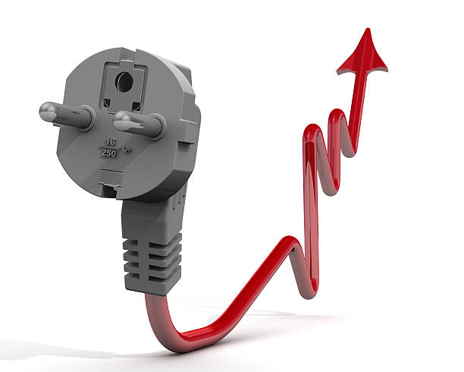
Constituency Capacity Building
Business: Secured a service provider to provide technical assistance in respect of the electricity price path
Community: Three feedback provincial workshops convened in September
Labour: Made plans to secure a resource to support them with research, policy development, legal advice and negotiations

Slide 13
Financial report
Financial Performance data | Quarter 1 Actual for 2021/22 | Quarter 2 Actual for 2020/21 | Quarter 2 Actual for 2021/22 | Quarter 2 YTD budget for 2021/22 | Variance between YTD actual and YTD budget
R’000
Revenue
Grants | 14 773 249 | 31 057 000 | 29 546 500 | 29 546 500 | -
Interest and other income received | 336 114 | 691 802 | 668 532 | 438 500 | 230 032
Total revenue | 15 109 363 | 31 748 802 | 30 215 032 | 29 985 000 | 230 032
Expenditure
Compensation of employees | 6 814 078 | 13 845 566 | 13 336 541 | 14 230 000 | -893 459
Goods and services | 1 986 515 | 2 908 716 | 5 766 774 | 14 800 000 | -9 033 226
Depreciation and amortisation | 400 569 | 727 426 | 780 774 | 955 000 | -893 459
Total expenses | 9 201 162 | 17 481 708 | 19 884 089 | 29 985 000 | -10 100 911
Surplus / (Deficit) | 5 908 201 | 14 267 094 | 10 330 943 | - | 10 330 943

Slide 14
Comments on financial report
There is a saving on Compensation of employees due to vacancies.
There is a significant increase in goods and services budget (from R1.9 million in Q1 to R5.7 million in Q2), but still an underspend compared to year to date. However there were plans to spend in place.
There are no new transactions of irregular expenditure or fruitless and wasteful expenditure
Four bids were awarded (Electricity price path, Communications service provider, Digitalisation, Energy expert and facilitator)

