Slide 1




DEPARTMENT OF EMPLOYMENT AND LABOUR
COMPENSATION FUND
QUARTER 2 PERFORMANCE REPORT
FOR THE FINANCIAL YEAR 2021-2022
PRESENTATION TO THE PORTFOLIO COMMITTEE ON EMPLOYMENT AND LABOUR
June 2022

Slide 2
PRESENTATION CONTENT
Introduction
Vision and Mission
Footprint
Strategic Focus and Service Offerings
Link to Government Priorities
Quarter Performance
Provincial Breakdown
Financial Performance

Slide 3
INTRODUCTION
- The Constitutional Mandate of the CF
- The Policy Mandate of the CF

Slide 4
INTRODUCTION: THE MANDATE OF THE CF
Constitutional Mandate
The mandate of the Compensation Fund is derived from Section 27 (1) (c) of the Constitution of the Republic of South Africa. In terms of this Act, specifically the mentioned Section, all South Africans have a right to social security. The Compensation Fund is mandated to provide social security to all injured and diseased employees.
Legislative Mandate
The Compensation Fund is established in terms of section 15 of the Compensation for Occupational Injuries and Diseases Act as amended. The main objective of the Act is to provide compensation for disablement caused by occupational injuries or diseases sustained or contracted by employees or for death resulting from such injuries or diseases and provide for matters connected therewith.

Slide 5
VISION AND MISSION
  VISION
  To be a world class provider of sustainable compensation for occupational injuries and diseases, rehabilitation and reintegration services
  MISSION
The Mission of the Compensation Fund is to:
  Provide efficient, quality, client centric and accessible COID service
  Sustain financial viability
  Ensure an organisation which takes care of the needs of its staff for effective service delivery

Slide 6
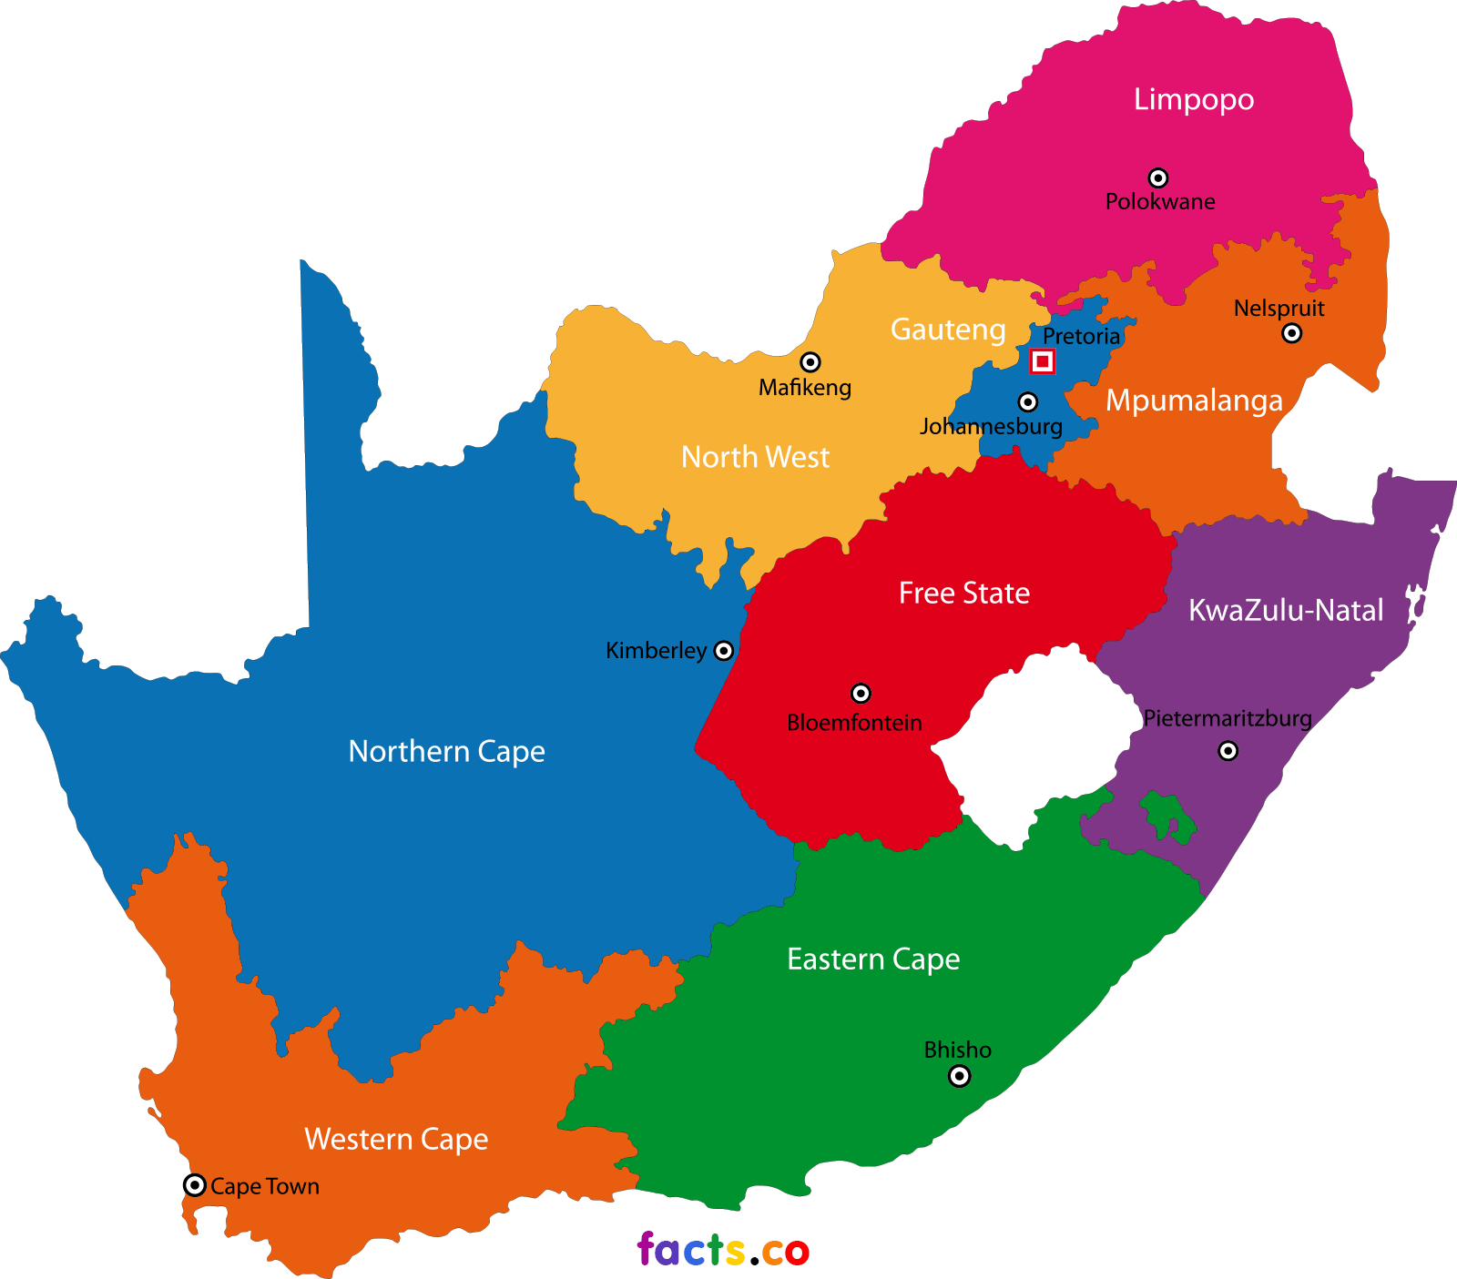
FOOTPRINT
126 LABOUR CENTRES
3
33 LABOUR CENTRES WITH COID FUNCTIONS
3
3
9
2
3
3
4
3

Slide 7
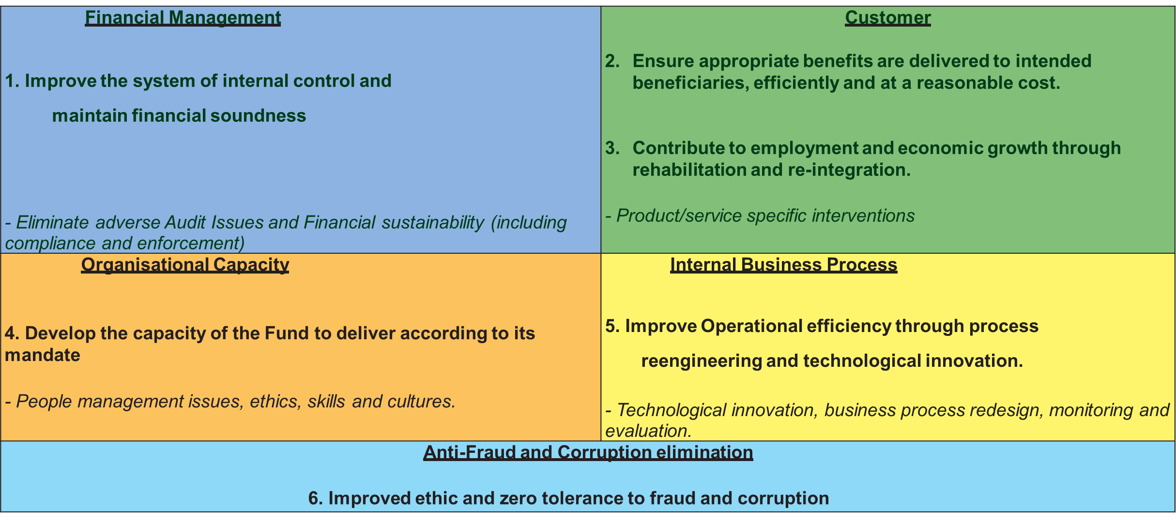
STRATEGIC FOCUS
The Compensation Fund shall focus on the following Strategies which will further inform Institutional Policies over the five year cycle.

Slide 8
SERVICE OFFERING
GOVERNANCE
Compensation and Pension Benefits
Medical Benefits
Disability Care & Rehabilitation
COMPLIANCE
CORPORATE SUPPORT

Slide 9
LINK TO GOVERNMENT PRIORITIES
The Compensation Fund is responding to the three Medium Term Strategic Framework (MTSF) Priorities to deliver on its vision and to help realise the objectives of the National Development Plan (NDP) 2030 over its five-year term. The Priorities are;
i) Priority 1: Capable, Ethical and Developmental State;
ii) Priority 2: Economic Transformation and Job Creation; and
iii) Priority 4: Consolidating the Social Wage through Reliable and Basic Services.
Impact statement | Sound and sustainable control environment, transformed financial sector, enhanced institutional capacity to deliver and improved accessibility and visibility of COID services
 | Sustainable Compensation Fund based on ethical principles
 | Ethical, effective, efficient, accessible and cost effective compensation of beneficiaries
 | Reliable, efficient and cost effective medical benefits system
 | Efficient, effective and reliable rehabilitation and return to work services for the promotion of rights of injured workers with disabilities

Slide 10
LEGEND
Implication: ACHIEVED
Performance Indicator is on track or reflects complete implementation. Target achieved
100% + Complete
Implication: NOT ACHIEVED
Performance Indicator behind schedule. Target not achieved
0% - 99% Complete

Slide 11
Q2 REPORT PERFORMANCE PER PROGRAMME 2021/22
Programme | Annual Planned Indicators | Indicators with targets reporting in Q2 | Achieved | Not Achieved | Overall Achievement %
Programme 1: Administration | 11 | 3 | 2 | 1 | 67%
Programme 2: Compensation for occupational injuries and diseases Services operations | 3 | 2 | 1 | 1 | 50%
Programme 3: Medical Services | 2 | 2 | 2 | 0 | 100%
Programme 4: Orthotic and Rehabilitation | 3 | 1 | 1 | 0 | 100%
Total number of Indicators | 19 | 8 | 6 | 2 | 75%
Overall Performance

Slide 12
COMPARATIVE PERFORMANCE ANALYSIS PER PROGRAMME FROM Q1 TO Q2
Programme | Quarter 1 Planned Targets | Achieved | Overall Achievement %
Programme 1: Administration | 3 | 2 | 67%
Programme 2: Compensation for occupational injuries and diseases Services operations | 2 | 1 | 50%
Programme 3: Medical Services | 2 | 2 | 100%
Programme 4: Orthotic and Rehabilitation | 1 | 1 | 100%
Total number of Indicators | 8 | 6 | 75%
Overall Performance
Quarter 2 Planned Targets | Achieved | Overall Achievement %
3 | 2 | 67%
2 | 1 | 50%
2 | 2 | 100%
1 | 1 | 100%
8 | 6 | 75%

Slide 13
PERFORMANCE PER INDICATOR
Programme 1
PERFORMANCE INDICATORS FOR THE FINANCIAL YEAR 2021/22 | Annual Target | Q2 Target 2021/22 | Q2 Actual Achievement 2021/22 | LEGEND
1.1 Funds allocated to Small and Medium Enterprises | R200 Million | Reports Annually
1.2 Number of decent jobs created through job summit initiatives (Investment activities) | 1000 | Reports Annually
1.3 Percentage increase in total assets per annum | 10% | Reports Annually
1.4 Percentage reduction in matters affecting the audit opinion | 75% | Reports Annually

Slide 14
PERFORMANCE PER INDICATOR
Programme 1
PERFORMANCE INDICATORS FOR THE FINANCIAL YEAR 2021/22 | Annual Target | Q2 Target 2021/22 | Q2 Actual Achievement 2021/22 |  | LEGEND
1.5 Percentage of wasteful and fruitless expenditure eliminated | 50% | Reports Annually
1.6 Percentage of irregular expenditure reduced | 25% | Reports Annually
1.7 Percentage implementation of programmes in the approved visibility and accessibility strategy | 30% | 20% | 21%
1.8 Percentage of reported cases investigated | 65% | Reports Annually
1.9 Implement ethics management programme | Conduct annual ethics risk assessment | Reports Annually
1.10 Percentage reduction in vacancy rate | 9.9% | 13.3% |  | 15.54%
1.11 Number of quarterly and annual reports on monitored performance of Mutuals reporting to the Fund. | 4 Quarterly reports and annual report | 1 Quarterly report |  | Quarterly report submitted

Slide 15
PERFORMANCE PER INDICATOR
Programme 2
PERFORMANCE INDICATORS FOR THE FINANCIAL YEAR 2021/22 | Annual Target | Q2 Target 2021/22 | Q2 Actual Achievement 2021/22 |  | LEGEND
2.1 Percentage of received return of earnings assessed annually. | 80% | Reports Annually
2.2 Percentage of claims adjudicated within 30 working days of receipt | 85% | 85% | 79% (42 353 of 53 310)
2.3 Percentage of approved benefits paid within 5 working days | 90% | 90% | 93.4% R2 087 050 905.31 of R2 234 807 167.79

Slide 16
PERFORMANCE PER INDICATOR
Programme 3
PERFORMANCE INDICATORS FOR THE FINANCIAL YEAR 2021/22 | Annual Target | Q2 Target 2021/22 | Q2 Actual Achievement 2021/22 | LEGEND
3.1 Percentage of requests for pre-authorisation of Specialised Medical Interventions finalised within 10 working days of receipt | 85% | 85% | 97% (5 068 of 5 198 )
3.2 Percentage of accepted medical invoices finalised within 40 working days of receipt | 80% | 80% | 88% (300 139 of 340 673)

Slide 17
PERFORMANCE PER INDICATOR
Programme 4
PERFORMANCE INDICATORS FOR THE FINANCIAL YEAR 2021/22 | Annual Target | Q2 Target 2021/22 | Q2 Actual Achievement 2021/22 | LEGEND
4.1 Percentage of compliant requests for assistive devices finalised within 15 working days of receipt | 85% | 85% | 95% (721 of 757)
4.2 Number of students enrolled at Post-School Education and Training (PSET) institutions in priority qualifications funded | 779 | Reports Annually
4.3 Number of Persons with Disabilities enrolled in Vocational Rehabilitation Programme through Post-School Education and Training institutions funded | 200 | Reports Annually

Slide 18
PERFORMANCE TREND DURING THE FINANCIAL YEAR 2021/22

Slide 19
PERFORMANCE TREND SINCE QUARTER 1 OF THE FINANCIAL YEAR 2020/21

Slide 20
UNDER PERFORMANCE, REASONS AND REMEDIAL ACTIONS
Percentage reduction in vacancy rate –
2. Percentage of claims adjudicated within 30 working days of receipt
Reason for Variance | Remedial Actions
Delay in triggering of posts by Line Management. Limited Resources in HRM to support the structure of the Compensation Fund. | Engagements has taken place with Line Management and it was agreed that this will be a joint effort in order to reduce the vacancy rate. The structure of the CF continues to increase whilst staff at HRM remained the same, hence additional resources is sought to assist in reducing the vacancy rate.
Reason for Variance | Remedial Actions
High number of claims awaiting information. | Regional offices to engage employers for outstanding information. Meetings were held with management teams of GAU, NW, NC, LIMP and EC to focus on performance targets; and to monitor individual performance.

Slide 21
PROVINCIAL BREAKDOWN
85% of requests for pre-authorisation of Specialised Medical Interventions finalised within 10 working days of receipt
Province | Total Received | Pre-authorisations responded to within 10 working days | % Pre-authorisations responded to within 10 working days
EC | 432 | 424 | 98%
FS | 403 | 402 | 99%
GP | 2363 | 2293 | 97%
KZN | 653 | 652 | 99%
LP | 116 | 114 | 98%
MP | 342 | 315 | 92%
NC | 174 | 170 | 98%
NW | 174 | 159 | 91%
WC | 541 | 539 | 99%
Total | 5198 | 5068 | 97%
Prov. | EC | FS | GP | KZN | LP | MP | NC | NW | WC | OVERALL
Q1 | 96% | 99% | 95% | 100% | 96% | 93% | 95% | 89% | 99% | 96%
Q2 | 98% | 99% | 97% | 99% | 98% | 98% | 92% | 91% | 99% | 97%

Slide 22
80% of medical invoices finalised within 40 working days of receipt
PROVINCIAL BREAKDOWN
PROVINCE | Total invoices Received | Total invoices Finalised | Total % Finalised | Total invoices finalised within 40 working days | Total % Finalised within 40 working days
EC | 21 435 | 20 172 | 94% | 19 468 | 91%
FS | 10 211 | 9 684 | 95% | 9 286 | 91%
GP | 130 755 | 116 654 | 89% | 110 695 | 85%
KZN | 39 569 | 38 202 | 97% | 36 519 | 92%
LP | 9 870 | 8 828 | 89% | 8 199 | 83%
MP | 23 345 | 21 964 | 94% | 21 074 | 90%
NC | 3 738 | 3 322 | 89% | 3 181 | 85%
NW | 10 800 | 10 336 | 96% | 9 925 | 92%
WC | 90 801 | 84 715 | 93% | 81 699 | 90%
Head Office | 149 | 114 | 77% | 93 | 62%
Total | 340 673 | 313 991 | 92% | 300 139 | 88%
Prov. | EC | FS | GP | KZN | LP | MP | NC | NW | WC | OVERALL
Q1 | 82% | 89% | 79% | 91% | 79% | 90% | 93% | 89% | 89% | 84%
Q2 | 91% | 91% | 85% | 92% | 83% | 90% | 85% | 92% | 90% | 88%

Slide 23
PROVINCIAL BREAKDOWN
85% of claims adjudicated within 30 working days of receipt
Province | Total registered claims | Claims adjudicated | %of claims adjudicated | Claims adjudicated within 30 working days | %of claims adjudicated within 30 working days
EC | 5345 | 4909 | 92% | 4220 | 79%
FS | 1969 | 1682 | 85% | 1445 | 73%
GP | 14889 | 12289 | 82% | 10190 | 68%
KZN | 6144 | 5726 | 93% | 5513 | 90%
LP | 2128 | 1533 | 72% | 1255 | 59%
MP | 2518 | 2448 | 97% | 2321 | 92%
NC | 901 | 809 | 90% | 660 | 73%
NW | 2498 | 2443 | 98% | 1897 | 76%
Not assigned | 250 | 203 | 81% | 173 | 69%
WC | 16668 | 16391 | 98% | 14679 | 88%
Grand Total | 53310 | 48433 | 91% | 42353 | 79%
Prov. | EC | FS | GP | KZN | LP | MP | NC | NW | WC | OVERALL
Q1 | 78% | 74% | 65% | 90% | 69% | 98% | 72% | 64% | 91% | 80%
Q2 | 79% | 73% | 68% | 90% | 59% | 92% | 73% | 76% | 88% | 79%

Slide 24
85% of compliant assistive devices requests responded to within 15 working days of receipt
PROVINCIAL BREAKDOWN
Province | Requests Received | Requests Responded | %Responded | Requests Responded to within 15 working days | % Responded to within 15 working days
EC | 28 | 27 | 97% | 26 | 93%
FS | 58 | 57 | 98% | 56 | 97%
GP | 234 | 228 | 97% | 223 | 95%
KZN | 139 | 138 | 99% | 134 | 96%
LP | 66 | 65 | 98% | 65 | 98%
MP | 81 | 78 | 96% | 71 | 88%
NC | 18 | 18 | 100% | 18 | 100%
NW | 52 | 49 | 94% | 49 | 94%
WC | 81 | 79 | 97% | 79 | 98%
Total | 757 | 740 | 97% | 721 | 95%
Prov. | EC | FS | GP | KZN | LP | MP | NC | NW | WC | OVERALL
Q1 | 100% | 100% | 97% | 97% | 100% | 94% | 100% | 100% | 100% | 98%
Q2 | 93% | 97% | 95% | 96% | 98% | 88% | 100% | 94% | 98% | 95%

Slide 25
FINANCIAL PERFORMANCE

Slide 26
FINANCIAL PERFORMANCE
1. Revenue from exchange transactions
Actual revenue increased by 36% as compared to the prior year and we received 28% more than budgeted revenue, the increase is due to higher interest rates and increased investment base.
2. Revenue from non-exchange transactions
Actual revenue is higher than the previous year by 8% and the budget by 7%, this is due to favourable economic conditions as compared to the previous year.
3. Total expenses
Total actual expenses are more that 100% as compare to the previous year, this is due to the following:
(a) monthly provision for benefits incurred and reported at year end when determined by the Actuaries

Slide 27
FINANCIAL PERFORMANCE
3. Total expenses (continued)
(b) Delays in the prior year in processing DeL related shared costs, this include Employee related costs, admin expenses and operating lease rentals.
4. Profit on sale of investment and Fair value adjustment
Profit on sale of investment was incorrectly classified and fair value adjustment in the prior year.
Actual fair value adjustment decreased by more than 100% and the budgeted amount is less by 36% as compared to the actual amount. The amount of fair value adjustment in the prior year was a recovery of losses incurred late in 2019 as a result of Covid-19 impact.
The markets are back to normal and the budget cannot be estimated accurately due to unpredictable markets.

Slide 28
FINANCIAL POSITION

Slide 29
FINANCIAL POSITION

Slide 30
FINANCIAL POSITION
Current assets
(a) Investment increased by 18% as result of higher interest rates and increased investment base as compare to the prior year. In addition, amounts collected from employer assessment were invested with the asset manager.
(b) Receivable from exchange and non-exchange and Statutory receivable
Receivable from employer assessments, exempted employers, third parties and mutual associations were classified as statutory receivables.
In total receivable decreased as a result of additional impairment allowance.

Slide 31
FINANCIAL POSITION
2. Non-current assets
(a) Investment increased by 11% as result of higher interest rates and increased investment base as compare to the prior year. In addition, amounts collected from employer assessment were invested with the asset manager.
(b) Investments in unlisted loans and associates
Investments in unlisted loans were separately disclosed and classified in the current year, in the prior year, they were included as non-current investments.
Investment in associates were previously classified as non-current investment as per GRAP 104 and equity accounted on consolidated financial statements as per GRAP 7, due to changes in accounting standards, these are equity accounted in the separate financial statements as per GRAP 36.
(c ) PPE decreased as a result of depreciation and Investment Property increased as a result of Joint Operation with Klentech.

Slide 32
FINANCIAL POSITION
3. Current Liabilities
Payables from exchange transactions decreased as a result of significant reduction in unallocated receipts and increase in operating related liabilities.
Payables from non-exchange transactions increased as result of classification of unclaimed monies from reserves to liabilities, this was done after robust discussion with the auditors.
Provision for outstanding claims and Capitalised Value of Pension is increase as a result of increase in benefits paid as compared to the previous years.
In 2020 financial year the Fund paid a total of R3,230 billion in claims versus R4,185 billion in 2021 as a result of a new system/CompEasy.
4. Non-current liabilities
(a) Provision for outstanding claims and Capitalised Value of Pension is increase as a result of actuarial benefit and monthly provision for accrued benefits.

Slide 33
RATIOS
1. Administrative cost ratio
Administrative cost ratio is calculated as total administrative costs including salaries over total revenue. The ratio is 8%, this ratio will increase due to upfront collection of revenue and costs that are incurred evenly throughout the year.
2. Assessment collection ratio
This ratio is calculated by dividing revenue raised over the amount collected, the collection ratio is at 88% and assumes collections are from debtors raised in the current year
3. Loss ratio
Loss ratio is calculated as benefits expense over assessment raised from employer, the ratio is currently at 30% and expected to increase as a result of claimed that are incurred evenly throughout the year and upfront collection of revenue.

Slide 34
RATIOS
4. Debt to Asset Ratio
The debt-to-assets ratio measures the Fund's total debt to its total assets, It measures Funds ability to pay off its debt with its available assets.
Debt to asset ratio is 1:0.49 and indicates the Fund is able to pay off its obligation easily.
However, we must be mindful of the audit finding on the Provision for Outstanding Claims as a result of data issues, the greatest risk is that the liability is understated.
The Actuaries, both from AGSA and the Fund, indicated the Capitalised Value of Pension is adequate for the Fund, the risk is overstatement of this liability.
As the Actuaries indicated the Pension Liability is adequate, the Fund has sufficient reserves to cover Outstanding Claims Liability.

Slide 35

Thank You…

