Slide 1
DCOG ANNUAL PERFORMANCE PLAN 2022/23 & BUDGET ALLOCATION
PORTFOLIO COMMITTEE ON COOPERATIVE GOVERNANCE AND TRADITIONAL AFFAIRS
Ms A Williamson: 03 MAY 2022

Slide 2
PRESENTATION OUTLINE
Introduction and Background
Part 1 – Annual Performance Plan for the Department of Cooperative Governance for the Period 2022/23; and
Part 2 – DCoG MTEF Budget Allocation.
Recommendations

Slide 3
Introduction
Purpose
To Present to the Portfolio Committee on Cooperative Governance and Traditional Affairs the Annual Performance Plan for the Department of Cooperative Governance for the Period 2022/23 and DCoG MTEF Budget Allocation.

Slide 4
Background
The Department revised its Strategic Plan 2019-2024 to ensure alignment to the core mandate of the Department. This resulted in the review of the Departmental Operating Model and Organisational Structure. The new structure will be shared once approved by the Minister.
The review of the Strategic Plan was also informed by the review of the MTSF by DPME, including the need to adjust our plans in line with the COVID-19 pandemic and unrests in KZN and Gauteng.
The Annual Performance Plan FY 2022/23 for the Department of Cooperative Governance (DCOG) was submitted on 11 March 2022 for tabling in Parliament.
The tabled APP include the revised Strategic Plan 2019-2024 as Annexure.

Slide 5
Revised Vision, Mission and Value
Efficient & effective cooperative governance system that enables resilient, safe, sustainable, prosperous, cohesive, connected and climate smart communities
A Commitment to public service that demonstrates Energy, Enthusiasm and Enjoyment
Professionalism, Integrity and Accountability
Servant leadership and a hands-on approach
Vision
Values
Mission
To lead the Cooperative Governance System in support of integrated planning and implementation across all spheres of government

Slide 6
Revised priorities, focus areas and outcomes
Mission: Lead the Cooperative Governance System in support of integrated planning and implementation across all spheres of government
Impact: Efficient & effective cooperative governance system that enables resilient, safe, sustainable, prosperous, cohesive, connected and climate smart communities
Outcomes
Functional inter-governmental governance systems
Citizens engaged and participating in Government
Basic services delivered to all citizens in an effective and efficient manner
Financially viable municipalities and metros
Sustained Good Municipal Governance
Focus
Direct
Cooperate
Coordinate
Support / Intervene
Enable
Legislation and Policy
Cooperative & Participatory government
Integrated planning and implementation
Institutional capacity, governance & accountability
Integrated knowledge management
Priorities
Policy Review
Policy Compliance
Policy triggers
IGR– horizontal + vertical integration
Social Compacts & Citizen participation
District profiles, District One-Plans, All plans, budgets aligned to One-Plans
Integrated Knowledge
Integrated Monitoring & Reporting
Governance, Financial Viability, Capacity, Support / Intervention
The revised SP prioritizes the right policy universe that enables IGR to jointly plan, monitor, support, and intervene. The focus is therefore on active policy levers to direct implementation of government initiatives through cooperation of government and non-government actors including communities. The achievement of the intended Outcomes is an enabler to realise our Impact = resilient, safe, sustainable, prosperous, cohesive, connected and climate smart communities

Slide 7
Departmental Priorities
1. A capable, ethical and developmental state;
2. Economic transformation and job creation;
3. Spatial integration, human settlements and local government;
4. Education, skills and health;
5. Consolidating the social wage;
6. Social cohesion and safe communities; and
7. A better Africa and World.
1 Functional inter-governmental governance systems
2 Citizens engaged and participating in Government
3 Basic services delivered to all citizens in an effective and efficient manner
4 Financially viable municipalities and metros
5 Sustained Good Municipal Governance
6 Effective and Efficient Internal Corporate Governance Systems
Seven Government Priorities
SIX DCoG Strategic Outcomes
The revised SP emphasizes the use of the District Development Model as an all of government approach to jointly plan, support, monitor and implement in the Spirit of IGR to realise the intended outcomes

Slide 8
PART A
ANNUAL PERFORMANCE PLAN:
Outputs Indicators and Targets Allocations per Programme for 2022/23

Slide 9
Summary number of project per programme
Programme | Targets
Administration | 7
Local Government Support and Interventions Management (LGSIM) | 11
Institutional Development (ID) | 7
National Disaster Management Centre (NDMC) | 3
Community Work Programme (CWP) | 2
Total | 30
The total number of Key Performance Indicators is 30.

Slide 10
Outputs and Targets- Programme 1
Outputs | Output Indicators | Target 2022/23
Annual Financial Statements | 1.1 Improved audit opinion expressed by the AGSA | Unqualified audit opinion for 2021/22 financial year by 31 March 2023
Approved Corporate Services Improvement Plan (CSIP) and Reports on implementation of the plan | 1.2 Number of CSIP progress report approved by Exco | Four CSIP progress report approved by Exco by 31 March 2023
 | 1.3 Percentage implementation of approved CSIP | 90% implementation of approved CSIP by 31 March 2023
Approved Financial Management Improvement Plan (FMIP) and Reports on implementation of the plan. | 1.4 Number of FMIP progress report approved by Exco | Four FMIP progress report approved by Exco by 31 March 2023
 | 1.5 Percentage implementation of approved FMIP | 90% implementation of approved FMIP by 31 March 2023
Report on investigated corruption cases | 1.6 Percentage of reported corruption cases that are investigated and resolved | 90% of reported corruption cases investigated and resolved by 31 March 2023
Policy Toolkit | 1.7 DCoG Policy toolkit developed | DCoG Policy toolkit developed by 31 March 2023

Slide 11
Local Government support and interventions management
Outputs | Output Indicators | Target 2022/23
DDM districts and metro One-Plans | 2.1 Number of districts and metro One-Plans reviewed and updated | 44 districts and 8 metro One Plans reviewed and updated by 31 March 2023
GBVF preventative measures | 2.2 Guideline for mainstreaming of the GBVF in the IDPs of municipalities developed | Guideline for mainstreaming of the GBVF in the IDPs of municipalities developed by 31 March 2023
DDM Integrated Monitoring Framework | 2.3 Integrated Monitoring Framework for DDM reporting consulted and piloted in identified districts/Metros | Integrated Monitoring Framework for DDM reporting consulted and piloted in 3 Districts/ Metros 31 March 2023
DDM Integrated Monitoring Systems (IMS) | 2.4 DDM IMS developed and piloted in identified district | DDM IMS developed and piloted in 1 Districts by 31 March 2023
Local Economic Development | 2.5 Number of District and Metro Economic Recovery Plans implementation monitored | 44 District and 8 Metro Economic Recovery Plans implementation monitored by 31 March 2023
MIG expenditure on municipal infrastructure | 2.6 Percentage of MIG allocations spent on municipal infrastructure | 85% of 2021/22 MIG allocations spent on municipal infrastructure by 30 June 2022
 |  | 60% of 2022/23 MIG allocations spent on municipal infrastructure by March 2023

Slide 12
Local Government support and interventions management Continued
Outputs | Output Indicators | Target 2022/23
District/Metro hubs | 2.7 number of reports on the identified District/Metros readiness to establish and operationalise the District/ Metro Hubs | 3 reports on the identified District/Metros readiness to establish and operationalise the District/ Metro Hubs by 31 March 2023
Three Smart Cities (Small Towns) | 2.8 Number of Small towns identified for redesign and refurbishment as smart cities/ towns | Three existing towns identified and plans for redesign and refurbishment as cities/ towns developed by 31 March 2023
One Coastal City planned | 2.9 Number of progress reports on planned Coastal City | Three progress Reports on planned Coastal City by 31 March 2023
Intergovernmental Monitoring, Support, and Intervention Bill (IMSI) | 2.10 Intergovernmental Monitoring, Support and Intervention Bill submitted in Parliament | IMSI Bill submitted in Parliament by 31 March 2023
Municipal Support and Intervention plans | 2.11 Number of dysfunctional municipalities supported to implement Municipal Support & Intervention Plans (MSIPs) | 64 dysfunctional municipalities supported by 31 March 2023

Slide 13
Institutional development
Outputs | Output Indicators | Target 2022/23
Financially viable municipalities | 3.1 Number of reports on the implementation of the recommendations of the Budget Forum on the Local Government Fiscal Framework (LGFF) | Four reports by 31 March 2023
Integrated local government Capacity building strategy | 3.2 Integrated Local Government Capacity Building Strategy (LGCBS) piloted in identified Districts and Metros | Integrated LGCBS piloted in 2 Districts and 1 Metro by 31 March 2023
Reports on National Responsible Citizenry Campaign | 3.3 Number of District Stakeholder engagements held on Responsible Citizenry | 18 district stakeholder engagements held on Responsible Citizenry by 31 March 2023
Active citizenry and leadership | 3.4 Number of provinces implementing the GovChat social media platform for community engagement and service delivery improvement | 9 provinces by 31 March 2023
Effective community engagement structures, systems, and processes | 3.5 Number of Provinces supported to capacitate municipalities to maintain functional ward committees | 9 Provinces supported to capacitate municipalities to maintain functional ward committees by 31 March 2023
Municipal Public Accounts Committees functionality assessment reports | 3.6 Number of MPAC functionality assessment reports developed | 4 MPAC functionality assessment reports developed by 31 March 2023
Improved Audit Outcomes | 3.7 Report on the implementation of actions to address issues raised by the AGSA in line with Section 134 of the MFMA | Report on the implementation of actions to address issues raised by the AGSA in line with section 134 of the MFMA submitted to form part of sec 48 report/ state of local government report by 31 December 2022

Slide 14
DISASTER MANAGEMENT
Outputs | Output Indicators | Target 2022/23
Revised Disaster funding arrangements | 4.1 Report on identified sector departments supported on the implementation of disaster funding arrangements | Report indicating two sector departments supported on the implementation of disaster funding arrangements by 31 March 2023
 | 4.2 Number of organs of state (including municipalities) supported to prevent, prepare for and mitigate disaster risks through applicable disaster management plans | 10 municipalities and one Sector department supported to prevent, prepare for and mitigate disaster risks through the effective implementation of applicable disaster management plans by 31 March 2023
Updated National Disaster Management Framework | 4.3 Draft adjusted National Disaster Management Framework approved | Draft adjusted National Disaster Management Framework approved by 31 March 2023

Slide 15
Community Work programme
Outputs | Output Indicators | Target 2022/23
CWP participants enrolled | 5.1 Number of people participating in the CWP | 250 000 people participating in the programme by 31 March 2023
CWP participants trained | 5.2 Number of participants trained annually | 25 000 CWP participants trained annually by 31 March 2023

Slide 16
PART B:
MTEF Budget Allocation of DCOG
COSTING AND AFFORDABILITY ANALYSIS

Slide 17


KEY VALUE DRIVERS
Administration
Local Government Support & Intervention Management
Institutional Development
National Disaster Management Centre
Community Work Programme
Compensation of employees
Goods and services
Capital
Annual Performance Plan & Operational Plan
Procurement Plan
Service delivery

Slide 18
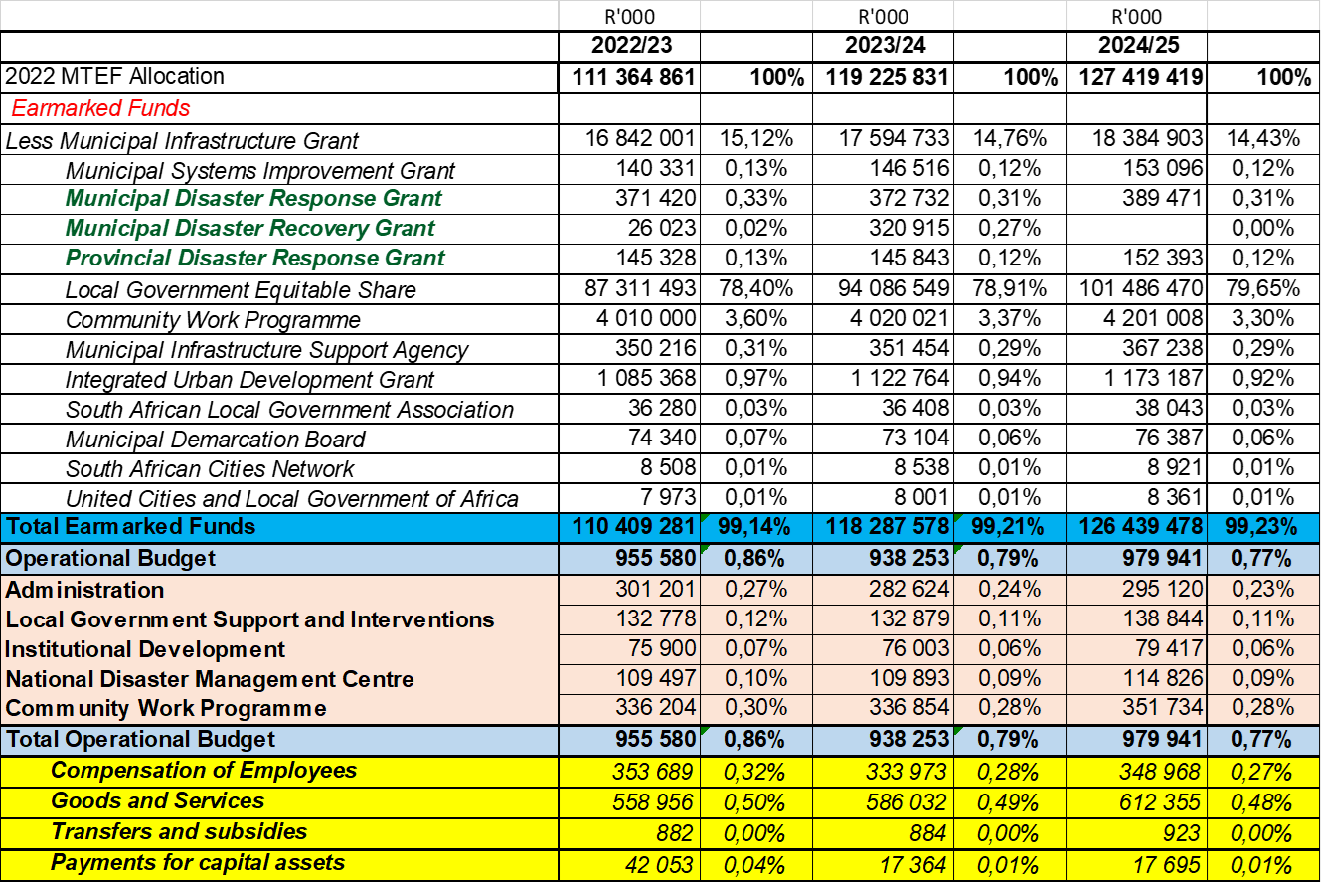
2022 ESTIMATES OF NATIONAL EXPENDITURE
(Breakdown allocation)

Slide 19
BUDGET ALLOCATION

Slide 20
Recommendations
It is recommended that the Portfolio Committee note the Annual Performance Plan and allocated budget FY 2022/23

