Slide 1
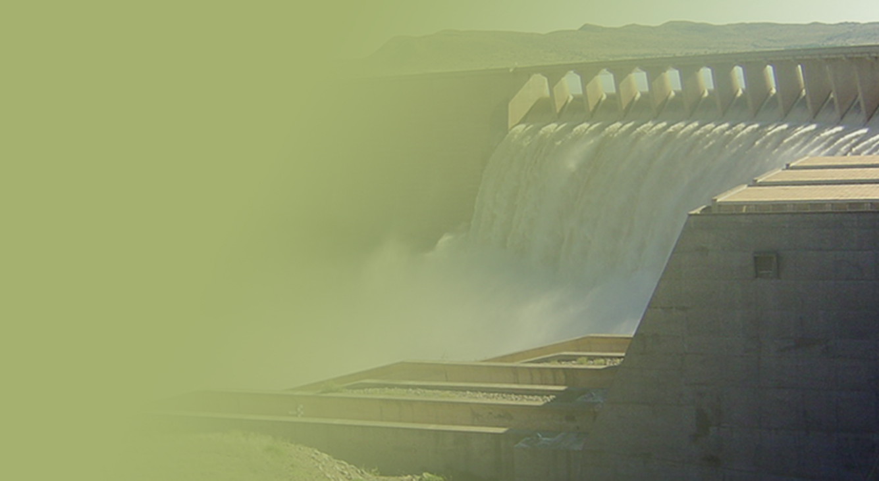
PROGRESS REPORT ON THE GIYANI WATER SUPPLY PROGRAMME PRESENTED BY: ACTING DDG: MR MOSHODI MOTEBELE DATE: 29 MARCH 2022
PRESENTATION TITLE
Presented by:
Name Surname
Directorate
Date

Slide 2
Contents
Introduction and background
Status of Project
Weakness in Planning and Implementation
Causes of Lack of progress
Final Technical Solution
Construction schedule for Giyani WS
Construction schedule for Nandoni to Nsami pipeline project
Cost to completion for Nandoni to Nsami & Giyani WS projects
Reticulation & Relocation progress for areas under Hosi Ramovha Relocation progress
Improving Project management
Way Forward

Slide 3
Introduction and background
The Department of Water and Sanitation initiated the Giyani Water Services intervention in August 2014 with the intention to address water services challenges experienced by the communities in Giyani.
The project was initiated as a Ministerial directive to Lepelle Northern Water (LNW) for immediate intervention in Mopani District to address water challenges.
The project was initiated to address water services challenges in Giyani due to failure of infrastructure perpetuated by drought conditions that affected the yield of both the Nsami and Middle Letaba dams
The intervention included:
Refurbishment of existing water and sanitation infrastructure, including pump stations, repairs of leaking pipes and reservoirs, borehole development and installation of package plant for immediate supply to social facilities (Nkhensani Hospital)
Construction of 1.5 Ml/d Wastewater Treatment Works (WWTW) to augment existing Giyani WWTW
Revitalization of 154 boreholes to augment water supply in 55 villages around Giyani
Replacement of inefficient bulk pipelines that supply water to 55 villages around Giyani (about 325 km of pipeline)

Slide 4
Status of Project
In 2019 Lepelle Northern Water (LNW) as Implementing Agent (IA) on the project terminated both contracts with Professional Service Provider (PSP) for Nandoni-Nsami pipeline and the Turnkey service provider for Giyani Water services but continued with Vharanani for the pipeline.
At that stage the pipeline was reported to be 50% complete by LNW but later verified to be only 35%
Similarly, the additional works were reported to be 92% complete, but subsequent investigations by the Department of Water and Sanitation (DWS) indicated that the project progress was 48%
Currently:
The pipeline is being constructed by the Vharanani with a new PSP as the Engineer: this is at 38 % complete
The additional works are being completed by the DWS Construction unit with the new PSP as Engineer and assistance from LNW for procurement of materials : this is at 58% complete
Clearly from the progress since 2019 there are serious problems in terms of implementation

Slide 5
Weakness in planning and implementation
Water resources planning for this project was inadequate
As a result, the conceptual design of the project as it is currently being implemented is neither optimal nor efficient from a water resources planning perspective
It also resulted in indecisiveness in design during implementation
Project management planning was also inadequate
Under LNW and the old PSP, pipelines were laid and paid for in full without being tested (this was one of the main causes for revising the percentage progress down)
Contractors were appointed on the basis of incomplete designs
Designs were not ready when required by the contractors
Lack of stakeholder involvement and support, including by the Mopani District Municipality

Slide 6
Causes of lack of progress
Timeous decision making by LNW (especially with regard to dealing with service providers and contractors)
DWS oversight and support to the project has been lacking
Due diligence by DWS should have been done to ascertain LNW capacity before and during project implementation
Poor performance of contractors
Poor performance of DWS construction unit due to weak SCM and logistic management in DWS
Poor performance by the old PSP as Engineer

Slide 7
The final technical solution
The assessment of DWS planning units is as follows:
The Nandoni to Nsami pipeline will be a raw water pipeline which will join the existing canal system
The supply to Malamulele will be potable water supplied via Mavambe
Upgrading of the Water Treatment Works WTW at the Nandoni dam by 60 Ml/d to serve the communities along the pipeline and other areas in Vhembe
Repair/refurbish existing (old) WTW plant at the Nsami dam to operate at design capacity
Rebuild the new WTW plant to design capacity increase water supply to Giyani villages
Villages in Giyani will be further served by water from Nwamwitwa dam when it comes online
The Mopani DM will be assisted to take advantage of unspent WSIG money over the years to extend reticulation in the villages and synchronize with completed sections of the pipeline
Communication will be made to the new PSP via LNW to finalise designs based on the above

Slide 8
Construction schedule for Giyani WS
Work package | Current Progress | Anticipated completion | Comments
Pipeline A (37.9km) | 65% | Dec 2022 | 3 months delays due to number of challenges including: DWS construction procurement processes Plant breakdowns Material shortages Action taken: Sub-contractor appointed to assist DWS construction with supply of material and plant Based on the above completion date change from Dec 2022 to Mar 2023
Pipeline B (81.8km) | 62% | Feb 2023
Pipeline C1/D1 (11.3km) | 69% | Jul 2022
Pipeline C2 (10.3km) | 39% | Mar 2023
Pipeline D (107.7km) | 43% | Mar 2023
Pipeline D2 (7km) | 39% | Jan 2023
Pipeline F1 (45.3km) | 21% | Mar 2023
Pipeline F2 (22.4km) | 69% | Oct 2022
MAKOSHA PIPELINE | 0% | Mar 2023
Summary progress inclusive of all items | 58% | Mar 2023

Slide 9
Construction schedule for Nandoni to Nsami pipeline project
Work packages | Current Progress | Planned Completion | Comment
Nandoni-Nsami line (49,1km) | 28.61km | Sep 2022 | Approximately 3-4 months behind current program. Planned progress: 43% Anticipated completion based on estimated time lost above is Dec 2022
Malamulele line (26,5km) | 18.56km
Pressure Testing (75,6km) | 0km
Pipe Jacking (320m) | 0.0%
Luvuvhu crossing (120m) | 0.0%
Chambers (197) | 9.9%
Summary progress inclusive of all items | 38.9% |  | Approximately 3-4 months behind current program. Current target = 44.9%

Slide 10
Cost to completion for Nandoni to Nsami & Giyani WS projects
Project | Expenditure (Feb 2022) R’000 | Cost to complete the remaining scope R’000 | Estimated project cost R’000
Nandoni to Nsami | 498 288 | 535 977 | 1 034 265
Giyani WS | 3 396 058 | 704 087(exc. Service reservoirs & contingencies) | 4 100 145
 |  | 978 262 (all incl.) | 4 374 320

Slide 11
Reticulation & Relocation progress for areas under Hosi Ramovha
Reticulation progress
Vhembe District Municipality(VDM) is implementing reticulations in 5 villages within Mulenzhe area (Jimmy Jones, Dididi, Mulenzhe, Tambaulate & Tshitomboni)
The reticulations are up to street connection (standpipes)- Overall progress of reticulation is 68%
The project includes construction of elevated tanks in each village- overall progress is 39%
Budget approved for DWS construction to extend the reticulation to household connections- to be done once VDM is complete with their scope
Relocation progress
1140 beneficiaries paid out of 1362

Slide 12
Improving project management
DWS will provide strong project management support to LNW to strengthen its role as the Implementing Agent by assigning an experienced Engineer in the capacity of a Chief Director to the project
The DWS Chief Director will assist in the decision making on the project and advise the LNW on challenges and actions required
The Chief Director has already been assigned to LNW to commence in this role
In line with standing contractual relationships, the DWS will intervene through LNW
An escalation route for unresolved challenges has been established to the Director General and Minister to intervene if required

Slide 13
Way Forward
The project detailed designs to be finalised on the basis of the final conceptual designs by the DWS planning units.
The current shortfall in funding to complete this project will be addressed by shifting funds from under performing projects to this project and extended reticulation to take advantage of unspent WSIG funds
The DWS team, including Limpopo office, Infrastructure Branch and Planners from Waters Services Branch and Mopani DM to develop consolidated implementation plans for:
The Nsami WTW and reticulation network to the 55 villages
Reconstruction/repair of new WTW plant
DWS to proceed with planning to upgrade Nandoni WTW, in parallel to the Giyani water project

Slide 14
Thank you

