Slide 1
IMPLEMENTATION PROGRESS OF PILLAR 1 OF THE NATIONAL STRATEGIC PLAN ON GENDER BASED VIOLENCE AND FEMICIDE: ACCOUNTABILITY, LEADERSHIP AND COORDINATION

Slide 2
Introduction
In South Africa we have made great strides in advancing women’s rights, in broadening women’s access to education, in provision of health care and social support to women, as well as in improving their participation in the economy. However, the lived reality of millions of our women does not live up to this.
Women’s Month allows us to gauge how far we have come in transforming society, particularly the transformation of unequal power relations between women and men. While also focusing on and addressing gender oppression, patriarchy, sexism, racism, ageism, structural oppression, and creating a conducive environment which enables women to take control of their lives.
Our history abounds with patriots whose actions have paved the way for our democracy and freedom.
2021 marks the 150th anniversary of struggle icon and human rights campaigner Charlotte Maxeke. She and other selfless women were at the forefront of fighting for the many freedoms that we enjoy today.
Together we can use her legacy to ensure the transformation of gender relations and the political, social and economic empowerment of women, including young women and those with disabilities.

Slide 3
DCDT Responsibilities
DCDT response to the Objectives of the NSP GBV and aligned the Department plans to the National Strategic Plan- Gender Based Violence and Femicide and committed on the following
To strengthen implementation of NSP on GBVF by all social partners.
To expand on the call to action for men as partners and boys to stand against the rape and sexual abuse of women and children.
To increase awareness and drive change in patriarchal social norms and behaviour through multiple platforms, sectors and activism including technology, social media, culture and customs, Arts, journalism, faith-based organisations, private sector, trade unions, sports fraternity, taxi industry, traditional leaders and youth sector.

Slide 4
Overview and Background of DCDT
The Department of Communications and Digital Technologies, tasked with the responsibility of developing polices for the ICT Sector has recently drafted the National Integrated Information and Communications Technology (ICT) Policy that includes several provisions for the empowerment of women in the ICT Sector. The department has also released the Broadband Policy that outlines the plan to connect South Africa and the needs of women has again been centrally placed as part of the implementation of the policy.
The National Development Plan indicates that by 2030, ICTs will underpin the development of a dynamic information society and knowledge economy that is more inclusive and prosperous. A seamless information infrastructure will meet the needs of citizens, business and all the public sector, providing access to the wide range of services required for effective economic and social participation – at a cost and quality at least equal to South Africa’s competitors.
The DCDT will therefore play a specific role in fostering broader economic and social participation by all citizens through digital transformation underpinned by the Fourth Industrial Revolution (4IR). The Department aims to create a South Africa where citizens can enjoy greater economic and social prosperity and comfort, enjoy higher levels of health, wellbeing and safety through levering the 4IR. The benefits that come with the adoption of these advanced 4IR technologies bring both economic and social advantages and benefits, transforming how we relate as individuals, groups, and organizations across the globe.

Slide 5
Fourth Industrial Revolution [1]
The Fourth Industrial Revolution (4IR) is increasingly dominating our digital world, we need to be proactive through policy and strategy development to make sure that women can benefit from the opportunities offered within the space. The outbreak of COVID 19 has escalated the use of technologies across the world and we must advance on what has been started through the platforms that have been made available for learning. These opportunities if they are used accordingly they can help women to be equipped with relevant skills. The reskilling and upskilling imperative present an opportunity we need to finally steer meaningful change in the struggle for gender equality.
For women to participant in the 4IR era and to break the structure of gender inequality and the gender digital gap, it is critical to ensure that women at all stages of their careers are being inspired through mentorship programmes, career coaching, and many more avenues to actively participate in the development and use of new technologies
To increase awareness around women in ICT and alleviate gender inequality in the technological sphere, women must be up-skilled, re-skilled in future-ready disciplines. The importance of women taking up skills in computer science, blockchain, data science, AI and other key 4IR enablers such as telecommunication and machine learning cannot be overemphasised.

Slide 6
Fourth Industrial Revolution [2]
It is pivotal that women participate and have opportunities created for lifelong learning to be globally competitive, contribute to the economic growth and bridge the gender gap in the digital domain.
The use of 4IR technologies in health and social e-platforms and their broad application can be a valuable tool in the fight against GBV. Technology platforms can empower women bringing them education and avenues through which they can tell their own stories.
Women must take the lead in the development and application of 4IR technologies to solve women’s issues. Awareness and reporting of incidents of GBV could be facilitated through the use of 4IR technologies in e-health applications, wearable digital devices, via SMS, social media and helpline platforms.
The Covid-19 pandemic has also brought awareness around the abuse and terror that woman face within the online gaming industry. Developing specific transformative regulatory mechanisms to protect our woman online has become increasingly necessary.

Slide 7
Fourth Industrial Revolution [3]
Many educational institutions started offering courses online to ensure education was not disrupted by quarantine measures. Technologies involved in online learning include virtual reality, augmented reality, 3D printing and artificial-intelligence-enabled robot teachers. However, the difficulties with online learning for women is the likelihood that the technologies might create a wider digital skill divide and broaden the income gap.
COVID-19 has established the importance of digital skill, which allows women to continue with life as usual during pandemics. Building the necessary structures to support a digitized world and stay current in the latest technology will be essential for women to participate in the development and use of new technologies.
To alleviate women illiteracy and bridge the inequality challenges that have been a disadvantage for women to be able to participant in the economy, advance technologies must be used to offer learning opportunities for women. For women that are already in the technology development discipline, as entrepreneur, system developers etc. it would be great to also see their inventions being used to provide and improve the e-learning services.

Slide 8
State of Readiness of DCDT
DCDT has the mandate to enable the country to be digitally ready and in this regard it will be best placed to advice on how technology can play a role in combatting Gender Base Violence and Domestic Violence, this is one of the key roles the DCDT could play
In terms of readiness to play this role it should be noted that the DCDT has implemented programs in regard to GBV.
There is a need to expand some of the programs to include matters related to Domestic Violence and in this regard they may a need to review the financial and human resources available to do this.
DCDT has State Owned Companies in its area of focus that can assist with raising awareness on the existence of the Bills amongst citizenry in terms of the readiness, to do this it will have to be discuss with the relevant SOCs but, the observation is that they do have the capacity and expertise to provide this service to have clear enforcement clauses in regard to this matter.

Slide 9
Implementation to date by DCDT
DCDT has included Gender Equity and Women’s Empowerment Targets in its Business Plan for the current financial year focuses online safety for girl Children and Cyber Security targeting general population .
DCDT has also provided input to the amendment process on the GBV Bills .
DCDT has a critical focus on Sexual Offences, as these are either perpetrated online or through utilizing online platforms to access the persons against whom these offences are perpetrated.
DCDT is in a process of implementing , ICT Women Empowerment Program as well as Comprehensive Child Online Protection Program.
The department has included targets on gender mainstreaming and gender equity in its business plan 2020/21 in line with the NSP.
The DCDT has developed a Gender and ICT Strategy that is the guiding document for the DCDT with regard to implementation of Gender Programs.
Supported Places of Safety for Women and Children through facilitating access to ICT Training and ICT Equipment.
Raised awareness on online safety of women and the importance of cyber security as well as commemorating critical International and National Days focusing on Women and Girls such as International Girls in ICT Day, International Women’s Day and National Women’s Day and 16 Days of Activism on No Violence Against Women and Children

Slide 10
Work done by Entities [1]
SABC
SITA
In addition to the inclusion of GBV matters in the programming on all SABC platforms, the following are noteworthy:
The GBV campaign still continues to date with liners, interviews, discussions etc. around GBV as part of the broadcast plan.
SABC Education has a year-long campaign against femicide and rape, launched in February 2020 and is still continuing on SABC Radio stations (Budget for TV is R2.7m and R3.8m for Radio).
SABC Corporate Service Investments [CSI] supported the following NGO’s on GBV (budget of R2.9m) through broadcast of public service announcements regarding the services SABC provide. This was during the periods of hard lockdown, when the number of domestic violence cases increased significantly:
SITA has the following departments namely, Wellness Department in HCM, Governance, Risk, Compliance and Integrity (GRCI) as well as Information Systems Security are working collaboratively to ensure compliance and adherence to a zero-tolerance approach to cyber violence/bullying.
SITA Harassment Policy is being reviewed and currently consultation with various stakeholders is undertaken addressing amongst others Sexual Harassment, Bullying, Victimization, forms of violence, sexual assault or rape. Furthermore, a Diversity and Inclusivity Plan has been consulted with and approved by the People and Work Committee to ensure that appropriate, sensitive reporting and interventions anchor the zero-tolerance approach.
Information Security advocates for and ensures prevention of cyber bullying and fosters adherence to existing ISS Policies.

Slide 11
Work done by Entities [2]
SAPO
Post Bank
In 2019 SAPO launched a gender desk that consists of both genders to coordinate responses to the crisis of gender-based violence and Femicide. The outcome has been shown with clear budgeting. We also developed policies such as Sexual harassment policy that enforce gender mainstreaming.
The strategy seeks to also address challenges faced by all genders, especially women within SAPO to address the plight of all affected by violence, discrimination, lack of safety and inequality. SAPO has also enforced a review of remuneration strategy with commitment between leadership and labour to redress the inequality in terms of gender gap pay.
Currently SAPO aims at changing patriarchal norms and behaviour through high-level raising awareness and prevention workshops. SAPO has further partnered with NEMISA and services SETA on empowering the skills of all employees with a special emphasis on women.
S A Postbank has developed the following policies which are meant to actively discourage and prevent acts that employees particularly directed at women in the workplace:
Sexual Harassment policy
Ethics policy –under-development
Disciplinary and Grievance procedures
Postbank also offers employee assistance and support through Employee Assistance Programme such as counselling for trauma for victims who have suffered harassment or any mental; emotional and physical harm.
These policies and procedures are geared at prohibiting conduct that is against Postbank values and are aligned to the employment legislation of South Africa.
Postbank’s values; policies and procedures provide a mechanism for the protection of vulnerable employees from acts of violence, intimidation and harassment.

Slide 12
Work done by Entities [3]
BBI
USAASA
Broadband Infraco has several initiatives to address Gender-Based Violence and Femicide:
zero tolerance approach to cyber violence/bullying through appropriate policies and sensitive reporting of GBVF;
challenges that hamper progress made with regard to the above, and the steps taken or required to mitigate such challenges.
White Ribbon Campaign
A flagship programme led by the Joe Slovo Foundation and supported by the United Nations. The programme sets criteria for meeting and being a White Ribbon environment, which include:
Leadership support, buy in and messaging on zero tolerance to GBV and bullying
HR Policies that address the prohibition of GBV
Dealing with Perpetrators of GBV
Supporting the victims of GBV
Creating an enabling an environment for women to work and thrive
Training of employees to be alert to issues of GBV
Drive Campaigns and co-operation with initiatives that are driving the Anti-GBV messaging
The quarterly progress on the implementation of the Gender Based Violence & Femicide plan.
GBV&F committee was appointed and the USAASA implementation plan was adopted and approved.
The committee holds regular meetings to implement the activities of the implementation plans as per the approved USAASA Gender Based Violence & Femicide plan.
As per our mandatory Pillar 5, Economic Power;
The first quarter recruitment was one female Senior Manager; the appointed District Coordinators was 33 tertiary qualified unemployed youth of which 13 was female.

Slide 13
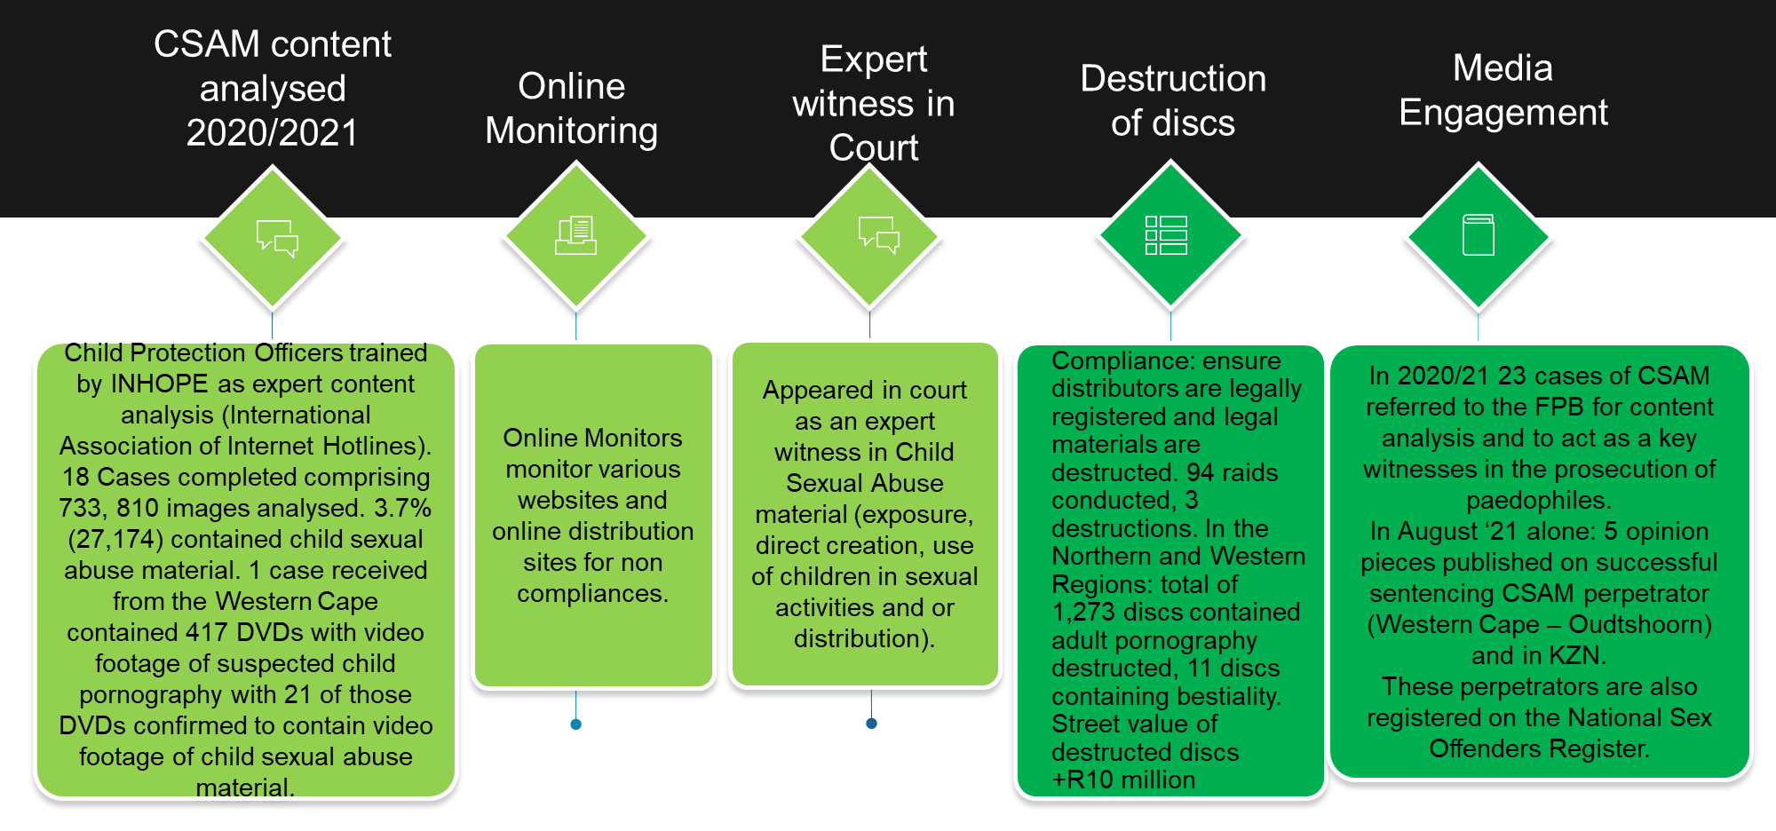
Work done by Entities [4]
FPB
LEGISLATION: Amendment act includes criminalizing of Revenge pornography: (def: revealing or sexually explicit images or videos of a person posted on the internet, typically by a former sexual partner, without the consent of the subject and in order to cause them distress or embarrassment, harassment and defamation).
Familiarize Law Enforcement Officers with the contents of the FP Act to protect women and children.
Stakeholder management focus on NGO’s CBOs schools, religious groups working with in the child protection space.

Slide 14
Work done by Entities [5]
FPB
Operational Performance: Research
Research reports
Produced 2 insight reports:
Role of regulator in curbing power of tech giants.
Violence against women – Presidential Council on Women – report produced.
Develop a 6-year outlook (Trends Analysis) of various statistics and trends and shared with key stakeholders.
Working with GIZ and UN Women on the “Step it up for Gender” project.
Working with Gender Links on The role of Women in Media research.
Convergence survey – testing patterns of content consumption and caregiver controls on media used by children (detailed report available).

Slide 15
THANK YOU

