Slide 1


SENTECH APP and Budget
FY2021/22
Presented to: Department of Communication & Digital Technologies
Date: 20 April 2021

Slide 2



Our Strategic Focus

Slide 3

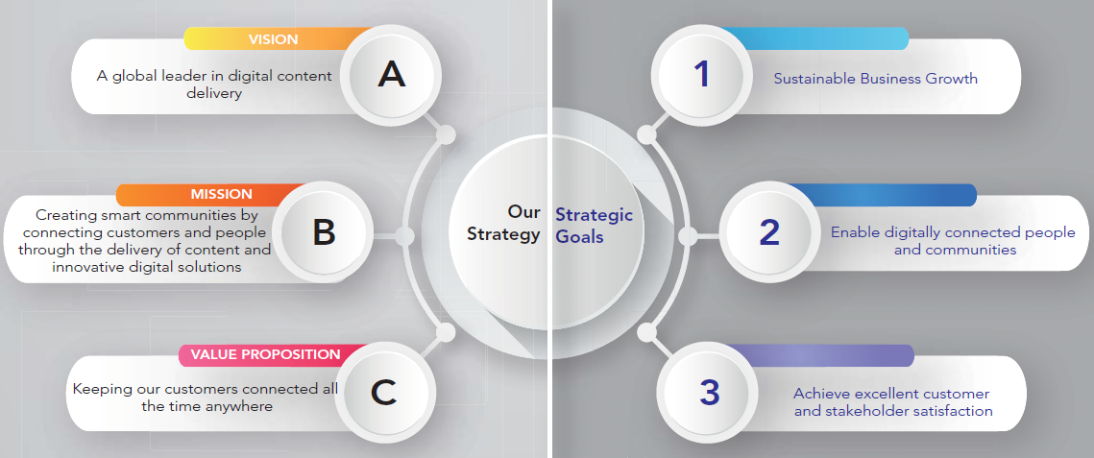
Strategic Focus, Vision, Mission and Values
Vision, Mission and Values

Slide 4
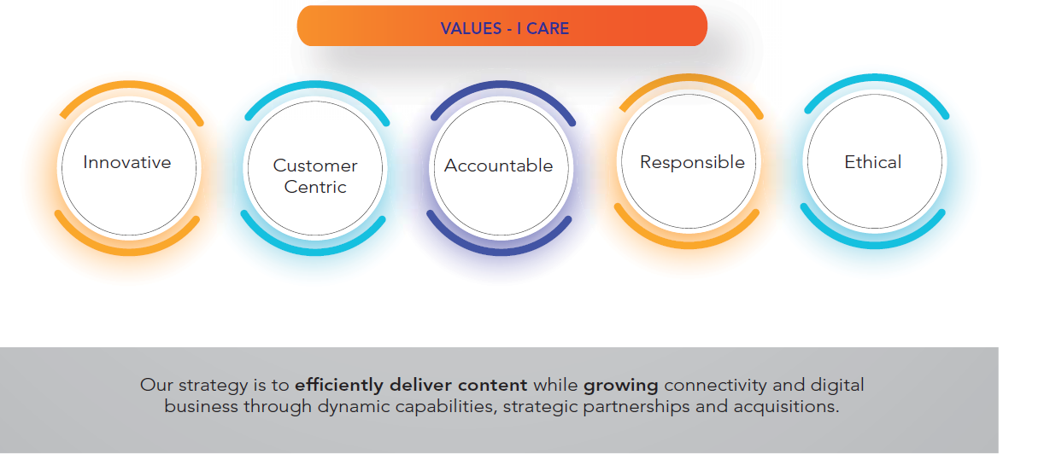
Strategic Focus, Vision, Mission and Values
Vision, Mission and Values

Slide 5
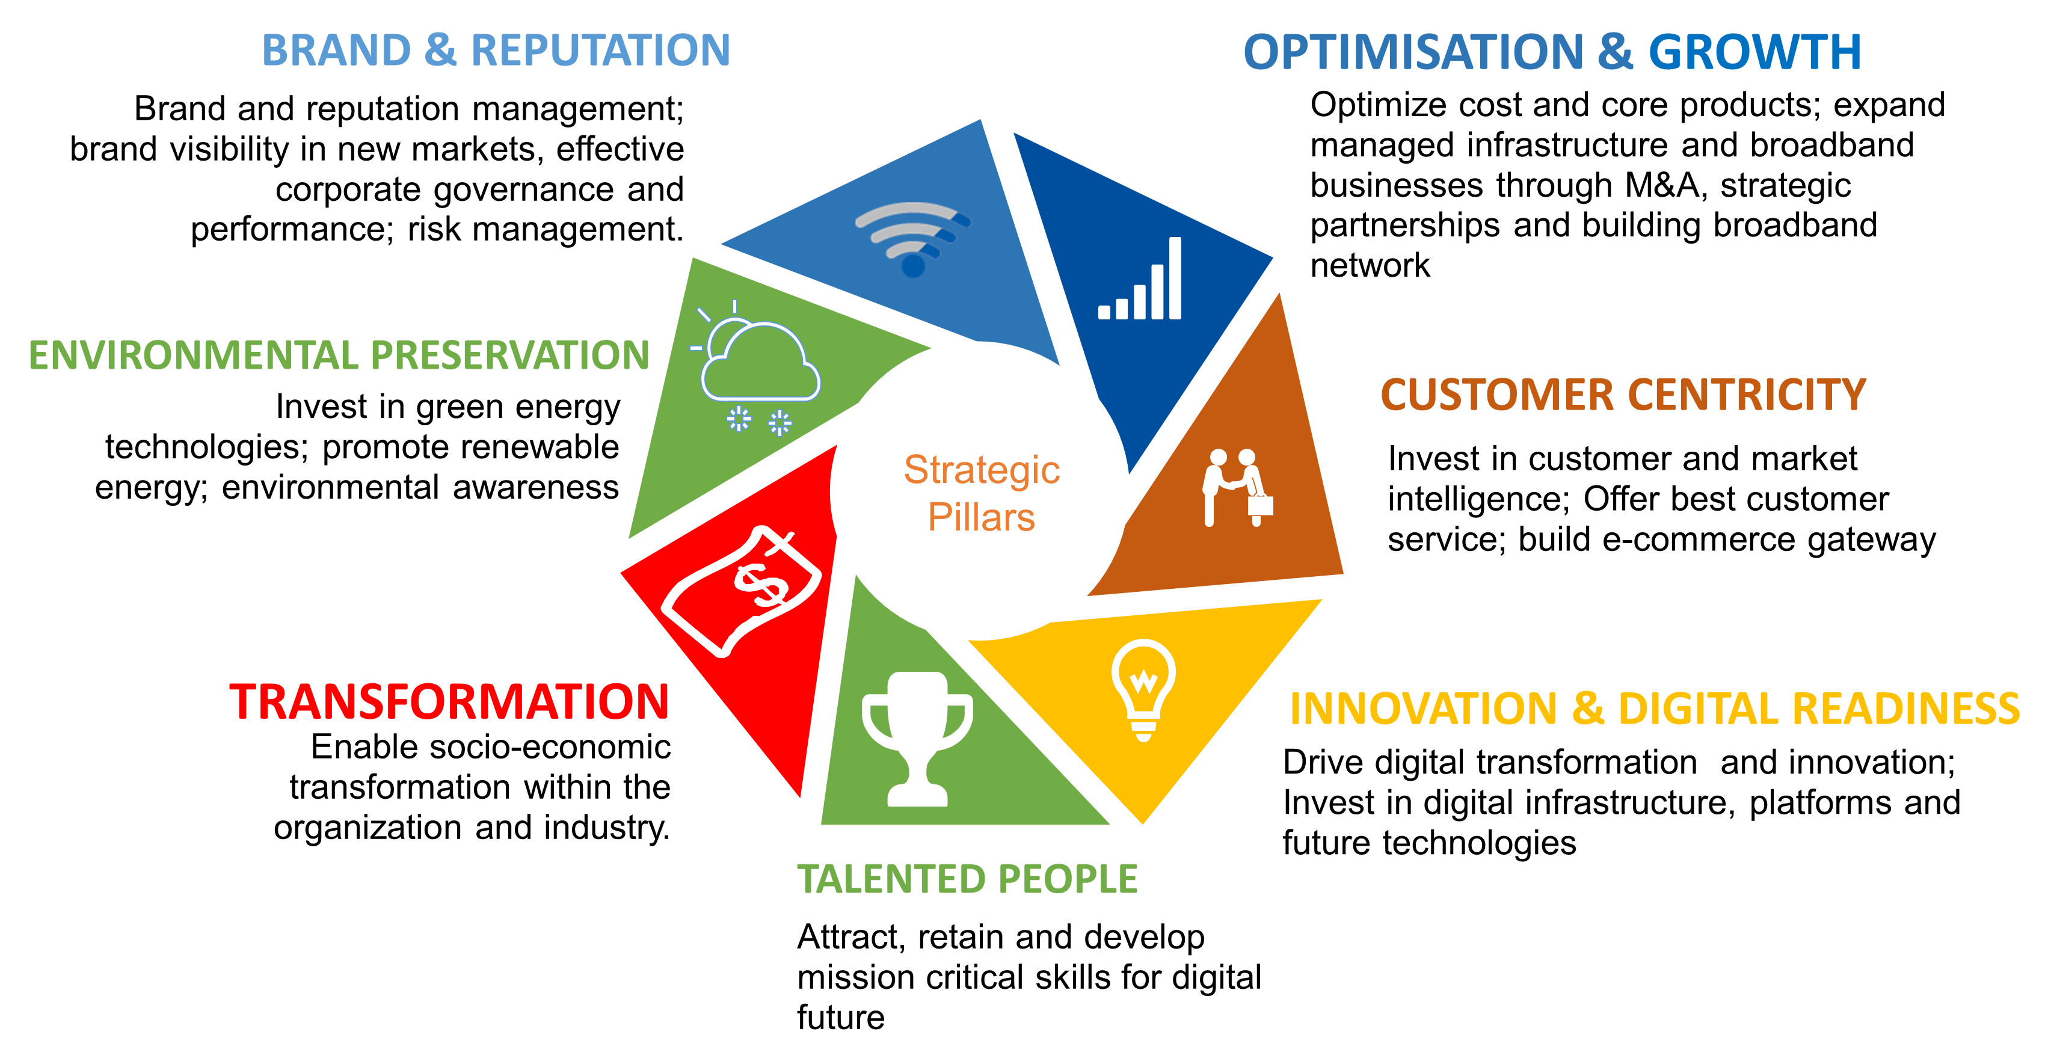
Business Strategy :
7 Strategic Pillars

Slide 6
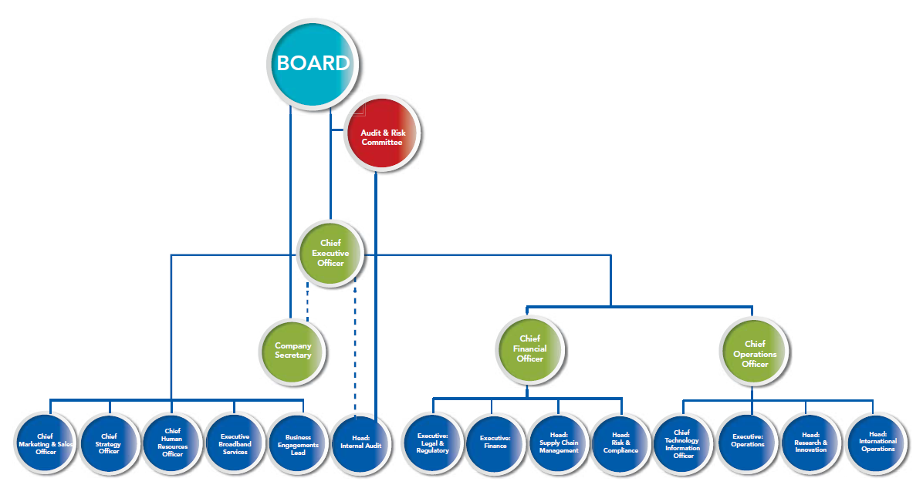
Organizational Structure
Measuring our Performance and APP
Vision, Mission and Values

Slide 7
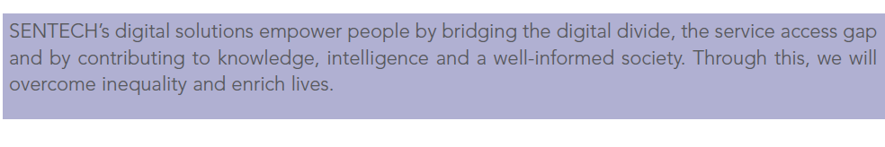
Impact Statement

Slide 8
SENTECH APP: FY2021/22
Strategic Pillars | Outcomes | Outcomes Indicators | Annual Targets (FY 2021/22) | Budget R (FY 2021/22)
Optimisation and Growth | Revenue growth | Sales Revenue (R) | R 1,257 billion | R1,104 billion
 | Increased Profitability | 2) Operating Profit (R) | R 154 million
 | Sustainable digital infrastructure business (SOC Rationalisation) | 3) Business Model for State Digital Infrastructure Company (SDIC) developed | Business Model for SDIC developed | R1m
Talented People | Right people in the right place at the right time with the right skills and mindset | 4) Percentage of planned digital skills training interventions implemented | 90% | R15m
Innovation and Digital Readiness | Right technology in the right place at the right time/able to use | 5) Number of Set-Top Box Installations | 810 000
 | Analogue Switch Off | 6) Number of analogue sites switched off | 155 | R4m
 | Increased broadband network coverage | 7) Number of connected sites | 200 | As per business case approval
Customer Centricity | Satisfied customers Customer Loyalty | 8) Customer satisfaction levels (%) | Baseline +5% | R2m
Transformation | Transformed communities and enterprises | 9) Allocated budget spent on Enterprise and Supplier Development (ESD) | R6m | R6m
Environmental Preservation | Carbon footprint reduced Energy efficiencies achieved | 10) Number of sites converted to green energy supply | 2 | R16m
Brand & Reputation | Effective and corporate governance and citizenry | 11) Clean Audit Achieved | Clean Audit Achieved | R3m

Slide 9
SENTECH APP: FY2021/22 QUARTERLY TARGETS
Quarterly Targets
Strategic Pillars | Outcomes | Outcomes Indicators (KPIs) | Annual Target | Q1 | Q2 | Q3 | Q4
Optimisation and Growth | Revenue growth | Revenue Growth ( R) | R1, 257million | R 316 million | R 617 million (Cumulative) | R 915 million (Cumulative) | R 1, 257 million (Cumulative)
 | Increased Profitability | Operating Profit (R ) | R 154 million | R 46 million | R 76 million (Cumulative) | R 112 million (Cumulative) | R 154 million (Cumulative)
 | Sustainable broadband business (SOC Rationalisation) | Business Model for the SDIC developed | Business Model for the SDIC developed | Identification of resources required | Terms of reference and project plan developed | Business Model for the SDIC initial draft developed | Final Business Model for the SDIC developed
Talented People | Right people in the right place at the right time with the right skills and mindset | Percentage of planned digital skills training interventions implemented | 90% of planned digital skills training interventions implemented | 20% of planned digital skills training interventions implemented | 45% of planned digital skills training interventions implemented | 65% of planned digital skills training interventions implemented | 90% of planned digital skills training interventions implemented
Innovation and digital readiness | Increased broadband network coverage | Number of connected sites | 200 connected sites | 50 connected sites | 100 connected sites (Cumulative) | 150 connected sites (Cumulative) | 200 connected sites (Cumulative)
 | Right technology in the right place at the right time/able to use | Number of Set-Top Box Installations | 810 000 Set-Top Box installations | 330 000 Set-Top Box Installations | 480 000 Set-Top Box Installation | Project closure and draft report developed | Project closure final report developed and submitted
 | Analogue switch off | Number of analogue sites switched off | 155 analogue sites switched off | 54 analogue sites switched off | 92 analogue sites switched off (cumulative) | 135 analogue sites switched off (cumulative) | 155 analogue sites switched off (cumulative)

Slide 10
SENTECH APP: FY2021/22 QUARTERLY TARGETS
Quarterly Targets
Strategic Pillars | Outcomes | Outcomes Indicators (KPIs) | Annual Target | Q1 | Q2 | Q3 | Q4
Customer centricity | Customer Loyalty | Customer satisfaction levels (%) | Customer satisfaction levels of baseline +5% | Customer Satisfaction Survey Monitoring Tool developed | Engagements with top 5 Tier 1 customers | Engagements with all Tier 1 customers | (65%+ 5%) baseline Customer satisfaction levels achieved
Transformation | Transformed communities and enterprises | % Spend on Enterprise and Supplier Development | Percentage of allocated budget spend (R6m) on Enterprise and Supplier Development (ESD) | Enterprise and Supplier Development Plan completed | Achieve 50% spend of allocated budget for ESD | Achieve 75% spend of allocated budget for ESD | 100% of allocated budget spent (R6m) on Enterprise Supplier Development (ESD)
Environmental Preservation | Carbon footprint reduced Energy efficiencies achieved | Number of sites converted to green energy supply | 2 sites converted to green energy supply | Green energy supply project plan developed for 2 sites | Design and solutions requirements concluded for 2 sites | 1 site converted to green energy supply | 2 sites converted to green energy supply (cumulative)
Brand and Reputation | Effective corporate governance | Clean Audit Achieved | Clean Audit Achieved | No performance required | No performance required | Reduction of Management Letter Points by 50% | Complete and issue Interim Financial Statements for the 9 months period ending 31 December 2021

Slide 11
CONCLUSIONS
The APPs were submitted to the DCDT and National Treasury in line with regulations .
SENTECH Focuses on deliver of strategic objectives in line with national objectives.
The Annual Performance plans presented are budgeted for.
A risk register focusing on business sustainability and continuity is monitored by the Board.
Focus on promoting SMMEs in our procurement is part of our strategy execution activity
The Business operates under tough market conditions constrained by the COVID-19 Pandemic.

Slide 12

Thank You!

