Slide 1
SOUTH AFRICAN WEATHER SERVICE QUARTER 4 PERFORMANCE REPORT FINANCIAL YEAR 2019/20
“South African Weather-related Solutions for everyone, everyday”
Mr Mnikeli Ndabambi
Acting Chief Executive Officer

Slide 2
TABLE OF CONTENTS
OVERALL SUMMARY OF QUARTER 4 PERFORMANCE
PERFORMANCE LOGFRAME
PROGRAMME 1: WEATHER AND CLIMATE SERVICES
PROGRAMME 2: RESEARCH AND INNOVATION
PROGRAMME 3: INFRASTRUCTURE AND INFORMATION SYSTEMS
PROGRAMME 4: ADMINISTRATION
FINANCIAL PERFORMANCE OF QUARTER 4

Slide 3
OVERALL SUMMARY OF QUARTER 4 PERFORMANCE
Programmes | Number of targets | Achieved (100%) | Partially Achieved (50-99%) | Not Achieved (0-49%)
Programme 1: Weather and Climate Services | 4 | 4 | - | -
Programme 2: Research and Innovation | 2 | 2 | - | -
Programme 3: Infrastructure and Information Systems | 7 | 5 | 2 | -
Programme 4: Administration (Incl. Corporate and Regulatory Services) | 8 | 5 | 1 | 2
Total | 21 | 16 | 3 | 2
Percentage |  | 76.2% | 14.3% | 9.5%

Slide 4
PROGRAMME 1:
WEATHER AND CLIMATE SERVICES

Slide 5
PROGRAMME 1: WEATHER AND CLIMATE SERVICES
Strategic Objective 1.1: Warnings, alerts and advisories - Provide timeous and accurate impact based early warnings, alerts and advisories to safeguard life and property against the impact of severe weather on land, oceans and in the air.
Performance indicator | Annual Target 2019/20 | 4th Quarter Target | 4th Quarter Progress and Analysis | Annual Progress and Analysis
Percentage of national weather (FPZA41) available | 98% | 98% | Achieved 99% FPZA41 available (98% + 100% + 98%) ÷ 3) = 98.67% | Achieved 99% FPZA41 available
Percentage of Aerodrome warnings accuracy | 98% | 98% | Achieved 98% Aerodrome warning accuracy (97.6% + 97.4% + 97.6%) ÷ 3) = 97.5% | Achieved 99% Aerodrome warning accuracy
Percentage accuracy of meteorological information for flight planning and en-route operations (TAF) | 90% | 90% | Achieved 93% TAF accuracy (93.6% + 92.3% + 93.5%) ÷ 3) = 93.1% | Achieved 94% TAF accuracy
Percentage availability of Marine (SOLAS) | 95% | 95% | Achieved 98% SOLAS availability ((99.2% + 98% + 97.5%) ÷ 3) = 98.23% | Achieved 98% SOLAS availability
= On target
= work in progress
= Off target
= No milestone

Slide 6
OVERALL SUMMARY OF PROGRAMME 1 PERFORMANCE
% On target | % Work in progress | % Off target | % No milestone
100% (4/4) | 0% (0/4) | 0% (0/4) | 0% (0/4)

Slide 7
PROGRAMME 2:
RESEARCH AND INNOVATION

Slide 8
PROGRAMME 2: RESEARCH AND INNOVATION
Strategic Objective 2.1: Research - Generate new scientific insights in atmospheric and related sciences in collaboration with relevant stakeholders. Expand the existing knowledge base and intelligence related to climate change.
Performance indicator | Annual Target 2019/20 | 4th Quarter Target | 4th Quarter Progress and Analysis | Annual Progress and Analysis
Number of Research outputs (publications, articles, conference papers, etc.) | 45 | 5 | Achieved 10 Research outputs (9 x Journal articles, 1 x Conference Paper) | Achieved 52 Research outputs
Strategic Objective 2.2: Solution development - Provision of innovative meteorological and related products and services through the development and implementation of a community weather-smart products and service plan
Performance indicator | Annual Target 2019/20 | 4th Quarter Target | 4th Quarter Progress and Analysis | Annual Progress and Analysis
Number of Solutions developed | 5 | 5 solutions signed-off | Achieved Five (5) solutions developed and signed-off by users. Lightning product Impact -Based AvRDP product Multi-Model EPS Malaria Prediction System (MPS) AQ scenario tool for Mpumalanga province | Achieved Five (5) solutions developed
= On target
= work in progress
= Off target
= No milestone

Slide 9
OVERALL SUMMARY OF PROGRAMME 2 PERFORMANCE
% On target | % Work in progress | % Off target | % No milestone
100% (2/2) | 0% (0/2) | 0% (0/2) | 0% (0/2)

Slide 10
PROGRAMME 3:
INFRASTRUCTURE AND INFORMATION SYSTEMS

Slide 11
PROGRAMME 3: INFRASTRUCTURE AND INFORMATION SYSTEMS
Strategic Objective 3.1: Optimal management of infrastructure - Ensure optimal infrastructure and systems uptime of observations, information dissemination and exchange that enables SAWS to achieve its mandate.
Performance indicator | Annual target 2019/20 | 4th Quarter Target | 4th Quarter Progress and Analysis | Annual Progress and Analysis
Percentage of Surface observation infrastructure availability (AWS, ARS) | 85% | 85% surface observation infrastructure available | Achieved 85% surface observation infrastructure availability ((86.7% AWS + 83.4% ARS) ÷ 2) = 85.05% | Achieved 85% surface observation infrastructure availability
Percentage of GAW infrastructure availability | 90% | 90% GAW infrastructure available | Partially Achieved 73% GAW infrastructure availability ((58% + 86.9%) ÷ 2) = 72.45% Challenges: Load shedding resulting in multiple instrumentation failure. Ageing infrastructure, Ozone sondes depleted. Corrective measures: Ozone sonde order arrived in March 2020. Backup power acquisition and GAW Business Case implementation | Partially Achieved 86% GAW infrastructure availability
Percentage of Remote sensing observation infrastructure availability (Radar) | 80% | 80% remote sensing observation infrastructure available | Achieved 90% Radar availability ((94.14% + 90.89% + 86.08%) ÷ 3) =90.37% Effective response and availability of resources contributed to overachievement | Achieved 92% Radar availability
= On target
= work in progress
= Off target
= No milestone

Slide 12
PROGRAMME 3: INFRASTRUCTURE AND INFORMATION SYSTEMS
Strategic Objective 3.1: Optimal management of infrastructure - Ensure optimal infrastructure and systems uptime of observations, information dissemination and exchange that enables SAWS to achieve its mandate.
Performance indicator | Annual target 2019/20 | 4th Quarter Target | 4th Quarter Progress and Analysis | Annual Progress and Analysis
Percentage of Remote sensing observation infrastructure availability (LDN) | 90% | 90% remote sensing observation infrastructure available | Achieved 91% LDN availability ((89.16% + 91.23% + 93.38%) ÷3) = 91.26 | Achieved 92% LDN availability
Percentage of Upper air observation infrastructure availability | 80% | 80% upper air observation infrastructure available | Partially achieved 63% upper air observation infrastructure available Challenges: Springbok generator faulty since February. Durban and Gough Island infrastructure remain non-operational. Corrective measures: Gough Island will be replaced in the next take over. Evaluation for supplier to install new upper air infrastructure evaluated. | Partially achieved 59% upper air observation infrastructure available.
Percentage of ICT system availability | 96% | 96% | Achieved 99% ICT system availability ((98.3% MPLS + 99.9% Server + 98.2% HPC) ÷ 3) = 98.8% | Achieved 99% ICT system availability
= On target
= work in progress
= Off target
= No milestone

Slide 13
PROGRAMME 3: INFRASTRUCTURE AND INFORMATION SYSTEMS
Strategic Objective 3.2: Quality data – Provide quality data meeting minimum data requirements
Performance indicator | Annual target 2019/20 | 4th Quarter Target | 4th Quarter Progress and Analysis | Annual Progress and Analysis
Percentage of Air quality stations available on SAAQIS | 90% | 90% | Achieved 93% priority areas air quality stations available on SAAQIS (14 ÷ 15) x 100 = 93% Sharpeville station was vandalised and some equipment stolen in December 2019. This station has remained offline pending installation of improved security measures. | Achieved 98% priority areas air quality stations available on SAAQIS
= On target
= work in progress
= Off target
= No milestone

Slide 14
OVERALL SUMMARY OF PROGRAMME 3 PERFORMANCE
% On target | % Work in progress | % Off target | % No milestone
71% (5/7) | 29% (2/7) | 0% (0/7) | 0% (0/7)

Slide 15
PROGRAMME 4:
ADMINISTRATION (INCLUDING CORPORATE AND REGULATORY SERVICES)

Slide 16
PROGRAMME 4: ADMINISTRATION (INCLUDING CORPORATE AND REGULATORY SERVICES)
Strategic Objective 4.1: Sound Corporate Governance - Provide Business management and leadership.
Performance indicator | Annual target 2019/20 | 4th Quarter Target | 4th Quarter Progress and Analysis | Annual Progress and Analysis
Current ratio for Liquidity | 1.5 | 1.5 | Partially Achieved 0.75 Liquidity ratio Challenges: Mainly due to increase in cash and cash equivalents, trade payables, unspent government grants and short-term employee benefits. | Partially Achieved 0.75 Liquidity ratio
Percentage Expenditure on affirmative procurement | 65% | 65% | Achieved 94% local expenditure on affirmative procurement (R47 057 096.23 ÷ R50 298 660.67) x 100 = 93.6% | Achieved 95% local expenditure on affirmative procurement
= On target
= work in progress
= Off target
= No milestone

Slide 17
PROGRAMME 4: ADMINISTRATION (INCLUDING CORPORATE AND REGULATORY SERVICES)
Strategic Objective 4.1: Sound Corporate Governance - Provide Business management and leadership.
Performance indicator | Annual target 2019/20 | 4th Quarter Target | 4th Quarter Progress and Analysis | Annual Progress and Analysis
Level of BBBEE | BBBEE level 7 | BBBEE level 7 achieved | Not Achieved No valid BBBEE certificate Corrective measures: BBBEE Task team established and formally appointed by CEO. Employment Equity focus towards PWDs and targeting of TVET Colleges. Spending on management training through partnership with Universities (Henley and GIBS Business School, as well as Stellenbosch University | Not achieved No valid BBBEE certificate
Commercial revenue | R36.19 mil | R12 mil | Achieved R14.71m | Partially Achieved R35.55m Commercial
= On target
= work in progress
= Off target
= No milestone

Slide 18
PROGRAMME 4: ADMINISTRATION (INCLUDING CORPORATE AND REGULATORY SERVICES)
Strategic Objective 4.2: Adequate, Appropriately Skilled, Transformed and Diverse Workforce - Develop programmes which create a supportive environment for high performance, employee wellness, career development, attraction and retention.
Performance indicator | Annual target 2019/20 | 4th Quarter Target | 4th Quarter Progress and Analysis | Annual Progress and Analysis
Percentage of Attrition rate | 8% | 8% | Achieved 1% attrition rate (5 ÷ ((489 + 524) ÷ 2)) x 100) = 0.98% | Achieved 6% attrition rate
Percentage of Workplace skills plan targets met | 95% | 95% | Not achieved 30% WSP target met ((43 people trained ÷ 144 planned to train) x 100) = 29.9% Challenges: Procurement of required WSP Training was delayed with most procured towards the end of the quarter under reporting. Corrective measures: Plans in place to enable conducting of training beginning of 2020/21 FY. | Not Achieved 30% WSP target met
= On target
= work in progress
= Off target
= No milestone

Slide 19
PROGRAMME 4: ADMINISTRATION (INCLUDING CORPORATE AND REGULATORY SERVICES)
Strategic Objective 4.3 Stakeholder Engagement Network Development - Engagement of stakeholders for mutual benefit relationships.
Performance indicator | Annual target 2019/20 | 4th Quarter Target | 4th Quarter Progress and Analysis | Annual Progress and Analysis
Percentage rating of External stakeholder perception | 85% | 85% | Achieved 89% stakeholder development plan implemented ((16 out of 18 initiatives executed) x 100) = 88.8% | Achieved 89% stakeholder development plan implemented
Strategic Objective 4.4: Corporate Communication/Branding - Development and maintenance of various platforms for engagement with stakeholders to extend the reach and increase awareness of the SAWS brand.
Performance indicator | Annual target 2019/20 | 4th Quarter Target | 4th Quarter Progress and Analysis | Annual Progress and Analysis
Advertising value equivalent (R value million) (cumulative) | R155m | R155m | Achieved R294m AVE ((R50 434 988 + (R84 807 808 + R84 114 286 + R75 013 513)) = R294 370 595 Increase in Broadcast media with top broadcast story stemming from reports of the tornado that ripped through the Hanover region in KwaZulu-Natal | Achieved R294m AVE
= On target
= work in progress
= Off target
= No milestone

Slide 20
OVERALL SUMMARY OF PROGRAMME 4 PERFORMANCE
% On target | % Work in progress | % Off target | % No milestone
50% (5/8) | 37,5% (1/8) | 12,5% (2/8) | 0% (0/8)

Slide 21
QUARTER 4 FINANCIAL REPORT

Slide 22
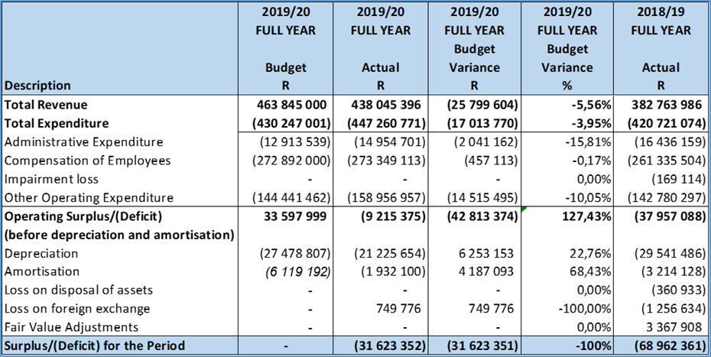
FINANCIAL REPORT
SUMMARY OF THE STATEMENT OF FINANCIAL PERFORMANCE

Slide 23
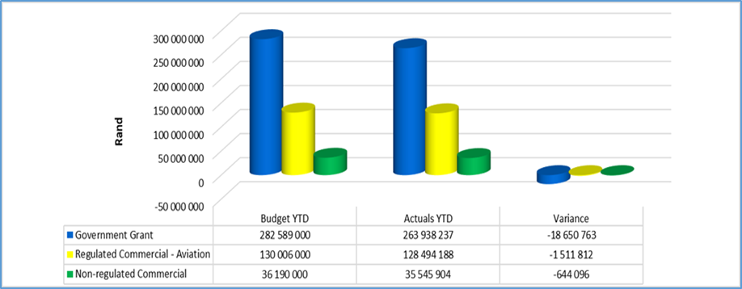
SUMMARY OF REVENUE

Slide 24
SUMMARY OF REVENUE
The Total Actual Revenue for the period ending 31 December 2019 was R332,09m against the budget of R354,90m resulting in a negative variance of R22,80m for the period.
The Government Grant comprises of:
R186,27m Operational Grant; and
R17,80m South African Air Quality Information System (SAAQIS) Grant
The Capital Expenditure Grant and the Early Warning Grant allocation amounts to R78,52m, and of this amount, only R59,86m has been recognised as revenue in the current financial year; the remaining amount of R19m has been included under the Unspent Government Grants – Capital Expenditure .
The Total Commercial Revenue which is made up of Aviation (Regulated) Revenue and Non-Regulated Revenue is as follows:
Regulated Commercial - Aviation Revenue is slightly below the budget of R130m by R1,51m (Actual: R128,49m); and
Non-regulated Commercial Revenue for the period amounts to R35,55m, which is 2% below the budget of R36,19m.

Slide 25
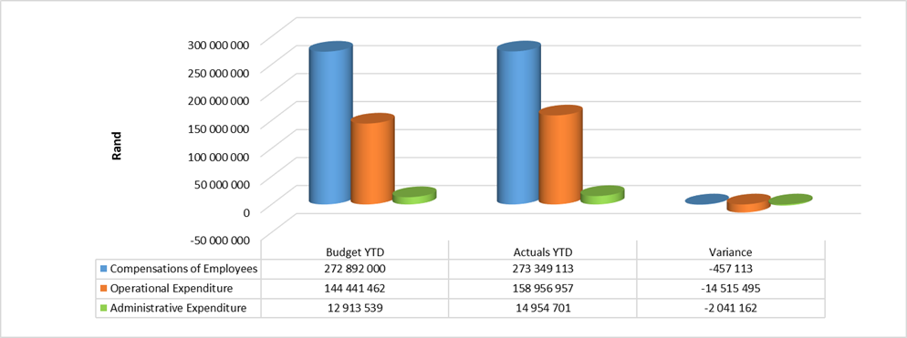
SUMMARY OF EXPENDITURE

Slide 26
SUMMARY OF EXPENDITURE
The Total Expenditure year to date (excluding Depreciation and Amortization) amounts to R447,26m which is 3.95% above budget of R430,25m.
The Administrative Expenditure for the period amounts to R14,95m which is above the budget of R12,91m by 15% with major over-spending attributed to the following:
Bad debts provision of R6,9m due to long outstanding debtors.
The Operating Expenditure is 10.05% (R14,52m) above the budget of R144,44m (Actual: R158,96m) and the major areas of over-expenditure were mainly due to among others, the following:
Cost of sales exceeded budget by R6,1m as a result of additional revenue from the sale of Instruments as well as the payments for the purchase of gases for all Air Quality stations.
Information and Communication costs, which are related to internet costs, telephone, data and lease data costs exceeded budget by R2,3m.
Software licenses costs for Microsoft, Modelling Research and NetSuite exceeded budget by R6,8m.
Repairs and Maintenance and Relocation Costs: The over spending amount of R2,5m relates to System support and infrastructure maintenance.
Equipment expensed: The over-spending of R850k is due to the purchase of Radiosondes and upper-air balloons to support the observations.

Slide 27
End Thank you!

