Slide 1

ANNUAL REPORT 2018/19
PRESENTATION
8 OCTOBER 2019
Ms NZH Mpofu
DIRECTOR GENERAL, DPME

Slide 2

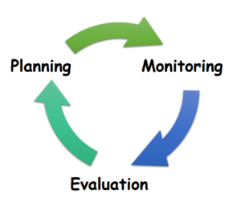
Table of Contents
Functions and mandate
1
Organisational performance
2
Human Resources
3
Financial Information
4
Auditor General-Report
5

Slide 3



DPME HAS THREE CORE FUNCTIONS:

Slide 4
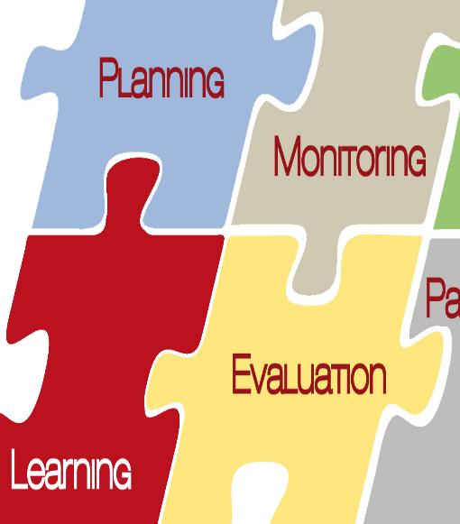
DPME Mandate
Institutionalisation of planning. Institutionalisation needs to take account of two distinct dimensions of planning:
Long-term planning – charting the country’s developmental trajectory, anticipating, analysing and responding to emerging trends
Co-ordination of the planning system, responsible for coherence, alignment and quality of plans – as well as follow-through from planning to implementation
Monitoring the implementation of the NDP by developing robust monitoring systems backed by evidence.
Evaluating critical government programmes with the intention to inform planning, monitoring and interventions as well as budget prioritisation.
Interventions on behalf of Cabinet and the President through Inter-Ministerial Committees – e.g. North West intervention.

Slide 5
Overall Performance Information

Slide 6

Highlights
7th Consecutive Clean Audit
Planning:
Drafted Integrated Planning Framework Bill on National Development Planning.
Framework for Strategic Plans and Annual Performance Plans revised.
Draft MTSF developed comprising NDP Five year Implementation Plan and Monitoring framework.
Monitoring:
Facilitated section 100 interventions in the North West through the work of Inter-Ministerial Committees.
Coordinated the review of South Africa’s 25 years of democratic governance
Evaluations:
Number of evaluations increased from 59 to 67 in the past financial year covering over R143 billion of government expenditure
Reviewed the evaluations system to focus on rapid evaluations

Slide 7
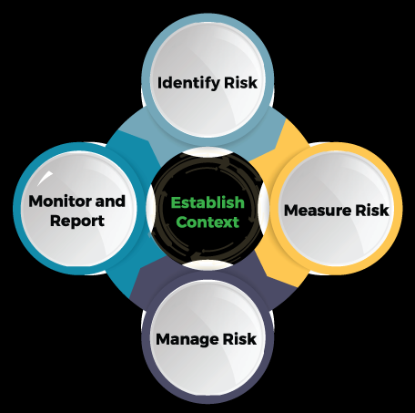
Detailed Performance Information Report for 2018/19

Slide 8
PROGRAMME 1: ADMINISTRATION
Total targets = 17 for the financial year. 12 achieved, 4 achieved late and 1 not achieved
Targets achieved late or Not achieved related to: Produce an Annual Performance Plan according to prescribed standards/frameworks and timelines: Final Annual Performance Plan 2019/20 was not tabled in Parliament. Parliament issued a communique dated 22 February 2019 indicating that Strategic Plans and/or APPs for 2019/20 should be tabled after the adoption of the Fiscal Framework. Maintain a vacancy rate of 10% or less annually: The average vacancy rate as at quarter 4 was 11.4%. The filling of some senior management posts was delayed due to the inception of the 6th administration Workplace Skills Plan approved by DG by 30 April 2018: WSP was approved by DG on 4 May 2018 which was after the due date of 30 April 2018 due to delays in the finalisation process. 100% compliance in submission of financial interests by all designated employees within the specified time frames: 95% of SMSs disclosed (79/83). 96% of other designated employees disclosed their financial interests within the specified time frames (136/141*). 3 Members of the SMS who did not disclose were appointed during the course of the year. 2 designated employees who did not disclosed left the department. Communication plan was produced but not approved. 98% activities in the draft Communication plan were conducted (84/86).: Management took a decision to defer the approval of the annual communication plan pending the departmental strategic session which was scheduled for mid-July 2018.

Slide 9
ADMINISTRATION
Achieved Targets 1/3
Sub-programme | Targets/actual achievement
Strategy and Service Delivery | Produce 4 quarterly implementation report against APP 4 quarterly implementation reports were produced against APP
 | Produce AR and submit AGSA for audit and to NT and Parliament by due dates Audited Annual Report was produced and submitted to National Treasury and Parliament by due date
Human Resources | 3. 5% or more (of the approved funded post establishment) of interns are appointed annually in the Department The Department appointed 6.9% of interns during the financial year. (30/430*100-6.9% of approved funded post establishment of interns appointed)
 | Achieve 90% submissions of performance agreements, reviews and assessments by due date 95% (325 out of 341) of expected performance agreements were submitted to HR by 31 May 2018 96% (304 out of 317) of assessments were submitted, however the results were not communicated by due date 98% (342 out of the expected 350) midterm reviews were submitted by due date

Slide 10
ADMINISTRATION
Achieved Targets 2/3
Sub-programme | Targets/actual achievement
Human Resources | Achieve 80% of targets in the WSP by the end of the financial year 173% of WSP targets were achieved by end of financial year (607/350*100=173%)
Office of the Chief financial Officer | 6. 100% of valid invoices paid within 30 days or disciplinary action taken in 100% of cases where invoices are not paid within 30 days 100% of valid invoices were paid within 30 days
Office of the Chief Information Technology | 7. Annual ICT Plan produced and approved by head of ICT by 30 June Annual ICT Plan was produced by 30 June 2018
 | 8. Produce quarterly monitoring reports against the ICT plan within 30 days of end of the quarter Quarterly monitoring reports against the ICT plan were submitted and 14/16*100= 88% achievement against the ICT Standards

Slide 11
PROGRAMME 1 : ADMINISTRATION
Achieved Targets 3/3
Sub-programme | Targets/actual achievement
Risk Management | Conduct annual risk assessment and produce risk management implementation plan Annual risk assessment was conducted and risk management implementation plan was produced
 | 10. 4 quarterly progress report produced 4 Quarterly Risk management progress report produced
Internal Audit | 11. Produce a 3 year rolling strategic internal audit plan and submit to the Audit Committee for approval by 30 June 2018 3- Year Rolling Plan and IA Annual Plan developed and tabled at the AC meeting held on 28 March 2018 for approval
 | 12. Quarterly audit monitoring reports presented to Audit Committee and Management produced Quarterly audit implementation reports were produced and presented to the Audit Committee and Management

Slide 12
PROGRAMME 2 : NATIONAL PLANNING COMMISSION
Achieved Targets
Sub-programme | Targets/actual achievement
National Planning Commission | 4 Integrated Planning Forums convened 7 Planning forums were held in the financial year
 | 2. 3 research projects in support of the NPC 4 research projects in support of the NPC completed
 | 3. 10 stakeholder engagements and 1 annual report in support of the NPC 20 stakeholder engagements were conducted to support the NPC and an annual report was produced 4. 9 NPC Plenaries meetings were held in the financial year instead of 10 NPC Plenaries meetings: 1 plenary meeting was cancelled due to preparations of SONA.

Slide 13
PROGRAMME 2 : NATIONAL PLANNING COORDINATION
Had 14 targets for the financial year. 10 targets were achieved, 3 were not achieved and 1 achieved late The Not achieved targets related to: 1. Legislation for national Planning finalized by 31 March 2018: The Integrated Planning Bill was approved by Cabinet and gazetted for public comments on 07 May 2018. Consultations on the Bill took longer and Parliament also closed the acceptance on new legislation for processing in June 2018. The Bill will be submitted for processing to the Sixth Administration. 2. National Spatial Development Framework (NSDF) approved by Cabinet: National Spatial Development Framework was developed but not approved by Cabinet and non transfer of SPLUMA meant this was still responsibility of DRDLR. The JCPS DGs Cluster Meeting of 05 March 2019 recommended that an ad hoc meeting be convened to deal with all security gaps, risks and mitigation measures associated with the Draft National Spatial Development Framework. 3. Annual Budget Mandate Paper finalised by 30 April 2018: Annual Budget Mandate Paper was developed by April and approved by Cabinet on 20 June 2018. A new cabinet was installed which required more consultation on the Annual Budget Prioritisation Framework (Mandate Paper). Extended consultation with Mincom Bud also delayed the finalisation of the Annual Budget Mandate paper by due date. The target achieved in June 2018).

Slide 14
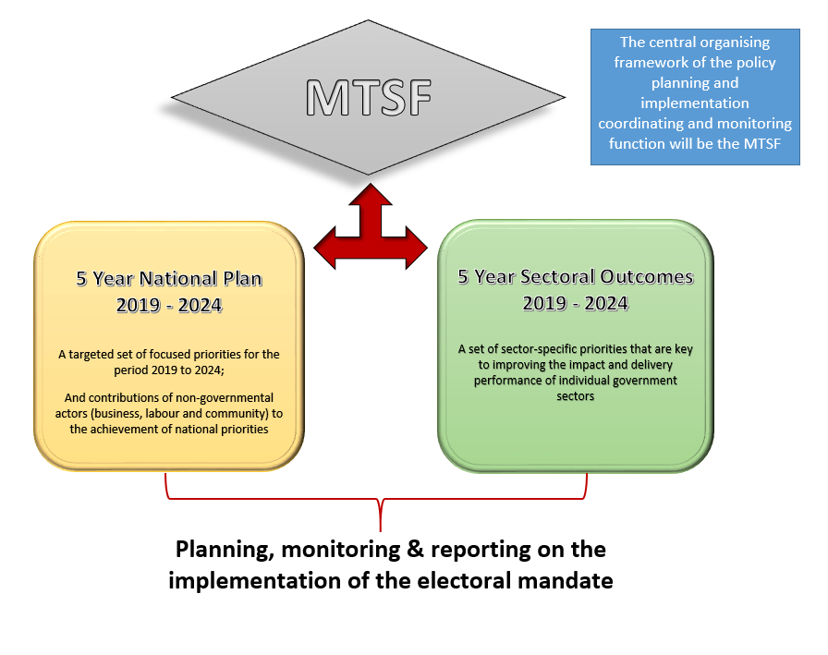
Medium Term Strategic Framework (MTSF)
MTSF is a high-level strategic document to guide the 5 year implementation and monitoring of the NDP 2030
In line with electoral mandate identifies the Priorities to be undertaken during 2019-2024 to put the country on a positive trajectory towards the achievement of the 2030 vision
It sets targets for implementation of the priorities and interventions for the 5 year period, and states the Outcomes and Indicators to be monitored

Slide 15

NATIONAL PLANNING COORDINATION
Achieved Targets
Sub-programme | Targets/actual achievement
National Planning Coordination | Guideline for the development of the NDP 5 year implementation plan developed Guideline for the development of the NDP 5 year implementation plan was developed
 | 40 assessment reports on the second draft Annual Performance Plans provided to national departments by 31 January 2019 45 Assessment reports on the second draft APPs were submitted to national department by 31 January 2019
 | 7 assessment reports on the second draft Annual Performance Plans provided to Offices of the Premier by 31 January 2019 7 Assessment reports on the second draft APPs were submitted to Offices of the Premier by 31 January 2019
 | 1 Quarterly Performance Reporting Guidelines issued to all National departments by 15 May 2017 1 Guideline issued to all national departments by 15 May 2018

Slide 16

NATIONAL PLANNING COORDINATION
Achieved Targets
Sub-programme | Targets/actual achievement
National Planning Coordination | 1 Quarterly Performance Reporting Guidelines issued to all Offices of the Premier by 15 May 2017 1 Guideline issued to all Offices of the Premier by 15 May 2018
 | 6. Guideline for integrated planning developed Guideline for integrated planning was developed
 | 7. Assessment report on the review of the planning cycles developed An assessment report on the review of the planning cycles was developed

Slide 17
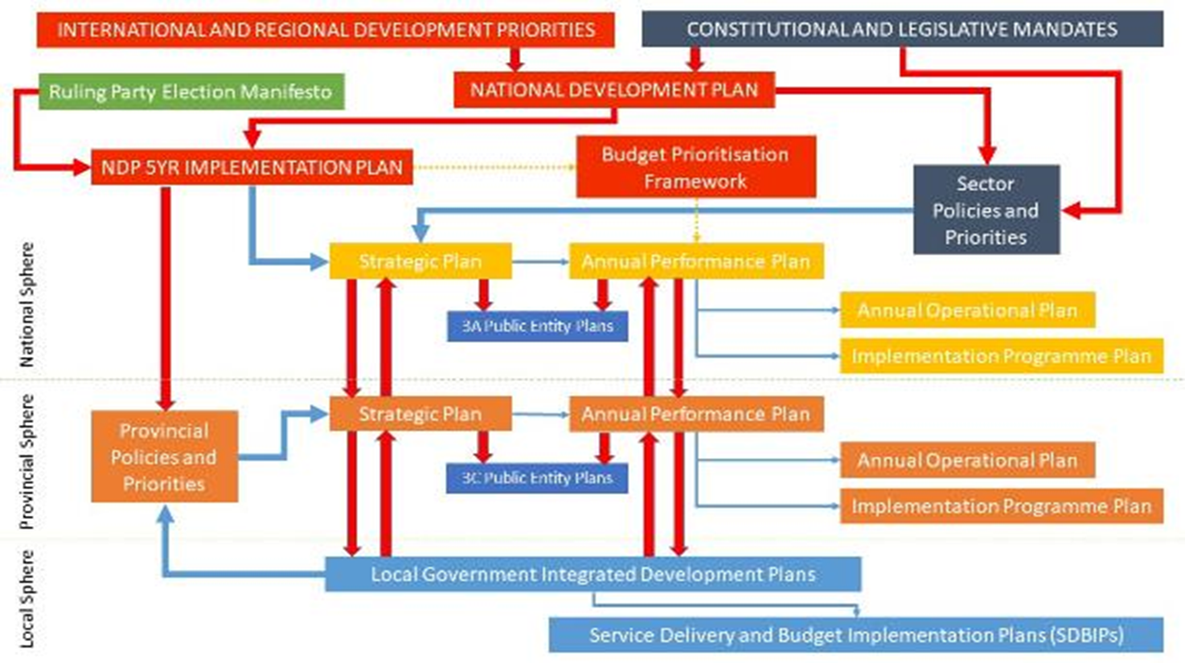
INTEGRATED PLANNING FRAMEWORK

Slide 18
PROGRAMME 3: SECTOR MONITORING
Had 10 targets for the financial year. 9 targets achieved and 1 was not achieved The Not achieved targets related to: Two comprehensive progress reports on the implementation of outcomes of the Inter-Ministerial Committees were produced against a target of three reports The Inter-Ministerial Committees of Distressed Mining Towns meeting was held in the last quarter. This resulted in the report not being produced as planned.

Slide 19
SECTOR MONITORING
The Progress report on 25 year review:
  The 25-Year Review Report was presented to the Joint Cabinet Committees in September 2019, and was approved subject to the incorporation of the amendments required by Ministers.
  The report was subsequently approved by Cabinet, and is being finalised for printing.
  The President will launch the report publicly, at a date to be determined by the Presidency.
  Cabinet also approved that after the report has been launched by the President, National and Provincial Government Departments, who have been working with the DPME, can publish their own 25-Year Review Reports.

Slide 20

SECTOR MONITORING
Achieved Targets
Sub-programme | Targets/actual achievement
Outcome Monitoring | Revised Guidelines for the POA Monitoring System finalised and approved by Cabinet in 2018 Guidelines document has been reviewed and approved by Cabinet on 9 May 2018
 | Revised Guidelines for Outcomes Coordination produced and approved by Cabinet in 2018 Guidelines reviewed and approved by Cabinet on 9 May 2018
 | Report on the review of implementation forums and coordination structures of government Report on the review of implementation forums and coordination structures of government was developed
 | 24 MTSF progress reports submitted to Cabinet in June and November 2018 24 Outcomes reports have been produced and presented to Cabinet on 20 June and 21 November 2018

Slide 21
SECTOR MONITORING
Achieved Targets
Sub-programme | Targets/actual achievement
Outcome Monitoring | Framework for SOCs, SOE and DFIs developed Framework for SOCs, SOE and DFIs developed
 | 6. Produce 2 progress reportson SOC’s, SOE and DFI’s 2 progress reports produced
Operational Phakisa | 7. 4 Quarterly integrated reports on the implementation of the Operation Phakisa Delivery labs 4 quarterly Operation Phakisa Integrated Progress Reports produced
SEIAS | 8. Progress report showing 80% of feedback provided on SEIAS reports analysed Progress reports showing average 94.25 % of feedback provided on SEIAS reports analysed
Mining Towns | 9. Three Comprehensive Progress Reports on the Special Presidential Package on Mining towns and labour sending areas 3 comprehensive progress report in the form of briefing note on Special Presidential Package for the Revitalization of Distressed Mining Communities and Labour sending areas were produced

Slide 22
INTEGRATED MONITORING FRAMEWORK
INTEGRATED MONITORING SYSTEM
MTSF
Monitoring System
Frontline Monitoring
Citizen Based Monitoring
District based Izimbizo
Presidential Hotline
Preliminary Impact Assessment

Slide 23
PROGRAMME 4: PUBLIC SECTOR MONITORING AND CAPACITY DEVELOPMENT
Had 6 targets for the financial year and all 6 targets were met Targets/actual achievement
4 MTSF progress reports submitted to Cabinet in June, and November 2018 (Outcome 9 and 12) 4 Outcomes reports have been produced and submitted to Cabinet on 20 June and 21 November 2018
6 public entities and SOEs performance analysed based on the approved framework 6 public entities and SOEs performance analysed based on the approved framework
Approved report on Directors General Performance Agreements adhere to Head of Department Management and Development System (HPMDS) and guidelines Report on submission of Directors General Performance Agreements adhering to Head of Department Management and Development System (HPMDS) and guideline was approved
4 analytical reports on 30 day payments produced 4 analytical reports on 30 day payments produced
80% of targets in the PM&E Capacity Development plan achieved 100% of targets in the PM&E Capacity development plan were achieved (36/36 X 100=100%)
Conducted 30 self-assessments by end of financial year 37 scorecards were completed by end of financial year

Slide 24
PUBLIC SECTOR MONITORING AND CAPACITY DEVELOPMENT
The Progress report on 30 day payment:
  The DPME is monitoring the payment of suppliers on a quarterly basis utilising information provided by National Treasury and the Presidential Hotline. 30 day payments is also an indicator in the capability index being finalised within the DPME.
  The Minister of Public Works is actively involved in ensuring that suppliers are paid timeously so that they in turn can honour their own contractual obligations. The Department of Public Works has made great strides in reducing the amount owed to suppliers.
  The bulk of invoices that are owed by provincial departments are attributable to the health sector.
  The North West province has shown improvements in paying outstanding amounts owed to suppliers. Some of the shortages in medical supplies and equipment are attributable to non/late payments of invoices.

Slide 25
PROGRAMME 5 : FRONTLINE AND CITIZEN BASED SERVICE DELIVERY MONITORING
Had 5 targets for the financial year 4 targets achieved and 1 not achieved
The Not Achieved target related to: Number of customer satisfaction survey reports produced indicating 80% satisfaction by respondents who logged queries with the Presidential Hotline. 4 customer satisfaction surveys were produced showing an average of 67.22% of client satisfaction against the target of 80%. The methodology used on the surveys was depended on the cooperation by other stakeholders that DPME did not have control over. The methodology used focuses on rating the level of satisfaction in relation to the services received from other state departments and institutions instead of the services provided by the Presidential Hotline. The methodology will be revised to measure what DPME has control over without relying on other departments.
Achieved

Slide 26
FRONTLINE AND CITIZEN BASED SERVICE DELIVERY MONITORING
Achieved Targets
Sub-programme | Targets/actual achievement
Frontline Monitoring | 400 of monitoring visits conducted for frontline monitoring (CBM, FSDM and Mystery Client 412 monitoring visits were conducted
CBM | 3 government institutions supported Four government institution were supported to implement citizen based monitoring
Presidential Hotline | 80% achievement of targets in Annual Presidential Hotline Enhancement Plan 95% achievement of targets in the Presidential Enhancement Plan (20/21x100=95%)
Siyahlola and Izimbizos | Conduct 20 visits and produce area profiles/briefing notes/reports on Siyahlola and Izimbizo quarterly 20 visits were conducted and area profiles/briefing notes/reports were produced

Slide 27
PROGRAMME 6 : EVIDENCE AND KNOWLEDGE SYSTEMS
Had 17 targets for the financial year. 13 targets achieved and 4 were not achieved
The targets that were Not Achieved related to: 2019-20 National Evaluation Plan (NEP) was developed. However, it was deferred for consideration by the 6th administration to ensure that it is aligned with the NDP five-year implementation plan which has not yet been approved. The Cabinet Memorandum was deferred for consideration by the 6th administration 6 NEP evaluation reports against a target of 8 were approved by Evaluation Steering Committees. Two evaluation reports were not produced due to challenges with service providers. One (Integrated Social Crime Prevention Strategy) evaluation contract was terminated by the service provider and no suitable service provider could be sourced for the Non-profit organisations. 3 of the targeted 5 SOE Evaluation Plans were not produced due to lack of capacity. 2017 Development Indicators were not published by November 2018. 2018 DI database were not produced and posted on DPME website by 31 March 2019. Cabinet took a decision to compile a 25 year review report of government performance. Datasets were produced and redirected to contribute to the 25 year review report

Slide 28

EVIDENCE AND KNOWLEDGE SYSTEMS
Achieved Targets 1/3
Sub-programme | Targets/actual achievement
Evaluation, Evidence and Research | Two courses for senior managers in evidence (70 people trained) Two courses were convened in May and October 2018. 35 participants confirmed attendance for the 1st course in May, 32 participants attended full 3-day course, 2 attended for 2 days and 1 did not attend. 42 participants confirmed attendance for the second course in October, 39 participants attended the full 3-day course and 3 did not attend
 | 8 improvement plans produced from NEP evaluations 8 Improvement plans produced from NEP evaluations
 | 7 Provincial evaluation plans covering 2018/19 5 Provincial Evaluation Plans covering 2018/19 were produced. 2 Provinces developed multiyear evaluation plans covering 2018/19 (North West and Free State)
 | 60 verified DEPs as per MPAT results 60 Departmental Evaluation Plans as per MPAT results were verified

Slide 29
EVIDENCE AND KNOWLEDGE SYSTEMS
Achieved Targets 2/3
Sub-programme | Targets/actual achievement
 | 2 models applied in DPME/ Government 3rd model piloted 2 models of short evaluative assignments were applied to assess the functioning of Ministerial Implementation Forums (MIF) and Technical Implementation Forums (TIF) and Gender Responsive Evaluations. MIF and TIF were piloted and a report was produced. A model for rapid evaluation guideline was developed
 | 4 strategic research /synthesis assignments were completed by the end of the financial year 4 strategic research/ synthesis assignments completed by the end of the financial year
Knowledge System | NIDS data accessible through DPME knowledge Hub 3x NIDS research papers NIDS launched 3x NIDS research papers were developed and NIDS data is accessible through DPME knowledge Hub NIDS was launched on the 31 January 2019
 | 5 thematic events conducted 5 knowledge sharing platforms were conducted

Slide 30
EVIDENCE AND KNOWLEDGE SYSTEMS
Achieved Targets 3/3
Sub-programme | Targets/actual achievement
 | 13 knowledge products (e.g. policy briefs or reports) developed and disseminated 14 papers were developed and disseminated through the DPME website
 | Knowledge Hub functional Business Plan for Centre developed Knowledge Hub functional Business Plan for Centre developed
Programme of Action | 3 reports for each outcome on the POA system (excluding outcomes for which the reports are classified) by 31 March 2019 3 reports for each outcome on the POA system (excluding outcomes for which the reports are classified) were produced by 31 March 2019
 | 8 data analysis assignments undertaken for DPME 25 data analysis assignments undertaken
Twede Mbele Programme | Twende Mbele Programme annual review completed with a score of A Twende Mbele Programme annual review completed with a score of A

Slide 31
PROGRAMME 7: YOUTH DEVELOPMENT
Had 3 targets for the financial year and all 3 targets were met Targets/actual achievement
4 National Youth Programme (NYP) monitoring reports were produced
NYP mid-term evaluation report produced
NYDA performance reports to be quality assured and transfer payment made

Slide 32

HUMAN RESOURCE MANAGEMENT

Slide 33



EMPLOYMENT & VACANCIES
FILLED POSTS BY GENDER
380
FILLED POSTS BY RACE
87% | Black African
5% | White
4% | Coloured
4% | Indian

Slide 34
EMPLOYMENT & VACANCIES
Vacancies by salary band as on 31 March 2019:

Slide 35
EMPLOYMENT & VACANCIES
Vacancy rate by Programme:

Slide 36
EMPLOYMENT EQUITY & STAFF TURNOVER
Disability: 8 staff (2,1%)
Terminations: 42
New appointments: 104
Women in SMS: 47,7%

Slide 37

UTILISATION OF LEAVE
Utilisation of leave for the period 1 January 2018 to 31 December 2018
Sick Leave:
Sick leave: on average 7 days per staff member
Temporary Incapacity Leave:
Temporary Incapacity leave: on average 17 days per staff member

Slide 38


BUDGET AND EXPENDITURE
REPORT

Slide 39
2018/19 FINANCIAL PERFORMANCE
Departmental appropriation | 2018/19 (‘000) |  |  |  | 2017/18 (‘000)
 | Final Appr. | Actual Exp. | Variance | Exp. % of final Appr. | Final Appr. | Actual Exp.
Administration | 170 840 | 151 077 | 19 763 | 88.4% | 173 432 | 154 931
National Planning Coordination | 81 470 | 63 920 | 17 550 | 78.5% | 47 639 | 46 139
Sector Monitoring | 62 235 | 45 319 | 16 916 | 72.8% | 44 093 | 40 902
Public Sector Mon.& Capacity Dev. | 44 786 | 36 969 | 7 817 | 82.5% | 34 618 | 34 343
Frontline Monitoring | 63 317 | 59 077 | 4 240 | 93.3% | 53 421 | 51 786
Evidence and Knowledge Systems | 46 763 | 34 104 | 12 659 | 72.9% | 105 129 | 101 172
National Youth Development | 488 624 | 484 288 | 4 336 | 99.1% | 440 164 | 437 565
TOTAL | 958 035 | 874 754 | 83 281 | 91.3% | 898 496 | 866 838
Compensation of employees | 312 594 | 266 742 | 45 852 | 85.3% | 243 634 | 234 168
Goods and services | 150 811 | 115 414 | 35 397 | 76.5% | 208 261 | 191 921
Interest and rent on land | - | - | - | -% | 5 | 5
Transfers and subsidies | 477 592 | 477 592 | - | 100.0% | 433 144 | 433 084
Payments for capital assets | 16 975 | 14 943 | 2 032 | 88.0% | 13 379 | 7 587
Pmt for financial assets: Thefts & losses | 63 | 63 | - | 100.0% | 73 | 73

Slide 40
40
2018/19 FINANCIAL PERFORMANCE

Slide 41
41
2018/19 FINANCIAL PERFORMANCE
The Department spent 91.3% of its allocated budget for 2018/19. Reasons for under-spending include:
  Compensation: Initial delays in implementing of the revised organisational establishment structure
  Goods and Services/Capital: Delays in securing additional office accommodation and a surplus of R7 million on wave 5 of the National Dynamics Study which impacted on the expenditure on consultants.
Fruitless and wasteful expenditure:
  R1,035,000 confirmed fruitless and wasteful expenditure:
    R622,000 – ICT systems developed but not functioning.
    R338,000 – Travel related
    R75,000 – Over-catering
  R330,000 – cases under investigation.
Irregular expenditure:
  R375,000 confirmed irregular expenditure: Full amount related to travel / conferences in 2017/18 financial year.
  19 cases worth R152,000 under investigation.

Slide 42




