Slide 1
ANNUAL PERFORMANCE PLAN Presentation to the Portfolio Committee on Agriculture, Land Reform and Rural Development 03 July 2019 ____________________________________________________
(2019/2020)

Slide 2
PRESENTATION OUTLINE
Part A: Strategic overview
Part B: Programme and sub-programme plans
Strategic Objectives, Annual and Quarterly targets
Programme 1: Administration
Programme 2: Real Estate
Part C: Links to other plans
Conditional Grants
Public-private partnerships
Part C: Amendments in the Annual Performance Plan
New Strategic Objectives
Revised Strategic Objectives

Slide 3
PART A
STRATEGIC OVERVIEW

Slide 4
VISION
To become a leader in sustainable communal land management.
MISSION
To contribute to the improvement of the quality of life of the members of the traditional communities living on Ingonyama Trust land by ensuring that land management is to their benefit and in accordance with the laws of the land.
To develop progressive business models for the social and economic upliftment and the empowerment of the members of traditional communities on land administered by the Trust.

Slide 5
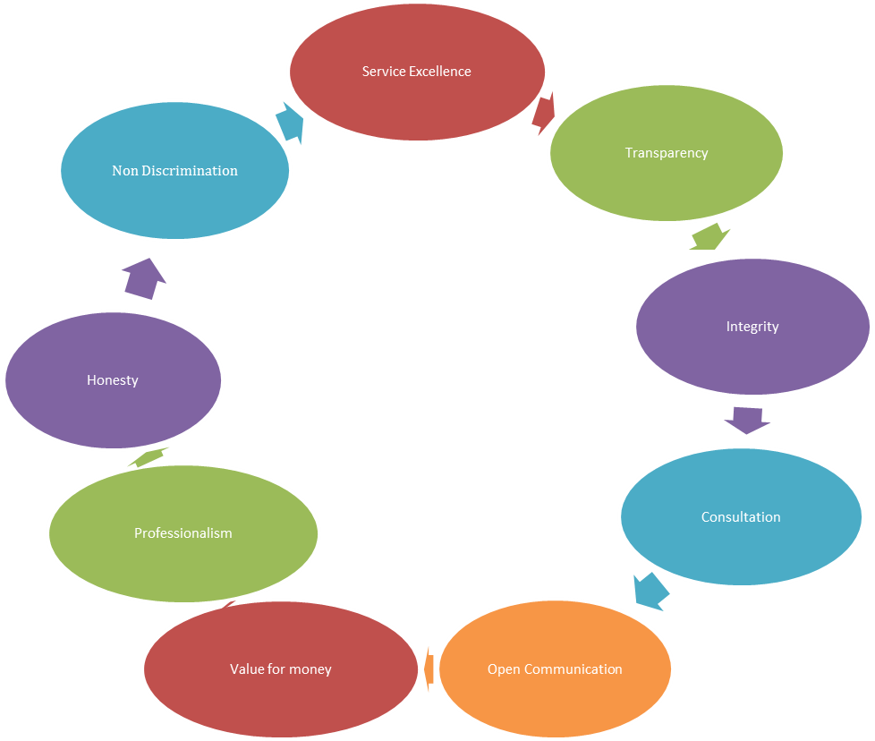
VALUES

Slide 6
PART B
PROGRAMME AND SUB – PROGRAMME PLANS

Slide 7
Programme 1: General Administration
Purpose
The General Administration component provides administrative support services to the Board, and the Secretariat as a whole.
The core functions of this component include:
Fleet management, logistics, registry and reception
Human Resources

Slide 8
STRATEGIC OBJECTIVES AND ANNUAL TARGETS
Strategic Objectives |  | Measurable Performance Indicator | Estimated Performance | Planned Performance | Medium Term Targets
 |  |  | 2017/18 | 2018/19 | 2019/20 | 2020/21
1. | Efficient resource management to ensure effective internal control systems in order to comply with legislative requirement | Number of Policies developed | 1 | 1 | 16 | 3 (HRM, BCP & LTRP)
 |  | Number of policies reviewed | New indicator | New indicator | - | 3 Disbursement. Fleet Management & IT policy
 |  | % vacancies filled within 120 days | New indicator | New indicator | 100% | 100%
 | Efficient resource management to ensure effective internal control systems in order to comply with legislative requirements | Audit outcome by AGSA | New indicator | Unqualified audit | Unqualified audit | Unqualified with no findings
 |  | % of undisputed invoices paid within 30 days of receipt by finance | 100% | 100% | 100% | 100%

Slide 9
QUARTERLY TARGETS 2019/20
Strategic Objectives |  | Measurable Performance Indicator | Estimated Performance 2017/18 | Quarterly Target
 |  |  |  | Quarter 1 | Quarter 2 | Quarter 3 | Quarter 4
1.1. | Number of policies developed |  | 16 | - | 4 | 3 | 9
1.2 | Number of policies reviewed |  | 3 | - | - | 3 | -
1.3 | Percentage vacancies filled within 120 days |  | 100% | 100% | 100% | 100% | 100%
1.4 | Audit outcome by AGSA |  | Unqualified audit opinion | - | Unqualified audit opinion | - | -
1.5 | Payment of undisputed invoices paid within 30 days of receipt by finance |  | 100% | 100% | 100% | 100% | 100%

Slide 10
Programme 2 : Real Estate
Purpose
The Real Estate Department has a number of sub – programmes. These are Land and Asset Management, Rural Development and Traditional Council support.
Programme Structure
The programme comprise of the following:
Land and Asset Management
Rural Development
Traditional Council Support

Slide 11
STRATEGIC OBJECTIVES AND ANNUAL TARGETS
Strategic Objectives |  | Measurable Performance Indicator | Estimated Performance | Planned Performance | Medium Term Targets
 |  |  | 2018/19 | 2019/20 | 2020/21 | 2021/22
2.1 | Provision of secure Tenure rights | Number of land tenure rights approved by the Board | 1450 | 1500 | 1550 | 1600
2.2. | Ensure effective land administration | Number of updates to the land holding register | 4 | 4 | 4 | 4

Slide 12
QUARTERLY TARGETS 2019/20
Strategic Objectives |  | Measurable Performance Indicator | Annual Target 2019/20 | Quarterly Target
 |  |  |  | Quarter 1 | Quarter 2 | Quarter 3 | Quarter 4
2.1 | Number of land tenure rights approved by the Board |  | 1000 | 200 | 400 | 200 | 200
2.2 | Number of updates to the land holding register |  | 4 | 1 | 1 | 1 | 1

Slide 13
SUB PROGRAMME: PROACTIVE LAND PLANNING
 | Strategic Objective | Programme Performance Indicator | Audited/ Actual Performance | Estimated Performance | Planned Performance | Medium Term Targets
 |  |  | 2017/18 | 2018/19 | 2019/20 | 2020/21 | 2021/22
3.1 | To ensure sustainable land planning which attracts investments on IT land | Number of Traditional Councils with development plans | 0 | 5 | 6 | 6 | 11
 |  | Number of community development initiatives implemented | New Indicator | New Indicator | 12 | 12 | 12

Slide 14
QUARTERLY TARGETS
Strategic Objectives |  | Programme Performance Indicator | Planned Performance | QUARTERLY TARGETS
 |  |  | 2019/2020 | Quarter 1 | Quarter 2 | Quarter 3 | Quarter 4
3.1 | To ensure sustainable land planning which attracts investment on IT land | Number of Traditional Councils with development plans | 5 | TOR finalized and approved. Service Provider appointed | Research and drafting of plans | 3 reports on traditional council development plans available | 2 reports on traditional council development plans available
 |  | Number of community development initiatives implemented | 12 | - | - | 12 | -

Slide 15
PART C
LINKS TO OTHER PLANS

Slide 16
PART C: CONDITIONAL GRANTS
Ingonyama Trust Board does not have any conditional grants; however transfer payments are received from the DRDLR based on a budget approval process.
NAME OF DEPARTMENT |  | MANDATE | OUTPUTS | CURRENT ANNUAL BUDGET | DATE OF NEXT EVALUATION
Department of Rural Development and Land Reform |  | Support the ITB in terms of the Ingonyama Trust Act, Act 3 of 1994 as amended | Land management and administration support | R 19,272 | Annually

Slide 17
PUBLIC – PRIVATE PARTNERSHIPS
No Public private partnerships exist as defined in terms of the PFMA.
NAME OF ENTITY | MANDATE | OUTPUTS | CURRENT ANNUAL BUDGET | DATE OF NEXT EVALUATION
Tongaat Hullet | Upliftment of the rural communities through the production of sugarcane in traditional areas | Improved production of sugar cane Capacity building for the traditional communities infrastructure development | Not quantifiable | Annually
Adamopix | Upliftment of the rural communities through agricultural production in traditional areas |  | Not quantifiable | Annually
Merensky | Upliftment of the rural communities through timber production in traditional areas |  | Not quantifiable | Annually

Slide 18
PART 2 INGONYAMA TRUST BOARD BUDGET 2019/2020
3 July 2019

Slide 19
CONTENTS
Background
Funding of the Ingonyama Trust Board – Historic review
Programmes of the Ingonyama Trust Board and the Ingonyama Trust
Income and expenditure of the Ingonyama Trust Board and Ingonyama Trust

Slide 20
BACKGROUND TO THE INGONYAMA TRUST BOARD
The Ingonyama Trust was created by the Kwazulu Legislative Assembly as a repository for the communal land of the Zulu Nation with His Majesty the King as sole Trustee .This was by way of the Ingonyama Trust Act 3 of 1994kz. In 1997 the democratic National Parliament amended this Act, so that it is consistent with modern constitutional order.
This amendment involved changes to all sections of the Act by way of the Kwazulu-Natal Ingonyama Trust Amendment Act No 9 of 1997. Importantly this Act established the Trust Board appointed by the then Minister of land affairs following a consultative process with the KZN Premier – in – Executive Council and the Chairperson of the KZN House of Traditional Leaders. The King remains the sole Trustee and he (or his nominee) chairs the Board. The 1997 amendment Act also excluded application of private trust legislation to the Ingonyama Trust.

Slide 21
BACKGROUND TO THE INGONYAMA TRUST BOARD CONT…
The effect of this amendment among others was to create a Board which is a separate and independent legal entity. The members of the Board are not trustees but are appointed by the Minister responsible for Rural Development and Land Reform.
The function of the Board is to administer the affairs of the Ingonyama Trust and Trust land. This is a unique situation since trusts are ordinarily controlled by boards of trustees.
The Ingonyama Trust Board is the Accounting Authority of the Trust.
Trust money and property is to be reported in terms of National Treasury regulation 14 and the Ingonyama Trust financial
regulations.
Treasury regulation 14 reads as follows: -
Responsibility for trust money and Property
For purposes of this regulation, trust money or property is money or property that does not belong to the State and that is held by an institution on behalf of other persons or entities in terms of a deed of trust or equivalent instrument that details the specific purposes for which it may be used.
The accounting officer, through the chief financial officer or a duly authorised agent, is responsible for the safekeeping and proper use of trust money and property, in accordance with the relevant deed of trust or equivalent instrument.
The institution, or its duly authorised agent, may charge a fee for the administration of a trust account at rates approved by the board of trustees or, in its absence, as agreed with the trustee. Such fees are payable from the trust account and are revenue accruing to the relevant revenue fund.

Slide 22
FUNDING OF THE INGONYAMA TRUST BOARD - HISTORIC REVIEW
Separate budgets are prepared and approved for the Ingonyama Trust and the Ingonyama Trust Board.
In terms of section 4 of the Ingonyama Trust Act, 1994 the Department is required to bear the administration cost of the Board.(Accounting Authority)
The Department has up to now not fully funded the Ingonyama Trust Board in terms of the said act.
A demonstration of the under-funding for the past four years is noted below.
Shortfall in the funding of the Ingonyama Trust Board for operational costs over the past four years
The transfer payment received from the Department for the Ingonyama Trust Board was based on an allocation of R 18 m for 2015/2016 increased to R 20.50 m for 2018/2019, hence resulting in an estimated shortfall of R 56.87 m for the past four financial years.
2015/2016 - R 8,50 m
2016/2017 - R 12, 60 m
2017/2018 - R 15, 27 m
2018/2019 - R 20.50 m
----------------
R 56.87 m

Slide 23
PROGRAMMES OF THE INGONYAMA TRUST BOARD AND THE INGONYAMA TRUST
Ingonyama Trust Board
Comprises of one programme - Administration
Ingonyama Trust
Comprises of two programmes
Corporate services and Financial administration programme
Land and Tenure management services

Slide 24
INCOME : INGONYAMA TRUST BOARD
 | Ingonyama Trust Board |  |  | Approved
 |  |  |  | Budget
 |  |  |  | 2019/2020
 | Income
 | Transfer Payment from Department of Rural Development and Land Reform |  |  | 21 489 000.00
 | Interest Income |  |  | 100 920.46
 | Additional funding |  |  | 44 026 732.42
 | TOTAL INCOME |  |  | 65 616 652.88

Slide 25
EXPENDITURE – INGONYAMA TRUST BOARD
 |  |  |  | Approved
 |  |  |  | Budget
 | EXPENSES |  |  | 2019/2020
 | Board Members' fees |  |  | 4 304 290.28
 | Board related Expenses |  |  | 1 027 291.48
 | Bank Charges |  |  | 17 286.18
 | Travel & accomadation & meetings |  |  | 2 548 582.49
 | Salaries ( cost based on employing persons on a phased in approach in respect of the new organogram) |  |  | 50 848 792.61
 | External audit fees |  |  | 1 747 364 .57
 | Internal audit fees |  |  | 284 106.37
 | Internal audit committee members' fees |  |  | 55 226.09
 | Stationery & other |  |  | 697 960.04
 | Motor Vehicle expenses |  |  | 445 283.85
 | Computer software/internet fibre costs |  |  | 316 500.00
 | Electricity and water |  |  | 616 380.00
 | Security expenses – ( Ingonyama Trust - Head office ) |  |  | 772 260.00
 | Telephone |  |  | 291 180.00
 | Cleaning |  |  | 759 600.00
 | General expenses |  |  | 77 911.75
 | Staff Training |  |  | 612 163.75
 | Office rental |  |  | 189 900.00
 | Depreciation - assets |  |  | 4 573.43
 | TOTAL EXPENDITURE |  |  | 65 616 652.88

Slide 26
Expenditure analysis of the Ingonyama Trust Board
Fixed expenditure of the Ingonyama Trust Board will be spent more or less consistently throughout the year.
Employees will be appointed in a phased in approach based on the needs of the entity in terms of the new organogram.

Slide 27
ECONOMIC CLASSIFICATION – INGONYAMA TRUST BOARD
ECONOMIC CLASSIFICATION | R millions
Compensation of employees ( includes cost of new organogram) employees to appointed on a phased in approach | 50,849
Goods and services | 14,768
Total | 65 ,617

Slide 28
GRAPHICAL PRESENTATION OF BUDGETED EXPENDITURE TO BE FUNDED BY THE ITB AND IT
 |  | 2019/2020
Ingonyama Trust Board |  | 28.37%
Ingonyama Trust |  | 71.63%
Total |  | 100.00%

Slide 29
TOTAL BUDGETED EXPENDITUREOF THE INGONYAMA TRUST BOARD AND THE INGONYAMA TRUST
 |  | 2019/2020
Ingonyama Trust Board |  | 65 616 652 .88
Ingonyama Trust |  | 165 644 249.24
Total |  | 231 260 902.12

Slide 30
INGONYAMA TRUST INCOME – PROJECTIONS
 | Budget
 | 2019/2020
Rental Income - non - mining |  | 38 682 862
Contractual Royalties |  | 1 087 246
Interest Income ( on Trust funds invested) |  | 18 933 947
Interest on overdue debtors account |  | 912 681
Special Projects Income |  | 146 200 000
TOTAL TRUST INCOME |  | 205 816 736

Slide 31
Ingonyama Trust
 | Approved
 | Budget
EXPENSES | 2019/2020
Corporate Services and Financial Administration ( programme 1 ) | 52 046 793.57
Advertisements | 447 510.62
Insurance ( of assets ) | 708 960.00
Legal fees ( illegal occupation of land/ legal opinions/safeguarding of IT land ) | 18 900 000.00
Bank charges | 70 689.96
Provision for doubtful debts ( debts owed to the Ingonyama Trust ) | 5 000 000.00
Capital expenditure - new infrastructure development at 65 Trelawney road | 15 000 000.00
Capital expenditure - vehicles | 2 500 000.00
Capital expenditure - Computer hardware | 615 000.00
Capital expenditure - Computer software | 1 200 000.00
Capital expenditure - furniture | 1 000 000.00
Depreciation ( assets ) | 4 311 637.36
Communication Expenses | 367 298.25
Asset tagging | 5 565.13
General,repairs, grass cutting and maintenance | 350 000.00
Computer software/Licencing | 545 382.25
Development of IT strategy | 150 000.00
Development of business continuity plan | 400 000.00
Review and maintenance of policies/ Strategies | 474 750.00
Land and Tenure Management Services (Programme 2 ) | 113 597 455.67
Land tenure management and planning projects | 6 645 445.00
Workshops ( with Traditional Councils and Amakhosi ) | 4 972 010.67
Rates provision(new rates on IT land ) | 95 000 000.00
Bursaries - Funda Zulu | 650 000.00
Business and Agricultural Projects ( food security ) | 6 330 000.00
Total Expenditure | 165 644 249 .24

Slide 32
Capital Expenditure
Total Capital expenditure Cost – R 20 315 000.00
Comprises of :
New infrastructure development at 65 Trelawney road – R 15 000 000.00
Vehicles - R 2 500 000.00
Computer hardware - R 615 000.00
Computer software - R 1 200 000.00
Furniture - R 1 000 000.00
Note : Capital expenditure is funded by the Ingonyama Trust

Slide 33
PART D
AMENDMENTS IN THE ANNUAL PERFORMANCE PLAN

Slide 34
Strategic Objectives applicable to Programme 1
New Strategic objectives
Strategic Objective 1.1 | Corporate Governance
Measurable Performance Indicator | Number of policies developed
Strategic Objective 1.1 | Corporate Governance
Measurable Performance Indicator | Number of policies reviewed
Strategic Objective 1.1 | Corporate Governance
Measurable Performance Indicator | % vacancies filled within 120 days
Strategic Objective 1.1 | Corporate Governance
Measurable Performance Indicator | Audit outcome by AGSA
Strategic Objective 3.1 | To ensure sustainable land planning which attracts investment on IT Land
Measurable Performance Indicator | Number of community development initiatives implemented

Slide 35
Thank You!

