Slide 1
Public Hearings on the Copyright Amendment Bill 2017 Parliamentary Portfolio Committee
1 August 2017 Dr. Tobias Schonwetter, Director: UCT IP Unit

Slide 2
[introductory remarks]
Notes:
Good morning, honourable members.
My name is Dr. Tobias Schonwetter and I am the director of the IP Unit in UCT’s faculty of law.
I want to start off by thanking you for the opportunity to present my views here on the Copyright Bill and I want to congratulate you and the dti on the transparent, open and inclusive way in which you are conducting this important law revision process. I have followed various such processes in other countries and regions around the world, and this one certainly stands out very positively.

Slide 3
[why we need to reform our copyright laws]
Notes:
No doubt, this week you will here a lot of doom and gloom (and also a quite of fearmongering I am sure) about the proposed revisions –
but I think it is worthwhile stressing right from the outset that this law reform presents us with a great opportunity and is indeed urgently needed to finally:
update our hopelessly outdated copyright legislation,
address some of its well-known short comings that have troubled us for long,
align it with international best practices,
recalibrate it to better reflect circumstances and challenges we face in South Africa; and
embrace digital technologies and seize the opportunities of a knowledge economy.

Slide 4
[the structure of this intervention]
Notes:
Now, I want to divide up my 20 minutes or so into 2 main parts:
First, I think it is crucial to make a number of general comments which in my opinion are essential for the members of this committee in order to assess the merits and legitimacy of the many comments and views that will be presented to you during the next 3 days.
There are, of course, benefits in speaking at the beginning like I do - but the risk is also that others do have the ”last word”. But it is my hope that during the next days you keep some of my general comments somewhere on the side of your desk as some sort of a checklist to evaluate the views voiced here.
In the second part of my presentation, then, I will hone in on some of the specifics of the Copyright Bill.

Slide 5
The overarching purpose of copyright protection from a law and policy makers perspective:
Reward and incentivise creativity to create maximum levels of creativity!
Notes:
The first general point I wish to make is that, contrary to what I read & heard in some of the comments to the Bill (also on the radio), the overarching objective of copyright law has never been and hopefully will never be to maximise private profits. And it is certainly not an end itself. Instead, we provide for copyright protection (or differently put: time-limited monopolies on knowledge materials and cultural goods) to reward creators for their creativity and, in doing so, to incentivise creativity so that people are sufficiently incentivised to create at maximum levels for the benefit of society at large.
We refer to this as the utilitarian nature of copyright protection.

Slide 6
Over and underprotection are equally harmful in that they both prevent optimal levels of creativity.
What we are really after here is finding just the right balance between protection on the one hand and access and openness of the system on the other.
Notes:
My second, related, point is that that both over and underprotection are equally harmful in that they both prevent optimal levels of creativity. So, what we are really after here is finding just the right balance between protection on the one hand and access and openness of the system on the other.
And especially the latter part tended to be overlooked in both international and domestic lawmaking in the past - and if I understand the dti’s remarks about this being an access-driven initiative, this Bill seeks to remedy this. And this is good!

Slide 7
Context matters!
We need a tailored law that is cognisant of what is happening on the ground in this country, including and especially in areas outside of our larger cities.
A copyright law that aims to address and help solve some of the very unique challenges we as a country face, for example in the educational sector and those faced by creators in this country.
Notes:
Thirdly, context matters!
We are a developing country facing very unique challenges, so we DON’T need is, well, a “copy” of copyright legislation from overseas that might, if at all, speak to circumstances found to be in the Sandtons and so forth of this country.
Instead, what we really need is a tailored law that is cognisant of what is happening on the ground in this country, including and especially in areas outside of our larger cities; i.o.w.: a copyright law that aims to address and help solve some of the very unique challenges we as a country face, for example in the educational sector and those faced by creators in this country.

Slide 8
The plight of and difficulties faced by many SA creators.
This is a real and existential problem and we must find ways of tackling it.
But the vast majority of concerns expressed by real grassroot creators are often actually not copyright issues but issues related to unfair competition, abuse of privacy rights, defamation and issues resulting from exploitative contract clauses in agreements concluded by them.
Notes:
This brings me to my forth, and penultimate, general point:
the plight of and difficulties faced by many South African creators.
This is a real and existential problem and we must find ways of tackling it. And copyright certainly has some role in this.
However, the vast majority of concerns expressed by real grassroot creators – not intermediaries!! – were often actually not copyright issues but issues related to unfair competition, abuse of privacy rights, defamation and – most often in my impression – issues resulting from exploitative contract clauses in agreements concluded by them with, for example, some publishers or record labels.

Slide 9
As far as protection is concerned, our current copyright law already is in full compliance with all major international copyright instruments that we are bound by
Pretty much everything that should be illegal under copyright already is illegal.
The real problems are related to the enforcement
If anything, too many things are now illegal because of advances of technology that weren’t anticipated in the 1970s
Notes:
I would go as far as saying that since our current copyright law is already in full compliance with all major international copyright instruments that we are bound by (incl the TRIPS agreement and the Berne Convention), pretty much everything that in all our views should be illegal under copyright already is illegal.
The real problems are related to the enforcement of these rules - which is a different discussion altogether of course - and that arguably too many things are now illegal because of advances of technology that weren’t anticipated in the 1970s (such as copying a legally bough CD onto an MP3 player).

Slide 10
Distinguish the real copyright issues from the many smokescreens.
Who really benefits from the current system and who lobbies the loudest to oppose change and retain the status quo?
Notes:
So my plea to the honorable members here is to be alert at all times and distinguish the real copyright issues from the many smokescreens that have been created by the main beneficiaries of the current system.
And this, in fact, is my last general point really.
The current copyright system seems to have disenfranchised many local creators and users alike while it, in many instances, strengthened overseas rightsholders and intermediaries. And my observation is that these main beneficiaries now fight the Bill the hardest and sometimes under the pretence of being a voice for South African creators, even though some of them – according to the Farlam report – have in the past added to some of the grievances of creators in South Africa.

Slide 11
Select specific points with regards to some of the provisions proposed in the Bill. [ Much more detail in our written submission (http://bit.ly/2u0SU5T) ]
In several provisions, the term ‘rights owner’ should be used instead of ‘author’
A less complex definition for ‘person with a disability’
“People with disabilities" means people who have a long-term or recurring physical or mental impairment which substantially limits their ability to access and use a work without an accessible format."
Amendment of clause dealing with state-funded IP, s5
"Copyright shall be conferred by this section on every work which is eligible for copyright and which is made by, or funded and [emphasis added] made under the direction or control, of the state. . ."
Notes:
Now, during the remaining minutes of my presentation I wish to make a couple of specific points with regards to some of the provisions proposed in the Bill.

Slide 12
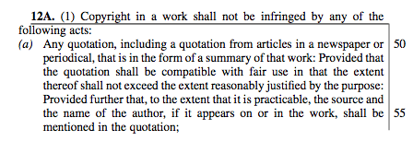
A comma needs to be deleted from the Quotation right in s12A(1) to not unduly limit its application

Slide 13
Open licences
Open licences such as Creative Commons licences facilitate the voluntary waiver of rights holders of some of their rights to enable access and sharing. More than 1 billion works are already shared that way and the concept provides the legal basis for access-enabling open access, open science similar initiatives. It is important that the law encourages and supports this, and the revised s39B(2) is therefore crucial as s39 in its previous form seemed to prevent this. However, s39B(2) needs further fixing:
"(2) This section does not prohibit or otherwise interfere with public and open licences or voluntary dedications of a work to the public domain."
Parallel importation
Nowadays, there should really be nothing preventing us from purchasing legally produced books from, say, India or China at cheaper prices and import them into South Africa. In practice, however, current copyright laws severely impede this flexibility. We therefore welcome s12B which does away with restrictions on parallel importation and thereby limits questionable territorial rights practices employed by some publishers.
Freedom of panorama
If compared to other countries, less information about modern South Africa is available to a global audience via popular digital media such as Wikipedia due to undue limitations on the use of public artworks. We therefore support calls for inserting a so-called ’Freedom of Panorama’ provision into our copyright law.
More information on this is contained in Wikimedia SA’s submission on presentation (http://bit.ly/2hb5Ct0) .

Slide 14
5 minutes on Fair Use!

Slide 15
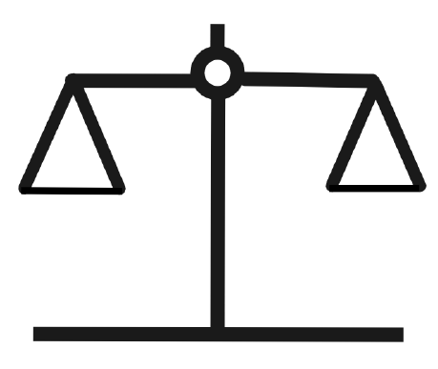
To reward creators and incentivise and maximise creativity, copyright law must strike a fair balance between the interests of rights holders and users/the public interest.
The Copyright contains numerous rights for rights holders, and user/public rights are safeguarded through so-called copyright exceptions and limitation (or “users rights”).

Slide 16
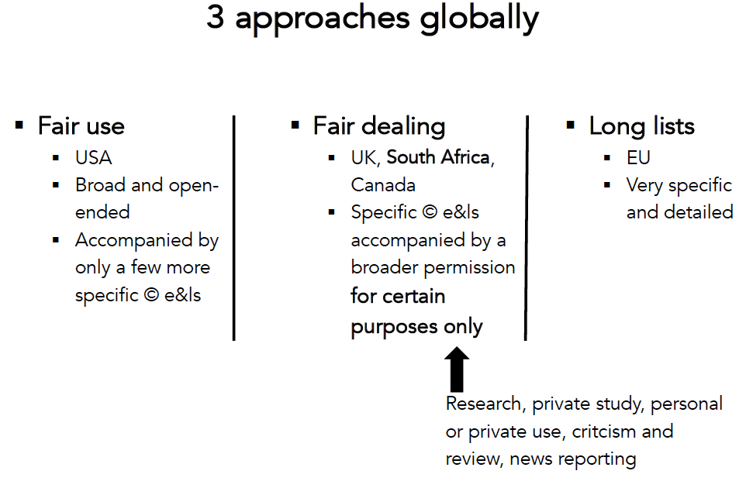

Slide 17
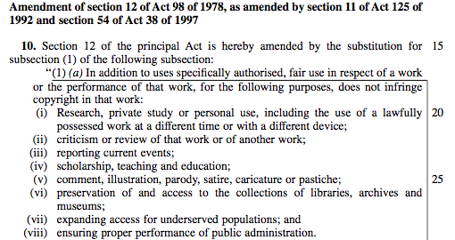
“for purposes such as”

Slide 18
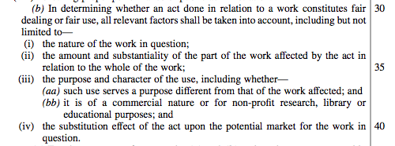

Slide 19
The key advantage of fair use vis-à-vis the other approaches is its flexibility, which, among other things:
allows equitable case-by-case decisions;
makes it futureproof and therefore avoids regular revisions of the law as a result of, eg, new technologies;
facilitates innovation and supports innovative business models

Slide 20
Points raised against fair use
It only takes one case to create precedent; general problem of litigation, not just fair use; with caution, guidance from overseas can be used; if anything, this might create a problem for users, as creators’ need to seek help from the courts isn’t affected by broader e&l such as fair use; based on overseas experiences: abuse of fair use doesn’t seem to be a real world problem
Relies to heavily on litigation, which is problematic in SA as it is expensive and cumbersome
Whoever makes this claim has not understood fair use; fair use it not a carte blanche for free use; it is not fair use if the use deprives the owner of revenue by substituting for the need of buying (see fairness factor 4)
It will destroy licensing revenues for copyrighted works
See the point about fair use not destroying licensing revenues; US publishers no longer make such claims; Canada has far dealing (what we have now) not fair use; key reasons for the struggles of academic publishers in Canada include: reduced government spending & non-adaptation of business models to digital technologies.
Fair use promotes piracy
It will destroy the publishing industry (and has done so in Canada).
??? ; fair use makes certain uses legal and is therefore unrelated to (or the opposite of) piracy (illegal use)

Slide 21
Points raised against fair use
No, it will create flexibility needed to better respond to rapid (technological) change. This avoids regular updating of our law in the future. Complete legal certainty is unattainable. The current law is already uncertain and vague; in the US only a few leading cases were necessary to interpret the law (which could be considered until we have our own cases), grassroot stakeholders have created helpful guidelines
Fair use will cause uncertainty in the law
There is nothing new, unlawful or unconstitutional (see s36 of the Constitution) about limiting the owner’s property right by balancing it with legitimate usage rights of users – this, btw, already happens through existing existing exceptions and limitations and through, eg, time limits for protection.
Fair use violates the right to property

Slide 22
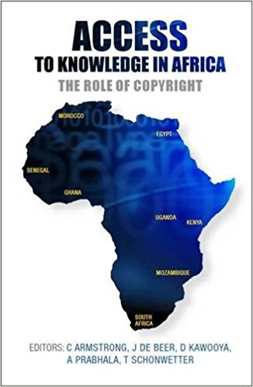
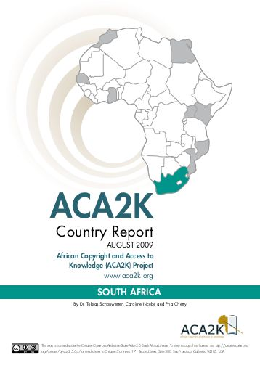
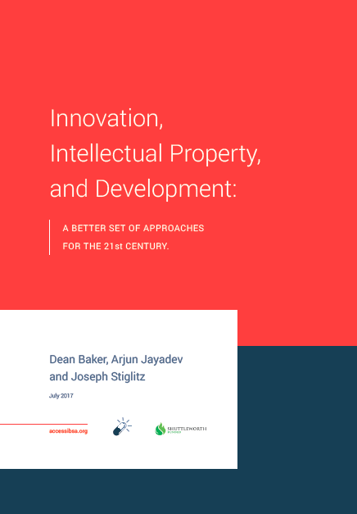
Research-based evidence

Slide 23
”the ‘weightless economy‘ - the economy of ideas, knowledge and information - will become an increasingly important fraction of economic output and ever more important for economic growth and development, both in developed and developing economies.”
” If the knowledge economy and the economy of ideas is to be a key part of the global economy and if static societies are to be transformed into ‘learning societies’ that are key for growth and development, there is a desperate need to rethink the current regime and to allow for a much less restrictive flow of information and knowledge. Moreover, if we are considering questions of ethics, the current regime is deeply regressive and inefficient”
“A fundamental component of the right to education is access to high quality textbooks and other learning materials… Copyright is one of several factors contributing to the cost and scarcity of learning materials in developing countries.”
“Copyright must be calibrated so as to remove unjust barriers to access, and to ensure that the most vulnerable among us can access the vast opportunities that a high-quality education provides.”

Slide 24
Lawmaker Checklist
Is this really a copyright issues?
Is the problem raised really a result of insufficient copyright protection – or, instead, lack of enforcement and unequal power dynamics?
Is the issue complained about a result of the current law or a predicted result of the proposed amendments?
Is the solution presented tailored to South Africa’s needs and circumstances?
Is the solution in line with international instruments that SA is bound by (or intends to join soon)?
Is the solution backed up by solid empirical evidence – or are these just unfounded claims?
Is the solution presented modern, forward-looking and future-proof or predominantly aimed at preserving the status quo?
Is what is proposed maximising creativity and advancing development in South Africa?
Does it help local creators or, rather, serve the interests overseas and local rightsholders and intermediaries?

Slide 25
Creative Commons Licence
This presentation is the work of Dr. Tobias Schonwetter.
It is licensed under a
Creative Commons Attribution-ShareAlike 4.0 international License.
To view a copy of this license, visit
http://creativecommons.org/licenses/by-sa/4.0/

Slide 26
Thank you!
tobias.schonwetter@uct.ac.za
@tobyschonwetter

