Slide 1
Presentation of the Revised Strategic Plan 2015/2020 and APP 2017/18 Portfolio Committee
Acting Director General: Tshediso Matona- Overview
04 May 2017

Slide 2
Introduction
The vision of DPME is to facilitate, influence and support effective planning, monitoring and evaluation of government programmes for service delivery, and socio-economic transformation, as outlined in the National Development Plan (NDP).
This is done by planning for and monitoring the implementation of the NDP through the Medium Term Strategic Framework (MTSF)
The work entails :
establishing systems, policies, guidelines, frameworks and processes for planning in government as a whole to influence the planning philosophy of the country. Currently the focus is on National and Provincial spheres of governments (and should be extended to municipal sphere);
developing requisite institutional capacity for planning (institutionalisation of planning across government);
developing evidence-based plans that draw on monitoring and evaluation and other data sources;
ensuring that planning sets the priorities that inform the allocation of resources;
monitoring and evaluation of the implementation of the plans and reporting on progress being made; and
supporting interventions to unblock service delivery challenges.

Slide 3
Revised Strategic Plan 2017-2020 and APP 2017-18
To support the vision, DPME engaged in a strategy and organisational review exercise to align its delivery strategy mandate
The process resulted in the development of a limited number of strategic objectives and associated departmental outputs and the revision of the strategic plan for the remainder of the planning cycle and the realignment of the APP 2017/18
The outcomes that the Department seeks to achieve are as follows:
Policies, Plans and Budget of government departments and entities are aligned with NDP priorities
Effective M&E of implementation of government policies and plans
Youth development mainstreamed across government
Broader society is mobilised and engaged in the advancement of NDP/MTSF
The strategy and organisational review resulted in the increase of programmes from 5 to 7 and posts from about 310 to 447

Slide 4
DPME SERVICE DELIVERY MODEL
Alignment of Plans with Budget aligned to NDP
Govt. Wide M&E
CAB Dec 2015
National Planning Commission(NPC)
Assessing Achievement (Evaluations and Outcome Monitoring)
Communication and engagement
Diagnosing
Planning
Implementation (Outputs)
Achievements (outcomes)
Gather evidence on what is needed:
Research
Evaluation
Using Admin data
Long Term Trends
Sector Expertise
Sector Debate
Communication and engagement
Agenda NDP/MTSF
Sustained Agenda= Institutionalisation of planning, Implementation monitoring and Evaluation of impact of govt. policies programmes
Develop policies and plans:
MTSF(Outcome Plans)
Dept. Plans
Programme Plans
Budget Prioritisation (cabinet Lekgotla decision0
Communication and engagement
Monitoring Implementation
Feeding Lessons Monitoring
Identify Areas to Unblock
Communication and engagement
MPAT & CBM
Data and Knowledge Systems= Evidence . Tools (MPAT; LGMIM; FSDM; Phakisa; CBM;

Slide 5
Key Strategic objectives
Strategic Objectives | Goal statement
To facilitate and coordinate macro and transversal planning across government and coordinate planning functions in the department | Promote coherent policy making, planning and implementation of government programmes Facilitate the development of medium and long-term plans in all spheres of government Provide oversight, direction and regulation in respect of strategic and annual performance planning in government Develop high level planning frameworks to guide the detailed planning in departments, government agencies as well as provincial and local government Engage different sectors of society on planning process to solicit input and secure buy-in.

Slide 6
Key Strategic objectives (2)
Strategic Objectives | Goal statement
Develop, facilitate, support and monitor the implementation of sector plans and intervention strategies | Coordinate and manage by monitoring and reporting of progress on implementation of government priorities aimed at achieving NDP priorities and evaluating impact Integrate and coordinate planning, implementation, performance monitoring and evaluation in order to achieve prioritised outcomes Maintain a system of monitoring performance of departments and Ministers on behalf of the President Advise and support political principals/Presidency on strategic matters, including Cabinet memoranda and other key issues and initiatives Support departments, other spheres of government, clusters and Cabinet committees to identify and address blockages in achieving government objectives by applying appropriate methodologies, such as Operation Phakisa Conduct evaluation and policy research on key government programmes in support of the Government-wide Monitoring and Evaluation System

Slide 7
Key Strategic objectives (3)
Strategic Objectives | Goal statement
To support the implementation of the medium-term strategic framework by monitoring and improving the capacity of state institutions to develop and implement plans, and provide services | Review, monitor and support the implementation of the medium term strategic framework’s chapters relative to capacity of national and local government department and entities. Develop and implement intervention strategies and programmes, as required Coordinate capacity development programmes to ensure the effective development and application of planning, monitoring and evaluation policies, tools and guidelines Develop and promote good Monitoring and Evaluation practices Assess management practises and service delivery in government by developing and applying appropriate tools
To facilitate service delivery improvements through frontline and citizen-based monitoring and effective complaints resolution systems | Expand frontline monitoring, citizen and community monitoring and complaints resolution systems capable of verifying government performance and implementing strategic interventions to improve performance Involve citizens in monitoring of government services at selected facilities

Slide 8
Key Strategic objectives (4)
Strategic Objectives | Goal statement
To coordinate and support the generation, collation, accessibility and timely use of quality evidence to support performance monitoring and evaluation across government | Provide evaluation, research, knowledge management and data integration and analysis services Provide support to the Department and government on evidence-based planning and monitoring and evaluation
To oversee youth development policy and its implementation. | Facilitate the development and implementation of national youth policies, strategies and program Transfer of funds to the National Development Youth Agency.

Slide 9
Key APP commitments for 2017-18
The key focus for the APP for 2017-18 for the current financial year is on :
Coordination of macro-planning to ensure policy coherence and to support the implementation of the NDP priorities through the MTSF;
Coordinate micro-planning through facilitation of the development of strategic sector specific plans to ensure attainment of sustainable development goals; eg water and energy sectors plans;
Assess and support alignment of strategic and annual plans of national and provincial government departments with the NDP/MTSF, and other priorities such as the Nine Point Plan;
Assess and support alignment of national budgets to the NDP/MTSF and other government priorities;
Monitor and evaluator the impact and return on investment of government programmes such education, health, infrastructure towards the NDP goals of addressing poverty, unemployment and inequality, and outline remedial interventions.

Slide 10
Key APP commitments for 2017-18 (2)
Expand on-the-ground monitoring through programmes such as the Frontline Delivery Monitoring visits and Presidential Hotline.
Continue to roll-out other monitoring initiatives such as:
payment of suppliers within 30-days of receipts of receipts of valid invoices;
reforms in mining towns and labour sending areas;
Monitoring of management practices through the Management Practices Assessment Tool (MPAT);
Monitoring of selected municipalities using Local Government Monitoring Tool.
Promote mainstreaming of youth development initiatives into the plans of government
Implement of Operation Phakisa initiatives to unlock critical service delivery challenges

Slide 11
Focus for 2017-18 (1)
Institutionalising planning in government
A planning policy document setting out broad planning reforms, including, developmental role of planning, problem-solving and strengthening the link between planning and budgeting
Transfer Spatial and Land-use Management Act (SPLUMA) to DPME
A Proclamation has been prepared and agreed to by Ministers of all departments
Officials working on details of resources, finances, etc. implications
Commission started a consultation process on NSDF development
Government Performance Information
Government performance Information function ‘moved’ from National Treasury to DPME. The shift requires formalization/proclamation
Finalised revised medium and short-term planning framework

Slide 12
Focus for 2017-18 (2)
Mid-term review of MTSF
Undertake a mid-term review of the MTSF outcomes for period 2014-2019
Since 1994, Government at critical intervals of each administration (term of office) reflects on progress towards electoral goals
Government has previously conducted and published a 5-year review; 10-year review; 15-year review and 20-year review of its performance and service delivery to the people
In-between these milestones, government has conducted internal mid-term performance reviews
This approach is consistent with the results-based approach for monitoring and evaluation
The report will be tabled by the DPME at the July 2017 Cabinet Lekgotla

Slide 13
Focus for 2017-18 (3)
Implementation of the revised organisational structure and budget structure
Change management
Filling of critical vacant posts

Slide 14
MACRO-STRUCTURE

Slide 15
DPME Budget 2017/18

Slide 16
Budget: 2016/17 and 2017/18
Budget / Expenditure ('000) | 2016/17 |  |  |  | 2017/18
 | Budget | Exp. | Saving | % Spent | Budget
Compensation | 216 367 | 202 190 | 14 177 | 93.4% | 268 937
Goods &Services | 125 637 | 124 721 | 916 | 99.3% | 137 254
NIDS | 40 776 | 40 776 | - | 100.0% | 65 557
Capital | 8 824 | 7 443 | 1 381 | 84.3% | 18 942
Transfers | 406 058 | 406 058 | - | 100.0% | 432 806
TOTAL | 797 662 | 781 188 | 16 474 | 97.9% | 923 496
Saving on compensation due to delays in implementing new organisational structure
Saving on capital expenditure due to delay in DPW sourcing additional office accommodation for Department

Slide 17
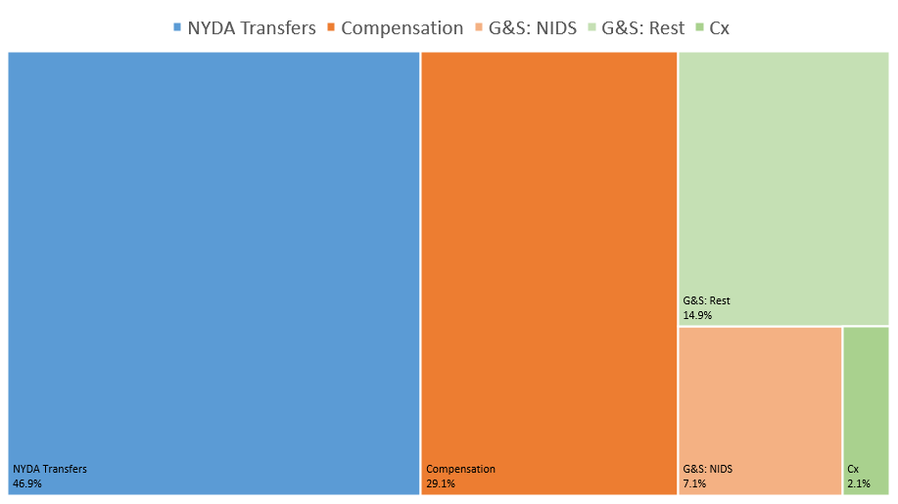
Budget Allocations 2017/18

Slide 18
G&S Cost Drivers: 2017/18
Item | Budget (‘000)
NIDS | 65 557 | 32.3%
Travel & Subsistence | 35 254 | 17.4%
Professional Services | 23 340 | 11.5%
Comp. Services: Hotline | 13 128 | 6.5%
Comp. Services: Department | 11 237 | 5.5%
Operating Leases | 15 840 | 7.8%
Operating payments | 6 393 | 3.2%
Venues, catering | 6 069 | 3.0%
Communication | 5 688 | 2.8%
Advertising | 4 022 | 2.0%
Property payments | 4 000 | 2.0%
Training and Bursaries | 3 500 | 1.7%
Audit costs: External | 2 600 | 1.3%
Rest | 6 183 | 3.0%
Total | 202 811 | 100%
Professional services: Evaluation and research projects (R20m), payment of NPC commissioner retainers (R2.5m), Once-off outsourced HR functions related to new structure (R0.8m)
Computer services Department: Includes payments to SITA (R4.2m) for data lines and server space, external service providers (R1.4m) for website and applications hosting as well as annual software licenses (R4m) and provision for new building cabling etc. (R1.6m)
Operating leases: Building rent
Venues/Catering: Additional office space will reduce requirement for external venues
Communication: Payments to Telkom and mobile service providers
Advertising: Remainder of NDP campaign (R2m), marketing campaigns (R1m) and advertising of news posts and tenders (R1m)
Property payments: Cleaning services, security services, water and electricity.

Slide 19
Allocation per programme: 2017/18

Slide 20
Allocation per programme: 2017/18

Slide 21
Administration: 2017/18

Slide 22
Questions and Discussions

Slide 23
Ke a leboha Ke ya leboga Ke a leboga Ngiyabonga Ndiyabulela Ngiyathokoza Ngiyabonga Inkomu Ndi khou livhuha Thank you Dankie

