Slide 1
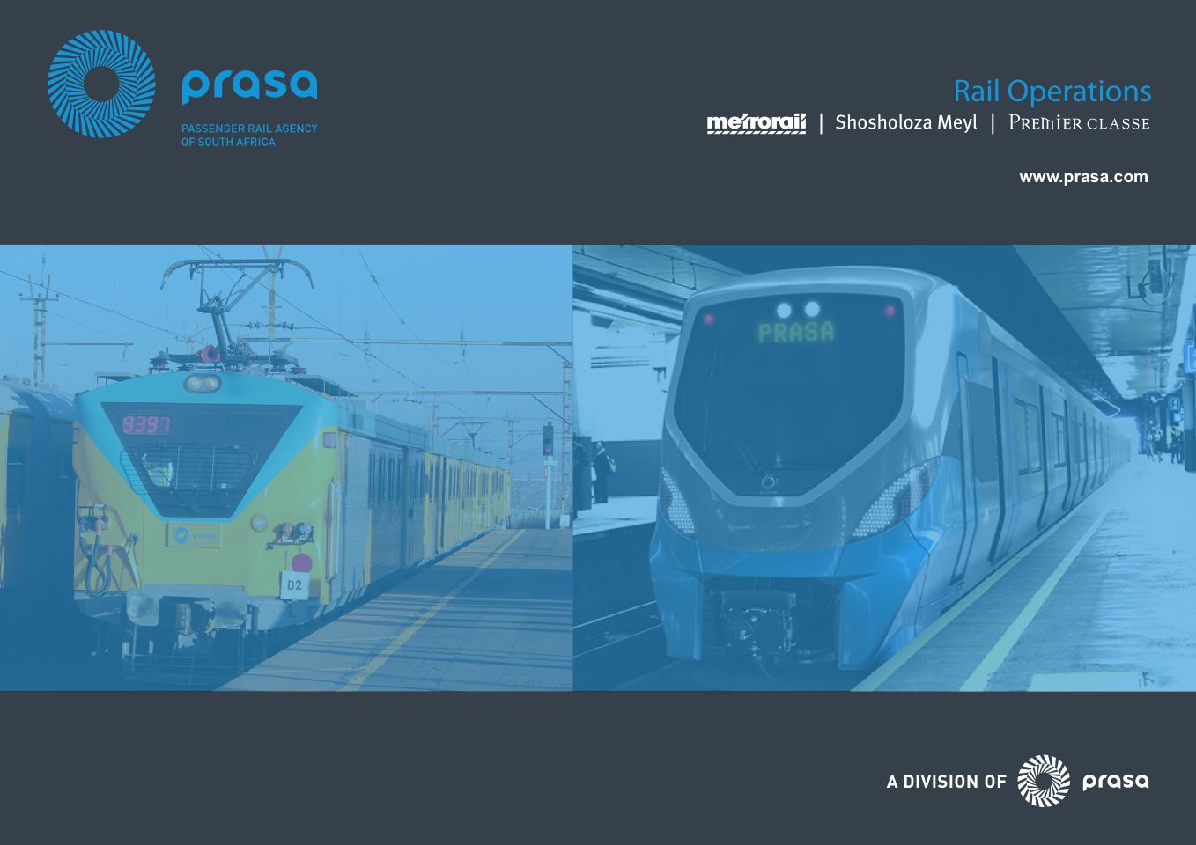
SERVICE DELIVERY OF METRORAIL
Presented to
PORTFOLIO COMMITTEE ON TRANSPORT
7th MARCH 2017

Slide 2
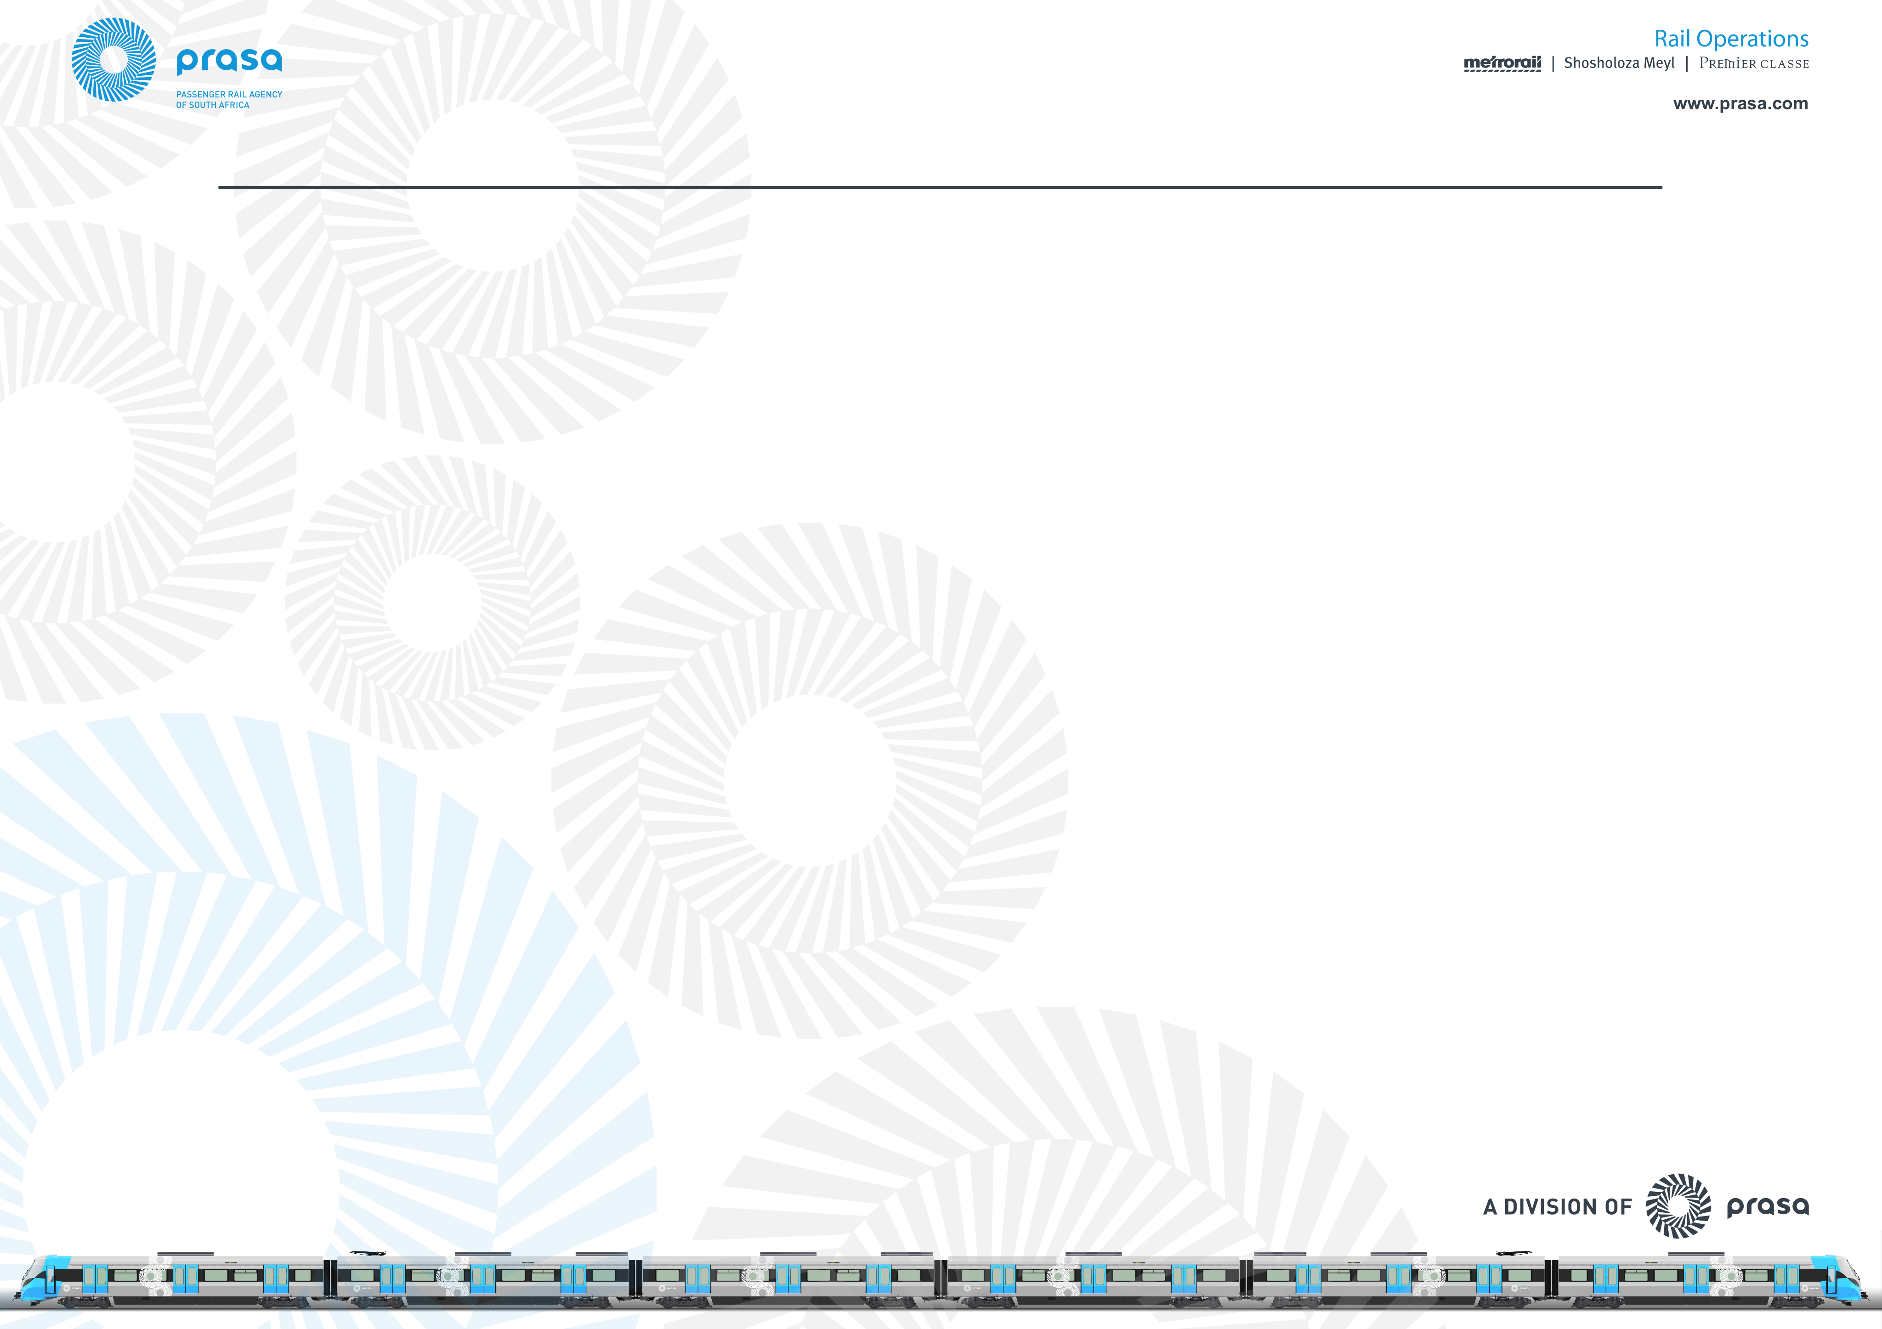
Contents
Background (Operations problem statement)
Current performance
Key interventions (Operations/Engineering Turn-Around)
Rolling Stock/Infrastructure focus – capacity constraints

Slide 3
Operations – Problem statement
Unreliable Service
Customer Service
Revenue Management
Supervision
Security
Maintenance of Rolling Stock and Infrastructure
Trains are not starting nor completing journeys as per schedule
Frequent failure of rolling stock – currently 40% of fleet is out of service
Perway, signaling & electrical continue to fail
Timeous maintenance not undertaken
Lack of communication to the customer
Inadequate focus on customer service
Safety of Passengers is highly compromised
High occurrences of vandalism
High levels of cable theft
Revenue leakage is recorded due to manual collection of cash, access control, open system etc.
Supervision is lacking at all levels of operations

Slide 4
PRASA Rail Performance – 3rd Quarter 2016
METRORAIL | 1st Quarter |  | 2nd Quarter |  | 3rd Quarter
 | TARGET | ACTUAL | TARGET | ACTUAL | TARGET | ACTUAL
Metrorail Trips | 117,3m | 93,88m | 117,6 | 99,17m | 109,62m | 90,3m
Metro On-time | 82% | 77,2% | 82% | 79,4% | 82% | 77,56%
Metro Availability (Cancellations) | 96% | 91,8% | 96% | 91,9% | 96% | 92,63%
Metro PPM | 85% | 70,9% | 85% | 73,0% | 85% | 71,84%
Infra Reliability | 80% | 76% | 80% | 80,0% | 80% | 80%
Infra Availability | 93% | 71% | 93% | 71% | 93% | 70%
Impact speed restrictions (on-time) | 0,35% | 0,61% | 0,35% | 0,63% | 0,35% | 0,71%
Rolling Stock availability (sets) | 260 | 245 | 276 | 240 | 279 | 242
Rolling Stock availability (fleet availability) | 70% | 64,4% | 70% | 60,2% | 70% | 66,0%
Sets running short configuration | 40% | 47,7% | 40% | 55,4% | 40% | 58,6%
MDBF Rolling Stock | 800km | 771km | 1 000km | 779km | 1 000km | 648km

Slide 5
PRASA Rail Performance – 3rd Quarter 2016
SAFETY AND SECURITY | 1st Quarter |  | 2nd Quarter |  | 3rd Quarter
 | TARGET | ACTUAL | TARGET | ACTUAL | TARGET | ACTUAL
Security Incidents Assets | 775 | 752 | 773 | 936 | 773 | 936
Security Passenger Incidents | 120 | 119 | 129 | 154 | 129 | 153
Passenger Injuries and Fatalities | 542 | 398 | 542 | 260 | 542 | 459
Public Injuries and Fatalities | 136 | 162 | 136 | 173 | 136 | 170

Slide 6
CUSTOMER DISSATISFACTION - DECREASING CAPACITY AND POOR SERVICE

Slide 7
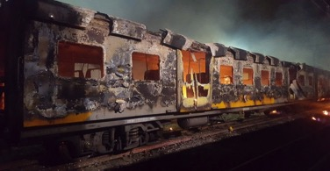
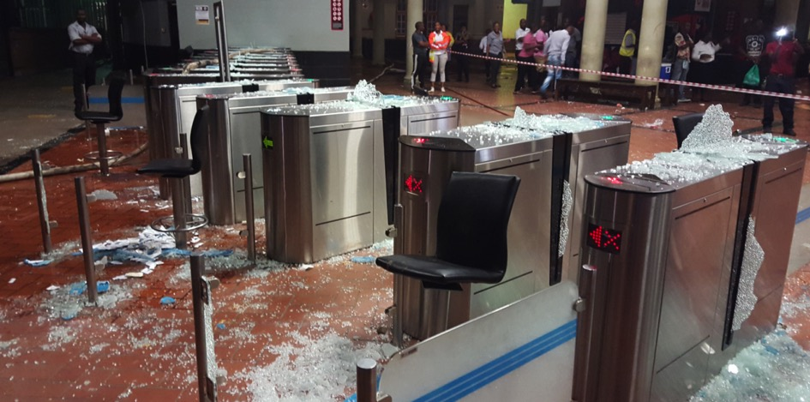
PRASA Assets under Siege since 2013
Including commuter backlash as a result of train delays and/or ancellations
Over the last four years PRASA has suffered and recorded the following incidents relating to theft and vandalism on Rolling Stock and Infrastructure, train fires – commuter backlash and service delivery protests:
2013
1 621 incidents
2014
2 568 incidents
2015
1 773 incindents
2016
470 incidents (Jan- April)
Estimate 2016/17: 1830

Slide 8
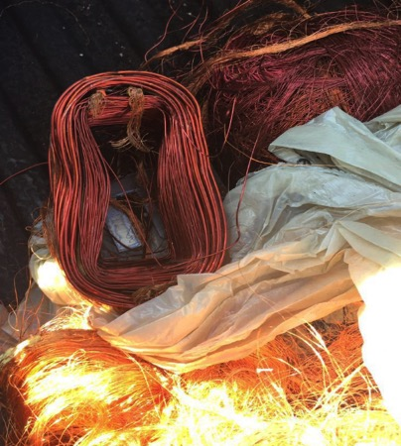
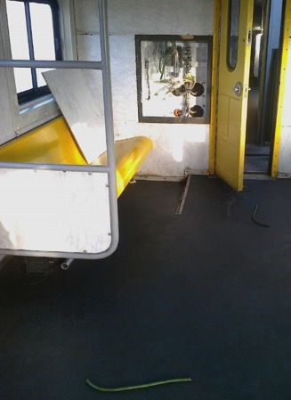
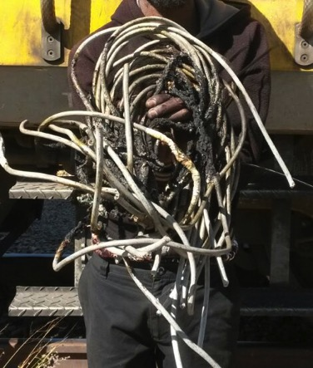
Crimes on PRASA Assets: Cable Theft Incidents

Slide 9
Turn-Around Plan
Turn Around Plan
Aimed at stabilising the organisation and addressing the issue of its poor offering and financial distress. Our customers require a reliable, safe, clean and dignified service. The Plan will assist PRASA to achieve the objectives.

Slide 10
PRASA Turn-Around Interventions
Operational Turn-Around
Engineering (Technical) Turn-Around
Human Capital Turn-Around
Property portfolio Turn-Around
Systems and processes Turn-Around
Finance and funding Turn-around

Slide 11
Operations Turn around Plan in perspective
Rail Service
Operations/Timetable/Capacity
2008/09
Rail Service
Rolling Stock
2016/17
Rail Service
Rolling Stock
2017/18
Rail Service
Rolling Stock
88% OTP
650m p/annum
3585 coaches
Infra (P/E/S)
Avl 90/90/60 (%)
Rel 42/49/2.7 (hr)
78% OTP
±380m p/annum
2750 coaches
Infra (P/E/S)
Avl 91/92/58 (%)
Rel 25/27/2.4 (hr)
88% OTP
457m* p/annum
3500 coaches
Infra (P/E/S)
Avl 94/94/74 (%)
Rel 33/37/4.27(hr)
Safety Management System
(Operational safety/ human
factors)
Securitisation of the system.
Transport (Rail) System
Rolling Stock
Infrastructure (P-Perway, E-Electrical, S-Signals & Tel)

Slide 12
Objective of the Operations Turn-Around Plan
Objective: Service restoration/improvement to 2008/09 service levels. Provide predictable service within current capacity constraints over short term (12 months), as measured by increased ridership, customer satisfaction and efficiency ratios.

Slide 13
Summary of Operations Turn-Around Plan
  Service redesign to ensure demand driven services according to customer travel needs, and ensuring a predictable service with easy understandable time table in the form of regular head ways around the hour (i.e. every 15 minutes in the peak, or every 30 minutes in the off peak).
  Customer responsiveness through listening to customers, dignified treatment of customers and communicating to customers. Using various communication and digital channels for customers to understand services, buying tickets and be kept informed on status of services, as well as improving customer experience on-board and at stations.
  Improve supervision and control in key areas such as security, train operations and station operations to ensure efficiencies aligned with peak period demands.
  Revenue improvement plan to ensure customers can obtain/pay for tickets and tickets are verified to reduce fare evasion through technology assisted automation. The revenue and cost coverage improvement program also includes efficiency initiatives to optimise and reduce costs to impact on the bottom line.

Slide 14
Summary of Operations Turn-Around Plan
Engineering support (providing rolling stock and infrastructure), together with Security services and the Safety Management System will ensure an integrated approach to the management of the system to deliver quality and safe service to customers.
Sustainability of the Operations Turn around plan:
The turn-around plan will provide the basis and catalyst to address the longer term operating model improvements of improved systems, processes and HCM capacity to sustain the turn-around into the future.

Slide 15
Improving Customer Experience
Marked improvement in customer experience as measured against customer satisfaction and driven through the following Action Plans:
Functional communication platforms such as Integrated website(s), Prasa Smartphone Applications (APPs), Social Network, Public Address systems and Loudhailers
Integration of Railcom / ISAMS to provide commuters with real time service level information
Establishment of Customer Desks at Key Stations
Integration of Call Centers for Metrorail/MLPS and Autopax
Driving the total station management programme that ensures accountability at a frontline level for service performance.

Slide 16
Improve Rail System Performance.
Reverse the current operational performance and improve service offering to the users of the rail system.
Marked improvement in operational performance levels to restore to the 2008/09 levels through :
Service Predictability by introducing a Regular/Clock-face timetable for peak/off-peak service, introducing inner / outer services.
Marked improvement in financial performance and sustainability through
Fare revenue collection by monitoring revenue budgets for high level corridor / stations, and reviewing the ticketing / tariff regime.
Fare evasion is being addressed by increasing the closure of the rail system through walling and fencing of stations and corridors, automation of ticketing and verification.
Marked improvement in passenger safety through
Reduction in crime related incidents involving passenger
Reduction in the number of passenger injuries and fatalities through improved service availability, reliability and predictability that addresses overcrowding on trains as well as order on stations.

Slide 17
Improve Rail System Performance (Engineering).
The Engineering Turnaround has been developed to improve Reliability, Availability, Predictability and Safety of the service. The Engineering Turnaround Plan will be measured against the following:
Arresting the decline in the operations by improving infrastructure reliability
Raising performance levels through interventions focused on improving service
reliability
Improving rolling stock availability
Reducing infrastructure contribution to train delays and cancellations
Rolling Stock:
The Rolling Stock target is to increase the number of coaches from 2 702 to 3 500 coaches in service (out of a total fleet of 4 500 coaches); equivalent to 291 fully configured 12 coach set. The focus areas are:
Improve availability by recovering coaches that are out of service.
Improving reliability to prevent further loss of in-service fleet.
Infrastructure:
The Infrastructure Target is to improve performance through the improvement of Infrastructure Availability, Reliability and kilometers under speed restriction

Slide 18
Thank you

Slide 19
Engineering Turn Around supporting Operational Turn-Around
2008/09
2016/17
2017/18
  Challenges
  Rolling stock performance
  High rate of vandalism of coaches
  Arson incidents destabilised train services (especially the Cape)
  Old rolling stock – over 40 years
  Age and quality of refurbished components with poor reliability
  Incidents require long term intervention
  Infrastructure performance
  Old signalling system prone to high failure
  Lack of signalling result in manual operation and
  Loss of capacity/skills (levels of skills and vacancies)
  Inadequate contracts management of suppliers leading to poor asset performance
  Open nature of the system leaves infrastructure vulnerable to metal theft and vandalism, fare evasion and community safety incidents
  Commuter and community unrest, protests and dissatisfaction with service delivery
  Lack of track material, poor formation and drainage made worse by severe rains
  Turnaround Interventions
  Rolling stock performance
  Recover 798 coaches to restore capacity to 3500 coaches
  Review and update Maintenance at depots nationally to improve reliability of trains in service
  Review Condition-based Maintenance(CBM) for General Overhaul to improve reliability of trains from Contractors
  Maintenance execution with modern Computerised Maintenance Information System (SAP Plant)
  Rollout of New Rolling Stock
  Infrastructure
  Long term Re-signaling Programme to replace legacy signalling in all Regions
  Interim interventions to stabilise faulty equipment, spares provision and power supplies
  Rehabilitation of Electrical infrastructure
  Rehabilitation of Track and Civil infrastructure through on track machines and replacement of perway material
  Implementation of ISO Quality Management System
  Corridor, depot, yard and station fencing (walling) for the protection of Infrastructure and Rolling Stock

Slide 20
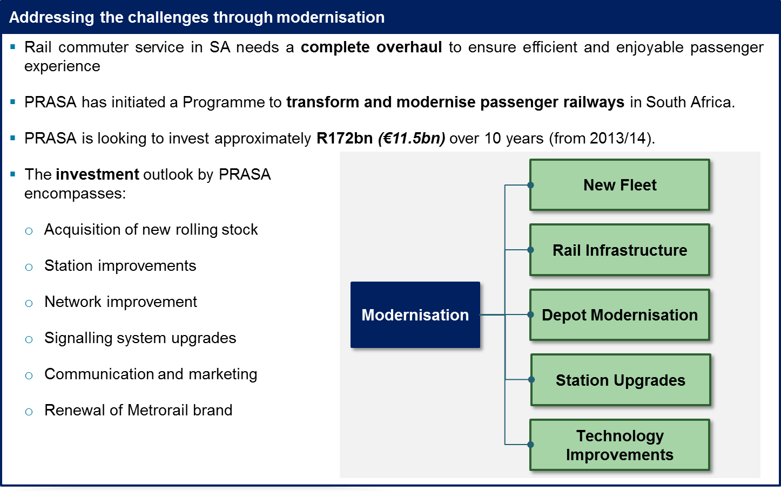
PRASA’s Modernisation Programme

Slide 21
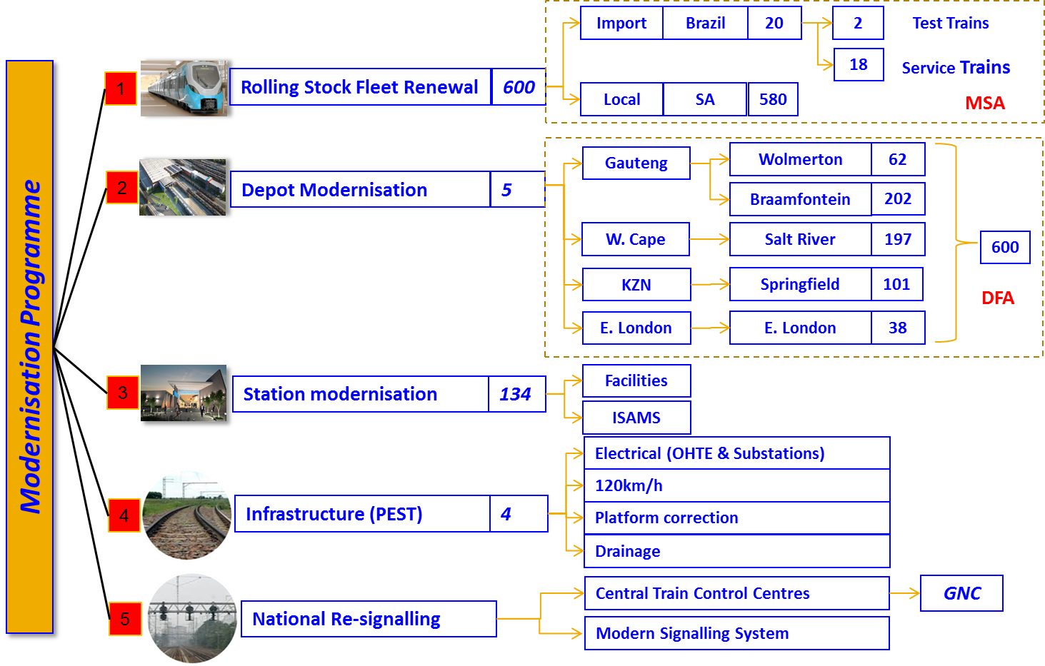
Creating a “new” Modern Business: Projects Summary

Slide 22
PRASA Readiness Delivery Objectives– 15 year Programme
2015
2016
2017
2018
2019
Q1
Q2
Q3
Q4
Q1
Q2
Q3
Q4
Q1
Q2
Q3
Q4
Q1
Q2
Q3
Q4
Q1
Q2
Q3
Q4
New Rolling Stock
Train No. 1
7
13
18
20
27
37
39
A1:39 – GAUTENG
Crd_1: Proof of service
PTA – PSP/SVL
Crd_2: Roll Out of service
PTA – JHB
5
18
35
A1:35 – W/Cape
3
15
29
39
A1:39 – KZN
Start Local Factory Construction
Local Factory Completed (P)
A1:35 – JHB- NLD
46
62
68
First SA train
Infrastructure Readiness
Wolmerton Test & Maintenance Facility
Braamfontein
Depot
Salt River
Depot
Springfield, KZN
Depot
120km/h Test Section
120km/h programme
WC: 120km/h programme
KZN: 120km/h programme
Signalling
GAUTENG: Stations Platform Rectification Programme
Pantograph Test Section
WC: Stations, Platform Rectification Programme
KZN: Platform Rectification Programme
Rail Operations Readiness
Training, Test drivers, personnel, processes & Procedures
Maintenance Ready (GP)
Maintenance
Ready (WC)
Maintenance Ready ( KZN)
Train Operations Readiness (GP)
Train Operations Readiness (WC)
Train Operations Readiness (KZN)
Business Processes Readdiness
ICT: MMIS & Train to Ground
Customer Services, Safety & Protection Plan, People & Processes - WC
Safety & Asset Protection Plan – Testing Phase
Customer Services, Safety & Protection Plan, People & Processes - GP
Customer Services, Safety & Protection Plan, People & Processes - KZN
Company Wide Change Management: New PE concept; Personnel Resourcing, Impact, business processes; Communications
20 July 2015

Slide 23
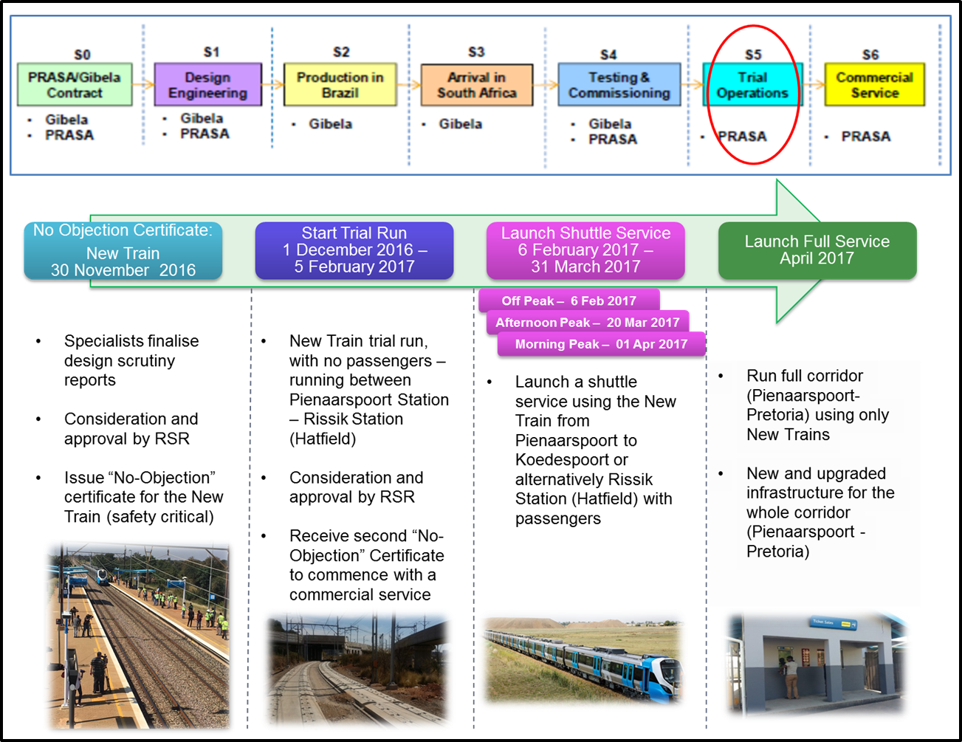
Road to EMU Commercial Service

Slide 24
Roll-out of New Fleet

