Slide 1
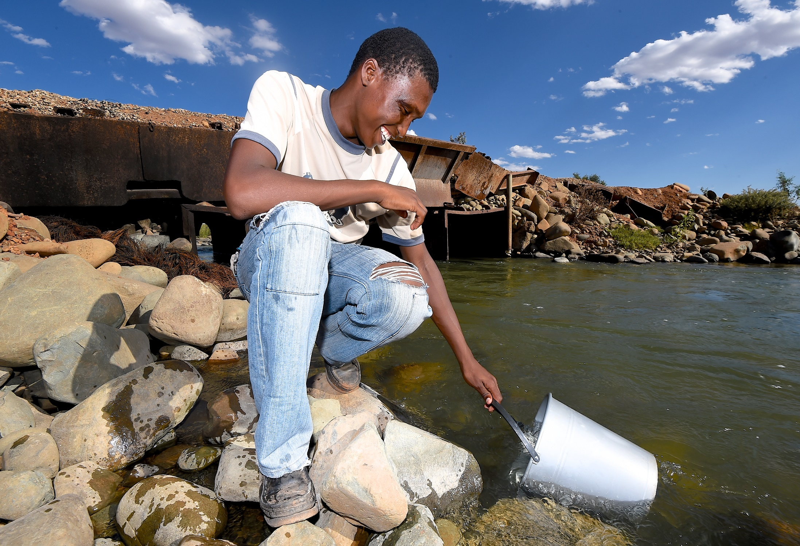
GHS Series Volume VIII
Water and Sanitation
In-depth analysis of the General Household Survey 2002–2015 and Community Survey 2016 data
Dr. Kefiloe Masiteng
Deputy Director General

Slide 2
The right to clean water and sanitation
The Constitution provides for the right of access to sufficient water for everyone
According to the World Health Organisation (WHO), the quantity of safe
water required is 20-40 litres per person per day. In South Africa, the
Department of Water and Sanitation has set the minimum quantity at
25 litres per person per day, the minimum cartage distance at 200 metres
A number of progressive water and sanitation policies and strategies have been developed since 1994, aimed at improving the health and quality of life of the population

Slide 3
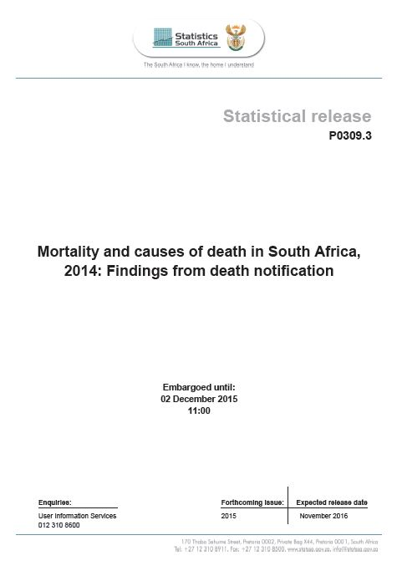
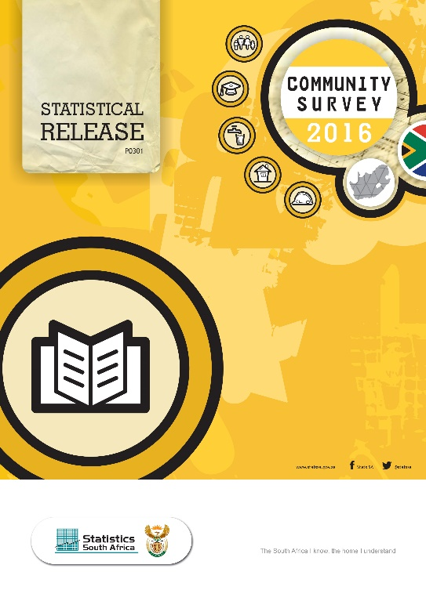
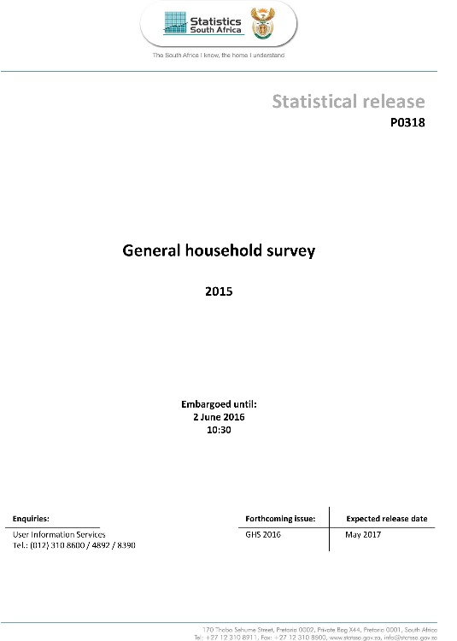
Data Sources
1
Community Survey 2016 (CS2016)
2
GHS 2002 - 2015
3
Causes of Death 2014

Slide 4
Access to water
Improved water source

Slide 5
What does improved mean?
Improved Drinking Water
Unimproved Drinking Water
Piped water into dwelling, yard or plot
Public tap or standpipe
Tubewell or borehole
Protected dug well
Protected spring
Rainwater collection
Unprotected dug well
Unprotected spring
Cart with small tank or drum
Tanker truck
Surface water (river, dam, lake, pond, stream, canal,
Irrigation channel)
Bottled water

Slide 6
Context
NDP: Increase in the percentage of households with access to a functional water service from 85% in 2013 to 90% by 2019.
SDG: Achieve universal and equitable access to safe and affordable drinking water for all by 2030

Slide 7


Percentage of households with access to piped or tap water in their dwellings, off-site or on-site
2015: 89%
2002: 85%

Slide 8
Percentage of households with access to improved drinking water sources by province, 2015
Western Cape (99,4%), Free State (99,3%), Northern Cape (99,1%) and Gauteng (98,6%) reported almost universal access to improved drinking water sources.

Slide 9
Percentage of households with access to improved drinking water sources by province, 2002 – 2015
LP
KZN
EC
Although Eastern Cape had the lowest percentages of households (75,7%) with access to improved drinking water sources, the province reported the largest increase from 2002 when 60,9% of households reported accessing improved drinking water sources.

Slide 10
Percentage of households with access to improved drinking water sources by dwelling type, 2002 – 2015
Households living in formal and informal dwellings had greater access to improved drinking water sources than households living in traditional dwellings

Slide 11
Access to improved drinking water sources by the population group of the head of the household
Although black Africans lagged behind other population groups in 2015, their access to improved drinking water sources increased from 86,1% in 2002 to 91,7% in 2015.

Slide 12
Percentage of households with access to improved drinking water sources by income quintile
Households in the two poorest income quintiles reported the lowest percentage of access to improved drinking water sources, whilst households in the wealthiest income quintile reported the highest percentage of access to improved drinking water sources

Slide 13
Percentage of households with access to improved drinking water sources per metropolitan area, 2015
Access to improved drinking water sources was greater for households living in Mangaung (100%)
Households in Buffalo City, eThekwini and the City of Tshwane had the lowest access to improved drinking water sources

Slide 14
Predictors of households with access to unimproved water sources using logistics regression
The odds of households in Eastern Cape (3,227), KwaZulu-Natal (2,713), Gauteng (2,748), North West (1,317), Mpumalanga (1,567) and Limpopo (1,400) accessing unimproved drinking water sources were greater than the odds of households in Western Cape
The odds of households in rural areas, non-metro, traditional and informal dwellings were respectively 2,664, 3,549, 2,495 and 1,594 times more than the odds of households in urban areas, metros and formal dwellings to access unimproved drinking water sources
Generally, households in poor income quintiles were more likely to have access to unimproved drinking water sources than households in wealthier income quintiles.

Slide 15
Distance to water source

Slide 16
In South Africa, the Department of Water and Sanitation has set the minimum cartage distance at 200 metres

Slide 17
Distance to outside yard / dwelling drinking water source source by province
Nearly three-tenths of households in KwaZulu-Natal (28,2%) that did not have access to water in the yard or dwelling lived more than 500 metres away from their drinking water source followed by households in Limpopo (16,3%).

Slide 18
Households living more than 500 metres away from outside yard/dwelling drinking water source , by rural / urban area
More rural households that did not have access to water in the yard or dwelling consistently lived more than 500 metres away from the drinking water source as compared urban households.

Slide 19
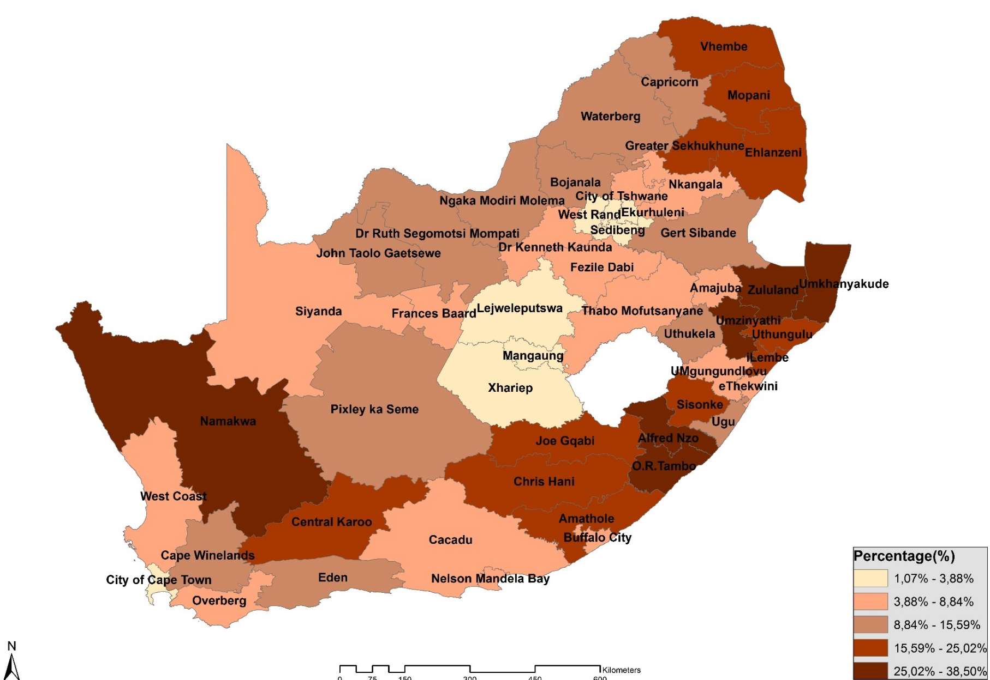
Households without water in the dwelling or yard living more than 500 metres away from drinking water source by District Council
Households in Umkhanyakude (38,5%), Zululand (35,6%) and OR Tambo (34,6%) without water in the dwelling or yard lived more than 500 metres away from the drinking water source
Source: Community Survey 2016

Slide 20
Municipal Water Source

Slide 21
Households with access to municipal water, by sources of drinking water and province
Nearly one fifth of households main source of drinking water, was supplied by municipalities. In Northern Cape (19,2%), Kwazulu-Natal (18,9%) and North West (17,2%), had access to Public or Communal taps.

Slide 22
Metropolitan households who pay for Municipal water
Payment for municipal water was below average in five municipalities namely: Nelson Mandela bay (53,7%), Ekurhuleni (52%), the City of Johannesburg (47,3%), Buffalo City (41,4%), Mangaung (36,8%)

Slide 23
Water Quality and Interruptions

Slide 24
Percentage of households rating the quality of water services provided by the municipality as good, and those that reported water interruptions, by province, 2015
An inverse relationship between the perceived quality of services and the number of interruptions exists.

Slide 25
Percentage of households rating the quality of water services provided by the municipality as good, and those that reported water interruptions, by Metro, 2015
An inverse relationship between the perceived quality of services and the number of interruptions exists.
Mangaung has a significantly higher percentage of interruptions than the average for all metros

Slide 26
Main reasons provided by households who experienced water interruptions in the past twelve months
Majority of households that reported water interruptions said that general maintenance was the main reason for the interruptions.
In Mpumalanga and Limpopo interruptions attributed to water delivery only at fixed times.

Slide 27
Access to Sanitation Facilities

Slide 28
Context
NDP: Increase in the percentage of households with access to a functional sanitation service from 84% in 2013 to 90% by 2019
SDG: By 2030, achieve access to adequate and equitable sanitation and hygiene for all

Slide 29
What does improved mean?
Improved sanitation
Unimproved sanitation
Flush or pour-flush to:
Piped sewer system
Septic tank
Pit latrine
Ventilated improved pit (VIP) latrine
Pit latrine with slab
Composting toilet
Flush or pour-flush to elsewhere (ie not to piped
Sewer system, septic tank or pit latrine)
Pit latrine without slab/open pit
Bucket
Hanging toilet or hanging latrine
Shared facilities of any type
No facilities- bush or field

Slide 30
Improved Sanitation Facilities

Slide 31
Households with access to improved sanitation facilities by province
The majority of households in the Western Cape (93,3%) and Gauteng (91%) had access to improved sanitation facilities
About half those in Limpopo (54%) and just below two-thirds of those in Mpumalanga (65,8%) had access to improved sanitation facilities.

Slide 32
Households with access to improved sanitation facilities by income quintile
Households in the poorest income quintile reported the lowest percentage of access to improved sanitation facilities, whilst households in the wealthier income quintile reported the highest percentage of access to improved sanitation facilities

Slide 33
Households living in traditional dwellings with access to improved sanitation facilities
Increase of 62,2 percentage points from 2002 to 2015

Slide 34
Households with access to improved sanitation facilities by metropolitan area
The metros with the lowest percentages of households with access to improved sanitation facilities were the City of Tshwane (82%) and eThekwini (83,5%)

Slide 35
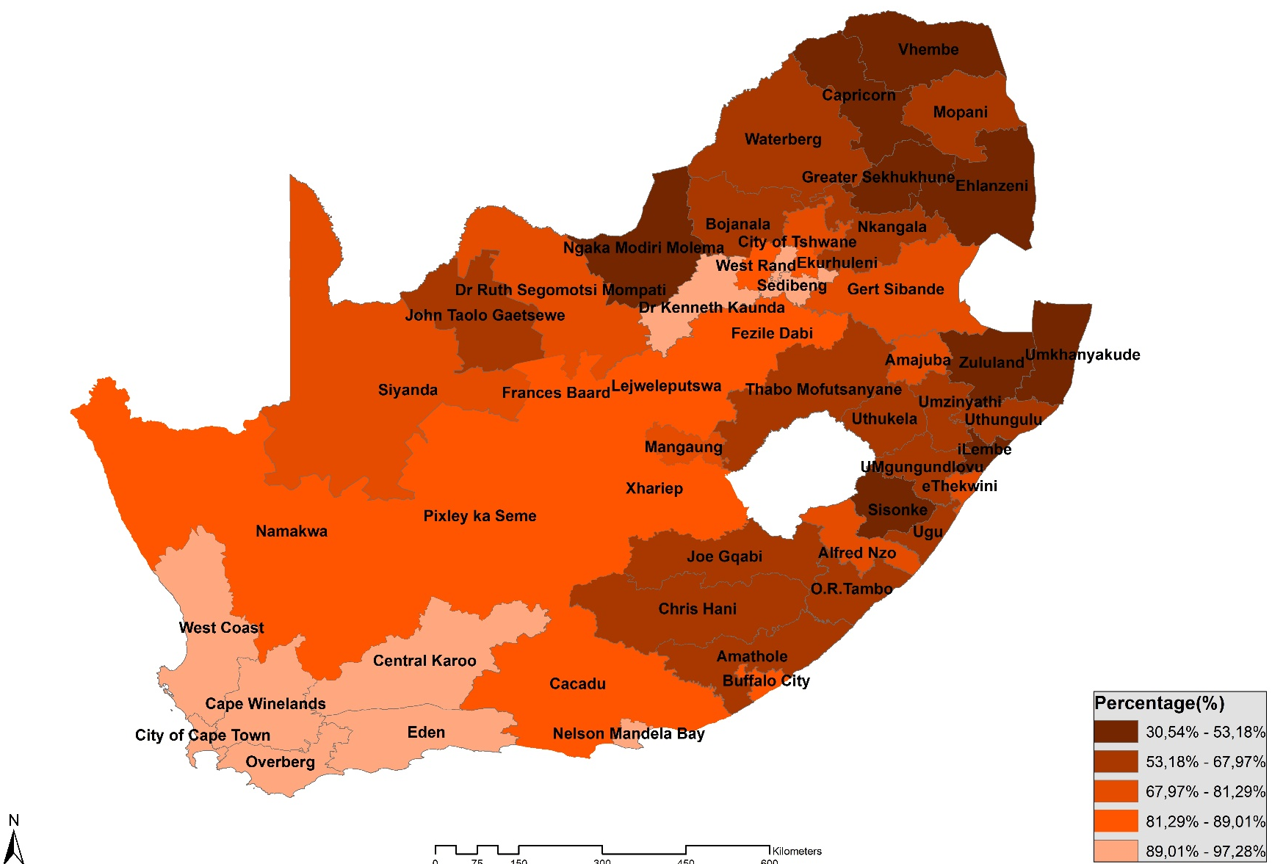
Households with access to improved sanitation facilities by District Council
Households residing in Central Karoo (97,3%), Cape Winelands (96%), Overberg (95,5%) and Eden (94,6%) reported the highest percentages in terms of access to improved sanitation facilities.
Source: Community Survey 2016

Slide 36
Predictors of households with access to unimproved sanitation facilities using logistics regression
The odds of households in eight provinces, to have access to unimproved sanitation facilities, were greater than the odds of households in Western Cape.
The odds of households in rural areas were 3,859 times more than the odds of households in urban areas to have access to unimproved sanitation facilities.
The odds of households living in non-metro areas, to have access to unimproved sanitation facilities were 1,837 times more than the odds of households living in urban areas.

Slide 37
Distance to Sanitation Facilities

Slide 38
Households who lived more than 200 metres away from the outside yard toilet facility by rural/urban area
Nationally, the percentage of households who reported living more than 200 metres away from the outside yard toilet facilities increased from 1,3% in 2014 to 6,1% in 2015

Slide 39
Households who lived more than 200 metres away from the outside yard toilet facility by gender of head of the household 2015
Households headed by females lived further away from outside yard toilet facilities compared to households headed by males. There is a noticeable decline in the percentage of households who reported living more than 200 metres away from the outside yard toilet facility

Slide 40
Shared Toilet Facilities
Bucket Toilet
Open Defecation

Slide 41
Percentage of households who shared toilet facilities by rural/urban area

Slide 42
Percentage of households who shared toilet facilities, by dwelling type
More than two-thirds (68%) of households living in informal dwellings shared toilet facilities in comparison to 19% of households living in formal dwellings and 12% of households living in traditional dwellings.

Slide 43
Problems experienced by households that shared sanitation facilities during the six months before the survey
24,7% of households were concerned by poor lighting and inadequate hygiene (22,2%).
4,8% of households complained about breakages in the municipal system and 7,5% had blocked up toilets.

Slide 44
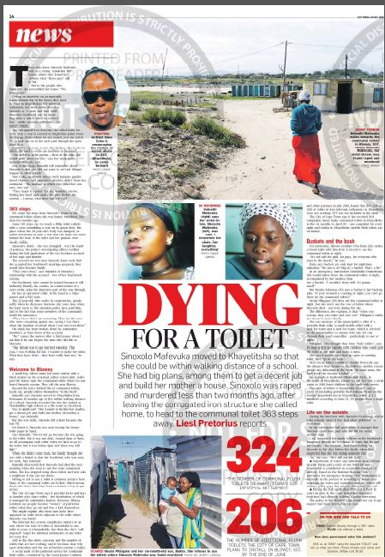
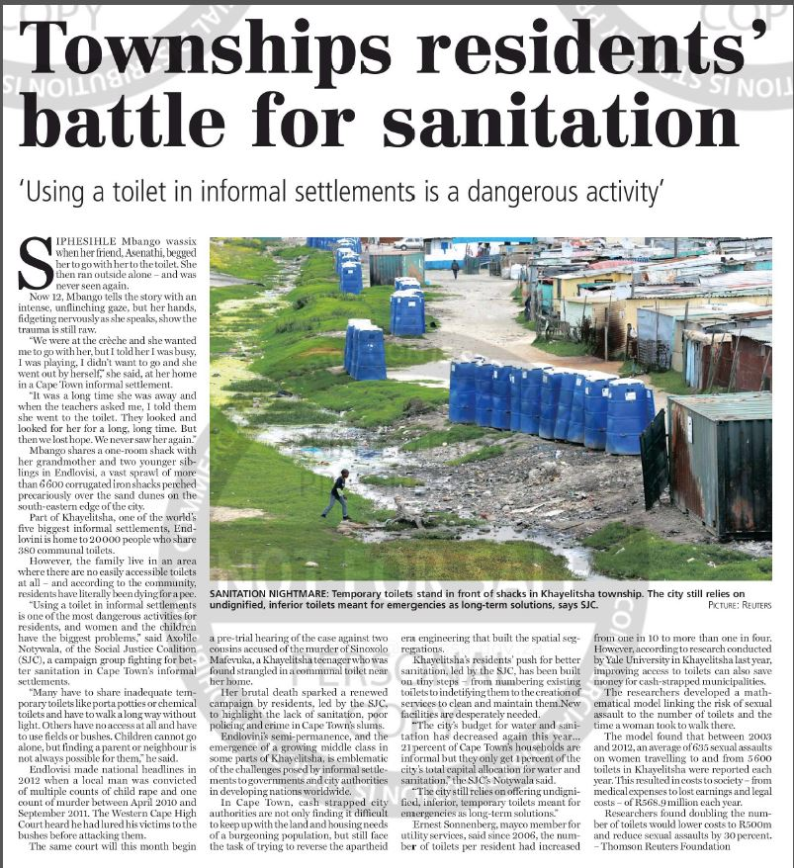
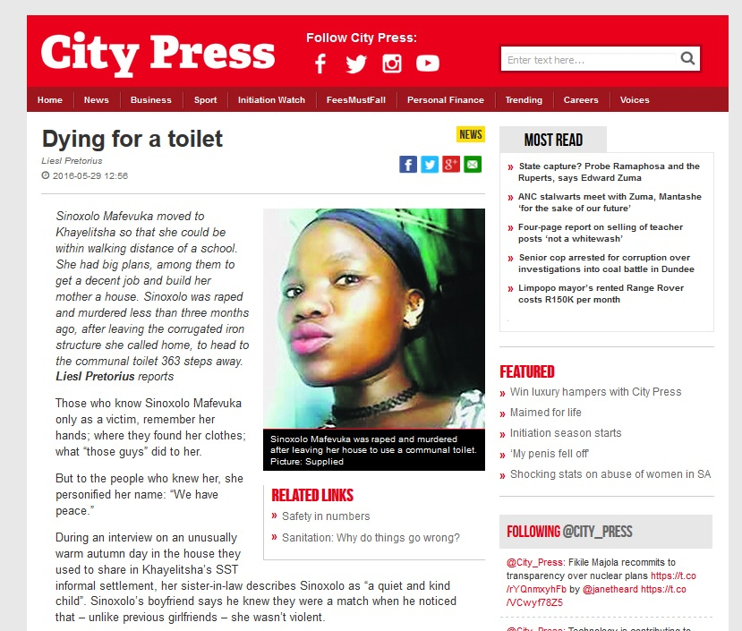
Threat of physical safety
“For protection Sbu carries a bread knife with him”
“It’s not safe for girls, for guys, for everyone who stays in the shacks”
Rape and murder of 19 year old Sinoxolo Mafevuka, 363 steps from her home to the communal toilets

Slide 45
Households using bucket toilet system by province
Western Cape recorded the highest percentage of households using bucket toilet system followed by Free State and the Northern Cape, while Mpumalanga reported the lowest number of households using bucket toilet system followed by Limpopo and North West

Slide 46
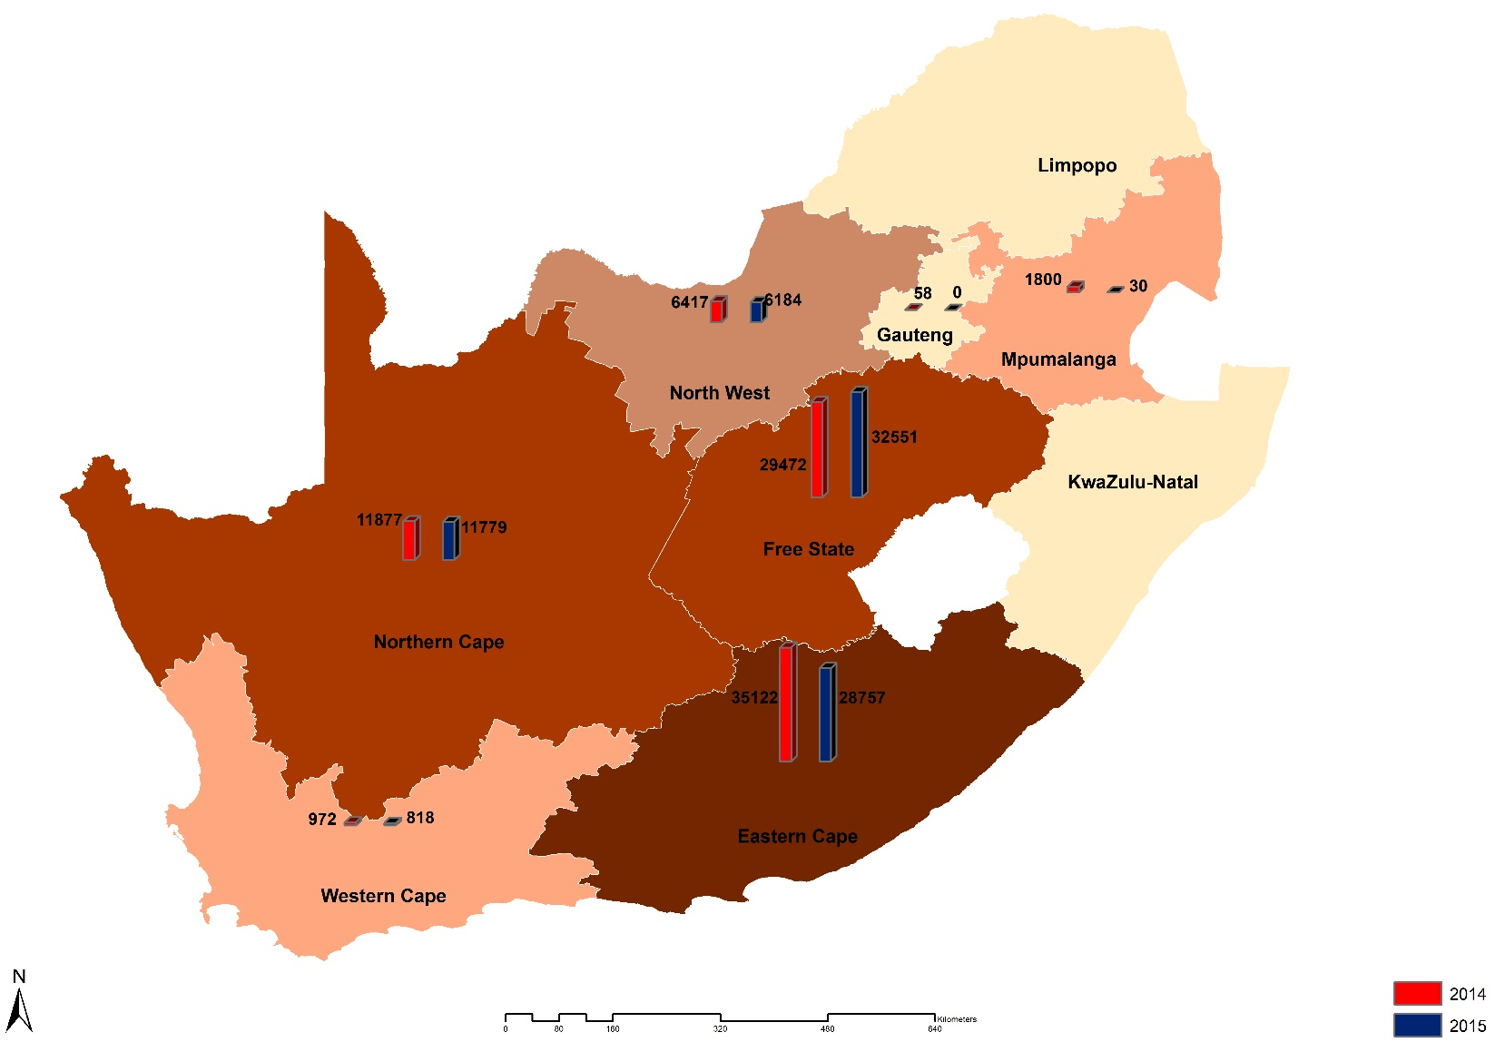
Number of consumer units using bucket toilet system provided by municipalities in each province
Over the period 2014 to 2015, Free State was the only province that showed an increase in the provision of the bucket toilet system. All other eight provinces showed a decrease in the provision of bucket toilet system, with Gauteng province reporting zero in 2015
Source: Non-financial census of municipalities for the year ended 30 June 2015

Slide 47
Households using bucket toilet system by dwelling type
Households living in informal dwellings were more likely to be using bucket toilet system than households living in formal and traditional dwellings.

Slide 48
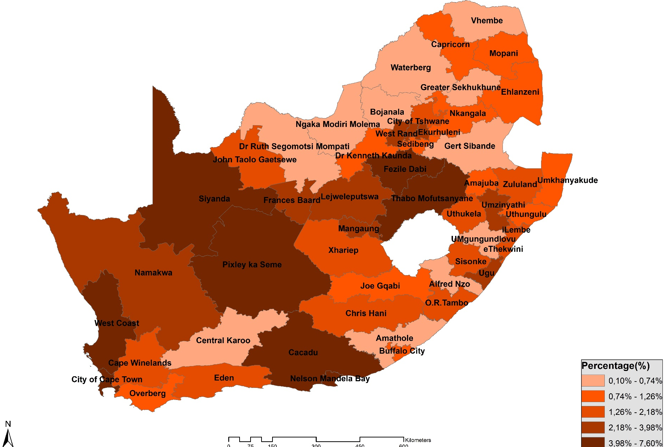
Households using bucket toilet system by District Council
4,7% of households in Nelson Mandela Bay and 4,5% of households in the City of Cape Town used the bucket toilet system.
Households that lived in Buffalo City, eThekwini and the City of Tshwane reported the lowest percentage with regard to the use of the bucket toilet system.
Source: Community Survey 2016

Slide 49
Open Defecation

Slide 50
Context
SDG:By 2030, end open defecation, paying special attention to the needs of women and girls and those in vulnerable situations.
Open defecation refers to households without any toilet facility.

Slide 51
Households practising open defecation by dwelling-type, 2015
Nationally, nearly 4% of households’ still practice open defecation. The numbers were higher for traditional dwellings (12,1%) and informal dwellings (10,3%).

Slide 52
Households practising open defecation by rural/urban, 2015
Eight per cent of rural households practised open defecation as compared to 2,2% of urban households .

Slide 53
Households practising open defecation by metropolitan area
Households in Buffalo City (4,1%), eThekwini (2,6%), Mangaung (2,2%) and Nelson Mandela Bay practised open defecation and these percentages were more that metro average of 1,6%.

Slide 54
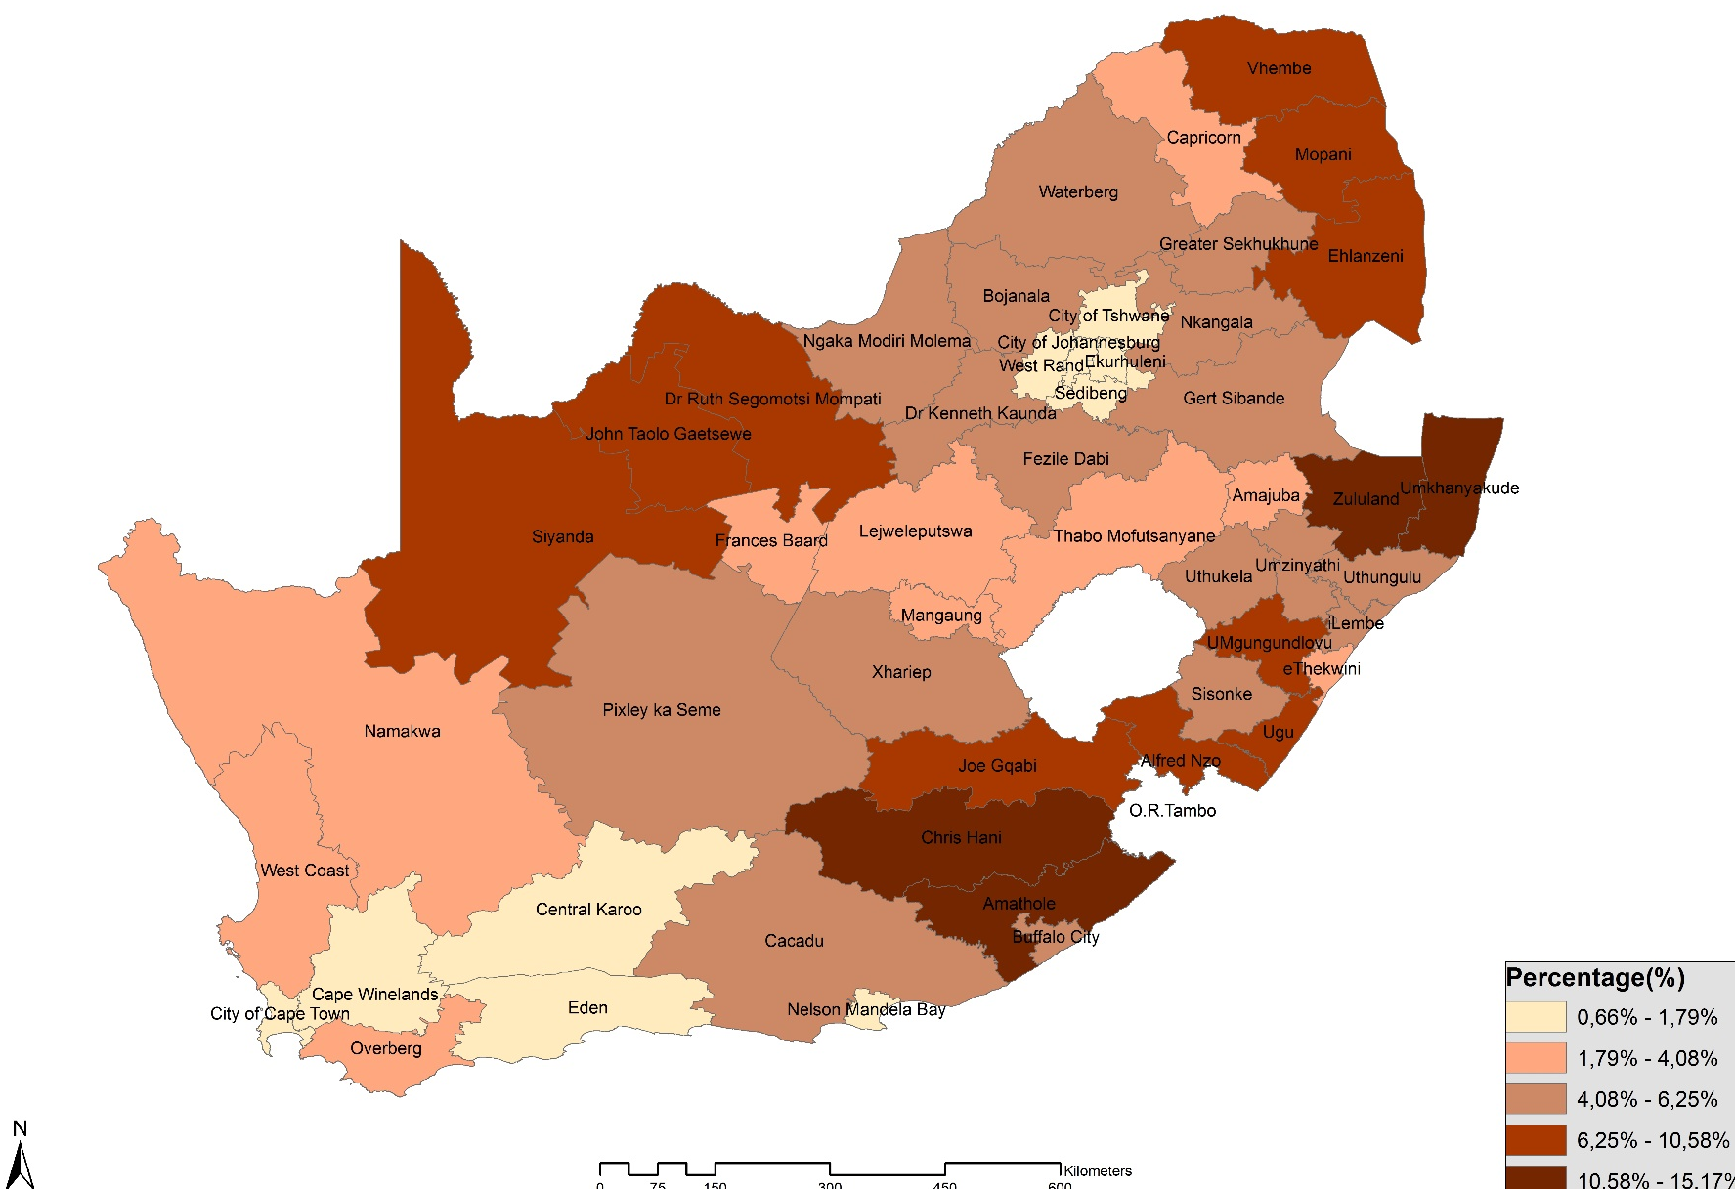
Households that practice open defecation by District Council
Households in Amathole (15,2%), Chris Hani (14,9%), Zululand (14,7%), Umkhanyakude (13,5%) and John Taolo Gaetsewe (10,6%) practised open defecation.
Source: Community Survey 2016

Slide 55
Relationship between causes of
death and key water and sanitation indicators At District level

Slide 56
Relationship between diarrhoea related deaths and key water and sanitation indicators
There is a significant correlation between the percentage of households experiencing municipal water interruptions and the practice of open defecation with the percentage of diarrhoeal related death
Source: Causes of Death 2014 and CS2016

Slide 57
Relationship between diarrhoea related deaths and key water and sanitation indicators
A statistically significant and negative moderate correlation was found between the use of improved toilet facilities and diarrhoeal related deaths.
Districts with higher percentage of households with improved toilets, are significantly less likely to have high percentages of deaths caused by diarrhoea
Source: Causes of Death 2014 and CS2016

Slide 58
Summary and conclusions
1
Inequalities in relation to access to safe water and sanitation continue to persist
2
Those at a disadvantage are :
Rural
Poor ( Quintiles 1 and 2)
Africans
Eastern Cape, KwaZulu Natal and Limpopo residents
3
Significant progress has been made in improving sanitation especially in rural provinces with
Large traditional settlements

Slide 59
Summary and conclusions continued
Water
Sanitation
Nationally, 92,5% of households had access to improved drinking water sources. 15% of households without water in the dwelling / yard lived more than 500 metres away from the drinking water source during 2015
Nationally, the percentage of households with access to improved sanitation facilities increased from 62,3% in 2002 to 80% in 2015.During 2015 6,1% of households lived more that 200 metres away from the outside yard / dwelling toilet facility.
Payment for and rating of municipal water as good declined during 2015. The proportion of households who reported interruptions over the 12 months before the survey increased from 23,1% to 25,4% between 2009 and 2015.
Nationally, 1,2% of households reported using the bucket toilet system whilst 4% practised open defecation.
The odds of households in the other eight provinces, to have access to unimproved sanitation facilities and unimproved water sources, were greater than the odds of households in Western Cape.

Slide 60
Thank You

