Slide 1


Slide 2

^{CONTENTS}
^{STRATEGIC} ^{OVERVIEW}
^{PERFORMANCE OVERVIEW}
^{FINANCIAL OVERVIEW}
^{AUDIT OVERVIEW}
^{CONCLUSION}

Slide 3

^{STRATEGIC OVERVIEW}
^{Executive Summary}
Strategic Transformation Initiatives
^{Strategic Outcome} ^{Orientated Goals}

Slide 4
^{Executive Summary}
2015/2016 financial year represented a special and positive turning point in the history and future of SITA.
SITA created programmes that laid the foundation for better insight into the operational environments in finance, supply chain and certain technical operations, enabling management to implement certain improvements.
SITA launched a campaign that provided an attractive and cost effective incentive for its customers to upgrade their bandwidth. As at the end of the financial year, 504 proposals were sent to clients, of which 252 have been accepted.
The organisation assisted the Western Cape Government with their requirement to provide a high-speed broadband telecommunications network and provide connectivity for the transmission of data, voice and video. 1,090 Layer 2 sites and 1,001 Layer 3 sites were activated.
SITA has successfully connected the eight (8) banking sites making it easier for the public to attain the new ID cards through the Department of Home Affairs Modernisation Project.
Notes:
IBM
Microsoft
Software AG

Slide 5
^{Executive Summary}
SITA together with the Department of Higher Education and Training(DHET) implemented robust collaborative service delivery mechanisms to significantly reduce the National Certificates backlog.
The organisation adopted a new programme that will accelerate the changes in the procurement processes through the introduction of extensive automation in almost all aspects of the supply chain of goods and services for both SITA’s internal consumption and on behalf of our customers.
SITA participated in the training and development of 210 youth. The programme emphasized women empowerment; with 60% of the learners and interns being young female candidates.
SITA achieved the EE target for Africans, where the actual performance was 72.1% against a target of 70%. Programmes to address women in leadership are being initiated.
SITA has adopted a risk management approach in the prevention, detection and investigation of suspected fraudulent activities, this approach is incorporated into the business processes, management practices, internal controls and related activities.

Slide 6
The organisation has defined six strategic
outcome orientated goals to be achieved within the medium term strategic cycle
Goal 1: To provide high-quality IT services to enable Government to deliver efficient and convenient services through the use of ICT.
Goal 2: To optimise the provision of SITA’s IT infrastructure services in order increase availability, flexibility, scalability, predictability and security
Goal 3: To address all issues relating to delayed procurement turnaround times, removing customer pain points, and transforming the procurement function
Goal 4: To ensure an effective and efficient financial management and ensure financial growth and sustainability.
Goal 5: To build and maintain organisational capability to enable SITA to achieve its strategic imperatives and becomes an employer of choice within the ICT industry.
Goal 6: To provide leadership, strategic management, governance, risk and resource management in line with government-accepted norms and standards.

Slide 7
Achievement of the strategic goals and objectives
is realised through the implementation of the
^{23 strategic initiatives}
1
  Implement contract tracking & management system
  Implement new approach to technical specifications
  Launch new procurement process
  Establish contract model
  Launch On-line Buying
  Introduce new organisation model
  Revise SITA’s procurement policies
8
  Consolidate & modernise data centres
  Upgrade bandwidth & network
  Design and implement security system
  New IT Service Delivery Model, System Integration & e-GOV
  Build internal capabilities
  Design and implement retained organisation (contract external assistance)
2
9
3
10
4
11
5
6
12
7
Procurement
E-Gov &
IT Service Portfolio
13
A
B
SITA
18
  Create transparency on cost
  Integrate and automate finance and procurement process
  Develop and implement new customer engagement model
  Recruit top talent to SITA
  PMO Strategy Institutionalization
  Financial Sustainability
D
C
14
  Create a customer centric
  organisation (include stakeholder)
  Reward and recognise exceptional performance
  Implement HPO across organisation
  Empower SITAzens to fully leverage their capabilities
19
Business
Enablers
Organisa-
tional Health
15
20
16
21
17
22
23

Slide 8

^{PERFORMANCE OVERVIEW}
^{Service} ^{Delivery Environment}
^{Organisation Environment}
^{Annual Performance Results}
Strategies to Overcome Areas of Non-Performance

Slide 9

The service delivery environment has been
stabilised and revitilised to improve performance
The e-Government programme has taken momentum with delivery through various streams, twenty four (24) e-services were developed by the end of the financial year.
SITA has developed an application architecture definition which is used for the development of all transversal e-services in alignment with the Government MTSF outcomes.
SITA is leading the Western cape Government broadband connectivity and has connected fifteen (15) additional sites to the targets at layer three (3).
SITA has deployed the Health System for the South African Military Health Service(SAMHS) which provides an offline capability for officials of the Department of Defence (DoD) involved in South African National Defence Force (SANDF) military missions to manage the clinical and health data.
The procurement environment has been re-engineered with policies, processes and procedures to ensure quicker turnaround times; reduction of backlogs and provision of qualitative bid information to enable decision making.
A new SMME strategy has been adopted, this promotes the growth of ICT industry from a BEE and provincial perspective to have more dynamism in the local ICT sector.

Slide 10
The internal organisational environment has
been optimised to generate value and
^{improve service delivery}
The macro organisational structure has been revised to ensure high-level coordination between the service delivery functions and better coordination and monitoring and evaluation of all the strategic programs of the organisation
SITA still aims to become a High Performance Organisation (HPO) and has achieved a marked improvement of 10% from the baseline of the 2014/2015 OHI results

Slide 11
The Organisation has achieved 68% of its
planned Annual Performance Plan Targets
Strategic Program | Total | Achieved | Not Achieved | % Achieved | % Not Achieved
Procurement | 7 | 6 | 1 | 86% | 14%
Service Delivery | 7 | 4 | 3 | 57% | 43%
Infrastructure | 1 | 0 | 1 | 0% | 100%
Financial Sustainability | 4 | 3 | 1 | 75% | 25%
Organization | 1 | 1 | 0 | 100% | 0%
Governance & Administration | 2 | 1 | 1 | 50% | 50%
Total | 22 | 15 | 7 | 68% | 32%

Slide 12
^{Organizational} ^{Performance: Procurement}
The purpose of this programme is to address all issues relating to delayed procurement turnaround times, removing customer pain points, and transforming the procurement function. SITA has progressively maintained a positive performance against the majority of its targets.
Strategic Objectives | Performance Indicator | Actual Achievement 2014/2015 | Planned Target 2015/2016 | Actual Achievement 2015/2016 | Deviation from planned target for 2015/2016 | Reason for Variance
C3: Review and improve performance of SCM | M10: % of tender awards completed within the targeted turnaround time | - | 70% of tender awards completed within the targeted turnaround time | Not achieved 55% | -15% | Mostly due to unavailability of evaluators from client and numerous clarifications required from bidders during evaluation
 | M11: % of tender contracting completed within the targeted turnaround time of 30 days | - | 40% of tender contracting completed within the targeted turnaround time | Achieved 58% | 18% | a)Due to streamlined processes and the allocation of dedicated resources b)Improved collaborative working relationship with the designated department
Notes:
End to end procurement process alignment to 2005 procurement regulations

Slide 13
^{Organizational} ^{Performance: Procurement}
The purpose of this programme is to address all issues relating to delayed procurement turnaround times, removing customer pain points, and transforming the procurement function. SITA has progressively maintained a positive performance against the majority of its targets.
Strategic Objectives | Performance Indicator | Actual Achievement 2014/2015 | Planned Target 2015/2016 | Actual Achievement 2015/2016 | Deviation from planned target for 2015/2016 | Reason for Variance
C3: Review and improve performance of SCM | M12: % of tenders published completed successfully/ awarded | - | 75% of tender published completed successfully/ awarded | Achieved 92% | 17% | Due to current work done by management to address bid specification deficiencies and improved approach to RFQ supplier engagement
C4: Drive economies of scale in the acquisition of large ICT goods and services | M13: % savings on acquisition of ICT goods and services with major OEMs | 16% | 12% savings on acquisition of ICT goods and services with major OEMs | Achieved 24% | 12% | Due to negotiated deals and discounts

Slide 14
^{Organizational} ^{Performance: Procurement}
The purpose of this programme is to address all issues relating to delayed procurement turnaround times, removing customer pain points, and transforming the procurement function. SITA has progressively maintained a positive performance against the majority of its targets.
Strategic Objectives | Performance Indicator | Actual Achievement 2014/2015 | Planned Target 2015/2016 | Actual Achievement 2015/2016 | Deviation from planned target for 2015/2016 | Reason for Variance
C5.Drive transformation agenda | M14: % of ICT acquisition spend through SMME entities | 6% | 10% of ICT acquisitions spend through SMME entities | Achieved 11% | 1% | More spend realised on SMME
 | M15: % of ICT acquisition spend through BBBEE-L1-4 compliant entities | 71% | 60% of acquisitions spend through BBBEE entities. | Achieved 85% | 25% | Due to the majority of suppliers who have BBBEE accreditation within level 1-4
P2: Curb fraud and corruption in procurement-process-related activity | M18: Number of findings per interim external audit with respect to fraud and corruption in procurement-process-related activities | - | 0 findings | Achieved 0 findings | None | N/A

Slide 15
^{Organizational} ^{Performance: Service Delivery}
The purpose of this programme is to provide high-quality IT services to enable government to deliver efficient and convenient services through the use of ICT.
Strategic Objectives | Performance Indicator | Actual Achievement 2014/2015 | Planned Target 2015/2016 | Actual Achievement 2015/2016 | Deviation from planned target for 2015/2016 | Reason for Variance
C1: Enhance efficiency of government business processes | M5: No. of e-Government services implemented | 97% implementation of e-Government plan | 15 vertical integrated e-services Implemented for 2015/16 | Achieved 24 e-services developed for 2015/16 | 9 | Development of e-queries was fast-tracked
 | M6: % implementation of e-Cabinet lead site implementation | 95% implementation of e-Cabinet plan | 50% of national government departments trained on e-cabinet | Achieved 77% | 27% | Presidency nominated more departments/ resources to be trained than initially planned
 | M7.1: Approval of the award recommendation for the new IFMS project | 100% of award recommendation to the client | Lead site implementation | Not achieved | -100% | The delay in awarding the tender adversely impacted this target and other APP targets related to IFMS

Slide 16
^{Organizational} ^{Performance: Service Delivery}
The purpose of this programme is to provide high-quality IT services to enable government to deliver efficient and convenient services through the use of ICT.
Strategic Objectives | Performance Indicator | Actual Achievement 2014/2015 | Planned Target 2015/2016 | Actual Achievement 2015/2016 | Deviation from planned target for 2015/2016 | Reason for Variance
C1: Enhance efficiency of government business processes | M7.2: Approval of the award recommendation for the new IFMS project | - | Configuration completed for testing | Not achieved | -100% | The delay in awarding the tender adversely impacted this target and other APP targets related to IFMS .
 | M8: % level of performance against signed SLA metrics contracted | 95% | 95% performance against contracted SLA metrics | Achieved 96% | 1% | Positive progress is being recorded as a result of weekly SLA committee meetings and process forums tracking, monitoring, reporting and driving continual improvement

Slide 17
^{Organizational} ^{Performance: Service Delivery}
The purpose of this programme is to provide high-quality IT services to enable government to deliver efficient and convenient services through the use of ICT.
Strategic Objectives | Performance Indicator | Actual Achievement 2014/2015 | Planned Target 2015/2016 | Actual Achievement 2015/2016 | Deviation from planned target for 2015/2016 | Reason for Variance
C2: Improve security of government data assets | M9: % of ICT controls implemented according to plan | 97% | >90% of security ICT controls plan implemented | Not achieved 45% | -45% | Cybersecurity implementation timelines were not met due to delays in the approval of business cases, tender publications and bid award process. The physical security tender had to be cancelled due to an unfavorable audit report.
P1: Enhance efficiency of government business processes | M17: % Implementation of Process Automation and integration | 91% | 90% milestones completed as per plan | Achieved 99% | 9% | All planned modules were developed as per plan.

Slide 18
^{Organizational} ^{Performance: Infrastructure}
The purpose of this programme is to optimise the provisioning of SITA’s IT infrastructure services in order to increase availability, flexibility, scalability, predictability and security.
Strategic Objectives | Performance Indicator | Actual Achievement 2014/2015 | Planned Target 2015/2016 | Actual Achievement 2015/2016 | Deviation from planned target for 2015/2016 | Reason for Variance
P1: Enhance efficiency of government business processes | M16: % implementation of infrastructure upgrades and modernisation plan | 100% | 90% of milestones completed as per annual plan | Not achieved 80% | -10% | Implementation was impacted by the revised implementation approach due to prioritisation and reduction in Capex funding

Slide 19
^{Organizational} ^{Performance: Financial} ^{Sustainability}
The purpose of this programme is to ensure effective and efficient financial management and to ensure financial growth and sustainability.
Strategic Objectives | Performance Indicator | Actual Achievement 2014/2015 | Planned Target 2015/2016 | Actual Achievement 2015/2016 | Deviation from planned target for 2015/2016 | Reason for Variance
F1: Achieve revenue growth | M1: % increase in revenue (year-on-year) | 8.6% | R5.390 m (6% of forecast revenue for 2014/15 of R5.086 m) | Achieved 7.25% | 1.25% | The increase in revenue is mainly attributable in growth in the sale of licenses.
F2: Achieve sound financial management | M2: % profitability | 2.3% | 3% surplus after tax | Not achieved 2.9% deficit | -5.9% | This is mainly due to the accounting impairment of the IFMS and JIG intangible assets

Slide 20
^{Organizational} ^{Performance: Financial} ^{Sustainability}
The purpose of this programme is to ensure effective and efficient financial management and to ensure financial growth and sustainability.
Strategic Objectives | Performance Indicator | Actual Achievement 2014/2015 | Planned Target 2015/2016 | Actual Achievement 2015/2016 | Deviation from planned target for 2015/2016 | Reason for Variance
F2: Achieve sound financial management | M3: Liquidity ratio | 3.1:1 | L≥1.2:1 | Achieved 2.3:1 | 1.1 | The higher than expected liquidity ratio is mainly due to the capital expenditure budget that had not been utilised fully and cash received in advance for specific projects that is ring-fenced.
 | M4: Expenditure against approved Capex budget | 16.5% | 60% expenditure against approved Capex | Achieved 95.8% | 35.8% | This is mainly due to monitoring controls put in place during the year to ensure that capital expenditure is spent on projects with the best possible impact.

Slide 21
^{Organizational} ^{Performance: Organization}
The purpose of this programme is to build and maintain organizational capability to enable SITA to achieve its strategic imperatives.
Strategic Objectives | Performance Indicator | Actual Achievement 2014/2015 | Planned Target 2015/2016 | Actual Achievement 2015/2016 | Deviation from planned target for 2015/2016 | Reason for Variance
L1: Build a performing organisation | M21: % improvement on HPO baseline | 10 points increase on OHI | 10% improvement on HPO baseline (6 dimensions as per plan) | Achieved 10% | None | N/A

Slide 22
^{Organizational} Performance: Governance & Admin
The purpose of this programme is to provide leadership, strategic management, governance, and risk and resource management in line with government’s accepted norms and standards.
Strategic Objectives | Performance Indicator | Actual Achievement 2014/2015 | Planned Target 2015/2016 | Actual Achievement 2015/2016 | Deviation from planned target for 2015/2016 | Reason for Variance
P3: Establish effective governance practice | M19: Compliance with Internal Control Framework | Unqualified audit report | All 2014/15 MLPs resolved | Not achieved 81.5% | -18.5% | The remedial actions have been identified and will be implemented in the next financial year
 | M20: Maturity level of risk management implementation | - | Maturity Level 4 | Achieved Maturity level 4 | None | N/A

Slide 23
^{The Organisation is} implementing the following Strategies to Overcome Areas of Non-Performance
The bid specifications are being scrutinised more closely with “blind” evaluations being done prior to approval to ensure specifications are clear. Clients are engaged to ensure that evaluators selected will be available as part of the procurement project plan.
Focus is being placed on an effective process of planning to ensure that procurement is done in line with set timeframes. Security implementation is prioritised in the procurement activities .
The infrastructure approach has been revised to include business continuity requirements matched with available CAPEX funding
We have introduced a strategic initiative to ensure effective and efficient financial management and to ensure financial growth and sustainability.
Customer engagement process are being improved to ensure that better service offerings are delivered to customers
The internal service delivery processes are being optimised, which will entail a new service delivery model, including pricing and innovative product lifecycle management.
A renewed drive has begun to improve debt collection by engaging with debtors around reasons for non-payment and exploring alternative means of recovery.

Slide 24

^{FINANCIAL} ^{OVERVIEW}
^{Overview}
Statement of Financial Position
Statement of Financial Performance
^{Statement of Cash Flow}

Slide 25

SITA is still working towards improved financial performance and sustainability
The revenue for the year of R5.459bn is R133.7m (2.39%) below the revised budget of R5.592bn
The actual service revenue performance for the year was below the revised budget by R517.8m, while the agency revenue over performed by R384.1m
The expected gross margin on services based on the revised budget was R1.164bn and represented a margin of 25% on services revenue. The actual gross margin was R653.6m or 16% of revenue. This left a gross margin shortfall on services revenue for the year of R510.4m
The expected gross margin on agency related sales according to the revised budget was R51.6m at5% of revenue. The actual margin for the year on agencies was R94.7m at 7% of agency revenue. This was a positive variance of R43.1m as per the revised budget
The actual gross surplus was R748.3m which is R467.3m below the budget gross margin of R1.216bn
The under performance in the finances was a combination in respect of an underachievement of labour based revenue , business opportunities that did not materialise as planned and the impairment of two discontinued projects

Slide 26
^{Statement of Financial} ^{Position}
in Rand | 2016 | 2015
Assets
Non-current assets | 1 249 749 321 | 1 008 780 868
Property, plant and equipment | 839 191 465 | 613 913 014
Intangible assets | 331 994 474 | 291 785 142
Non-current portion of Prepayments | 13 723 977 | -
Deferred tax assets | 64 839 405 | 103 082 712
Current assets | 2 542 430 712 | 2 717 061 257
Cash and cash equivalents | 1 152 485 518 | 1 539 404 636
Trade and other receivables | 1 038 188 548 | 1 022 868 657
Income Tax receivable | 322 622 972 | 140 478 942
Current portion of Prepayments | 29 133 674 | 14 309 022
Total assets | 3 792 180 033 | 3 725 842 125
Net assets and liabilities
Net assets | 2 573 646 745 | 2 730 915 672
Share capital | 1 | 1
Reserves | 627 334 546 | 627 334 546
Accumulated surpluses | 1 946 312 198 | 2 103 581 125
Liabilities
Non-current liabilities | 122 627 745 | 127 445 745
Current Liabilities | 1 095 905 543 | 867 480 708
Total net assets and liabilities | 3 792 180 033 | 3 725 842 125
Property, plant and equipment/ intangible assets:
  Represents the infrastructure assets of the Agency. The increase is due to capital expenditure incurred to replace ^{and expand the asset base.}
^{Cash and cash equivalent}
  detailed explanation per cashflow statement.
Trade and other receivable (Note 9)
  This represents the amount owed to the Agency by departments. The agency is working with DPTS to collect the debts.
^{Income tax} ^{receivable}
  Amount due to the Agency from SARS. The amount for 2015 was received in 2016.
  Trade and other payables (Note 14)
  The increase is mainly licences invoiced at year end that were subsequently paid in April.

Slide 27
^{Statement of Financial} ^{Performance}
In Rand | 2016 | 2015
Revenue | 5 458 602 601 | 5 089 678 442
Cost of sales | (4 710 313 016) | (3 954 846 525)
Gross surplus | 748 289 585 | 1 134 831 917
Other income | 57 419 222 | 34 457 302
Operating expenses | (1 139 152 306) | (1 083 613 962)
(Deficit)/Surplus from operating activities | (333 443 499) | 85 675 257
Finance income | 169 474 785 | 160 654 579
Finance expenses | (43 986 595) | (38 333 766)
(Deficit)/Surplus before income tax | (207 955 309) | 207 996 070
Income tax expense | 50 686 382 | (63 706 934)
(Deficit)/Surplus for the year attributable to shareholder | (157 268 927) | 144 289 136

Slide 28
^{Revised Annual} ^{Performance Plan Budget}
In Rand | ACTUAL 2016 | APP BUDGET 2016 | REVISED BUDGET 2016 | VARIANCE TO APP | VARIANCE TO REVISED
Revenue | 5 458 602 601 | 5 390 000 001 | 5 592 317 853 | 68 602 599 | (133 715 252)
- Agency revenue | 1 338 203 652 | 1 479 287 456 | 954 154 795 | (141 083 805) | 384 048 857
- Services revenue | 4 120 398 949 | 3 910 712 545 | 4 638 163 058 | 209 686 404 | (517 764 109)
Cost of sales | (4 710 313 016) | (4 312 000 000) | (4 376 694 969) | (398 313 015) | (333 618 047)
- Agency cost of sales | 1 243 532 407 | 909 372 482 | 902 537 219 | 334 159 924 | 340 995 188
- Services cost of sales | 3 466 780 609 | 3 402 627 518 | 3 474 157 750 | 64 153 091 | (7 377 141)
Gross surplus | 748 289 585 | 1 078 000 001 | 1 215 622 884 | (329 710 416) | (467 333 299)
- Agency gross surplus | 94 671 245 | 569 914 974 | 51 617 576 | (475 243 729) | 43 053 669
- Services gross surplus | 653 618 340 | 508 085 027 | 1 164 005 308 | 145 533 313 | (510 386 968)
Other income | 57 419 222 | 35 268 000 | 29 945 000 | 22 151 222 | 27 474 222
Operating expenses | (1 139 152 306) | (875 638 120) | (1 165 622 353) | (263 514 186) | 26 470 047
(Deficit)/Surplus before income tax | (333 443 499) | 237 629 881 | 79 945 531 | (571 073 380) | (413 389 030)
Net Finance income | 125 488 190 | 54 601 250 | 54 601 250 | 70 886 940 | 70 886 940
(Deficit)/Surplus before income tax | (207 955 309) | 292 231 131 | 134 546 781 | (500 186 440) | (342 502 090)
Income tax | 50 686 382 | (81 824 717) | (37 673 099) | 132 511 099 | 88 359 481
(Deficit)/Surplus for the year | (157 268 927) | 210 406 414 | 96 873 682 | (367 675 341) | (254 142 609)

Slide 29
Statement of Financial Performance – Costs Performance Against Budgets Analysis
The Agency revised its budget costs by R354 million in order to deal with labour costs, service delivery and depreciation costs which had previously been under budgeted
The Actual costs versus APP were above budget by R661 million. The reason for the variance is mainly due to the under budgeting on labour costs and over ^{budgeting of procurement} ^{agency margins due to under} ^{budgeting of costs.}
Against the revised budget, the costs were above budget by R307 million mainly due procurement ^{agency costs that remained} high and the impairment of intangible assets amounting to R134 million. The impairment was for IFMS 1 and E-gov software. The higher procurement agency costs were fully recovered ^{in revenue.}

Slide 30
Statement of Financial Performance – Costs Performance Against Budgets Analysis – HR
In terms of SITA Annual Reports, the net change in the number of employees between financial years 2013/14 and 2014/15 was 498.
The distribution of the net gain could have been better aligned to enable SITA to increase its capabilities in service operations.
The APP budget for 2015/2016 (R1.50bn) was also not set correctly against the actuals of 2014/15 (R1.53bn) against the net gain in employees during 2014/15 and inflation increases related to employee costs.
The revised budget (R1.74bn) corrected the error and management instituted HR costs control measures resulting in lower year end HR costs (R1.69bn) against the revised budget.
The HR costs control measures continue to this day and the employee numbers have further reduced by 138 as at 31 August 2016.

Slide 31
^{Statement} of Financial Performance – Margin Analysis
^{Gross} margins on procurement agency operations were unrealistically high in the APP budget.
The revised budget reduced procurement margins to realistic levels through reduction of procurement income targets and a strategy to redirect operational efforts towards services.
^{Against the revised budget,} procurement margins were as expected albeit on the similar larger APP scope. The poor performance in service operations meant lower margins against revised budget and insufficient funds to compensate for the under-budgeted and yet fixed labour costs.

Slide 32
Statement of Financial Performance –Revenue ^{Performance Against budgets}
Against the revised budget revenue was below budget by R133 million. The actual service revenue performance for the year was below the revised budget by R517.8m, while the agency revenue over performed by R384.1m
^{This is attributable to wrong} budgeting on margins on procurement agency work in the APP budget and execution not transferring sufficiently quickly away from procurement agency work to services in terms of the revised budget.

Slide 33
^{Statement of Cash Flow}
in Rand | 2016 | 2015
Cash flows from operating activities
Receipts | 5 509 063 148 | 5 162 983 377
- Sale of goods and services | 5 440 497 384 | 5 088 469 135
- Finance income received | 68 565 765 | 74 514 242
Payments | (5 392 784 180) | (5 002 827 361)
- Payment to suppliers and employees | (5 300 353 301) | (4 863 307 114)
- Finance costs paid | (5 947 054) | (13 130 037)
- Income tax paid | (86 483 825) | (126 390 210)
Net Cash flows from operating activities | 116 278 969 | 160 156 016
Cash flows from investing activities
Purchase of property, plant and equipment | (309 733 542) | (194 400 037)
Purchase of intangible assets | (193 758 913) | (59 994 211)
Proceeds from the sale of property, plant and equipment | 294 368 | 3 489 930
Net Cash flows from investing activities | (503 198 087) | (250 904 318)
Cash flows from financing activities
Net Cash flows from financing activities | - | -
(Decrease) in cash and cash equivalents | (386 919 118) | (90 748 302)
Cash and cash equivalents at beginning of year | 1 539 404 636 | 1 630 152 938
Cash and cash equivalents at end of year | 1 152 485 518 | 1 539 404 636
SITA is not generating enough cash from operations to fund capital expenditure
Cash reserves are depleted to fund urgent capital expenditure procurement
SITA is developing a finance strategy which will deal with this conundrum

Slide 34
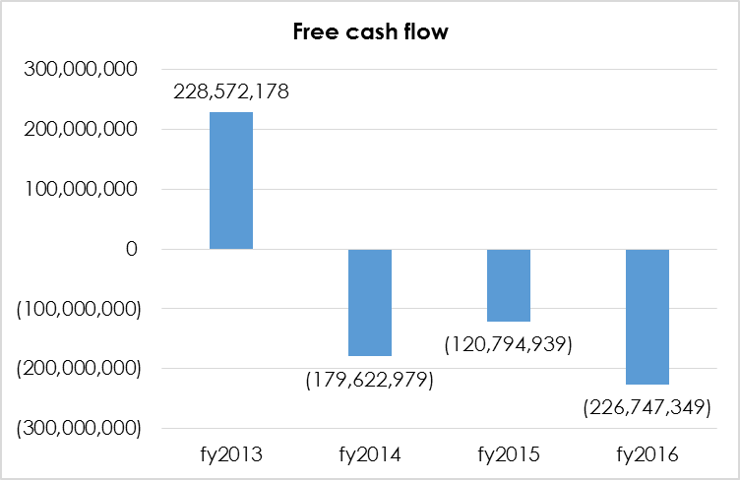
Statement of Cash flow – Free cashflow
Free cashflow represents the cash that a company is able to generate after spending the required funds to maintain and/or expand its asset base.
SITA over the years has been producing negative free cashflow due to low cash generated from operations. This resulted in the Agency utilizing its cash reserves to fund the business operations,
This is evident when looking at the bank balance which has been depleting year on year

Slide 35
^{AUDIT OVERVIEW}
^{Summary of Audit Findings}
^{Fruitless} & Wasteful and Irregular Expenditure Summary

Slide 36
^{Audit} ^{Summary}
The Agency received an unqualified audit opinion on both the financial statements and the predetermined objectives.
There were issues relating to non-compliance to legislation noted in the audit report, namely:
  The commitment disclosure to financial statements submitted on 31 May 2016 was materially adjusted. The amount presented as at 31 May 2016 was consistent with prior year. During the audit, there was discussion between the Agency and the auditor-general where the completeness of commitment figures was raised. The Agency subsequently adjusted the figures to include all future contractual obligations as at 31 March 2016 and restated prior year figures.
  The Agency has incurred irregular expenditure and fruitless and wasteful expenditure amounting to R63.4 million and R1.3 million respectively.

Slide 37
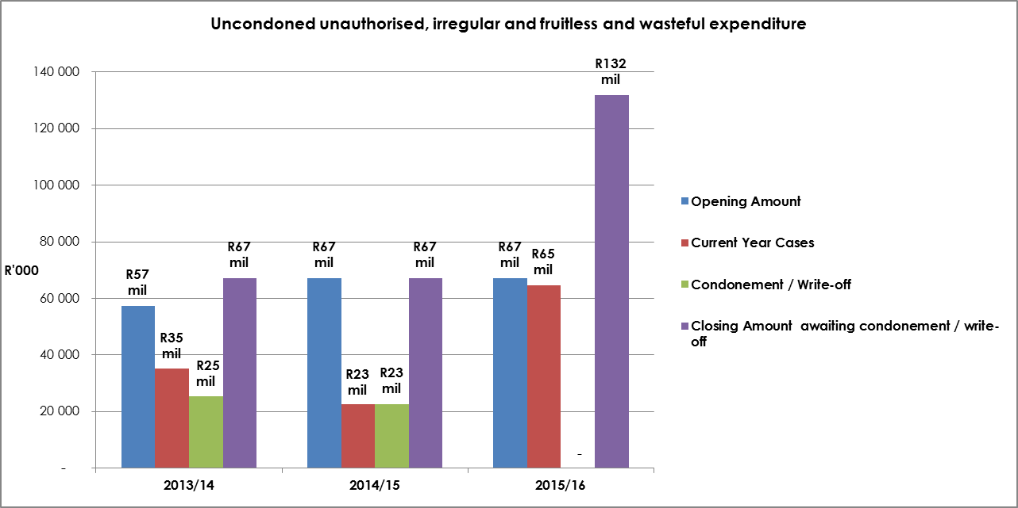
Uncondoned unauthorised, irregular and fruitless and wasteful expenditure year on year comparison

Slide 38
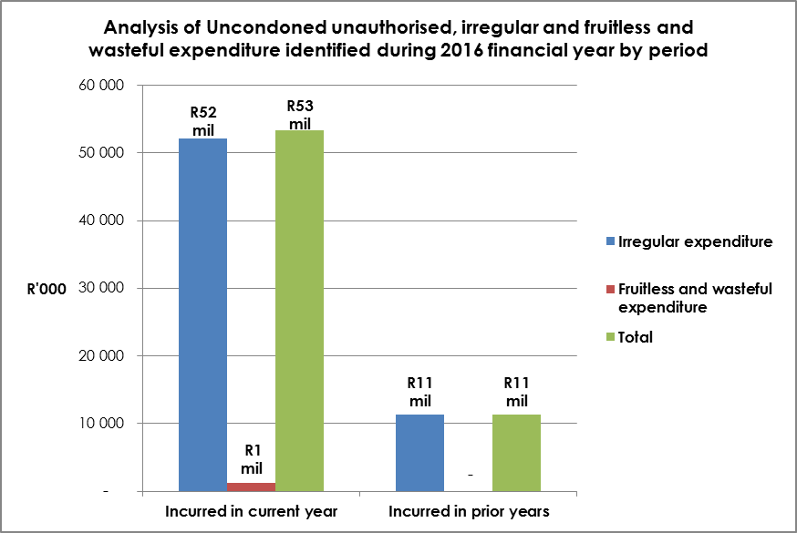
Uncondoned unauthorised, irregular and fruitless and wasteful expenditure incurred in current and prior financial years

Slide 39
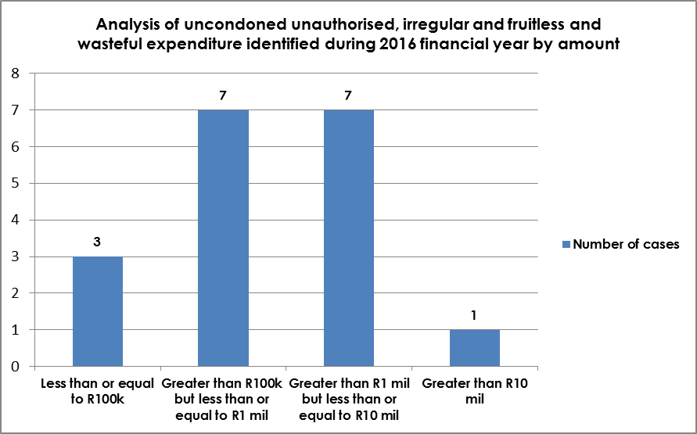
Uncondoned unauthorised, irregular and fruitless and wasteful expenditure in number of cases incurred in 2016 financial year
^{SITA} ^{has Improved its} system of internal control resulting in a better identification of irregular expenditure.
Management has initiated a number of formal investigations relating to irregular expenditure and fruitless and wasteful expenditure. Majority of the cases were still under investigation at year end.
As a result no disciplinary cases were concluded during the year. Appropriate action will be taken as soon as the investigations have been finalised.
Once these procedures have been compiled, permission for condonement will be sort in line with the revised National Treasury guidelines.
A loss control committee has been established and is mandated to deal with all outstanding investigations. The committee reports to the Managing Director and progress on the actions taken is monitored on a monthly basis

Slide 40
^{Irregular} ^{Expenditure Breakdown (1)}
Item No. | Date of incident | Name of supplier | Incident | Amount R | Department involved | Investigation Status | Action taken
1 | 16-Apr-14 | Vodacom | Continued procurement of systems maintenance services, including rental of the required backhaul service without a valid contract in place, due to inadequate contract management. | 1,041,030 | Operations | Investigation in progress | Handed over to the Loss control committee
2 | 17-Mar-15 | Mustek Ltd | Continued leasing of Desktops and Laptops after expiry of the contract extension on 31 March 2015 due to inadequate contract management. | 6,039,805 | Internal IT | Investigation in progress | Handed over to the Loss control committee
3 | 24-Jul-15 | Telkom | The contract for VPN services for the Department of Justice and Constitutional Development (DOJCD) expired on 31 March 2015 but continued to be utilised. There were delays in finalising the contract between SITA, DOJCD and Telkom. | 39,026,891 | Operations | Investigation in progress | Handed over to the Loss control committee
4 | 1-Jul-15 | Prestige Cleaning Services | Continued procurement of office cleaning services, after expiry of the initial contract extension on 30 June 2015 due to inadequate contract management. | 33,227 | EC Province | Investigation in progress | Handed over to the Loss control committee
5 | 1-Jul-15 | Metro Security Services | Continued procurement of security services, after expiry of the initial contract extension on 30 June 2015 due to inadequate contract management. | 95,388 | EC Province | Investigation in progress | Handed over to the Loss control committee

Slide 41
^{Irregular} ^{Expenditure Breakdown (2)}
Item No. | Date of incident | Name of supplier | Incident | Amount R | Department involved | Investigation Status | Action taken
6 | 30-Oct-15 | CHM Vuwani | Continued procurement of systems security services due to inadequate contract management. | 6,973,842 | Operations | Investigation in progress | Handed over to the Loss control committee
7 | 31-Aug-15 | Infrasol (Pty) Ltd | Emergency procurement process incorrectly utilised in respect of acquisition of diesel for DATA centres generators due to lack of proper planning. | 166,291 | EC Province | Investigation in progress | Handed over to the Loss control committee
8 | 20-Oct-15 | Southern Sun Hotel Interest (Pty) Ltd | Deviation from SITA procurement process with regards to the procurement of accommodation in respect of the GovTech 2015 event. | 1,317,555 | Corporate Services | Completed | Based on the outcome of the investigation, the case is recommended for condonement.
9 | 1-Nov-15 | Internet Solutions | Continued procurement of mail cleansing services from the service provider after contract expired due to inadequate contract management. | 807,500 | Operations | Investigation in progress | Handed over to the Loss control committee
10 | 10-Mar-15 | BCIT | Procurement of maintenance and support services in respect of the Track and Trace System IT requirements outside the contract period due to inadequate contract management. | 919,494 | Operations | Completed | Based on the outcome of the investigation, no SITA official was held liable for the irregular expenditure as it was a result of circumstances outside management control. Case is recommended for condonement.

Slide 42
^{Irregular} ^{Expenditure Breakdown (3)}
Item No. | Date of incident | Name of supplier | Incident | Amount R | Department involved | Investigation Status | Action taken
11 | 30-Sep-15 | Garden and Home Décor CC | Continued occupation of office premises after expiry of the lease contract due to inadequate contract management. | 774,119 | Mpumalanga Province | Investigation in progress | Handed over to the Loss control committee
12 | 28-Jan-16 | Quantum Leap Consulting (PTY) LTD | Exceeding of the contract amount in respect of Provision of Business Analysis services due to inadequate contract management. | 1,837,972 | WC Province | Investigation in progress | Handed over to the Loss control committee
13 | 23-Mar-16 | The Hilton Durban | Booking of accommodation at rates higher than the approved National Treasury rates in respect of GovTech 2015 event contrary to the Instruction Note on Cost Containment Measures. | 2,001,600 | Corporate Services | Completed | Based on the outcome of the investigation, the case is recommended for condonement.
14 | 1-Mar-16 | Semax suppliers | Quotation publication period shortened by more than specified in terms of SCM policy. | 13,242 | Mpumalanga Province | Investigation in progress | Handed over to the Loss control committee
15 | 31-Dec-15 | Dimension Data | The specifications of the request for quotation that was published to prospective suppliers was unclear, resulting in some bidders being irregularly disqualified. | 155,982 | Supply Chain Management | Investigation in progress | Handed over to the Loss control committee
16 | 31-Dec-15 | Storage Technology Services | Price adjustment on the extension of the original contract being more than the allowable threshold due to inadequate contract management. | 2,214,570 | Supply Chain Management | Investigation in progress | Handed over to the Loss control committee

Slide 43
Fruitless & Wasteful Expenditure Breakdown
Item No. | Date of incident | Name of supplier | Incident | Amount R | Department involved | Investigation Status | Action taken
1 | 23-Oct-15 | City of Tshwane | Interest charged on late payment of invoices | 14,806 | Facilities Management | Investigation in progress | Handed over to the Loss control committee
2 | 20-Aug-15 | JHI | Interest charged on late payment of invoices | 23,820 | Facilities Management | Investigation in progress | Handed over to the Loss control committee
3 | 16-Mar-16 | Manto Management | Settlement amount paid in respect of the cancellation of work awarded to the supplier (RFB 1075/2013) without notifying the supplier of the cancellation. | 450,000 | Corporate Strategy and Planning | Investigation in progress | Handed over to the Loss control committee
4 | 24-Jul-15 | Telkom | Interest charged on late payment of invoices | 783,781 | Operations | Investigation in progress | Handed over to the Loss control committee

Slide 44
^{Audit} ^{Summary}

Slide 45

^{CONCLUSION}
SITA is focused, dedicated and well-structured to deliver on its mandate, to make it more successful and better equipped to thrive in a challenging future.
SITA will continue to increase focus on information technology procurement, e-Government and data security as defined in our revised 2015/19 strategic plan.
^{SITA will implement} initiatives in our customer satisfaction index to improve service delivery and meet customers’ expectations.
SITA will also implement a customer relationship management strategy and a new customer centric engagement model.
SITA will accelerate the implementation of various initiatives to drive financial sustainability.
Implementation of an integrated talent management strategy to position SITA as a premier employment destination within the ICT industry is our destination and will continue as planned.

