Slide 1

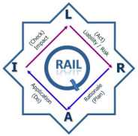
12 April 2016
RSR Strategic Plan
2016-2021
    PRESENTATION BY: NKULULEKO POYA

Slide 2
CONTENT
    INTRODUCTION
      9-POINT PLAN
      SONA CONTRIBUTION
    HISTORICAL BACKGROUND
    STRATEGIC OVERVIEW
    ORGANISATIONAL STRUCTURE
    ANNUAL PERFORMANCE
    STRATEGIC ALIGNMENT TO SIP 7
    CHANGES TO THE RSR 2015/16 MTSF
    RSR 2016/17 – 2020/21 MTSF
    STRATEGIC RISK REGISTER
    BUDGET INFORMATION
    STRATEGIC PROJECTS
    CHALLENGES

Slide 3
INTRODUCTION
9-point plan contribution
State reform and boosting the role of state-owned companies, information and communication technology infrastructure or broadband roll-out, water, sanitation and transport infrastructure
  Conducting Technology Reviews on all new technology introduced in support of the PRASA modernisation project and TFR’s market demand strategy.
  Support Operators in mitigating risks within the railway landscape to ensure safe and efficient railway operations.
2. Encourage private sector investment
  Development of Regulations

Slide 4
INTRODUCTION (Cont.)
Sona contribution
SONA | RSR Intervention
Performance by State Owned Entities | Ensure that Strategic Objectives are achieved Ensure that RSR maintains its unqualified audit status and moves towards a clean audit Ensure increased revenue to fund RSR’s activities
Continuous rail infrastructure development | Support introduction of new technology through technology reviews Development of the Asset Management Regulation
Empowerment of SMME’s | More than 80 % of new procurement if from BBBEE companies
Empowerment of Youth | Internship Program Junior Inspector Training Program
International Travel | Reduction in delegation size Strong motivations on the benefits derived by the country as a whole

Slide 5
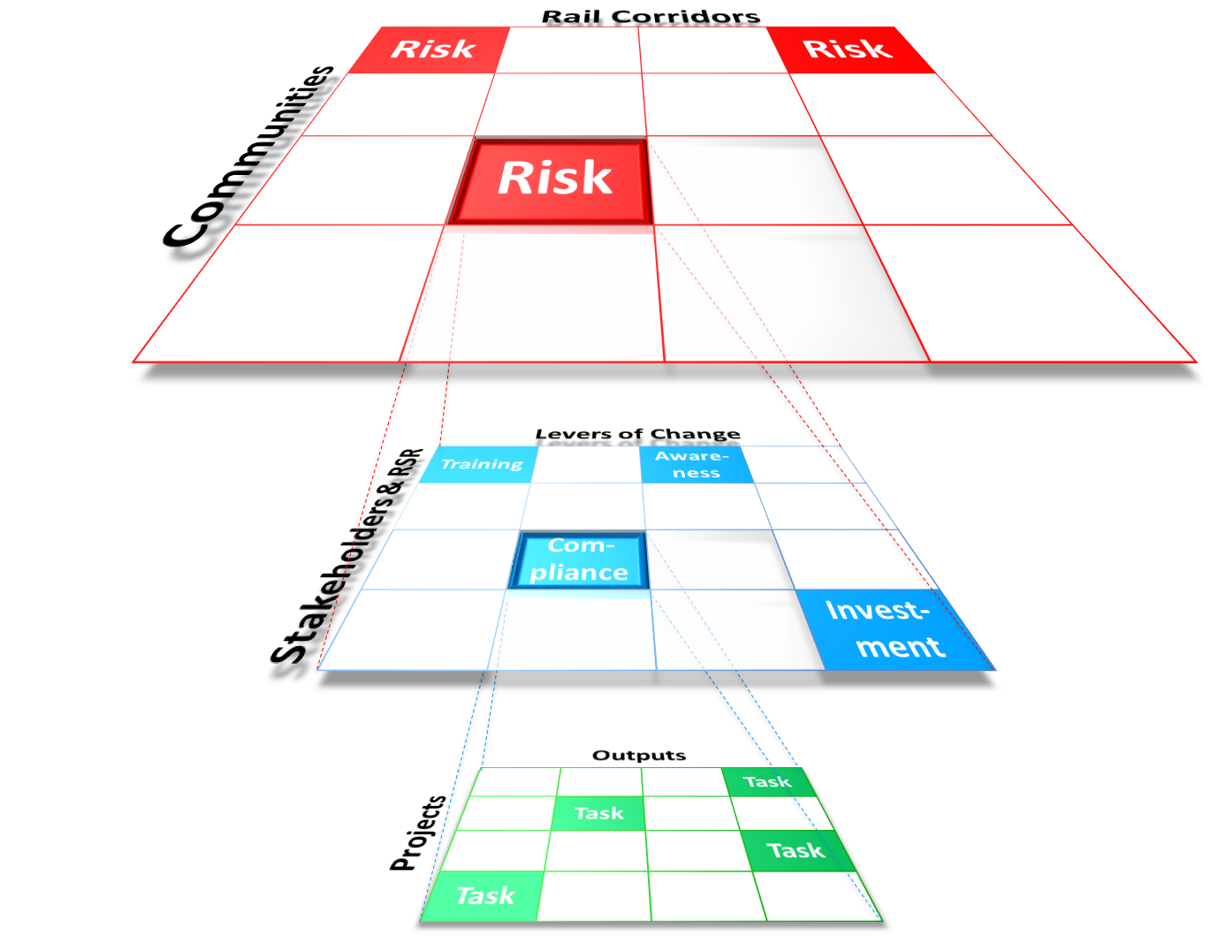
HISTORICAL BACKGROUND
Time
2015/16 +
Risk
landscape
Collaboration
landscape
2014/15
Compliance
landscape
PAST
Impact & Change

Slide 6
Strategic Overview
Vision
Aspire to achieve Zero Occurrences
Underlying philosophy:
“Every occurrence can be avoided and every occurrence is everybody's responsibility"
Mission
To oversee and promote safe railway operations through appropriate support, monitoring and enforcement, guided by an enabling regulatory framework
Values
Integrity & Trust
Transparency
Fairness & Equity
Innovation
Speed of Execution

Slide 7
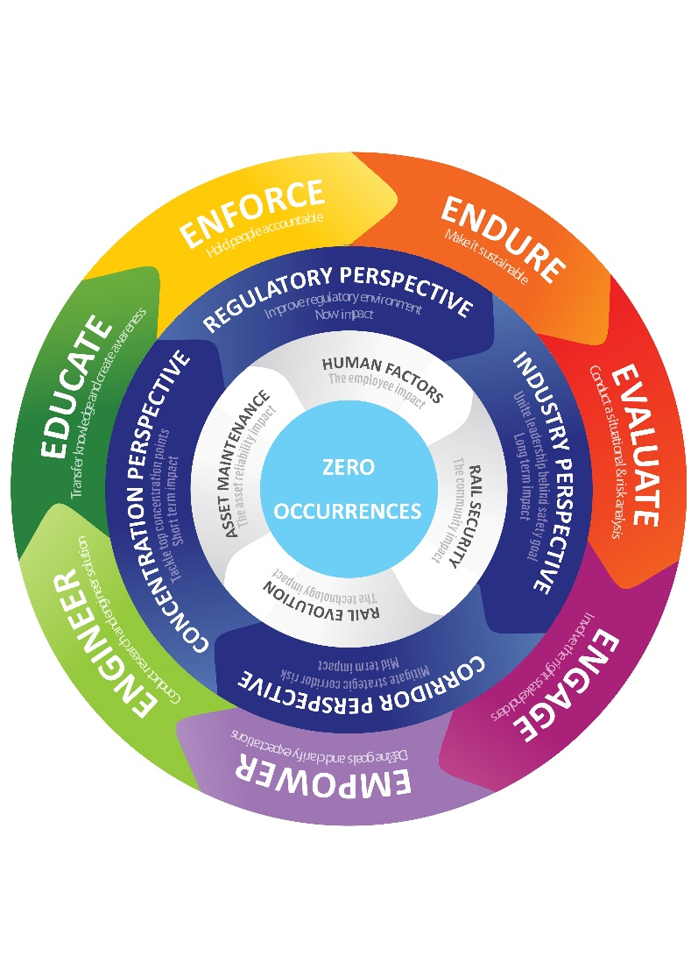
Strategic OVERVIEW:
7 ‘E’s - LEVERS/DRIVERS OF CHANGE

Slide 8
Strategic PILLARS – THE 3 ‘E’S
ENGINEERING
Technologies that enable/promote safety
LEADERSHIP & CULTURE:
INSTITUTIONAL GROWTH AND STRENGTHENING
ENFORCEMENT
Regulatory instruments
EDUCATION
Safety promotion

Slide 9
Strategic framework
Impact
ZERO OCCURRENCES
Risks in the railway landscape have been mitigated
(Focus on FIVE risk categories)
Sustainable institutional growth and development
Outcomes
Outputs
Enforcement
Education
Engineering & Human Factors
Effective Governance, Risk & Financial Management
Normative Framework
MTSF Objectives
DoT Strategic Goals

Slide 10
ORGANISATIONAL STRUCTURE
CEO
OCEO
OCOO
Legal Services
Occurrence Investigations
Human Resources
Internal Audit
Company Secretary
Safety Compliance
Media & Communications
ICT
International Relations
Finance
Perway &
Civil Works
Electrical, Signalling & Telecom
Rolling Stock
Train Operations
Technical Services
Technical
Training
Legislation
Litigation & Dispute Resolutions
Corporate Legal Services
Human Factors
Board of Inquiry
Railway Security
Information Systems
IT Infrastructure
Remunerations & Benefits
Employee Relations
Performance & OD
Supply Chain Management
Financial Management
PR & Events
Corporate
Communications
Stakeholder Engagement
Investigations
Engineering & Materials Testing Centre
Internal
Training
External
Training
Facilities Management
Regional Operations
Operational Planning
Africa Business
International Cooperation
Risk Management
Employee Wellness & Employment Equity
Internal Risk Management
External Risk Management

Slide 11
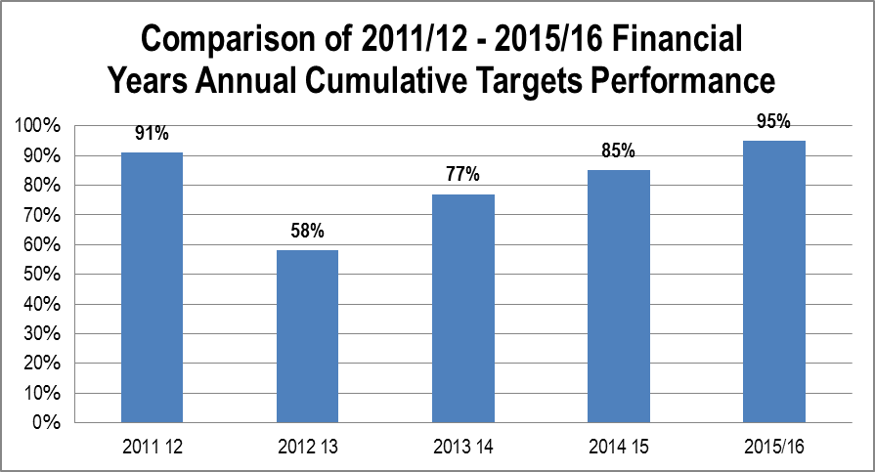
ANNUAL PERFORMANCE

Slide 12
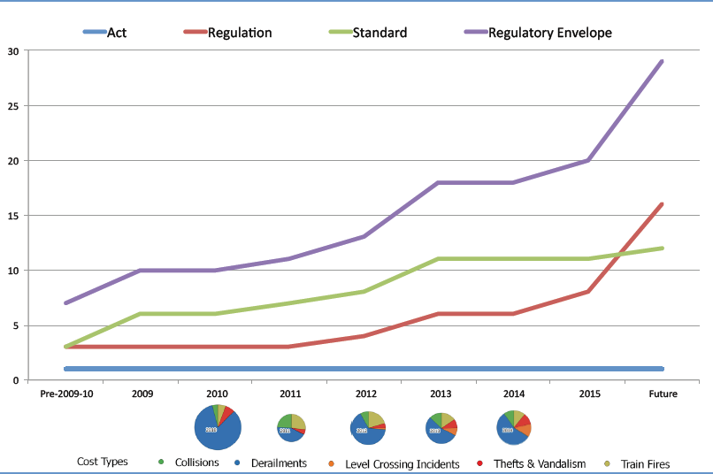
RSR REGULATORY IMPACT ASSESSMENT

Slide 13
RSR REGULATORY IMPACT ASSESSMENT
Cost-Benefit analysis of TFR and Prasa over period 2010/11 to 2014/15
Cost of occurrences (costs) versus Value Add of transported goods (benefits)
Findings :
  Gaps in terms of RSR Regulatory Framework identified:
    Rail Reserve / access control
    Security issues regarding theft and vandalism
  Collisions main cost driver for TFR
  Train fires (arson and electrical) main cost driver for PRASA
  0.1% Cost of Risk discriminator introduced to identify High risk railway lines / corridorrs
Outcomes will inform RSR Regulatory Framework development and focus of planning of RSR Interventions

Slide 14
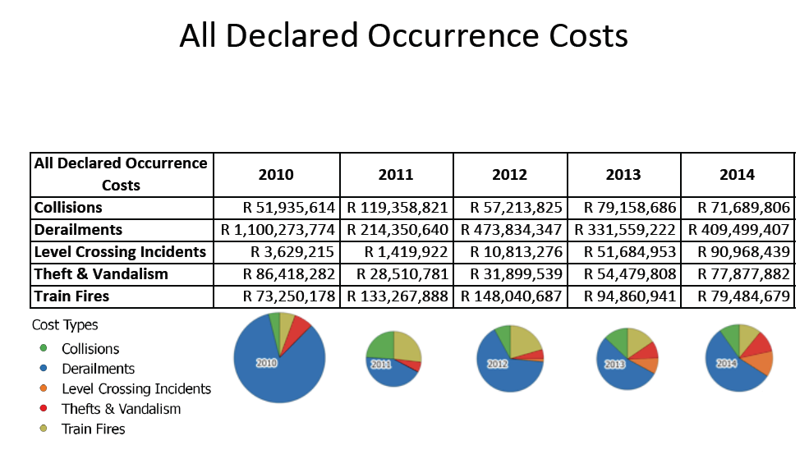
RSR REGULATORY IMPACT ASSESSMENT

Slide 15
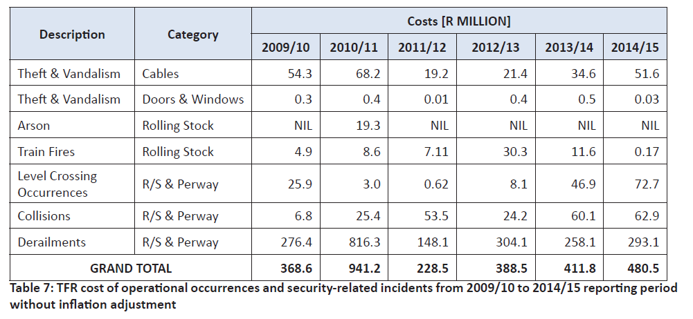
TFR OCCURRENCE COSTS
Note : as per State of Safety report for period 2014/15

Slide 16
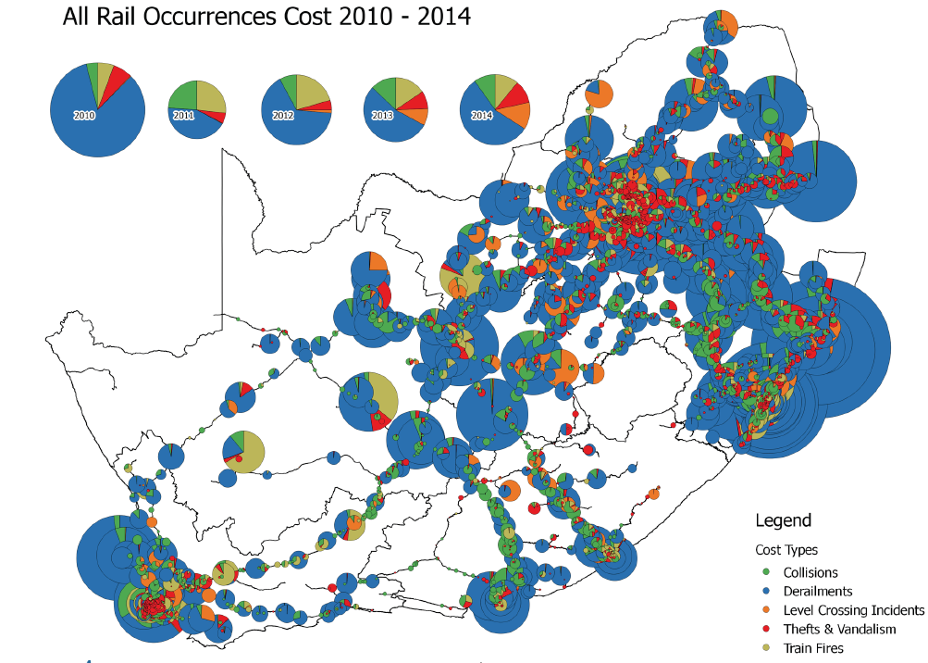
TFR Occurrence Costs 2010-2014

Slide 17
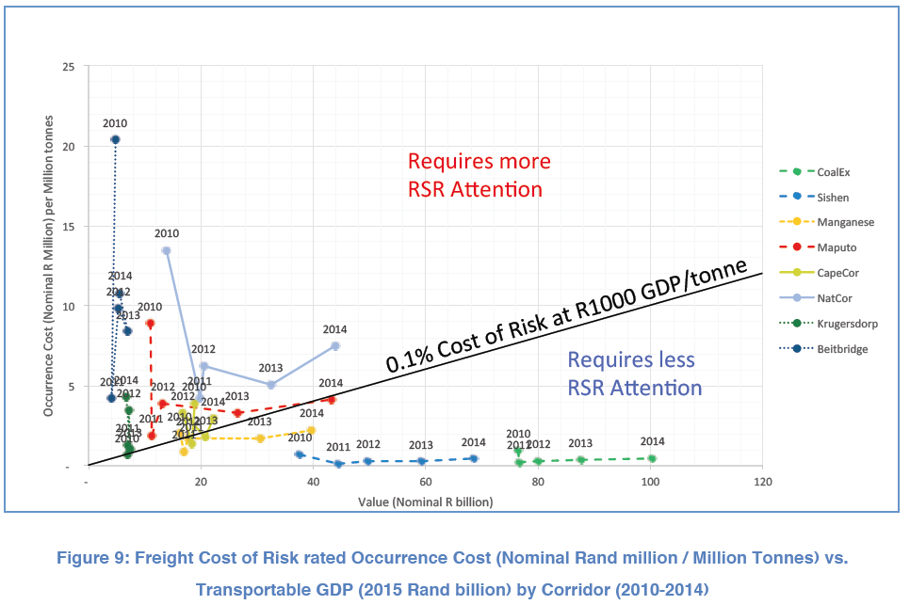
TFR COST OF RISK PROFILE

Slide 18
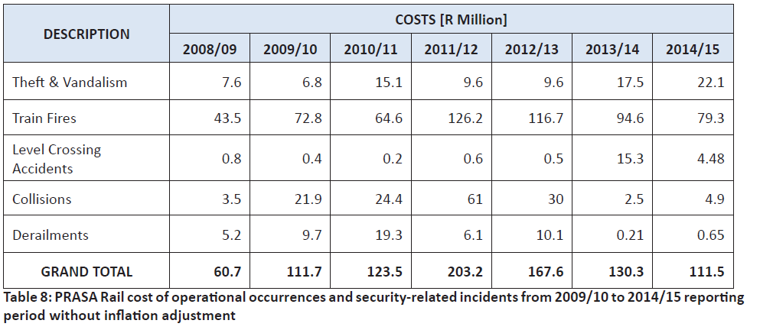
PRASA OCCURRENCE COSTS
Note : as per State of Safety report for period 2014/15

Slide 19
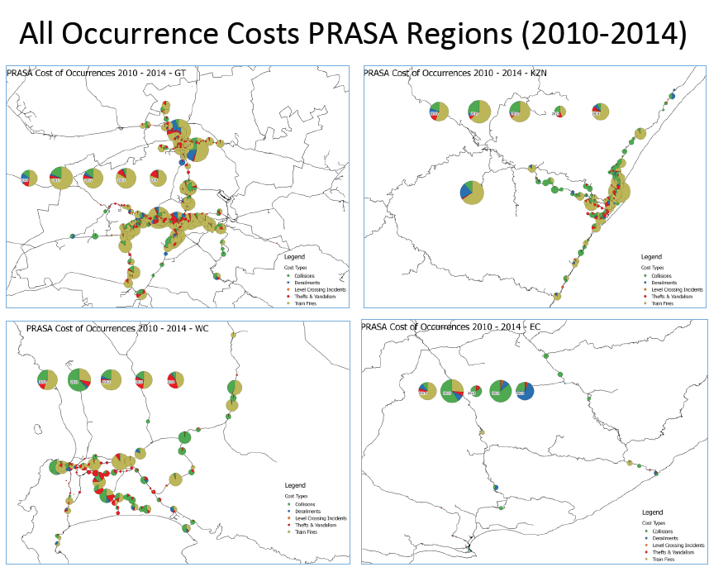

Slide 20
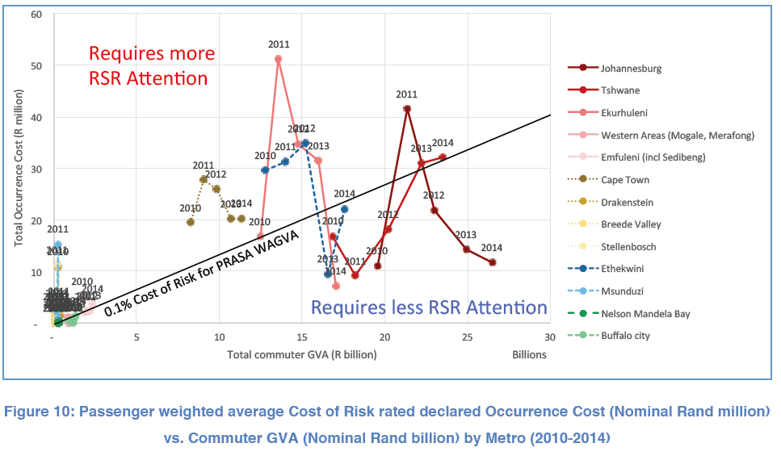
PRASA COST OF RISK PROFILE

Slide 21
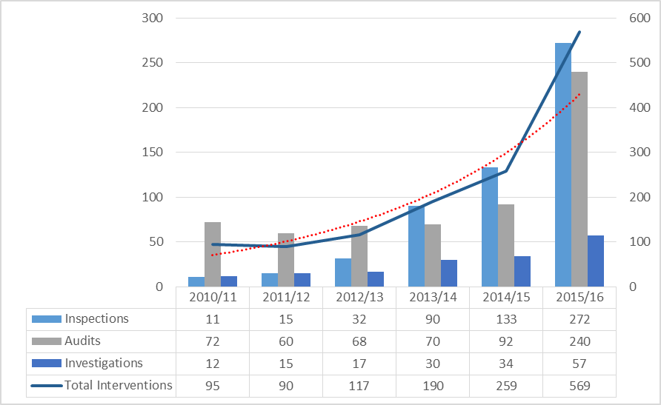
COMPLIANCE AND RISK INTERVENTIONS

Slide 22
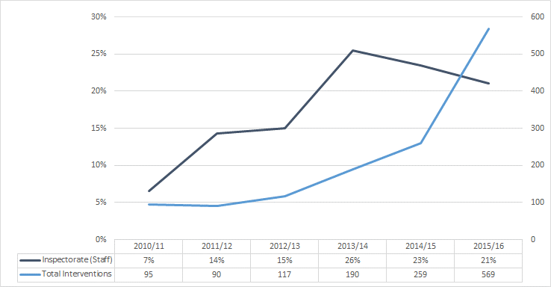
RSR INSPECTORATE vs. RSR INTERVENTIONS
Note : Inspectorate calculated as number of inspectors as % of total staff compliment

Slide 23
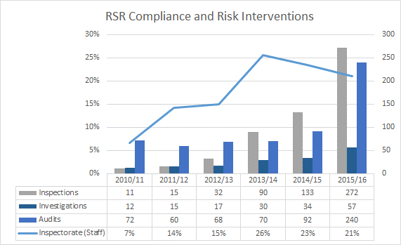
RSR INSPECTORATE vs. RSR INTERVENTIONS
Note : Inspectorate calculated as number of inspectors as % of total staff compliment

Slide 24
NON ACHIEVED KPA’S
2015/16 TARGET | INTERVENTIONS
1000 Train Drivers Certified | A pilot project with PRASA to licence train drivers is underway
PERFORMANCE MONITORING MECHANISMS
Quarterly Internal Audits conducted Interim Audit by the Auditor General Submission of quarterly performance information reports to Board Committees DoT Rail Branch Quarterly reporting (performance oversight)

Slide 25
Strategic ALIGNMENT
MTSF Outcome 6 Supports SIP 7
An efficient, competitive and responsive economic infrastructure network
DoT Strategic Outcome Goal 1
Ensure an efficient and integrated infrastructure network that serves as a catalyst for social and economic development
Oversee the safe expansion of rail as a mode of both passenger and freight transport
Enforce sector-wide safety compliance
Encourage contracted operators and independent service providers to invest in, and provide, safer and more commuter-friendly experiences
Encourage investments in safe technologies (e.g. ATP systems), components and systems
Educate the public (commuters, pedestrians and motorists) on safe railway behaviour

Slide 26
CHANGES to the strategic plan
2015/16 – 2019/20 STRATEGIC PLAN
Strategic Outcomes
2016/17 – 2020/21 STRATEGIC PLAN
Strategic Outcomes
Enforcement: Risks in the railway landscape have been mitigated
Education: Railway safety effectively promoted
Engineering: New investments in rail infrastructure and technology impact positively on railway safety
Integration of Engineering, Enforcement and Education initiatives:
Risks in the railway landscape have been mitigated – Focus on five main occurrence categories
Sustainable institutional growth and development
Sustainable institutional growth and development

Slide 27
CHANGES to the strategic plan
2015/16 STRATEGIC OBJECTIVES
2016/17 STRATEGIC OBJECTIVES
OUTCOME 1: Risks in the railway landscape have been mitigated
Objective 1.1
To secure the sufficiency of safety related and safety critical competencies in the rail industry
Objective 1.2
To mitigate human factor risks
Objective 1.3
To enable people and rail to co-exist safely
Objective 1.4
To strengthen the regulatory approach on asset maintenance
Objective 1.5
To enable people and rail to co-exist safely
OUTCOME 1: Risks in the railway landscape have been mitigated
Objective 1.1
To reduce the number of level crossing occurrences
Objective 1.2
To reduce the number of people struck by trains
Objective 1.3
To reduce the number of mainline derailments
Objective 1.4
To reduce the number of mainline collisions between rolling stock
Objective 1.5
To reduce the number of PTI occurrences

Slide 28
CHANGES to the strategic plan
2015/16 STRATEGIC OBJECTIVES
2016/17 STRATEGIC OBJECTIVES
OUTCOME 2: Railway safety effectively promoted
Objective 2.1
Create awareness that can lead to a culture of safety
Objective 2.2
Create and Promote awareness of the financial impact of unsafe railway operations
OUTCOME 3: New investments in rail infrastructure and technology impact positively on railway safety
Objective 3.1
Manage the risks of new works and technology developments
Objective 3.2
Eliminate Platform-Train Interface (PTI) occurrences on commuter railway lines
OUTCOME 1: Risks in the railway landscape have been mitigated
Objective 1.1
To reduce the number of level crossing occurrences
Objective 1.2
To reduce the number of people struck by trains
Objective 1.3
To reduce the number of mainline derailments
Objective 1.4
To reduce the number of mainline collisions between rolling stock
Objective 1.5
To reduce the number of PTI occurrences

Slide 29
CHANGES to the strategic plan
2015/16 STRATEGIC OBJECTIVES
2016/17 STRATEGIC OBJECTIVES
OUTCOME 4: Sustainable institutional growth and development
Objective 4.1
To institute effective governance and internal control systems
Objective 4.2
To secure a sustainable financial environment
Objective 4.3
To ensure Performance Excellence
OUTCOME 2: Sustainable institutional growth and development
Objective 2.1
To secure a sustainable financial environment
Objective 2.2
To ensure Performance Excellence

Slide 30
RSR Strategic Plan 2016 – 2021

Slide 31
STRATEGIC OUTCOME 1 risks In the landscape have been mitigated

Slide 32
FOCAL AREA 1:
LEVEL CROSSING OCCURRENCES

Slide 33
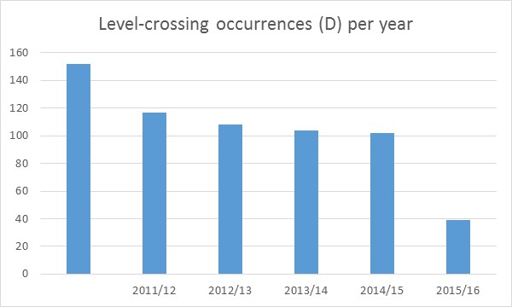
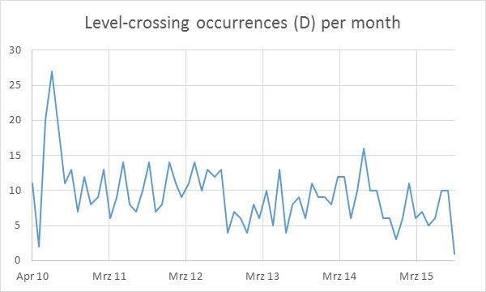
PROFILING THE RISK LANDSCAPE
LEVEL CROSSING OCCURRENCES

Slide 34
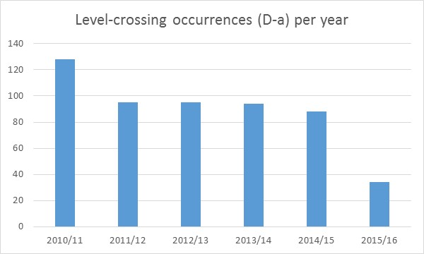
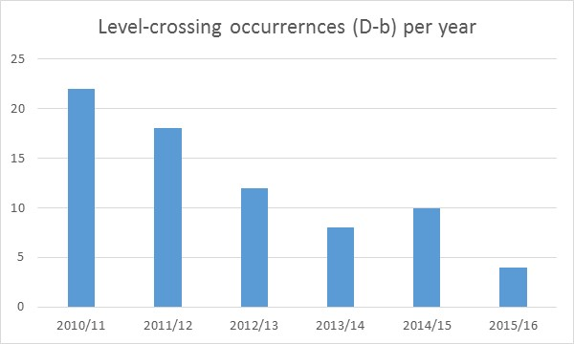
PROFILING THE RISK LANDSCAPE
LEVEL CROSSING OCCURRENCES
Collision between rolling stock and a road vehicle(s) (including motor vehicles, bicycle or animal-drawn vehicles) at a recognized level crossing on a running line
Collision between rolling stock and a road vehicle(s) on any line other than a running line (including yards, sidings and private sidings) at a recognized level crossing

Slide 35
Strategic Outcome 1 : Risks in the Railway landscape have been Mitigated
Objective statement: Increase level of compliance at level crossings and change the public attitude and behaviour through collaboration with all relevant role-players, stakeholders, affected parties and the introduction of modern technologies aimed at eliminating opportunities for destruction of infrastructure
Strategic Objective 1.1 | Medium-Term Targets
 | 2016/17 | 2017/18 | 2018/19 | 2019/20 | 2020/21
Reduction in the number of level crossing occurrences | New Level and Pedestrian Crossing Standard developed | Level and Pedestrian Crossing Standard Implemented | 5 % Reduction in the number of Level Crossing occurrences | 8 % Reduction in the number of Level Crossing occurrences | 10 % Reduction in the number of level crossing occurrences
 | 100 % Implementation of all Level Crossing Improvement Directives due for closure in 2016/17 | 100 % Implementation of all Level Crossing Improvement Directives due for closure in 2017/18 | 100 % Implementation of all Level Crossing Improvement Directives due for closure in 2018/19 | 8 % Reduction in the number of Level Crossing occurrences | 10 % Reduction in the number of level crossing occurrences
 | 100 % Compliance to 50 % (5) of Directives issued in 2016/17 | 100 % Compliance to 60 % of all Directives issued in 2016-18 | 100 % Compliance to 70 % of all Directives issued in 2016-19 | 8 % Reduction in the number of Level Crossing occurrences | 10 % Reduction in the number of level crossing occurrences

Slide 36
Objective statement: Increase level of compliance at level crossings and change the public attitude and behaviour through collaboration with all relevant role-players, stakeholders, and affected parties and to ensure the application of suitable engineering solutions
Strategic Objective 1.1 | Medium-Term Targets
 | 2016/17 | 2017/18 | 2018/19 | 2019/20 | 2020/21
Reduction in the number of level crossing occurrences | 10 % of Level Crossing occurrences investigated | 20 % of Level Crossing occurrences investigated | 30 % of Level Crossing occurrences investigated | 40 % of Level Crossing occurrences investigated | 50 % of Level Crossing occurrences investigated
 | Behavioural risks of pedestrians and motorists interacting with the railway network researched | Behavioural change strategy in association with stakeholders developed | Risk relevant promotional material developed | Public Awareness created of the risks associated with man-machine interface at Level Crossings | 100 % Public compliance to rail-road interface rules
 | Level crossing training course developed | Level Crossing Training Course Accredited | Operator awareness of the risks associated with the public interfacing with Level Crossings created | 100 % Operator compliance to rail-road interface rules | 100 % Operator compliance to rail-road interface rules

Slide 37
FOCAL AREA 2:
PEOPLE STRUCK BY TRAINS

Slide 38
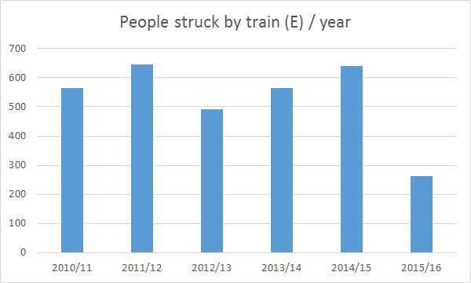
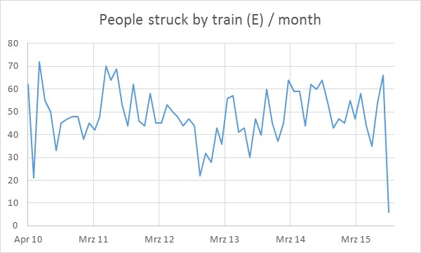
PROFILING THE RISK LANDSCAPE
PEOPLE STRUCK BY TRAINS

Slide 39
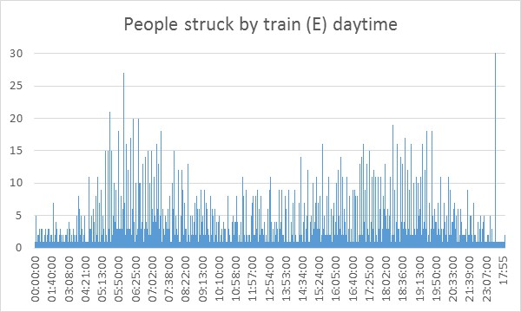
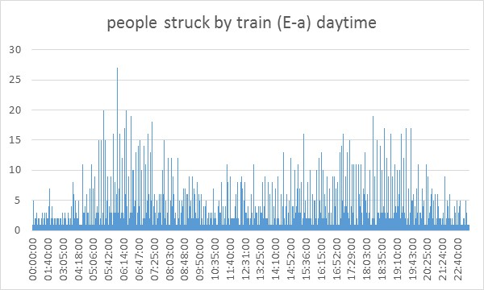
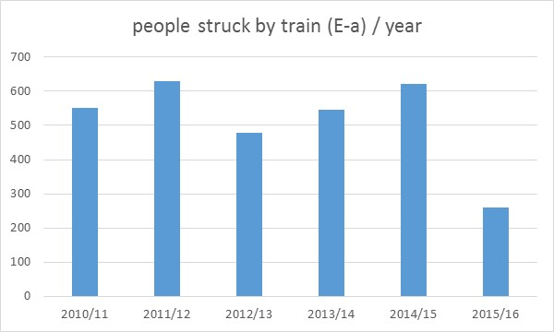
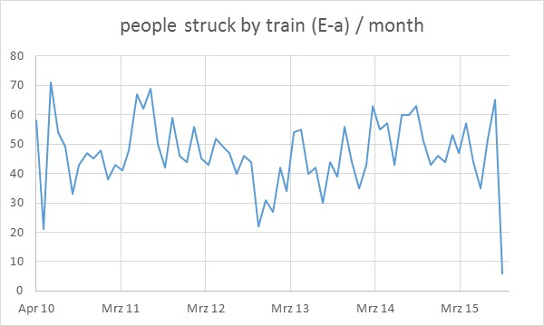
PROFILING THE RISK LANDSCAPE
People struck by trains
Occurrence categories combined
Occurrence where a member of the public is struck by rolling stock on a running line

Slide 40
Objective Statement: To substantially reduce the number of people struck by trains by securing the rail reserve, ensuring its integrity while providing alternate access across railway tracks, and educating communities, within the constraints of financial resources and regulatory framework
Strategic Objective 1.2 | Medium-Term Targets
 | 2016/17 | 2017/18 | 2018/19 | 2019/20 | 2020/21
Reduction in the number of people struck by trains | 100 % Implementation of all Improvement Directives in high risk corridors due for closure in 2016/17 | 100 % Implementation of all Improvement Directives in high risk corridors due for closure in 2017/18 | 20 % Reduction in the number of people struck by train | 30 % Reduction in the number of people struck by train | 40 % Reduction in the number of people struck by train
 | 100 % Compliance to 50 % of all Directives issued in 2016/17 | 100 % Compliance to 60 % of all Directives issued in 2016-18 | 20 % Reduction in the number of people struck by train | 30 % Reduction in the number of people struck by train | 40 % Reduction in the number of people struck by train
 | Railway Reserve Regulation implemented | Implementation of the Railway Reserve Regulation monitored | 100 % Operator Compliance to the Railway Reserve Regulation | 30 % Reduction in the number of people struck by train | 40 % Reduction in the number of people struck by train

Slide 41
Objective Statement: To substantially reduce the number of people struck by trains by securing the rail reserve, ensuring its integrity while providing alternate access across railway tracks, and educating communities, within the constraints of financial resources and regulatory framework
Strategic Objective 1.2 | Medium-Term Targets
 | 2016/17 | 2017/18 | 2018/19 | 2019/20 | 2020/21
Reduction in the number of people struck by trains | 5 % of people struck by train occurrences investigated | 10 % of people struck by train occurrences investigated | 15 % of people struck by train occurrences investigated | 20 % of people struck by train occurrences investigated | 30 % of people struck by train occurrences investigated
 | Psychological and physiological risk factors associated with train drivers and assistants who have struck people identified | Human Factors program to address identified risk factors developed and implemented | Public Awareness created of the risks associated with People Struck by train | Effectiveness of the human factors program monitored and evaluated | Psycho-sociological and physiologically fitness of train drivers and train driver assistants ensured

Slide 42
FOCAL AREA 3:
MAINLINE DERAILMENTS

Slide 43
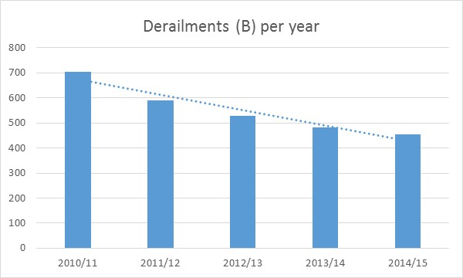
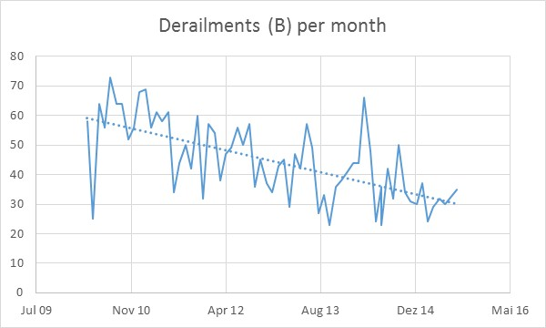
PROFILING THE RISK LANDSCAPE
DERAILMENTS

Slide 44
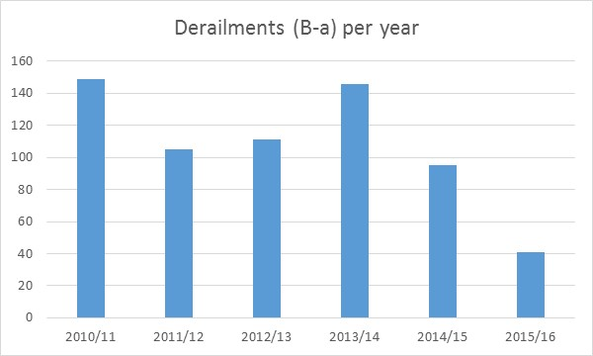
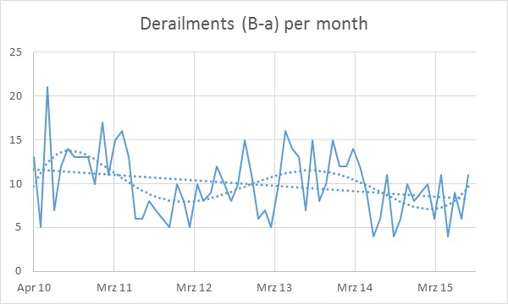
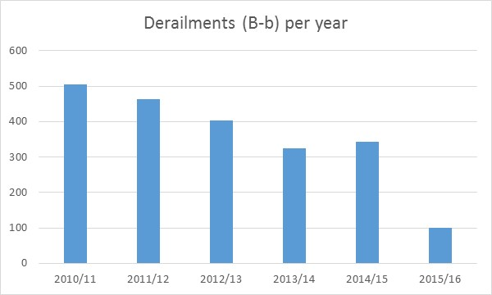
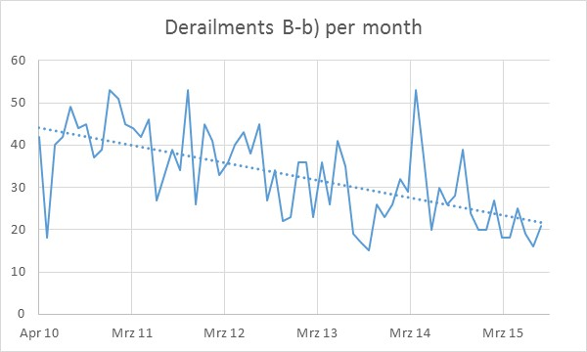
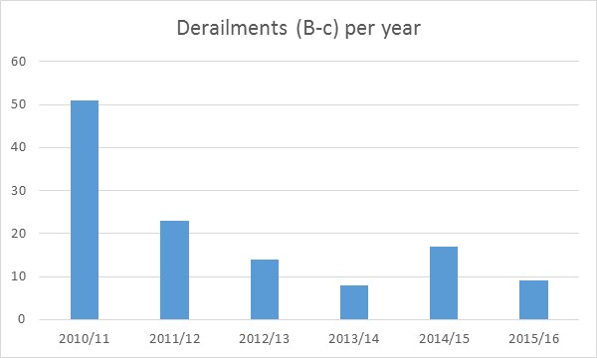
PROFILING THE RISK LANDSCAPE
DERAILMENTS
B-a Derailment of rolling stock on a running line
B-b Derailment of rolling stock on a line other than a running line
B-c Derailment during tippler activities

Slide 45
Objective statement: To strengthen the regulation of railway asset management by: Supplementing the existing reactive (i.e. identifying and fixing) maintenance approach by developing a more proactive (predictive and preventative) approach Influencing the quality of maintenance suppliers for safety critical systems and components, Improving the maintenance regulatory framework and Implementing best practice maintenance standards.
Strategic Objective 1.3 | Medium-Term Targets
 | 2016/17 | 2017/18 | 2018/19 | 2019/20 | 2020/21
Reduction in the number of mainline derailments | 100 % Implementation of all maintenance related Improvement Directives due for closure in 2016/17 | 100 % Implementation of all maintenance related Improvement Directives due for closure in 2017/18 | 15 % Reduction in the number of mainline derailments | 20 % Reduction in mainline derailments | 30 % Reduction in mainline derailments
 | 100 % Compliance to 50 % of all Directives issued in 2016/17 | 100 % Compliance to 60 % of all Directives issued in 2016-18 | 15 % Reduction in the number of mainline derailments | 20 % Reduction in mainline derailments | 30 % Reduction in mainline derailments

Slide 46
PROFILING THE RISK LANDSCAPE
DERAILMENTS
“Derailment of rolling stock on a line other than a running line” accounts for over 70 % of all Derailments. The respective time series (on a monthly and a yearly basis) show comparable patterns, indicating a decreasing linear tendency.
“Derailment of rolling stock on a running line” indicates a less significant decreasing tendency probably superposed by variations if monthly values are taken into consideration.
The time series of derailments per day or per daytime do not show distinctive patterns, except expected clusters of elevated derailment frequencies between 8 am and 5 pm, due to operation activity.

Slide 47
Objective statement: To strengthen the regulation of railway asset management by: Supplementing the existing reactive (i.e. identifying and fixing) maintenance approach by developing a more proactive (predictive and preventative) approach Influencing the quality of maintenance suppliers for safety critical systems and components, Improving the maintenance regulatory framework and Implementing best practice maintenance standards.
Strategic Objective 1.3 | Medium-Term Targets
 | 2016/17 | 2017/18 | 2018/19 | 2019/20 | 2020/21
Reduction in the number of mainline derailments | 10 % of Perway and Rolling Stock related derailments investigated | 15 % of Perway and Rolling Stock related derailments investigated | 20 % of Perway and Rolling Stock related derailments investigated | 25 % of Perway and Rolling Stock related derailments investigated | 30 % of Perway and Rolling Stock related derailments investigated
 | Asset Management Regulation developed | Asset Management Regulation implemented | 100 % Operator Compliance to the Asset Management Regulation | 20 % Reduction in Mainline Derailments | 30 % Reduction in Mainline Derailments

Slide 48
FOCAL AREA 4:
MAINLINE COLLISIONS

Slide 49
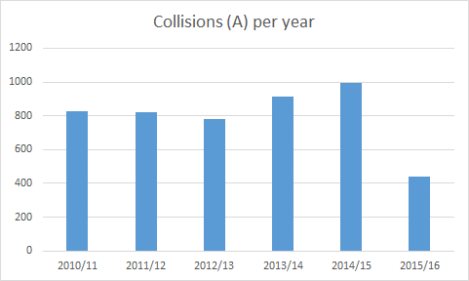
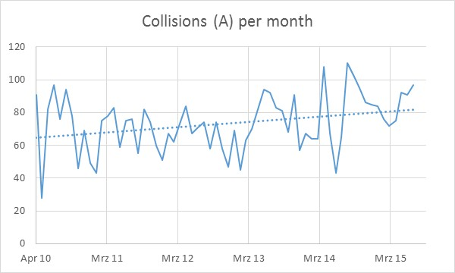
PROFILING THE RISK LANDSCAPE
COLLISIONS

Slide 50
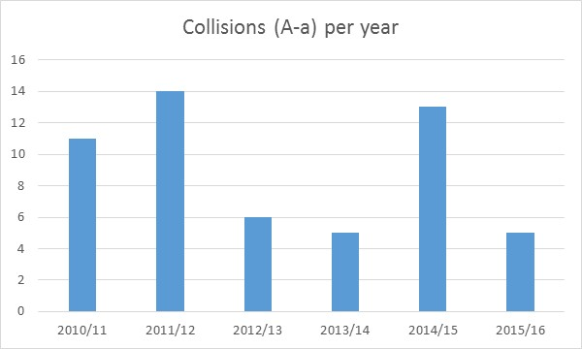
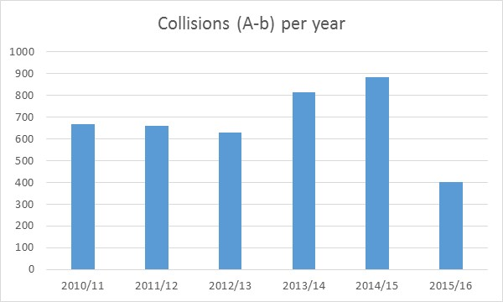
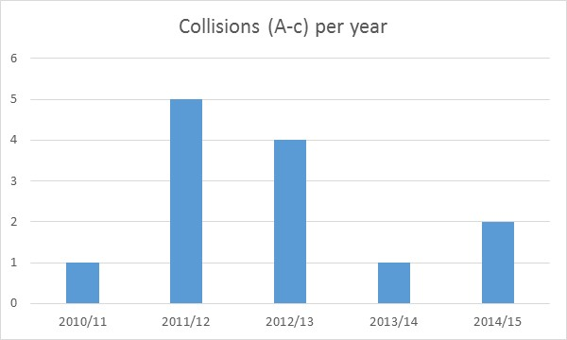
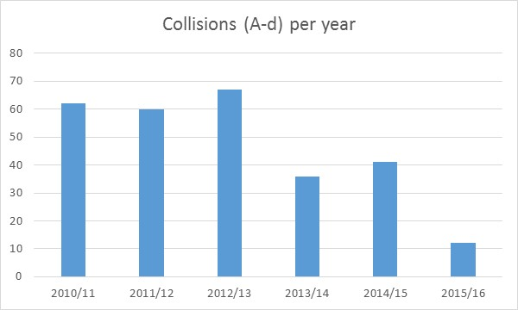
PROFILING THE RISK LANDSCAPE
COLLISIONS
Collision between rolling stock on a running line
Collision of rolling stock with an obstruction on a running line
Collision with a stop block on a running line
Collision between rolling stock other than on a running line

Slide 51
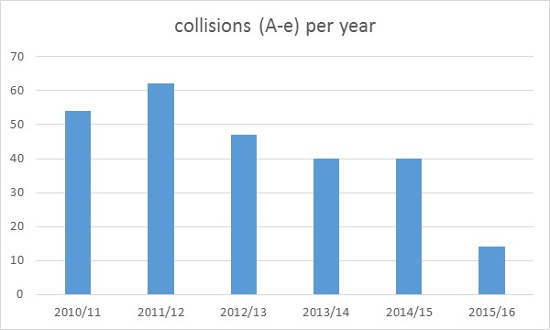
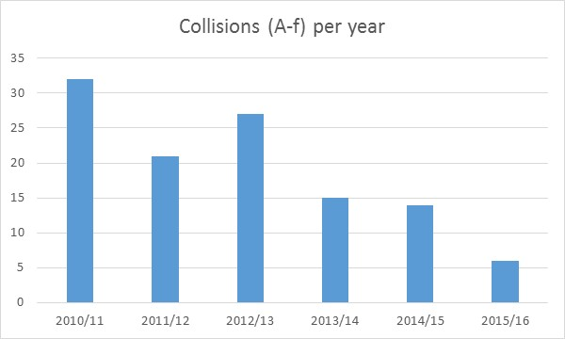
PROFILING THE RISK LANDSCAPE
COLLISIONS
Collision of rolling stock with an obstruction other than on a running line
Collision with a stop block (other than on a running line)

Slide 52
Objective statement: To work towards a Zero Tolerance culture by implementing a proactive risk management process that allows for the early identification and assessment of human factors and technical risks and by promoting a safety culture that would be embraced by all railway Operators.
Strategic Objective 1.4 | Medium-Term Targets
 | 2016/17 | 2017/18 | 2018/19 | 2019/20 | 2020/21
Reduction in the number of mainline collisions between rolling stock | 100 % Implementation of all Telecoms and Signalling Improvement Directives due for closure in 2016/17 | 100 % Implementation of all Telecoms and Signalling Improvement Directives due for closure in 2017/18 | 100 % Implementation of all Telecoms and Signalling Improvement Directives due for closure in 2018/19 | 100 % Implementation of all Telecoms and Signalling Improvement Directives due for closure in 2019/20 | 0 Collisions between rolling stock
 | 100 % Compliance to 50 % of Telecoms and Signalling Directives issued during 2016/2017 | 100 % Compliance to 50 % of Telecoms and Signalling Directives issued during 2016-2018 | 100 % Compliance to 50 % of Telecoms and Signalling Directives issued during 2016-2019 | 100 % Compliance to 50 % of Telecoms and Signalling Directives issued during 2016-2020 | 0 Collisions between rolling stock
 | 100 % of mainline collisions between rolling stock investigated | 100 % of mainline collisions between rolling stock investigated | 100 % of mainline collisions between rolling stock investigated | 100 % of mainline collisions between rolling stock investigated | 0 Collisions between rolling stock

Slide 53
Objective statement: To work towards a Zero Tolerance culture by implementing a proactive risk management process that allows for the early identification and assessment of human factors and technical risks and by promoting a safety culture that would be embraced by all railway Operators.
Strategic Objective 1.4 | Medium-Term Targets
 | 2016/17 | 2017/18 | 2018/19 | 2019/20 | 2020/21
Reduction in the number of mainline collisions between rolling stock | Human Factor Regulation implemented | Implementation of the Human Factor Regulation monitored | Implementation of the Human Factor Regulation evaluated | Human Factor Regulation reviewed | 100 % Compliance to the Human Factor Regulation
 | Human Factors causality analysis for mainline collisions conducted | Human Factors intervention training course for Operators developed and implemented | Operator awareness of the man-machine-organisational interface risks associated with collisions between rolling stock created | 70 % Reduction in human factor contribution to mainline collisions between rolling stock | 0 Collisions between rolling stock

Slide 54
FOCAL AREA 5:
PLATFORM-TRAIN INTERFACE OCCURRENCES

Slide 55
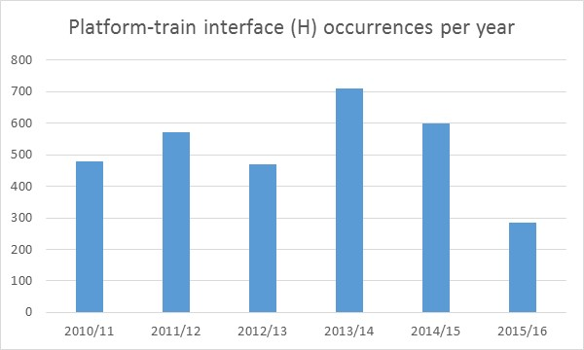
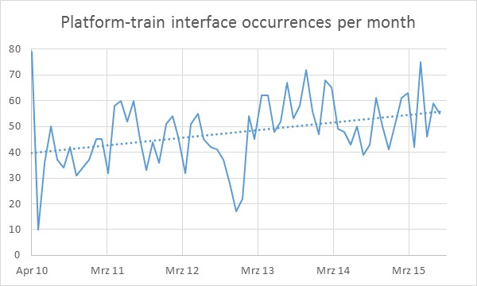
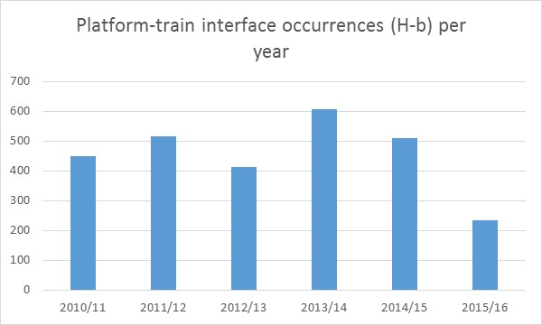
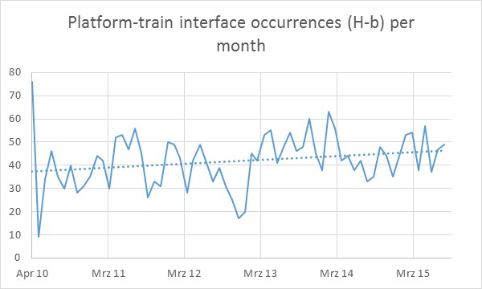
PROFILING THE RISK LANDSCAPE
PLATFORM-TRAIN INTERFACE OCCURRENCES
Collective PTI Occurrences
Occurrence where a passenger fell on the platform whilst entraining/detraining a stationary or moving train

Slide 56
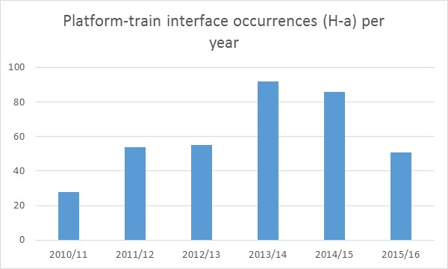
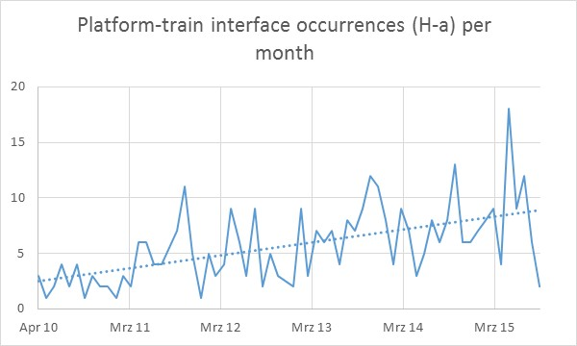
PROFILING THE RISK LANDSCAPE
PLATFORM-TRAIN INTERFACE OCCURRENCES
Occurrence where a passenger fell between the train and the platform whilst entraining/detraining a stationary or moving train

Slide 57
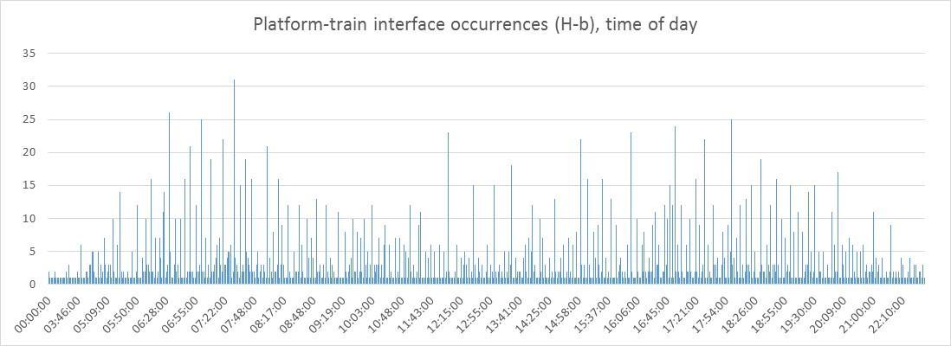
PROFILING THE RISK LANDSCAPE
PLATFORM-TRAIN INTERFACE OCCURRENCES
Estimation of collective risks is not appropriate for this category and its subcategories.
An analysis of the individual risk would be of interest to be able to give evidence, whether only the number of passengers (linear proportionality) or also the density (exponential proportionality) influences the risk.

Slide 58
Objective statement: To reduce Platform Train Interface occurrences by identifying the causal factors associated with train delays and PTI occurrences; identifying and recommending applicable and financially feasible engineering solutions; influencing the introduction of new technologies, and by encouraging safety behaviours, attitudes and practices among operators and commuters.
Strategic Objective 1.5 | Medium-Term Targets
 | 2016/17 | 2017/18 | 2018/19 | 2019/20 | 2020/21
Reduction in the number of PTI Occurrences | 100 % Implementation of all PTI Improvement Directives due for closure in 2016/17 | 100 % Implementation of all PTI Improvement Directives due for closure in 2017/18 | 30 % Reduction in the number of PTI Occurrences | 40 % Reduction in the number of PTI Occurrences | 50 % Reduction in the number of PTI Occurrences
 | 100 % Compliance to 50 % of all PTI Improvement Directives issued during 2016/17 | 100 % Compliance to 60 % of all PTI Improvement Directives issued during 2016-2018 | 100 % Compliance to 70 % of all PTI Improvement Directives issued during 2016-2019 | 40 % Reduction in the number of PTI Occurrences | 50 % Reduction in the number of PTI Occurrences
 | 2 % of PTI occurrences investigated | 5 % of PTI occurrences investigated | 8 % of PTI occurrences investigated | 10 % of PTI occurrences investigated | 12 % of PTI occurrences investigated

Slide 59
Objective statement: To reduce Platform Train Interface occurrences by identifying the causal factors associated with train delays and PTI occurrences; identifying and recommending applicable and financially feasible engineering solutions; influencing the introduction of new technologies, and by encouraging safety behaviours, attitudes and practices amongst operators and commuters.
Strategic Objective 1.5 | Medium-Term Targets
 | 2016/17 | 2017/18 | 2018/19 | 2019/20 | 2020/21
Reduction in the number of PTI Occurrences | 100 % Audits conducted on high risk Stations | 100 % Audits conducted on high risk Stations | 100 % Audits conducted on high risk Stations | 100 % Audits conducted on high risk Stations | 100 % Audits conducted on high risk Stations
 | - | RSR-PRASA PTI safety culture awareness intervention program developed | RSR-PRASA PTI safety culture awareness intervention program implemented and monitored | Commuter awareness created of the risks associated with unsafe behaviours at Stations | Safe commuter behaviour at Stations
 | Anthropometric (study of the human body and its movement) and biomechanical guidelines for railway technologies developed | Anthropometric (study of the human body and its movement) and biomechanical guidelines for railway technologies implemented | 100 % Compliance to the Anthropometric (study of the human body and its movement) and biomechanical guidelines of all new railway technologies | 40 % Reduction in the number of PTI Occurrences | 50 % Reduction in the number of PTI Occurrences

Slide 60
STRATEGIC OUTCOME 2:
SUSTAINABLE INSTITUTIONAL GROWTH & DEVELOPMENT

Slide 61
Strategic Outcome 2 : Sustainable Institutional Growth and Development
Objective statement: To generate revenue by providing safety services to the industry
Strategic Objective 2.1 | Medium-Term Targets
 | 2016/17 | 2017/18 | 2018/19 | 2019/20 | 2020/21
To secure a sustainable financial environment | R123 500 000 of Revenue generated from the main revenue stream | R143 100 000 of Revenue generated from the main revenue stream | R161 650 000 of Revenue generated from the main revenue stream | R180 200 000 of Revenue generated from the main revenue stream | % of Revenue generated from the main revenue stream

Slide 62
Objective statement: Sustained performance can be achieved by the effective management of the organisation, through awareness of the organisation’s environment, by learning, and by the appropriate application of either improvement, or innovations, or both. This requires a robust, integrated and objective performance management system i.e. a Management Quality System (MQS) that can evaluate the maturity level of the organisation – covering its leadership, strategy, management systems, resources and core business processes – to identify areas of strengths and weaknesses and opportunities for either improvement, or innovations, or both.
Strategic Objective 2.2 | Medium-Term Targets
 | 2016/17 | 2017/18 | 2018/19 | 2019/20 | 2020/21
Ensuring Performance Excellence | RSR SDIX = 46 | RSR SDIX=51 | RSR SDIX=55 | RSR SDIX = 58 | RSR SDIX = 60
 | RSR Profiling and Stakeholder Engagement Strategy developed and implemented | Implementation of the RSR Profiling and stakeholder engagement Strategy monitored | Implementation of the RSR Profiling and stakeholder engagement Strategy monitored | RSR Profiling and stakeholder engagement Strategy evaluated and amended | RSR recognised as the authority on railway safety

Slide 63
Strategy and
Planning
Customer
Focus
C
Leadership
Core
Processes
Organisational
Results
P
A
Resources
Management
Employee
Management
D
South African
Excellence Model XIII

Slide 64
Actual SDIX 2014 / 2015 Scores and 2015/ 2016 Goals
Criterion | Actual SDIX Scores 2014 | Actual SDIX Scores 2015 | SDIX Goals 2016
1 - Leadership | 38 | 45 | 52
2 - Strategy and Planning | 29 | 42 | 46
3 - Customer Focus | 9 | 33 | 42
4 - Human Resource Management | 44 | 39 | 41
5 - Financial Management | 29 | 26 | 40
6 - Operational and Technical Support | 35 | 41 | 50
Overall SDIX (PDCA based) | 30.4 | 37.7 | 46
30
37
47
SDIX Scores 2014/2015 and Goals 2015 / 2016

Slide 65
RSR SDIX Scores 2014/2015 and SA Global Innovation Index Scores

Slide 66
STRATEGIC RISK REGISTER

Slide 67
STRATEGIC OUTCOME 1: RISKS IN THE RAILWAY LANDSCAPE HAVE BEEN MITIGATED Outcome Description: Mitigate risks of occurrences by designing and establishing an appropriate regulatory approach to oversee, monitor and enforce railway safety within the regulatory framework provided by the NRSR Act, national transport and rail policies, regulations, standards and other regulatory instruments.
OBJECTIVE NO | RISK NO | RISK | INHERENT RISK LEVEL | MITIGATION | RESIDUAL RISK LEVEL
1.1-1.5 | 3 | Lack of buy-in from industry role players and target population (communities, commuters, etc.) | High | Current Mitigation Regular engagement sessions with Operators Safety Awareness Campaigns Engagement of stakeholders on new regulatory instruments Collaboration with other organs of state to promote safe railway behaviour | High
 |  |  |  | Future Mitigation Intensify strategic engagements to promote rail as safe and efficient mode of transport | Target Date 31/03/2016

Slide 68
STRATEGIC OUTCOME 1: RISKS IN THE RAILWAY LANDSCAPE HAVE BEEN MITIGATED Outcome Description: Mitigate risks of occurrences by designing and establishing an appropriate regulatory approach to oversee, monitor and enforce railway safety within the regulatory framework provided by the NRSR Act, national transport and rail policies, regulations, standards and other regulatory instruments.
OBJECTIVE NO | RISK NO | RISK | INHERENT RISK LEVEL | MITIGATION | RESIDUAL RISK LEVEL
1.1 - 1.5 | 4 | Non-alignment of RSR’s risk reduction strategy with that of the Operators | High | Current Mitigation Improvement notices and directives Penalties issued for contraventions Safety Management System implemented | Moderate
 |  |  |  | Future Mitigation Ensure Operator adherence to their approved Safety Management Systems

Slide 69
STRATEGIC OUTCOME 1: RISKS IN THE RAILWAY LANDSCAPE HAVE BEEN MITIGATED Outcome Description: Mitigate risks of occurrences by designing and establishing an appropriate regulatory approach to oversee, monitor and enforce railway safety within the regulatory framework provided by the NRSR Act, national transport and rail policies, regulations, standards and other regulatory instruments.
OBJECTIVE NO | RISK PRIORITY RATING | RISK | INHERENT RISK LEVEL | MITIGATION | RESIDUAL RISK LEVEL
1.1 – 1.5 | 2 | The insufficient technical capacity as well as rapid technological advancements may result in the RSR’s inability to effectively respond to the impacts of new technologies on safety | Very High | Current Mitigation A panel of experts has been established to augment technical capability Processes for evaluation of technologies are strengthened by independent peer reviews | Moderate
 |  |  |  | Future Mitigation Forge new, and strengthen partnerships with established regulators and academic institutions (creation of expert groups with collaborators of RSR, operators, industry and external experts) | Target Date Immediate

Slide 70
STRATEGIC OUTCOME 2: SUSTAINABLE INSTITUTIONAL GROWTH AND DEVELOPMENT Outcome Description: Implement mechanisms that promote integrated thinking and collaboration, and enable the sustainable growth and development of the RSR
OBJECTIVE NO | RISK PRIORITY RATING | RISK | INHERENT RISK LEVEL | MITIGATION | RESIDUAL RISK LEVEL
2.1 | 1 | RSR financial position may not be sustainable due to poor economic growth and the possible reduction in revenue towards the latter part of the infrastructure investment programs | Very High | Current Mitigation Tighter budgetary and expenditure management controls have been implemented Implementation of the consultancy reduction program | Very High
 |  |  |  | Future Mitigation Facilitate the amendment of the RSR Act to provide for the generation of revenue from alternate revenue streams. | Target Date 31/03/2018

Slide 71
BUDGET INFORMATION
Revenue | 2016/17 FY | 2017/18 FY | 2018/19 FY
Transfers – Government Grant | R 55 987 000 | R 59 564 000 | R 63 018 000
Permit Fee | R 123 500 000 | R 143 100 000 | R 157 410 000
Permit Application Fees | R 7 590 000 | R 8 045 400 | R 8 528 124
Capital / New Works Projects | R 60 400 000 | R 65 860 000 | R 70 470 000
Investment Income | R 349 000 | R 370 000 | R 420 000
Investigations | R 5 151 000 | R 4 250 000 | R 4 494 400
GRAND TOTAL | R 252 977 000 | R 281 189 400 | R 304 340 524
Expenditure | 2016/17 FY | 2017/18 FY | 2018/19 FY
Compensation of Employees | R 150 112 201 | R 162 050 017 | R 175 830 898
Goods and Services | R 100 364 800 | R 116 139 383 | R 125 009 626
Capital Expenditure | R 2 500 000 | R 3 000 000 | R 3 500 000
TOTAL EXPENDITURE | R 252 977 000 | R 281 189 400 | R 304 340 524

Slide 72
FINANCIAL INFORMATION
Below is the trend analysis of revenue for the past six years:
FINANCIAL YEAR | 2011/12 (‘000) | 2012/13 (‘000) | 2013/14 (‘000) | 2014/15 (‘000) | 2015/16 (‘000) | 2016/17 (‘000)
Grant Income | 37 475 | 39 349 | 46 513 | 51 504 | 53 379 | 55 987
Permit Fee | 20 596 | 38 414 | 57 919 | 79 000 | 106 000 | 131 090
New Capital Works | - | - | - | 2 500 | 76 000 | 61 551
TOTAL | 58 071 | 77 763 | 104 432 | 130 504 | 235 379 | 248 628

Slide 73
PERCENTAGE GROWTH
FINANCIAL INFORMATION
Percentage growth | 2011/12 | 2012/13 | 2013/14 | 2014/15 | 2015/16 | 2016/17
Grant Income - OPEX | 5% | 5% | 5.50% | 6.00% | 4% | 4%
Permit Fees | 83% | 87% | 51% | 36% | 27% | 27%

Slide 74
FINANCIAL INFORMATION

Slide 75
FINANCIAL INFORMATION

Slide 76
FINANCIAL INFORMATION

Slide 77
FINANCIAL INFORMATION

Slide 78
Strategic projects
Asset Management (NIMS)
Association of Railway Regulators in SADC
High Speed Rail Regulation and related Standards
Security Regulation and related Standards

Slide 79
CHALLENGES
Unsecured railway reserves compromising assets and resulting in an increase of fatality rates within the people struck by trains category
Revenue generating streams not explicitly mentioned in the RSR Act

Slide 80
THANK YOU

