Slide 1
PRASA presentation to Portfolio Committee of Transport
April 2016

Slide 2
Structure of the Presentation
Part A:
Annual Corporate Plan
MTEF Budget
Capital Programme
Part B:
SONA 2016 and 9-Point Plan
Part C:
Annual Performance Indicators and Targets 2016/17
Part D:
Financial performance as at 29 February 2016

Slide 3
PART A:
ANNUAL CORPORATE PLAN

Slide 4
Purpose of the Corporate Plan
Compliance with Section 52 of the PFMA
In accordance with Section 52 of the PFMA, which deals with annual budgets and corporate plans provides that PRASA as an State Owned Entity must annually submit a Corporate Plan in the prescribed format covering the affairs of that public entity or business enterprise for the following three (3) financial years, and, if it has subsidiaries, also the affairs of the subsidiaries.
The corporate plan must cover the MTEF period (covering 3 years), and will cover strategic objectives and outcomes identified and agreed on by the executives authority in the shareholder’s compact.

Slide 5
Structure and Format: 2016- 2019 Corporate Plan
The 2016/17 – 2018/19 Corporate Plan for PRASA has the following Headings and Sub-Headings:
The PRASA Mandate
  Statement of Purpose
  Vision and Mission
  Values
  Operating Principles
Operating Environment
  Legislative Framework
  Regulatory Environment
  Other
Market and Industry Overview
  Transport and other Related Sectors
  Key Assumptions
  Market and Economic Developments
  National Imperatives (NDP)

Slide 6
Structure and Format: 2016- 2019 Corporate Plan…cont
Executive Summary and Performance and Outlook
  Summary of PRASA Key Successes
  Evolution PRASA Strategy
  Key strategic themes and assumptions informing PRASA Strategy\
  Financial Performance Overview
PRASA Strategic Focus Areas for the next 3 years
  PRASA Strategy and Core Strategic Objectives for the MTEF Period
  Critical Success Factors and Challenges
Business Unit Contribution to the Corporate Plan
  Functional/Business Unit Main Objectives
  Key Priority Areas for the MTEF Period
  Strategic Deliverables
  Key Performance Areas
Risk Management Framework & Plan
Fraud and Prevention Plan
Budget
Capital Programme
Annual Performance Plan

Slide 7
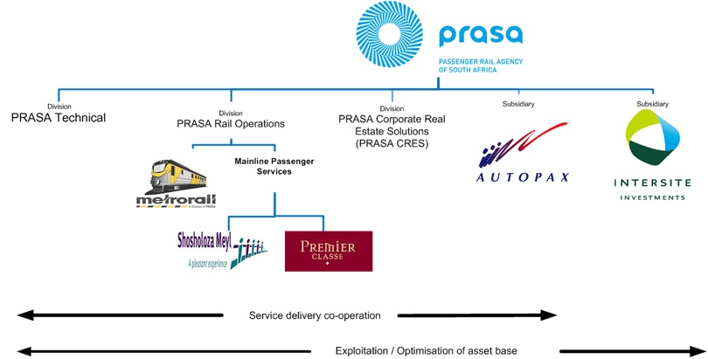
Legal Operating Structure

Slide 8
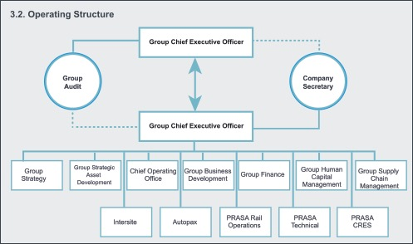
Organisational Structure
Board of Control

Slide 9
PRASA Mandate
PRASA, as the implementing arm of the National Department of Transport, the sole shareholder, is primarily focused on the mandate contained in the Legal Succession Act of South African Transport Services (SATS) Act of 1989, as amended in November 2008.
The main objective and main business of PRASA is to:
Ensure that, at the request of the Department of Transport, rail commuter services are provided within, to and from the Republic in the public interest, and
Provide, in accordance with the Department of Transport, for long haul passenger rail and bus services within, to and from the Republic in terms of the principles set out in section 4 of the National Land Transport Transition Act, 2000 (Act No. 22 of 2000)
The second objective and secondary business of PRASA is that:
PRASA shall generate income from the exploitation of assets acquired by it, which include real estate and property portfolio.
A further requirement is that, in carrying out its objectives and business, PRASA shall have due regard for key Government, social, economic and transport imperatives and policy objectives.

Slide 10
Prasa Strategic Roadmap
Since its inception, and building on the strategic initiatives of its Predecessor, the SARCC, PRASA has embarked on systematic and sustained programme 0f redressing some of the legacy programs arising out of decades of under investment in public transport infrastructure and services.
This programme has been rolled out in 3 phases:
2009-2010: Stabilization of Commuter Rail
2011-2014: A Focus away from Refurbishment to Replacement
2015- : Recapitalisation, Growth and Expansion

Slide 11
Other Government Policies and Relevant Legislation
As a public entity, the national Government policies and relevant legislation, including initiatives, remain a strategy driver for PRASA. This is manifested through, government policies and strategic, such as:
National Land Transportation Act
Public Transport Strategy
The National Transport Master Plan
National Rail Policy Green Paper
National Development Plan
Government Imperatives
  Industrialisation
  Women Empowerment
  Youth Empowerment
  People with Disabilities
Public Finance Management Act
9-Point Plan

Slide 12
Supporting the National Development Plan
The National Development Plan calls for Integrated, holistic, long-term perspective on all transport networks informed by growth priorities, the environment, inclusivity and access.
In the NDP, Transportation cuts across the economy, environmental sustainability, spatial transformation, global connectivity, state capability, social cohesion and health.
PRASA has noted from the NDP the following strategic focus areas and planning priorities focusing on the creation of workable urban transit solutions that will streamline an effective urban transport system, thus contributing to:
Increasing investment in public transport and resolving existing public-transport policy issues
Provision of affordable, faster, reliable and safe transport
Transport plans that are aligned with spatial development
Renewing the commuter train fleet
Property Development
Broadband Connectivity

Slide 13
Implementing PRASA National Strategic Plan
PRASA’s National Strategic Plan is aligned with National Transport Masterplan 2050 and has a long-term horizon that is implemented on various phases of the MTEF Period(s), through the Corporate Plan. It focuses on the following.
A prioritized list of rail service and network expansion interventions that:
provide more capacity to accommodate forecast growth,
transform the rail product on many corridors,
seek to make better use of the network, and
propose corridor extensions to new or growing settlement.
Specific initiatives and investment programs are rolled out throughout the Corporate Plan of each succeeding MTEF Period, as per the following:
Rolling Stock Fleet Renewal Investment Program (20-year program)
Depot Modernisation (Over 10 Year)
Station Modernisation (Over 10 Years)
Signalling (5 - 7 Year Program)

Slide 14
Key Themes informing the Corporate Plan
The Themes informing the delivery on the Corporate Plan and its strategic objectives will be characterized by the following:
Mode of Choice: A shift in the public thinking about public transport that recognizes rail as a viable option for commuters
Modernisation: Reversing decades of underinvestment in rail infrastructure and improving the property condition and creating a modern public entity
Public Value: PRASA providing public passenger transport solution and services that far outweigh the financial value generated through the provision of such service and solutions to both the individual and society
Growth and Expansion: Extension of bus services integrated with commuter trains and linking-high volume corridors into effective service

Slide 15
Key Themes Informing the Strategy (Cont.)
The Themes informing informing the delivery on the Corporate Plan and its strategic objectives will be characterized by the following:
Mobility: Rural access and mobility is the key focus for the provision of public transport as people relocate from isolated rural homes to settle at transport nodes or along transport corridors in order to access services
Accessibility: PRASA shall provide quality rail, bus property management services that enable individual communities to access socio-economic opportunities and contribute to a better quality of life of the people as a whole
Service Excellence: A deep commitment to superior performance that is safe, reliable and affordable, provide a dignified travel experience that makes a lasting impression, and builds brand loyalty – both internally (employees) and externally (customers) – that adds benefits to the passenger
Sustainability: A focus on sustainable development in business that considers not just the financial ‘bottom line’ of prosperity, but the environmental quality and social equity

Slide 16

Our Strategic Thrust
The Corporate Plan is informed by the Medium to Long Term Business Objectives that seek to position rail as the backbone of public transport supported by bus services and a real estate and property development strategy through:
Rolling out a Train System of the Future
Expanding PRASA Networks and Services
Executing the Real Estate Strategy
Embarking on a Robust Assets Investment Program
Enhancing Organisational Capacity
Improving Financial Position
Public Employment Creation
Stakeholder Relations and Engagement
PRASA’s understanding interpretation and implementation of the Mandate contained in the Legal succession Act of South African Transport Services (SATS) Act of 1989, as amended in November 2008.
Key Drivers:
Attractive Value Proposition for Customer and Employees
Positioning Rail as the Mode of Choice
Organisational Efficiencies and Effectiveness
Maintaining Relevance in Public Transport Solutions
A Viable Funding Model
An Appropriate Operating Model
PRASA ‘s understanding of its role and contribution to the Government’s National Development Plan.
Notes:
----- Meeting Notes (2015/10/17 11:59) -----
Enablers of our strategy
- separate enablers and ambitions
funding gap (public value, operations, infrastructure)
people development
right structure
people management
customer satisfaction
- ambitions
- public solutions
AU decision to create prasa as hub for rail

Slide 17
PRASA’s Strategic Considerations
External Challenges
PRASA Ambitions
Solutions
Understand the changing preferences of commuters, passengers and users of our facilities
Maintaining relevance in a highly competitive public passenger transport environment
Striking a balance between the current services and planned future offerings
Position Rail as a Mode of Choice
Deliver a reliable, safe and efficient modern Metro service
Build a Modern Public Entity
Deliver Public Value
Become a Leader in Passenger Transport Solutions
Grow the Customer base
Improve Financial Position
Stabilise the current service
Deliver the modernisation programme
Roll out a Train System of the Future
Provide an Integrated transport network
Unlock the value of assets
Offer Differentiated Customer service offerings
Customer-Centric
Public Value Driven
Secured Future

Slide 18
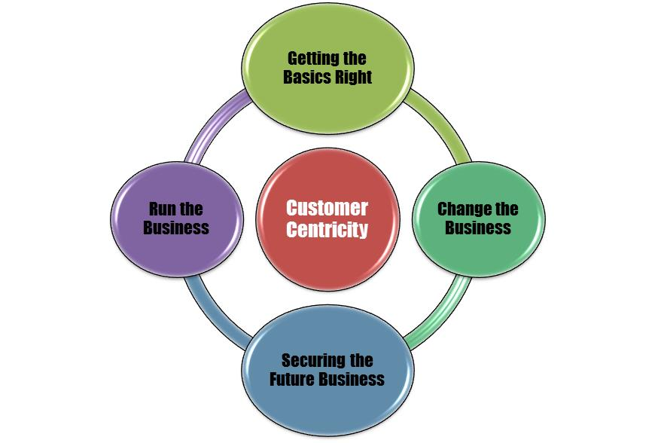
Our Strategic Priorities for the MTEF Period
Notes:
Relevance and Sustainability
Government imperatives
Expanding networks and services
Stakeholder relations and engagement
Deliver on the Brand Promise
Viable Funding Model
Delivers public value
Changing the Business
Modernisation readiness
Infrastructure readiness
Rolling Fleet Renewal Program
Skills and talent development

Slide 19
Getting the Basics Right
Fixing the Business
Fixing the business requires a clear commitment in Getting the Basics Right through:
Governance & Compliance
Performance and Consequence Management
Projects Execution and Contracts Management
Operational Efficiencies and Effectiveness
Instilling the Right Organisational Culture and Behaviour

Slide 20
Running the Business
Running the Business
Ensuring that various business units and divisions stay focussed in:
Delivering on the mandate
Delivering value for customers
Revenue collection and reduced fraud and fare evasion
Rightsizing and efficient deployment of resources
Building positive stakeholders

Slide 21
Modernisation Readiness
Changing the Business
At the centre of PRASA creating a modern public entity is the modernisation readiness delivered through:
Infrastructure readiness
Rolling Stock Fleet Renewal
Deployment Corridor strategy
Future Skills and Capacity development
Marketing and communication of PRASA’s modernisation program
Stakeholder Engagement and Managing Expectations

Slide 22
Maintaining Relevance in Public Transport Solutions
Securing the Future Business
For PRASA to maintain relevance in public transport solutions it has to focus on:
Delivering on the Modernisation Program
Expanding PRASA Networks and Services
Delivering on National Government Imperatives
Integrated Network Planning aligned with other Transport Authorities
Growing the Revenue base
A viable Funding Model and appropriate Operating Model

Slide 23
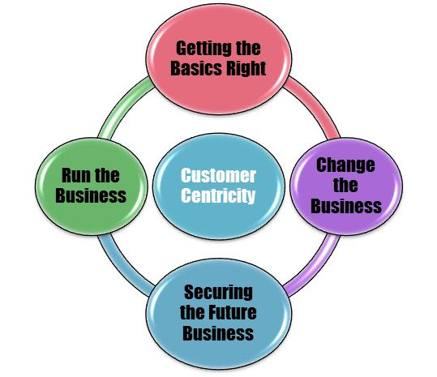
Strategic Pillars of PRASA Strategy
5 Key STRATEGIC PILLARS underpin the achievement of the strategic priorities:
Meet Customer Expectations
Superior Performance
Close the Funding Gap
Delivering Public Value
Deliver on the Brand Promise

Slide 24
Summary of strategic priorities over the next 3 years:
The Corporate Plan takes into account that sustaining the current operations and growing the business, underpinned by customer service excellence, would require a dedicated focus on:
Rolling out the Train System of the Future,
Improving the financial position and containing the cost of doing business,
Addressing operational inefficiencies and improving service delivery,
Sweating PRASA’s non-operational and strategic assets,
Executing a robust real estate strategy,
Capacity development for the modernisation program,
Securing future business expanding the current network and new services
Developing a viable Funding Model
Redefining PRASA’s Operating Model, and
Delivering on the Brand Promise

Slide 25
MTEF BUDGET

Slide 26
  Projections of revenue, expenditure and borrowings

Slide 27
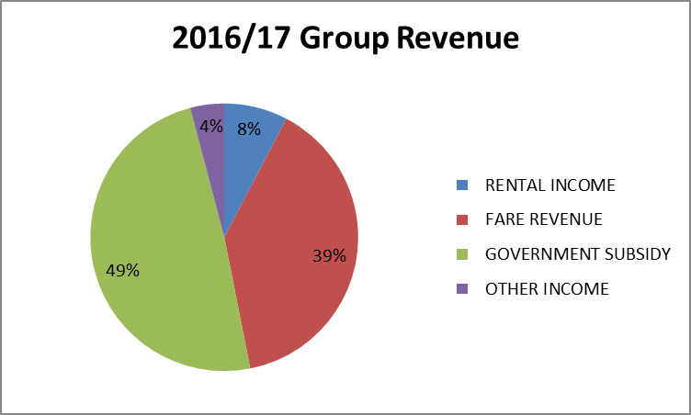
  Group Revenue Streams
Major Income Streams
Operational Subsidy (From Department Of Transport)
Fare revenue (Autopax and PRASA Rail)
Rental Income (PRASA CRES and PRASA Rail)
30

Slide 28
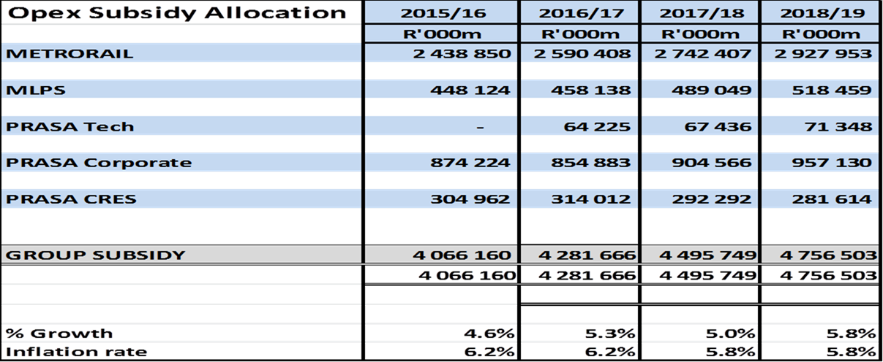
  Subsidy Allocation per Programme
Group Subsidy shows an increase above 5.0% during the MTEF period.
Subsidy growth is below National Treasury projected inflation.
No additional subsidy was allocated for MLPS on National Treasury allocation. However Rail subsidy was reduced to provide for MLPS.
31

Slide 29
    Asset and Liability Management

Slide 30
    Cash Flow Projections

Slide 31
CAPITAL PROGRAMME

Slide 32
Investment Outlook
Infrastructure vs. Rolling Stock Investment Outlook
Programmes Overview
Infrastructure
Corridor Modernization Programme
Capital Intervention Programme
Station Improvement and Upgrade Programme
Rail Network Extensions
Depots Programme
Workplace Improvement Programme
Electrical Programme
Rolling Stock
Rolling Stock Fleet Renewal Programme
Accelerated Rolling Stock Programme
New Locomotives

Slide 33
Allocation per Division - Overview
2015 MTEF Capital Programme
Allocation per Division (Annual breakdown)

Slide 34
2016 MTEF Capital Programme
28

Slide 35
PART B:
2016 SONA & 9-POINT PLAN

Slide 36
PRASA’s Response and Contribution to the 9-Point Plan
9-Point Plan
Contribution
Comments
Industrial Policy Action Plan
Resolving the energy challenge
Stabilising the labour market
Scaling-up Private Sector Investment
Transport Infrastructure
Local Train Manufacturing Plant
Energy Savings Program
Job Creation and Skills Development
Property and Asset Development with Private Sector Investment
Rail as a Backbone of Public Transport
580 Trains to built in RSA
65% local content
Industrial Supplier Park
20% Energy Regeneration (New Trains)
16645 Jobs (see next slide)
1 Station Built with Private Sector Participation
4 More Stations in the Pipeline (C.T. & Dbn)
Affordable, Safe, Secure and Reliable Transport
R172 Billion Investment

Slide 37
Impact of the PRASA Investment Program
Job Creation Programmes
Impact
Rolling Stock Fleet Renewal Programme | 8 088 direct jobs to be created over the next 10 years, with R59 billion committed for spending.
National Signaling Programme | 762 already jobs created. Additional 150 new jobs to be created targeting signal engineers and technicians for the maintenance.
Rail Extensions Implement Motherwell Rail Extension Green View - Pienaarspoort | 1000 jobs to be created. 325 jobs created over the past 3 years.
Rolling Stock Refurbishment Metrorail Coaches S/Meyl Coaches | Sustain 2004 jobs annually.
National Station Upgrade | Sustain 1005 jobs annually.
Depot Modernisation Programme: Wolmerton Depot Braamfontein Depot | 3000 jobs expected to be created during construction.

Slide 38
PART C:
ANNUAL PERFORMANCE INDICATORS & TARGETS

Slide 39
Applied principles for PRASA Performance Targets
Focus on achievable and realistic targets
Consider challenges, competency and capability of organisation
Use forecasting with Statistical time series, proper consideration of the baseline (history) combined with “Expert” forecasting
Set range target for all numerical & project indicators using statistical principles for Quality performance improvements
Alignment with deficit budget

Slide 40
Key Performance measures and indicators

Slide 41
Key Performance measures and indicators

Slide 42
Key Performance measures and indicators

Slide 43
Key Performance measures and indicators

Slide 44
Key Performance measures and indicators

Slide 45
Key Performance measures and indicators

Slide 46
Key Performance measures and indicators

Slide 47
Key Performance measures and indicators

Slide 48
Key Performance measures and indicators

Slide 49
Actions to Improve Future Performance
Review of target setting process for realistic and achievable targets
  Range target
  Based on statistical principles of Quality Control
Reduce the number of indicators
  From 46 to 31. (30% reduction)
Alignment of Budget to APP to Performance Agreements of Executives.
Consequence management
Monitoring and evaluation process via Group Exco and Board
44

Slide 50
PART D:
Financial Performance as at
29 February 2016

Slide 51
Cash Position
PRASA is technically solvent
Operational side, risk of not being able to pay all of its operational obligations.
  Salary bill 50% of total expenditure
  Therefore only 50% to be distributed amongst other expenditure in fulfilling our mandate of providing high quality services;
  Operational subsidy grew on average by 5% a year,
  Fare revenue shows a decline when compared to fare revenue of R2.9bn in prior year;
  Capital investment is slow in generating additional returns, or may not generate income at all;
  Some capital investment requires additional operational expenditure but no additional funding/income is received for this expenditure.
Underfunding in operational activities.
Current income and expenditure trends now require transfer from capital grant to operational subsidy on an annual basis.
PRASA was granted only R800 million from the request for transfer of R1.6 billion from capital subsidy to operational subsidy, leaving an operational cash shortfall of R599m as at the end of February 2016.

Slide 52
Income Statement as at 29 February 2016

Slide 53
