Slide 1
Briefing to the Portfolio Committee on Agriculture, Forestry and Fisheries
Financial and Fiscal Commission
7 April 2016
For an Equitable Sharing of National Revenue

Slide 2
Presentation Outline
Introduction to the Financial and Fiscal Commission
Evolution of agriculture and contribution to economy
Departmental MTEF and APP Analysis
Concluding Remarks
FFC Recommendations

Slide 3
Role and Function of the FFC
The Financial and Fiscal Commission (FFC)
Is an independent, permanent, statutory institution established in terms of Section 220 of Constitution
Must function in terms of the FFC Act
Mandate of Commission
To make recommendations, envisaged in Chapter 13 of the Constitution or in national legislation to Parliament, Provincial Legislatures, and any other organ of state determined by national legislation
The Commission’s focus is primarily on the equitable division of nationally collected revenue among the three spheres of government and any other financial and fiscal matters
Legislative provisions or executive decisions that affect either provincial or local government from a financial and/or fiscal perspective
Includes regulations associated with legislation that may amend or extend such legislation
Commission must be consulted in terms of the FFC Act
The Commission’s current submission on the 2017/18 Division of Revenue will focus on the impact of the IGFR instruments on rural development

Slide 4
2. Agriculture, Forestry and Fisheries in the Context of the Broader Economy

Slide 5
Background
Despite its small contribution to the economy (less than 3% since early 1990s), agriculture is still an important sector of the economy
The sector has large linkages with rest of the economy making its contribution to economy much larger than its overall size
In 2015, agriculture contributed approximately 5% of total exports, making it an important earner of nett foreign exchange
However, employment in agriculture lower than other comparable countries with same agriculture size
Fisheries contributes roughly 0.1% to GDP but play a significant role in local economies with a strong fisheries sector
Forestry sector maintained a trade balance of R22.8 billion in 2014. Most of the investment in Forestry are in rural provinces and therefore the sector can play a significant role in contributing rural development

Slide 6
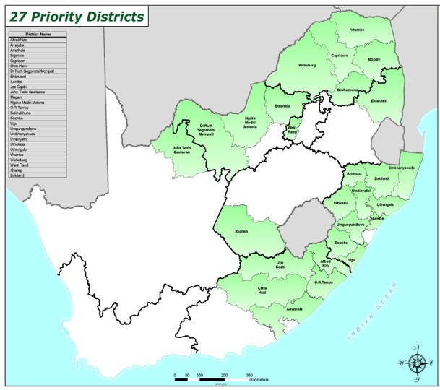
Agricultural performance
SA agriculture is dualistic: Include commercial and emerging farmers
Commercial produce about 95% of agricultural output & rest by emerging farmers
Commercial farmers been declining standing around 37 000 in 2014 due to consolidation of farm units (i.e. farm unit size increasing and number of farmers decreasing)
Bulk of emerging farmers located in 27 priority districts and lack infrastructure
Market destination for agricultural products are EU accounting 32% share in exports; Africa with 31%; Asia 20% and USA 3% in 2014
Agriculture, Forestry and Fisheries trade
Total production by commodity

Slide 7
Agricultural Employment
The consistent decline in agricultural employment over time from 1.8 million in 1962 to 879 000 in 2015 may be turning around
The trend has been positive in the past year with the labour force survey showing nett job creation in the agriculture sector in all four quarters of 2015 compared to 2014
The recent draught may see a reversal of this trend and will require active policy intervention to avoid anticipated job losses, especially in the commercial sector
Source: StatSA

Slide 8
Impact of the drought
Already there is a noticeable impact of drought – average contraction of about 5% through first 3 quarters of 2015 in contrast to average growth of 1.5% in normal years 2013 – 2014
South Africa set to become significant net importer of grains in 7 years: Estimated 5 million tons of maize and 2 million tons of wheat will be imported between May 2016 – April 2017
Against backdrop of currency depreciation and rising global grain prices, results in significant costs: R11.5 billion for imported grains PLUS increased pressure on timeous and efficient delivery of imports due to constrained infrastructure capacity for agricultural bulk operations at Transnet

Slide 9
Food Prices
CPI and Food Inflation Increase, 2003-2015
Source: Statssa
Although food inflation was lower than CPI inflation in 2015, unlikely to see this trend continuing in 2016.
Forecasts suggest outlook for 2016 is expected to put further upward pressure on food prices with the recent draught, exchange rate depreciation and other policy updates (E.g. increase in the fuel levy, etc.)

Slide 10
NDP and Agriculture
The National Development Plan (NDP) envisages the agriculture sector as one of the key levers for job creation and ensuring food security in South Africa. The NDP identified the following objectives for the sector:
Create one million jobs in agriculture, agro processing, and related sectors by 2030
Increase investments in new agricultural technologies and research and development
Realise a food surplus with 1/3 produced by small-scale farmers or households
Create security of tenure for communal farmers, especially women
A reduction in the growth of government expenditure due to lower than anticipated economic outlook likely to have an impact on the medium term spending plans of DAFF as well as its strategy to achieve NDP goals
By reducing costs in non-core expenditure areas and improving spending efficiency, the impact of spending pressures on programme delivery will be lessened until economy recovers

Slide 11
3. Departmental MTEF and APP Analysis

Slide 12
Departmental Overview
The department consists of 6 programmes
Administration, Agricultural Production Health and Food Safety, Food Security and Agrarian Reform, Trade Promotion and Market Access, Forestry and Natural Resources Management and Fisheries
Six entities report to and fall under the budget of the DAFF
Mandate: value chains, inputs, production and consumption in the agriculture, forestry and fishery sectors.
Department contributes to outcome 4 (decent employment through inclusive economic growth), outcome 7 (comprehensive rural development and land reform) and outcome 10 (enhance environmental assets and natural resources)
Focus of the department over the medium term informed by NDP and relates to:
Increasing food security, creating decent jobs, and improving the contribution of agriculture to national GDP

Slide 13
Spending and MTEF Budget by Programmes
In 2016/17, the DAFF is allocated a budget of R6.3 billion which increases to R6.99 billion in 2018/19
This represents a real annual average decline of 3.2% per annum over the MTEF
The sizeable decline in growth of allocations to Forestry and Fisheries programmes continue over the 2016 MTEF, despite increased attention being given to aquaculture as an area for potential job creation (aquaculture was included in Operation Phakisa in 2014)
Priority programmes such as Agricultural Production and Food Security is also declining over the 2016 MTEF period
 | 2012/'13 | 2013/'14 | 2014/'15 | 2015/16 | 2016/17 | 2017/18 | 2018/19 | 20012/13 - 2015/16 | 2016/17 - 2018/19
R'million |  |  |  |  |  |  |  | Real Avge Growth P.A | Real Avge Growth PA
Admin. | 645 | 682 | 738 | 729 | 788 | 803 | 840 | -1.3% | -1.4%
Agric. Prodn, Health & Food Safety | 1 875 | 2 001 | 2 184 | 2 145 | 1 953 | 2 183 | 2 293 | -0.9% | -3.6%
Food Security & Agrarian Reform | 1 405 | 1 590 | 1 656 | 1 919 | 1 890 | 2 018 | 2 091 | 5.5% | -3.3%
Trade & Market Access | 212 | 256 | 307 | 234 | 298 | 265 | 275 | -0.5% | 0.5%
Forestry | 1 192 | 1 145 | 1 304 | 906 | 946 | 961 | 1 003 | -12.5% | -2.8%
Fisheries | 484 | 438 | 440 | 465 | 459 | 476 | 498 | -6.7% | -3.9%
DAFF | 5 813 | 6 111 | 6 629 | 6 399 | 6 333 | 6 706 | 6 999 | -2.2% | -3.2%

Slide 14
Programme Share of Total Spending and Budget
Agricultural Production, Health and Food Safety and Food Security and Agrarian Reform consume the bulk of the department’s resources (62% over 2016 MTEF)
Over the 2016 MTEF period, the proportion of allocation to Forestry decline from 18% to 15%, while Food Security increases from 26% to 30%. These adjustments reflect the relative prioritisation of the department and speak to the medium term priorities of the department

Slide 15
Spending and MTEF Budget by Economic Classification
Effect of Cabinet-approved reductions evident particularly with respect to goods and services (-9.7%), transfers and subsidies (-3.6%) and payment for capital assets (-12.3%)
The CoE budget increases by 1.6% over 2016 MTEF, despite reductions of R149.3 million in 2017/18 and R233.9 million in 2018/19
An amount of R60 million from the CASP grant was retained by the National department for beefing-up its support and oversight function over the implementation of the agriculture grants over the medium term
 | 2012/'13 | 2013/'14 | 2014/'15 | 2015/16 | 2016/17 | 2017/18 | 2018/19 | 20012/13 - 2015/16 | 2016/17 - 2018/19
R'million |  |  |  |  |  |  |  | Real Avge Growth P.A | Real Avge Growth PA
CoE | 1 419 | 1 525 | 1 662 | 1 763 | 2 055 | 2 129 | 2 202 | 1.9% | 1.6%
Goods and Services | 730 | 746 | 732 | 772 | 660 | 687 | 688 | -3.9% | -9.7%
Transfers and Subsidies | 3 493 | 3 638 | 4 029 | 3 695 | 3 496 | 3 766 | 3 975 | -3.7% | -3.6%
Payments for Capital Assets | 169 | 200 | 206 | 167 | 121 | 122 | 132 | -5.2% | -12.3%
Payments for financial Assets | 1.3 | 1.4 | 0.2 | - | 0 | 0 | 0 | -63.8% | 0.0%
TOTAL DEPT EXP. & ESTIMATES: | 5 812 | 6 111 | 6 629 | 6 397 | 6 332 | 6 705 | 6 998 | -2.2% | -3.2%

Slide 16
Line Item Share of Total Spending and MTEF Budget
The bulk of the department’s resources are allocated to transfers and subsidies in the form of conditional grants to provinces and transfers to public entities
Over the 2016 MTEF, transfers and subsidies decline from 60% to 56%, largely as a result of reprioritisation
Compensation rises significantly as a proportion of the department’s budget allocation. If increased allocation is as a result of improving capacity to monitor agriculture grants, then this should be commended

Slide 17
Assessing APP and sector challenges
While the department mentions the major challenges facing the sector, it is unclear how strategies that address these challenges have filtered into the strategic objectives and performance indicators of the department (E.g. lack of sufficient infrastructure; erosion of competitiveness of commercial farmers)
While the department (and provinces) have taken various measures to address the drought crisis in South Africa, it is unclear whether the allocated funds and measures taken will be enough to avoid adverse impact on the sector as a whole
The APP is silent on an assessment of whether current implementation is sufficient to address the crisis and whether any gaps still need to be addressed
The Commission welcomes the department’s initiative towards climate smart agriculture as a way of mitigating the impact of drought
While putting land under crop production is a major initiative under the food security programme, what seems missing are ways in which the department will ensure cultivated land are according to agreed upon standards
The department reported a very low compliance rate against agreed upon standards in its 2014/15 annual report

Slide 18
Assessment of Performance information in the APP (1)
The quality of performance information contained in the APP is extremely poor and may pose significant oversight challenges in assessing the in-year performance of the department
The annual target of some indicators do not reconcile with the quarterly breakdown (e.g. in annual column, 5 operation Phakisa projects for P1 supported, but quarterly breakdown comes to 8)
Some indicators are vague and may not be focusing on the area of performance that should be measured (e.g. no. of households benefiting from food production initiatives, no. of small holder producers receiving support, etc.)

Slide 19
Assessment of Performance Information in the APP (2)
Some indicators are not in accordance with the SMART principle which may raise concerns about how DAFF will correctly report against these indicators (E.g. Sector research agenda implemented and monitored, resources developed, etc.)
Confusion between an activity and performance indicator
Many indicators sounds like an activity. There is therefore no performance dimension that can be measured (E.g. risk-based annual plan implemented, fraud prevention plan implemented, etc.).
The alignment between the NDP and the department’s APP is not explicit enough
DAFF can enhance the linkage by aligning main outputs related to DAFF in the NDP with current implementation of 2016 APP

Slide 20
Assessment of Conditional Grants (1)
Spending of the agricultural conditional grants over the period 2012/13 – 2014/15 reflect inadequate spending performance
CASP only spent on average 92% over the period
For the 2015/16 FY, spending on all three conditional grants are significantly below the N.T benchmark figure of 91% as at the end of February 2016
Some of the main challenges in the sector include poor planning, contractor challenges, late changes to business plans and weak and ineffective procurement processes
Spending performance of Agricultural Grants
 | 2012/13-2014/15 | Mar 2015 - Feb 2016 | Benchmark (Mar '15 - Feb'16)
CASP | 92% | 67% | 91%
Illima/Letsema | 96% | 78% | 91%
Land Care | 95% | 76% | 91%
Source: National Treasury Database

Slide 21
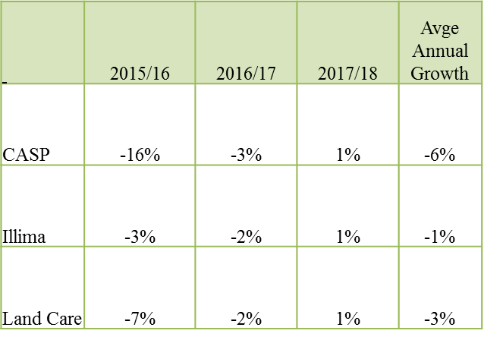
Assessment of Conditional grants (2)
Spending allocations to agricultural grants declining over the MTEF period mainly as a result of underspending and reallocating resources into other priority areas
CASP is reduced by R150 million over the MTEF period
An amount of R2.8 billion is reallocated to Fetsa Tlala from the Infrastructure allocation of CASP to support farmers with production inputs (E.g. seeds, fertilizer, etc.)
DAFF also intends to use allocations from CASP and Illima Letsema grants to assist in providing drought relief to farmers
Source: DORB (2016)

Slide 22
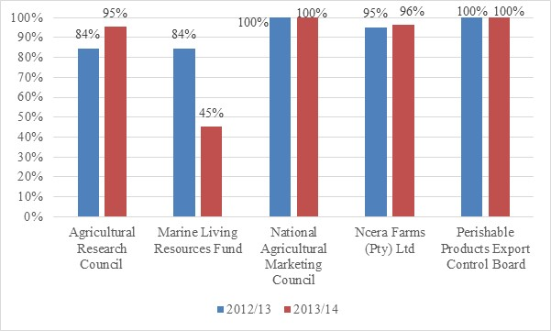
Spending Performance of Entities, 2012/13 and 2013/14
Some entities reporting to DAFF are underspending on allocations received (i.e. Agricultural Research Council, Marine Living Resources Fund and Ncera Farms)
It is unclear what some of the reasons for the underspending are and whether DAFF has taken any active steps to assist these entities in addressing any underlying issues

Slide 23
Concluding Remarks
NDP envisages a major role for DAFF in creating employment, growth and ensuring food security
Aspects requiring attention
Department oversight role in relation to provinces needs to be strengthened
Underspending on grants generally as a result of weak procurement processes in provincial DAFF – what role can DAFF play to enhance performance of provincial departments
The Commission welcomes the retainment of R60 million from the CASP to improve national oversight over agriculture grants
The quality of performance information in the APP does not allow for effective oversight over the department’s performance
It is unclear how many of the sector challenges will be addressed in the APP

Slide 24
5. FFC Agriculture –Related Recommendations for 2015/16 DoR

Slide 25
Submission | FFC Recommendation
Submission for the 2015/16 DoR | DAFF should strengthen its ability to enforce the conditions in the grant framework to ensure better oversight of provinces, so that spending and performance of agricultural conditional grants can be improved. The Commission suggests that norms and standards be developed to assess the performance of provinces and five-year evaluations of conditional grants be institutionalised Government Response: Government supports recommendation on development of norms and standards. Government (via the DPME) has initiated evaluation of agricultural conditional grants, incl. CASP. The report of this review will be used as a basis to institutionalise evaluation processes
 | The Commission recommends that special focus is put on improving the operations of different food security programmes, especially Agriculture, EPWP and the School Nutrition Programme, which accelerate reduction in household food security without necessarily increasing programme expenditure. Areas that can yield improved results include better joint planning and streamlining procurement processes with the assistance of the Chief Procurement Officer. The ability to use available resources optimally for the food security programmes have declined overtime Government Response:*Recommendation was part of an Annexure to the FFC”s DoR Submission, hence no formal response from Government

Slide 26
Submission | FFC Recommendation
Submission for the 2015/16 DoR | Government should clarify the legislative mandate and responsibility of municipalities in relation to food security. In this regard, DAFF should develop a policy on urban food security with concrete proposals on how such a mandate will be funded. Currently food security is not seen as a competence of municipalities and therefore cannot be funded Government Response: *Recommendation was part of an Annexure to the FFC”s DoR Submission, hence no formal response from Government
 | The terms of reference for the committee to review the agricultural conditional grants should be finalised without delays. The review should be comprehensive in scope and should include assessing the value chain of conditional grants and unlocking operational constraints, especially in relation to planning, procurement, comprehensive smallholder support, cash-flow and monitoring and evaluation. Stakeholders such as the Department of Rural Development and Land Reform should be invited to be part of the committee and ways to streamline the funding overlap between the Ilima/Letsema grant and the recapitalisation and development programme should be examined Government Response: Government agrees this is a priority. Discussions have begun between the Department of Agriculture and Forestry, National Treasury and Department of Rural Development and Land Reform to streamline the overlaps that exist in grants to provinces

Slide 27
FFC’s Website: www.ffc.co.za
FFC MTBPS Training for SCoA_September 2014
Introduction to the Financial and Fiscal Commission 2014

