Slide 1
PRESENTATION ON LISTERIOSIS OUTBREAK IN SOUTH AFRICA
Portfolio Committees on Agriculture Forestry and Fisheries, Trade and Industry and Health
28 March 2018

Slide 2
CONTENT
General Information on Listeriosis
The Situation in South Africa
The NDoH’s response to the outbreak
The role of the NDOH in food safety and inspections
Relevant Legislation and Regulations through which the NDoH carries out it food safety mandate and its alignment with other departments

Slide 3
CONTENT
General Information on Listeriosis
The Situation in South Africa
The NDoH’s response to the outbreak
The role of the NDOH in food safety and inspections
Relevant Legislation and Regulations through which the NDoH carries out it food safety mandate and its alignment with other departments

Slide 4
WHAT IS LISTERIOSIS?
Listeriosis is a serious but treatable and preventable disease caused by a bacterium called Listeria monocytogenes
This bacterium is widely distributed in nature and can be found in –
Soil
Water
Vegetation
Faeces of some animals
From the above sources, food and food products can be contaminated. This will include -
animal products
fresh produce, such as fruits and vegetables

Slide 5
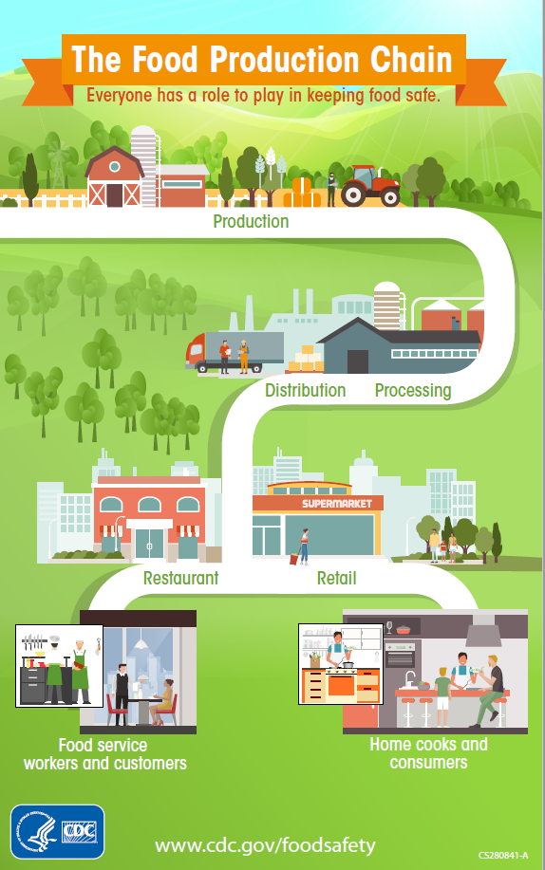
WHERE IS LISTERIA FOUND
widely found in agricultural environments (soil, manure, water); contaminates fresh produce
can directly infect food animals
Easily introduced into processing environments; produces biofilm and adheres to range of surfaces (plastic, metal)
Can grow under wide range of growth conditions during food processing and storage (particularly refrigeration; survives at temps as low as -0.4⁰C)

Slide 6
WHAT HAPPENS WHEN A PERSON HAS BEEN INFECTED
Once infected, the following three conditions can occur in a person:
Flu-like illnesses, resulting in fever, general body pains, joint pains, diarrhea and vomiting, and general weakness
Meningoencephalitis which is infection of the brain and the membranes covering the brain
Septicaemia which is infection of the blood which is called

Slide 7
CAN LISTERIA INFECT EVERYBODY?
Although anyone can get Listeriosis, there are people who are particularly vulnerable and at high risk of developing severe disease. These include:
Newborns
Pregnant women
The elderly
Persons with weak immunity, such as people living with HIV, Diabetes, cancer, chronic liver of kidney diseases

Slide 8
CONTENT
General Information on Listeriosis
The Situation in South Africa
The NDoH’s response to the outbreak
The role of the NDOH in food safety and inspections
Relevant Legislation and Regulations through which the NDoH carries out it food safety mandate and its alignment with other departments

Slide 9
LISTERIOSIS IN SOUTH AFRICA
Listeria was first diagnosed in South Africa in the Western Cape, in 1977
From there it occurs in our hospitals every year, and typically 60-80 cases were detected and treated annually

Slide 10
WHY WAS LISTERIA NOT A NOTIFIABLE DISEASE?
For a disease to be notifiable, it has to meet at least two (2) of five (5) qualifying criteria
The disease must be contagious/communicable
Rapid spread
Unusual or unexpected behaviour
Risk of spilling across borders
Risk of restriction to business or travel, especially across borders
For the past 40 years Listeria did nothing of these 5, but it now qualifies in at least 2 of the criteria, viz rapid spread, and an unusual/unexpected behaviour

Slide 11
NOTIFIABILITY OF LISTERIA
Since 15 December 2017, the Department of Health amended the list of notifiable diseases to include Listeriosis
The notice of notifiability appears in Government Gazette No. 41330 of 15 December 2017
Notifiability means that health workers are expected to do the following:
Report all cases of Listeriosis they come across, whether in public or private, in terms of reporting procedures
Complete case investigation forms for patients with Listeriosis and submit these to the NICD. Details are available on the NICD website

Slide 12
HOW WAS LISTERIA DECLARED AN OUTBREAK?
In July 2017, doctors from neonatal units at the Chris Hani Baragwanath Hospital and Steve Biko Academic Hospital, alerted the NICD about the unusually high numbers of babies with Listeriosis
The NICD then triggered a review of all cases diagnosed in both private and public hospitals, by contacting both private and public laboratories

Slide 13
ACTIONS SINCE THE NICD WAS INFORMED
Tracing of laboratory infected cases dating from 1 January 2017
Mapping these in the form of graphs
In October 2017 the Multisectoral National Outbreak Response Team (MNORT) which has been formed since the 2010 FIFA World Cup was reactivated and briefed on the situation in the country
On 29 November 2017 when a total of 557 cases were confirmed.
The MNORT informed the NDoH and the Minister called a meeting on 4 December 2017 and an outbreak was declared. A press conference was called on 5 December 2017 to inform the Nation

Slide 14
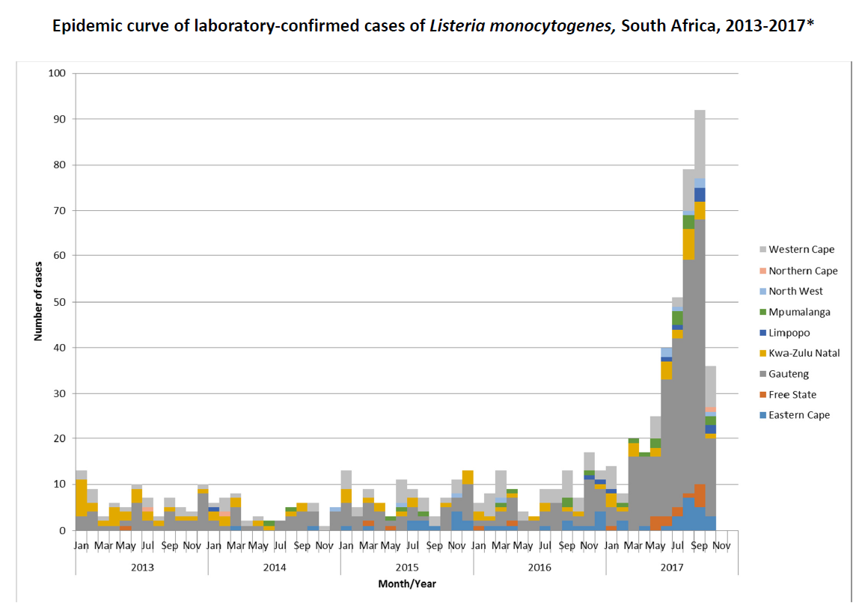

Slide 15
THE CURRENT SITUATION
Tracing from 1 January 2017, as of 23 March 2018, a total of 995 laboratory-confirmed cases were reported from all nine provinces.
749 cases were reported in 2017, and 246 cases in 2018
Public Sector (65%, 649/995), Private Sector (35%, 346/995)
Most cases have been reported from Gauteng Province (59%, 591/995) followed by Western Cape (12%, 119/995) and KwaZulu-Natal (7%, 72/995) provinces.
These 3 Provinces alone, are responsible for 78% of the total cases, with the remaining 22% distributed in the remaining 6 provinces
Outcome is known for 685/995 (69%) patients of whom 185 (27%) have died
Most cases have been reported from Gauteng Province (59%, 591/995) followed by Western Cape (12%, 119/995) and KwaZulu-Natal (7%, 72/995) provinces.

Slide 16
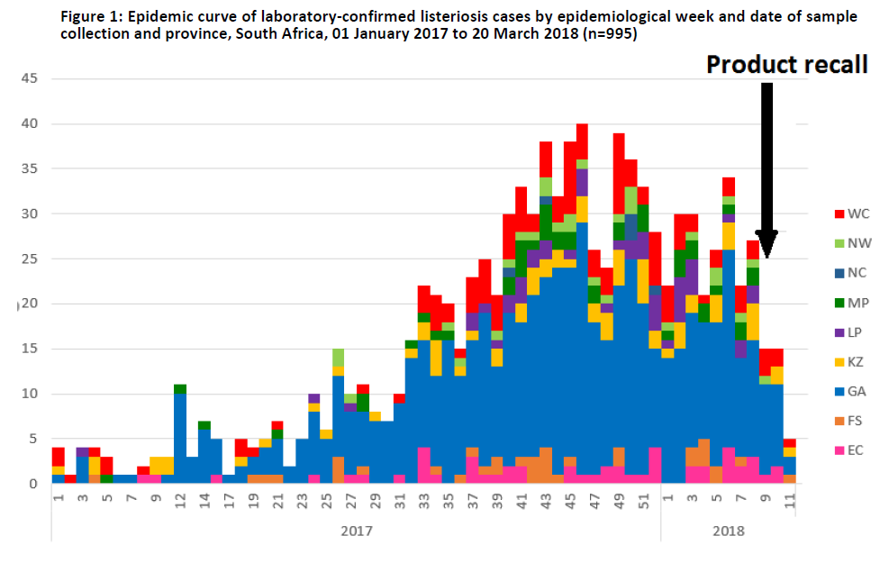
Listeriosis outbreak situational update
Mandatory case notification

Slide 17
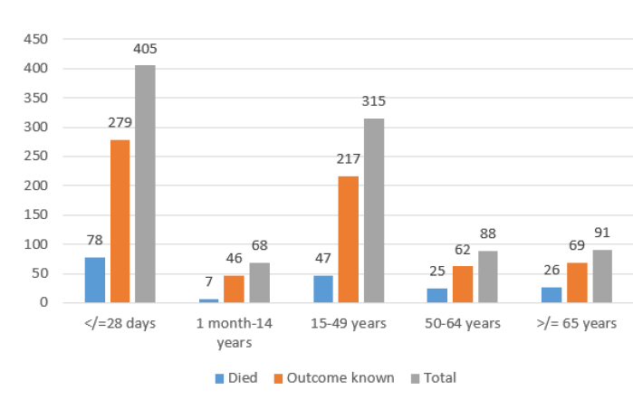
Age distribution and outcome of laboratory-confirmed cases of listeriosis from
01 January 2017 to 20 March (n=967 where age was reported)

Slide 18
CONTENT
General Information on Listeriosis
The Situation in South Africa
The NDoH’s response to the outbreak
The role of the NDOH in food safety and inspections
Relevant Legislation and Regulations through which the NDoH carries out it food safety mandate and its alignment with other departments

Slide 19
ACTIVATION OF MNORT
Immediate call for collaboration with DAFF and DTI to ensure a multi-national response
Coordination
Risk communication
Clinical and molecular investigations (NICD)
Targeted environmental sampling (NDOH Environmental Health Section)
Food safety records (NDOH Food safety section)
Processing plant inspections (NDOH Environmental Section, and DAFF Veterinary public health section)
External collaboration (DTI National Consumer Council)
Requested technical assistance from WHO which sent a Risk Communication Specialist, and Epidemiologist and a Foodborne outbreak experts who analysed the situation and provided advice

Slide 20
COMPOSITION OF MNORT
National Department of Health as the Chair
Provincial Outbreak Response Teams (PORTs)
Department of Agriculture, Forestry and Fisheries (DAFF)
Department of Trade and Industry (DTI)
National Institute for Communicable Diseases (NICD)
Environmental Health Practitioners from Municipalities
World Health Organisation (WHO) Country Director
MNORT meets monthly

Slide 21
ACTIVATION OF PHECC
Public Health Emergency Coordinating Committee (PHECC) was set up for Listeriosis – core team to oversee and monitor the response
Function: To ensure strategic coordination, management of ALL-health threats, natural or man-made disasters that may have a negative impact on the health care system in South Africa
Composition: Consist of various sector departments
DAFF, Env Affairs, National Consumer Council, Depart of Int Relations, Education, Cogta NDMC, SAPS Natjoints, Dept Agric Forest Fisheries, Dept Trade Industry, SALGA, Nat Inst Com Disease, NDOH, National Regulator for Compulsory Specifications(NRCS), Correctional Services
PHECC that has been set up for Listeriosis now meets weekly

Slide 22
FINDING A SOURCE OF THE OUTBREAK
12 January 2018: Febrile gastroenteritis in 9 children attending a crèche in Soweto (Johannesburg), who all consumed polony sandwiches
L. monocytogenes ST6 (outbreak strain) confirmed in one case
L. monocytogenes ST6 (outbreak strain) detected in food samples (two different polony brands produced by different manufacturers) collected from refrigerator at crèche
Investigation of polony manufacturer (Enterprise Foods’ production facility in Polokwane)
L. monocytogenes ST6 (outbreak strain) detected in 28 environmental and product casing swabs

Slide 23
ACTIONS FOLLOWING THE CONFIRMING OF A SOURCE
Minister of Health announced the outcome of the investigation on 04 March 2018
The Director-General issued a directive to municipalities on environmental health investigations and response, 05 March 2018
The National Consumer Council issued a recall notice to affected food processing companies
Department of Environmental Affairs provided a list of approved landfill sites to be used for recalled products

Slide 24
RISK COMMUNICATION
Joint media briefing by Minister of Health, in collaboration with NICD, DTI, DAFF and GCIS – December 2017, January 2018 and 04 March 2018
WHO 5 keys to food safety
Keep clean. Wash your hands before handling food and often during food preparation
separate raw from cooked food
cook food thoroughly, never eat half cooked or uncooked food especially meat products.
Food that does not usually need cooking before eating, needs to be thoroughly washed with clean running water.
keep food at safe temperatures.

Slide 25
CONTENT
General Information on Listeriosis
The Situation in South Africa
The NDoH’s response to the outbreak
The role of the NDOH in food safety and inspections
Relevant Legislation and Regulations through which the NDoH carries out it food safety mandate and its alignment with other departments

Slide 26
NDOH’S FOOD CONTROL ROLE
Food Control is:
“A mandatory regulatory activity of enforcement by national or local authorities to provide consumer protection and ensure that all foods during production, handling, storage, processing and distribution are safe, wholesome and fit for human consumption; conform to quality and safety requirements; and are honestly and accurately labelled as prescribed by law”

Slide 27
ENVIRONMENTAL HEALTH INSPECTIONS AND INVESTIGATIONS
Environmental Health Practitioner in Municipalities issued Section 83 Notice (Compliance notice) to the affected facilities
Municipalities are monitoring compliance with Compliance notices and the recall notice issued by the NCC.
Industry is being assisted with ensuring compliance to both Notices.
Key affected Industry players were engaged by a Multi-stakeholder team to discuss the recall, its implication and what industry should do to address the identified health risks.
Department of Labour was engaged to look at the Occupational Health and Safety risks to employees in affected processors, distributors, retailers and final treatment and disposal processes.

Slide 28
FOOD CONTROL AS GOVERNED BY THE CONSUMER PROTECTION ACT, 2008
DAFF
Quality assurance and export of regulated agricultural products
Registration of pesticides and stock remedies
Meat Hygiene Import and Export of fresh meat
Sanitary and Phyto Sanitary Agreement contact point
DOH
Food safety Regulations nutritional labelling
CODEX contact Point INFOSAN Emergency Contact Point
Raped Alert System for Food and Feed Contact Point
DTI
National Regulator for Compulsory Specification
Canned and frozen fish/ products Fresh seafood
Canned meat products
Imports and Certification of exports
South African Bureau of Standards
Technical Barriers to Trade Agreement Enquiry Point
Voluntary Standards South African National Accreditation Service
National Consumer Commission

Slide 29
ENVIRONMENTAL HEALTH INSPECTIONS AND INVESTIGATIONS
Patient interviews
In depth food histories obtained by a small dedicated team
Clinical vigilance
Specifically for febrile gastroenteritis
Sensitisation of health care professionals especially microbiologists, paediatricians and obstetricians
Environmental Health sampling
Of foodstuffs retained in patient’s households and their refrigerators
Of all food production facilities (Processing Plants & bulk packagers and distributors):
Processing surfaces
Processed Food (ready to eat food)
Food processing plant inspections and samplings
Increased vigilance and testing
Targeted plant inspections based on epidemiological evidence

Slide 30
RECALL OF UNSAFE FOOD
inspecting food production, distribution and consumption areas;
monitoring informal food trading;
enforcing food legislation and the Codex Alimentarius;
applying food quality monitoring programmes and principles through various techniques, e.g. Hazard Analysis and Critical Control Points System (HACCP System) audits;
promoting the safe transportation, handling, storage and preparation of foodstuffs used in the Primary School Nutrition Programme (PSNP), prisons, health establishments, etc
promoting the safe handling of meat and meat products in the points of entry.
promoting the safe handling of milk and milk products.
Monitoring safe disposal.
Providing general export inspections and certifications

Slide 31
COLLABORATING PARTNERS IN FOOD SAFETY
NDoH
Communicable Diseases Cluster
Environmental Health and Port Health Services
Food Safety
Communications
NHLS laboratories
NICD
Centre for Enteric Diseases
Outbreak Response Unit
Several private sector food microbiology laboratories
DAFF
Veterinary public health
Provinces
CDCCs
Hospital services
Veterinary Public Health
DTI -NCC
SALGA
SANAS
US CDC
Institut Pasteur
WHO

Slide 32
CONTENT
General Information on Listeriosis
The Situation in South Africa
The NDoH’s response to the outbreak
The role of the NDOH in food safety and inspections
Relevant Legislation and Regulations through which the NDoH carries out it food safety mandate and its alignment with other departments

Slide 33
INTERNATIONAL HEALTH REGULATIONS (IHR) 2005
IHR 2005 is a legally binding instrument of international law whose aim is to:
assist countries to work together to save lives and livelihoods endangered by the international spread of diseases and other health risks, and
avoid unnecessary interference with international trade and travel
South Africa, as signatory to IHR, should notify WHO about the outbreak, coordinate the response and contain the spread of listeriosis. Regular updates are sent to WHO when necessary.

Slide 34
LEGISLATION GOVERNING ENVIRONMENTAL HEALTH INSPECTIONS AND INVESTIGATION
National Health Act,2003, (Act no 61 of 2003)
Section 1 defines Municipal Health Services as follows:
water quality monitoring;
food control;
waste management;
health surveillance of premises;
surveillance and prevention of communicable diseases, excluding
immunisations;
vector control;
environmental pollution control;
disposal of the dead; and
chemical safety,
but excludes port health, malaria control and control of hazardous substances;
Chapter 3,Section 21(2)(b)(ii) stipulates that the DG must issue, and promote adherence to Norms and Standards on health matters, including environmental conditions that constitute a health hazard.

Slide 35
LEGISLATION GOVERNING ENVIRONMENTAL HEALTH INSPECTIONS AND INVESTIGATIONS
The NDOH has developed Environmental health norms and standards for South Africa.
Signed off by the Director-General and Gazetted for implementation in December 2015
The aim of the norms and standards are:
To Provide a national approach towards standardisation in the delivery of environmental health services in the country;
To set a benchmark for quality against which delivery of EHS can be monitored.
To monitor compliance with the set norms and standards, municipalities are audited annually.
Implementation strengths are communicated as lessons in good practice
Recommendations are issued for implementation weaknesses

Slide 36
NDOH’S FOOD CONTROL LEGISLATION
Foodstuffs Cosmetics and Disinfectants Act, (Act 54 of 1972):
Controls the Sale, Manufacture, Importation and Exportation of Foodstuffs, Cosmetics and Disinfectants; and to provide for incidental matters
Control of imported foodstuffs by National (3 Regions)
Enforcement of local foodstuffs by 52 Metro and district Municipalities

Slide 37
THANK YOU FOR YOUR CONTRIBUTION TO HEALTH SYSTEM STRENGTHENING AND THUS THE ABILITY OF SOUTH AFRICANS TO HAVE LONG AND HEALTHY LIVES!

