Slide 1
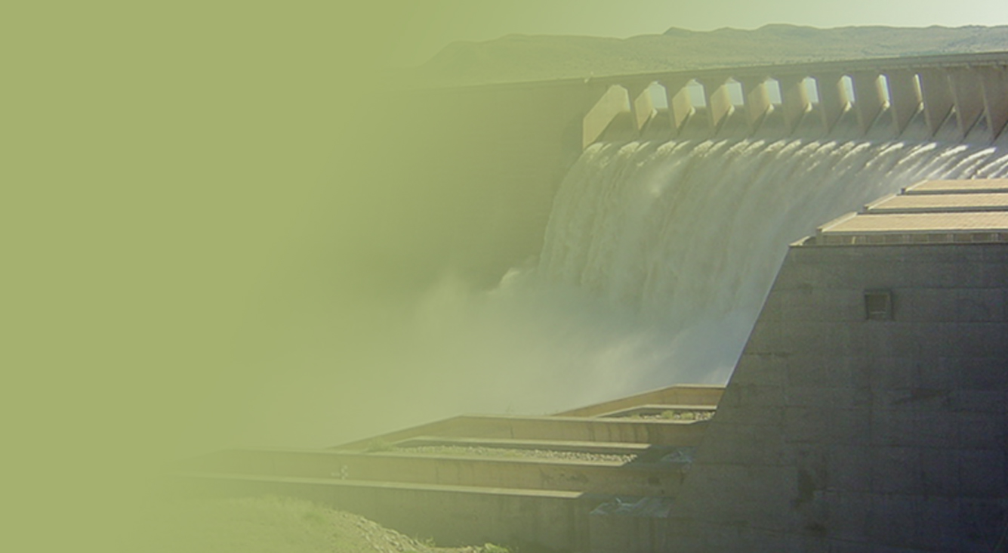
BRIEFING THE PORTFOLIO COMMITTEE ON THE DROUGHT SITUATION
IN WESTERN CAPE
Presented by:
THE MINISTER
THE DEPARTMENT OF WATER AND SANITATION
Date: 7 February 2018
PRESENTATION TITLE
Presented by:
Name Surname
Directorate
Date

Slide 2
TABLE OF CONTENTS
Background
Monitoring of System Performance for the WCWSS
Intervention strategies
Existing system optimization
Desalination
Ground water
Boreholes
Springs
Existing boreholes

Slide 3
BACKGROUND
The western cape water supply system (WCWSS) serves the city of cape town surrounding urban centers and irrigators along the Berg, Eerste and Sonderend Rivers.
The combined storage of the WCWSS shows that the system is under stress (approx. 13% lower than 2017)
Domestic and Industrial users supply reduced to 45% and agricultural use to 60%

Slide 4
MONITORING OF SYSTEM PERFORMANCE

Slide 5
WCWS System overview
24 Rivers
Withoogte
Misverstand
a
LBerg IB
Swartland
Mis
d
VLV
Legend
CCT
Voelvlei
Irrigation demand
UBerg IB
CCT: Drakenstein
Metro demand
WHK
Other urban demands
WynlandsWUA
Sbosch
Wemmershoek
dam
e²
BRD
Berg River Dam
Kleinplaas
tunnel
c
Theewaterskloof
tunnel
TWK
LS
US
b
Supply line
Vyeboom
RSE IB
Upper and Lower Steenbras
Palmiet
Notes:
Swartland = Riebeek Wes,Malmesbury, Moreesburg,Yzerfontein
Withoogte = Vredenburg,Langebaan, Saldanha
Wynlands WUA: Stellenbosch (from Quinton), Helderberg(from CCT pipeline), Eerste R (Kleinplaas and Stellenbosch “lei-water”)

Slide 6
State of Storage
Dam | Nett Cap 10⁶m³ | 22 Jan 2018 | 29 Jan 2018 | Difference
Western Cape: Voëlvlei Berg River Theewaterskloof Wemmershoek Upper Steenbras Lower Steenbras | 889 159 127 479 59 32 34 | 26,9% 18,8% 53,9% 13,9% 52,6% 89,9% 43,6% | 26,0% 18,3% 52,7% 13,1% 52,7% 85,5% 41,9% | 0,9% 0,5% 1,2% 0,8% 0,1% 4,4% 1,7%

Slide 7
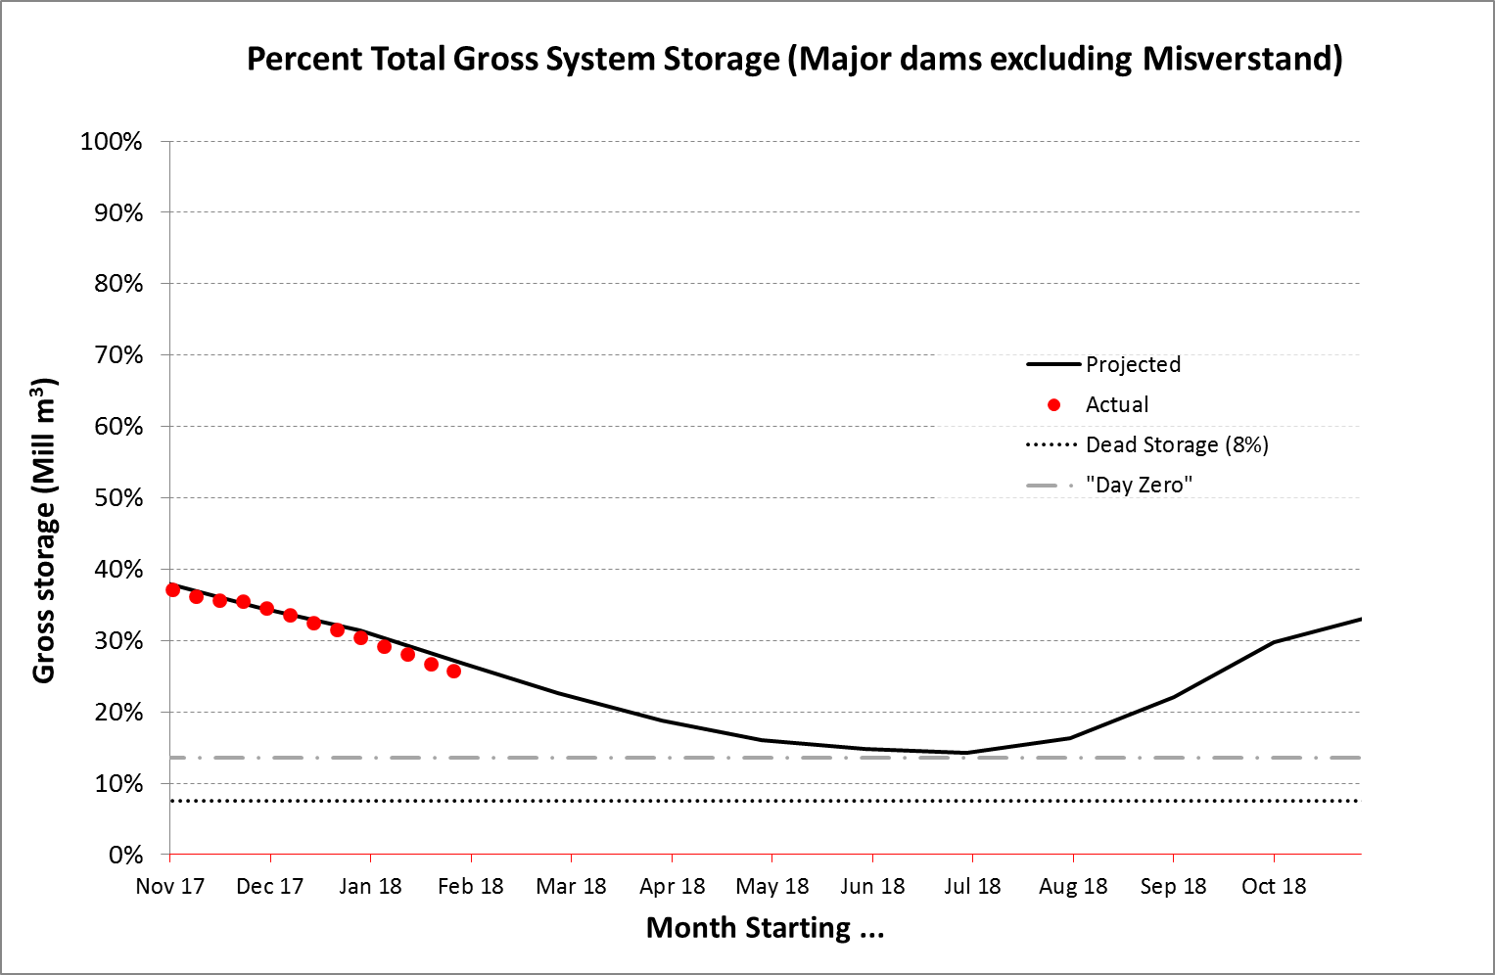
Notes:
Storage projection based on last year’s inflows which was the worst case scenario

Slide 8
WATER REQUIREMENT PROJECTIONS AND ACTUAL WATER USE

Slide 9
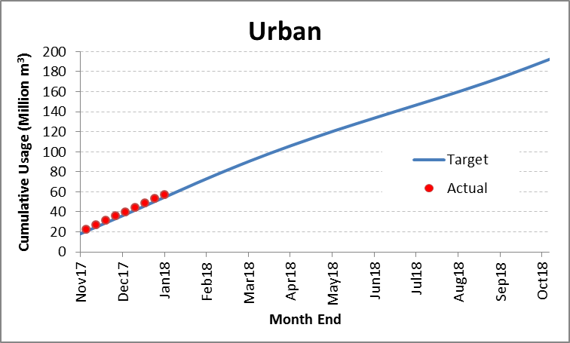
Date | Urban Cumulative Target (Mm³) (A) | Actual (Mm3) (B) | Difference (Mm³) (A-B) | Annual Target (Mm³)
Nov 17 | 18.2 | 22.2 | -3.8 | 192.1
Dec 17 | 36.8 | 35.8 | 1.0
Jan 18 | 55.8 | 57.2 | -1.4

Slide 10
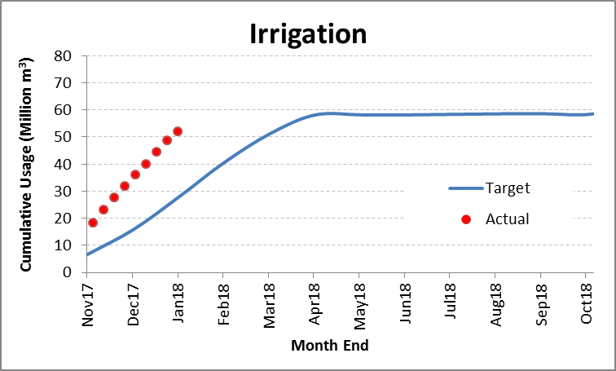
Date | Irrigation Cumulative Target (Mm³) (A) | Cumulative Actual (Mm³) (B) | Difference (Mm³) (A-B) | Annual Target (Mm³)
Nov 17 | 6.6 | 22.2 | -15.6 | 58.8
Dec 17 | 16.0 | 37 | -21
Jan 18 | 28.4 | 51.9 | -23.5

Slide 11
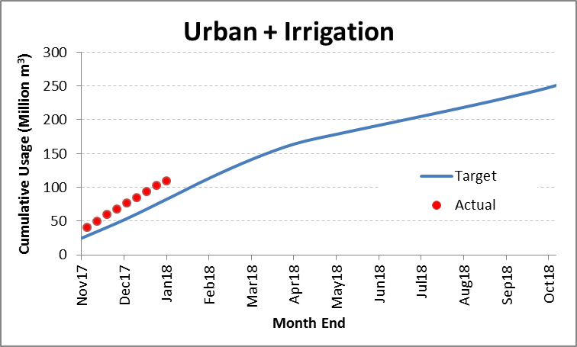
Date | Urban + Irrigation Cumulative Target (Mm³) (A) | Urban + Irrigation Cumulative Actual (Mm³) (B) | Difference (Mm³) (A-B)
Nov 17 | 24.8 | 44.4 | -19.6
Dec 17 | 52.7 | 72.8 | -20.1
Jan 18 | 84.2 | 109.1 | -24.9

Slide 12
INTERVENTION STRATEGIES

Slide 13
Western Cape Water Supply System Intervention Strategy
Intervention | Strategy | Output
Project coordination | Establishment of War Room War Room Management and Coordination Compliance and Enforcement License Approvals | Stakeholder Coordination Communication
Ground Water Resources | Ground Water exploration Selection Process and assessment of viable aquafers Implementation proposals Implementation of viable aquafers Development of identified Springs | Augmentation of existing system

Slide 14
Western Cape Water Supply System Intervention Strategy
Intervention | Strategy | Output
Desalination Plant | Assessment cost effective options Recommend viable option Implementation of preferred option | Augmented Medium to long term system
Optimisation of Existing Systems | Assessment of the status quo Recommendation of viable options Implement cost effective options | Improved yields of existing system Efficient delivery system
Operations and Maintenance | Compliance with Operating Roles and quotas Propose viable maintenance strategies | Reliable system

Slide 15
EXISITNG SYSTEM OPTIMISATION

Slide 16
1) MISVERSTAND DAM
Project Objective:
To secure continued supply from Misverstand to West Coast area for domestic supply
Misverstand Dam can only be operated effectively above 82%. Need to provide supplement pump to Withoogte WTW (Wes Coast area) when dam drops below 50%.

Slide 17
MISVERSTAND DAM cont….
Status
Pump and Electricity secured.
Switchboard outstanding
Procurement process of switchboards. Delivery period 10 – 30days..
Project Information
Pipe work. Need to be confirmed in writing by the Municipality. 300mm (suction) and 250mm (delivery) <50m in length.
Work done by O&M staff in cooperation with the WCDM.
All base work completed, but Switchboard outstanding.
Impact: All West Coast dams… towns will not run out of water but this will lead to supply being completely compromised..
Project Risk
Compliance Effort in Voelvlei to Misverstand in the Berg River; IMPORTANT (Risk). Highest risk if Compliance efforts fails, require functional within 7 days.
If 100% success rate.. Project not required. (Enough storage to see out the drought period to the rainy season… )
3 Mitigating factors:
Compliance of Berg Users
Emergency Project
Increase release from Berg River Dam.. (Voelvlei Dam only have 5weeks mitigating possibility)

Slide 18
2) RUENSVELD (OVERBERG)
Project Objective:
To ensure abstraction from lower flowing river (securing access to water for Overberg Water operations)
To ensure continued domestic supply to Overberg Water to Ruensveld East (Swellendam area)

Slide 19
RUENSVELD (OVERBERG) cont….
Status
SLA signed.
Construction mobilised (31 January 2018)
Project Information
2 Weirs to be raised by 1 meter. Im-permeability of existing weir is compromised (additional work will be done to improve the stability of bottom section); this will then required the top to built from bottom to top on the upstream side.
Duration: 20 working days..
Expected Cost: R1.5 million
Project Risk
Limited procurement (<R30k X 2; Biddem and Plastic)
Adverse Weather
Construction staff from other areas to be used.. No Appointments required

Slide 20
3) THEEWATERSKLOOF DAM (CHARMAINE TUNNEL)
Project Objective:
To Construct a coffer embankment and pump system to Charmaine inlet tower from main water body when dam reach 10%.
(Dam was designed to fail at 10%; so redesigning the operations philosophy of the dam)

Slide 22
THEEWATERSKLOOF cont…
Status
Project planning commenced last year.
Procurement being prepared for possible failures. All procurement will be done within R500k. (3 X WQ items; Suctions Hoses, Black Plastic, Concrete)
Project Information
This pump-set will be able to access 4.25% (26million m³; 235 days at that rate)
6 Pump-sets (300mm) and 5 x 150mm standby pumps.
All 11 pump-sets are in Drakenstein Construction workshop. Being tested under load conditions to ensure efficiency. Also testing suction and delivery hoses..
Mobilisation commences 5 February 2018 (All plant in Western Cape, and will be moved as per priority of programme).
Pumping date: 13 March 2018. (BoQ allows for 10 weeks of pumping R2m)
R11,7m total costs.
Project Risk
Rain
Extended pumping period
Labour secured (Also engaging Working for Water to accommodate affected agriculture labour in the area)

Slide 23
4) VOËLVLEI DAM EMERGENCY PROJECT
Project Objective:
Pump water from main body (dam) into outlet works and removal of sediment in feeder canal when dam reach 12.5%; supply Swartland WTW.

Slide 24
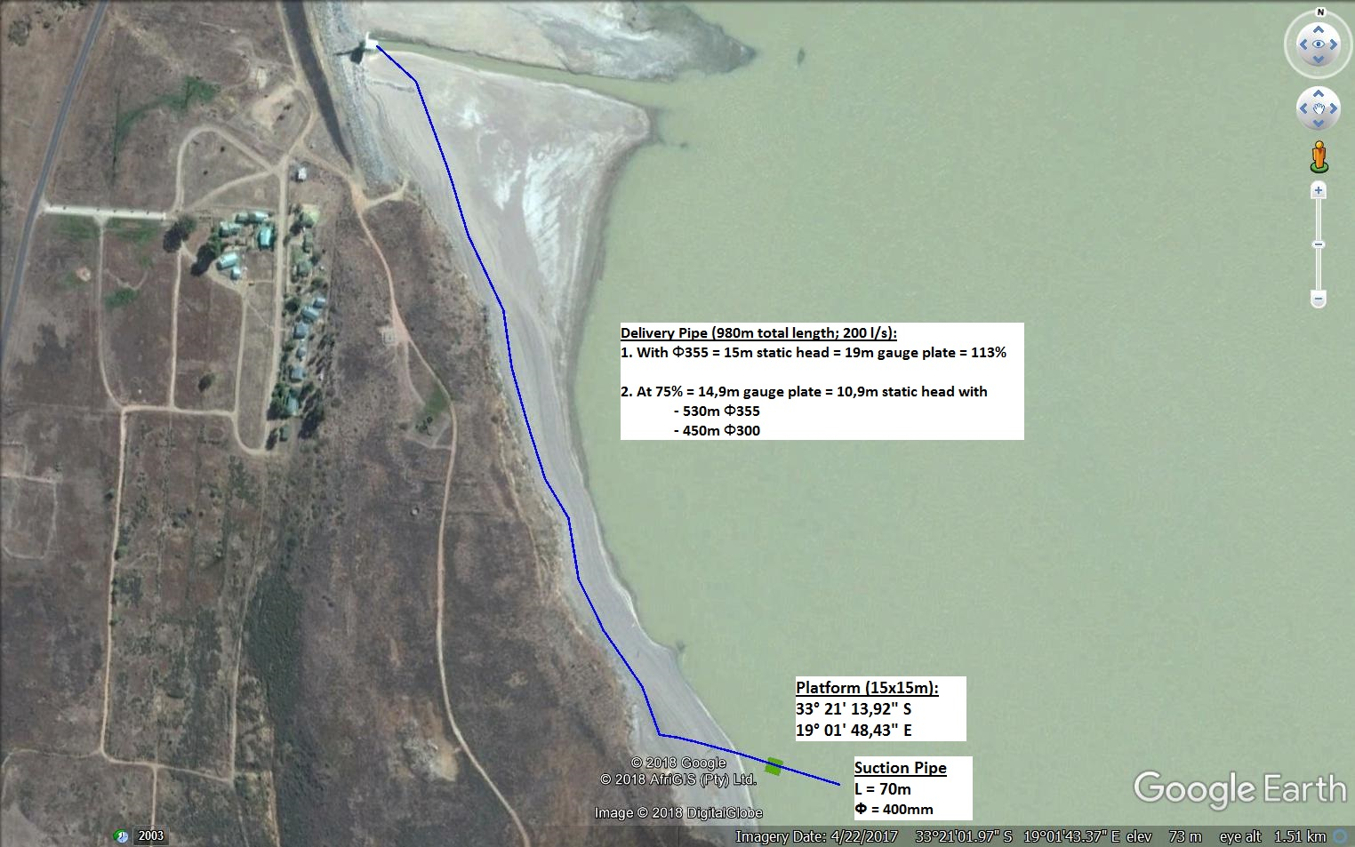
Schematic layout of the emergency abstraction work at Voëlvlei Dam

Slide 25
VOËLVLEI DAM cont…
Status
Irrigation releases were stopped
Machine mobilising started 1 February – Commencement 5 February 2018. Target date for completion 16 March 2018 (worst case scenario) Pipe work required at 5 March.
R3.5m (incl. Procurement, Installation and operation)
Project Information
Pipe line (1km), pump platform and pump-set (0.2m³/s) (CCT is currently taking 10Ml/d from this dam; 0.113m³/s)
Cleaning of the approach channel to inlet tower (150m) (Secondary task which is water level driven)
At 0.2m3/s; at current level of the dam this will last for 470 days..
Pipe line installed at 75%... If dam raise the work needs the be removed.
12.5% is the lowest level for current; CCT can go down to 5%
Project Risk
SCM processes being accelerated internally ); Only for pipe work. Pumps available, GenSet available at Clanwilliam.
Work could be done for nothing; Doing work to offset risk of CCT should they shift their demand to Voelvlei..

Slide 26
5) DASBOS PUMP STATION
Project Objective:
Pump station need to pump at full capacity when emergency scheme is in operation to enable us to deliver 4m3/s.

Slide 27
DASBOS PUMP STATION cont…
Reliable maintenance capacity required to ensure reliable operations of pump-stations.
Hands-on support (Artisan) for the entire Western Cape pump-stations (till after rainy season; to be re-evaluated):
Mechanical
Electrical
Standby Maintenance Contract Capacity which can respond in emergency circumstances with turn-around assurance of 48hours.
Drakenstein PS only required in the Winter months, but opportune to ensure 100% operability.

Slide 28
6) EIKENHOF DAM TO STEENBRAS DAM
Project Objective:
Water will be transferred through Palmiet Pumped Storage Scheme with existing infrastructure

Slide 29
SYSTEM OPTIMISATION COSTS
 | Projects | Work to be done | Cost Estimated
1. | Voelvlei Dam water supply to Swartland WTW -operations | Pump water from main construction into outlet works and removal of sediment in feeder canal when dam reach 12.5% | R3.5 million
2. | Overberg Water (Ruensveld East) (rehabilitation of two weirs) -operators -operating rules | Need to increased storage in river at abstraction point. Water does not reach bottom of river. Emergency weirs will enable to pump for longer periods from the low flowing river | R1.5 million
3. | TWK Dam: supply to Charmaine Tunnel | Coffer embankment and pump system to Charmaine inlet tower from main water body when dam reach 10% Can only provide 105 m3/s into tunnel | R9.0 million
4. | Exytra pumping at Dasbos pump station | Pump station need to pump at full capacity when emergency scheme is in operation to enable us to deliver 4m3/s. | Servicing of pump station + Eskom Power
5. | Misverstand Dam operational problems | Dam can only be operated effectively above 82%. Need to provide supplement pump to Withoogte WTW when dam drop below 50% | R0.5 million
6. | Transfer of water from Eikenhof Dam to Steenbras Dam | Water will be transferred through Palmiet Pumped Storage Scheme with existing infrastructure. | Eskom Power

Slide 30
POTENTIAL CHALLENGES
An external risk: Agricultural Labour impact of drought, to be used as an opportunity for labour to be used in labour-intensive maintenance projects.
Coordination of Stakeholders (i.e. City of Cape Town, Disaster Management, Dept. of Human Settlement, COGTA etc.)

Slide 31
WATER LEVEL MONITORING
The operational staff is assisting with the continuous monitoring of storage levels which forms part of the integrated drought management in the Western Cape.
The unit is also working in close cooperation with officials of the City of Cape Town (on a continuous basis) to ensure the responsible abstraction patterns are followed from the integrated system.

Slide 32
DESALINATION

Slide 33
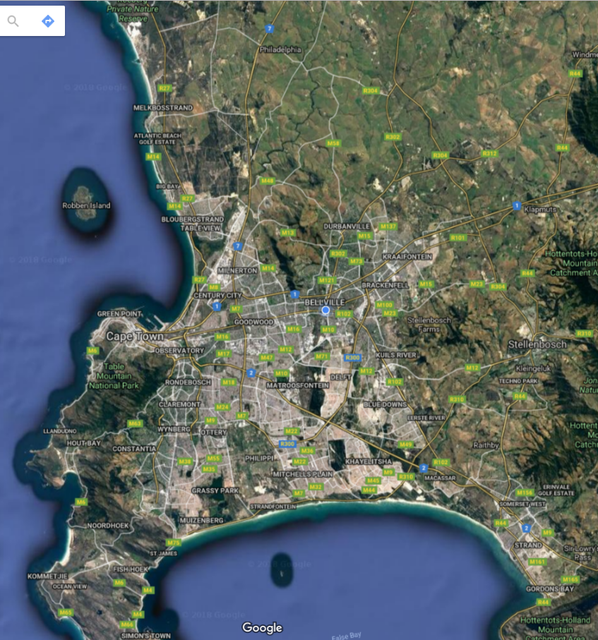
DESALINATION PLANTS
Koeberg
Potential Sites Identified include:
Koeberg | This site is close to Koeberg Power Station
Harbor | This is inside Transnet Port Industrial park.
Harmony park | Site is closer to Gordon Bay
Harbor (PIP)
Harmony Park

Slide 34
DESALINATION PLANTS
 | Potential Capacity | Comments
Koeberg | 50ML/day | Reticulation is 3km radius. Long term Lease agreement in place. City of Cape town has plans of 20ML.
Harbor | 100ML/day | Sea water quality has high probability of contamination. Tests being conducted. Currently Transnet offering short term lease agreement.
Harmony park | 30ML/day | Abstraction and Sea outfall pipelines not available. Short term lease agreement.
Other desalination Points
City of Cape Town has other desalination plants outside the above totaling 30ML/day.
NB: The existing desalination plants identified require further detailed assessments to establish condition and effort required to connect.
Time line: Anticipated implementation period: 6-8 weeks

Slide 35
DESALINATION PLANTS
Risks
1. Land Acquisition
Opportunities
1. EIA Waiver
Construction can
start and run
concurrently with
Environmental
management
Plans.
Interventions
1. Engagement
with Department
of Transport and
Public Enterprise
for land.
2. Lead time
specialised
equipment.
(Desal).
3. Litigations
i.e. community
needs.
4. Construction
Permit

Slide 36
ESTIMATED COST FOR DESALINATION FOR THE PROPOSED 3 PLANTS
Auxiliary Equipment | Scope | Budget | Comments
1. Reverse Osmosis (RO) Equipment/desalination | Reserve osmosis | R915m
2. Pumps | Abstraction Circulation | R20m
3. Pipelines | Connection to Abstraction Sea Outfall Main header | R250m
4. Pre-treatment | Filter Sludge disposal Drying beds | R30m
5. Mineralization and buffer | Tanks | R20m
6. Civil Works | Foundation Plinth Warehouses Control room | R20m
7. Control System | SCADA, PLC | R15m
8. Power Supply | 20 MVA bulk supply | R30m
Estimated Total |  | R1.3bn

Slide 37
REQUESTED PLANT CAPACITY BY THE CITY OF CAPE TOWN
The department seeks to install a minimum of 10ML/day desalination plant (technology will be reverse osmosis).
Following meetings with Ex-Mayor CoCT, Directive issued to Umgeni Water to procure the plant.
Estimated cost R397 million (capital), Operation and maintenance R6.29/kl
Currently engaging with CoCT to finalise site, electrical supply, connector infrastructure and 36 month off-take agreement, regulatory requirements.

Slide 38
GROUND WATER

Slide 39
GROUND WATER PROJECTS
Site | Progress | Challenge | Recommendations | Total Project Cost
Theewaterskloof | Not yet drilled Site surveyed Near existing dam | Need to drill deep boreholes up to 500m to get adequate amount of water | Recommendations to use contract to appoint Private driller to drill deep boreholes | R10 million
Steenbras dam | Site surveyed 1 borehole completed > 3 underway | Environmental issues | To engage City of Cape Town to address Environmental issues DWS can support the drilling but on shallow boreholes up to 150m
Cape flats Aquifer | Site surveyed 8 boreholes completed Depth of boreholes mostly 50-60m deep Alluvial formation | 24-30 inch borehole diameter We have no mud pump | Cannot drill, can appoint contractor
Peninsula (Southern planning district | Site surveyed Depth of boreholes up to 200m | Hard rock fractured | Access need to be finalised

Slide 40
CONCLUSION
The drought situation in the Western Cape is dire with dam levels falling week on week
Water use is still above the targeted use
Efforts to comply with water restrictions need to be intensified

Slide 41
THANK YOU

