Slide 1

REPORT ON THE DROUGHT SITUATION IN THE COUNTRY AND INTERVENTION MEASURES
PORTFOLIO COMMITTEE:
WATER & SANITATION
07 FEBRUARY 2018

Slide 2
Drought Risk Profile and Outlook
The role of the National Department of Cooperative Governance and Traditional Affairs;
The efficacy of the intergovernmental relations framework in dealing with the drought crisis
Challenges and achievements facing local government structures in dealing with the drought crisis;
Funding disbursed through the National Disaster Grant Funding Process.
Solutions and Recommendations on developing short, medium and long-term Strategies to address the ongoing drought;
Communication Plan
Key milestones of the IMTT and Wayforward
Recommendations

Slide 3
Drought Risk Profile and Outlook

Slide 4
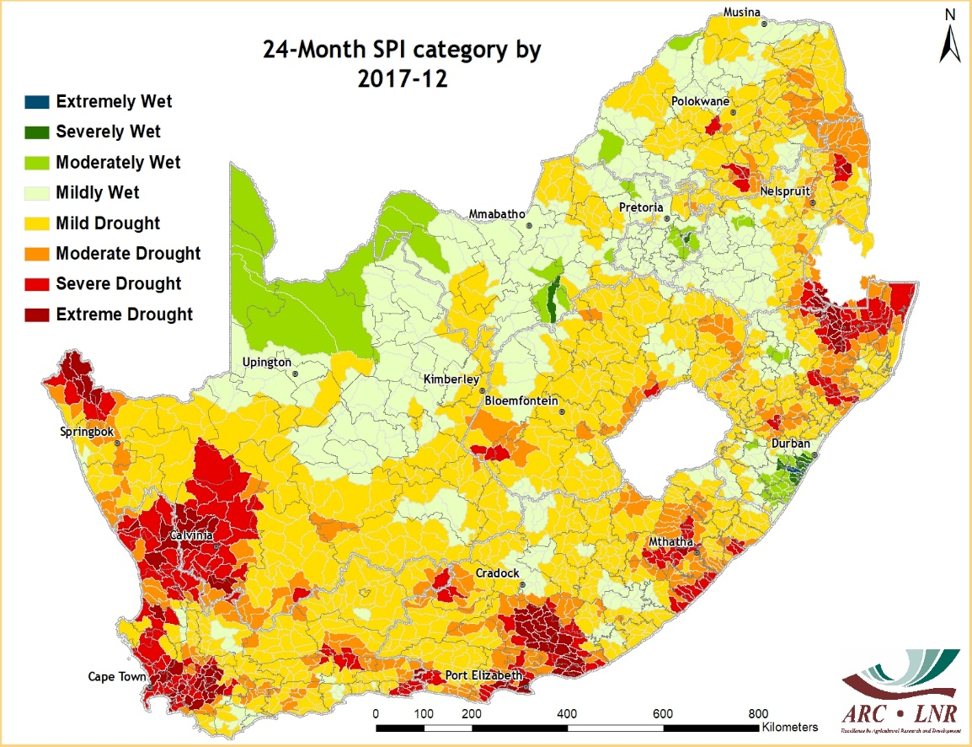
Drought Indicator: Standardized Precipitation Index (SPI) 24 Month Period
SPI for the 24 month period indicates areas of mild to extreme drought categories across SA as a result of 4 consecutive seasons of low rainfall.
Extreme areas of drought evident for :
  the Western cape
  Northern Cape
  Eastern Cape and Northern portion of KZN.

Slide 5
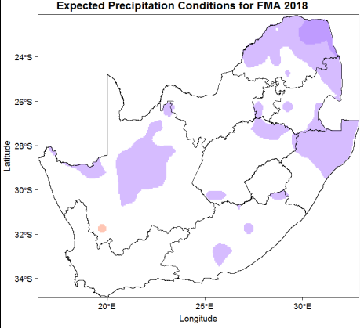
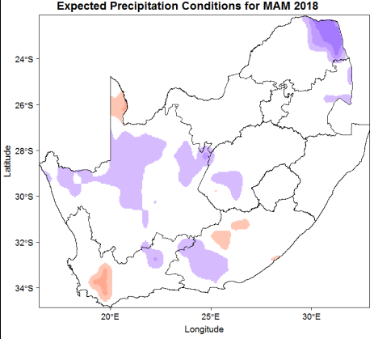
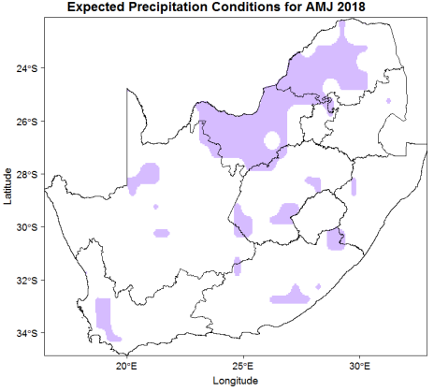
OUTLOOK FOR LATE SUMMER /AUTUMN SEASON
A fairly strong signal in FMA and MAM that precipitation over the extreme north-eastern parts may well be above normal.
The central interior of Northern Cape may experience higher than normal rainfall (in places) during FMA and MAM
Unfortunately the (seasonal precipitation) signals for Western Cape are neither strong nor consistent (from one overlapping 3 month period to the next). Consequently, the seasonal precipitation outlook for the Cape Peninsula (and the greater Western Cape province) remains largely uncertain.
FMA = February, March, April,
MAM = March, April, May,
AMJ = April, May, June

Slide 6
The Role of the National Department of Cooperative Governance & Traditional Affairs

Slide 7
Role of the NDMC
The role of the NDMC within the Department of Cooperative Governance includes the following:
In line with the mandate of the NDMC, to promote risk reduction for the drought situation;
Assess and classify disasters where applicable;
Application for funding to National Treasury;
Oversight of implementation of projects funded through disaster grants;
Chairing of the NJDCC and intervention task teams;
Reports to the IMTT based on decisions of the NJDCC;
Support to GCIS on implementation of the drought communication strategy
Reporting to other fora, including national and regional structures.

Slide 8
Role of DCoG
The Department of Traditional Affairs and other programmes within COGTA that support drought interventions include:
Department of Traditional Affairs regarding engagement with the National and Provincial Houses of Traditional Leaders.
Municipal Infrastructure Support Agency (MISA) (infrastructure development and maintenance)
Local Government Support and Intervention (e.g. Municipal Infrastructure Grant (MIG) programmes (Back to Basics & Development Planning)
Institutional Development (re municipal bylaws, governance, LG capacity building, etc)
Community Works Programme (CWP)

Slide 9
The efficacy of the intergovernmental relations framework in dealing with the drought situation

Slide 10
Institutional Arrangements to Coordinate Response to the Drought Situation in the Country
Integrated Institutional Arrangement
It is important to note that similar structures are replicated at Provincial and Local Spheres ( e.g. work streams as called in the WC).
IMTT ON DROUGHT AND WATER SCARCITY
National Food & Nutrition Security Task Team
National Communication Task Team
National Intervention Task Team
NJDCC
Sectoral Teams
Sectoral Teams
Sectoral Teams
Civil Society Coordination Task Team

Slide 11
The role of the National Joint Disaster Coordinating Committee (NJDCC)
Objectives of the NJDCC
To coordinate all the response and recovery plans from all relevant sectors in an effort to develop a coherent, comprehensive, substantive and practical drought response plan.
To effectively gather all relevant information to ensure positive communication on the state of South Africa pertaining to current drought situation and build resilience among our communities.

Slide 12
The Role of the National Joint Disaster Coordinating Committee (continue)
To facilitate and coordinate the development and implementation of a national, integrated and inclusive drought response and recovery plan.
To ensure well integrated and coordinated planning, response and intervention toward the drought hazard in all the affected provinces through cooperative governance.
To develop relevant frameworks as well as align, integrate already existing frameworks for organs of state in addressing the drought situation in the country such as plans, reporting frameworks and other relevant documents as identified by the committee.

Slide 13
The Role of the National Joint Disaster Coordinating Committee (continue)
Functioning of the NJDCC, chaired by the NDMC
Technical team that looks at measures to mitigate the impact of drought across all sectors
  Reports considered from various spheres and sectors
  Reflect – enhanced systems and approach
  Reinvigorate - move from commitment to action
To report and make recommendations to the Inter-ministerial Committee (IMTT) on Drought and Water Scarcity.

Slide 14
Challenges and achievements facing local government structures in dealing with the drought crisis

Slide 15
Challenges & achievements facing local government structures in dealing with the drought crisis
The following challenges have been identified as hindrances towards addressing the drought situation:
  Prioritisation of unsustainable and costly temporary response measures such as water tankering and carting as opposed to repairing existing boreholes or drilling new ones.
  Distressed municipalities often suffer the most in the face of incidents and disaster due to lack of reserves to deal with unforeseen shocks. This calls for strengthening of the local government system to enhance their capacity to cope with natural and anthropogenic shocks.

Slide 16
Challenges & achievements facing local government structures in dealing with the drought crisis
The following challenges have been identified as hindrances towards addressing the drought situation:
  Delayed implementation of funded drought related projects due to insufficient capacity within municipalities.
  Lack of/Poor Integration of disaster management planning in the programmes of organs of states and non state entities.
  Exorbitant costs for drilling and equipping of boreholes in provinces which lessen the impact of interventions by government within affected communities.

Slide 17
Challenges & Interventions
General challenges | Interventions
Lack of capacity and financial resources for disaster risk reduction, mitigation programmes and response (No dedicated capacity in some municipalities) | Reconsider budgets to identify funding for re-allocation Allocation of funds from disaster grants Executive support mobilised to increase disaster management capacity
Ageing infrastructure in municipalities | Municipalities encouraged to intensify maintenance programs to reduce water losses MIG funding now provides for refurbishment and replacement of infrastructure
Poor Operations and maintenance in municipalities, especially on water infrastructure | Municipalities to intensify maintenance programs
Ineffective communication between sector departments and a lack of awareness programmes | Improve communication through a centralised strategy and conduct targeted education and awareness programs

Slide 18
General Challenges & Interventions
General challenges | Interventions
Poor provincial IGR and Coordination structures | Convene PDJCC meetings (more regularly) to improve coordination and support the NDJCC, the NDMAF and IMTT
Lack of integrated contingency plans and consideration of disaster risk profiles in Municipal Integrated Development Planning resulting in at risk developments and unsustainable services. | Develop an integrated national contingency plan Integrate DRR into municipal IDP’s
Inclusion of O&M projects in funding request not related to drought disaster | Verify relief projects proposed to ensure its relevance and impact

Slide 19
Challenges & Interventions
General challenges | Interventions
Impact of other hazards, e.g Avian Influenza, severe weather etc. dilutes resources available to drought | Reconsider budgets to identify funding for re-allocation Allocation of funds from disaster grants
Water restrictions not enforced | Enforce water restrictions
Loss of operational income | Reconsider budgets to identify funding for re-allocation
Insufficient technical capacity to address infrastructure failures e.g. Operations and maintenance; | MISA to support municipalities with required expertise focusing on infrastructutre planning, operations and maintenance, capacity building through deployment of artesans
Slow / lack of Organs of state and Executive support (EC, NC, Lim) | Convene PDJCC meetings (more regularly) to improve coordination and support the NDJCC, the NDMAF and IMTT

Slide 20
Funding disbursed through the National Disaster Grant Funding Process.

Slide 21
Funding Allocations for Drought Intervention Measures
The National Treasury has (in 2016) approved funding to address the emergency needs for farming communities affected by drought. The amounts of R212 million was allocated to the agricultural sector.
R341 million has been made available to the Water Sector and was spend.
The funding was supposed to be made available from the Provincial Disaster Grant (PDG) within COGTA/NDMC however the available funding was not enough, PDG had R111 million.
Implementation was over 3 months period and all work has been completed.

Slide 22
2016/17 Disaster Grant funding to augment the shortfall from sector departments
The funds for drought intervention measures were allocated as follows:
The details for the allocation of R341 million to DWS for drought. intervention measures (October 2016).
NO | PROVINCES | PROJECTS IMPLEMENTED | AMOUNT ALLOCATED (OCT 2016)
 | KwaZulu-Natal | Mobile Desalination Package Plant | R290.7 million
2. | Eastern Cape, Kwazulu-Natal, Free State, North West | Water tankering and storage | R50.6 million
Total amount |  |  | R341.3 million

Slide 23
2016/17 Disaster Grant funding to augment the shortfall. (Cont.)
The details for the distribution of the R212 million for the Department of Agriculture, Forestry and Fisheries for drought intervention measures (October 2016).
NO | PROVINCE | PROJECTS IMPLEMENTED | ALLOCATION (October 2016)
 | Eastern Cape | Provision and transportation of livestock feed | R29 million
2 | Free State | Provision and transportation of livestock feed | R31 million
3 | KwaZulu-Natal | Provision and transportation of livestock feed | R23 million
4 | Limpopo | Provision and transportation of livestock feed | R28 million
5 | Northern Cape | Provision and transportation of livestock feed | R25 million
6 | Mpumalanga | Provision and transportation of livestock feed | R26 million
7 | North West | Provision and transportation of livestock feed | R38 million
8 | Western Cape | Provision and transportation of livestock feed | R12 million
Total amount |  |  | R212 million

Slide 24
2017/18 Drought Allocations
The Department of Cooperative Governance facilitated immediate relief funding through the National Treasury to address the immediate needs for both hydrological and agricultural drought.
An amount of R74 866 263 (R74.8 million) was approved by the National Treasury in August 2017 to provide assistance within the affected sectors in the Western Cape.
A total of R40 million (of the R74.8 million) was allocated to the Western Cape Department of Agriculture for the provision and transportation of livestock feed to assist farming communities affected by drought and fires.

Slide 25
BREAKDOWN FOR THE ALLOCATIONS
The funding was accessed from the Municipal Disaster Grant for drought intervention (water projects).
NO | MUNICIPALITIES | PROJECTS | AMOUNT (September 2017)
 | City of Cape Town | Drilling of boreholes and installation of water pumps and pipelines | R20.8 million
2. | Bitou Local Municipality | Drilling of boreholes and installation of water pumps and pipelines | R10.9 million
3. | Theewaterskloof Local Municipality | Drilling of boreholes and installation of water pumps and pipelines | R3.1 million
Total: |  |  | R34.8 million

Slide 26
BREAKDOWN FOR DROUGHT ALLOCATIONS(cont.)
Of the R74.8 million, the Department of Agriculture was allocated an amount of R40 million from the Provincial Disaster Grant to address the short-term needs within the sector.
NO | PROVINCE & DEPARTMENT | PROJECTS | AMOUNT (October 2017)
 | Western Cape Department of Agriculture | Provision and transportation of livestock feed | R40 million

Slide 27
DROUGHT FUNDING ALLOCATIONS 2017: EC
NO | DEPARTMENT | PURPOSE | AMOUNT (October 2017)
 | Department of Water and Sanitation | Butterworth, Eastern Cape Emergency Water Supply Scheme | R200 million

Slide 28
Current Funding Requests being evaluated
No | Province | Municipalities & Sectors | Projects | Amount
 | Eastern Cape | Amathole DM | Water infrastructure | R 27 036 000
 |  | Nelson Mandela Bay Metro | Water infrastructure | R7 016 000 000
 |  | Sarah Baartman DM | Water infrastructure | R 350 500 000
 |  | Eastern Cape Total : R7 393 536 000
2. | Northern Cape | Pixley ka Seme DM | Water infrastructure | R 32 200 000
 |  | Namakwa DM | Water infrastructure | R 58 500 000
 |  | Agriculture (Pixley Ka Seme & Namakwa DMs | Livestock feed | R 127 000 000
 |  |  | Removal of alien species | R 56 000 000
 |  | Northern Cape Total: R 273 700 000
Grand Total: (EC & NC) : R7 667 236 000

Slide 29
Current Funding Request for drought intervention measures
No | Province | Municipalities & Sectors | Projects | Amount
3. | Western Cape (Additional funding request) | City of Cape Town | Water infrastructure | R6.8 billion
 |  | Matzikama | Water infrastructure | R 2 077 million
 |  | Drakenstein | Water infrastructure | R51.4 million
 |  | Western Cape Total :
Grand Total: (EC, NC & WC)

Slide 30
NATIONAL GOVERNMENT FUNDING FOR DROUGHT
NT will consider drought funding by ensuring that normal infrastructure projects are fast-tracked to respond to drought. Contingency Reserve, Provincial Disaster Grant (PDG) and Municipal Disaster Grant (MDG) should respond.
Short and long term interventions
  2018/19 allocation: MDG ( R370 597 m) and PDG (R130 391 m) : Total R501 188 mil.
  Various municipal infrastructure grants can be reprioritised to drought in terms of Section 20(6) of the DoRA.

Slide 31
Solutions and Recommendations on developing short, medium and long-term strategies to address the ongoing drought;

Slide 32
Short, Medium and Long Term solutions
 | Ten Key Considerations for Sustainable Water Management (Source, DEA)
1 | Conservation of supply of water, especially in “water factories”. | Control of invasive plants in mountains and riparian areas; wetland management; wild fire and soil management.
2 | Demand-side management. | Households, industry, agriculture: tariffs, billing, water-saving fittings, advocacy, smart metering, green buildings, Enforcement of water restrictions.
3 | Reduction of unaccounted-for water. | War on Leaks; rapid response to leaks; reduce theft; pressure reduction; retrofit; Free Basic Water tariffs; insurance against genuine leaks.
4 | Conservation and sustainable utilization of ground water. | Optimal use of boreholes/wells; metering of and charging for use; aquifer re-charging; quality control.

Slide 33
Short, Medium and Long Term solutions
5 | Regulation of land-use practices. | Planning; forestry/agricultural options; urban development; water-wise gardens/horticulture; bush encroachment.
6 | Protection of water quality. | Catchments; pollution management; artificial wetlands; acid mine drainage; waterweeds; sewerage systems.
7 | Re-use of waste water. | Sewage, grey-water and storm-water; household capturing of water into pools (and back-washing), water-tanks.
8 | “Load-shedding” in supply of water (limited times of supply of water, in emergencies). | Efficiency & probity in tanker supply; vulnerable low-lying areas; sustaining agriculture priority water investments.)
9 | New dams are a low priority. | Best sites already developed; expense; evaporation; but, de-silting of dams whilst water levels are low is important.
10 | Desalination should be a last-resort, and then at a modest scale, where planning and rainfall have failed.

Slide 34
Solutions and Recommendations on developing short, medium and long-term strategies
Thus far, the following solutions are put in place;
  Institution of water restrictions in different municipalities at varying levels, e.g. Level 6B water restrictions have been instituted in the City of Cape Town. (strengthen enforcement)
  The DWS has also instituted new water restrictions of 45% urban and 60% on irrigation to all surface & ground water abstractions within the Western Cape system. The restrictions will be accordingly adjusted as the supply decreases/increases.
  Removal of invasive alien species that consume a huge amount of underground water (e.g Prosopis in N-Cape)
  Procurement and transportation of fodder to affected farmers (Department of Agriculture).
  Aggressive awareness campaigns on water saving amongst communities and business.
  Rain water harvesting and re-use of grey water.

Slide 35
Solutions & Recommendations on developing short, medium and long-term strategies (continue)
Drilling and refurbishment of boreholes in :
      Northern Cape Province (Namaqua DM and Prixley ka Seme);
      Eastern Cape Province (Sarah Bartman and Amathole DMs, Koukamma LM;
      Free State Province (Moqhaka LM and Letsemeng LM); and
      KwaZulu Natal Province (Newcastle and uGu DM).
      Western Cape Province (Kannaland, Prince Albert, Laingsburg, Beaufort, Matzikama, Cederberg, Mossel Bay, Oudtshoorn, and Hessequa LMs)
      Limpopo Province (Mopani and Sekhuhkhune DMs)
Undertaking process audit on the state of Waste Water Treatment Works (WWTW) and Water Treatment Works (WTW). MISA is engaging East Rand Water Care Company (ERWAT), which is a government owned entity established by Ekurhuleni Metro specialising on waste water and water works through MOU to conduct the process audit. A detailed report is expected to be completed before end June 2018.

Slide 36
Solutions & Recommendations on developing short, medium and long-term strategies (continue)
  To respond to Operations and maintenance challenges, MISA is in a process of recruitment of qualified artisans and water process controllers to be placed in identified municipalities which made requests for same. 100 artisans and water and waste water process controllers will be deployed to needy municipalities at the beginning of March 2018.
  MISA , in collaboration with South African Institute of Civil Engineering’s Professional Development and Projects (SAICE PDP), is training municipal officials on advanced water treatment processes.
  MISA is also putting in place a range of framework contracts for refurbishment or building of new waste water treatment plants and water treatment plants. This is aimed at easing procurement challenges in municipalities. Municipalities will simply place orders against the relevant national framework contract with rates already negotiated and set.

Slide 37
Solutions and Recommendations:
Medium to Long Term Adaptation Strategies
  The Disaster Management Act 2002 (as amended) affords priority to risk reduction as a key approach to disaster risk management to ensure prevention, mitigation, preparedness and emergency response.
  Various sector legislation (agriculture, water, environment, forestry, fire management, health, transport, etc) promote adaptation to climate change in line with the Climate Change Response White Paper of 2011. The measures being implemented include:
  Facilitation of auction sale facilities to reduce overstocking of farms through DRDLR and DAFF.
  Conservation of indigenous genetic material e.g. the Nguni Cattle project under the Kaonafatso ya Dikgomo (KWD), etc.
  Subsistence farmers participating in the Kaonafatsa Ya Dikgomo programme are supported in various provinces including the Western Cape, Eastern Cape and KwaZulu-Natal provinces, to sell their stock to save for restocking and procuring feed to maintain other stock.
  The promotion of the uptake of the drought resistant maize seen in order to ensure resilience of small holder farmers in the face of drought.

Slide 38
Solutions and Recommendations:
Medium to Long Term Adaptation Strategies (cont,)
Drought adaptation measures are implemented in line with the White Paper on Climate Change Response Policy (2011) administered by the Department of Environmental Affairs.
Organs of states are working hand in glove with the DEA to ensure implementation on Climate Change Adaptation strategies. The long term adaptation scenario planning were developed for 5 sectors including the Department of Agriculture, Forestry and Fisheries on drought.
Better veld management practices including camping system and rotational grazing, being implemented through municipal bylaws to avoid overgrazing.

Slide 39
Solutions and Recommendations:
Medium to Long Term Adaptation Strategies (cont.)
  Veld Management projects such as de-bushing, removal of alien species, creation of gabions and resting of grazing land in various provinces including Northern Cape and Western Cape.
  Adherence to the National Veld and Forest Fire Act 101 of 1998 regarding fire prevention and preparedness, e.g. Fire Protection Associations, fire breaks in NW, WC, Limpopo, KZN, FS and conducting awareness campaigns awareness in various provinces.
  Implementation of crop suitability through Climate Smart Agriculture (CSA) programme on sustainable soya bean production is on-going in Mpumalanga, Limpopo, Free State and North West Provinces.
  Improved monitoring and new monitoring systems for resource status, quality and use through DWS.

Slide 40
Solutions & Recommendations on Developing Short, Medium And Long-term Strategies (Conclusion)
The National Joint Drought Coordination Committee will continue coordinating integrated multi-sectoral intervention measures to address the drought situation in the Western Cape and other provinces.
Implement “ War on Leaks” Campaign programme where communities report all the leaks and municipalities must act by repairing the leaking pipes.
All sectors will mobilise their resources and implement relevant sectoral programmes to deal with drought in collaboration with other relevant sectors to avoid duplication of efforts.
The sectors will continue activating their climate change adaptation strategies and plans to different municipalities within the provinces.

Slide 41
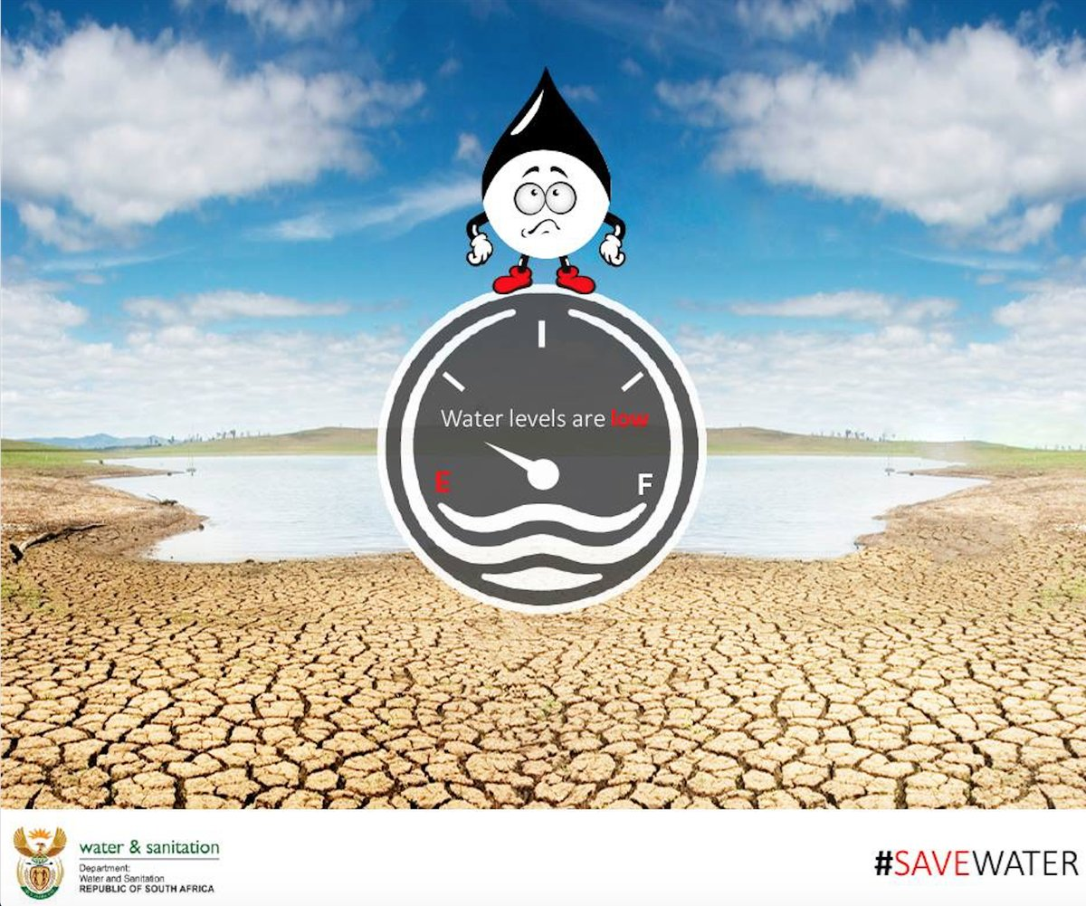
SOLUTIONS AND RECOMMENDATIONS:
DROUGHT COMMS IMPLEMENTATION PLAN
A Comprehensive communication strategy developed
A number of departments are currently implementing their own programmes which also find resonance in the plan.
Partnerships have been developed and others are continuing to be harnessed for better sharing of messages.
Various communication platforms and channels have been activated to carry messages across.
4

Slide 42
Task | Activity | Actions
Content Development | Speeches | All speeches to have water saving messages.
 | Statements | Monthly Statement – unless a need arises.
 | Key Messages | Key messages done – to be shared with the rest of govt – advocating saving water.
Products | Leaflets | Development and sharing leaflets, posters and flyers.
 | Posters
 | Pamphlets/ flyers
Social Media | Twitter | Twibbon Twitter adverts
 | Facebook | Messages on saving water
Digital Media | Websites | All Websites of government to be continually updated
Govt platforms | Vuk’uzenzele SA News PSM | Sharing messages through govt platforms – Save Water

Slide 43
Task | Activity | Actions
Media engagement: Print and Electronic Community & Mainstream | International Editors SANEF | IMTT briefing to media on drought issues – this will enhance better reporting.
 | Issuing of Media statements | Ongoing release of media Statements.
 | Placement of opinion pieces | Monthly Opeds
 | Media Briefings | Monthly Media Briefings. 12 Feb – IMTT Media Briefing
 | Paid Platforms | Outdoor Adverts (Airport, Taxi, Train and Bus Terminals) Street Screens. Soapies, News clocks, adverts, squeeze backs
 | Community Radio | Drought and Save Water messages - Phone in Programme - 65 Community Radios

Slide 44
Task | Activity | Actions
Outreach & Stakeholder Engagements | IMTT Outreach Regular Outreach programmes. Visiting affected areas Blitz with flash mobs Community engagements | Outreach beginning in March 2018 Butterworth and Port Elizabeth Identified taxi ranks on the Cape Flats
 |  | Information distribution: Leaflets Posters Information available at hubs (walk in centres, multi purpose centres) Sharing with schools, messages on municipal bills
 | Industrial theatre, Puppet Shows & Soapies | Engaging the art industry and SABC to carry messages
 | Stakeholders | Stakeholder briefings Roundtable discussions

Slide 45
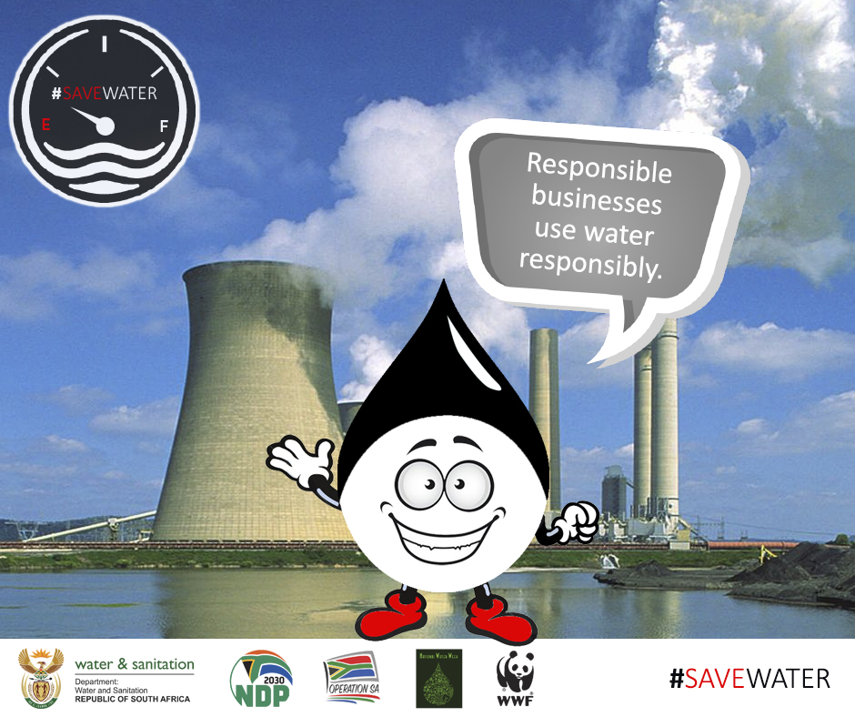
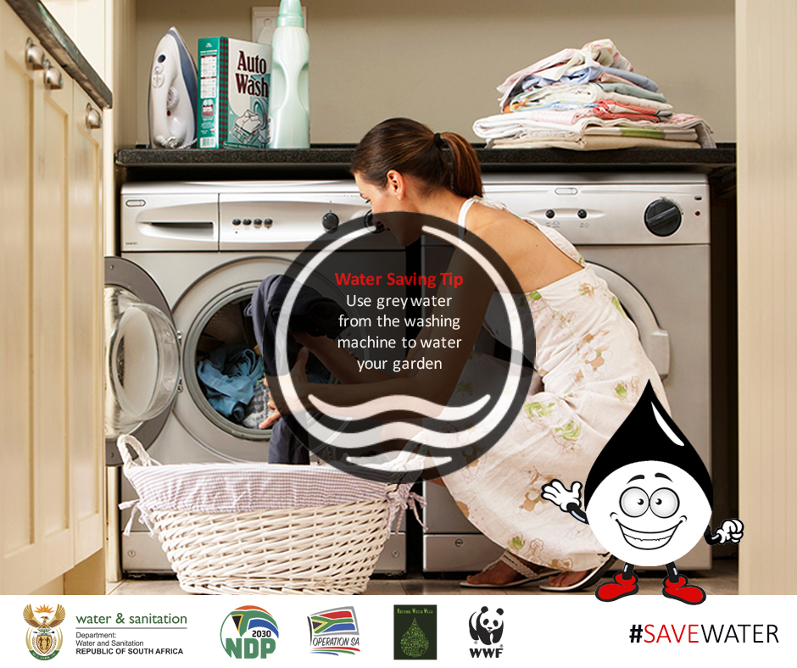
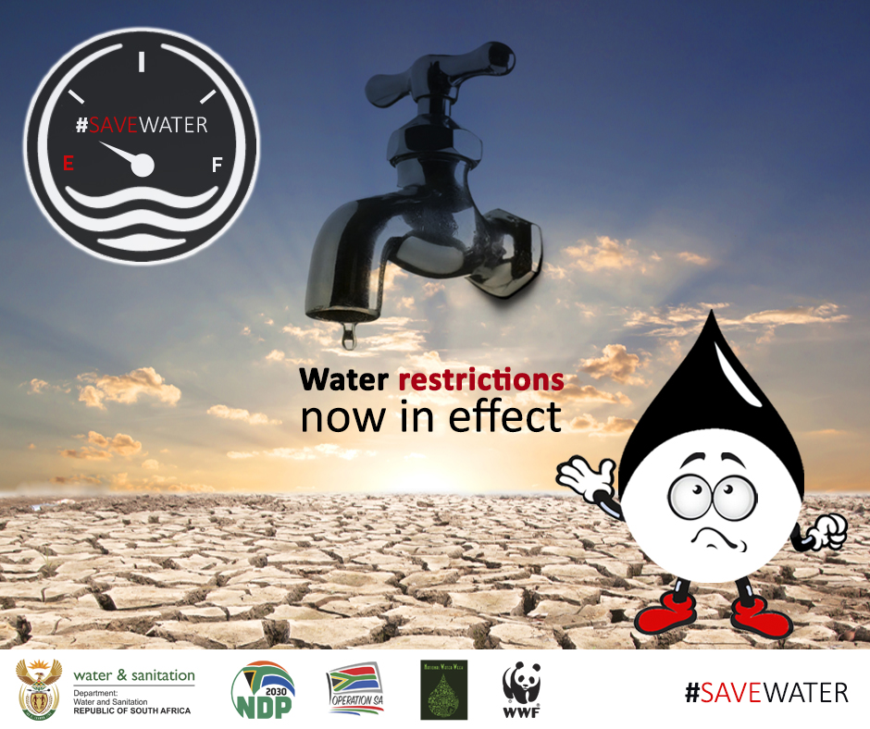
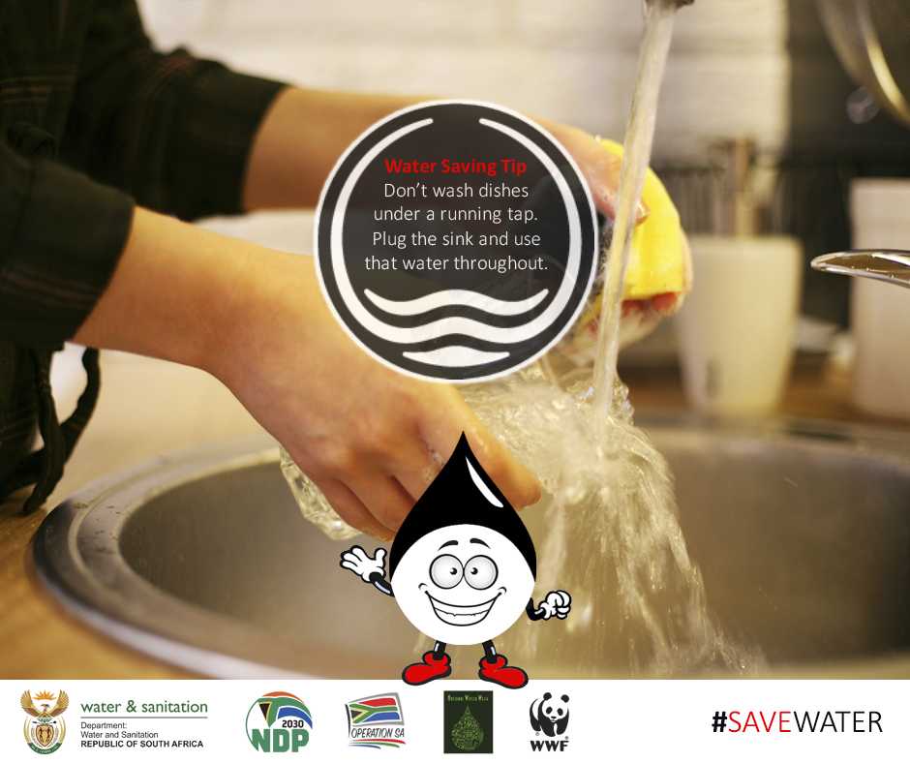
SOCIAL MEDIA INFOGRAPHICS

Slide 46
MILESTONES OF THE IMTT
Adopted an integrated Communication Strategy and its Implementation Plan.
Conduct regular media briefings and roadshows to engage and inform the public about interventions on drought and water scarcity.
Oversight of implementation of funded projects.
Provide guidance to strengthen coordination (vertical and horizontal) particularly with regard to reporting, communications and response measures.
Regular reporting to Parliament.
      WAYFORWARD FROM THE IMTT
A national disaster to be classified by the National Disaster Management Centre on or before 14 February 2018.
A decision for a declaration to be finalised within a month.
Robust public awareness, advocacy and community roadshows to commence with immediate effect.
The IMTT (06 February 2018) resolved to meet monthly to receive reports and guide national interventions.

Slide 47
RECOMMENDATIONS
It is recommended that the Portfolio Committee:
Notes progress report regarding interventions in dealing with drought and water shortages across the country.
Provides support and leadership to ensure heightened interventions.

Slide 48


