Slide 1

DEPARTMENT OF PLANNING MONITORING AND EVALUATION
PARLIAMENT PORTFOLIO COMMITTEE PROGRESS REPORT
SPECIAL PRESIDENTIAL PACKAGE FOR THE REVITALISATION OF DISTRESSED MINING COMMUNITIES AND LABOUR SENDING AREAS
29 November 2017

Slide 2
Table of Contents
Introduction and background to the October 2012 Social Accord Progress reports 2.1 Summary of progress since October 2016 IMC 2.2 Integrated Sustainable Human Settlements 2.3 Socio Economic Development 2.4 Improving working conditions and mine community health 2.5 Decent living conditions for mine workers and meaningful contribution to the development trajectory of mining towns and labour sending areas, led by DMR 3. Update on other strategic projects- Mining Phakisa 4. Conclusions 5. Recommendations

Slide 3
1. Introduction and background to the October 2012 Social Accord

Slide 4
Introduction and background to the October 2012 Social Accord
In October 2012 the President led the signing of a Social Accord (not confined to the mining industry) with Government, Business and Labour referred to as the Special Presidential Package (SPP) which made a number of commitments :
  Part 1: Restoring confidence in labour market institutions, addressing income inequalities and building social cohesion
  Part 2: Action to combat violence and lawlessness
  Part 3: Addressing socio-economic challenges

Slide 5
IMC for the Revitalisation of Distressed Mining Communities
In late 2012, an Inter Ministerial Committee for the Revitalisation of Distressed Mining Communities was established to address Part 3 of the Social Accord (SPP): Addressing socio-economic challenges in mining districts and their labour sending areas. The IMC has focused on:
  Integrated and sustainable human settlements, led by the DHS and supported by its agencies, e.g. NHFC, HDA
  Improved socio-economic conditions, led by thedti, DCO, Dept. of Traditional Affairs, DRDLR and supported by EDD, Treasury, DBSA, SALGA, IDC, MISA
  Improved working conditions of mine workers led by DoL
  Decent living conditions for mine workers and meaningful contribution to the development trajectory of mining towns and labour sending areas, led by DMR

Slide 6
Twenty two priority mining towns for the Revitalisation of Distressed Mining Communities
Twenty two mining areas in six provinces and their associated labour sending areas have been prioritised for the revitalisation of distressed mining communities.
PROVINCE | DISTRICT MUNICIPALITY | LOCAL MUNICIPALITES
Limpopo | Sekhukhune | Fetakgomo, Tubatse, Elias Motsoaledi
 | Waterberg | Lephalale, Mogalakwena
Gauteng | West Rand | Westonaria, Randfontein, Mogale City, Merafong
North West | Bojanala | Rustenburg, Moses Kotane, Madibeng
 | Dr. Kenneth Kaunda | Matlosana
Mpumalanga | Nkangala | Emalahleni, Steve Tshwete
Free State | Lejweleputswa | Matjhabeng
Northern Cape | Taolo Gaetsewe | Ga-segonyana, Gamagara,
 | ZF Mgcawu | Kgatelopele, Tsantsabane
 | Namakwa | Khai-Ma

Slide 7
Twelve Priority Labour Sending Areas for the Revitalisation of Distressed Mining Communities
Twelve labour sending areas in two provinces have been prioritised for the revitalisation of distressed mining communities
PROVINCE | DISTRICT MUNICIPALITY | LOCAL MUNICIPALITY
Eastern Cape | OR Tambo | King Sabata Dalindyebo, Nyandeni, Nquza Hill, Mhlontlo, Port St Johns
 | Alfred Nzo | Mbizana, Ntabankulu
Kwa-Zulu Natal | Zululand | AbaQulusi, eDumbe, Nongoma, Ulundi, uPhongolo

Slide 8
2. Progress reports

Slide 9
2.1 Summary of Progress

Slide 10
Summary of Progress (1)
Integrated and Sustainable Human Settlements
  Draft document on Human Settlements, Housing and Living Conditions Framework for the Minerals and Mining Industry is being developed by DMR in partnership with NDHS and other sector departments
  A Special Presidential Package Mining Towns Integrated Human Settlements High Level working session has been implemented
  Invited the prioritised municipalities development planning practitioners and municipal managers to discuss challenges relating to mining
  For the current financial year (2017/18), approximately R899 800 million has been ring-fenced for informal settlements upgrading and human settlements delivery in mining towns
  COGTA, DWS has provided infrastructure (water and sanitation) needs from the prioritised municipalities in line with future planned humans settlement projects

Slide 11
Summary of Progress (2)
Integrated and Sustainable Human Settlements
  The DMR is finalising the process of obtaining information about the existing and spare infrastructure capacity from the mines to be assessed by DWS
  The DMR has provided information of all the mineworkers on a living out allowance in all the prioritised municipalities
  This information will be useful for the NDHS to respond to the exact housing requirements in mining towns

Slide 12
Summary of Progress (3)
Socio-Economic Development
  COGTA and DSBD convened a National Local Economic Development (LED) Conference
    Crafting a new South African Local Economic Development agenda guided by the National Development Plan (NDP) priorities
    Its outcomes included the launch of the first Economic Development Council of South Africa (EDCSA), a professional body which aims to professionalize the economic development sector capacitate LED practitioners
  COGTA convened a workshop on Intermediate Cities Programme (Secondary Cities). The ICMs have a high proportion of mining towns and in consideration of the implementation approaches of the Integrated Urban Development Framework, specific approaches to Mining Towns will be deliberated between ICM Programme and the Distressed Mining Towns Programme with the possibility of piloting in a Mining Town.

Slide 13
Summary of Progress (4)
Socio-Economic Development
A clearing house model has been developed to review applications for government funding for catalytic economic development projects – will be piloted with the Dept. of Rural Development and Land Reform for the Mpumalanga Beef Value Chain

Slide 14
Summary of Progress (5)
Mine Health and Safety
  Following the October 2016 decision by the IMC to pursue legal action, The Dept. of Health met with the Chamber of Mines who has agreed to purchase the ex-mineworkers records of service from TEBA, for compensation purposes.
  The Chamber of Mines Convened the Pension Fund/unclaimed benefits meeting on 17 November 2017 to obtain progress with the payment of unclaimed pensions and provident funds for mineworkers
  A consultative workshop for the fast tracking of payments of unclaimed financial benefits to ex-mineworkers took place on the 15 and 16th of August 2017 to find innovative ways to ensure that payments to ex-mineworkers are effected speedily
  3 One Stop Service Centres operational in neighbouring countries (Botswana, Lesotho, Swaziland)
  Burgersfort One stop Centre opened, and Kuruman One Stop Service Centres will be opened in December 2017
14

Slide 15
Summary of Progress (6)
The DMR has joined other government agencies, including law enforcement agencies, to come up with integrated solutions to stop and manage the illegal mining of chrome around the Sekhukhune District Municipality
2017 Reviewed Mining Charter has been published by the DMR
15

Slide 16
2.2 Integrated Sustainable Human Settlements

Slide 17
Integrated Sustainable Human Settlements (1)
1) Purpose: The integrated human settlements intervention in mining towns programme is focussed on; Fast-tracking the existing project pipeline, development and implementation of human settlement transformation strategies and plans for each mining town and the formation of partnerships with mining companies
2) Challenges: Legislation and policy challenges, Informal settlements and the living out allowance , the delivery of bulk infrastructure cannot keep pace with housing demand
3) Solutions reviewed/implemented: Various mine-worker employer assisted housing models (2014), dialogue with stakeholders on defining, advancing and monitoring the right to adequate housing in mining towns (2014), state assisted mineworker financial model by government (2015) – model piloted in the Marikana Ext 2 project, a state supported mineworker housing model is being investigated in line with the Royal Bafokeng Developmental Wholesale Funding Model

Slide 18
Integrated Sustainable Human Settlements – Informal settlements in SPP provinces (1)
There's been a 123% (from 159 to 356) increase of informal settlements within SPP Provinces as from 31 March 2015 to 31 March 2017

Slide 19
Integrated Sustainable Human Settlements – Capital subsidy funding expenditure and delivery (historical:2014/15 – 2016/17) to date (2)
A total of 338 projects have been implemented in municipalities with mining towns
A total number of 187,501 sites and 265,271 units were completed from the 2014/15 financial year until the period ending 31 March 2017, at a total expenditure of R4 billion
For the current financial year (2017/18), approximately R899 800 million has been ring-fenced for informal settlements upgrading and human settlements delivery in mining towns

Slide 20
Integrated Sustainable Human Settlements – Capital subsidy funding expenditure and delivery (historical:2014/15 – 2016/17) to date (3)
To date (period ending June 2017) a total number of 1 594 sites and 579 units have been delivered in mining towns, at a total expenditure of R1297 107 million
In accordance with approved DORA, HSDG makes provision for provinces to utilize 2% of allocations to unblock bulk infrastructure challenges in projects.
  However, funding streams of other sector departments are also required to complement HSDG ring-fenced funding

Slide 21
Integrated Sustainable Human Settlements – Informal settlements upgrading and NUSP in mining town (4)
To date, there is a total number of 356 informal settlements in mining towns as follows:
  72 informal settlements in North West Province
  26 informal settlements in Free State Province including Moqhaka
  20 informal settlements in Limpopo Province
  97 informal settlements in Mpumalanga Province
  116 informal settlements in Gauteng Province
  25 informal settlements in Northern Cape Province

Slide 22
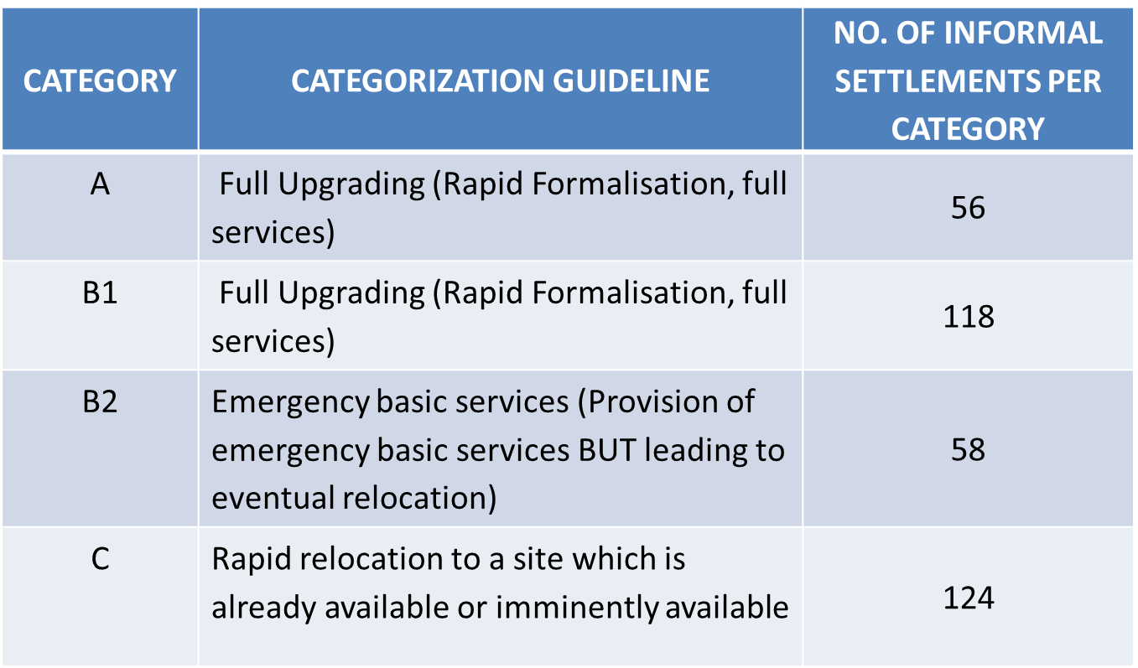
Integrated Sustainable Human Settlements – Informal settlements upgrading (5)

Slide 23
Integrated Sustainable Human Settlements – Programme progress status: Limpopo (6)
  Detailed planning underway for 1670 mixed units in Tubatse (GTLM)
  Detailed Planning/amendment underway for Lephalale Altoostyd: approximately 5000 units
  Proposed detailed planning/upgrading underway for Marapong: over 300 units (Lephalale)
  Proposed detailed planning/upgrading for Mamojela park for 600 units (Lephalale)
  Proposed detailed planning/upgrading for Skierlek Informal settlement: over 500 units (Thabazimbi)
  Detailed Planning underway for Motetema for over 350 units (Elias Motsoaledi)

Slide 24
Integrated Sustainable Human Settlements – Programme progress status: Free State (7)
  ISU work (rapid assessments and enumerations) completed
  Technical Upgrading Plans
  ISU Chapters for inclusion in the Municipal Housing Sector Plan
  Resettlement Plans through NDP&M
  ISU Settlement-Level Plans (Business Plans)
  Technical support provided on a quarterly basis through FS ISU Forum (NUSP Structure)

Slide 25
Integrated Sustainable Human Settlements – Programme progress status: Northern Cape (8)
Land assembly support :
  Facilitation of acquisition of private land
  Request for acquisition of State
Project Implementation support (NUSP)
  Dolomitic Investigation commissioned by CoGHSTA and Detailed Planning for upgrading
Project Implementation support
  Procurement of the service providers for Design and Installation of civil services
  Pre-planning ; Programme management support in Tsantsabane and Galowe 5000 as per the signed new catalytic project MoU and IP, 22 Houses and a Clinic constructed by HDA in Heuningvlei (Joe Morolong District) to replace the houses and a clinic that were affected by asbestos after a settlement payment by the Mining Company through DMR following a court case that the community won

Slide 26
Integrated Sustainable Human Settlements – Programme progress status: North West (9)
Madibeng
  Appointment of Land Surveyors and property evaluations
  Appointment of service providers to undertake township establishments, approval of General Plans and Conditions of Establishment
  Acquisition of private land for ISU and formalization
  Land assembly and release of state land for tenure upgrading
Matlosana (Catalytic Project)
  Township establishment processes
  Assessment of Project Readiness
  Sites and services
Rustenburg
  Township establishment processes (including Bokamoso Catalytic Project) Enumeration on the settlements which we are formalising; Bulk infrastructure assessments; Facilitation of installation of services; Acquisition of private land for ISU and integrated settlements Land assembly and release of state land

Slide 27
Integrated Sustainable Human Settlements –Programme progress status: Gauteng (West Rand Plan and Approach) (10)
Planning Alignment
  Alignment of spatial elements and dimensions of identified mining towns
  Identification of existing plans and strategies within the mining town areas
Governance Framework
  Analyze and provide for institutional support to drive regional mining towns approach
  Identification of credible partners for joint planning and coordination
Tools and Instruments
  Identify priority areas and interventions based on scale, severity and conditions of human settlements

Slide 28
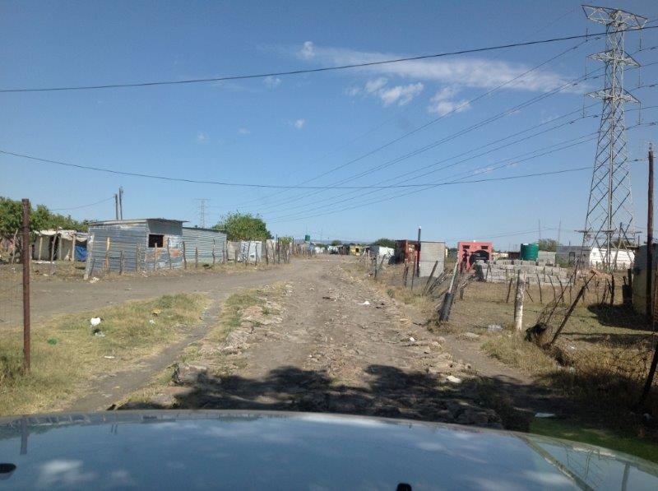
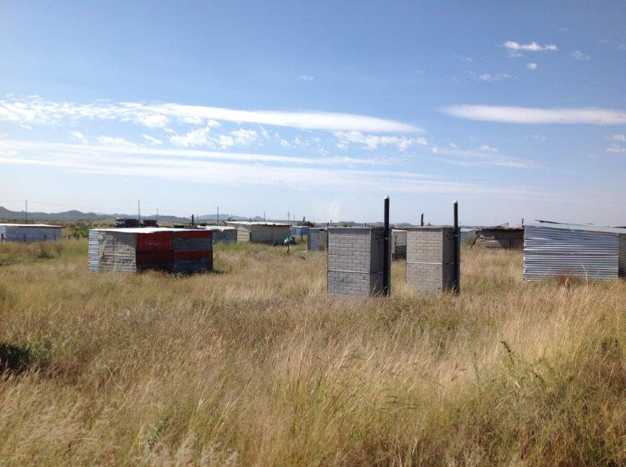
Integrated Sustainable Human Settlements – Progress with Integrated Human Settlements projects in Marikana (12)
The Marikana area is characterized by the most extreme poor living conditions
Overall population of approximately 24 000 with approximately 85% of these inhabitants working at the nearby mines mostly for the Lonmin Mining Company
It is estimated that 18 000 of these people live in informal settlements as a result of the Living out allowance

Slide 29
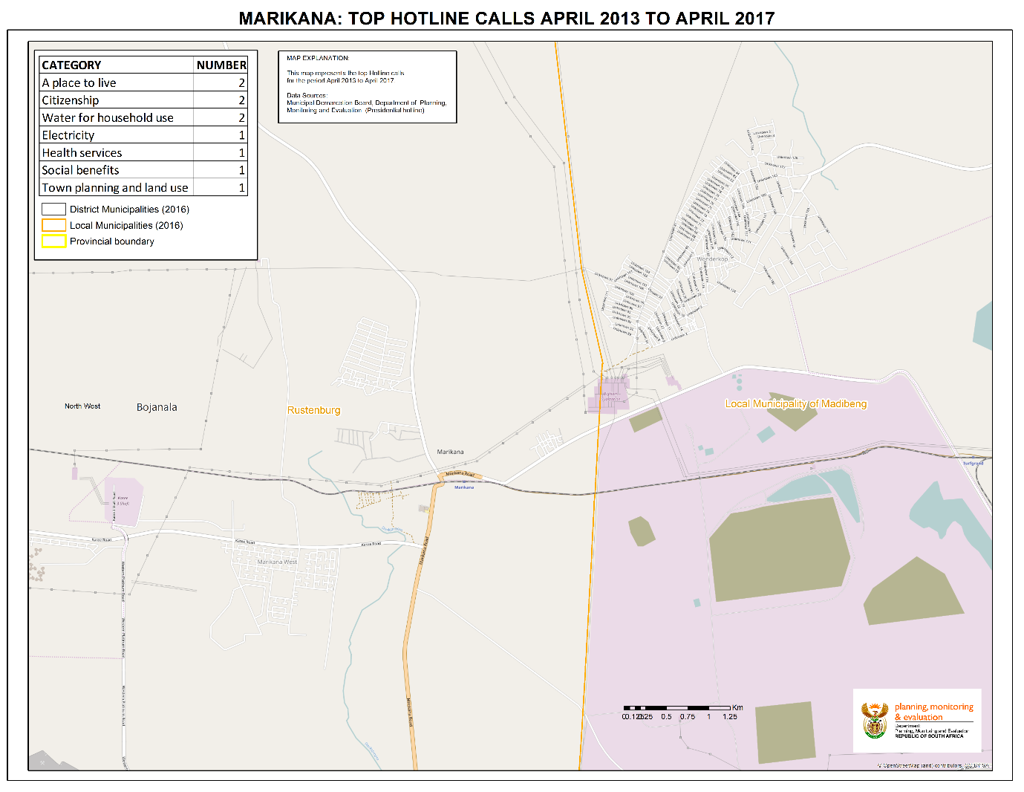
Integrated Sustainable Human Settlements –Marikana Top Presidential Hotline Calls from April 2013 to April 2017 (13)

Slide 30
Integrated Sustainable Human Settlements – Lonmin housing demand and Government Integrated Human Settlements Project (14)
The majority of Lonmin mining company employees on a living out allowance are living in informal settlements with limited access to piped water, limited sanitation, inadequate refuse removal, illegal electricity connections, very limited health care and education services
Currently Lonmin’s total workforce is approximately 28 000 and 11 500 workers need decent accommodation
In 2013, Lonmin Mining Company donated 50 hectares’ portion of land (valued at R 10 000 000.00) with 860 serviced sites to the North West Department of Local Government and Human Settlements (NWLGHS), which was subsequently transferred to the Rustenburg Local Municipality (RLM) for the entire Marikana Integrated Housing Development Project.
The 860 serviced sites were redesigned to a densification yield of 2600 mixed typology units spreading across four key housing programmes, namely: Breaking New Ground (BNGs), Community Residential Units (CRUs), Finance Linked Individual Subsidy Programme (FLISP) and Social Housing

Slide 31
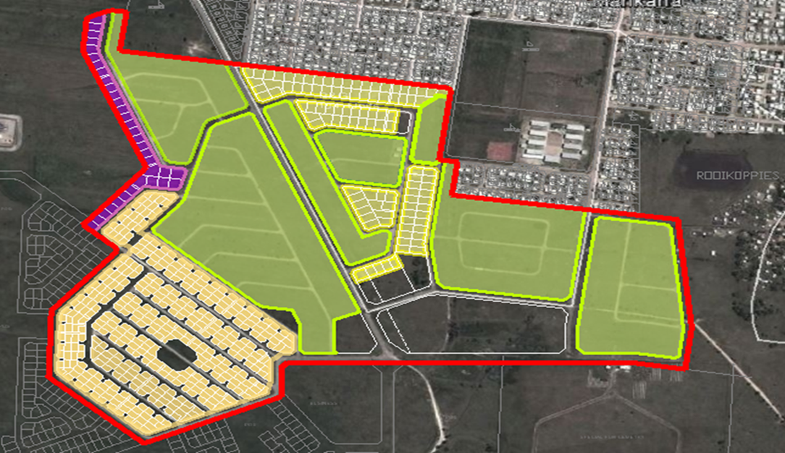
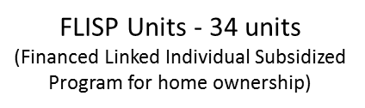
Integrated Sustainable Human Settlements – Marikana Redesigned Densification to yield 2 600 units (15)
BNG – 292 units
CRU – 252 units
BNG Units - 243units
(Free for income earners
< R 3500 pm)
Legend colours:
Yellow: BNG 292 units under construction with completion at end Nov 2015
Green: CRU 252 units under construction with completion at end Nov 2015
Purple: FLIP units 34 not yet under construction

Slide 32
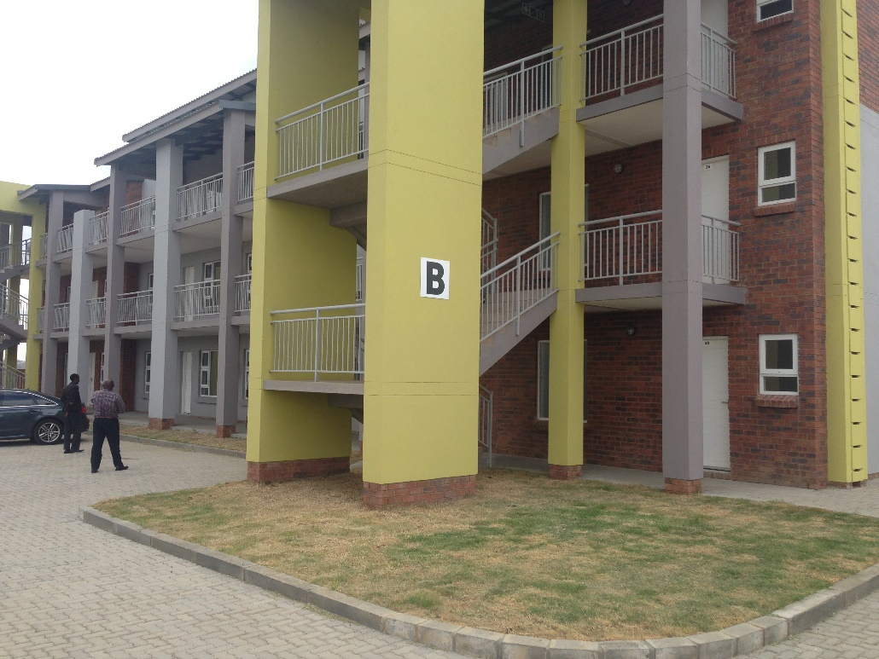
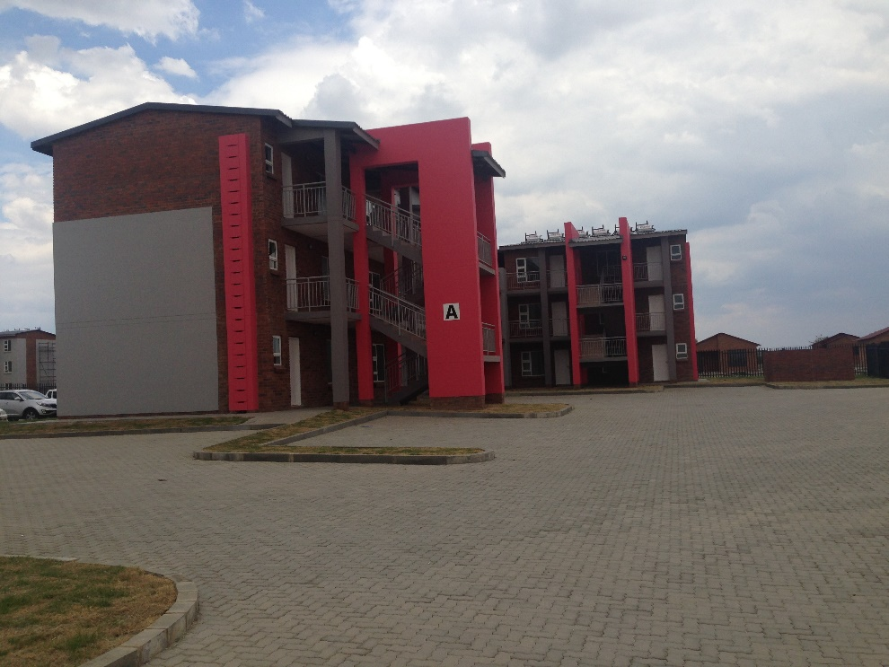
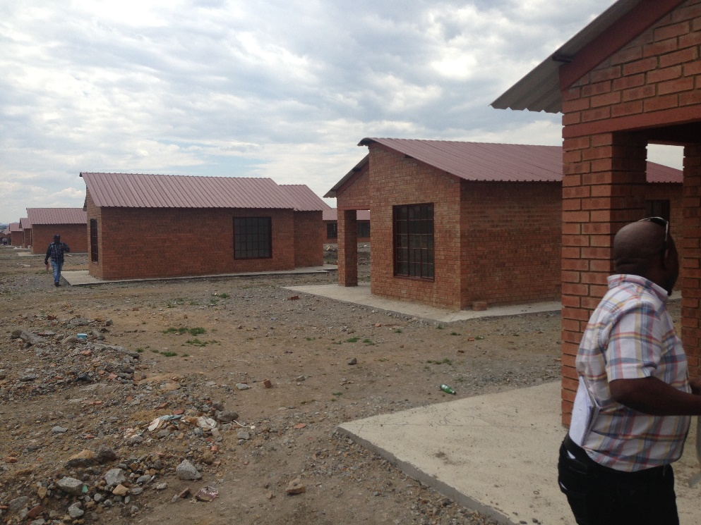
Integrated Sustainable Human Settlements – Marikana Extension 2 (16)

Slide 33
Integrated Sustainable Human Settlements – Marikana Extension 2 (17)
Phase 1, which is the current phase of the project, is complete consists of a total of 292 BNG units and a total 252 CRUs.
The project value of the CRUs is R 121 864 202.00 whilst the project value of the BNGs is R 38 880 956.00. The total investment by the Department of Human Settlements amounts to R 160 000 000.00
During the rental rates negotiation process for the CRU’s, government proposed a 70/30 split of the rental units, in which case the Lonmin employees requested that 70% of the units should be allocated to them, and 30% to the broader Marikana Community. Subsequently, the Marikana Community, the Association of Mineworkers and Construction Union (AMCU) as well as the South African National Civic Organisation (SANCO), had accepted this proposal.
Disputed rental amounts between the government and AMCU
Government proposed rental amounts | AMCU preferred rental amounts | Difference | Final negotiated rental amounts
Bachelor flat R900 | Bachelor flat R350 | R500 | No consensus reached, government rates apply.
Single bedroom unit R1600 | Single bedroom unit R400 | R1 200
Two bedroom unit R2 200 | Two bedroom unit R600 | R1 600

Slide 34
Integrated Sustainable Human Settlements – Living out allowance and informal settlements (18)
Alignment of NDHS and DMR information on Informal Settlements and Housing options provided by Mining Companies
SPP Provinces | Total No. of Informal Settlements within SPP Municipalities in provinces (NDHS) |  | Estimated No. Of Households In The Informal Settlements (NDHS) |  | No. Of Employees On LOA (DMR) |  | No. Of Employees In Hostels (DMR) |  | No. Of Employees Staying In Mine Provided Housing Schemes (DMR) |  | No. Of Employees On Home Ownership Schemes (DMR)
Provinces | 2015 | 2017 | 2015 | 2017 | 2015 | 2017 | 2015 | 2017 | 2015 | 2017 | 2015 | 2017
North West | 61 | 72 | 80 041 | 84 389 | 70221 | 83 298 | 46087 | 8 491 | 6629 | 6 124 | 15908 | 4 114
Free State | 20 | 26 | 6 331 | 7 768 | 12428 | 13 605 | 5720 | 11 043 | 744 | 839 | 726 | 343
Limpopo | 15 | 19 | 11 789 | 20 676 | 10326 | 8 728 | 194 | 0 | 947 | 779 | 1947 | 1 697
Mpumalanga | 16 | 97 | 3 006 | 19 020 | 4717 | 4 567 | 0 | 1 | 2051 | 2 031 | 6952 | 6 998
Gauteng | 24 | 116 | 37 834 | 51 259 | 18810 | 2 762 | 16019 | 21 317 | 15958 | 20 860 | 6324 | 989
Northern Cape | 23 | 26 | 20 192 | 20 460 | 5449 | 5 162 | 2778 | 976 | 8909 | 6 177 | 2483 | 2 855
Totals | 159 | 356 | 159 193 | 203 572 | 116 502 | 118 122 | 68 020 | 41 828 | 26 329 | 36 810 | 31 857 | 16 996
Note: Total number of informal settlements within SPP Municipalities (including Moqhaka) and estimated number of households in the informal settlements (NDHS information, 31 January 2017)

Slide 35
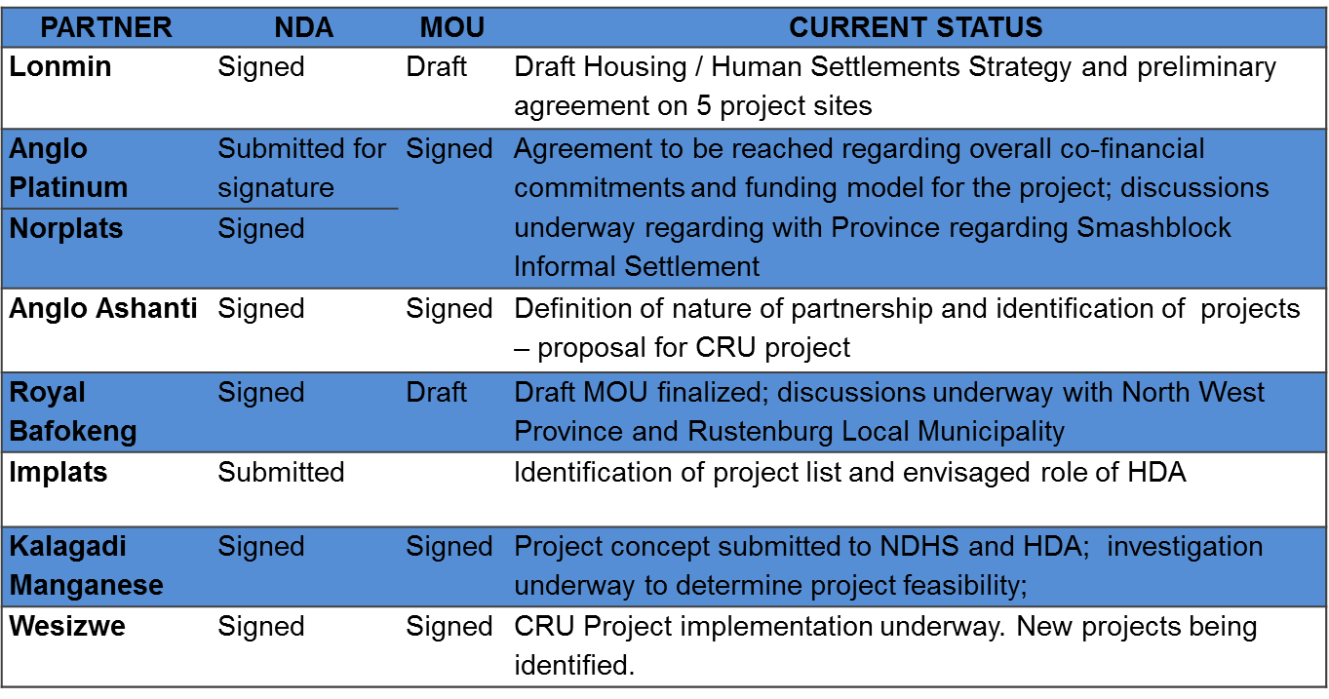
Integrated Sustainable Human Settlements – On-going partnerships with mining companies (3)

Slide 36
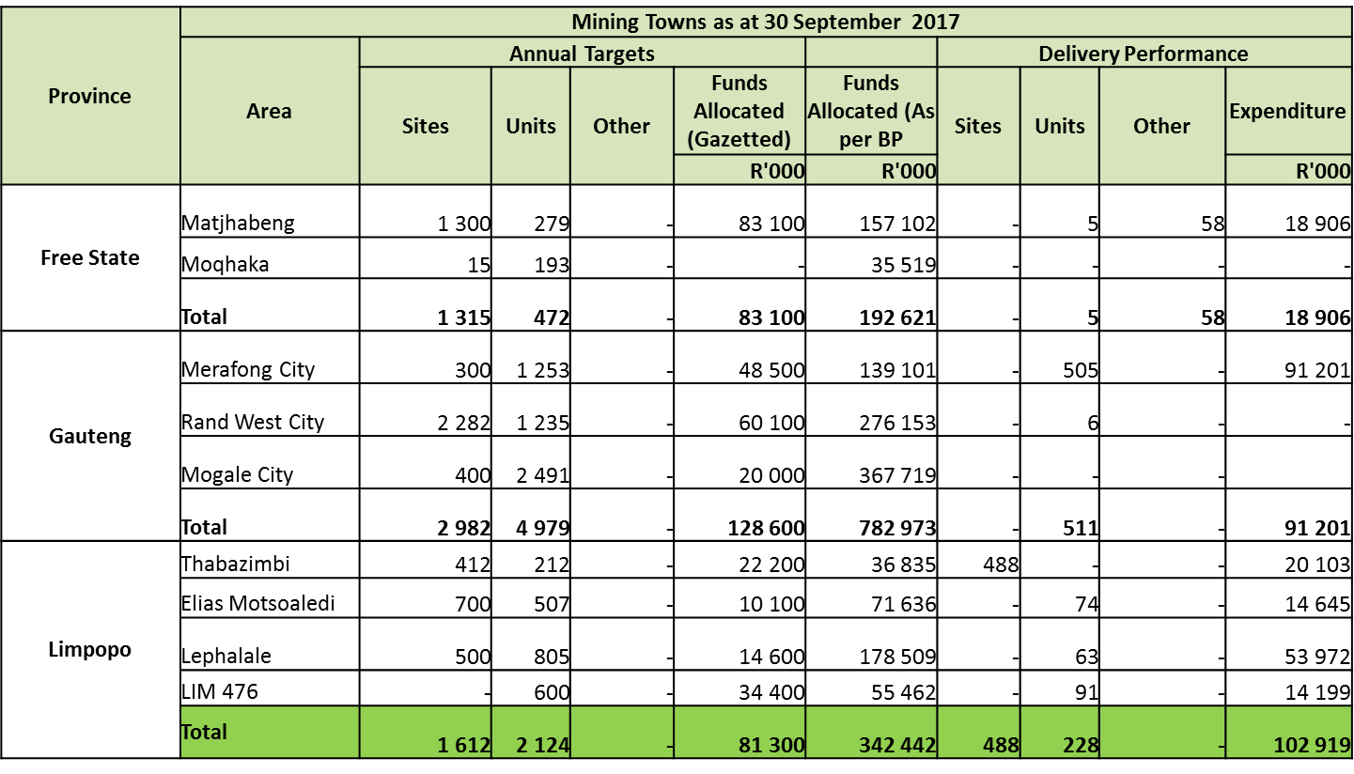
Capital Subsidy Funding – Delivery and Expenditure
2% of ring-fenced allocations to unblock bulk infrastructure challenges (4)

Slide 37
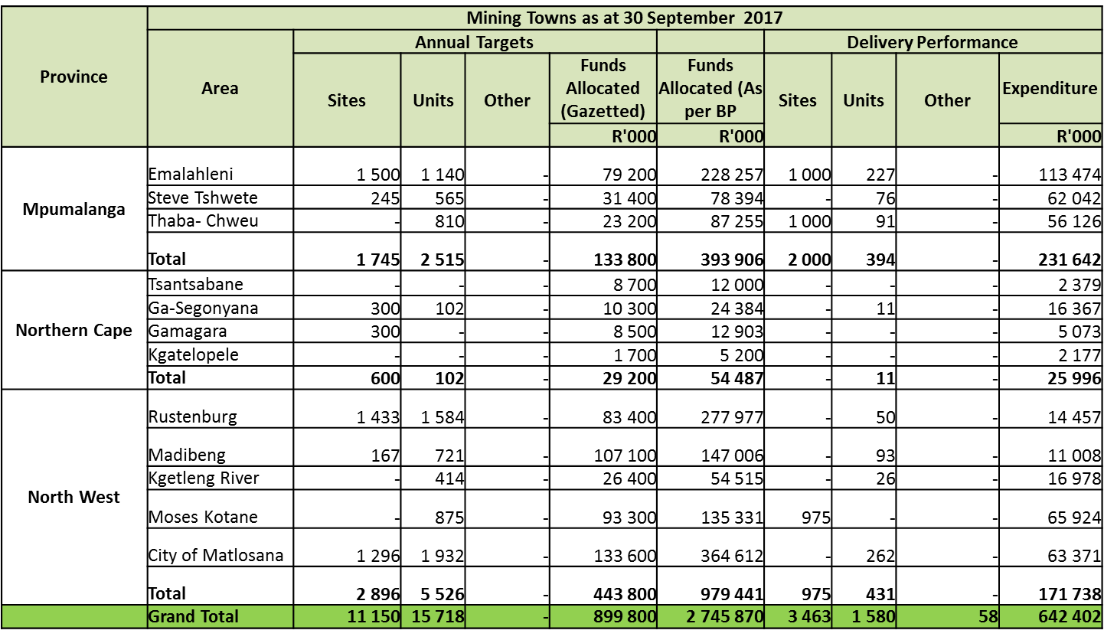
Capital Subsidy Funding – Delivery and Expenditure
2% of ring-fenced allocations to unblock bulk infrastructure challenges (5)

Slide 38
Integrated Sustainable Human Settlements - Infrastructure (6)
1) Purpose: To provide co-ordinated support to mitigate challenges with infrastructure provision in mining towns
2) Challenges: Challenges with Integrated settlement planning, Influx of migrant job seekers in mining communities, limited management or in some cases inadequate use of the Municipal Infrastructure Grant (MIG) due to capacity constraints, difficulty in attracting skilled engineers and financial managers to work in rural municipalities and aging bulk and reticulation infrastructure
3) Solutions reviewed/implemented: DWS, and sector agencies, DBSA and MISA and Mining companies contribute towards infrastructure through capacity assistance/provision/enhancement; funding infrastructure provision and partnership projects in the provision of infrastructure. High level water supply needs assessments prepared (current water service levels, current backlogs, scheme development and refurbishment and water and sanitation demand management)

Slide 39
Integrated Sustainable Human Settlements- Infrastructure DWAS update (7)
DWS has conducted an in depth assessment of the water and sanitation current supply and demand which illustrates Water Service Levels: Backlog Solution Category and Intervention Requirement Programs
DMR is currently conducting an assessment of all the mines spare infrastructure capacity to review possible areas of collaboration between the mines and local municipalities – spare capacity will unlock numerous projects (economic and housing)

Slide 40
Integrated Sustainable Human Settlements (8)
Province | No. of projects | Projects | Project value (R'000) | Project expenditure (R'000)
Free State | 4 | Nala LM Bulk sewer project; Mmamahabane WWTW; Upgrading of sewer network in Kutlwanong; Vaal-Gamagara Bulk water supply scheme | R 1 448 000 | R 573 000
North west | 2 | Madibeng bulk water supply; Pilanesburg bulk water supply | R 1 623 000 | R 404 000
Limpopo | 6 | Moutse Bulk water supply and Sekhukhune bulk water supply; Nebo bulk water supply; Mooihoek Tubatse bulk water supply; Olifants river water resource development project; Mooihoek Tubatse Bulk water scheme: Mooihoek WTW; Mokolo and crocodile water augmentation project Ph 1; | R 7 135 000 | R 4 076 000
Eastern Cape | 12 | Greater Mbizana Regional bulk Water Supply; Mthatha Raw Water Bulk Supply; KSD PI Bulk Water: Ph 2: Mthatha south; KSD PI bulk water: Ph 2: Airport corridor; KSD PI Bulk water: Phase 2: Mthatha North; KSD PI Bulk water: Ph 2 Mqanduli corridor; KSD PI Bulk water: Package 5: Rosedale and Thornhill; KSD PI Bulk water: Package 6: Libode corridor; KSD PI Bulk water: Package 7: Nqgeleni corridor; KSD PI Bulk water: Package 9: Thornhill WTW upgrading; Mthatha waste water treatment works; Mthatha Northern outfall sewer; | R 3 852 000 | R 1 316 000
Total | 24 |  | R 14 058 000 | R 6 369 000

Slide 41
2.3 Socio-Economic Development

Slide 42
Socio-Economic Development (1)
1) Purpose: To diversify the local economies and regional economies in both mining towns and labour sending areas, to develop alternative economic opportunities during and beyond the life of mines. Emphasis on economic development in Labour Sending Areas
2) Challenges: The nature of the mining sector is associated with boom and bust cycles. During economic downturns, single sector reliant economies cannot absorb the shocks and are therefore not resilient. LED municipal function is under resourced – cant package catalytic economic development projects, poor business investment climate beyond mining, inadequate economic infrastructure, insufficient PPP’s to drive economic development; and very low literacy levels
3) Solutions reviewed/implemented: Support to LED municipal officials by the DTI to package catalytic economic development projects and to link with government grants and subsidies, support and formalization of small businesses, coordinating economic development planning with infrastructure development planning, PPP models used where feasible

Slide 43
Socio-Economic Development: Eastern Cape OR Tambo and Alfred Nzo (2)
Project Name & Location | Sector | Project Status | Budget | Project Requirements
Informal Trade Infrastructure Development | Retail Services | 3-Applications being assisted for funding from DSBD (Mhlontlo; Nyandeni & PSJ) | R15m (R5m each for the 1st phase) | Infrastructure Capacity building for traders
Vegetable Crop & Essential Oils Cluster | Agriculture & Agro-processing | Successful pilot studies completed. 3-plantation areas identified. Existing markets in place. | R15m (for implements and crops) | Infrastructure Capacity building for farmers
Mining Quarries Cluster | Mining | Small mining quarries in operation but need equipment and further training. Existing markets from government infrastructure projects. Projects spread across 3-regions | R60m | Funding for equipment Capacity building / mentorship
Enterprise Development Centres | Services | Existing Capacity building project sponsored by Anglo Gold Ashanti in KSD/ORT. Need to expand to Mhlontlo LM | R13m allocated by Anglo Gold in ORT Funding for Mhlontlo still to be determined | Funding for expansion to other areas
Fruit Farming Cluster | Agriculture and agro-processing | Project feasibility done ARC in different areas. Land available to start | R30m | Business Case Crop, equipment and land preparation
Wool (Sheep) Beneficiation Cluster | Agro-processing | 13-shearing sheds currently in operation, with 7 of these in need of refurbishment. The project will be expanded to Nyandeni LM | R15m | Equipment Capacity building and mentorship
Maize Milling Cluster | Agro-processing | Operational milling facility in Mqanduli owned by 20 farming coops – having more than 3000 hectares. Need to expand to Mhlontlo LM for maize growers | R42m (provided through Jobs Fund for Mqanduli) R10m needed for expansion | Funding for farmer co-operatives – fencing and implements

Slide 44
Socio-Economic Development: Zululand District Municipality (3)
Project Name & Location | Sector | Project Status | Budget | Project Requirements
Pongola Maize Milling Plant | Agriculture and Agro-processing | Linking farmers into the grain value chain of the maize production and processing. Potential job opportunities - 350 | R11m | Equipment for the plant Mechanisation for farming Maize storage facilities
Active Blue Quarrying | Mining and beneficiation | Approved for R35.5m by the dti – finalising the process of disbursements. NEF application for the balance of the loan facility required at final stage. Potential jobs opportunities - 400 | R15m | Operational Costs Equipment for expansion

Slide 45
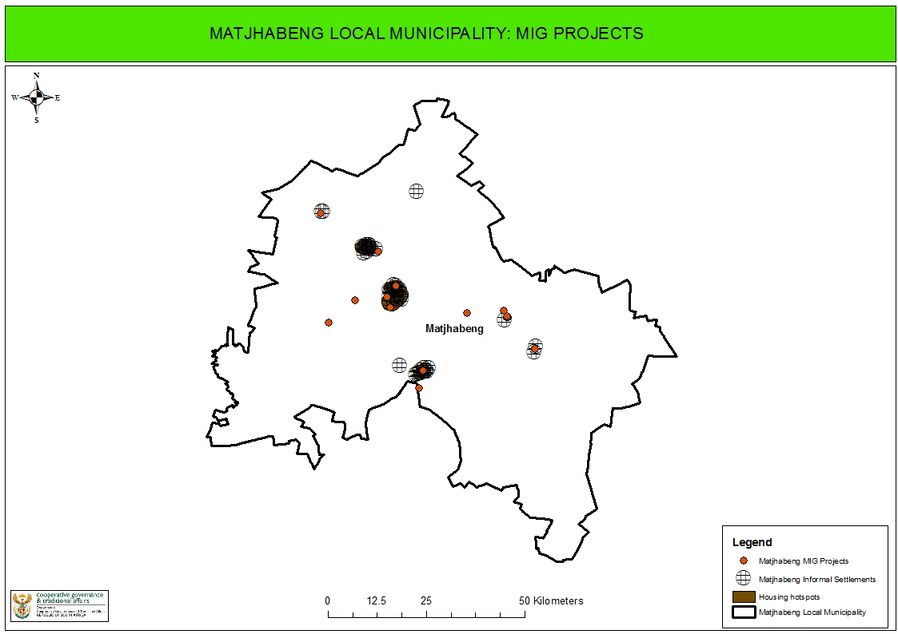
Socio-Economic Development - MIG(4)

Slide 46
Socio-Economic Development – MIG Matjhabeng (5)

Slide 47
Socio-Economic Development – Special Economic Zones (6)
NATIONAL TREASURY: KEY CONCERNS WITH SEZ PROGRAMME
    The over reliance of the SEZ Programme on the fiscus and the resultant negative impact,
    Rapid roll-out leading to revenue erosion risks,
    The use of multi-sites is likely to worsen revenue erosion but unlikely to contribute to cluster development,
    The administrative burden on SARS,
    Poor performance of the designated zones in relation to investment attraction, job creation and export promotion

Slide 48
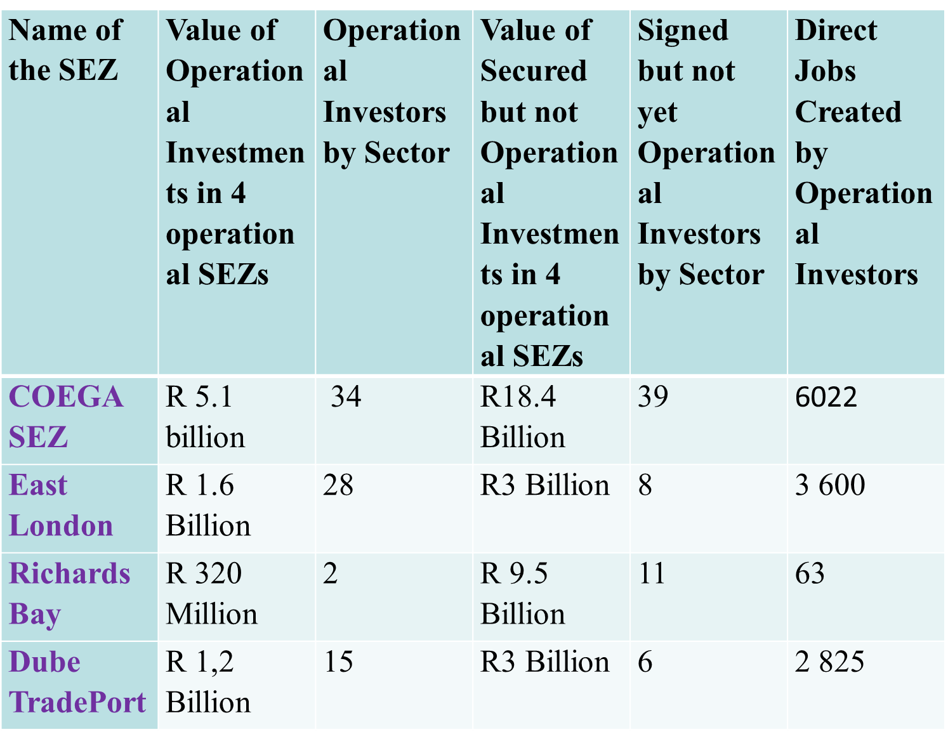
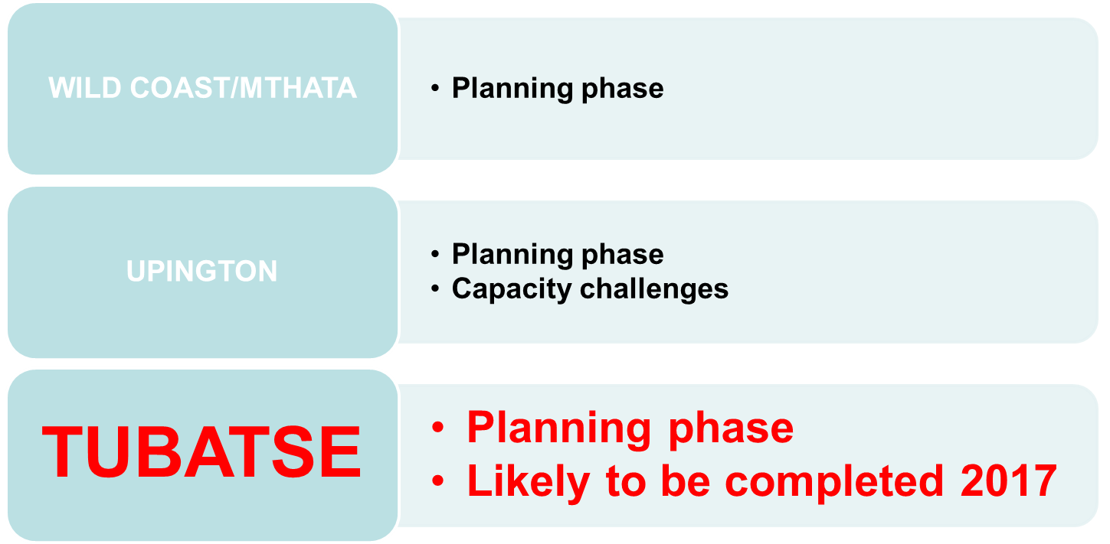
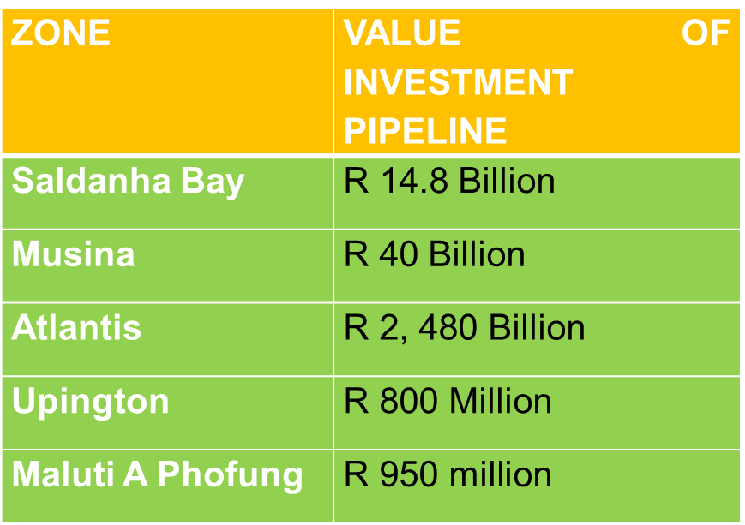
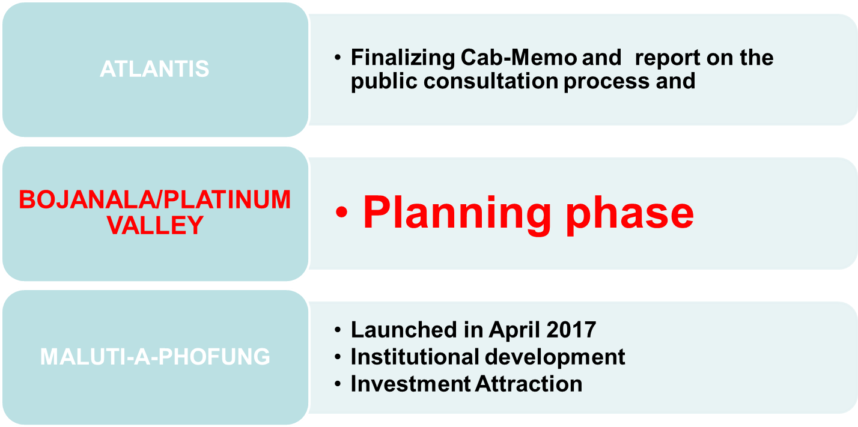
Socio-Economic Development – Eastern Cape (7)

Slide 49
Socio-Economic Development – Mogalekwena Local Municipality Mine Socio-Economic Development Intervention (8)
The DPME has been tasked by the Minister in the Presidency, in May 2017, to engage with the community of Skimming and Leruleng in Mapela, Mogalekwena Local Municipality, regarding concerns that have been raised on the impacts of the Anglo Platinum Mine operations on the community
The DPME has engaged various stakeholders, to facilitate in the intervention:
    Mogalekwena Local Municipality
    Department of Mineral Resources,
    Office of the Premier, Limpopo
    Provincial Departments: Basic Education; Cooperative Governance, Housing and Traditional Affairs; Police Service
    The South African Human Rights Commission
    Anglo Platinum Mine

Slide 50
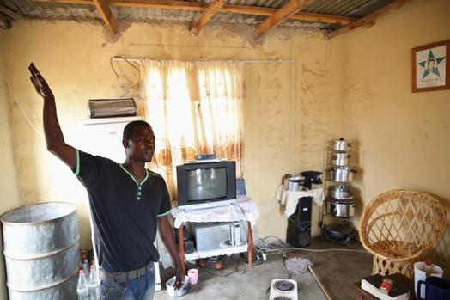
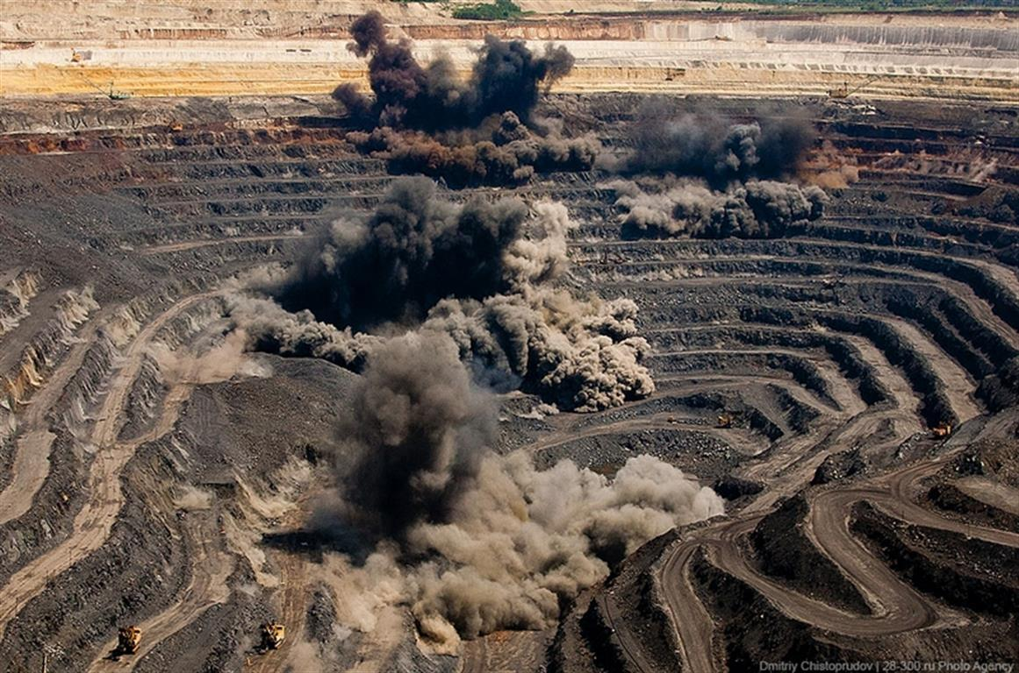
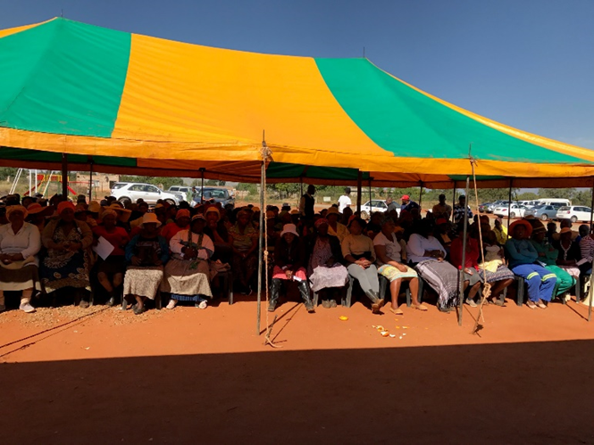
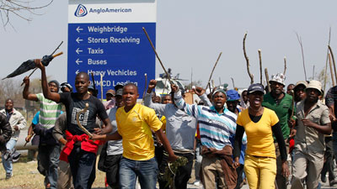
Socio-Economic Development – Mogalekwena Local Municipality Mine Socio-Economic Development Intervention (9)

Slide 51
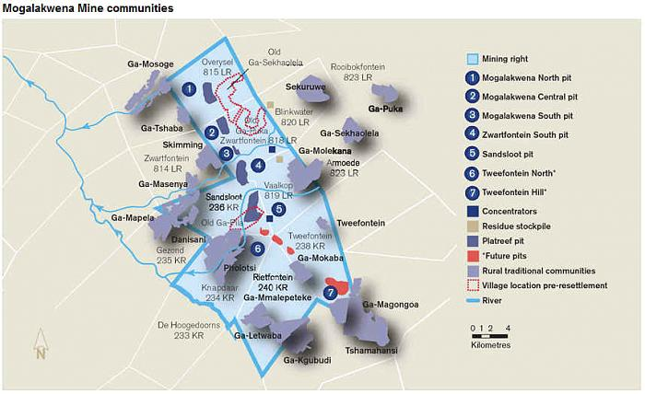
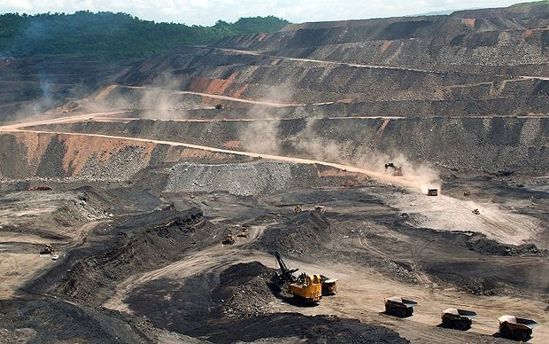
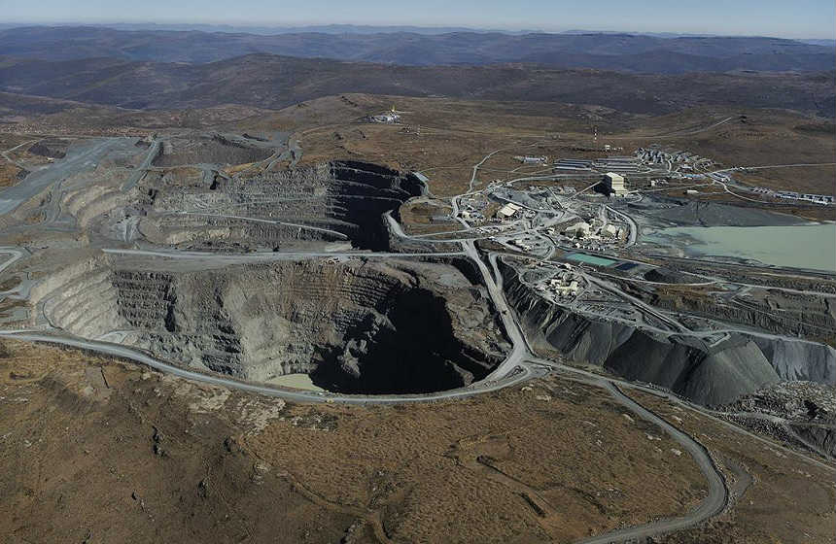
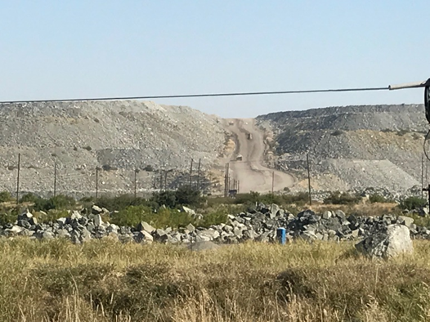
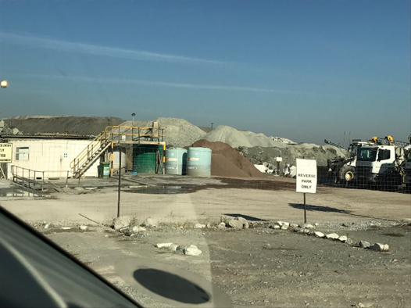
Socio-Economic Development – Mogalekwena Local Municipality Mine Socio-Economic Development Intervention (10)

Slide 52
Socio-Economic Development – Mogalekwena Local Municipality Mine Socio-Economic Development Intervention (11)
Main concerns raised by the community:
  Healthy and safety ; proximity of mine to residential areas, impact of mine operation on a school, impact of blasting on houses and dust from mining operations
  Inadequate community engagement
  lack of community economic development
  Lack of employment opportunities
  Violation of human rights
A process has been established to resolve concerns raised by the community:
  Community engagements
  Discussions with the mining company
  Engage with the Local Municipality and the Limpopo Office of the Premier & other government departments
The intervention will form an entry point into a broader review, as mandated by the IMC, to focus on spatial transformation, through strategic spatial planning of the Mogalakwena Local Municipality

Slide 53
2.4 Improving working conditions and mine community health

Slide 54
Improving working conditions and mine community health (1)
Purpose: To provide co-ordinated stakeholder support in ensuring health services, products and retirement benefits are made easily accessible to ex-mineworkers
2) Challenges: Mine workers operate under challenging working conditions which exposes them to numerous occupational diseases such as TB, Silicosis, and injuries. Generally inadequate compensation is provided, especially to ex-mineworkers. Ex- mineworkers experience great difficulty in accessing health compensation and retirement benefits. These occupational diseases have created unhealthy conditions in mining communities and labour sending areas in which people are born, grow, work, live and age; thus influencing a wider set of forces and systems shaping the conditions of their daily lives.
3) Solutions reviewed/implemented: Integration of the compensation systems on occupational health and safety (COIDA and ODIMWA), improving mine health and safety, tracking and tracing and paying ex-mineworkers their health compensation and retirement benefits

Slide 55
Improving working conditions and mine community health – Occupational Diseases in Ex-Mineworkers (2)
In summary:
3837 South Africans paid R123m over a 1-year period
2934 SADC persons paid R91m over a 1-year period
Total of R214m to 6771 persons compared to 2631 ~ R114m in previous year

Slide 56
Improving working conditions and mine community health – Unclaimed/Unpaid ex-mineworkers pension and provident funds (3)
Estimated R41 billion owed to 4.2 million beneficiaries (cutting across economic sectors)
  In the mining industry estimated R5 billion owed to 180,000 beneficiaries, average benefit is R23,610
  Approximately 65% of claims owed are older than 16 years and more than 70% of claims relate to withdrawal and death benefits
Challenges experienced by beneficiaries
  No / insufficient documentation (record of service); not knowing which mine let alone the fund the member belonged to; no access to information such as where to go to claim; living in remote areas and not being accessible through mainstream checks such as ID number and unscrupulous tracers/agents and third parties

Slide 57
Improving working conditions and mine community health – Unclaimed/Unpaid ex-mineworkers pension and provident funds (4)
On 15 and 16 August 2017 a Government and ex-mineworkers Consultative Workshop on unpaid pensions and provident funds for ex-mineworkers took place
The workshop served as a platform for ex-mineworkers leadership formations to directly engage the pensions and provident funds administering unclaimed pensions and provident funds of ex-mineworkers
To develop a clear program of action with clear deliverables, timeframes and indicators for the next 12 months to fast track the payment of approximately R6 billion unpaid pension and provident funds to ex-mineworkers
DPME hosted the workshop in partnership with the DMR and the Financial Services Board (FSB)
Funds in attendance: Anglo American Pensions Fund, Mineworkers Provident Fund and Sentinel

Slide 58
Improving working conditions and mine community health – Plan of Action from the 15 & 16 August 2017 Workshop (5)
Outcome Area | Responsibility / Champion | Timeframe / Deadline
1. Improving Tracking & Tracing – include Ex-mineworkers - Costs associated with finding and paying a beneficiary (internal transfers) | DPME, FSB | On-going
2. Corrupt Activities – Forensic investigation – CCOD, Funds and Ex-Mineworkers Formations | DPME, Ex-Mineworkers | TBC
3. Collaborating with Ex-Mineworkers - Information gathering for interim – Discussion with principal officer | DPME, FSB, Funds, Ex-Mineworkers | TBC
4. Logistics Co-ordinating Centre | Chamber of Mines, DMR, DPME , Department of Health (DoH) and FSB | 13 September 2017
5. Provisions within Pension Funds Act Legislation / Regulatory Constraints. Implications of Central Fund | National Treasury, FSB, DMR and DPME | 31 August 2017
6. Central Unclaimed Benefits Fund – Plan & Mechanics | National Treasury, FSB, DPME | TBC
7. Decentralisation of MBOD & CCOD Services – Taking Services to the People | DPME, DoH and DMR | 12 September 2017
8. Involvement of Other Stakeholders to include in Tracing Process and Awareness Campaigns (Home Affairs, Banks, SARS etc.) – MWPF to provide list from Lesotho. Speak to Dr Barry regarding Absa arrangement. | DPME, FSB, DMR and DoH | TBC
9. Eastern Cape SteerCo | DPME, DMR | September 2017
10. Exhumation and Repatriation of ex-mineworkers who died and buried at place of work. Social support provided to families of sick and injured mineworkers | DPME, DMR, Social Development, EC (OTP) | September 2017

Slide 59
Improving working conditions and mine community health – Unclaimed/Unpaid ex-mineworkers pension and provident funds (6)
Beneficiaries/Claimants – Assist with directing their enquiries to the relevant funds (post, e-mail, telephone and walk-in clients) – currently utilising the database
From 1 Jan 2015 to 31 March 2017 the FSB has received a total of 10 598 enquiries of these 3 903 were for ex-mineworkers. The FSB has now developed an unclaimed retirement benefits electronic database
Collected unclaimed data
 | No. of funds | Aggregate amount of unclaimed benefits | % | Number of beneficiaries for whom unclaimed benefits are held | %
Occupational retirement funds | 1 190 | 34 005 109 852 | 81.62 | 3 188 457 | 78.02
Beneficiary funds | 7 | 68 510 148 | 0.18 | 1 213 | 0.03
Unclaimed benefits funds | 41 | 7 585 111 899 | 18.20 | 896 615 | 21.95
Total | 1 238 | 41 658 731 899 | 100 | 4 086 285 | 100
 | No. of funds | Aggregate amount of unclaimed benefits | % of total unclaimed benefits | Number of beneficiaries for whom unclaimed benefits are held | % of unclaimed benefits
Data collected | 1 781 | 37 672 988 784 | 90.04 | 3 719 792 | 91.03

Slide 60
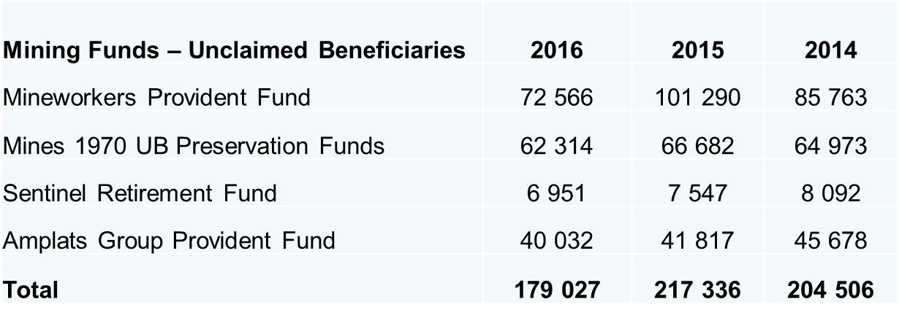
Improving working conditions and mine community health – Unclaimed/Unpaid ex-mineworkers pension and provident funds statistics (7)
Mining Funds –Unclaimed Assets4 | 2016 (Rm) | 2015 (Rm) | 2014 (Rm)
Mineworkers Provident Fund | 3 177 | R3 756 | R3 219
Mines 1970 UB Preservation Funds | 652 | 663 | 616
Sentinel Retirement Fund | 175 | 206 | 223
Amplats Group Provident Fund | 223 | 228 | 178
Total | 4 227 | 4 863 | 4 236

Slide 61
Improving working conditions and mine community health – Occupational Diseases and Ex-Mineworkers (8)
The work on fast tracking payment of unclaimed pension and provident funds for ex-mineworkers is ongoing
  Financial Services Board (FSB) currently busy drafting proposed amendments to the Pension Funds Act
  A provision for the establishment of a “Central Unclaimed Retirement Benefits Fund” forms part of the above proposed amendments, which will be submitted to the National Treasury for consideration - No timelines
  The Chamber of Mines – is also playing a role to ensure payment is fast tracked through a structured process
Another proposal for the ex-mineworkers :
  Other means to force them to pay the money are a class action lawsuit
  Similar to that currently faced by mining ex-mine workers who contracted silicosis on South Africa’s gold mines

Slide 62
Improving working conditions and mine community health – Next step is to centralize all the unclaimed funds (9)
Central Unclaimed Retirement Benefit Fund
  To get all the unclaimed funds to be administered in one central fund by the FSB
  This will required amendments to the Pensions Funds Act
  A process of developing the proposal has started

Slide 63
Improving working conditions and mine community health – Occupational Diseases and Ex-Mineworkers (10)
EXAMPLE : “Sentinel Retirement Fund”
Challenges and solutions: Death claims with no identifiable beneficiaries and ensure member data integrity
* This is made up of: 40 640 active and deferred members and 34 420 pensioners and beneficiaries
Period covered by report: 1 July 2016 to 30 June 2017
Total members in fund (as at 30 June 2017) | 75 060*
No of Unclaimed Benefits on first day of reporting period (1 July 2016) | 6 951
Additions | 98
Paid | (620)
Adjustments (Zero value and membership type changes) | (246)
Number of Unclaimed benefits as at last day of reporting period (30 June 2017) | 6 183
Value of Unclaimed Benefits paid during reporting period (1 July 2016 – 30 June 2017) | R159,42m
Value of claims in progress | Not confirmed yet
Value of unclaimed benefits as at last day of reporting period (30 June 2017 | R215,99m

Slide 64
Improving working conditions and mine community health – Occupational Diseases and Ex-Mineworkers (11)
EXAMPLE : “Mine Workers Provident Fund”
Period covered by report:
Total members in fund (contributing member @ September 2017) | 90 242
No of Unclaimed Benefits on first day of reporting period | 70 788
Additions | 1 065
Paid | 7513
Adjustments (Zero value and membership type changes) | 2 453
Number of Unclaimed benefits as at last day of reporting period | 65 602
Value of Unclaimed Benefits paid during reporting period | R 382 536 923
Value of claims in progress | R 357 631 253.80
Value of unclaimed benefits as at last day of reporting period | R 3,177,796,787.45

Slide 65
2.4. Decent living conditions for mine workers and meaningful contribution to the development trajectory of mining towns and labour sending areas

Slide 66
Decent living conditions for mine workers and meaningful contribution to the development trajectory of mining towns and labour sending areas (1)
1) Purpose: To ensure regulatory compliance and to steer the mining industry towards a sustainable development trajectory.
2) Challenges: Inadequate infrastructure (electricity) to unlock the mineral development potential of the country. Transfer Mis-Pricing. Misalignment of IDPs and SLPs. Mining towns are characterized by low literacy and numeracy levels. Local community members lack the technical artisanal skills needed for employment opportunities in technical fields at the mines.
3) Solutions reviewed/implemented: The Mining Charter assessment finalized and results were published. Orders issued to those mining companies who have failed to comply. Improved monitoring mechanisms to address the failure of mining companies to implement their Environmental Management Programmes has been implemented. International and local investment road shows conducted to market the domestic mining industry. The new Mining Charter targets published for public comment and SPP departments studying the revised targets to align with respective departmental mandates.

Slide 67
Decent living conditions for mine workers and meaningful contribution to the development trajectory of mining towns and labour sending areas (2)
Mining Charter, 2017
  The implementation of the Mining Charter, 2017 has been put on hold due to the pending Court Case between the Chamber of Mines and the department which is scheduled to be heard on the 13 and 14 December 2017
  The department is currently implementing the Mining Charter, 2010 when processing applications
MPRDA Bill
  Both the NCOP Select Committee and Provincial Legislatures have concluded public consultations on the Bill
  Provincial legislatures have to date submitted negotiating mandates wherein 8 provinces have voted in favour of the Bill with proposed amendments.
  1 Province which is Western Cape did not submit its negotiating mandate as they have requested additional time to consider the NCOP Select Committee’s report on the Bill
.

Slide 68
Conclusions (1)
The Integrated Human Settlements, Housing and Living Conditions Framework for the Minerals and Mining Industry is being developed by NDHS in partnership with DMR and other sector departments
The Chamber of Mines process initiated by this IMC to assist in fast tracking the payment of unclaimed pensions and provident funds to ex-mineworkers is operating steadily
There is no specific housing financial model for mineworkers but rather the use of the various Humansettlements programs where they are
Major demand for bulk and reticulation infrastructure in mining towns -Government is reviewing partnerships with mining companies which have spare capacity
Mining Charter, 2017 process to be finalised after the December court proceedings , MPRDA Bill nearing finalization
There is significant overlap in the prioritized mining towns and the ICM and the Mining Towns Programme and ICM Programme require closer collaboration
Significant progress made on the compensation of ex-mineworkers for lung diseases

