Slide 1
FOREST SECTOR CHARTER COUNCIL
PRESENTATION TO THE DEPARTMENT OF AGRICULTURE, FORESTRY & FISHERIES PORTFOLIO COMMITTEE
FY2015-2016 B-BBEE STATUS of TRANSFORMATION
28 NOVEMBER 2017
DR. DE MAHANGO (FSCC CHAIRMAN)

Slide 2
PRESENTATION OUTLINE
Overview- Forest Sector Code
Briefing - Forest Sector Charter Council’s role
B-BBEE Transformation Status report
Medium & Large Enterprises (MLE) analysis
Qualifying & Small Enterprises (QSE) analysis
Exempted Micro Enterprises (EME) analysis
Challenges

Slide 3
Forest Sector Code
Originates from the B-BBEE Amendment Act, No 53 of 2003
Launched in 2005
Finalised draft Charter in 2008
Forest B-BBEE draft Charter gazetted for public comments in May 2008
Published as a Sector Code in June 2009
Revised in 2014, Amended gazetted in 2017

Slide 4
Forest Sector Code (cont.)
Main objective:
“To extend economic opportunities and benefits of Forest
Sector to the previously disadvantaged black groups”
Reporting entities
Growers: plantations, nurseries & indigenous forest
Contracting: Silviculture, harvesting, fire fighting
Fibre: pulp & paper, paper board, timber products etc
Sawmilling: industrial, structural & mining timber, match producers
Pole: Pole treatment plants
Charcoal: charcoal producers (not represented & organised)

Slide 5
Forest Sector Charter Council
FSCC or Council, (Operating as a section 21 Company).
Council representation;
Industry
Government
Community
FP&M Seta
Labour
Reporting:
The President’s B-BBEE Advisory Council,
Minister of Trade & Industry &
Minister of Agriculture, Forestry & Fisheries

Slide 6
Forest Sector Charter Council (cont.)
Mandate- Council
Develop Sector Codes
Publicise Sector Codes
Facilitate B-BBEE implementation
Monitor & report on B-BBEE implementation
Review, monitor & report on progress of Undertakings

Slide 7
Forest Sector Charter Council (cont.)
Mandate- Council
Develop sector specific ED & SED guidelines
Provide technical interpretation on Sector Codes
Review and realign Sector Codes
Issue scarce, core and critical skills for the Sector
Develop yearly plan of activities for implementation

Slide 8
B-BBEE Status of Transformation
B-BBEE Status report:
Annual report on scorecard implementation and performance
Assesses the status of transformation in the Sector
Assessment based on 7 scorecard elements
Measured entities are:
Medium & Large Enterprises (MLE,˃ R35M turnover),
Qualifying Small Enterprises (QSE, R5M-R35M)&
Exempted Micro Enterprises (EME˂ R5M)

Slide 9
B-BBEE Status of Transformation(cont.)
Measurement
Medium and Large enterprises (MLE) scored on 7 elements
Qualifying Small Enterprises (QSE) scored on any 4 element
Exempted Micro Enterprises (EME) automatically level 4 status (level 3 - compliance with Codes of Good conduct)
Seventh (7th) Transformation status report completed

Slide 10
B-BBEE Status of Transformation(cont.)
Collect certificates with underlying information
Analyse information received
Analysis based on size of enterprise
Medium & Large Enterprises (MLE,˃ R35M turnover),
Qualifying Small Enterprises (QSE, R5M-R35M turnover), &
Exempted Micro Enterprises (EME˂ R5M)
Further Sub-sector analysis depending on available data (N/A)
Comparison of current results with past performances

Slide 11
B-BBEE Status of Transformation (cont.)
Comparison of certificates received:

Slide 12
B-BBEE Status of Transformation (cont.)
Certificates received per entity

Slide 13
B-BBEE Status of Transformation (cont.)
MLE average score comparison:

Slide 14
B-BBEE Status of Transformation (cont.)
MLE Targets:

Slide 15
B-BBEE Status of Transformation (cont.)
MLE Black owned Vs Black Women Owned Averages:

Slide 16
B-BBEE Status of Transformation (cont.)
QSE Average Score Comparison:

Slide 17
B-BBEE Status of Transformation (cont.)
QSE Target Attainment:

Slide 18
B-BBEE Status of Transformation (cont.)
EME certificates received:

Slide 19
B-BBEE Transformation Status (cont)
Summary- Medium and Large Enterprises
Sector maintained a level four B-BBEE status
Improvements on Socio- Economic Development, Enterprise Development, Preferential Procurement and Ownership
Low performance on, Management Control, Employment Equity & Skills Development (less than 50% achieved to target points)
Increase in terms of submission

Slide 20
B-BBEE Transformation Status (cont.)
Summary- Qualifying Small Enterprises
Maintained level 3 B-BBEE status
Outstanding performance in all elements
Lowest scored achieved for skills development even though there has been an improvement
EME’s maintained level 4 B-BBEE status
Indication shows most EMEs are non-women owned
Non compliance with industry Codes of Good Conduct

Slide 21
B-BBEE Status of Transformation ( cont.)
Challenges
Inconsistency in terms of submission (B-BBEE Act)
Insufficient underlying information making it difficult for in depth analysis- (B-BBEE Act)
Inaccurate database (Associations, CEO visits)
Verification using Generic scorecard (Regulators)
Some entities do not undertake B-BBEE verification
( SECTION 10 SUBSTITUTED BY SECTION 6 OF ACT)

Slide 22
B-BBEE Status of Transformation (cont.)
Action Plan:
Impact assessment
Database update and alignment
CEO visits by Chairperson
Intensified Community Outreach Programme

Slide 23
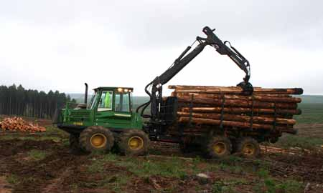
B-BBEE Status of Transformation (cont.)
Action Plan:
Intensified knowledge sharing exercise, SANAS, ABP, Government, Industry
Revised reporting on Undertakings

Slide 24
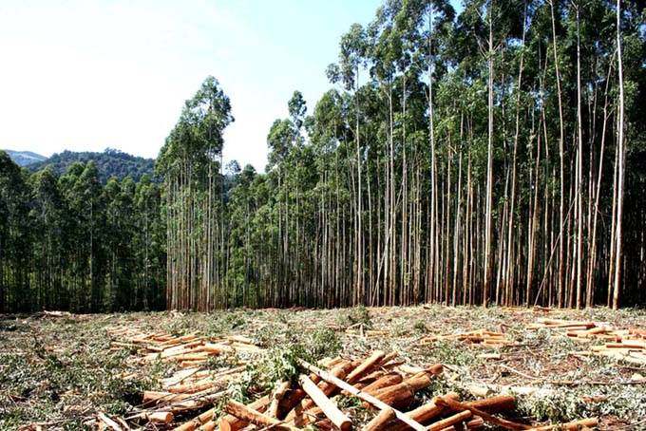
THANK YOU

