Slide 1
Prerequisites for integration on the African continent. A P2P perspective. Seminar on African Union Vision 2063 as it relates to migration, regional integration and the Africa passport
14 November, 2017
Venue: E249, Second floor, New Wing, Parliament, Capetown
Dr Emmanuel Sekyere (AISA)
Human Sciences Research Council

Slide 2
Outline
Aspirations of the Abuja Treaty of 1991, w.r.t. movement of people in the context of regional integration
Interlinkages with Agenda 2063
Status quo, an inter-REC comparison.
Benefits of P2P integration and movement of people
Pertaining challenges and pre-requisites for achieving P2P integration
Conclusion and recommendations

Slide 3
Abuja Treaty 1991, established the African Economic Community
“To promote economic, social and cultural development and the integration of African economies, in order to increase economic self reliance and promote an endogenous and self-sustained development”
Abuja Treaty establishing the African Economic Community, Article 4. Objective 1. (a)

Slide 4
Abuja Treaty 1991, w.r.t movement of people
Africa is a continent of small, fragmented and less developed states
The essence of integration is to join forces through integration to achieve a larger market, larger labour force, technological and skills transfer, free capita mobility, and
…in the process some scale and scope economies in production and growth (inclusive)
Enhance our collective comparative and competitive edge in a highly competitive and unfavourable global environment.

Slide 5
Abuja Treaty 1991, w.r.t movement of people
African states and their leaders committed to;
promoting free movement of persons, rights of residence, right of establishment, single tourist visas and regional passports.
urging one another to adopt employment policies that allow free movement of persons within the proposed African economic community (AEC)
strengthening co-operation in education and training, coordinate and harmonise their policies for developing the capacity/skills required to enhance social progress and the development of the continent.

Slide 6
Intercessions with linkages with Agenda 2063…the Africa we want
Free movement of people, rights of residence & establishment, visa relaxations, single tourist visas, continental passport
Employment policies that allow for free movement
Strengthening cooperation in education and training…enhancing social progress and development
An integrated continent, politically united and based on the ideals of Pan-Africanism and the vision of Africa’s Renaissance
An Africa whose development is people-driven, relying on the potential of African people, especially its women and youth, and caring for children
An Africa with a strong cultural identity, common heritage, shared values and ethics

Slide 7
Recent policy developments on free movement of people
In addition to the long standing Abuja Treaty of 1991, the Agenda 2063 calls for visa free travel by all Africans within Africa by 2018
AfDB’s Africa Visa Openness Index Report, launched in 2016
The move by several African countries to offer visas on arrival to citizens of AU member states;
The launch of the Africa passport in July 2016, 27th Africa Union Summit in Kigali, Rwanda

Slide 8
Implementation status quo; inter Rec comparison

Slide 9
REC | Freedom of movement protocol implementation | Common passport | Universal tourist visa | Right of establishment for business
AMU | 3 out of 5 | No | No | No
CEN-SAD | unclear | Visa waved for diplomats and selected professions | No | Right of residence (not ratified)
COMESA | Only Burundi has ratified | No | No | No
EAC | 3 out of 5 | Yes | Kenya, Rwanda, Uganda. | Yes; Kenya, Rwanda, Uganda
ECCAS | 4 out of 11 | Travel books, cards, special airport arrival facilities | In progress | Yes, (4 out of 11 implemented)
ECOWAS | All 15 | Yes, ECOWAS passport | Visa not required | Yes
SADC | 7 out of 15 | No | In progress | No
West African Economic and Monetary Union (UEMOA) | All 6 | Harmonised with ECOWAS | Visa not required | Yes

Slide 10
Ratification of REC f.m.p protocol
Proportion of REC member countries
whose nationals require no visas for entry
Proportion of REC member countries whose members are issued with visa on arrival

Slide 12
Cooperation in education and training for social progress and development
REC | Same University entry exam | Educational/training programmes | Cultural exchanges
AMU | No, national exam | Yes; inter-university cooperation (IUC) | Partially, Music & Arts
CEN-SAD | No, national exam | Unclear | Partially, Music & Arts
COMESA | No, national exam | Yes; inter-university cooperation (IUCEA, SARUA) | Partially, Music & Arts
EAC | No, national exam | Yes; inter-university cooperation (IUCEA) | Partially, Music & Arts
ECCAS | No, national exam | Unclear | Partially, Music & Arts
ECOWAS | Yes, Anglophone | Yes; inter-university cooperation | Partially, Music & Arts
SADC | No, national exams | Yes; inter-university cooperation (SARUA) | Partially, Music & Arts
UEMOA | Yes, Francophone | Yes; inter-university associations (CAMES) | Partially, Music & Arts

Slide 13
Benefits of free movement of people

Slide 14
Benefits of free movement of people
When viewed not in isolation but within the broad context of economic integration, immense benefits emerge
Mitigates uneven distribution of skills on the continent; help to address Africa’s labour needs in education, health and industrial sectors. AfDB estimates that 4 million more teachers, 2 million health workers are needed in Africa, potential exist within the continent to meet our skill shortages through f.m.p.
Increased level of cross border economic activity, potential for job creation and growth. Highly informal in nature currently, since movement not legal and data uncaptured
Potential for growth and job creation: Rwanda visa on arrival since 2013; 22% increase in African tourism and business travellers
All other dimensions of African integration, trade, production, infrastructure, macroeconomic and financial integration cannot be realised WITHOUT flexibility in the movement of people within the continent.

Slide 15
Benefits of free movement of people
When viewed not in isolation but within the broad context of economic integration, immense benefits emerge
SADC produces 60% of the world’s rough gem diamonds. This generates 800 000 jobs in the cutting and polishing industry globally, Sadly only 8000 are in the SADC region, approximately 1% of the global workforce
A lost opportunity for Africa’s 200 million youth, comprising 60% of Africa’s labour force.
Question is: what skills, labour policies, training facilities are required for SADC to bring 60% of the 800 000 jobs back to Africa, commensurate with our 60% production of the world’s diamonds?
How can other African countries help? Other regions in Africa also have diamonds. What are the opportunities for the creation of regional value chains in this respect?
Can free movement of skill/labour on the continent be beneficial? Yes I believe so!! For inclusive regional growth, job creation, poverty reduction and improved well being

Slide 16
Africa’s demographic dividend
From now to 2035, 450 million people will join the labour force in Africa, Where are the jobs?

Slide 17
Challenges to free movement of people

Slide 18
Along 6 key dimensions spread over the following…
Security concerns & political instability
Institutional factors
CHALLENGES TO FREE MOVEMENT
Fear of migration
Unanswered questions

Slide 19
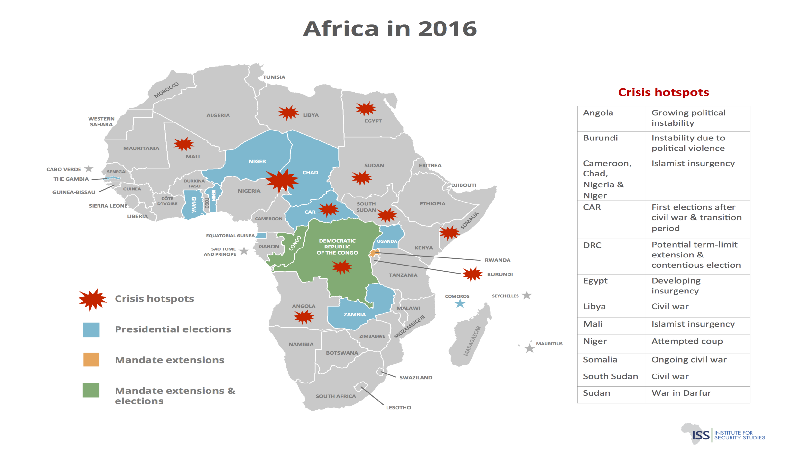
Security concerns & political instability

Slide 20
Institutional factors
Constraint | Description
1. Weak policy implementation capacity | Historically weak capacity to breakdown strategic vision into implementable programmes Leads to poor implementation
2. Policy uncertainty | Differing political priorities at country level Conflict between national interests and regional interests Progress made so far makes the 2018 timeline of Agenda 2063 ambitious
3. Poor Institutions and red tape | Corruption, Extreme bureaucracy

Slide 21
Institutional factors
Constraint | Description
4. Fear of migration and related challenges | Criminal trans-border networks might flourish Conflicts and negative effects on social cohesion driven by competition for services, jobs and local resources More tolerant of foreigners from the global north than from own our neighbourhoods and backyards - Differing levels of immigration management
5. Shifting loyalties | Multiple REC memberships, complicates policy coordination
6. Unanswered questions | Is an African passport and free movement really the answers to Africa’s problems? How does that address issues like political instability, wars and conflicts, lack of good leadership and governance etc? Is visa on arrival not adequate?

Slide 22
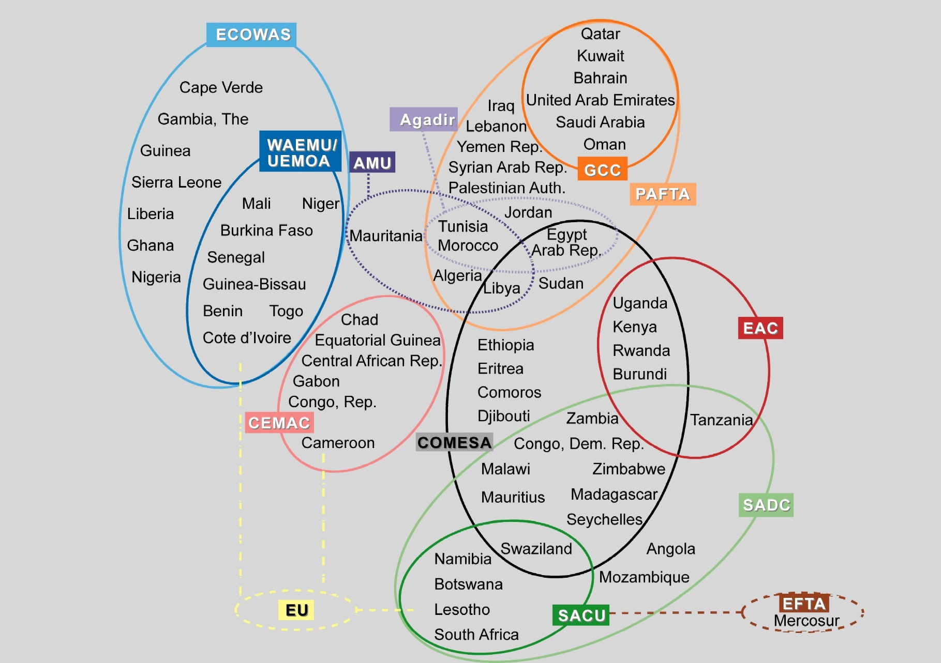
Multiple REC memberships and complexity of linkages

Slide 23
What should African governments do?

Slide 24
What should African government do?
Re-visit and review some of our integration aspirations wholistically, e.g. fmp within the entire integration agenda, agreed timelines unrealistic.
In the process, weigh the anticipated benefits of our integration aspirations against the realities of our continent and the costs of integration that could emerge.
Stagger implementation: Do we have to go as far as a single African passport to facilitate free movement or we can make do with visa on arrival facilities and visa waivers for countries with whom we have high levels of beneficial bilateral trade relations, for starters and see how it goes

Slide 25
What should Africa governments do?
SERIOUS HOUSE CLEANING: Should we not be addressing our current challenges simultaneously?
i.e. our level of acceptance of foreigners and cultures from our own backyards,
the ability of our security agencies to effectively work together to address cross border crime,
political instability, wars and conflicts,
poor leadership on the continent,
poor institutional quality,
weak implementation capacity

Slide 26
Conclusion
There are clear benefits to free movement of people on the continent, potential for inclusive growth, job creation, poverty reduction and improved standard of living.
However clear and strong challenges to integration exist; security concerns, conflicts and wars, leadership deficit, institutional quality, cross border crime, poor social cohesion and poor acceptance levels of each other, weak implementation capacity etc.
These challenges have been with us since time immemorial. Should we forge ahead in spite of our challenges?
Other frameworks exist to address some of these challenges and have to be expedited simultaneously alongside our integration aspirations, e.g. APRM, Agenda 2063.. A peaceful and secure Africa, find solutions to long standing conflicts on the continent etc.

Slide 27
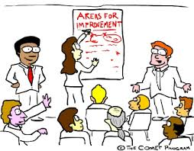
Africa clearly still has a lot of work to do. Lets discuss

Slide 28
Dr. Emmanuel Sekyere Chief Research Specialist Africa Institute of South Africa Human Sciences Research Council Email: esekyere@hsrc.ac.za URL: www.hsrc.ac.za
Thank you

Slide 29
References
Adeyeye, A. (2016) Beyond the AU passport: Prospects or Africa’s integration and prosperity. Available www.howwemadeitinAfrica.com [Assessed 02 November 2017]
AfDB & AUC (2016, 2017) Africa visa Openness Report. Available www.afdb.org. [Assessed 11 November 2017].
African Union Commission (1991) Abuja Treaty.
African Union Commission (2012) Agenda 2063, the Africa we want
Brookings Institute. (2012) Accelerating Growth through improved intra-African trade. Washington D.C: Brookings Institute.
Mupotola, M. (2016) Single African passport. A turning point for an integrated and prosperous Africa. Available www.afdb.org [Assessed 02 November 2017]

