Slide 1
FUNDING FOR NON-ENTITIES
DIRECTOR-GENERAL: ARTS AND CULTURE
DATE: 14 NOVEMBER 2017

Slide 2
PRESENTATION OUTLINE
PURPOSE
INTRODUCTION
BUSINESS ARTS COUTH AFRICA
ENGELENBURG HOUSE ART COLLECTION
BLIND SOUTH AFRICA
CULTURAL AND CREATIVE INDUSTRIES FEDERATION
DOWNTOWN MUSIC HUB
NATIONAL EMPOWERMENT FUND

Slide 3
1. PURPOSE
The purpose of this presentation is to brief the Portfolio Committee on Arts and Culture on funding on non DAC entities by the Department and the Venture Capital Fund management by the National Empowerment Fund
3

Slide 4
2. INTRODUCTION
The Department has 25 entities over which it has ownership control. These are Museums, Playhouses or Performing Arts Institutions, Libraries (National Library and the South African Library for the Blind). These entities were established through the Cultural Institution Act of 1998, National Heritage Resource Act of 1999, National Heritage Council Act of 1999, National film and Video Foundation Act of 1997, National Arts Council Act of 1997, South African Library for the Blind Act of 1998, and the National Library of South Africa Act of 1998
The Department funds other associated entities which are Business Arts South Africa (BASA) and the Engelenburg House Art Collection and Blind South Africa (Blind SA), Downtown Music Hub, Cultural and Creative Industries Federation ; and has partnered with the National Empowerment Fund in implementing the Venture Capital Fund Programme .
From the financial years 1997/98 to 2010/11 BASA and the Engelenburg House Art Collection were classified as Departmental Agencies and Accounts(Entities) as schedule 3A.
In the 2010/11 financial year their economic classification was changed to Non Profit Institutions as per the Standard Charts of Accounts (SCOA), appropriated and published in the Estimates of National Expenditure (ENE)

Slide 5
2. INTRODUCTION…cont
Prior 2010/11, the Blind SA was called the South African Blind Workers Organisation and was classified under Departmental Agencies and Accounts (Entities).
From 2010/11 financial year the economic classification of Blind SA was also changed to assume similar status as the institutions above.
The Downtown Music Hub is a project that was initiated by former Minister Jordan to improve access to recording facilities for the South African music sector.
The Cultural & Creative Industries Federation (CCIFSA) is a sector representative body, the establishment of which was supported by the Department in 2014 to enhanced governance and accountability in the sector. The establishment of CCIFSA was a result of several consultative processes between government and the cultural sector which began in 2009.
Below is a table of how funding has been allocated to these institutions and fund managers:
5

Slide 6
3. BUSINESS ARTS SA
BUSINESS ARTS SOUTH AFRICA
2014/15- R 7 312 million 2015/16- R 7 648 million 2016/17- R 8 053 million increased by R 3 million to R 11 053 million 2017/18- R 8 456 million TOTAL = R42 522 million | Business and Arts South Africa (NPC) is an internationally recognised South African development agency with integrated programmes implemented nationally and internationally promoting business and the arts. BASA encourages mutually beneficial partnerships between business and the arts, securing the future development of the arts sector in South Africa and contributing to corporate success through Shared Value. Business and Arts South Africa (BASA) was founded in 1997 as a joint initiative of the Department of Arts and Culture and the business sector as a public/private partnership. BUDGET UTILISATION Annually BASA receives support of about R8 456 million from the Department of Arts and Culture and an additional R3 million for the Debut Fund which provides training support and grants to entry level artists. CRITERIA AND DESCRIPTION BASA has instituted a supporting grant programme, the BASA Supporting Grant Programme, funded by the Department of Arts and Culture, is designed for artist/arts organisations and businesses to assist in activating sponsorship for a cross-section of arts projects in different regions of the country. This is done by providing financial support to a project that is in an already existing relationship between a business and arts organisation.
6

Slide 7
3. BUSINESS ARTS SA…cont
BUSINESS ARTS SOUTH AFRICA
 | APPLICATION PROCESS To apply for a BASA Supporting Grant, both the arts applicant and the sponsor must complete the application forms, which are designed to encourage the two partners to work together and identify areas of potential benefit. BASA allocates funds to the project once it has assessed how the partnership benefits both the sponsor and the recipient. Supporting Grant applications forms are now available in English, isiZulu and seSotho. BASA Supporting Grants are very specifically aligned to projects that are already linked to business or corporate support and leverage opportunities. KEY PROGRAMMES BASA hosts annual awards on the contribution of individuals, businesses, and organisations to the sustainability of South Africa’s arts, selected at the discretion of the BASA Board. #artMOVESme is an open source participatory and ongoing art campaign pioneered by BASA. It explores the value of the arts for both business and broader society, and is based on the understanding that the arts provide REAL value – social capital and social cohesion.
7

Slide 8
3. BUSINESS ARTS SA cont.
BUSINESS ARTS SOUTH AFRICA
 | Developed a guide to growing Creative Markets which is an animated e-learning platform showcasing initial results, lessons learned and unique South African case studies, launched in July 2016. BASA is working on the Creative Markets Growth Hub (CMGH). The CMGH is intended to become a focal point for creative market development thinking, research and online training within Africa. They are rolling out an in-depth research phase to fully understand the challenges the creative services are facing in maintaining and developing their markets. Hosts events and best practice seminars which include dinners and the Business Breakfasts that assist in promoting intra African market access and business in the arts skills and development. The BASA Young Business Professionals programme focuses on shaping a new generation of business leaders who are keen to take an active role in the arts community/sector, and creates opportunities for them to engage with the arts. BASA Dynamic and Established Education Programmes: This programme is for registered and more established organisations and comprises strategy, marketing and audience development, operations, finance, and governance workshops, and is underpinned by assignments and mentorship. The BASA annual report is tabled in Parliament
8

Slide 9
4. ENGELENBURG HOUSE ART COLLECTION
ENGELENBURG HOUSE ART COLLECTION
2014/15- R 289 thousand 2015/16- R 302 thousand 2016/17- R 318 thousand 2017/18- R 334 thousand TOTAL = R1 243 million | BACKGROUND: The Engelenburghuis Art Museum is named after Frans Vredenrijk Engelenburg (1863-1932). Engelenburg came to South Africa from the Netherlands in 1889. He built the house that is currently a museum in 1903. It houses the furniture and art collections that Engelenburg has collected during his lifetime. After his death in 1932, the house and the collections were donated to the government under the curatorship of the South African Academy for Science and Art. The Department of Arts and Culture has inherited the Engelenburghuis Art Museum from its predecessor, the National Department of Education (later the Department of Arts, Culture, Science and Technology). The Engelenburghuis Art Museum receives a subsidy from the Department of Arts and Culture. These funds are spent annually on maintenance and restoration of the museum and the collections.
ENGELENBURG HOUSE ART COLLECTION
2014/15- R 289 thousand 2015/16- R 302 thousand 2016/17- R 318 thousand 2017/18- R 334 thousand | The Engelenburghuis Art Museum is named after Frans Vredenrijk Engelenburg (1863-1932). Engelenburg came to South Africa from the Netherlands in 1889. He built the house that is currently a museum in 1903. It houses the furniture and art collections that Engelenburg has collected during his lifetime. After his death in 1932, the house and the collections were donated to the government under the curatorship of the South African Academy for Science and Art. The Department of Arts and Culture has inherited the Engelenburghuis Art Museum from its predecessor, the National Department of Education (later the Department of Arts, Culture, Science and Technology). The Engelenburghuis Art Museum receives a subsidy from the Department of Arts and Culture. These funds are spent annually on maintenance and restoration of the museum and the collections.
ENGELENBURG HOUSE ART COLLECTION
2014/15- R 289 thousand 2015/16- R 302 thousand 2016/17- R 318 thousand 2017/18- R 334 thousand | The Engelenburghuis Art Museum is named after Frans Vredenrijk Engelenburg (1863-1932). Engelenburg came to South Africa from the Netherlands in 1889. He built the house that is currently a museum in 1903. It houses the furniture and art collections that Engelenburg has collected during his lifetime. After his death in 1932, the house and the collections were donated to the government under the curatorship of the South African Academy for Science and Art. The Department of Arts and Culture has inherited the Engelenburghuis Art Museum from its predecessor, the National Department of Education (later the Department of Arts, Culture, Science and Technology). The Engelenburghuis Art Museum receives a subsidy from the Department of Arts and Culture. These funds are spent annually on maintenance and restoration of the museum and the collections.
9

Slide 10
5. BLIND SOUTH AFRICA
CURRENT ALLOCATION 2014/15- R 6, 795 million 2015/16- R 7, 108 million 2016/17- R 7, 485 million 2017/18- R 7, 859 million TOTAL = R2, 247 million CAPITAL ALLOCATION 2014/15- R 1, 345 million 2016/17- R 365 thousand TOTAL = R1, 710 million GRAND TOTAL= R3, 957million | Blind SA is governed by its members who elect the Head Committee. Most of its members and management are and insist on self-representation, work and speak from the viewpoint of blind people. They stand for equality, advocating the rights of the blind throughout South Africa and they serve the blind community at large. OBJECTIVE The purpose of Blind SA is to promote and facilitate the dignity and independence of blind and visually impaired South Africans. Their focus is on employment, education, mobility, and braille services. They actively lobby for the general rights of blind and visually impaired South Africans through the advocacy work. Blind SA is striving to end the cycle of poverty for Blind South Africans, empowering them with knowledge and information through education, braille and developmental services. They seek to break down barriers, provide opportunities and create answers that improve the quality of life for the blind community so that they can live the life they choose.
10

Slide 11
5. BLIND SOUTH AFRICA….cont
 | PROGRAMMES: Blind SA equips blind people with the skills they need to fully and independently participate in society. This includes support in living without assistance, getting about, using technology, reading, working and socialising. All this is made possible through advocacy, their Education Committee, Braille Services, orientation and mobility services and their employment programme. It is through these, and the support of donors, that they connect South African’s who are blind or visually impaired with the world they live in. BUDGET UTILISATION: In 2016/17 Blind SA spent their budget on the following projects: Braille Production Master Page Production During the past year Blind SA produced 101 347 new master pages. This is among others made up by the following categories: Braille Magazines: 2 170 p. Students and individuals: 22 977 p. School Text Books: 11 506 p. Government Information Brochures and Annual Reports: 6 114 p. Duplication Page Production Duplication pages showed 1 619 million braille pages.
11

Slide 12
5. BLIND SOUTH AFRICA…cont
 | BRAILLE MAGAZINES: Five magazines for Blind SA (Braillorama, Blind SA News, Braille Trumpet and Young Stoners – monthly and Brailllorette – bi-monthly). All these magazines are supplied to readers free of charge. INDIVIDUAL STUDENTS: Subsidized braille printing for individuals and students is their core business and 107 new documents/titles were produced in 2016/17. Total duplication pages were 73 765 pages, of which 22 214 was college study material and various examination papers for Blind SA’s Student Committee and other colleges and training institutions. OTHER WORK: The 2017 braille calendar was again produced in 750 pocket and 500 standard-size copies being distributed to schools, organisations and individuals. Blind SA is currently the only producer of braille calendars in South Africa. Braille Services’ mission states that “we will supply quality braille to blind people in the language of their choice at an affordable price” and they are striving to achieve this mandate through dedication and hard work.
09

Slide 13
6. CULTURAL AND CREATIVE INDUSTRIES FEDERATION
Funds allocated for the first three years - R15 784 000 and the breakdown is as follows: R5 784 000 in 2014-15 R5 000 000 in 2015-16 R5 000 000 in 2016-17 | The Cultural & Creative Industries Federation (CCIFSA) is a sector representative body that was established in 2014 to enhance governance and accountability in the sector. The establishment of CCIFSA was a result of several consultative processes between government and the cultural sector which formally started in 2009, when President Jacob Zuma met with musicians and actors to discuss their role and contribution to social cohesion and nation building, as well as to report back on issues they raised during his first meeting with them in 2008. It was noted that the biggest challenge facing the sector is fragmentation and lack of cohesive strategies and to address the issue of fragmentation it was felt that there was a need for establishment of a structure that will unify the sector to speak with one voice. The 2014-15 funding was allocated to the IC to conduct its mandate as indicated above, the 2015 allocation was directed to fund CCIFSA 2015/2016 action plan which was developed based on the recommendations made prior to and during the elective conference in March 2015 where many participants raised the need for further engagement with stakeholders. The 2016 allocation was for the organisation to continue implementing its mandate of consulting with relevant stakeholders and to host an AGM. CCIFSA has widely consulted with the sector and is now preparing for its AGM. Implementation overview: CCIFSA Identified 3 key KPAs as targets for implementation in the financial year 2016/17 namely; Establishment of Provincial CCIFSA Offices; Consultations and hosting an AGM.
13
CULTURAL AND CREATIVE INDUSTRIES FEDERATION
Funds allocated - R15 784 000 and the breakdown is as follows: R5 784 000 in 2014-15 R5 000 000 in 2015-16 R5 000 000 in 2016-17 | The Cultural & Creative Industries Federation (CIFSA) is a sector representative body that was established in 2014 to enhanced governance and accountability in the sector. The establishment of CCIFSA was a result of several consultative processes between government and the cultural sector which formally started in in 2009, when President Jacob Zuma met with musicians and actors to discuss their role and contribution to social cohesion and nation building, as well as report back on issues they raised during his first meeting with them in 2008. It was noted that the biggest challenge facing the sector is fragmentation and lack of cohesive strategies and to address the issue of fragmentation it was felt that there was a need for establishment of a structure that will unify the sector to speak with one voice. The 2014-15 funding was allocated to the IC to conduct its mandate as indicated above, the 2015 allocation was directed to fund CCIFSA 2015/2016 action plan which was developed based on the recommendations made prior to and during the elective conference in March 2015 where many participants raised the need for further engagement with stakeholders. The 2016 allocation was for the organisation to continue implementing its mandate of consulting with relevant stakeholders and to host an AGM. CCIFSA has widely consulted with the sector and is now preparing for its AGM. Implementation overview: CCIFSA Identified 3 key KPA’s as targets for implementation in the financial year 2016/17 namely; Establishment of Provincial CCIFSA Offices; Consultations and hosting an AGM. Establishment of Provincial CCIFSA Offices: The establishment of Provincial CCIFSA Offices comprises of setting up of sector specific leaders to represent various segments of the sectors. These are categorised as follows; Craft & Visual Arts; Performing & Celebrations; Cultural& Heritage; Indigenous Knowledge System; Arts Education & Training; Visual Arts; Language and Publishing; and Audio Visual; Design & Creative Architecture. In structuring the representation of the sectors, the Provinces were divided into 3 levels namely; Provincial Level; Local Municipality Level and District Municipality Level. For each sector there is one sector leader appointed. Consultations: In setting up the above structures you held consultations with various individual practitioners, cultural & artistic groups, organisations etc. These consultations led to the elections of the various sectors leaders Provincially, Local and District artists. At this stage the establishment of Provincial CCIFSA Offices has been successfully achieved in the Provinces listed below. Mpumalanga Eastern Cape Free State Limpopo However there some other Provinces which still need further work, here listed below: North West Western Cape KZN Northern Cape Gauteng AGM: The AGM was postponed to accommodate the finalisation of the work in other Provinces. Achievement: The establishment of the 4 Provincial offices. Setting up of a full office space in Mpumalanga with the full support from Mpumalanga Provincial Department of Culture Sports and Recreation. Work with various Government Spheres has been initiated. Provinces are beginning to understand CCIFSA and are responding positively. OTHER WORK: In the course for implementing the KPA’s for the financial 2016/17 as mentioned above, CCIFSA was approached by the Department of Arts and Culture at Ministerial level to assume a function as an Administrator for the Downtown Music Hub. WHY THE MANAGEMENT OF DOWNTOWN MUSIC HUB WAS MOVED FROM THE NAC TO CCIFSA The Downtown Studios property and business was purchased in 2008 by Department through the NAC (acting as a conduit) following the request by the Minister of Arts and Culture that the DAC invest in recording facilities as a means to increase access and lower entry barriers for accessing recording and production facilities. The intention was to establish an asset for the music sector (under the current Downtown Music Hub) in the form of a Special Purpose Entity (SPE) that was established in 2010 as a NPC, to use the asset as an instrument to support independent music creators and producers through business driven investment. The plan was that the NAC would transfer the asset to the NPC following instruction by the DAC. The transfer of the asset did not happen as planned and this resulted in the NAC registering and incorporating the asset into its financials. Since then, maintenance and management of the Downtown asset was done through the NAC, however, this created challenges as the NAC was not into the business of managing studio business and thus in possible contravention of the NAC Act. As a result of this, the NAC had on a number of occasions received adverse financial audits. Due to the audit challenges, the NAC took a decision not to continue with the arrangements of acting as a conduit for the management of the Downtown asset and requested the Department to finalise the transfer as soon as possible. Since the transfer of the asset is still pending, this resulted in the business not receiving funding for its operations. However the business was trading as a going concern and the NPC could not afford to continue financing the operations and this then put the asset at risk. The NPC did try to directly apply for funding from the NAC but failed to meet the necessary requirements because of outstanding taxes at SARS. To rescue the situation the Department took a decision to appoint a service provider to provide fiduciary services on behalf of the Department. Following SCM processes, CIFSA was appointed as the service provider to provide fiduciary services to Downtown for the period between 206/2017 – 2017/2018.

Slide 14
6. CULTURAL AND CREATIVE INDUSTRIES FEDERATION…cont
 | Establishment of Provincial CCIFSA Offices: The establishment of Provincial CCIFSA Offices comprises of setting up of sector specific leaders to represent various segments of the sectors. These are categorised as follows; Craft & Visual Arts; Performing & Celebrations; Cultural& Heritage; Indigenous Knowledge System; Arts Education & Training; Visual Arts; Language and Publishing; and Audio Visual; Design & Creative Architecture. In structuring the representation of the sectors, the Provinces were divided into 3 levels namely; Provincial Level; Local Municipality Level and District Municipality Level. For each sector there is one sector leader appointed. Consultations: In setting up the above structures CCIFSA held consultations with various individual practitioners, cultural & artistic groups, organisations etc. These consultations led to the elections of the various sector leaders from Provincial, Local and District artists. At this stage the establishment of Provincial CCIFSA Offices has been successfully achieved in the Provinces listed below: Mpumalanga Eastern Cape Free State Limpopo
14
CULTURAL AND CREATIVE INDUSTRIES FEDERATION
Funds allocated - R15 784 000 and the breakdown is as follows: R5 784 000 in 2014-15 R5 000 000 in 2015-16 R5 000 000 in 2016-17 | The Cultural & Creative Industries Federation (CIFSA) is a sector representative body that was established in 2014 to enhanced governance and accountability in the sector. The establishment of CCIFSA was a result of several consultative processes between government and the cultural sector which formally started in in 2009, when President Jacob Zuma met with musicians and actors to discuss their role and contribution to social cohesion and nation building, as well as report back on issues they raised during his first meeting with them in 2008. It was noted that the biggest challenge facing the sector is fragmentation and lack of cohesive strategies and to address the issue of fragmentation it was felt that there was a need for establishment of a structure that will unify the sector to speak with one voice. The 2014-15 funding was allocated to the IC to conduct its mandate as indicated above, the 2015 allocation was directed to fund CCIFSA 2015/2016 action plan which was developed based on the recommendations made prior to and during the elective conference in March 2015 where many participants raised the need for further engagement with stakeholders. The 2016 allocation was for the organisation to continue implementing its mandate of consulting with relevant stakeholders and to host an AGM. CCIFSA has widely consulted with the sector and is now preparing for its AGM. Implementation overview: CCIFSA Identified 3 key KPA’s as targets for implementation in the financial year 2016/17 namely; Establishment of Provincial CCIFSA Offices; Consultations and hosting an AGM. Establishment of Provincial CCIFSA Offices: The establishment of Provincial CCIFSA Offices comprises of setting up of sector specific leaders to represent various segments of the sectors. These are categorised as follows; Craft & Visual Arts; Performing & Celebrations; Cultural& Heritage; Indigenous Knowledge System; Arts Education & Training; Visual Arts; Language and Publishing; and Audio Visual; Design & Creative Architecture. In structuring the representation of the sectors, the Provinces were divided into 3 levels namely; Provincial Level; Local Municipality Level and District Municipality Level. For each sector there is one sector leader appointed. Consultations: In setting up the above structures you held consultations with various individual practitioners, cultural & artistic groups, organisations etc. These consultations led to the elections of the various sectors leaders Provincially, Local and District artists. At this stage the establishment of Provincial CCIFSA Offices has been successfully achieved in the Provinces listed below. Mpumalanga Eastern Cape Free State Limpopo However there some other Provinces which still need further work, here listed below: North West Western Cape KZN Northern Cape Gauteng AGM: The AGM was postponed to accommodate the finalisation of the work in other Provinces. Achievement: The establishment of the 4 Provincial offices. Setting up of a full office space in Mpumalanga with the full support from Mpumalanga Provincial Department of Culture Sports and Recreation. Work with various Government Spheres has been initiated. Provinces are beginning to understand CCIFSA and are responding positively. OTHER WORK: In the course for implementing the KPA’s for the financial 2016/17 as mentioned above, CCIFSA was approached by the Department of Arts and Culture at Ministerial level to assume a function as an Administrator for the Downtown Music Hub. WHY THE MANAGEMENT OF DOWNTOWN MUSIC HUB WAS MOVED FROM THE NAC TO CCIFSA The Downtown Studios property and business was purchased in 2008 by Department through the NAC (acting as a conduit) following the request by the Minister of Arts and Culture that the DAC invest in recording facilities as a means to increase access and lower entry barriers for accessing recording and production facilities. The intention was to establish an asset for the music sector (under the current Downtown Music Hub) in the form of a Special Purpose Entity (SPE) that was established in 2010 as a NPC, to use the asset as an instrument to support independent music creators and producers through business driven investment. The plan was that the NAC would transfer the asset to the NPC following instruction by the DAC. The transfer of the asset did not happen as planned and this resulted in the NAC registering and incorporating the asset into its financials. Since then, maintenance and management of the Downtown asset was done through the NAC, however, this created challenges as the NAC was not into the business of managing studio business and thus in possible contravention of the NAC Act. As a result of this, the NAC had on a number of occasions received adverse financial audits. Due to the audit challenges, the NAC took a decision not to continue with the arrangements of acting as a conduit for the management of the Downtown asset and requested the Department to finalise the transfer as soon as possible. Since the transfer of the asset is still pending, this resulted in the business not receiving funding for its operations. However the business was trading as a going concern and the NPC could not afford to continue financing the operations and this then put the asset at risk. The NPC did try to directly apply for funding from the NAC but failed to meet the necessary requirements because of outstanding taxes at SARS. To rescue the situation the Department took a decision to appoint a service provider to provide fiduciary services on behalf of the Department. Following SCM processes, CIFSA was appointed as the service provider to provide fiduciary services to Downtown for the period between 206/2017 – 2017/2018.

Slide 15
6. CULTURAL AND CREATIVE INDUSTRIES FEDERATION…cont
 | However there some other Provinces which still need further work, here listed below: North West Western Cape KZN Northern Cape Gauteng AGM: The AGM was postponed to accommodate the finalisation of the work in other Provinces. Achievement: The establishment of the 4 Provincial offices. Setting up of a full office space in Mpumalanga with the full support from Mpumalanga Provincial Department of Culture Sports and Recreation. Work with various Government Spheres has been initiated. Provinces are beginning to understand CCIFSA and are responding positively. OTHER WORK: In the course for implementing the KPA’s for the financial 2016/17 as mentioned above, CCIFSA was approached by the Department of Arts and Culture at Ministerial level to assume a function of an Administrator for the Downtown Music Hub.
15
CULTURAL AND CREATIVE INDUSTRIES FEDERATION
Funds allocated - R15 784 000 and the breakdown is as follows: R5 784 000 in 2014-15 R5 000 000 in 2015-16 R5 000 000 in 2016-17 | The Cultural & Creative Industries Federation (CIFSA) is a sector representative body that was established in 2014 to enhanced governance and accountability in the sector. The establishment of CCIFSA was a result of several consultative processes between government and the cultural sector which formally started in in 2009, when President Jacob Zuma met with musicians and actors to discuss their role and contribution to social cohesion and nation building, as well as report back on issues they raised during his first meeting with them in 2008. It was noted that the biggest challenge facing the hosting an AGM. However there some other Provinces which still need further work, here listed below: North West Western Cape KZN Northern Cape Gauteng AGM: The AGM was postponed to accommodate the finalisation of the work in other Provinces. Achievement: The establishment of the 4 Provincial offices. Setting up of a full office space in Mpumalanga with the full support from Mpumalanga Provincial Department of Culture Sports and Recreation. Work with various Government Spheres has been initiated. Provinces are beginning to understand CCIFSA and are responding positively. OTHER WORK: In the course for implementing the KPA’s for the financial 2016/17 as mentioned above, CCIFSA was approached by the Department of Arts and Culture at Ministerial level to assume a function as an Administrator for the Downtown Music Hub.

Slide 16
6. CULTURAL AND CREATIVE INDUSTRIES FEDERATION…cont
 | WHY THE MANAGEMENT OF DOWNTOWN MUSIC HUB WAS MOVED FROM THE NAC TO CCIFSA The Downtown Studios property and business was purchased in 2008 by Department through the NAC following the request by the Minister of Arts and Culture that the DAC invest in recording facilities as a means to increase access and lower entry barriers to accessing recording and production facilities. The intention was to establish an asset for the music sector (under the current Downtown Music Hub) in the form of a Special Purpose Entity (SPE) that was established in 2010 as a Non Profit Company, to use the asset as an instrument to support independent music creators and producers through business driven investment. The plan was that the NAC would transfer the asset to the NPC following instruction by the DAC. The transfer of the asset did not happen as planned and this resulted in the NAC registering and incorporating the asset into its financials. Since then, maintenance and management of the Downtown asset was done through the NAC, however, this created challenges as the NAC was not into the business of managing studio business and thus in possible contravention of the NAC Act. As a result of this, the NAC had on a number of occasions received adverse financial audits. Due to the audit challenges, the NAC took a decision not to continue with the arrangements of acting as an agent for the management of the Downtown asset and requested the Department to finalise the transfer as soon as possible. Since the transfer of the asset is still pending, this resulted in the business not receiving funding for its operations. However the business was trading as a going concern and the NPC could not afford to continue financing the operations and this then put the asset at risk. The NPC did try to directly apply for funding from the NAC but failed to meet the necessary requirements because of outstanding taxes at SARS. To rescue the situation the Department took a decision to appoint a service provider to provide fiduciary services on behalf of the Department. Following SCM processes, CIFSA was appointed as the service provider to provide fiduciary services to Downtown for the period between 2016/2017 – 2017/2018.
16
CULTURAL AND CREATIVE INDUSTRIES FEDERATION
Funds allocated - R15 784 000 and the breakdown is as follows: R5 784 000 in 2014-15 R5 000 000 in 2015-16 R5 000 000 in 2016-17 | The Cultural & Creative Industries Federation (CIFSA) is a sector representative body that was established in 2014 to enhanced governance and accountability in the sector. The establishment of CCIFSA was a result of several consultative processes between government and the cultural sector which formally started in in 2009, when President Jacob Zuma met with musicians and actors to discuss their role and contribution to social cohesion and nation building, as well as report back on issues they raised during his first meeting with them in 2008. It was noted that the biggest challenge facing the hosting an AGM. However there some other Provinces which still need further work, here listed below: North West Western Cape KZN Northern Cape Gauteng AGM: The AGM was postponed to accommodate the finalisation of the work in other Provinces. Achievement: The establishment of the 4 Provincial offices. Setting up of a full office space in Mpumalanga with the full support from Mpumalanga Provincial Department of Culture Sports and Recreation. Work with various Government Spheres has been initiated. Provinces are beginning to understand CCIFSA and are responding positively. OTHER WORK: In the course for implementing the KPA’s for the financial 2016/17 as mentioned above, CCIFSA was approached by the Department of Arts and Culture at Ministerial level to assume a function as an Administrator for the Downtown Music Hub.

Slide 17
7. DOWNTOWN MUSIC HUB
2008/2009 - initial investment in purchasing of asset, operations & business planning - R7,509,560 2009/2010 -Further business planning & operations - R 3,000,000 2010/2011 DAC Ad Hoc Grants: Programmes - R3,000,000 2011/2012 -DAC Ad Hoc Grants: Programmes - R3,000,000 2012/2013 -Auditing, operations & settling of debts - R 3,823,441 2013/2014 - DAC Infrastructure Grant - R20,000,000 2017 – 2018 -R11 900 000 – Operations | The Downtown Music Hub is a project that was initiated by former Minister of Arts and Culture, Pallo Jordan as a means to improve access to recording facilities for the South African music sector. Downtown comprised of two elements – the NPC and a building with studios facilities. The building is located at 62 Goud Street in Johannesburg. The asset was purchased through the NAC in 2008.The NPC was established in 2010 with the objective of donating the building and the studios so that it can be managed in a manner that ensures its viability, effective management and growth as a vehicle for the transformation of the music industry in the country”. It was expected that the effective management of the asset would result in strategic initiatives, and programmes that enables the realisation of the vision that was set out by the Minister of Arts and Culture. The donation has not yet been concluded. Technically the physical asset is still owned by the DAC through the NAC.
17
CULTURAL AND CREATIVE INDUSTRIES FEDERATION
Funds allocated - R15 784 000 and the breakdown is as follows: R5 784 000 in 2014-15 R5 000 000 in 2015-16 R5 000 000 in 2016-17 | The Cultural & Creative Industries Federation (CIFSA) is a sector representative body that was established in 2014 to enhanced governance and accountability in the sector. The establishment of CCIFSA was a result of several consultative processes between government and the cultural sector which formally started in in 2009, when President Jacob Zuma met with musicians and actors to discuss their role and contribution to social cohesion and nation building, as well as report back on issues they raised during his first meeting with them in 2008. It was noted that the biggest challenge facing the hosting an AGM. However there some other Provinces which still need further work, here listed below: North West Western Cape KZN Northern Cape Gauteng AGM: The AGM was postponed to accommodate the finalisation of the work in other Provinces. Achievement: The establishment of the 4 Provincial offices. Setting up of a full office space in Mpumalanga with the full support from Mpumalanga Provincial Department of Culture Sports and Recreation. Work with various Government Spheres has been initiated. Provinces are beginning to understand CCIFSA and are responding positively. OTHER WORK: In the course for implementing the KPA’s for the financial 2016/17 as mentioned above, CCIFSA was approached by the Department of Arts and Culture at Ministerial level to assume a function as an Administrator for the Downtown Music Hub.

Slide 18
8. NATIONAL EMPOWERMENT FUND
 | DAC Venture Capital Fund (VCF) Background
In 2016, DAC entrusted National Empowerment Fund (NEF) through a tender process to manage a Venture Capital Fund (VCF) for a period of 3 years with allocated budget of R20 million (2016/17), R30 million (2017/18) and R50 million (2018/19)
Research indicates that Arts and Culture has overtaken agriculture and mining in growth and is an industry of the future particularly as jobs are being lost to automation.
A detailed criteria to fund the Arts and Culture projects has been finalized and is available on the NEF website.
Objectives
Venture Capital Fund is designed to support black entrepreneurs wishing to start or expand existing businesses.
The Fund seek to redress past imbalances by addressing the lack of financing instruments for the creative industries, contribute to economic growth, the creation of decent work and income generating opportunities for creative industry practitioners.
VCF provide loans from R250 thousand to R5 million delivered through the following products:
- Entrepreneurship Finance
- Supply Chain Finance
18
CULTURAL AND CREATIVE INDUSTRIES FEDERATION
Funds allocated - R15 784 000 and the breakdown is as follows: R5 784 000 in 2014-15 R5 000 000 in 2015-16 R5 000 000 in 2016-17 | The Cultural & Creative Industries Federation (CIFSA) is a sector representative body that was established in 2014 to enhanced governance and accountability in the sector. The establishment of CCIFSA was a result of several consultative processes between government and the cultural sector which formally started in in 2009, when President Jacob Zuma met with musicians and actors to discuss their role and contribution to social cohesion and nation building, as well as report back on issues they raised during his first meeting with them in 2008. It was noted that the biggest challenge facing the hosting an AGM. However there some other Provinces which still need further work, here listed below: North West Western Cape KZN Northern Cape Gauteng AGM: The AGM was postponed to accommodate the finalisation of the work in other Provinces. Achievement: The establishment of the 4 Provincial offices. Setting up of a full office space in Mpumalanga with the full support from Mpumalanga Provincial Department of Culture Sports and Recreation. Work with various Government Spheres has been initiated. Provinces are beginning to understand CCIFSA and are responding positively. OTHER WORK: In the course for implementing the KPA’s for the financial 2016/17 as mentioned above, CCIFSA was approached by the Department of Arts and Culture at Ministerial level to assume a function as an Administrator for the Downtown Music Hub.

Slide 19
8. NATIONAL EMPOWERMENT FUND…cont
 | Detailed Expenditure of a Funded Project
19
CULTURAL AND CREATIVE INDUSTRIES FEDERATION
Funds allocated - R15 784 000 and the breakdown is as follows: R5 784 000 in 2014-15 R5 000 000 in 2015-16 R5 000 000 in 2016-17 | The Cultural & Creative Industries Federation (CIFSA) is a sector representative body that was established in 2014 to enhanced governance and accountability in the sector. The establishment of CCIFSA was a result of several consultative processes between government and the cultural sector which formally started in in 2009, when President Jacob Zuma met with musicians and actors to discuss their role and contribution to social cohesion and nation building, as well as report back on issues they raised during his first meeting with them in 2008. It was noted that the biggest challenge facing the hosting an AGM. However there some other Provinces which still need further work, here listed below: North West Western Cape KZN Northern Cape Gauteng AGM: The AGM was postponed to accommodate the finalisation of the work in other Provinces. Achievement: The establishment of the 4 Provincial offices. Setting up of a full office space in Mpumalanga with the full support from Mpumalanga Provincial Department of Culture Sports and Recreation. Work with various Government Spheres has been initiated. Provinces are beginning to understand CCIFSA and are responding positively. OTHER WORK: In the course for implementing the KPA’s for the financial 2016/17 as mentioned above, CCIFSA was approached by the Department of Arts and Culture at Ministerial level to assume a function as an Administrator for the Downtown Music Hub.

Slide 20
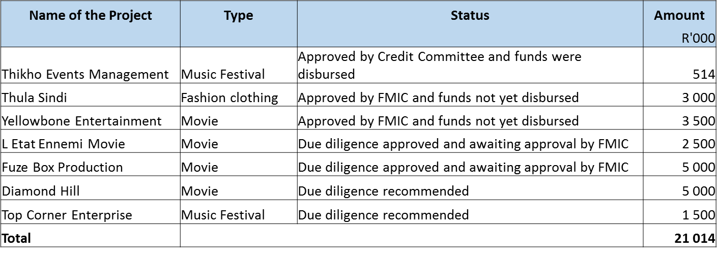
8. NATIONAL EMPOWERMENT FUND…cont
 | Detailed Project Funding Clients submitted all the required information Clients submitted all the required information
20
CULTURAL AND CREATIVE INDUSTRIES FEDERATION
Funds allocated - R15 784 000 and the breakdown is as follows: R5 784 000 in 2014-15 R5 000 000 in 2015-16 R5 000 000 in 2016-17 | The Cultural & Creative Industries Federation (CIFSA) is a sector representative body that was established in 2014 to enhanced governance and accountability in the sector. The establishment of CCIFSA was a result of several consultative processes between government and the cultural sector which formally started in in 2009, when President Jacob Zuma met with musicians and actors to discuss their role and contribution to social cohesion and nation building, as well as report back on issues they raised during his first meeting with them in 2008. It was noted that the biggest challenge facing the hosting an AGM. However there some other Provinces which still need further work, here listed below: North West Western Cape KZN Northern Cape Gauteng AGM: The AGM was postponed to accommodate the finalisation of the work in other Provinces. Achievement: The establishment of the 4 Provincial offices. Setting up of a full office space in Mpumalanga with the full support from Mpumalanga Provincial Department of Culture Sports and Recreation. Work with various Government Spheres has been initiated. Provinces are beginning to understand CCIFSA and are responding positively. OTHER WORK: In the course for implementing the KPA’s for the financial 2016/17 as mentioned above, CCIFSA was approached by the Department of Arts and Culture at Ministerial level to assume a function as an Administrator for the Downtown Music Hub.

Slide 21
8. NATIONAL EMPOWERMENT FUND…cont
 | Detailed Project Funding Clients to submit all the required information
21
CULTURAL AND CREATIVE INDUSTRIES FEDERATION
Funds allocated - R15 784 000 and the breakdown is as follows: R5 784 000 in 2014-15 R5 000 000 in 2015-16 R5 000 000 in 2016-17 | The Cultural & Creative Industries Federation (CIFSA) is a sector representative body that was established in 2014 to enhanced governance and accountability in the sector. The establishment of CCIFSA was a result of several consultative processes between government and the cultural sector which formally started in in 2009, when President Jacob Zuma met with musicians and actors to discuss their role and contribution to social cohesion and nation building, as well as report back on issues they raised during his first meeting with them in 2008. It was noted that the biggest challenge facing the hosting an AGM. However there some other Provinces which still need further work, here listed below: North West Western Cape KZN Northern Cape Gauteng AGM: The AGM was postponed to accommodate the finalisation of the work in other Provinces. Achievement: The establishment of the 4 Provincial offices. Setting up of a full office space in Mpumalanga with the full support from Mpumalanga Provincial Department of Culture Sports and Recreation. Work with various Government Spheres has been initiated. Provinces are beginning to understand CCIFSA and are responding positively. OTHER WORK: In the course for implementing the KPA’s for the financial 2016/17 as mentioned above, CCIFSA was approached by the Department of Arts and Culture at Ministerial level to assume a function as an Administrator for the Downtown Music Hub.

Slide 22
8. NATIONAL EMPOWERMENT FUND…cont
 | Detailed Project Funding Clients require non-financial support
Declined Projects
22
CULTURAL AND CREATIVE INDUSTRIES FEDERATION
Funds allocated - R15 784 000 and the breakdown is as follows: R5 784 000 in 2014-15 R5 000 000 in 2015-16 R5 000 000 in 2016-17 | The Cultural & Creative Industries Federation (CIFSA) is a sector representative body that was established in 2014 to enhanced governance and accountability in the sector. The establishment of CCIFSA was a result of several consultative processes between government and the cultural sector which formally started in in 2009, when President Jacob Zuma met with musicians and actors to discuss their role and contribution to social cohesion and nation building, as well as report back on issues they raised during his first meeting with them in 2008. It was noted that the biggest challenge facing the hosting an AGM. However there some other Provinces which still need further work, here listed below: North West Western Cape KZN Northern Cape Gauteng AGM: The AGM was postponed to accommodate the finalisation of the work in other Provinces. Achievement: The establishment of the 4 Provincial offices. Setting up of a full office space in Mpumalanga with the full support from Mpumalanga Provincial Department of Culture Sports and Recreation. Work with various Government Spheres has been initiated. Provinces are beginning to understand CCIFSA and are responding positively. OTHER WORK: In the course for implementing the KPA’s for the financial 2016/17 as mentioned above, CCIFSA was approached by the Department of Arts and Culture at Ministerial level to assume a function as an Administrator for the Downtown Music Hub.

Slide 23
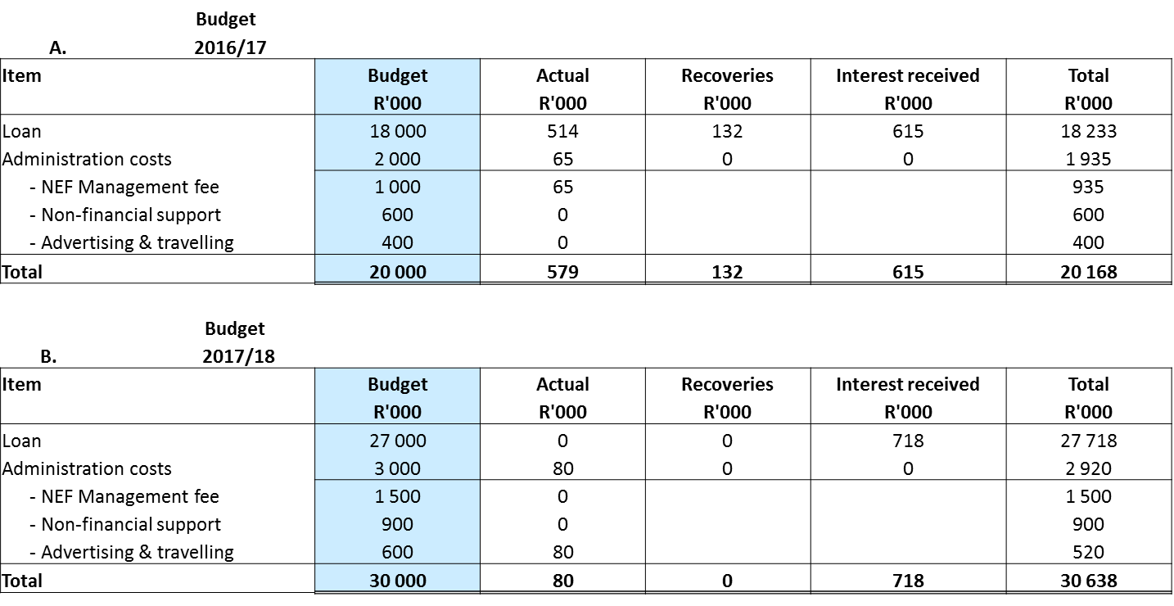
8. NATIONAL EMPOWERMENT FUND…cont
23
CULTURAL AND CREATIVE INDUSTRIES FEDERATION
Funds allocated - R15 784 000 and the breakdown is as follows: R5 784 000 in 2014-15 R5 000 000 in 2015-16 R5 000 000 in 2016-17 | The Cultural & Creative Industries Federation (CIFSA) is a sector representative body that was established in 2014 to enhanced governance and accountability in the sector. The establishment of CCIFSA was a result of several consultative processes between government and the cultural sector which formally started in in 2009, when President Jacob Zuma met with musicians and actors to discuss their role and contribution to social cohesion and nation building, as well as report back on issues they raised during his first meeting with them in 2008. It was noted that the biggest challenge facing the hosting an AGM. However there some other Provinces which still need further work, here listed below: North West Western Cape KZN Northern Cape Gauteng AGM: The AGM was postponed to accommodate the finalisation of the work in other Provinces. Achievement: The establishment of the 4 Provincial offices. Setting up of a full office space in Mpumalanga with the full support from Mpumalanga Provincial Department of Culture Sports and Recreation. Work with various Government Spheres has been initiated. Provinces are beginning to understand CCIFSA and are responding positively. OTHER WORK: In the course for implementing the KPA’s for the financial 2016/17 as mentioned above, CCIFSA was approached by the Department of Arts and Culture at Ministerial level to assume a function as an Administrator for the Downtown Music Hub.

Slide 24
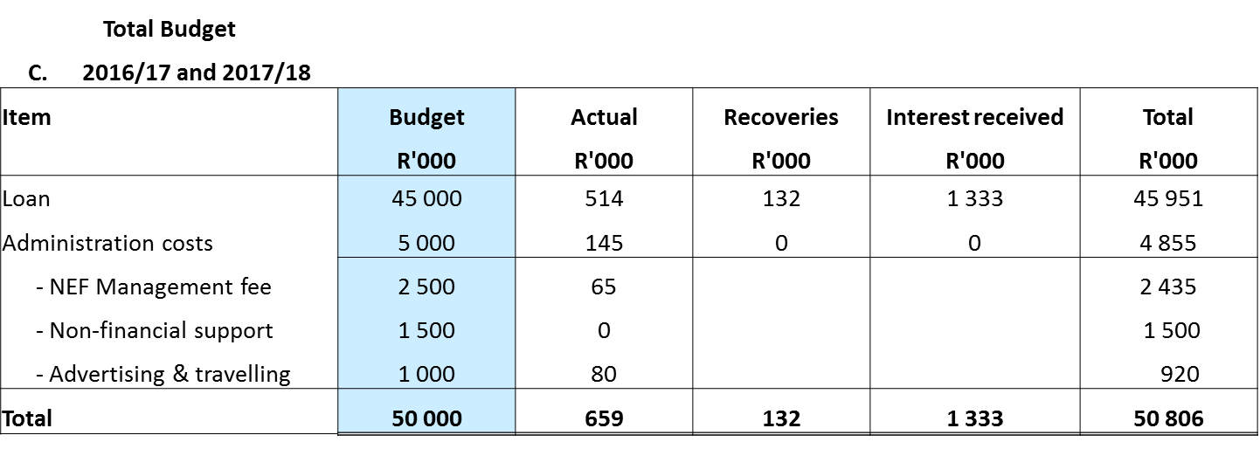
8. NATIONAL EMPOWERMENT FUND…cont
24
CULTURAL AND CREATIVE INDUSTRIES FEDERATION
Funds allocated - R15 784 000 and the breakdown is as follows: R5 784 000 in 2014-15 R5 000 000 in 2015-16 R5 000 000 in 2016-17 | The Cultural & Creative Industries Federation (CIFSA) is a sector representative body that was established in 2014 to enhanced governance and accountability in the sector. The establishment of CCIFSA was a result of several consultative processes between government and the cultural sector which formally started in in 2009, when President Jacob Zuma met with musicians and actors to discuss their role and contribution to social cohesion and nation building, as well as report back on issues they raised during his first meeting with them in 2008. It was noted that the biggest challenge facing the hosting an AGM. However there some other Provinces which still need further work, here listed below: North West Western Cape KZN Northern Cape Gauteng AGM: The AGM was postponed to accommodate the finalisation of the work in other Provinces. Achievement: The establishment of the 4 Provincial offices. Setting up of a full office space in Mpumalanga with the full support from Mpumalanga Provincial Department of Culture Sports and Recreation. Work with various Government Spheres has been initiated. Provinces are beginning to understand CCIFSA and are responding positively. OTHER WORK: In the course for implementing the KPA’s for the financial 2016/17 as mentioned above, CCIFSA was approached by the Department of Arts and Culture at Ministerial level to assume a function as an Administrator for the Downtown Music Hub.

Slide 25
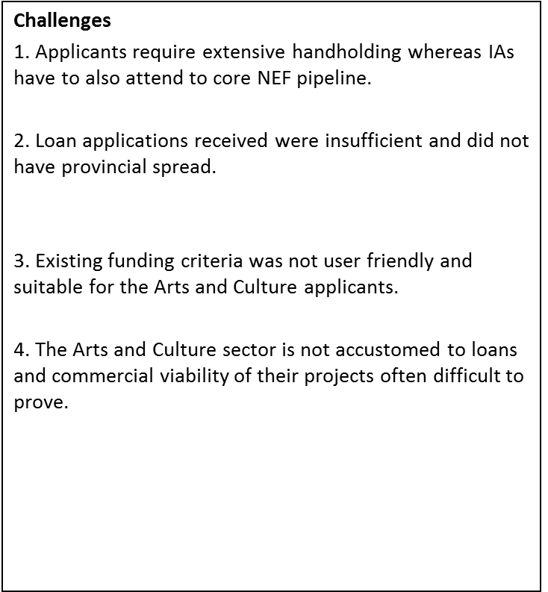
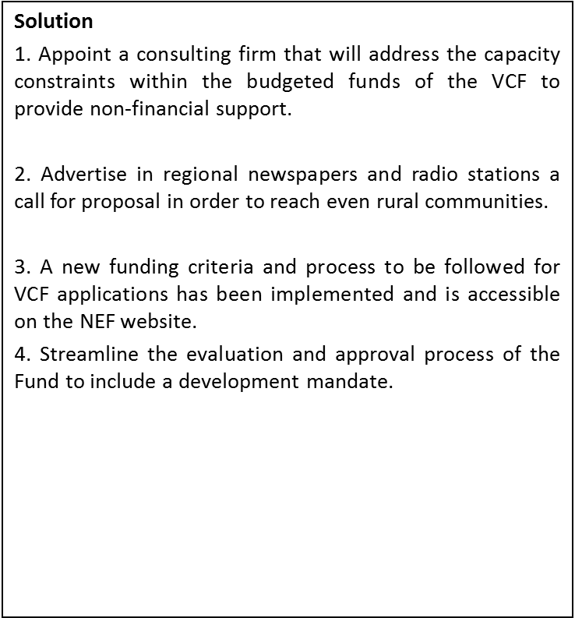
8. NATIONAL EMPOWERMENT FUND…cont
Investment Associates (IAs)
25
CULTURAL AND CREATIVE INDUSTRIES FEDERATION
Funds allocated - R15 784 000 and the breakdown is as follows: R5 784 000 in 2014-15 R5 000 000 in 2015-16 R5 000 000 in 2016-17 | The Cultural & Creative Industries Federation (CIFSA) is a sector representative body that was established in 2014 to enhanced governance and accountability in the sector. The establishment of CCIFSA was a result of several consultative processes between government and the cultural sector which formally started in in 2009, when President Jacob Zuma met with musicians and actors to discuss their role and contribution to social cohesion and nation building, as well as report back on issues they raised during his first meeting with them in 2008. It was noted that the biggest challenge facing the hosting an AGM. However there some other Provinces which still need further work, here listed below: North West Western Cape KZN Northern Cape Gauteng AGM: The AGM was postponed to accommodate the finalisation of the work in other Provinces. Achievement: The establishment of the 4 Provincial offices. Setting up of a full office space in Mpumalanga with the full support from Mpumalanga Provincial Department of Culture Sports and Recreation. Work with various Government Spheres has been initiated. Provinces are beginning to understand CCIFSA and are responding positively. OTHER WORK: In the course for implementing the KPA’s for the financial 2016/17 as mentioned above, CCIFSA was approached by the Department of Arts and Culture at Ministerial level to assume a function as an Administrator for the Downtown Music Hub.

Slide 26
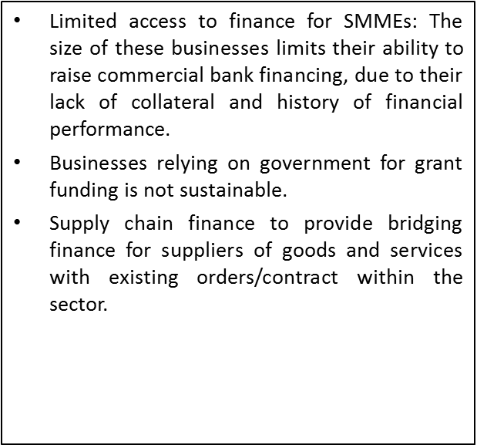
8. NATIONAL EMPOWERMENT FUND…cont
There must be enough time available (approximately 2 months) after disbursement of funds to the beneficiaries and the actual date of the project to allow time to raise sponsorships.
Films must be co-funded with other institutions such as DTI, IDC and NFVF. NFVF will provide assessment report on each Film as whether will generate enough revenue to repay the loan.
Big players/existing profitable businesses in the industry usually have means to raise funds and get grants (sponsorship) using their brand reputation. Loans are the last option for them.
Non-financial support must be provided to the Arts and Culture sector to prepare their projects to be fundable.
26
CULTURAL AND CREATIVE INDUSTRIES FEDERATION
Funds allocated - R15 784 000 and the breakdown is as follows: R5 784 000 in 2014-15 R5 000 000 in 2015-16 R5 000 000 in 2016-17 | The Cultural & Creative Industries Federation (CIFSA) is a sector representative body that was established in 2014 to enhanced governance and accountability in the sector. The establishment of CCIFSA was a result of several consultative processes between government and the cultural sector which formally started in in 2009, when President Jacob Zuma met with musicians and actors to discuss their role and contribution to social cohesion and nation building, as well as report back on issues they raised during his first meeting with them in 2008. It was noted that the biggest challenge facing the hosting an AGM. However there some other Provinces which still need further work, here listed below: North West Western Cape KZN Northern Cape Gauteng AGM: The AGM was postponed to accommodate the finalisation of the work in other Provinces. Achievement: The establishment of the 4 Provincial offices. Setting up of a full office space in Mpumalanga with the full support from Mpumalanga Provincial Department of Culture Sports and Recreation. Work with various Government Spheres has been initiated. Provinces are beginning to understand CCIFSA and are responding positively. OTHER WORK: In the course for implementing the KPA’s for the financial 2016/17 as mentioned above, CCIFSA was approached by the Department of Arts and Culture at Ministerial level to assume a function as an Administrator for the Downtown Music Hub.

Slide 27
8. NATIONAL EMPOWERMENT FUND…cont
 | Conclusion VCF is a good concept supported by National Treasury because it is one of the creative methods used by DAC to grow the economy, discourage the culture of dependency on fiscus/government grants to run projects, discourage being a consumption based to become a production based economy and be self-sustainable; The fund will operate efficiently provided that there is: Provincial spread including rural areas and provide non-financial support to prepare them for funding; Export markets for the Arts and Culture sector; Strategically position the fund, that is, create demand on cultural domains that are not popular such as African Cuisine, fine arts, establish our own Sollywood in SA, and leverage on the existing market in Music, live performances, creative design and TV series because they generate revenue quicker since there is high demand and abundant talent. BEE targets and emphasis of women and youth participation in the domains that are significant contributor to GDP such as Fashion and design, Performing Arts.
27
CULTURAL AND CREATIVE INDUSTRIES FEDERATION
Funds allocated - R15 784 000 and the breakdown is as follows: R5 784 000 in 2014-15 R5 000 000 in 2015-16 R5 000 000 in 2016-17 | The Cultural & Creative Industries Federation (CIFSA) is a sector representative body that was established in 2014 to enhanced governance and accountability in the sector. The establishment of CCIFSA was a result of several consultative processes between government and the cultural sector which formally started in in 2009, when President Jacob Zuma met with musicians and actors to discuss their role and contribution to social cohesion and nation building, as well as report back on issues they raised during his first meeting with them in 2008. It was noted that the biggest challenge facing the hosting an AGM. However there some other Provinces which still need further work, here listed below: North West Western Cape KZN Northern Cape Gauteng AGM: The AGM was postponed to accommodate the finalisation of the work in other Provinces. Achievement: The establishment of the 4 Provincial offices. Setting up of a full office space in Mpumalanga with the full support from Mpumalanga Provincial Department of Culture Sports and Recreation. Work with various Government Spheres has been initiated. Provinces are beginning to understand CCIFSA and are responding positively. OTHER WORK: In the course for implementing the KPA’s for the financial 2016/17 as mentioned above, CCIFSA was approached by the Department of Arts and Culture at Ministerial level to assume a function as an Administrator for the Downtown Music Hub.

Slide 28
THANK YOU

