Slide 1
PRIORITISED SOE’s Presentation to SCOA By Phelelani and Musa Dated: 3 August 2017

Slide 2
PRIORITISED ENTITIES 2016/17
1. PRASA
2. SANRAL
3. Road Accident Fund
4. RTMC
5. ALEXKOR
10. ESKOM
6. Transnet
8. SAFCOL
7. DENEL
9. SAX
ENTITIES
/SOEs

Slide 3
SECTION A
DEPARTMENT OF TRANSPORT
PRASA
SANRAL
ROAD ACCIDENT FUND
RTMC

Slide 4
PRASA
THE OBJECTIVES:
Provide commuter rail services in the public interest,
Provide for long haul passenger and bus services,
Qualification: Unqualified audit opinion

Slide 5
PRASA - CHALLENGES
Challenges - Compliance with legislations:
Procurement process not always followed is fair, equitable, transparent and competitive (Sec 51 (1) (a) of the PFMA.
Contracts issued in excess of period stipulated on the SCM policy,
Deviations were paid without approved extension
Payments being made in excess of contracts without approval by delegated officials.
Preferential point system was not always applied (Sec 2 (1) (a) of PPPFA.
Work awarded to companies that did not qualify as per the CIDB regulations.

Slide 6
PRASA - CHALLENGES CONTINUE…….
EXPENDITURE MANAGEMENT:
No steps were taken to prevent irregular as per Sec 51 (1)(b) of the PFMA,
PRASA incurred an irregular up to R14.7 billion accumulatively,
There were undisclosed conflicts of interest on SCM committees,
Failed to do feasibility before considering the supplier,
Failure to follow competitive bidding method when appointing suppliers,
Payments made to suppliers without approved contract,

Slide 7
PRASA – On Locomotive
PRASA incurred fruitless and wasteful exp. Of R255.3 million on the ff areas:
- Locomotives – R218.3 million
- Lack of Planning – R 4.7 million, and
- Uninstalled computer hardwares – R14.9 million
Credit cards were not used for permitted purpose,
Challenges: Leadership
Instability has negative impact (Vacancies)
No consequence mngt for transgressors,
Lack of review on certain policies such as bus continuity plan, disaster plan, technological strategic plan and gov policies.

Slide 8
SANRAL
The Objectives:
Manage national road networks effectively,
Provide safety roads,
Maintain good governance,
Pursue research, innovation and best practice,
Safeguard SANRAL reputation,
Pursue and maintain environmental sustainability,
Qualification - unqualified audit opinion.

Slide 9
SANRAL - CHALLENGES
Challenges – compliance with legislations
Tenders not always advertised in the bulletin,
Conflicting interests not always disclosed,
Preference points not always calculated according to PPPFA requirements,
Goods with a value below R500 000 were procured without obtaining price quotation (TR),
AA did not take steps to prevent irregular exp (51 (1)
There was lack of consequence management,
Investigation conducted by PP since 2012, was ongoing,

Slide 10
ROAD ACCIDENT FUND OBJECTIVES
Payment of compensations for loss and damages wrongfully caused by driving of motor vehicles,
Public entity listed in schedule 3a of the PFMA,
Qualification – Unqualified audit opinion
Expenditure Management – Challenges
AA did not take effective steps to prevent irregular, wasteful and fruitless exp.
RAF incurred irregular exp amounting to R11.6 billion cumulatively.
RAF incurred wasteful and fruitless exp amounting to R31.1 million.

Slide 11
ROAD ACCIDENT FUND - CHALLENGES
2. Non- compliance with SCM, PFMA and RAF Act practices.
3. Lack of consequence management for transgressors,
WHAT LED TO IRREGULA EXP?
1. Non-compliance with the provisions of the RAF Financial Misconduct Policy and the PFMA, which constituted financial misconduct and disciplinary actions.

Slide 12
RTMC
THE OBJECTIVES:
To enhance the quality of road traffic service,
To protect road infrastructure & environment,
To phase out public funding and phase in private sector investment,
To regulate, strengthen& monitor intergovernmental contact and cooperation in road traffic matters,
To improve the exchange and dissemination of information on road traffic matters,
To develop human resources in the public and private sectors that are involved in road traffic.

Slide 13
RTMC - CHALLENGES
The mngt did not implement adequate controls to validate, accuracy and completeness of database used to record number of cars stopped & checked,
Investigations pertaining fraud case occurred in 2014 has not been finalised
Qualification – unqualified audit opinion

Slide 14
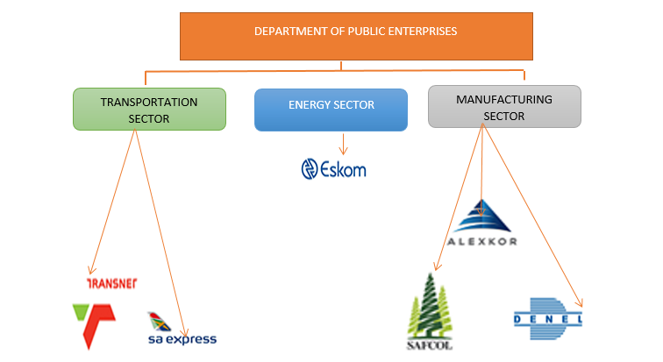
SECTION B
Major SOEs, Backbone of SA’s Economy, Cover critical economic sectors
Stakes are too high for these entities to fail (e.g. rating agencies use these to diagnose)

Slide 15
WHY THESE ENTITIES?
Denel: covers the defence force, a sector on its own, significant jobs, exports a great deal
Eskom: If it fails SA’s economy is on its knees- big industries, SMMEs, ordinary households and all sectors of the economy (health, education etc)
Transnet: connects SA with various regions in Africa, serious infrastructure investment and jobs , other sectors depend on Transnet
SA Express: connects SA various regions in Africa continent,
SAFCOL: significant job opportunities in the forestry sector
ALEXKOR: Deals with SA’s mineral wealth, which is the pride of the country

Slide 16
KEY OBSERVATIONS
Most challenges are common and seem to contagious
Most challenges are well documented & known (the e.g. AG-SA and the Media)
Governance; SCM processes; non-compliance with PFMA prescripts and regulations (mainly section 51); lack of consequence management; inadequate oversight by leadership; lack of leadership stability; financial and operational unsustainability; profitability issues
You can predict what will transpire in the Audited Reports

Slide 17
OTHER UNIQUE CHALLENGES
Global and domestic performance strains profitability and financial sustainability
E.g. Weak economic performance = weak demand for energy, commodities & travelling
Eskom is owed by big businesses, municipalities and illegal connectors (Izinyoka)
*Reportedly, Eskom is owed about R10bn by municipalities around the country

Slide 18
Key facts from the 2015 Annual Reports
MAIN REASONS FOR IRREGULAR, FRUITLESS & WASTEFUL EXPENDITURE
Procurement and Contract Management/ Supply Chain Management (unfair bidding processes or tax certificate related issues)
None Compliance with Section 51(I)(b)(ii) of the Public Finance Management Act (PFMA)

Slide 19
OTHER ENTITY SPECIFIC ISSUES
SAA Express:
Yet to table its Annual Report (very long overdue)
Profitability and liquidity challenges
Many aircraft on the ground, due to maintenance issues
Poor on time performance;
Increased flight delays;
Loss of critical skills.
DENEL
Reliant on client advance payments and short term paper to finance its working capital requirements (liquidity issues).

