Slide 1
^{NATIONAL UNION OF MINEWORKERS}
35
^{RECRUIT,} FIGHT RETRENCHMENTS, ASSESS AND FORGE UNITY
JOSEPH MONTISETSE
DEPUTY PRESIDENT
PRESENTATION ON MPRDA BILL (15D 2013)
SELECTION COMMITTEE ON LAND AND MINERAL RESOURCES
27 JUNE 2017

Slide 2
OUTLINE
INTRODUCTION
Sovereignty and Custodianship
DEFINISTIONS
Beneficiation
INDEPTH COMMENTS ON MPRDA BILL
Section 1 (m): Labour Sending Area
OUTSOURCING AND CONCLUSION
MPRDA Section 101: aligned with EEA
MPRDA Section 52 alignment with Section 189
Catalyst for Economic Development
NUM Transformation objectives on inclusive participation (workers and communities)
Equitable Access
Meaningful Consultation
HDSA
Alignment of MPRDA Section 52 with LRA Section 189
Section 28 (3) (Compliance matters)
Section 23, Section 26 (Compliance matters)
Section 11: LRA Section 197
Establishment of the MBC
MPRDA Section 47, 98, and 99
SLP Implementation
Community
Section 10 (A, B, C, D): Establishment of the RMDE Committee
Section (44, 47 (4) (a), 56, & 73 (2)

Slide 3
INTRODUCTION
The promulgation of the Mining and Petroleum Resource Development Act (28 of 2002) recognize the state’s sovereignty and custodianship over the country’s mineral resources.
The delays in the bill have left the workers vulnerable to the LRA Section 189 since Section 52 of the principal Act is open to various interpretation, a process which contributed to the shed jobs in the industry.
It is our firm conviction that in our country, transformation and advancement of previously disadvantaged must be seen as means not only to achieve sustainable economy but as a catalyst for economic growth.
The mining industry has a collective responsibility to ensure that mining companies comply with relevant legislative prescripts.

Slide 4
DEFINITIONS
DEFNITIONS | COMMENTS
BENEFICIATION | The NUM believes that there will be greater contributions to the country’s mineral wealth, host community empowerment and alignment of portable skills towards the expansion of the manufacturing beneficiation sector.
COMMUNITY | We welcome and support the amended definition of community as defined in the municipal structures act (1998), to enable easy identification of relevant communities for SLP’s including 60km radius.
MEANINGFUL CONSULTATION | The NUM is calling for the inclusion of “Meaningful consultation” in the definitions section, as we are currently finding it difficult to be meaningfully consulted in the implementation of charter targets and compilation of the mining charter report before submission to the regulator
EQUITABLE ACCESS | Fair and impartial or reasonable; just and right while addressing social and economic imbalances of the past. The NUM is making this accession to emphasize inclusivity when it comes to (Women, Youth and People with Disabilities ).
HDSA | The NUM remain resolute on the exclusion of “white women” as historically disadvantaged persons, thus not convinced on the current wording in the Bill or the principal act.

Slide 5
INDEPTH COMMENTS
Section 1 (m): NUM welcomes the inclusion of the Labour Sending Area to ensure economic growth even in rural areas, partnering with municipalities (IDP) and COGTA would be beneficial.
We also welcomes the inclusion of Residue stockpile ,this will ensure historic stockpiles fall within the MPRDA. E.g Jaggerfontein operations
Section 10 (A, B, C, D): Establishment of Regional Mining Development and Environmental Committee. 10C (2d) should provide for a labour representation elected from organized labour in the affected region with voting rights
Section 10: NUM propose insertion of 10.4: the regional manager and the mining rights applicant meaningfully consult stakeholders in the process of developing and approval of social labour plans
The suggestion that the Chairperson of the Ministerial Advisory Council be the Director General, is constraining on Advisory extent of the Council. The DG by appointment and job description is an advisor of the Minister therefore the incumbent becomes irrelevant for such position. The NUM suggests that the Chairperson of the Ministerial Advisory Council be elected by the appointed council members

Slide 6
INDEPTH COMMENTS cont…
Section 11: NUM propose an insertion that empowers the minister to impose an obligation for the transfer of the employment conditions of the previous holder (inline with Section 197 of LRA)
Section 23: NUM notes the increased prescribed period (from 30 to 60 days) to which could have its negative effects on investment and job creation.
Section 26: The addition on this section are welcomed, the NUM is of the view that both DMR and Dti should collaborate to develop an inclusive Beneficiation strategy aligned with the current IPAP 2016/17
Section 28 (3): We welcome the addition which requires mining rights holder to submit report detailing compliance with the act and the charter, it will make compliance with the SLP’s and the Charter non-negotiable .

Slide 7
INDEPTH COMMENTS cont…
Section 47 (4) (a): We welcome the removal of the word “reasonable opportunity” which has been replaced with 30 days, this insertion will enable enforcement of the legislation compliance
NUM notes the replacement of the Mineral and Petroleum Board with the Regional Manager throughout the amendment Bill, thus tightening the implementation of 52’s during downscalling and retrenchments
Section 52: The mining industry continue to shed a lot of jobs , therefore the NUM propose insertion of Section 52 (4) (a) the section 52 consultation should precede the Labour Relations Act (1995) section 189 for all mining rights holders.
Section 44: Empowers the Minister to establish a council depending on whether he sees the need to do so, however the NUM is of the view that the Council existence is crucial therefore propose that “MUST” should replace “MAY”

Slide 8
INDEPTH COMMENTS cont…
Section 56 (A, B, C, D, E, F & G) : Nomination of the Chairperson of the Ministerial Advisory Council to be anyone except the DG, the NUM is of the view that this will be strenuous on incumbent and that it will be difficult to achieve the council’s objectives
Section 56 (A): We propose that the Ministerial Advisory Council chairperson be elected by a “Secret ballot” on the first meeting to which only members referred by (e) and (g) should be legible to nominate and elect.
Section (26 & 107) The NUM propose an establishment of the Mineral Beneficiation Commission , funded and managed by Council for Geosciences.
Section 73 (z): We welcome the strengthened penalties , the replacement of R100 000 with a 10% of the annual turnover and imprisonment from two years to four years , we hope this will yield transformative results.

Slide 9
OUTSOURCING: MINING LICENSE OPERATION
Section 101: to include clearly determined conditions for outsourcing
Approval by the Minister
On approval: the salaries and working conditions should remain the same.
Implementation of “equal pay for work of equal value”
Compliance with all commitments made with all other government institution e.g. skills plan

Slide 10
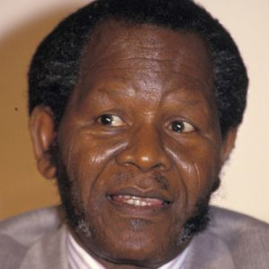
CONCLUSION
Racial discrimination, South Africa's economic power, its oppression and exploitation of all the black peoples, are part and parcel of the same thing
~ Cde O.R. TAMBO ~

Slide 11
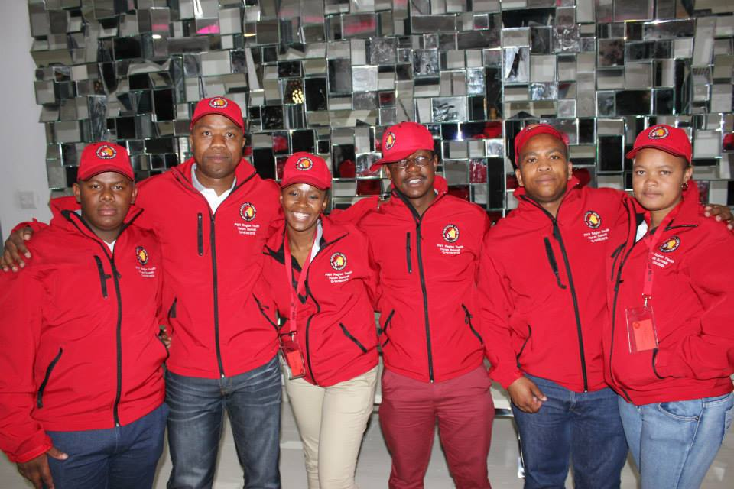
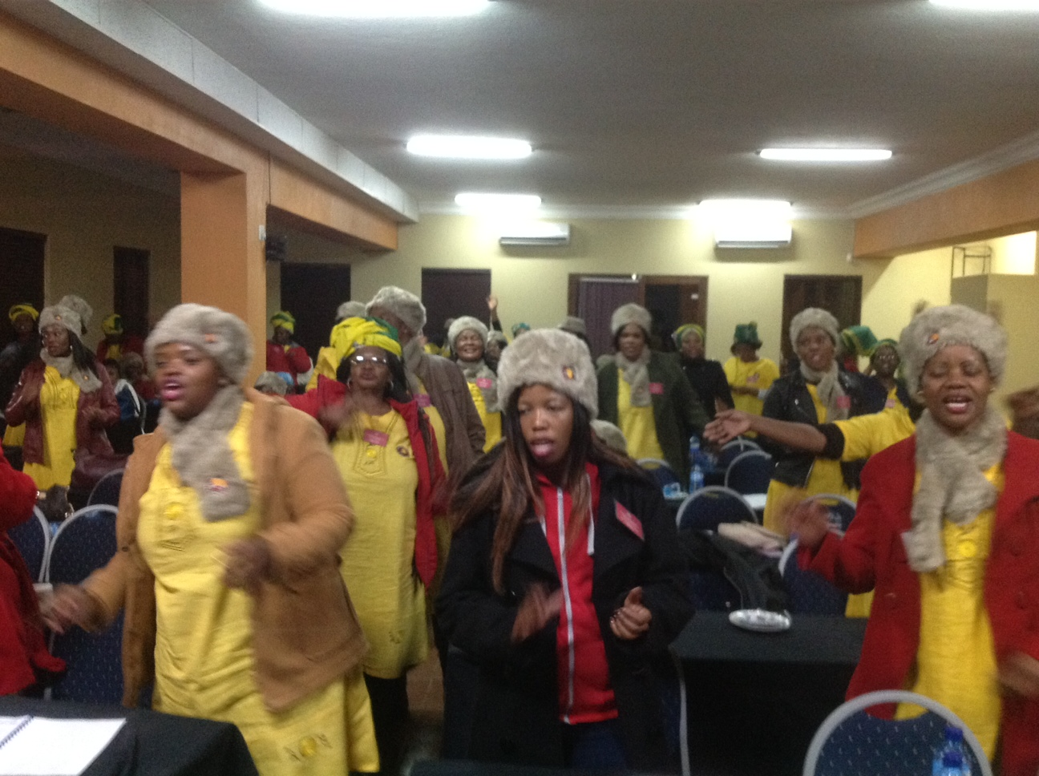
THANK YOU

