Slide 1
PORTFOLIO COMMITTEE ON HUMAN SETTLEMENTS
NHFC
ANNUAL PERFORMANCE PLAN 2017/18
17 MARCH 2017

Slide 2
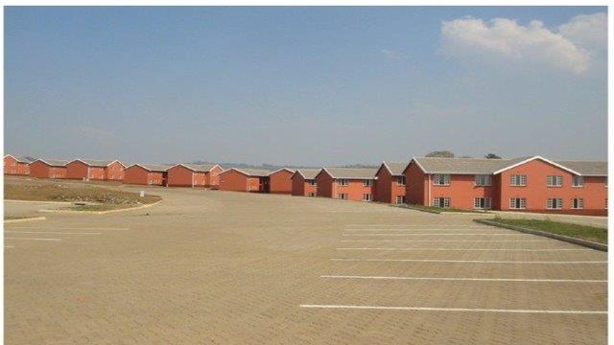
CONTENTS
    NHFC Overview
    Mandate and Business Model
    Overview of APP
    Business Performance
    NHFC Footprint
    Financial Performance
    Governance and Risk
Acacia Park, Munsduzi - Pietermaritzburg, KZN

Slide 3
NHFC OVERVIEW
Established: 1996
Type of Organisation: Development Finance Institution (DFI)
Ownership: State Owned Company, 100% SA government
Total Assets: R 3,2 billion (31 Jan 2017 – group)
Total liabilities: R 335 million (31 Jan 2017 – group)
Funding Status: Self sustaining, tax exempt as of 1 April 2016
Credit Rating: Long term A+, short term A1
Main business: Broadening and deepening access to
            affordable housing finance for the low-to-
            middle income SA households
Geographic activities: National
Number of Employees: Group 71 Company 54
3
TRANSACTION PHASE RISKS
# | RISK | INHERENT RISK RATING | MITIGATION STRATEGIES | RESIDUAL RISK RATING
1 | Transaction Execution Risk Ensuring that the donation of assets and liabilities meets the Tax Act, Companies Act, 2008, PFMA, National Treasury Regulations and any other legislation. | HIGH | National Treasury has amended the Tax Act to make NHFC a non-tax paying entity back dated to 1 April 2016. The tax amendment is to be signed into law by the State President around February 2017 A law firm (Werksman) appointed to draft and submit the Administrative Order to the Companies Tribunal (there is consensus amongst the three entities on going this route. | MEDIUM
2 | Governance/Leadership Risk Appointment of Board of the Super NHFC Appointment of Senior Management | HIGH | Governance/Leadership Risk The Shareholder has undertaken to appoint the Interim Board and the CEO. Establishment of Interim EXCO and delegation of Authority by the board. | MEDIUM
3 | Asset and Liabilities Fair Value Risk Accepting Donation of Assets and Liabilities at fair value | HIGH | NHFC to conduct due diligence/valuation of assets and liabilities that are donated to it to determine fair value. Transitional arrangements agreed by three CEOs. | MEDIUM
4 | Inflated Cost Structure Salary bill | HIGH | NHFC to conduct due diligence on salary bill of all the entities. Transitional arrangements agreed by three CEOs. | MEDIUM
# | RISK | INHERENT RISK RATING | MITIGATION STRATEGIES | RESIDUAL RISK RATING
5 | HR Risk Loss of skills Talent attraction Culture and service standards | HIGH | Compliance with Section 197 of the Labour Relations Act (Protection of Jobs). Draft and obtain approval of the interim organisation organogram Develop and implement change management strategies and plans Develop HR policies that will address talent attraction, culture and service standards Entities to operate under own brand until legislation is passed Undertake team building workshops | MEDIUM
6 | Integration Risk (Short-term) - systems, processes and people Short term Integration to commence 1 November 2016 and 31 March 2017 Operational policies | HIGH | Integration policies to be approved by the “Interim Board”. GTAC providing assistance | MEDIUM
7 | Communication Risk Communicating changes to the market. Internal Stakeholders External Stakeholders Shareholder | HIGH | Develop Communication strategy with input from NDoHS, Minister’s Office and the three entities to be approved by the “interim board”. | MEDIUM
8 | Brand Risk Avoiding confusion with regards to each entity’s identity and damage to the brand. | HIGH | Maintain NURCH and RLHF brands as divisions of NHFC pending passing of legislation by parliament. | MEDIUM

Slide 4
NHFC MANDATE
The National Housing Finance Corporation Soc Ltd (NHFC) is a state owned Development Finance Institution with a principal mandate to broaden and deepen access to affordable housing finance for the low- and middle-income households.
The low- to middle-income housing market is any South African household with a regular monthly income between R1 500 and R15 000.
The market segment is able to contribute towards its housing costs, but unable to access housing finance from Financial Institutions.
Target Market:
4
TRANSACTION PHASE RISKS
# | RISK | INHERENT RISK RATING | MITIGATION STRATEGIES | RESIDUAL RISK RATING
1 | Transaction Execution Risk Ensuring that the donation of assets and liabilities meets the Tax Act, Companies Act, 2008, PFMA, National Treasury Regulations and any other legislation. | HIGH | National Treasury has amended the Tax Act to make NHFC a non-tax paying entity back dated to 1 April 2016. The tax amendment is to be signed into law by the State President around February 2017 A law firm (Werksman) appointed to draft and submit the Administrative Order to the Companies Tribunal (there is consensus amongst the three entities on going this route. | MEDIUM
2 | Governance/Leadership Risk Appointment of Board of the Super NHFC Appointment of Senior Management | HIGH | Governance/Leadership Risk The Shareholder has undertaken to appoint the Interim Board and the CEO. Establishment of Interim EXCO and delegation of Authority by the board. | MEDIUM
3 | Asset and Liabilities Fair Value Risk Accepting Donation of Assets and Liabilities at fair value | HIGH | NHFC to conduct due diligence/valuation of assets and liabilities that are donated to it to determine fair value. Transitional arrangements agreed by three CEOs. | MEDIUM
4 | Inflated Cost Structure Salary bill | HIGH | NHFC to conduct due diligence on salary bill of all the entities. Transitional arrangements agreed by three CEOs. | MEDIUM
# | RISK | INHERENT RISK RATING | MITIGATION STRATEGIES | RESIDUAL RISK RATING
5 | HR Risk Loss of skills Talent attraction Culture and service standards | HIGH | Compliance with Section 197 of the Labour Relations Act (Protection of Jobs). Draft and obtain approval of the interim organisation organogram Develop and implement change management strategies and plans Develop HR policies that will address talent attraction, culture and service standards Entities to operate under own brand until legislation is passed Undertake team building workshops | MEDIUM
6 | Integration Risk (Short-term) - systems, processes and people Short term Integration to commence 1 November 2016 and 31 March 2017 Operational policies | HIGH | Integration policies to be approved by the “Interim Board”. GTAC providing assistance | MEDIUM
7 | Communication Risk Communicating changes to the market. Internal Stakeholders External Stakeholders Shareholder | HIGH | Develop Communication strategy with input from NDoHS, Minister’s Office and the three entities to be approved by the “interim board”. | MEDIUM
8 | Brand Risk Avoiding confusion with regards to each entity’s identity and damage to the brand. | HIGH | Maintain NURCH and RLHF brands as divisions of NHFC pending passing of legislation by parliament. | MEDIUM

Slide 5
VISION, MISSION, VALUES
VISION
To be the leader in development finance for the low-to-middle income housing market
MISSION
Provide innovative and affordable housing finance solutions to the low –to-middle income market
VALUES
OWNERSHIP
PASSION FOR PURPOSE
TEAMWORK
INTEGRITY
CREATIVITY
ACHIEVEMENT
STRATEGIC OBJECTIVES
Expand housing finance activities, through the effective provision of housing finance solutions, thus enabling low-to-middle income households to have choice of renting or owning or incrementally building, to meet their housing needs;
Facilitate the increased and sustained lending by financial institutions to the affordable housing market;
Mobilise funding into the human settlement space, on a sustainable basis, in partnership with the broadest range of institutions;
Conduct the business activities of the NHFC in a manner that ensures the continued economic sustainability of the NHFC whilst promoting lasting social, ethical and environmental development; and
Provide robust, timely and relevant market research
5
TRANSACTION PHASE RISKS
# | RISK | INHERENT RISK RATING | MITIGATION STRATEGIES | RESIDUAL RISK RATING
1 | Transaction Execution Risk Ensuring that the donation of assets and liabilities meets the Tax Act, Companies Act, 2008, PFMA, National Treasury Regulations and any other legislation. | HIGH | National Treasury has amended the Tax Act to make NHFC a non-tax paying entity back dated to 1 April 2016. The tax amendment is to be signed into law by the State President around February 2017 A law firm (Werksman) appointed to draft and submit the Administrative Order to the Companies Tribunal (there is consensus amongst the three entities on going this route. | MEDIUM
2 | Governance/Leadership Risk Appointment of Board of the Super NHFC Appointment of Senior Management | HIGH | Governance/Leadership Risk The Shareholder has undertaken to appoint the Interim Board and the CEO. Establishment of Interim EXCO and delegation of Authority by the board. | MEDIUM
3 | Asset and Liabilities Fair Value Risk Accepting Donation of Assets and Liabilities at fair value | HIGH | NHFC to conduct due diligence/valuation of assets and liabilities that are donated to it to determine fair value. Transitional arrangements agreed by three CEOs. | MEDIUM
4 | Inflated Cost Structure Salary bill | HIGH | NHFC to conduct due diligence on salary bill of all the entities. Transitional arrangements agreed by three CEOs. | MEDIUM
# | RISK | INHERENT RISK RATING | MITIGATION STRATEGIES | RESIDUAL RISK RATING
5 | HR Risk Loss of skills Talent attraction Culture and service standards | HIGH | Compliance with Section 197 of the Labour Relations Act (Protection of Jobs). Draft and obtain approval of the interim organisation organogram Develop and implement change management strategies and plans Develop HR policies that will address talent attraction, culture and service standards Entities to operate under own brand until legislation is passed Undertake team building workshops | MEDIUM
6 | Integration Risk (Short-term) - systems, processes and people Short term Integration to commence 1 November 2016 and 31 March 2017 Operational policies | HIGH | Integration policies to be approved by the “Interim Board”. GTAC providing assistance | MEDIUM
7 | Communication Risk Communicating changes to the market. Internal Stakeholders External Stakeholders Shareholder | HIGH | Develop Communication strategy with input from NDoHS, Minister’s Office and the three entities to be approved by the “interim board”. | MEDIUM
8 | Brand Risk Avoiding confusion with regards to each entity’s identity and damage to the brand. | HIGH | Maintain NURCH and RLHF brands as divisions of NHFC pending passing of legislation by parliament. | MEDIUM

Slide 6
BUSINESS MODEL
6
TRANSACTION PHASE RISKS
# | RISK | INHERENT RISK RATING | MITIGATION STRATEGIES | RESIDUAL RISK RATING
1 | Transaction Execution Risk Ensuring that the donation of assets and liabilities meets the Tax Act, Companies Act, 2008, PFMA, National Treasury Regulations and any other legislation. | HIGH | National Treasury has amended the Tax Act to make NHFC a non-tax paying entity back dated to 1 April 2016. The tax amendment is to be signed into law by the State President around February 2017 A law firm (Werksman) appointed to draft and submit the Administrative Order to the Companies Tribunal (there is consensus amongst the three entities on going this route. | MEDIUM
2 | Governance/Leadership Risk Appointment of Board of the Super NHFC Appointment of Senior Management | HIGH | Governance/Leadership Risk The Shareholder has undertaken to appoint the Interim Board and the CEO. Establishment of Interim EXCO and delegation of Authority by the board. | MEDIUM
3 | Asset and Liabilities Fair Value Risk Accepting Donation of Assets and Liabilities at fair value | HIGH | NHFC to conduct due diligence/valuation of assets and liabilities that are donated to it to determine fair value. Transitional arrangements agreed by three CEOs. | MEDIUM
4 | Inflated Cost Structure Salary bill | HIGH | NHFC to conduct due diligence on salary bill of all the entities. Transitional arrangements agreed by three CEOs. | MEDIUM
# | RISK | INHERENT RISK RATING | MITIGATION STRATEGIES | RESIDUAL RISK RATING
5 | HR Risk Loss of skills Talent attraction Culture and service standards | HIGH | Compliance with Section 197 of the Labour Relations Act (Protection of Jobs). Draft and obtain approval of the interim organisation organogram Develop and implement change management strategies and plans Develop HR policies that will address talent attraction, culture and service standards Entities to operate under own brand until legislation is passed Undertake team building workshops | MEDIUM
6 | Integration Risk (Short-term) - systems, processes and people Short term Integration to commence 1 November 2016 and 31 March 2017 Operational policies | HIGH | Integration policies to be approved by the “Interim Board”. GTAC providing assistance | MEDIUM
7 | Communication Risk Communicating changes to the market. Internal Stakeholders External Stakeholders Shareholder | HIGH | Develop Communication strategy with input from NDoHS, Minister’s Office and the three entities to be approved by the “interim board”. | MEDIUM
8 | Brand Risk Avoiding confusion with regards to each entity’s identity and damage to the brand. | HIGH | Maintain NURCH and RLHF brands as divisions of NHFC pending passing of legislation by parliament. | MEDIUM

Slide 7
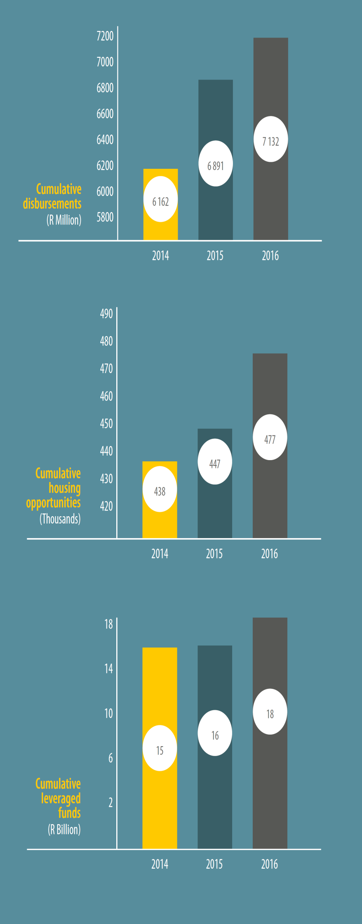

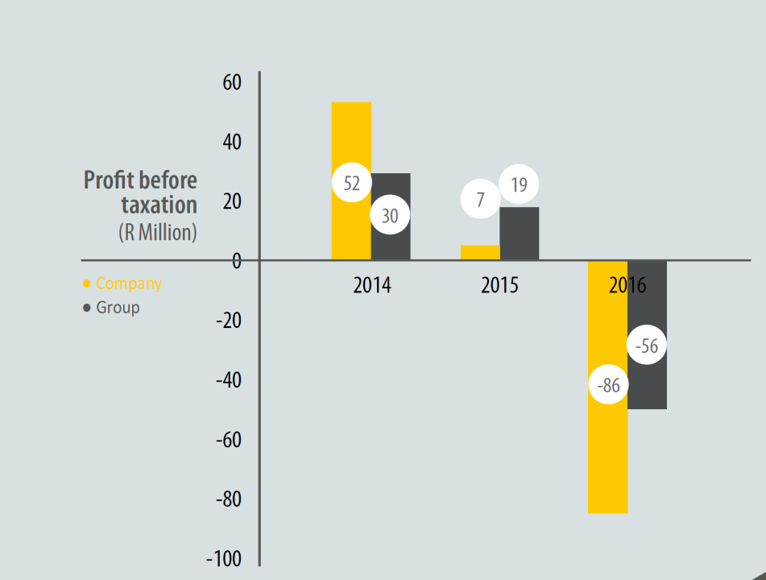
CUMULATIVE DEVELOPMENTAL IMPACT
7
7
TRANSACTION PHASE RISKS
# | RISK | INHERENT RISK RATING | MITIGATION STRATEGIES | RESIDUAL RISK RATING
1 | Transaction Execution Risk Ensuring that the donation of assets and liabilities meets the Tax Act, Companies Act, 2008, PFMA, National Treasury Regulations and any other legislation. | HIGH | National Treasury has amended the Tax Act to make NHFC a non-tax paying entity back dated to 1 April 2016. The tax amendment is to be signed into law by the State President around February 2017 A law firm (Werksman) appointed to draft and submit the Administrative Order to the Companies Tribunal (there is consensus amongst the three entities on going this route. | MEDIUM
2 | Governance/Leadership Risk Appointment of Board of the Super NHFC Appointment of Senior Management | HIGH | Governance/Leadership Risk The Shareholder has undertaken to appoint the Interim Board and the CEO. Establishment of Interim EXCO and delegation of Authority by the board. | MEDIUM
3 | Asset and Liabilities Fair Value Risk Accepting Donation of Assets and Liabilities at fair value | HIGH | NHFC to conduct due diligence/valuation of assets and liabilities that are donated to it to determine fair value. Transitional arrangements agreed by three CEOs. | MEDIUM
4 | Inflated Cost Structure Salary bill | HIGH | NHFC to conduct due diligence on salary bill of all the entities. Transitional arrangements agreed by three CEOs. | MEDIUM
# | RISK | INHERENT RISK RATING | MITIGATION STRATEGIES | RESIDUAL RISK RATING
5 | HR Risk Loss of skills Talent attraction Culture and service standards | HIGH | Compliance with Section 197 of the Labour Relations Act (Protection of Jobs). Draft and obtain approval of the interim organisation organogram Develop and implement change management strategies and plans Develop HR policies that will address talent attraction, culture and service standards Entities to operate under own brand until legislation is passed Undertake team building workshops | MEDIUM
6 | Integration Risk (Short-term) - systems, processes and people Short term Integration to commence 1 November 2016 and 31 March 2017 Operational policies | HIGH | Integration policies to be approved by the “Interim Board”. GTAC providing assistance | MEDIUM
7 | Communication Risk Communicating changes to the market. Internal Stakeholders External Stakeholders Shareholder | HIGH | Develop Communication strategy with input from NDoHS, Minister’s Office and the three entities to be approved by the “interim board”. | MEDIUM
8 | Brand Risk Avoiding confusion with regards to each entity’s identity and damage to the brand. | HIGH | Maintain NURCH and RLHF brands as divisions of NHFC pending passing of legislation by parliament. | MEDIUM

Slide 8
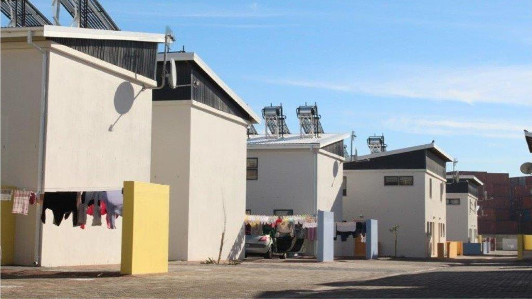
    OVERVIEW OF ANNUAL PERFORMANCE PLAN
Mountain View Villas, Maitland, Cape Town, Western Cape

Slide 9
ALIGNMENT TO GOVERNMENTAL POLICIES AND PLANS
The Annual Performance Plan (APP) for 2017/18 is aligned to the Medium Term Strategic Framework (MTSF), Outcome 8 and the approved Strategic Plan which covers the period 2014/15 to 2018/19 (5 year cycle).
The NHFC, through its programmes as well as other interventions, such as its equity investments, is supportive of the National Development Plan (NDP) commitment of revising the housing system. Examples of these are:
  Provision of housing finance options (private and social rental, home ownership, instalment sale agreements, incremental loans);
  Inner-city developments; and
  Leveraging of private sector funding into the affordable market.
9
TRANSACTION PHASE RISKS
# | RISK | INHERENT RISK RATING | MITIGATION STRATEGIES | RESIDUAL RISK RATING
1 | Transaction Execution Risk Ensuring that the donation of assets and liabilities meets the Tax Act, Companies Act, 2008, PFMA, National Treasury Regulations and any other legislation. | HIGH | National Treasury has amended the Tax Act to make NHFC a non-tax paying entity back dated to 1 April 2016. The tax amendment is to be signed into law by the State President around February 2017 A law firm (Werksman) appointed to draft and submit the Administrative Order to the Companies Tribunal (there is consensus amongst the three entities on going this route. | MEDIUM
2 | Governance/Leadership Risk Appointment of Board of the Super NHFC Appointment of Senior Management | HIGH | Governance/Leadership Risk The Shareholder has undertaken to appoint the Interim Board and the CEO. Establishment of Interim EXCO and delegation of Authority by the board. | MEDIUM
3 | Asset and Liabilities Fair Value Risk Accepting Donation of Assets and Liabilities at fair value | HIGH | NHFC to conduct due diligence/valuation of assets and liabilities that are donated to it to determine fair value. Transitional arrangements agreed by three CEOs. | MEDIUM
4 | Inflated Cost Structure Salary bill | HIGH | NHFC to conduct due diligence on salary bill of all the entities. Transitional arrangements agreed by three CEOs. | MEDIUM
# | RISK | INHERENT RISK RATING | MITIGATION STRATEGIES | RESIDUAL RISK RATING
5 | HR Risk Loss of skills Talent attraction Culture and service standards | HIGH | Compliance with Section 197 of the Labour Relations Act (Protection of Jobs). Draft and obtain approval of the interim organisation organogram Develop and implement change management strategies and plans Develop HR policies that will address talent attraction, culture and service standards Entities to operate under own brand until legislation is passed Undertake team building workshops | MEDIUM
6 | Integration Risk (Short-term) - systems, processes and people Short term Integration to commence 1 November 2016 and 31 March 2017 Operational policies | HIGH | Integration policies to be approved by the “Interim Board”. GTAC providing assistance | MEDIUM
7 | Communication Risk Communicating changes to the market. Internal Stakeholders External Stakeholders Shareholder | HIGH | Develop Communication strategy with input from NDoHS, Minister’s Office and the three entities to be approved by the “interim board”. | MEDIUM
8 | Brand Risk Avoiding confusion with regards to each entity’s identity and damage to the brand. | HIGH | Maintain NURCH and RLHF brands as divisions of NHFC pending passing of legislation by parliament. | MEDIUM

Slide 10
OPERATING ENVIRONMENT
The Market Context
Current economic and market conditions negatively affects both the NHFC’s beneficiaries and clients.
Social Housing
Challenges impacting Social Housing.
Graduation of our seasoned clients into the formal banking sector has resulted in early settlements of loans and a weakened pipeline. The emergence of a high number of start-up or emerging clients is the order of the day, however, these require significant handholding to get off the ground with long turn around times.
Lack of Bankable Projects
Shareholder Funding Support
Confirmed grant capital over MTEF albeit lower than originally requested.
Fast tracking of the process. Impact on staff morale. Delivering on core business.
DFI Consolidation
Drivers of financial sustainability
Operational efficiencies continue. Management of level of Non-Performing Portfolio.
10

Slide 11
KEY FACTORS IMPACTING APP
Funding Requirements – APP aligned to reduced capital allocation over MTEF (2018/19 and 2019/20).
Business Programmes - Changes in prior year and approved on that basis:
  Budgeted resources for the Incremental Housing Loan programme reallocated to the Private Rental programme. NHFC, through an existing facility with a retail intermediary, remains invested in this market and the resultant leveraged impact is expected to contribute to the achievement of the MTSF targets.
  Social Affordable housing reduced in line with Shareholder Support.
CTCHC - Strategic decision to reduce / dispose of the shareholding in CTCHC.
  APP on basis that CTCHC will continue as a wholly owned subsidiary and considers the strategic re-organisation where new development activities are curtailed.
  Treatment will be guided by the progress on the relevant governance and approval processes.
Tax Status of NHFC - NHFC Tax Amendment Bill (Tax Exemption & PBO status enablement), signed by the President Jan 2017. Not incorporated into APP. Envisaged impact:
    Increase in cash available for deployment – R40 million (2016/17 to 2019/20)
    Unwinding of Deferred Tax Asset - R 43.4 million write off. Given the low profitability
    levels, this may potentially lead to a net loss position profit after tax in FY 2016/17.
DFI Consolidation - NHFC Group and not the consolidated HSDB.
11
TRANSACTION PHASE RISKS
# | RISK | INHERENT RISK RATING | MITIGATION STRATEGIES | RESIDUAL RISK RATING
1 | Transaction Execution Risk Ensuring that the donation of assets and liabilities meets the Tax Act, Companies Act, 2008, PFMA, National Treasury Regulations and any other legislation. | HIGH | National Treasury has amended the Tax Act to make NHFC a non-tax paying entity back dated to 1 April 2016. The tax amendment is to be signed into law by the State President around February 2017 A law firm (Werksman) appointed to draft and submit the Administrative Order to the Companies Tribunal (there is consensus amongst the three entities on going this route. | MEDIUM
2 | Governance/Leadership Risk Appointment of Board of the Super NHFC Appointment of Senior Management | HIGH | Governance/Leadership Risk The Shareholder has undertaken to appoint the Interim Board and the CEO. Establishment of Interim EXCO and delegation of Authority by the board. | MEDIUM
3 | Asset and Liabilities Fair Value Risk Accepting Donation of Assets and Liabilities at fair value | HIGH | NHFC to conduct due diligence/valuation of assets and liabilities that are donated to it to determine fair value. Transitional arrangements agreed by three CEOs. | MEDIUM
4 | Inflated Cost Structure Salary bill | HIGH | NHFC to conduct due diligence on salary bill of all the entities. Transitional arrangements agreed by three CEOs. | MEDIUM
# | RISK | INHERENT RISK RATING | MITIGATION STRATEGIES | RESIDUAL RISK RATING
5 | HR Risk Loss of skills Talent attraction Culture and service standards | HIGH | Compliance with Section 197 of the Labour Relations Act (Protection of Jobs). Draft and obtain approval of the interim organisation organogram Develop and implement change management strategies and plans Develop HR policies that will address talent attraction, culture and service standards Entities to operate under own brand until legislation is passed Undertake team building workshops | MEDIUM
6 | Integration Risk (Short-term) - systems, processes and people Short term Integration to commence 1 November 2016 and 31 March 2017 Operational policies | HIGH | Integration policies to be approved by the “Interim Board”. GTAC providing assistance | MEDIUM
7 | Communication Risk Communicating changes to the market. Internal Stakeholders External Stakeholders Shareholder | HIGH | Develop Communication strategy with input from NDoHS, Minister’s Office and the three entities to be approved by the “interim board”. | MEDIUM
8 | Brand Risk Avoiding confusion with regards to each entity’s identity and damage to the brand. | HIGH | Maintain NURCH and RLHF brands as divisions of NHFC pending passing of legislation by parliament. | MEDIUM

Slide 12
OVERVIEW – IMPACT OF APP 2017/18 ON MTSF
 | Impact of APP 2017/18 on Strategic Plan | Approved Strategic Plan (February 2015)
 | MTSF 2014/15 -2018/19 (five years forecast) | MTSF 2014/15 -2018/19 (five years)
Funding Assumptions
Shareholder support (R'm) | 610 | 530
Debt funding (R'm) | - | -
Total funding requirements (R'm) | 610 | 530
Funding Impact
Disbursements (R'm) | 2 327 | 2 367
Leveraged funds (R'm) | 5 938 | 3 096
Total funding impact (R'm) | 8 291 | 5 463
Developmental Impact
Number of housing opportunities created | 83 164 | 47 897
Number of beneficiaries benefitting | 316 023 | 182 009
Number of jobs facilitated | 45 288 | 28 734
BEE targeted disbursement (R'm) | 1 133 | 474
Significant increase in leveraged funds as well as most of the developmental impact indicators:
  Contribution from strategic partnerships updated to reflect the bearing of the actual performance in the forecast/budget period.
  Impact of an existing facility with a retail intermediary that was not previously recognised in the Strategic Plan.
12
TRANSACTION PHASE RISKS
# | RISK | INHERENT RISK RATING | MITIGATION STRATEGIES | RESIDUAL RISK RATING
1 | Transaction Execution Risk Ensuring that the donation of assets and liabilities meets the Tax Act, Companies Act, 2008, PFMA, National Treasury Regulations and any other legislation. | HIGH | National Treasury has amended the Tax Act to make NHFC a non-tax paying entity back dated to 1 April 2016. The tax amendment is to be signed into law by the State President around February 2017 A law firm (Werksman) appointed to draft and submit the Administrative Order to the Companies Tribunal (there is consensus amongst the three entities on going this route. | MEDIUM
2 | Governance/Leadership Risk Appointment of Board of the Super NHFC Appointment of Senior Management | HIGH | Governance/Leadership Risk The Shareholder has undertaken to appoint the Interim Board and the CEO. Establishment of Interim EXCO and delegation of Authority by the board. | MEDIUM
3 | Asset and Liabilities Fair Value Risk Accepting Donation of Assets and Liabilities at fair value | HIGH | NHFC to conduct due diligence/valuation of assets and liabilities that are donated to it to determine fair value. Transitional arrangements agreed by three CEOs. | MEDIUM
4 | Inflated Cost Structure Salary bill | HIGH | NHFC to conduct due diligence on salary bill of all the entities. Transitional arrangements agreed by three CEOs. | MEDIUM
# | RISK | INHERENT RISK RATING | MITIGATION STRATEGIES | RESIDUAL RISK RATING
5 | HR Risk Loss of skills Talent attraction Culture and service standards | HIGH | Compliance with Section 197 of the Labour Relations Act (Protection of Jobs). Draft and obtain approval of the interim organisation organogram Develop and implement change management strategies and plans Develop HR policies that will address talent attraction, culture and service standards Entities to operate under own brand until legislation is passed Undertake team building workshops | MEDIUM
6 | Integration Risk (Short-term) - systems, processes and people Short term Integration to commence 1 November 2016 and 31 March 2017 Operational policies | HIGH | Integration policies to be approved by the “Interim Board”. GTAC providing assistance | MEDIUM
7 | Communication Risk Communicating changes to the market. Internal Stakeholders External Stakeholders Shareholder | HIGH | Develop Communication strategy with input from NDoHS, Minister’s Office and the three entities to be approved by the “interim board”. | MEDIUM
8 | Brand Risk Avoiding confusion with regards to each entity’s identity and damage to the brand. | HIGH | Maintain NURCH and RLHF brands as divisions of NHFC pending passing of legislation by parliament. | MEDIUM

Slide 13
PERFORMANCE AGAINST MTSF: FORECAST
 | NHFC Approved Strategic Plan Target | NDOHS MTSF Target | % MTSF * | Forecast NHFC MTSF Target | Forecast NHFC % MTSF Target
Number of Social Housing Units | 5 899 | 27 000 | 22% | 6 535 | 24%
Number of Private Rental Housing Units | 15 390 | 25 000 | 62% | 19 718 | 79%
Total Rental | 21 289 |  |  | 26 253
Number of Affordable Housing Units | 9 110 |  |  | 9 555
Number of Incremental Housing Loans | 17 498 |  |  | 47 355
Total Affordable Housing | 26 608 | 110 000 | 24% | 56 910 | 52%
Total | 47 897 |  |  | 83 163
13
TRANSACTION PHASE RISKS
# | RISK | INHERENT RISK RATING | MITIGATION STRATEGIES | RESIDUAL RISK RATING
1 | Transaction Execution Risk Ensuring that the donation of assets and liabilities meets the Tax Act, Companies Act, 2008, PFMA, National Treasury Regulations and any other legislation. | HIGH | National Treasury has amended the Tax Act to make NHFC a non-tax paying entity back dated to 1 April 2016. The tax amendment is to be signed into law by the State President around February 2017 A law firm (Werksman) appointed to draft and submit the Administrative Order to the Companies Tribunal (there is consensus amongst the three entities on going this route. | MEDIUM
2 | Governance/Leadership Risk Appointment of Board of the Super NHFC Appointment of Senior Management | HIGH | Governance/Leadership Risk The Shareholder has undertaken to appoint the Interim Board and the CEO. Establishment of Interim EXCO and delegation of Authority by the board. | MEDIUM
3 | Asset and Liabilities Fair Value Risk Accepting Donation of Assets and Liabilities at fair value | HIGH | NHFC to conduct due diligence/valuation of assets and liabilities that are donated to it to determine fair value. Transitional arrangements agreed by three CEOs. | MEDIUM
4 | Inflated Cost Structure Salary bill | HIGH | NHFC to conduct due diligence on salary bill of all the entities. Transitional arrangements agreed by three CEOs. | MEDIUM
# | RISK | INHERENT RISK RATING | MITIGATION STRATEGIES | RESIDUAL RISK RATING
5 | HR Risk Loss of skills Talent attraction Culture and service standards | HIGH | Compliance with Section 197 of the Labour Relations Act (Protection of Jobs). Draft and obtain approval of the interim organisation organogram Develop and implement change management strategies and plans Develop HR policies that will address talent attraction, culture and service standards Entities to operate under own brand until legislation is passed Undertake team building workshops | MEDIUM
6 | Integration Risk (Short-term) - systems, processes and people Short term Integration to commence 1 November 2016 and 31 March 2017 Operational policies | HIGH | Integration policies to be approved by the “Interim Board”. GTAC providing assistance | MEDIUM
7 | Communication Risk Communicating changes to the market. Internal Stakeholders External Stakeholders Shareholder | HIGH | Develop Communication strategy with input from NDoHS, Minister’s Office and the three entities to be approved by the “interim board”. | MEDIUM
8 | Brand Risk Avoiding confusion with regards to each entity’s identity and damage to the brand. | HIGH | Maintain NURCH and RLHF brands as divisions of NHFC pending passing of legislation by parliament. | MEDIUM

Slide 14
KEY PERFORMANCE INDICATORS – PROGRAMME 1
Programme | Expand housing finance activities through effective provision of housing finance opportunities through disbursements
Outcomes | Adequate housing and improved quality of living environments
Performance indicator | Audited / Actual |  |  | Forecast | Budget
 | 2013/14 | 2014/15 | 2015/16 | 2016/17 | 2017/18 | 2018/19 | 2019/20
Estimated number of housing opportunities facilitated through disbursements |  | 4 012 | 1 423 | 2 534 | 3 311 | 2 013 | 1 391
Number of beneficiaries benefitting (factor of 3.8 utilised) |  | 15 246 | 5 407 | 9 629 | 12 582 | 7 649 | 5 286
Value of funds disbursed( R'm) | 675 | 729 | 241 | 467 | 462 | 428 | 286
Value of approvals (R'm) | 754 | 186 | 340 | 489 | 364 | 351 | 371
14
TRANSACTION PHASE RISKS
# | RISK | INHERENT RISK RATING | MITIGATION STRATEGIES | RESIDUAL RISK RATING
1 | Transaction Execution Risk Ensuring that the donation of assets and liabilities meets the Tax Act, Companies Act, 2008, PFMA, National Treasury Regulations and any other legislation. | HIGH | National Treasury has amended the Tax Act to make NHFC a non-tax paying entity back dated to 1 April 2016. The tax amendment is to be signed into law by the State President around February 2017 A law firm (Werksman) appointed to draft and submit the Administrative Order to the Companies Tribunal (there is consensus amongst the three entities on going this route. | MEDIUM
2 | Governance/Leadership Risk Appointment of Board of the Super NHFC Appointment of Senior Management | HIGH | Governance/Leadership Risk The Shareholder has undertaken to appoint the Interim Board and the CEO. Establishment of Interim EXCO and delegation of Authority by the board. | MEDIUM
3 | Asset and Liabilities Fair Value Risk Accepting Donation of Assets and Liabilities at fair value | HIGH | NHFC to conduct due diligence/valuation of assets and liabilities that are donated to it to determine fair value. Transitional arrangements agreed by three CEOs. | MEDIUM
4 | Inflated Cost Structure Salary bill | HIGH | NHFC to conduct due diligence on salary bill of all the entities. Transitional arrangements agreed by three CEOs. | MEDIUM
# | RISK | INHERENT RISK RATING | MITIGATION STRATEGIES | RESIDUAL RISK RATING
5 | HR Risk Loss of skills Talent attraction Culture and service standards | HIGH | Compliance with Section 197 of the Labour Relations Act (Protection of Jobs). Draft and obtain approval of the interim organisation organogram Develop and implement change management strategies and plans Develop HR policies that will address talent attraction, culture and service standards Entities to operate under own brand until legislation is passed Undertake team building workshops | MEDIUM
6 | Integration Risk (Short-term) - systems, processes and people Short term Integration to commence 1 November 2016 and 31 March 2017 Operational policies | HIGH | Integration policies to be approved by the “Interim Board”. GTAC providing assistance | MEDIUM
7 | Communication Risk Communicating changes to the market. Internal Stakeholders External Stakeholders Shareholder | HIGH | Develop Communication strategy with input from NDoHS, Minister’s Office and the three entities to be approved by the “interim board”. | MEDIUM
8 | Brand Risk Avoiding confusion with regards to each entity’s identity and damage to the brand. | HIGH | Maintain NURCH and RLHF brands as divisions of NHFC pending passing of legislation by parliament. | MEDIUM

Slide 15
PROGRAMME 1 – HOUSING OPPORTUNITIES
Performance indicator | Actual | Actual | Forecast | Budget
Number of housing opportunities facilitated through disbursements | 2014/15 | 2015/16 | 2016/17 | 2017/18 | 2018/19 | 2019/20
Number of Social Affordable Housing Units* | 1 195 | 500 | 1 600 | 2 268 | 972 | 546
Number of Private Rental Housing Units* | 656 | 78 | 672 | 725 | 782 | 845
Total Rental | 1 851 | 578 | 2 272 | 2 993 | 1 755 | 1 391
Number of Affordable Housing Units** | 2 161 | 845 | 261 | 318 | 259 | -
Total | 4 012 | 1 423 | 2 534 | 3 311 | 2 013 | 1 391
Number of beneficiaries benefitting (factor of 3.8 utilised) | 15 246 | 5 407 | 9 629 | 12 582 | 7 649 | 5 286
Housing units include completed, transferred or occupied rental units. The decrease in 2015/16 is driven by a combination of a reduced business pipeline (due to previous funding constraints), the prevailing subdued economic and market context, challenges impacting the social housing space, lack of bankable projects and challenges in meeting of the Conditions Precedent in approved projects. * Social Affordable Housing in line with shareholder support.
** Affordable Housing – estimated number of mortgage loans originated through Strategic Partnerships, average loan size being R500 000. Instalment Purchase Agreements originated through intermediaries, units from previously funded integrated developments mainly Space, Mettle and CTCHC.
The decrease over the MTSF is due to market conditions impacting integrated developments and intermediaries as well as the projected forecast of key significant existing commitments relating to strategic partnerships which is completed and not repeated at the same scale.
15

Slide 16
PROGRAMME 1 – DISBURSEMENTS
Performance indicator | Actual | Actual | Forecast | Budget
Value of disbursements | 2014/15 | 2015/16* | 2016/17 | 2017/18 | 2018/19 | 2019/20
Social Affordable Housing** | 234 | 23 | 271 | 101 | 80 | 50
Private Rental Housing*** | 133 | 76 | 62 | 202 | 219 | 236
Total Rental Housing | 367 | 99 | 334 | 303 | 299 | 286
Affordable Housing**** | 362 | 142 | 133 | 159 | 129 | -
Total value of disbursements | 729 | 241 | 467 | 462 | 428 | 286
* The decrease in 2015/16 is driven by a combination of a reduced business pipeline (due to previous funding constraints), the prevailing subdued economic and market context which negatively affect both the households and clients of NHFC, challenges impacting the social housing space, lack of bankable projects and challenges in meeting of the Conditions Precedent in approved projects.
** As in prior year, Social Affordable Housing reduced in outer years in line with shareholder support.
*** The decrease over the MTSF is due to market conditions impacting integrated developments and intermediaries as well as the projected forecast of key significant existing commitments relating to strategic partnerships which is forecasted to be completed and not repeated at the same scale.
16

Slide 17
PROGRAMME 1 – APPROVALS
Performance indicator | Actual | Actual | Forecast | Budget
Value of approvals | 2014/15 | 2015/16* | 2016/17 | 2017/18 | 2018/19 | 2019/20
Social Affordable Housing** | 38 | 142 | 101 | 80 | 50 | 52
Private Rental Housing*** | 148 | 73 | 388 | 284 | 301 | 319
Total Rental Housing | 186 | 215 | 489 | 364 | 351 | 371
Affordable Housing**** | - | 125 | - | - | - | -
Total value of approvals | 186 | 340 | 489 | 364 | 412 | 371
* Facilities approved by the relevant governance structure in line with the delegated authority.
Facilities may be withdrawn and/or not taken by the client.
** Budget for social housing reduced in line shareholder support. Current weak pipeline. Established SHIs holding back new projects in anticipation of increase in the income bands as well as increase in the quantum of the RCG. Applications are being received from Other Delivery Agents, very few of these succeed due lack of social housing knowledge and experience.
*** No further approvals in line with risk appetite.
17

Slide 18
KEY PERFORMANCE INDICATORS – PROGRAMME 2
Programme | Facilitate the increased and sustained lending by financial institutions
Outcomes | Increased and sustained lending by private sector to human settlement developments
Performance indicator | Actual | Actual | Forecast | Budget
 | 2014/15 | 2015/16 | 2016/17 | 2017/18 | 2018/19 | 2018/19
Estimated number of housing opportunities facilitated through leveraged funds | 5 100 | 28 963 | 17 321 | 14 297 | 4 189 | 3 406
Number of beneficiaries benefitting (factor of 3.8 utilised) | 19 380 | 110 059 | 65 820 | 54 329 | 15 918 | 12 943
Value of leveraged funds from the Private sector (R'm) | 821 | 1 509 | 1 476 | 1 243 | 890 | 402
18

Slide 19
PROGRAMME 2 – HOUSING OPPORTUNITIES
Performance indicator | Actual | Actual | Forecast | Budget
Number of housing opportunities facilitated through leveraged funds | 2014/15 | 2015/16 | 2016/17 | 2017/18 | 2018/19 | 2019/20
Number of Private Rental Housing Units* | 4 050 | 3 977 | 2 704 | 2 920 | 3 154 | 3 406
Number of Affordable Housing Units** | 1 050 | 1 763 | 827 | 1 035 | 1 035 | -
Number of Incremental Housing Loans*** | - | 23 223 | 13 790 | 10 342 | - | -
Total | 5 100 | 28 963 | 17 321 | 14 297 | 4 189 | 3 406
Number of beneficiaries benefitting (factor of 3.8 utilised) | 19 380 | 110 059 | 65 820 | 54 329 | 15 918 | 12 943
Housing units include completed, transferred or occupied rented units. * Private Rental - estimated number of units arising from Strategic Partnership with TUHF. Decrease in 2016/17 due to impact of entrance of listed property investments vehicles.
** Affordable Housing – estimated number of mortgage loans arising through funds leveraged through Strategic Partnerships such as HIP and IHS, the average loan size being R500 000, revised from R400 000.
The decrease over the MTSF is due to market conditions impacting integrated developments and intermediaries as well as the projected forecast of key significant existing commitments relating to strategic partnerships which is forecasted to be completed and not repeated at the same scale. *** Incremental - estimated number of loans arising from funds leveraged by Intermediaries, the average loan size being R15 000. The facility is repaid in 2018/19 hence no impact in that year.
19

Slide 20
PROGRAMME 2 – LEVERAGED FUNDS
Performance indicator | Actual | Actual | Forecast | Budget
Value of leveraged funds from the Private sector* | 2014/15 | 2015/16 | 2016/17 | 2017/18 | 2018/19 | 2019/20
 | R'm | R'm | R'm | R'm | R'm | R'm
Rental Housing | 321 | 367 | 304 | 353 | 372 | 402
Affordable Housing** | 500 | 684 | 834 | 637 | 518 | -
Incremental Housing*** | - | 458 | 338 | 253 | - | -
Value of total funds leveraged | 821 | 1 509 | 1 476 | 1 243 | 890 | 402
* Formula applied based on historical observation: Rental Housing 1:0,3; Affordable Housing 1:4. Integrated developments and Instalments Purchase Agreements: existing commitments and projects funded previously and contribution from strategic partnership with TUHF. ** The decrease over the MTSF is due to market conditions impacting integrated developments and intermediaries as well as the projected forecast of key significant existing commitments relating to strategic partnerships to be completed and not repeated at the same scale. *** Funds leveraged through existing facility with retail intermediary. Facility is fully repaid in 2017/18 hence no impact in that year.
20

Slide 21
OTHER DEVELOPMENTAL IMPACT
Performance indicator | Actual | Actual | Forecast | Budget
 | 2014/15 | 2015/16 | 2016/17 | 2017/18 | 2018/19 | 2019/20
Estimated number of jobs facilitated* | 11 887 | 9 157 | 9 479 | 7 301 | 7 463 | 7 655
Value of disbursements targeted towards women, youth & emerging BEE entrepreneurs (R'm)** | 144 | 226 | 240 | 254 | 269 | 291
The drivers for both indicators are the level of disbursements, and the contribution from the strategic partnership with TUHF.
* Formula applied: for every R1 m spent in a project 11.13 jobs created based on outcome of research by NDOHS.
The decrease 2015/16 and 2017/18 is mainly due to the decrease in disbursements.
** The original APP forecast assumed 20% of funding going to BEE, but per the current position, in terms of the disbursements, 80% of the Private Rental disbursements go to BEE. The APP has been aligned accordingly going forward.
21

Slide 22
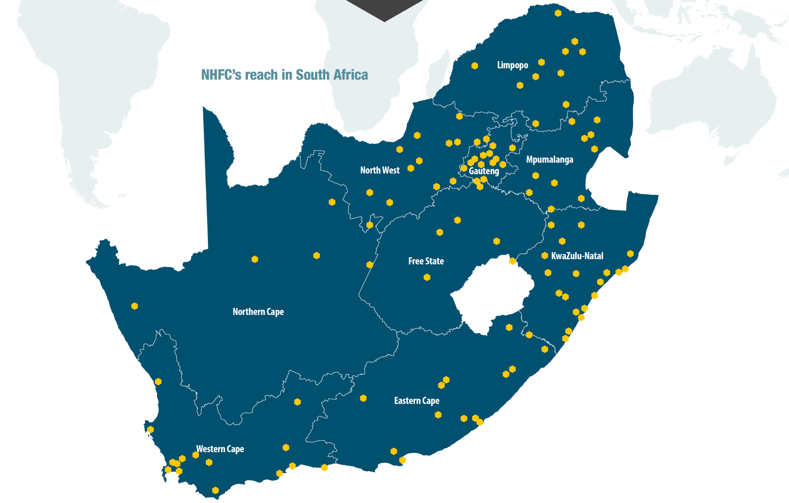
FOOTPRINT
22

Slide 23
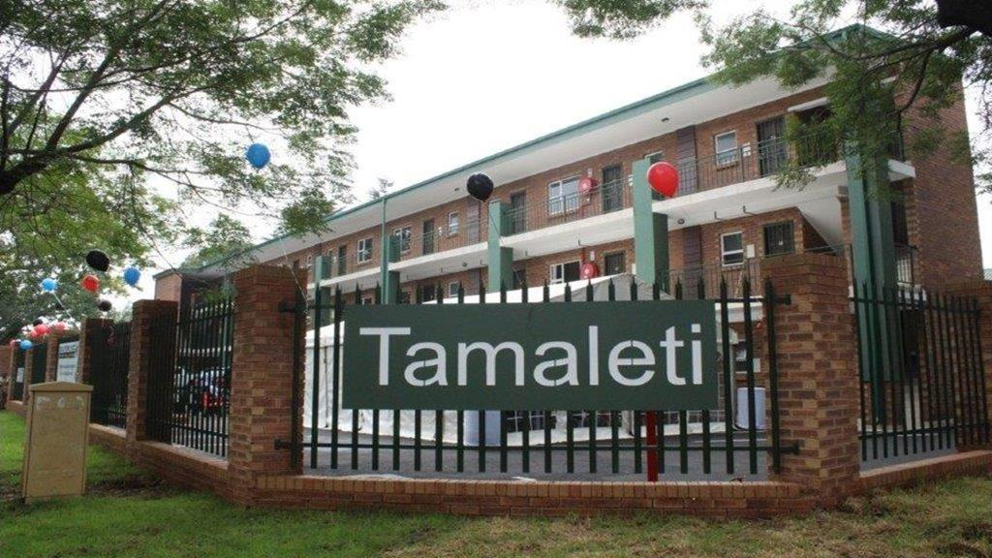
    FINANCIAL PERFORMANCE,
    CORPORATE GOVERNANCE & ENTERPRISE WIDE RISK
Tamaleti Flats, Kempton Park, Gauteng

Slide 24
GROUP SUMMARY STATEMENT OF FINANCIAL PERFORMANCE
Lending income | Projected growth in disbursements. Moderate interest rate increase. The interest on advances also considers the doubtful revenue following the move of key clients into the non-performing portfolio.
Sale of houses / Cost of sales | Decrease in the sale of houses (cost of sales) over the MTEF in line with the strategic decision to exit the business of CTCHC being a developer after completion of the existing projects.
Impairments | Driven by growth in advances portfolio. Credit loss ratio of 3% assumed.
Operational expenses | The overhead structure has improved with the previously concluded re-organisation.
Finance cost | Decrease in line with assumption of no additional borrowings.
24

Slide 25
GROUP SUMMARY STATEMENT OF FINANCIAL POSITION
Loan assets | Driven by level of disbursements and quality of the book.
Instalment sale agreements Properties developed for sale | Overall reduction in construction activities of CTCHC. No new investment. Shareholder approval for sale of CTCHC remains outstanding.
Funds under management | Decrease driven by FLISP disbursements. No new investment
Other financial liabilities | In line with repayment schedule, no new borrowings.
25

Slide 26
KEY PERFORMANCE INDICATORS
26

Slide 27
CORPORATE GOVERNANCE
27

Slide 28
ENTERPRISE WIDE RISK
28

Slide 29

29

